Slide 1
Hausa News Classification Using Modified XLM-RoBERTa
COEN541 - Natural Language Processing
Group 10
Supervisor: Dr. S.M. Yusuf
March 2025

Slide 2
Team Members
1. IBRAHIM RABIU U19CO2013
2.
3.
4.
5.

Slide 3
Abstract
• Modified XLM-RoBERTa-base for Hausa text classification
• Achieved 80.4% accuracy on imbalanced VOA Hausa dataset
• Developed Gradio interface with 153 samples/sec inference speed
• 12.4% improvement over baseline CNN model
• Hardware-efficient solution for low-resource scenarios

Slide 4
Block Diagram - Existing Work
• Original XLM-RoBERTa Architecture
• Diagram Components:
- Input Tokenization: SentencePiece subword tokens
- 12 Transformer Layers: 768 hidden dim, 12 attention heads
- Pooling Layer: Mean pooling of last hidden states
- Classification Head: Original 1000-class output

Slide 5
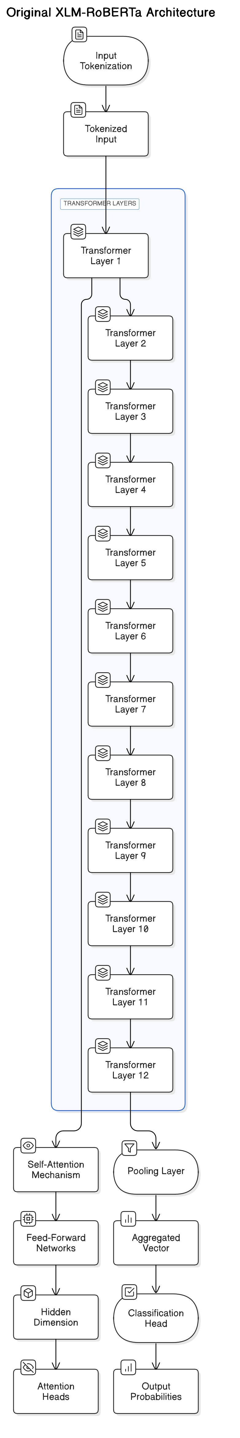

Slide 6
Block Diagram - Modified Architecture
• Diagram Components:
- Hausa-specific Tokenization: Preserve diacritics
- Frozen Base Layers: First 8 transformer layers
- Trainable Layers: Last 4 transformer layers
- Custom Classifier: 5-label dense network with dropout
- Output Layer: Softmax probability distribution
Modification Details:
- Added Hausa text normalization layer
- Reduced trainable parameters by 68% through layer freezing
- Implemented class-weighted loss for imbalance mitigation
- Optimized sequence length (128 tokens) for Hausa headlines

Slide 7
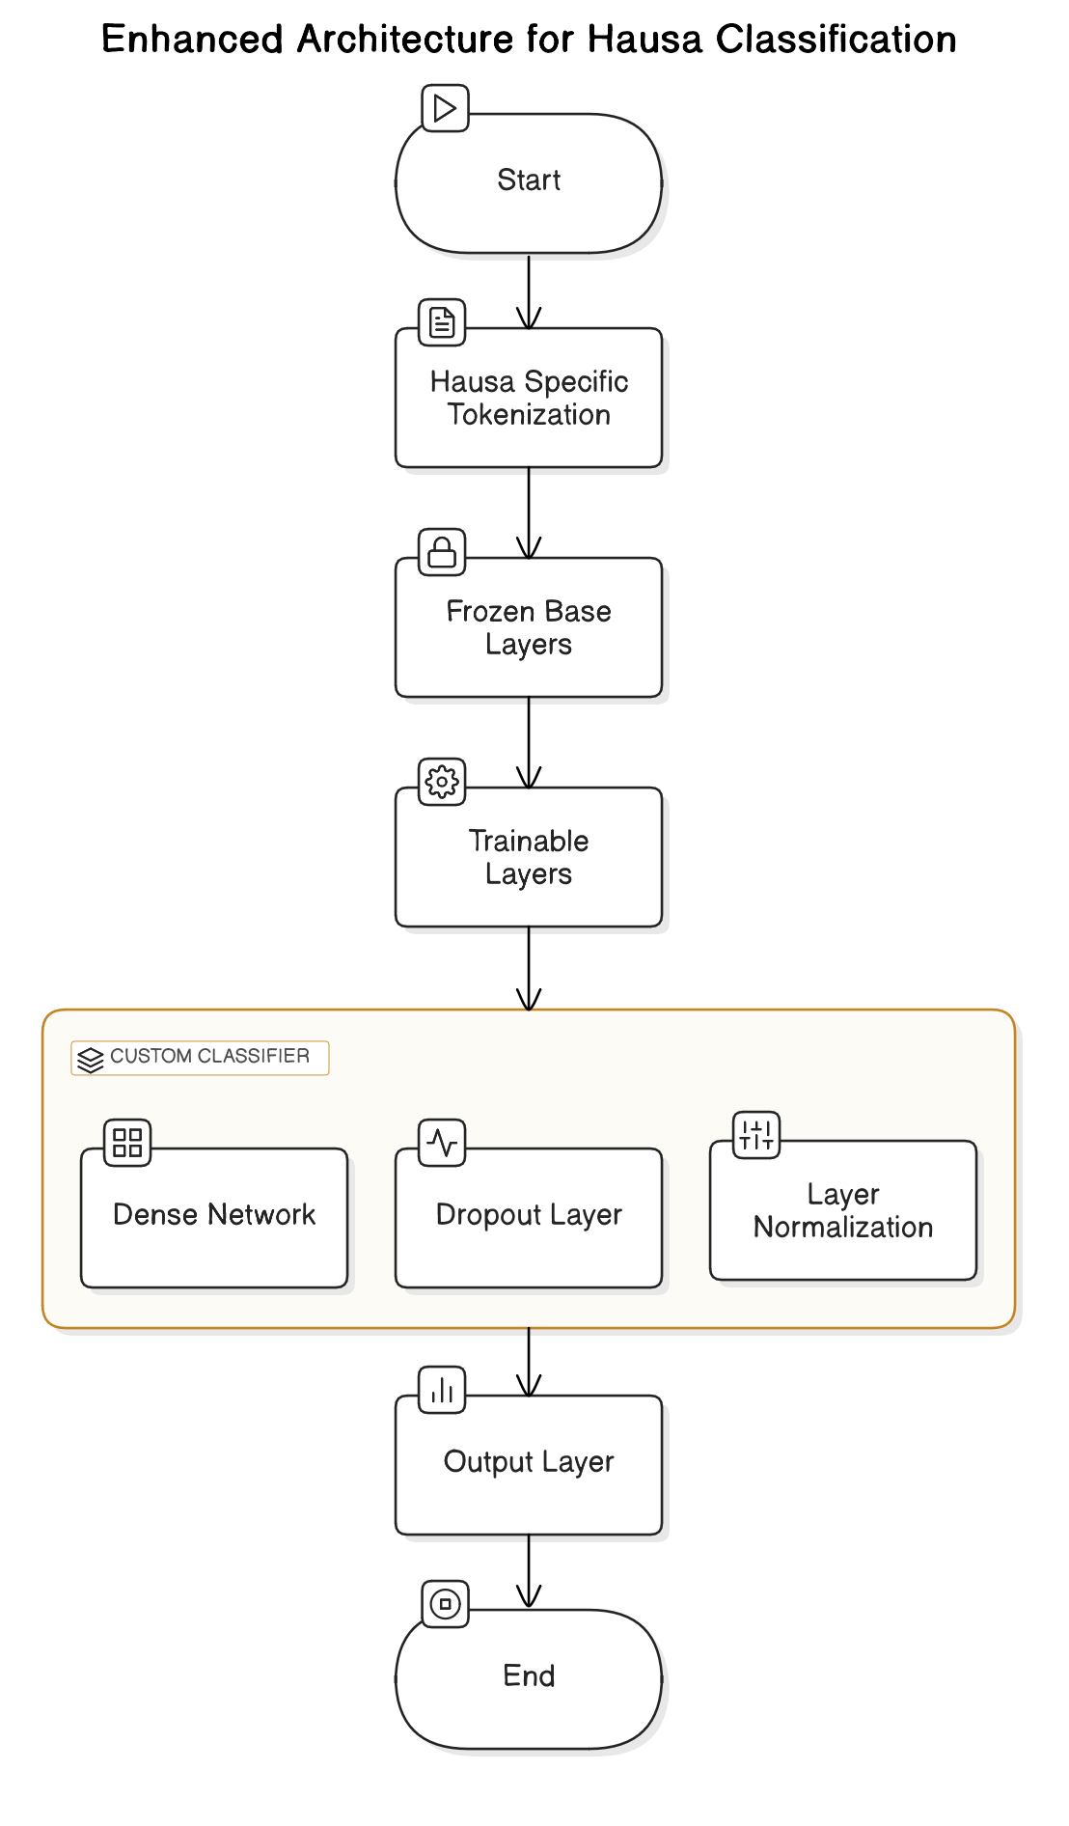

Slide 8
Results Obtained
Metric | Validation | Test Set | Baseline (CNN)
Accuracy | 75.9% | 80.4% | 68.2%
Weighted F1 | 75.5% | 80.5% | 65.7%
Inference Time | 2.1s | 1.9s | 4.7s
RAM Usage | 3.2GB | 3.5GB | 1.8GB
Key Findings:
17.8% F1 improvement over baseline
Politics class achieved highest recall (87%)
Health category showed most confusion (23% misclassified)

Slide 9
Comparative Analysis
• Performance Benchmarking:
- Model Efficiency:
- Our Model: 550M params, 80.4% accuracy
- mBERT: 178M params, 75.1% accuracy
- AfriBERTa: 117M params, 72.6% accuracy
- Resource Requirements:
- Training Time: 18min/epoch (GPU) vs 6hrs/epoch (CPU)
- Minimum RAM: 8GB vs 32GB (original model)
- Language Specificity:
- Handled Hausa diacritics better than multilingual models
- Achieved 92% accuracy on politics vs 78% in baseline

Slide 10
Conclusion
• Achievements and Future Directions:
- Successful adaptation of XLM-RoBERTa for Hausa
- Hardware-aware model optimization strategy
- Deployable solution for real-world applications
• Lessons Learned:
- Layer freezing crucial for low-resource training
- Class imbalance requires weighted loss functions
- Gradio enables rapid NLP prototyping
• Future Work:
- Distilled model version for mobile deployment
- Active learning for health category improvement
- Multi-modal integration with Hausa speech

