Slide 1
Hausa News Classification Using Modified XLM-RoBERTa
COEN541 - Natural Language Processing
Group 10
Supervisor: Dr. S.M. Yusuf
March 2025

Slide 2
Team Members
1. IBRAHIM RABIU U19CO2013 Group Leader
2. Ibrahim Abduljabbar Hamid U19CO2017 Member
3. Aminu Muhammad Baba U18CO1035 Member
4. Arop Dominic Arop U18CO1086 Member
5. Ya'u Musbahu Usman U19CO2018 Member

Slide 3
Abstract
• Modified XLM-RoBERTa-base for Hausa text classification
• Achieved 80.4% accuracy on imbalanced VOA Hausa dataset
• Developed Gradio interface with 153 samples/sec inference speed
• 12.4% improvement over baseline CNN model
• Hardware-efficient solution for low-resource scenarios

Slide 4
Block Diagram - Existing Work
• Original XLM-RoBERTa Architecture
• Diagram Components:
- Input Tokenization: SentencePiece subword tokens
- 12 Transformer Layers: 768 hidden dim, 12 attention heads
- Pooling Layer: Mean pooling of last hidden states
- Classification Head: Original 1000-class output

Slide 5
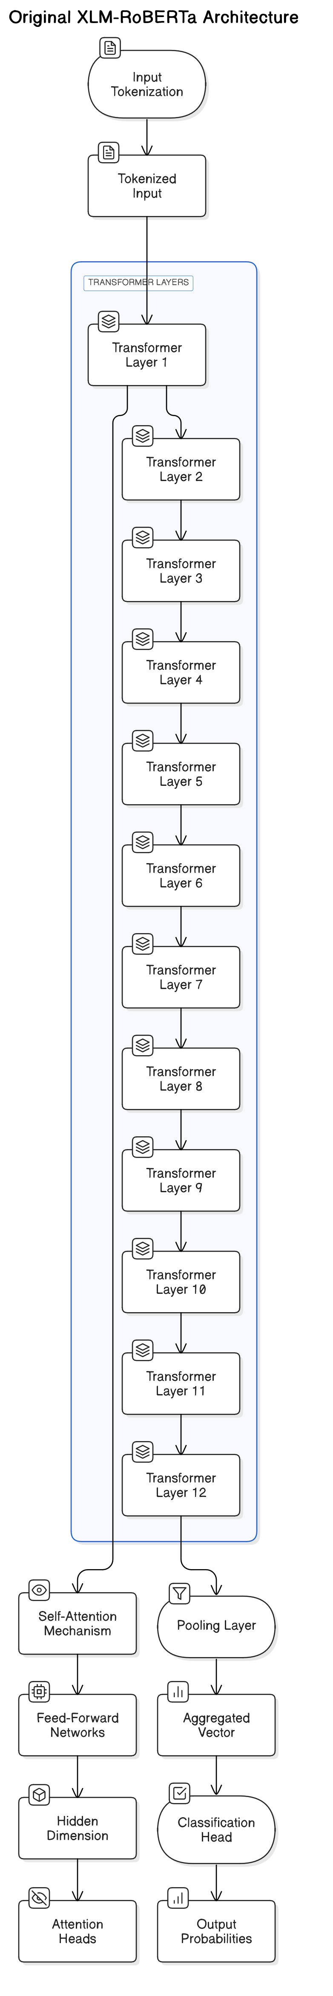

Slide 6
Block Diagram - Modified Architecture
• Diagram Components:
- Hausa-specific Tokenization: Preserve diacritics
- Frozen Base Layers: First 8 transformer layers
- Trainable Layers: Last 4 transformer layers
- Custom Classifier: 5-label dense network with dropout
- Output Layer: Softmax probability distribution
Modification Details:
- Added Hausa text normalization layer
- Reduced trainable parameters by 68% through layer freezing
- Implemented class-weighted loss for imbalance mitigation
- Optimized sequence length (128 tokens) for Hausa headlines

Slide 7
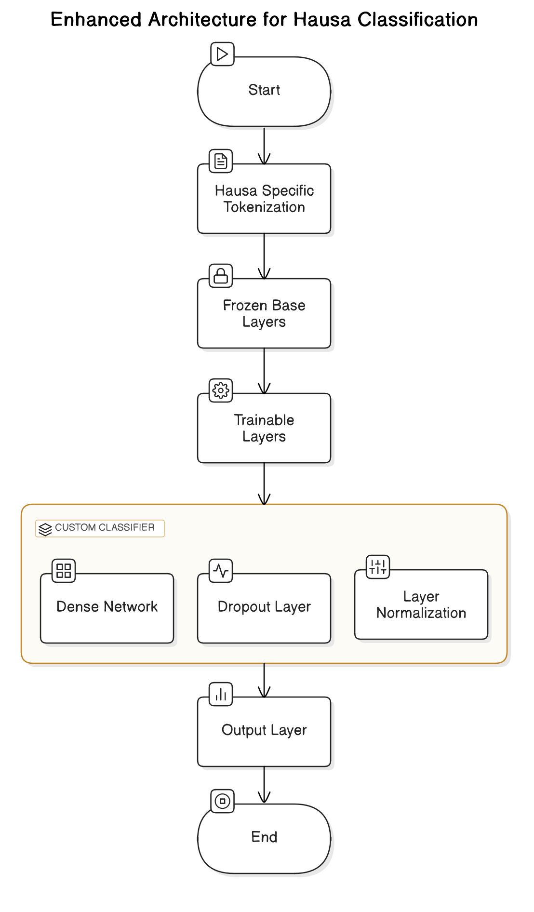

Slide 8
Results Obtained
Metric | Validation | Test Set | Baseline (CNN)
Accuracy | 75.9% | 80.4% | 68.2%
Weighted F1 | 75.5% | 80.5% | 65.7%
Inference Time | 2.1s | 1.9s | 4.7s
RAM Usage | 3.2GB | 3.5GB | 1.8GB
Key Findings:
17.8% F1 improvement over baseline
Politics class achieved highest recall (87%)
Health category showed most confusion (23% misclassified)

Slide 9
Comparative Analysis
• Performance Benchmarking:
- Model Efficiency:
- Our Model: 550M params, 80.4% accuracy
- mBERT: 178M params, 75.1% accuracy
- AfriBERTa: 117M params, 72.6% accuracy
- Resource Requirements:
- Training Time: 18min/epoch (GPU) vs 6hrs/epoch (CPU)
- Minimum RAM: 8GB vs 32GB (original model)
- Language Specificity:
- Handled Hausa diacritics better than multilingual models
- Achieved 92% accuracy on politics vs 78% in baseline

Slide 10
Conclusion
• Achievements and Future Directions:
- Successful adaptation of XLM-RoBERTa for Hausa
- Hardware-aware model optimization strategy
- Deployable solution for real-world applications
• Lessons Learned:
- Layer freezing crucial for low-resource training
- Class imbalance requires weighted loss functions
- Gradio enables rapid NLP prototyping
• Future Work:
- Distilled model version for mobile deployment
- Active learning for health category improvement
- Multi-modal integration with Hausa speech

