Slide 1
Decision Tree Classification
By:
Alhussein Nageh Hofny Mohammed

Slide 2

Dr:
Muhammad Atta Khafagy

Slide 3
Content
what is Decision Tree Classification? | 4
How does the Decision Tree algorithm Work? | 5
Advantages And disadvantages | 6
Implementation of Decision Tree | 7

Slide 4
what is Decision Tree Classification?
A decision tree is a supervised learning technique that can be used for both classification and regression problems, but mostly it is preferred for solving classification problems. it is a tree-structured classifier, where internal nodes represent the features of a dataset, branches represent the decision rules and each leaf node represents the outcome.
components :
In a decision tree, there are two nodes, which are the decision node and leaf node.

Slide 5
How does the Decision Tree algorithm Work?
In a decision tree, for predicting the class of the given dataset, the algorithm starts from the root node of the tree. this algorithm compares the values of root attribute with the record (real dataset) attribute and, based on the comparison, follows the branch and jumps to the next node
step-1: begin the tree with the root node, says s, which contains the complete dataset.
step-2: find the best attribute in the dataset using attribute selection measure (ASM).
step-3: divide the s into subsets that contains possible values for the best attributes.
step-4: generate the decision tree node, which contains the best attribute.
step-5: recursively make new decision trees using the subsets of the dataset created in step -3. continue this process until a stage is reached where you cannot further classify the nodes and called the final node as a leaf node.

Slide 6
Advantages of the decision tree
it is simple to understand as it follows the same process which a human follow while making any decision in real-life.
it can be very useful for solving decision-related problems.
it helps to think about all the possible outcomes for a problem.
there is less requirement of data cleaning compared to other algorithms.
Disadvantages of the decision tree
the decision tree contains lots of layers, which makes it complex.
it may have an overfitting issue, which can be resolved using the random forest algorithm.
for more class labels, the computational complexity of the decision tree may increase.

Slide 7
Implementation of Decision Tree
Now we will implement the Decision tree using Python. For this, we will use the dataset "Records on Students Fails in Each Semester.csv"
load dataset
Split dataset into training set and test set (Convert data)
Data Pre-processing
Building Decision Tree Model
Test accuracy of the result
Visualizing the test set result

Slide 8
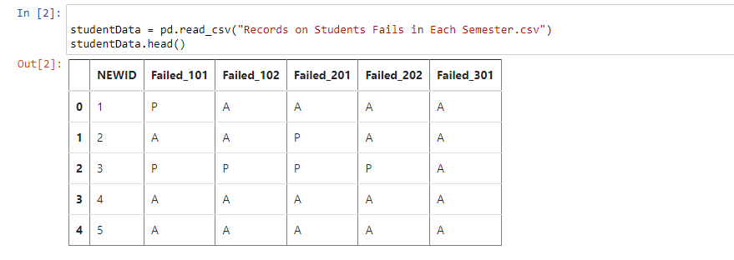
load dataset

Slide 9
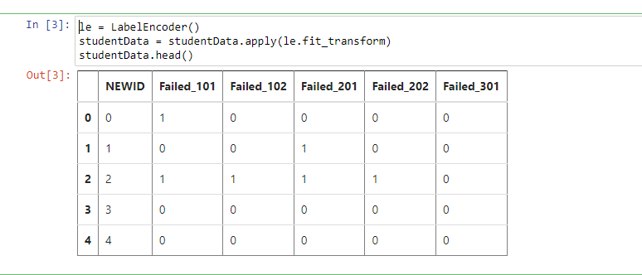
Convert data (Encoding )

Slide 10
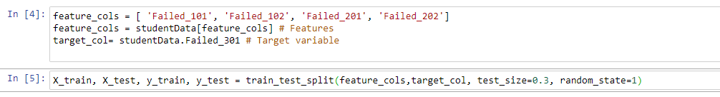
Features &Target variable

Slide 11
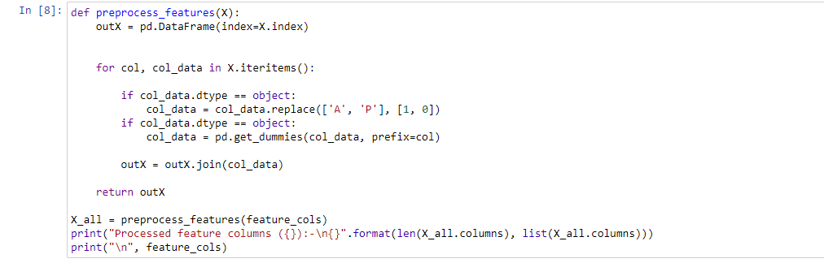
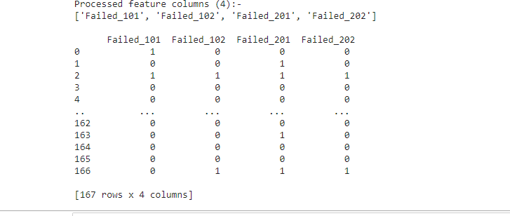
Data Pre-processing
Preprocess
Output

Slide 12
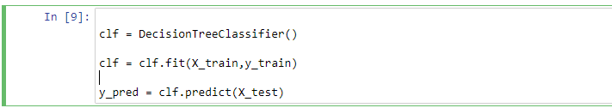
Create Decision Tree

Slide 13
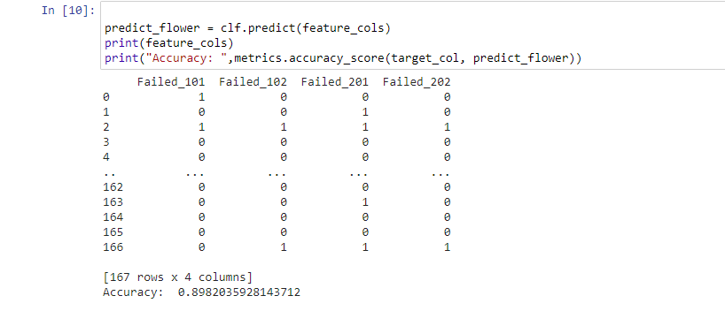
Accuracy

Slide 14
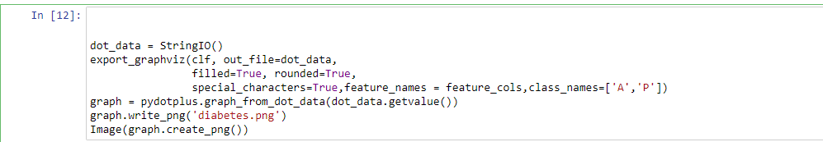
Visualizing Decision Trees Note: criterion : Gini, entropy
Notes:
Gini = 1 - (x/n)² - (y/n)²

Slide 15
