Slide 1
Shared Memory Multiprocessors
Courtesy:
A. Jantsch, professor, KTH, Sweden
Z. Lu, professor, KTH, Sweden
I. Sander, professor, KTH, Sweden

Slide 2
Outline
Shared memory architectures
Centralized memory
Distributed memory
Caches
Write through / write-back caches
The cache coherency problem
2

Slide 3
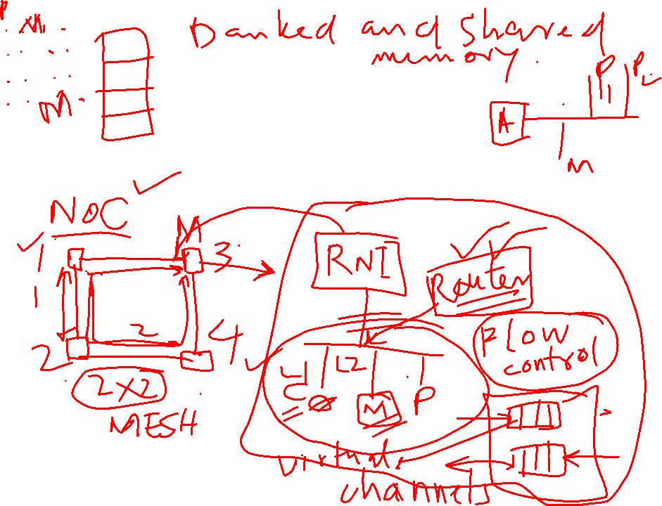

Shared Memory Architectures

Slide 4
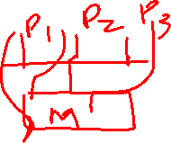
Shared Memory Architectures
Shared Memory Multiprocessor are often used
Symmetric Multiprocessors (SMP)
Symmetric access to all of main memory from any processor
also called UMA (uniform memory access)
Distributed Shared Memory (DSM)
Access time depends on the location of data word in memory
also called NUMA (non-uniform memory access)

Slide 5
Shared Memory Architectures
A shared memory programming model has a direct representation in hardware
Caches
Increase performance
Demand cache coherence and memory consistency protocols

Slide 6
Memory Bandwidth
Rate of data transfer to or from memory often measured in Gbytes/sec
Depends upon
Clock speed of memory
Number of data channels available
Width of each data channel

Slide 7
Shared Cache Architecture
Several processors are connected via a switch with a shared memory
Has been used for a very small number of processors
Is difficult to use for a large number of processors, since the shared cache must deliver an extremely large bandwidth
P₁
P_{m}
Switch
Cache
Main Memory

Slide 8
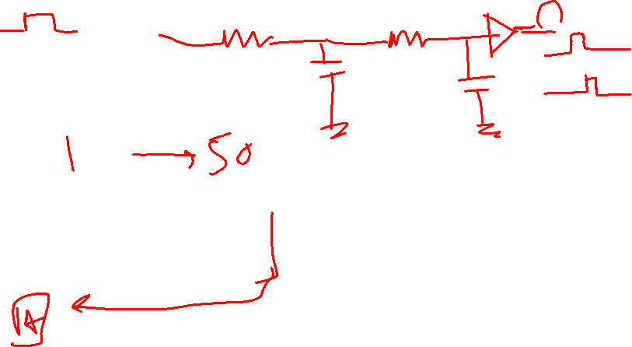
Bus-shared Memory
The interconnect is a shared bus between the processors local caches and the memory
Has been used up to 20 to 30 processors
Scaling is limited due to the bandwidth limitations of the shared bus
P₁
P_{m}
Cache
Cache
Bus
Main Memory

Slide 9
Dancehall Architecture
Scalable Point-to-Point Network placed between caches and memory modules that together form the main memory
Due to the size of the interconnection network, the memory can be very far from the processors
P
1
P
m
Cache Cache
Interconnection Network
Memory
Memory

Slide 10
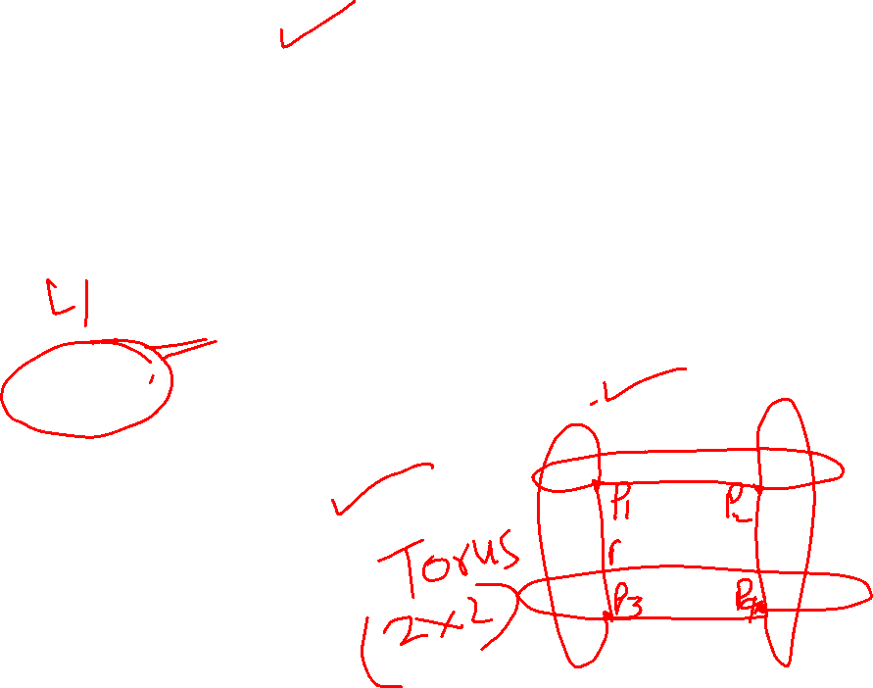
Distributed Memory
No symmetric approach
The local memory is much closer than the rest of the global memory
Structure works very well with scaling
Important in the design to use the local memory efficiently
cc-NUMA
Locality aware task scheduling
P₁
P_{m}
Cache
Cache
Memory
Memory
Interconnection Network

Slide 11
































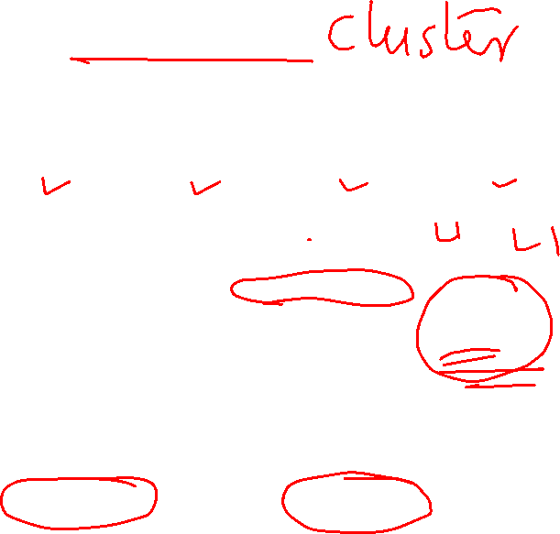
ARM’s Cortex-A9
FPU/NEON
PTM
I/F
FPU/NEON
PTM
I/F
FPU/NEON
PTM
I/F
FPU/NEON
PTM
I/F
Cortex-A9 CPU
Cortex-A9 CPU
Cortex-A9 CPU
Cortex-A9 CPU
Instruction | Data | Instruction | Data | Instruction | Data | Instruction | Data
Cache | Cache | Cache | Cache | Cache | Cache | Cache | Cache
Snoop Control Unit (SCU)
Accelerator Coherence
Port (AXI-3 Slave)
ACP AXI-3 Slave
H/W Accelerators 64-bit Non-cached AXI-3 Masters
Generalized Interrupt Control and Distribution
Cache-2-Cache
Transfers
Snoop Filtering
Timers
Advanced Bus Interface Unit
Primary AMBA 3 64bit Interface
Optional 2nd I/F with Address Filtering
L2 Cache Controller (PL310)
ACP AXI-3 Master
ACP AXI-3 Master
Three AXI-buses on the Cortex-A9
ACP port provides coherent access to L1 and L2 caches through the Snoop Control Unit
Two AXI masters off of the L2 cache provide 8GB/s at 500Mhz access to the main SoC bus
January 25, 2011 SoC Architecture 10

Slide 12
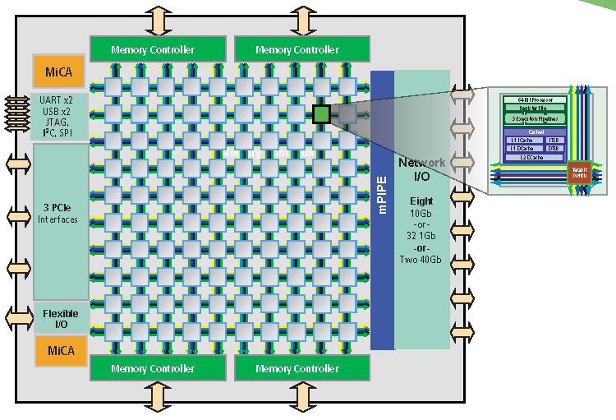
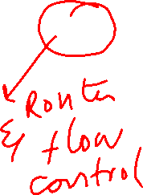
Tilera Gx Architecture
11
Source: https://www.pcmag.com/encyclopedia/term/tile-gx

Slide 13
Cache Coherency

Slide 14
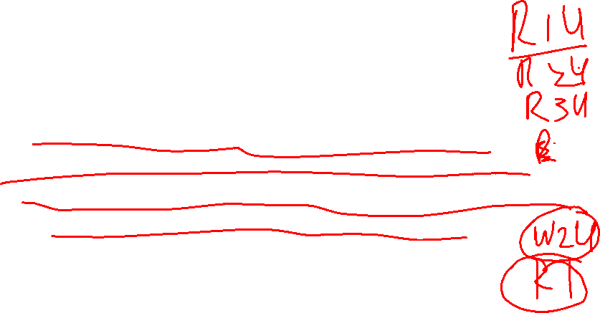
Caches and Cache Coherence
Caches play key role in all cases
Reduce average data access time
Reduce bandwidth demands placed on shared interconnect
But private processor caches create a problem
Copies of a variable can be present in multiple caches
A write by one processor may not become visible to others
They’ll keep accessing stale value in their caches
Cache coherence problem
Need to take actions to ensure visibility

Slide 15
Cache Memories
Main Memory
Processor
Cache
A cache memory is used to reduce the access time to memory
Cache misses can occur since the cache is much smaller than the memory

Slide 16
Cache Memories
Main Memory
Processor
Cache
The decision which parts of the memory reside in the cache is taken by a replacement-algorithm
There are different protocols for a write operation: Write-Back and Write-Through

Slide 17
Cache Memories Read Operation
Main Memory
Processor
Cache
If the memory location is in the cache (cache hit), the data is read from the cache.
If the memory location is not in the cache (cache miss), the block containing the data (is read from memory) and the cache is updated.

Slide 18
Cache Memories
Write Operation (Write Hit)
Main Memory
Processor
Cache
Write-Through Protocol
A write operation updates the main memory location
depending on protocol cache may also be updated

Slide 19
Cache Memories
Write Operation (Write Hit)
Main Memory
Processor
Cache
Write-Back Protocol
A write operation updates only the cache location and marks it as updated with an associated flag bit (dirty flag)
The main memory is updated later, when the block containing the marked address is removed from the cache (Replacement Policy)

Slide 20
Cache Memories
Write Operation (Write Miss)
Main Memory
Processor
Cache
Since data is not necessarily needed on a write there are two options
Write Allocate: The block is allocated on a write miss, followed by the corresponding write-hit actions
No-Write Allocate: Write misses do not affect the cache, instead only the lower-level memory is updated

Slide 21
Cache Memories
Write Operation (Write Miss)
Main Memory
Processor
Cache
Write-through and write-back can be combined with
write-allocate or no-write-allocate
Typically
Write-back caches use write-allocate
Write-through uses no-write-allocate

Slide 22
States for Cache Blocks
Write-through
Invalid
Valid
Write-Back
Invalid
Valid
Dirty (not updated in memory)

Slide 23
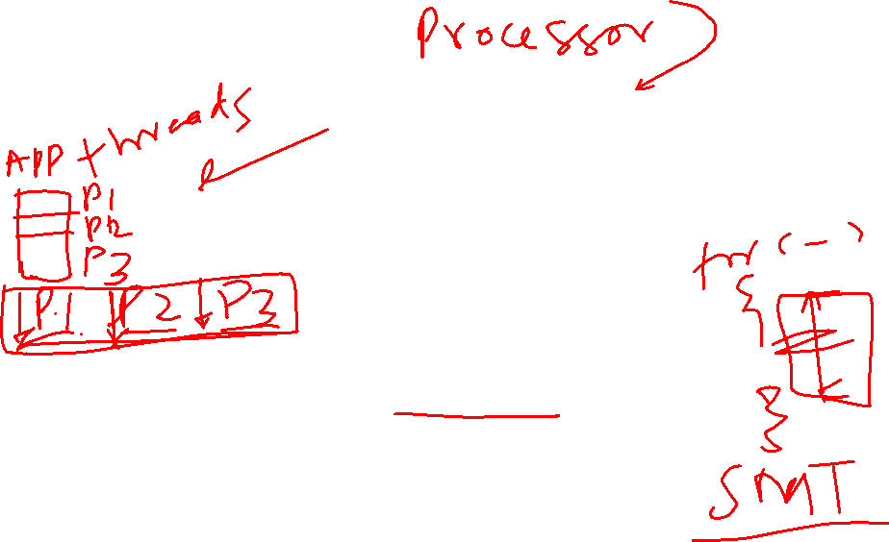
Cache Coherence Problem (Uniprocessor)
P P
P
Single Processor running 3 processes
1
2
3
Cache
Write-Back Cache
Bus
Main Memory
P1 reads location u (value 5) from main memory
P3 reads location u from main memory
P3 writes u, changing the value to 7
P1 reads value u again
P2 reads location u from main memory

Slide 24
Cache Coherence Problem (Uniprocessor)
P P
P
Single Processor running 3 processes
1
2
3
u=5
Cache
Bus
Read
Main Memory
u=5
P1 reads location u (value 5) from main memory
Cache of P1 is updated
The block containing u=5 is loaded into the cache

Slide 25
Cache Coherence Problem (Uniprocessor)
P P
P
Single Processor running 3 processes
1
2
3
Read
u=5
Cache
Bus
Main Memory
u=5
P3 reads location u from main memory
Cache and Memory have still the value u=5

Slide 26
Cache Coherence Problem (Uniprocessor)
P P
P
Single Processor running 3 processes
1
2
3
Write
u=7
Cache
Bus
Main Memory
u=5
P3 writes u, changing the value to 7
Cache is updated (u=7) and u is marked (Dirty)
Memory is not changed!

Slide 27
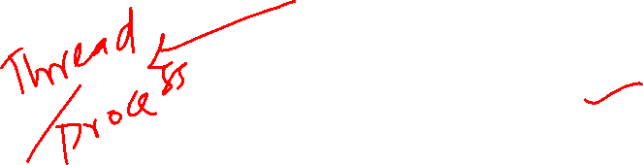
Cache Coherence Problem (Uniprocessor)
P₁ P₂ P
Read
Single Processor running 3 processes
3
u=7
Cache
Bus
Main Memory
u=5
P1 reads value u again
Since cache is common to all processes, there is no problem though the main memory is not updated! All processes have the same view of the cache!

Slide 28

Cache Coherence Problem (Uniprocessor)
P P
P
Single Processor running 3 processes
1
2
3
Read
Cache
u=7
Bus
Main Memory
u=5
P2 reads location u from main memory
Since cache is common to all processes, there is no problem though the main memory is not updated! All processes have the same view of the cache!

Slide 29

Cache Coherence Problem (Uniprocessor)
If only a uniprocessor is involved there is no cache coherence problem!
However, if another device on the bus is involved that has direct memory access (like a DMA), the cache may not represent the contents of the memory and the cache coherence problem can occur!

Slide 30

Cache Coherence Problem
P₁ P₂ P₃
Cache
Cache
Cache
Bus
Main Memory
P1 reads location u (value 5) from main memory
P3 reads location u from main memory
P3 writes u, changing the value to 7
P1 reads value u again
P2 reads location u from main memory

Slide 31

Cache Coherence Problem (Write-Through Cache)
P₁ P₂ P₃
u=5
Cache
Cache
Cache
Bus
Read
Main Memory
u=5
P1 reads location u (value 5) from main memory
P1’s cache is updated (u=5)

Slide 32
Cache Coherence Problem (Write-Through Cache)
P₁ P₂ P₃
u=5
Cache
Cache
Cache
u=5
Bus
Read
Main Memory
u=5
P3 reads location u from main memory
P3’s cache is updated (u=5)

Slide 33
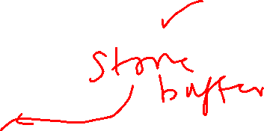

Cache Coherence Problem (Write-Through Cache)
P₁ P₂ P₃
u=5
Cache
Cache Cache
Write Through
u=5 (Inv)
Bus
Main Memory
u=7
P3 writes u, changing the value to 7
main memory is updated (u=7)
P3’s cache is not up-dated (no-write-allocate), but block is invalidated

Slide 34
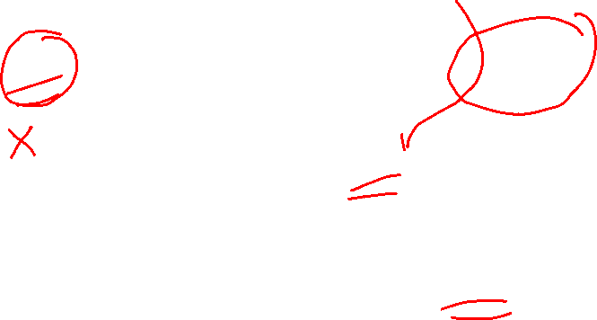
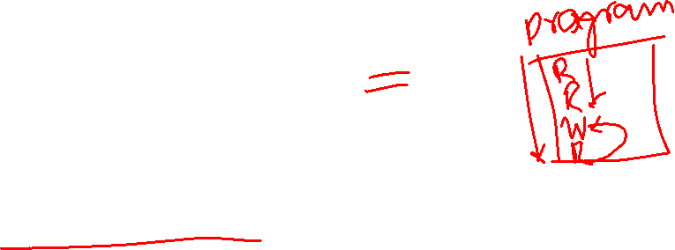
Cache Coherence Problem (Write-Through Cache)
P₁ P₂ P₃
Read
u=5
Cache
Cache
Cache
u=5 (Inv)
Bus
Main Memory
u=7
P1 reads value u again
P1 reads the value from the cache (u=5), which is not the correct value!

Slide 35

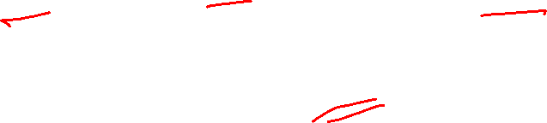
Cache Coherence Problem (Write-Through Cache)
P₁ P₂ P₃
Read
u=5
Cache Cache Cache
Bus
u=5 (Inv)
Main Memory
u=7
P2 reads location u from main memory
P2 reads the value from the main memory (u=7)

Slide 36
Cache Coherence Problem (Write-Back Cache)
P₁ P₂ P₃
u=5
Cache
Cache
Cache
Bus
Main Memory
u=5
P1 reads location u (value 5) from main memory
P1’s cache is updated (u=5)

Slide 37
Cache Coherence Problem (Write-Back Cache)
P₁ P₂ P₃
u=5
Cache
Cache
Cache
u=5
Bus
Read
Main Memory
u=5
P3 reads location u from main memory
P3’s cache is updated (u=5)

Slide 38
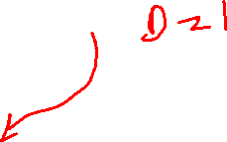
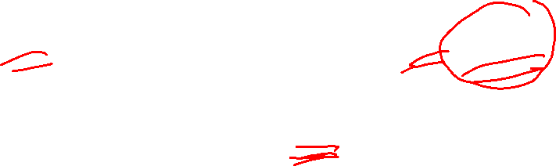
Cache Coherence Problem (Write-Back Cache)
P₁ P₂ P₃
Write Back
u=5
Cache
Cache
Cache
u=7
Bus
Main Memory
u=5
P3 writes u, changing the value to 7
P3’s cache is updated (u=7) and location u is marked
Main memory is NOT updated!

Slide 39

Cache Coherence Problem (Write-Back Cache)
P₁ P₂ P₃
Read
u=5
Cache
Cache
Cache
u=7
Bus
Main Memory
u=5
P1 reads value u again
P1 reads the value from the cache (u=5), which is not the correct value!

Slide 40
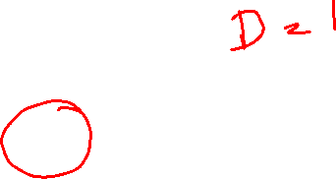

Cache Coherence Problem (Write-Back Cache)
P₁ P₂ P₃
Read
Cache
u=5
Cache
Cache
u=7
Bus
Main Memory
u=5
P2 reads location u from main memory
P2 reads the value from the cache (u=5), which is not the correct value!

Slide 41
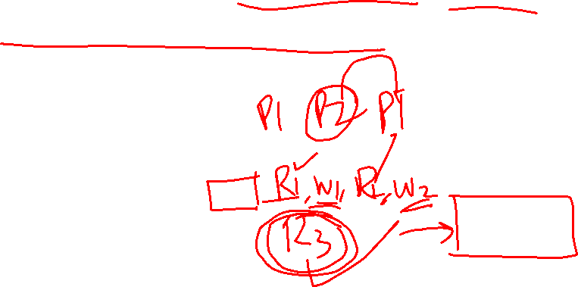
Cache Coherence
Since communication between processors is done by means of shared memory, cache coherence must be guaranteed.
The hardware should support cache coherence!
Everybody should have the same view of the memory system!

Slide 42
Next Lecture
Coherence Protocols

