Slide 1
Cache Coherence
Protocols
Courtesy:
A. Jantsch, professor, KTH, Sweden
Z. Lu, professor, KTH, Sweden
I. Sander, professor, KTH, Sweden

Slide 2
Formal Definition of Coherence
Results of a program: values returned by its read operations
A memory system is coherent if the results of any execution of a program are such that it is possible to construct a hypothetical serial order of all operations that is consistent with the results of the execution and in which:
Operations issued by any particular process occur in the order issued by that process, and
The value returned by a read is the value written by the last write to that location in the serial order

Slide 3
Formal Definition of Coherence
Two necessary features:
Write propagation: value written must become visible to others
Write serialization: writes to a location seen in same order by all
if I see w1 before w2, you should not see w2 before w1
no need for analogous read serialization since reads not visible to others

Slide 4
Example
Task A
x:=0;
y:=0;
Print (x+y);
Task B
x:=1; y:=x+2;
x:=1; y:=x+2;
x:=0;
y:=0;
Print (x+y);
0
x:=0;
y:=0;
x:=1; y:=x+2;
Print (x+y);
4
x:=0;
x:=1; y:=x+2;
y:=0;
Print (x+y);
1
x:=1;
x:=0;
y:=0;
y:=x+2;
Print (x+y);
2
Coherent memory system

Slide 5
Example
Task A
Task B
x:=0;
y:=0;
Print (x+y);
x:=1; y:=x+2;
x:=0;
y:=0;
x:=1;
y←3
Print (x+y); x←1
3
y:=x+2;
Incoherent memory system

Slide 6
Snooping-based Cache Coherence

Slide 7
Cache Coherence Using a Bus
Built on
Bus transactions
State transition diagram in cache
Uniprocessor bus transaction:
Serialization of bus transactions

Slide 8
Cache Coherence Using a Bus
Uniprocessor cache states:
Effectively, every block is a finite state machine
Write-through, write no-allocate has two states: valid, invalid
Write-back, write-allocate caches have one more state: modified (“dirty”)
Multiprocessors extend
cache states and
bus transactions
to implement coherence

Slide 9
Snooping-based Coherence Basic Idea
Transactions on bus are visible to all processors
Processors or cache controllers can snoop (monitor) bus and take action on relevant events (e.g. change state)

Slide 10
Snooping-based Coherence
Implementing a Protocol
Cache controller now receives inputs from both sides:
Requests from processor, bus requests/responses from snooper
In either case, takes zero or more actions
Updates state, responds with data, generates new bus transactions
Protocol is distributed algorithm: cooperating state machines
Set of states, state transition diagram, actions
Granularity of coherence is typically cache block
Like that of allocation in cache and transfer to/from cache

Slide 11
Cache Coherence with Write- Through Caches
P₁ P_{n}
Cache Coherence Protocol
V
V
Cache
Cache
I
Bus
I
Bus Snooping
Cache-Memory Transition
Main Memory
Key extensions to uniprocessor: snooping, invalidating/updating caches
no new states or bus transactions in this case
invalidation- versus update-based protocols
Write propagation: even in invalidation case, later reads will see new value
invalidation causes miss on later access, and memory up-to-date via write-through

Slide 12
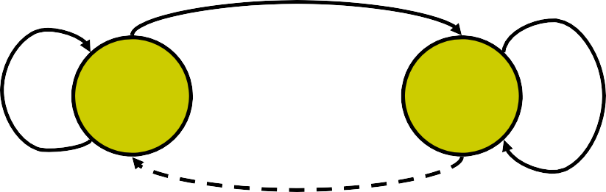
State Transition Diagram Write-Through Cache (Write no allocate)
PrRd/BusRd
PrWr/BusWr
PrRd/-
I
V
PrWr/BusWr
Block is not in Cache Block is in Cache
BusWr/-
Processor-initiated transactions Bus-snooper-initiated transactions
Protocol is executed for each cache-controller connected to a processor
Cache Controller receives inputs from processor and bus

Slide 13
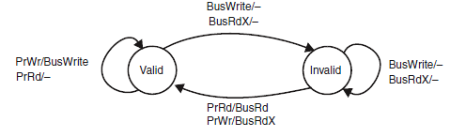
State transition diagram (valid- Invalid protocol) Write back cache

Slide 14
Problem with Write-Through
High bandwidth requirements
Every write from every processor goes to shared bus and memory
Write-through especially unpopular for Symmetric Multi- Processors
Write-back caches absorb most writes as cache hits
Write hits don’t go on bus
But now how do we ensure write propagation and serialization?
Need more sophisticated protocols: large design space

Slide 15
Limitation of Valid / Invalid protocol
All processor write to a local block will generate BusWrite both in write through and write back caches
BusWrite protocol action is generated even if CMP is used to
Improve performance of an explicitly parallel program
Run multiple parallel applications
Processor reads to an invalid block will read from main memory
Modified state is included in MSI protocol
Processor reads to an invalid block will be served by modified cache node (if block is in modified state at some node) and will not generate bus transaction
Modified block is the only valid copy of the block in the system
Processor reads and writes can be carried out in local block without need to generate any protocol action
Used in commercial machines
Shared block has multiple valid copies in the systems

Slide 16
Basic MSI Writeback Invalidation Protocol
States
Invalid (I)
Shared (S): memory and one or more caches have a valid copy
Dirty or Modified (M): only one cache has a modified (dirty) copy
Processor Events:
PrRd (read)
PrWr (write)
Bus Transactions
BusRd: asks for copy with no intent to modify
BusRdX: asks for an exclusive copy with intent to modify
BusWB: updates memory on write back
Actions
Update state, perform bus transaction, flush value onto bus

Slide 17
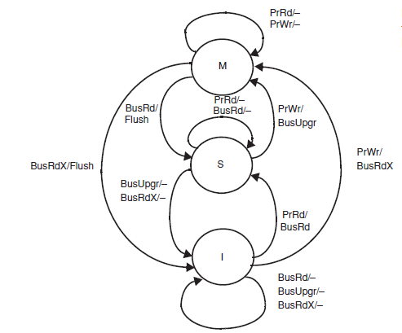
MSI State Transition Diagram (Write back cache)

Slide 18
Limitation of MSI protocol
If processor P1 reads memory block B1 in its cache it is in Shared state
Now if processor writes to this block Bus Upgrade protocol action is generated
This action is unnecessary since this block is only read by P1 and other processors do not have it by now
Solution
Add Exclusive state meaning that this is the only copy of the block in the system to the MSI protocol
Clean miss is served by memory and not by the cache
Both clean and dirty blocks must be served by cache
Solution
Addition of Ownership state to the MSI protocol

Slide 19
MOESI protocol
PrWr/BusUpgd
PrWr/-
PrRd/-
M
BusRd/Flush
BusRd/Flush
PrWr/-
PrWr/BusUpgd
PrRd/-
BusRd/Flush
PrRd/-
O
S
E
PrRd/-
BusRdX/-
BusUpgd/-
BusRdX/Flush
PrRd/BusRd
S=1
BusRdx/Flush
PrWr/BusRdx
I
PrRd/BusRd
S=0
BusRdx/Flush
BusUpgd/-
BusRd/- BusRdX/- BusUpgd/-

Slide 20
Modern Bus Standards and Cache Coherence Protocols
Both the AMBA and the Avalon protocols do not include a cache coherence protocol!
The designer has to be aware of problems related to cache coherence
We see cache coherence protocols for SoCs coming
E.g. ARM11 MPCore Platform support data cache coherence

Slide 21
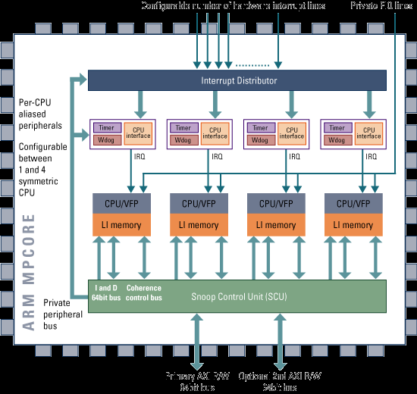
ARM11 MPCore Cache
Write back
Write allocate
MESI Protocol
Modified: Exclusive and modified
Exclusive: Exclusive but not modified
Shared
Invalid
Source: https://www.arm.com/products/silicon-ip-cpu

Slide 22
Directory Based Cache Coherence

Slide 23
Networks on Chip
MEM
MEM
Switch
P
C
NI
NI
C
P
Channel
P
C
NI
NI
C
P
MEM
Network Interface
MEM
In Networks-on-Chip cache coherence cannot be implemented by bus snooping!

Slide 24
Distributed Memory
Distributed Memory Architectures which do not have a bus as only communication channel cannot use snooping protocols to ensure cache coherence
Instead a directory based approach can be used to guarantee cache coherence
P
1
P
m
Cache
Cache
Memory
Memory
Interconnection Network

Slide 25
Directory-Based Cache Coherence Concepts
State of caches is maintained in a directory
A cache miss results in a communication between the node where the cache miss occures and the directory
Then information in affected caches is updated
Each node monitors the state of its cache with e.g. an MSI protocol

Slide 26
Multiprocessor with Directories
P
P
C
Cache
C
Directory
Memory
Memory
Directory
CA
Communication Assist
CA
Interconnection Network
Every block of main memory (the size of a cache block) has a directory entry that keeps track of its cached copies and the state

Slide 27
Tasks of the Protocol
When a cache miss occurs the following tasks have to be performed
Finding out information of the state of copies in other caches
Location of these copies, if needed (e.g. for Invalidation)
Communication with other copies (e.g. obtaining data)

Slide 28
Some Definitions
Home Node: Node with the main memory where the block is located
Dirty Node: Node, which has a copy of the block in modified (dirty) state
Owner Node: Node, that has a valid copy of the block and thus must supply data when needed (is either home or dirty node)
Exclusive Node: Node, that has a copy of the block in exclusive state (either dirty or clean)
Local Node (Requesting Node): Node, that has the processor issuing a request for the cache block
Locally Allocated Blocks: Blocks whose home is local to the issuing processor
Remotely Allocated Blocks: Blocks whose home is not local to the issuing processor

Slide 29


Read Miss to a Block in modified State in Cache
Requestor
P
1
Read request to directory
Memory/Dir
Directory Node for block
C
P
Memory/Dir
2
Response with owner identity
CA
C
Read request to owner
CA
3
4a
Data Reply
4b
Revision message
to directory (Data Reply)
P
Memory/Dir
C
CA
Node with dirty copy

Slide 30



Write Miss to a Block with Two Sharers
Requestor
P
1
ReadEx request to directory
Memory/Dir
Directory Node for block
C
P
Memory/Dir
Invalidation request to sharer
3a
Response with Sharer’s identity
CA
2
C
4b
CA
Invalidation
4a
Invalidation Acknowledgement
Acknowledgement
P
Memory/Dir
3b
P
Memory/Dir
C
Invalidation request to sharer
C
CA
CA
Node with shared copy
Node with shared copy

Slide 31
Organization of the Directory
A natural organization of the directory is to maintain the directory information for a block together with the block in main memory
Each block can be represented as a bit vector of p presence bits and one or more state bits.
In the simplest case there is one state bit (dirty bit), which represents if there is a modified (dirty) copy of the cache in one node

Slide 32
Example for Directory Information
P
C
Memory
Directory
CA
x
x
Dirty Bit
Presence Bits
An entry for a memory block consists of presence bits and a status bit (dirty bit)
If dirty == ON, there can only be one presence bit set

Slide 33
Read Miss of Processor i
If the dirty == OFF
Assist obtains the block from main memory, supplies it to the requestor and sets the presence bit p[i] ← ON
If the dirty == ON
Assist responds to the requestor with the identity of the owner node
Requester then sends a request network transaction to owner node
Owner changes its state to shared and supplies the block to both the requesting node and the main memory
The memory sets dirty ← OFF and p[i] ← ON

Slide 34
Write Miss of Processor i
If the dirty == OFF
The main memory has a clean copy of data
The home node sends the presence vector to the requesting node i together with the data
The home node clears its directory entry, leaving only the p[i] ← ON and dirty ← ON
The assist at the requestor sends invalidation requests to the nodes where the value of the presence bit was ON and waits for an acknowledgement
The requestor places the block in its cache in dirty state (dirty ← ON)

Slide 35
Write Miss of Processor i
If the dirty == ON
The main memory has not a clean copy of data
The home node requests the cache block from the dirty node, which sets its cache state to invalid
Then the block is supplied to the requesting node, which places the block in cache in dirty state
The home node clears its directory entry, leaving only the p[i] ← ON and dirty ← ON

Slide 36
Size of Directory
1 entry/memory block
SD = ST/SB x (N+1)
SD …size of directory ST … total memory
N … no of nodes CB…blocks per cache SB … block size
SC … cache size
Example:
ST = 4GB
N= 64 nodes CB = 128 K
SB = 64 Byte SC = 8 MB SD = 520MB
13% of total memory 102% of total cache size

Slide 37
Size of Directory
1 entry/cache block
SD = N x CB x (N+1)
SD …size of directory ST … total memory
N … no of nodes CB…blocks per cache SB … block size
SC … cache size
Example:
ST = 4GB
N= 64 nodes CB = 128 K
SB = 64 Byte SC = 8 MB SD = 65 MB
1.5% of total memory 12.6% of total cache size

Slide 38
Discussion
Directory based protocols allow to provide cache coherence for distributed shared memory systems, which are not based on buses
Since the protocol requires communication between nodes with shared copies there is a potential for congestion
Since communication is not instantly and varies from node to node there is the risk that there are different views of the memory at some time instances. These race conditions have to be understood and taken care of!

