Slide 1
C++ Programming Introduction - Basics of C++ programming Material courtesy: Prof. Dr. Zhongai LU Professor SoC design at KTH, Sweden
Week 2

Slide 2
Recap
C basics
Arrays, pointers, unions
Memory management in C
Heap and stack
Structures
Linked lists
Hash Tables

Slide 3
Contents
Introduction to C++
Simple program in C++
Constructor
Destructor
Inheritance
Access specifiers in C++
Friend class and friend functions
Multiple inheritance ambiguity
Polymorphism compile time
Polymorphism run time
Non-inheritable class
Virtual destructor
std::vector<>
Function pointers and lambdas
Virtual pointer
Multipath inheritance

Slide 4
Introduction to C++
A multi-paradigm programming language
Activities starting in 1980
Original intention was to extend C, called C with Classes. It was renamed C++ in 1983.
Creator: Bjarne Stroustrup
Standardized in late 1998 as ISO/IEC 14882
C++ reference
Online resources, e.g., www.cplusplus.com
Application
Widely used in general purpose domains
Embedded software development
For real time application development

Slide 5
Introduction to C++
C++ contains a lot of features
Object-oriented
Generic programming
Used features most related to Classes
Encapsulation – Data Abstraction
Inheritance
Polymorphism

Slide 6
Introduction to C++
Class
Encapsulation: data and function members
Constructor and destructor
Operator, function overloading
Initializer: objects insides a class
Class relation
Friendship, Inheritance, multiple inheritance
Polymorphism: virtual functions (methods)
Abstract class and virtual inheritance

Slide 7
Structure vs Class
S. No. | Class | Structure
1 | Members of a class are private by default. | Members of a structure are public by default.
2 | It is declared using the class keyword. | It is declared using the struct keyword.
3 | It is normally used for data abstraction and inheritance. | It is normally used for the grouping of different datatypes.
4 | Syntax: class class_name { data_member; member_function; }; | Syntax: struct structure_name { structure_member1; structure_member2; };

Slide 8
Simple C++ Program
Task: calculate the area of a rectangle
Define a class
Data members: x, y
Two functions (methods)
Scope operator “::”
Ownership
Private (default): x,y
Public: two methods
In main()
Define an object
An instance of the class
Call the method, “.”
Directives
#Include<iostream>

Slide 9
Class is a data type
Objects of a class
#include <iostream>
class CRectangle {
int x, y;
public:
void set_values(int,int);
int area () {return (x*y)};
};
CRectangle::set_values(int x, int y)
{
x = x;
y=y;
}
int main()
{
CRectangle recta, rectb;
recta.set_values(3,4);
rectb.set_values(5,6);
std::cout<<“recta area:”<<recta.area()<<endl;
std::cout<<“rectb area:”<<rectb.area()<<endl;
return 0;
}

Slide 10
Constructor
#include <iostream>
class CRectangle {
int width, height;
public:
CRectangle (int,int);
int area () {return(width*height);}
};
CRectangle:: CRectangle (int a, int b) :width(a),height(b)
{
std::cout<<“constructor called\n”<<std::endl;
}
int main()
{
CRectangle recta(3,4)
CRectangle rectb(5,6);
std::cout<<“recta area:”<<recta.area()<<endl;
std::cout<<“rectb area:”<<rectb.area()<<endl;
return 0;
}
What if call area() before setting values?
Need a constructor
to initialize values
Constructor
A special function
Use the class name
Has no return value,
Not even void (absence of type)
Default constructor if no constructor defined
Only automatically called
when construction occurs
A class can have multiple constructors since
C++ allows for function overloading

Slide 11
Destructor
Opposite as constructor
Need a destructor to release allocated memory
after execution
Destructor
As constructor
Use the class name, but with a tilde (~)
Has no return value, not even void
Automatically called when an object is destroyed
Not as constructor
No arguments
Only one per class
Useful if dynamic memory is assigned
Class members assigned dynamic memory
Class object is assigned dynamic memory
#include <iostream>
class CRectangle {
int *width, *height;
public:
CRectangle (int,int);
~CRectangle ();
int area () {return(*width * *height);}
};
CRectangle:: CRectangle (int a, int b) :width(new int(a)),height(new int(a))
{
std::cout<<“constructor called\n”<<std::endl;
}
CRectangle::~ CRectangle ()
{
delete height; delete width;
std::cout<<“destructor called\n”<<std::endl;
}
int main()
{
CRectangle recta(3,4)
CRectangle rectb(5,6);
std::cout<<“recta area:”<<recta.area()<<endl;
std::cout<<“rectb area:”<<rectb.area()<<endl;
return 0;
}

Slide 12
Default Constructor
Compiler assumes default constructor
If no constructor is provided
For example, class ABC; with no constructor
ABC abc(); (Not allowed)
ABC abc; (Allowed)
If constructor(s) are provided, then
ABC abc; (Not allowed)
ABC abc(//arguments); (Allowed)

Slide 13
Constructor Overloading
Constructors can be overloaded
Different versions of a class
constructor
Different number of arguments

Slide 14
Static class members / functions
Static members
Shared by all class objects
Must be initialized outside class
Static functions
Can be called without class object
static int area_half()
{return (width*height)/2;}
CRectangle :: area_half();
Class ABC{
public:
ABC();
private:
static int i;
};
int ABC::i=10;

Slide 15
Pointer to class members
Use class name as type of pointer
CRectangle * prect=new CRectangle [2];
prect ->set_values(3,4);
prect[1] . set_values(5,6); or *(prect+1).set_values(5,6);
std::cout<<“Area CRectangle[0]”<<prect[0].area()<<std::endl;
std::cout<<“Area CRectangle[1]”<< prect[1].area()<<std::endl;
Address of operator (&)
Returns the address of a class member
class abc {//class definition};
abc obj(//arguments of the constructor);
abc * ptr_abc=&obj;

Slide 16
Inheritance
Classes in C++ can be extended to provide more functionality
Types of inheritance
Single
Multiple
Hierarchical
Multipath

Slide 17
Inheritance
Single inheritance
Derived class has only one base class
Base Class
Derived Class

Slide 18
Inheritance
Multiple inheritance
Derived class has multiple base classes
Base class 1
Base class 2
Base class 3
Derived class

Slide 19
Inheritance
Hierarchical inheritance
Multiple derived classes have one base class
Used in run time polymorphism
Base class
Derived class
Derived class
Derived class

Slide 20
Inheritance
Multipath inheritance
Base class
Virtual
Virtual
Derived class A
Derived class B
Derived class C

Slide 21
Multipath Inheritance
Resolve the ambiguity caused by “diamond inheritance”.
Class A{ };
Class B: public A{ };
Class C: public A{ };
Class D: public B, public C{ };
D is actually inheriting the members of A “Twice”. (Incorrect)
Use virtual inheritance.
Class B: virtual public A{ };
Class C: virtual public A{ };
This is virtual inheritance, ensuring the join class (class D) inherits members of virtual class only once

Slide 22
Inheritance
Simple example
//Base class
class polygon{
protected: // or public:
int width, height;
public:
void set_values(int w, int h)
{
width =w;
height =h;
}
};
//class rectangle inherits polygon
class rectangle : public polygon
{
public:
int area(){
return width * height;
}
};

Slide 23
Access specifiers in C++
Public
Accessible for everyone from anywhere in program
Private
Only class functions and friend class functions can access
Protected
Only class member functions and inherited class member functions can access
Derived
Base | Public | Private | Protected
Public | Public | Private | Protected
Private | Not inherited | Not inherited | Not inherited
Protected | Protected | Private | Protected

Slide 24
Friend Functions
A friend class can access private members of a class
class rectangle{
int width , height;
public:
friend rectangle duplicate(rectangle obj);
};
rectangle duplicate (rectangle r){
rectangle r1;
r1.width = r.(width*2);
r1.height = r.(height*2);
return r1;
}

Slide 25
Friend Classes
A friend class can have access to private and protected members of a class
class square; //Forward definition of square class
class rectangle{
int width , height;
public:
void convert(square s);
};
class square{
private:
int side;
public:
void set_side(int a){side=a;}
friend class rectangle;
};
void rectangle ::convert(square s){
width = s.side;
height = s.side;
}

Slide 26
Multiple Inheritance Ambiguity
class base1{
int x;
public:
base1(int x):x(x){};
void print(){std::cout<<“base1 print”<<std::endl;}
};
class base2{
int y;
public:
base2(int y):y(y){}
void print()(){std::cout<< “base2 print”<<std::endl;}
};
class derived: public base1, public base2
{
int z;
public:
derived (int x, int y, int z):base1(x),base2(y),z(z){} //base class constructor called in initializer list
};

Slide 27
Multiple Inheritance Ambiguity
int main()
{
int a=10;
int b=20;
int c=30;
derived d(a,b,c);
d.print(); //ambiguous which print to call ?
//solution one
//object slicing
base1 b=d;
//solution two
//use scope resolution
d.base2::print();
derived * ptrd = &d;
//solution three
//cast derived class pointer to base class pointer
base1* ptrb = static_cast<base1*>(ptrd);
ptrb->print();
return 0;
}

Slide 28
Polymorphism (Compile Time)
Same function names with different parameter lists
Function overloading
Early binding at compile time
class A{
public:
void f1(int x){std::cout<<“value:”<<(x*2)<<std::endl;}
void f1(int x, float y){std::cout<<“value:”<<(x*y)<<std::endl;}
};
int main()
{
A a;
int r=10;
float t=10.3;
a.f1(r);
a.f1(r,t);
return 0;
}

Slide 29
Polymorphism (Run Time)
Dynamic dispatch
Base class pointer can point to any derived class pointer
Virtual function implementation of that class will be called
class A{
public:
virtual std::string Getname()=0; //Getname() is a pure virtual function
}; //class A is an abstract class since it has a pure virtual function
std::string A::Getname(){return “sk”;} // we can have body of pure virtual function
class B:public A{
public: std::string Getname() override{return “kh”;}
};
class C:public A{
public: std::string Getname() override{return “hk”;}
};
int main()
{
B b;
C c;
A* aptr;
aptr= &b;
std::cout<<aptr->Getname()<<std::endl;
aptr = &c;
std::cout<<aptr->Getname()<<std::endl; return 0; }

Slide 30
Virtual pointer
Class employee{
public: virtual raise_salary();
virtual promote();
};
Virtual Table
Function pointer to all overridden functions of all derived classes
//Derived class override virtual functions raise_salary and promote. Compiler adds a virtual pointer to point to Vtable functions

Slide 31
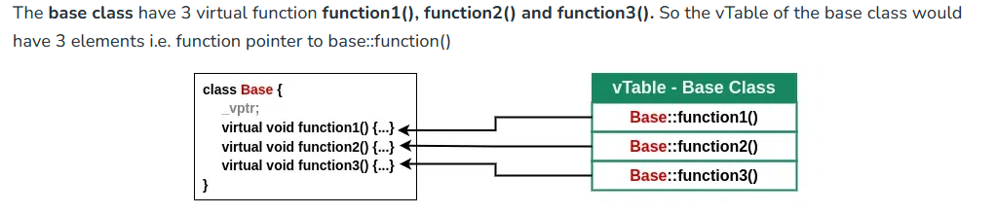
Vtable and Vpointer

Slide 32
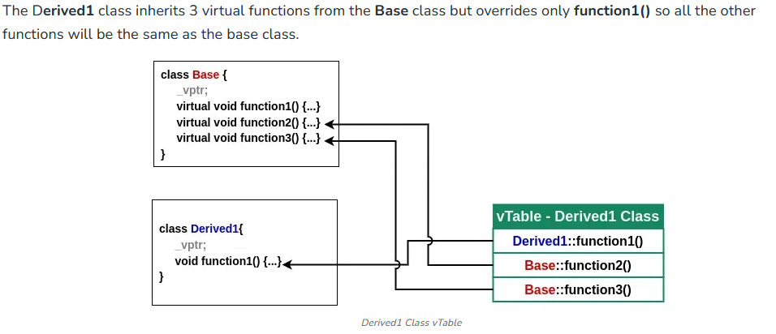
Vtable and Vpointer

Slide 33
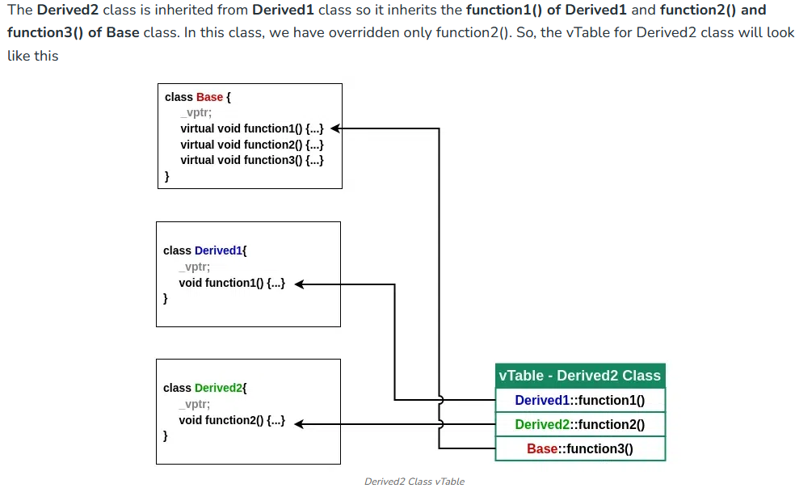
Vtable and Vpointer

Slide 34
Non-inheritable class
class B;
class A{
private:
A(){std::cout<<“A constructor called”<<<std::endl;}; //private constructor
friend class B; //friend class
};
class B:public virtual A{
public:
B(){std::cout<<“ B constructor called”<<std::endl;}
};
class C:public B{
public:
c()
{std::cout<<“c constructor called”<<std::endl;}
}; //Error this class will not inherit

Slide 35
Virtual destructor
Constructors are called from top to bottom
Base first then all derived classes constructors are called for derived class object
Destructors are called from bottom to top
Derived class destructors are called first then base class destructor is called
Virtual destructor in base class
If derived class(s) have members with dynamic allocation
If base class does not have virtual destructor, derived destructors are not called (memory leak)
Syntax: virtual ~base(){}
Dynamic allocated objects are explicitly destroyed with delete()

Slide 36
std::vector<>
Arrays offer fast access but has fixed size
Linked lists offer dynamic data addition / deletion
std::vector<> allow fast access and dynamic data addition / deletion
std::vector<int> vec;
vec.push_back(1);
vec.push_back(2);
vec.push_back(3);
vec.emplace_back(1);
std::vector<int> arr={1,2,3,4};
for(auto& r:arr) std::cout<< r<< std::endl;
arr[2] will return 3
std::vector<int>vec(5); will reserve a vector of five elements
Vector will double in size, if more than five elements are pushed in it
vec.reserve(1024); will reserve 1024 elements for vector

Slide 37
Function Pointers and Lambdas
What if we need to pass a function to a function as an argument
Function will be decided at the execution time
void fn (const std::vector<int>& v, void (*f) (const std::vector<int>&) {f(v);} //function with function //pointer as argument
void print(const std::vector<int>& v) {for(auto& r : v) std::cout<<“value:”<<r<<std::endl;}
int main() {typedef void (*f)(const std::vector<int>&)
f prn = print;
std::vector<int> vec;
vec.emplace_back(1);
vec.emplace_back(2);
vec.emplace_back(3);
vec.emplace_back(4);
fn(vec,prn); //we can pass function pointer to it
std::cin.get();}

Slide 38
Function Pointers and Lambdas
What if we need to pass a function to a function as an argument
Function will be decided at the execution time (using lambdas)
void fn (const std::vector<int>& v, void (*f) (const std::vector<int>&) {f(v);} //function with function //pointer as argument
void print(const std::vector<int>& v) {for(auto& r : v) std::cout<<“value:”<<r<<std::endl;}
int main() {
std::vector<int> vec;
vec.emplace_back(1);
vec.emplace_back(2);
vec.emplace_back(3);
vec.emplace_back(4);
fn(vec,[](const std::vector<int>& v){for(auto & r:v)std::cout<<“value:”<< r <<std::endl;}); //we can pass function pointer to it
std::cin.get();}

Slide 39
Dynamic memory allocation
new
Used to allocate memory dynamically
int * = new int;
int * = new int[10];
delete , delete[]
Used to free the allocated memory
#include <iostream.h>
int main(){
int* array = new int[10]; // Allocate Heap memory
delete[] array; // Deallocate Heap memory
return 0;
}

