Slide 1
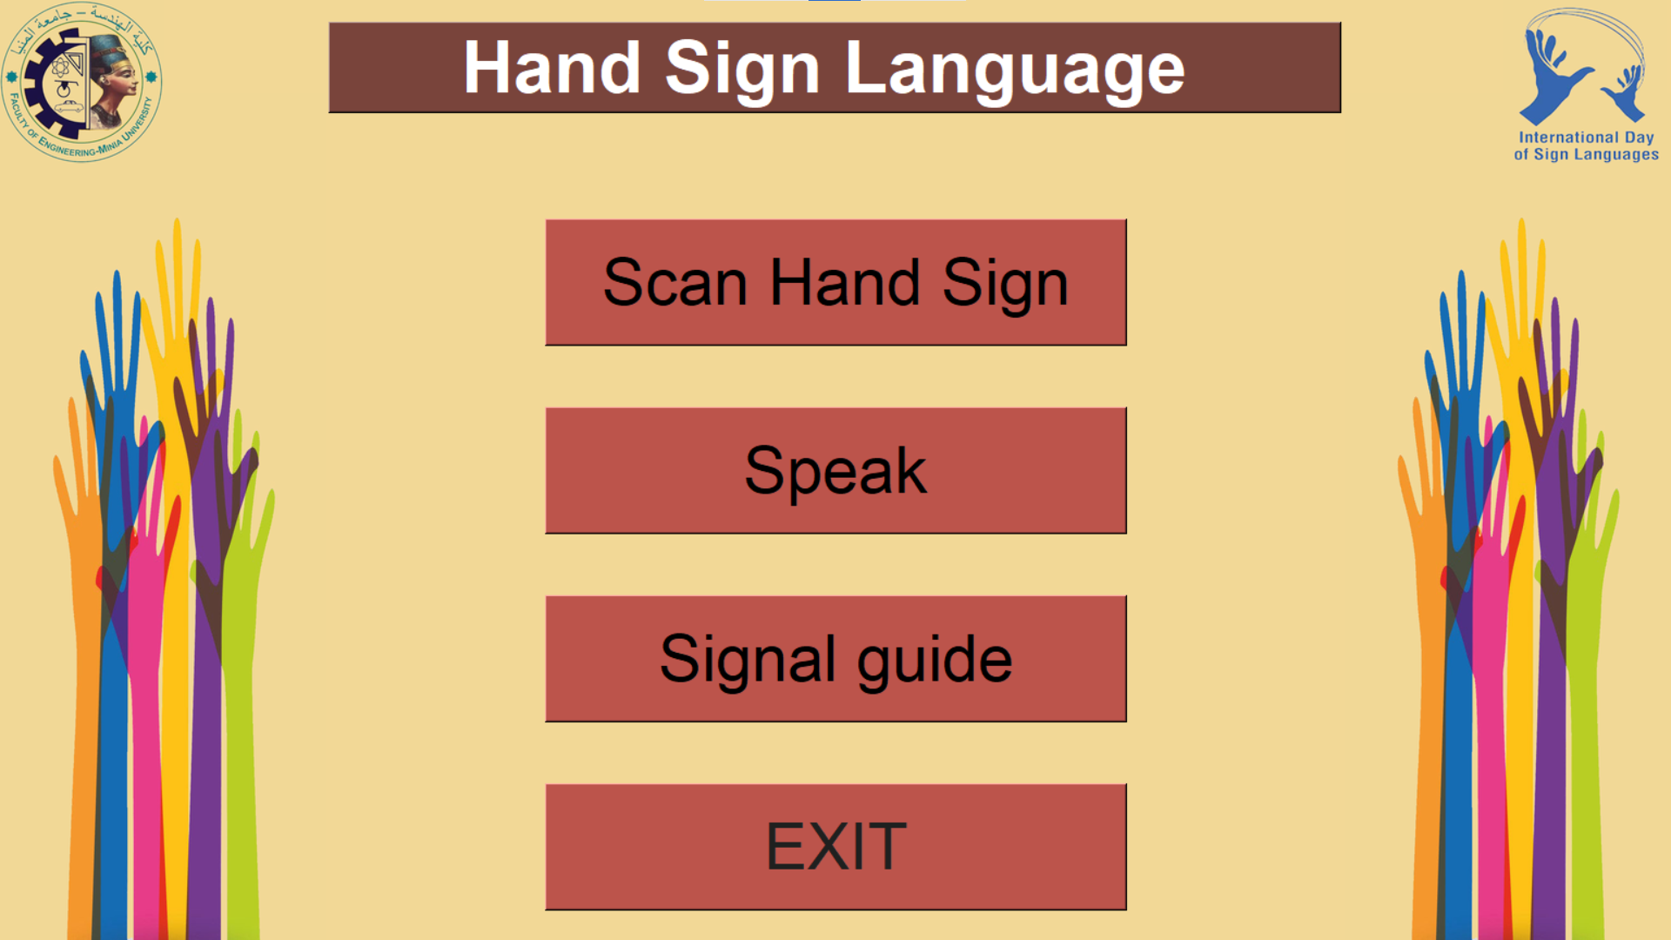
THKINTER IN PROJECT
01.
02.
We applied our studies in HCI (humam computer interaction)
Simple and Ease of use
when opening the interface ,you can see all feature in my project
Building a GUI for a desktop application
create the interface for a desktop application, including buttons, menus, and other interactive elements. using in scanning the signal and converting the speech sound into a signal

Slide 2
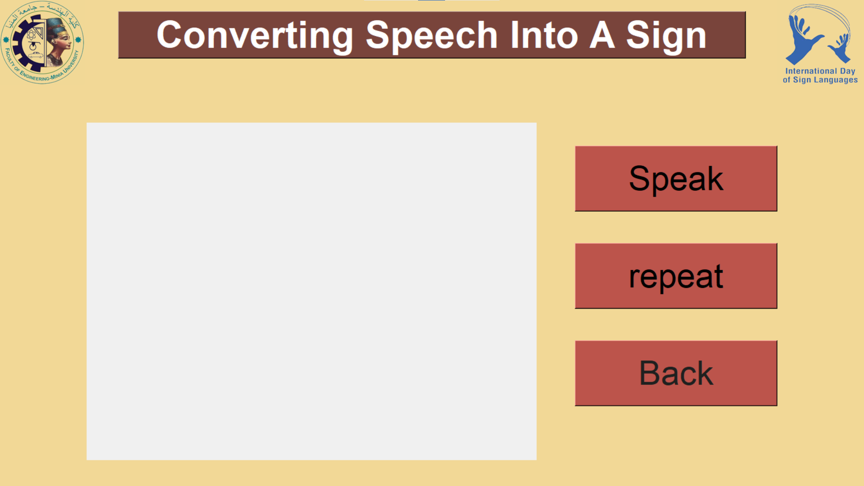
THKINTER IN PROJECT
03.
04.
We applied our studies in HCI (humam computer interaction)
Offline
You can use this project without any connection of internet
Built in with python
it comes with Python already. It gives an object-oriented interface to the Tk GUI toolkit.

Slide 3
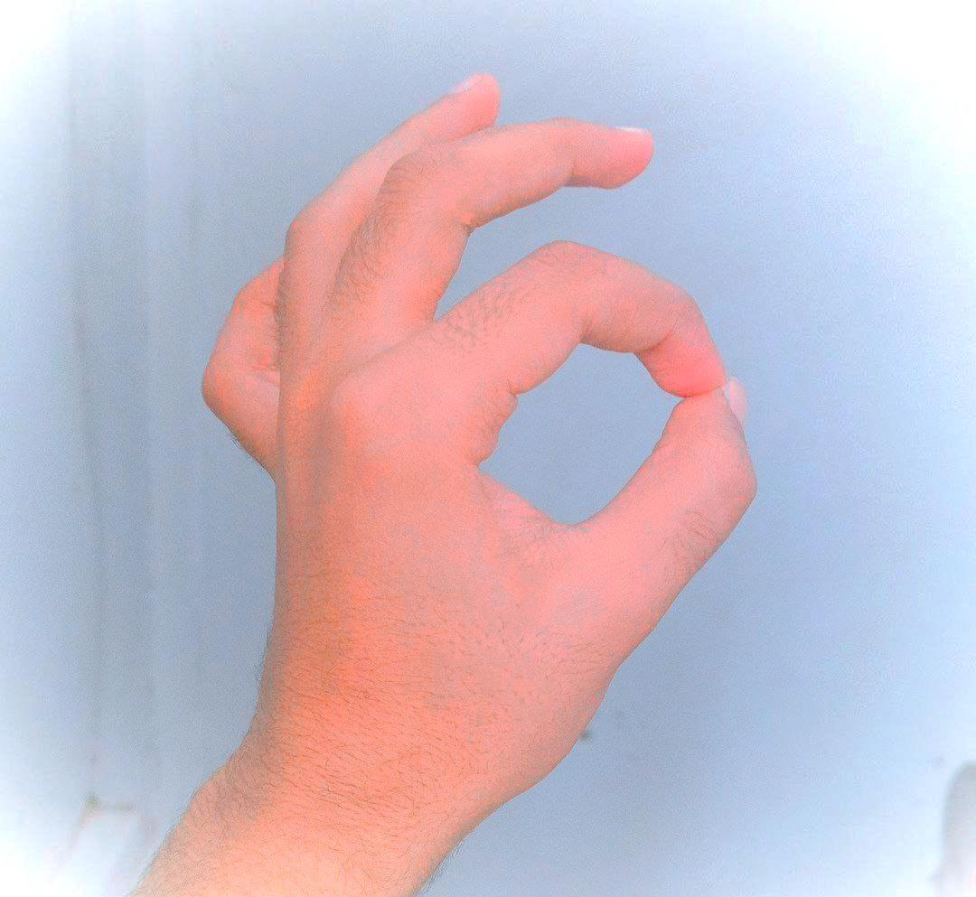
Convert text to voice:
There are several APIs available to convert text to speech in Python.
One of such APIs is the Google Text to Speech API commonly known as the gTTS API.
gTTS is a very easy to use tool which converts the text entered, into audio which can be saved as a mp3 file.
speak

Slide 4
Convert text to voice:
We use sign instead of button .
Why make it sign not button like some project?
Cause to be easy to Deaf and dumb users
We use this sign to give speak last detected sign
speak

Slide 5
QUESTION AND ANSWER
ال
Question
How to collect aword from detection of letter?
Answer
م
We make count when repeat detection of any letter then take it and write it on screen
Because the frame detect any sign every
10 ms

Slide 6
Software development(Agile)
Backlog
Sprint
We studied agile method by creating a backlog of features they want to include in the final product. they are going to work on during the sprint and testing in each deliver
A sprint is a set period (usually two weeks) during which the development team must achieve a specific goal.we meeting with other and doctor each two week and dicuess other
P
Tesitng
Reduced risks
Testing all feature in backlog after each sprint by make small version of project by make learning for few letter and testing it
By breaking down complex projects into smaller sprints.
Helping to ensure that we complete projects on time
M

