Slide 1


E-Tax AI Assistant
How the System Actually Works
Identity, voice, the fraud model, and the database security
behind every answer the assistant gives.
The digital taxation hub

Slide 2





THE PROBLEM
Filing taxes the traditional way is a hassle
→
→
→
Long queues
Stacks of paperwork
Hours lost per visit
Room for human error
A reliable process should leave no room for mistakes — but the manual version rarely does.
2

Slide 3

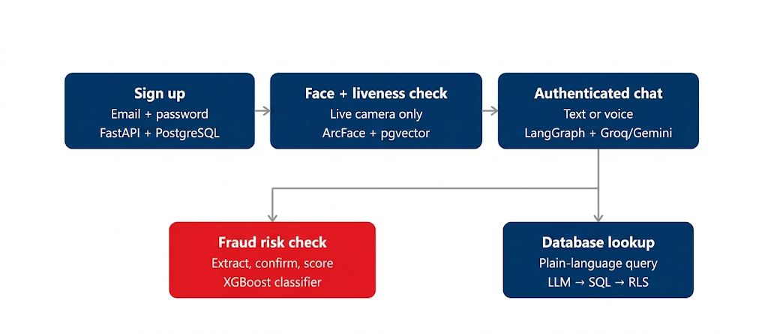

THE CORE IDEA
System Flow
3

Slide 4
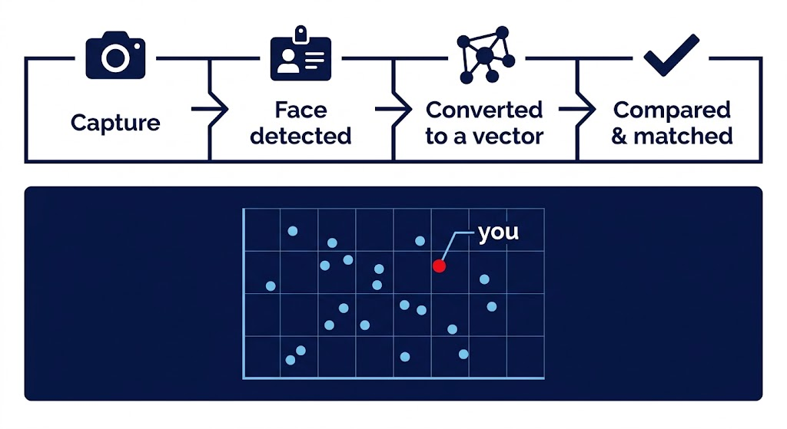
IDENTITY LAYER
Faces become points in a vector space
Similar faces land close together; verification checks distance, not pixels.
4

Slide 5
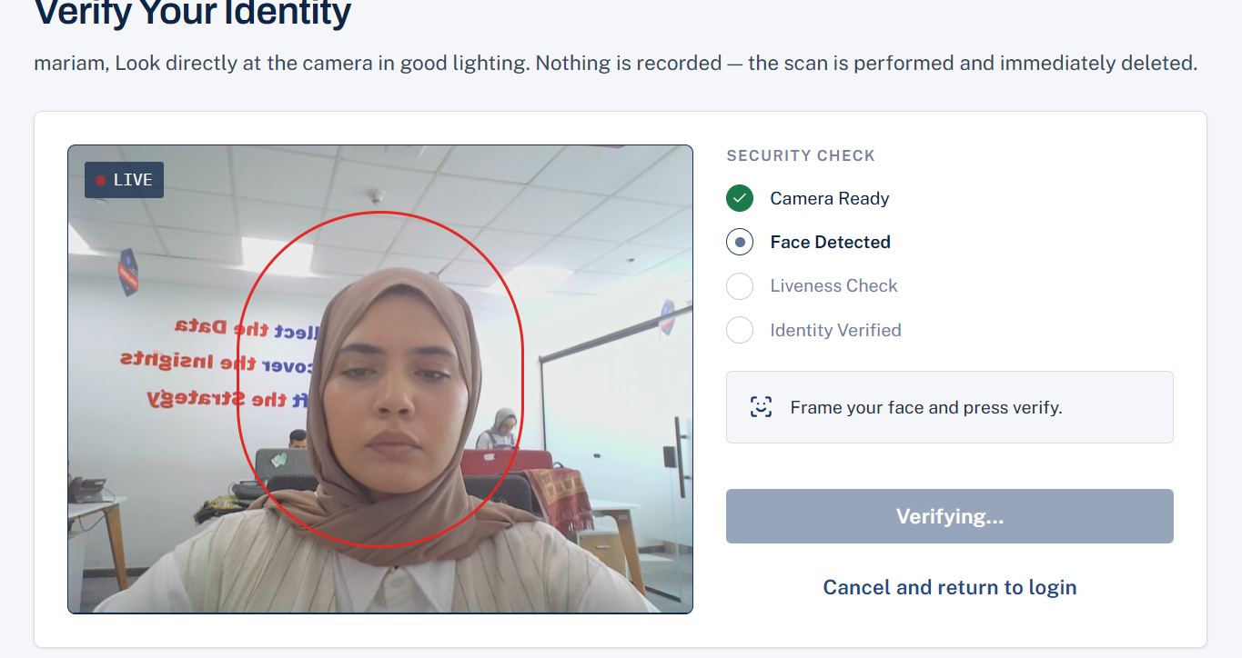
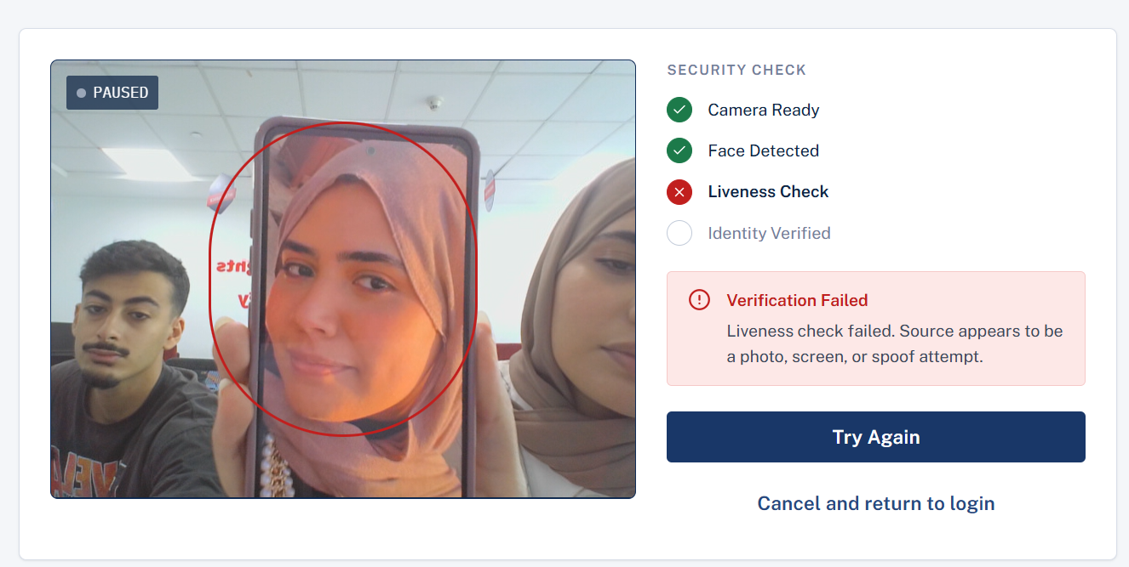


IDENTITY LAYER
Anti-spoofing: liveness beats a static face
[ placeholder — replace with real capture ]
[ placeholder — replace with real capture ]
Real face — passes liveness
Photo / screen / deepfake — rejected
5

Slide 6





VOICE LAYER
What the voice assistant lets you do
Speak a question
Type instead
Switch language mid-chat
User
Get a spoken reply back
6

Slide 7
VOICE LAYER
Speech-to-text pipeline, and live language switching
Browser (mic)
Groq Whisper
Cohere Transcribe
audio (detect role)
transcript + detected language
same audio + language code (transcribe role)
final transcript
Cohere unavailable? Groq's own transcript is used directly — no wasted call.
"إمتى آخر موعد لتقديم الإقرار؟"
"What about my VAT filing?"
7

Slide 8

VOICE LAYER
Text-to-speech: fallback, and an Egyptian voice
→
ElevenLabs
fallback
Gemini TTS
Primary — Egyptian colloquial voice
Fallback if ElevenLabs is unavailable
A local speech model would be more private — but this system uses hosted APIs deliberately, for GPU access and a faster demo response. A real deployment could trade that speed for a self-hosted, more secure setup.
8

Slide 9




Ownership-Based Data Exposure
Secure View Layer | Ownership Rule | Permitted Data Exposure
Company Metadata tax.v_my_companies | Any Share | General access to user's affiliated companies, core taxpayer details, ownership percentage, and access level.
Majority Financials tax.v_majority_transactions tax.v_majority_items | Share > 50% | Full Visibility: Allows the agent to query detailed Sales figures, Tax amounts, and line-item details.
Minority Financials tax.v_minority_transactions | Share ≤ 50% | Restricted Visibility: Exposes Tax obligations only. Sales data is redacted, and no line-item view is provided.

Slide 10
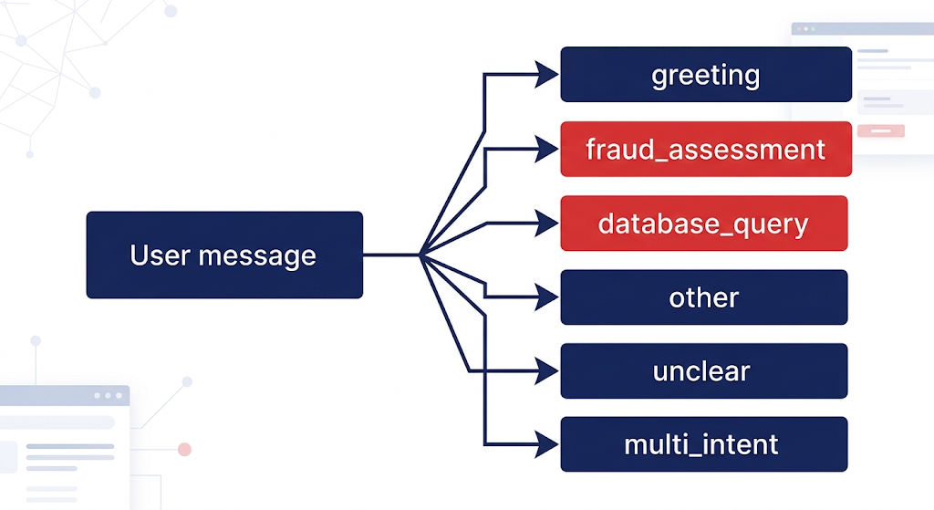
THE CORE IDEA
Not a chatbot — an intent router with judgment
It decides what kind of help you need first, and only then checks who you are and
what you're allowed to see — at every step along the way.
3

Slide 11
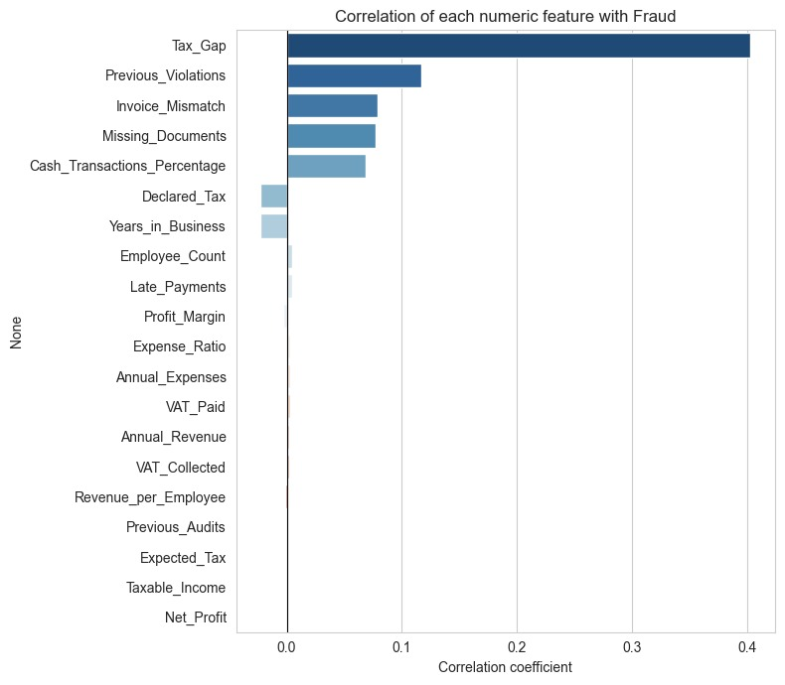
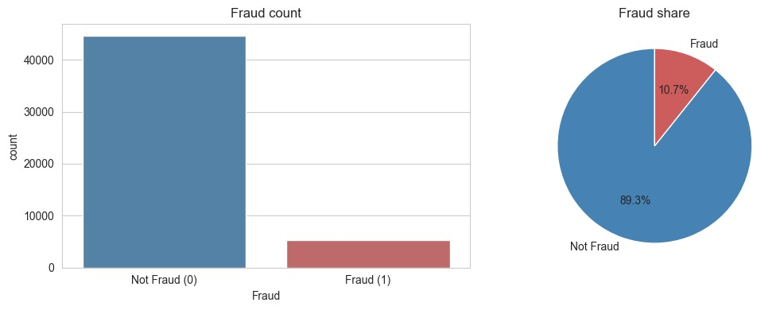
THE FRAUD MODEL
What the data actually showed
STRONGEST CORRELATION WITH FRAUD
10.7% of cases are fraud — a meaningfully imbalanced target, which is why evaluation is recall-first (see next) rather than relying on naive resampling.
An outlier isn't automatically bad data. In this dataset, an extreme value can mean a genuinely large company, an unusual but valid transaction — or a real fraud signal.
9

Slide 12
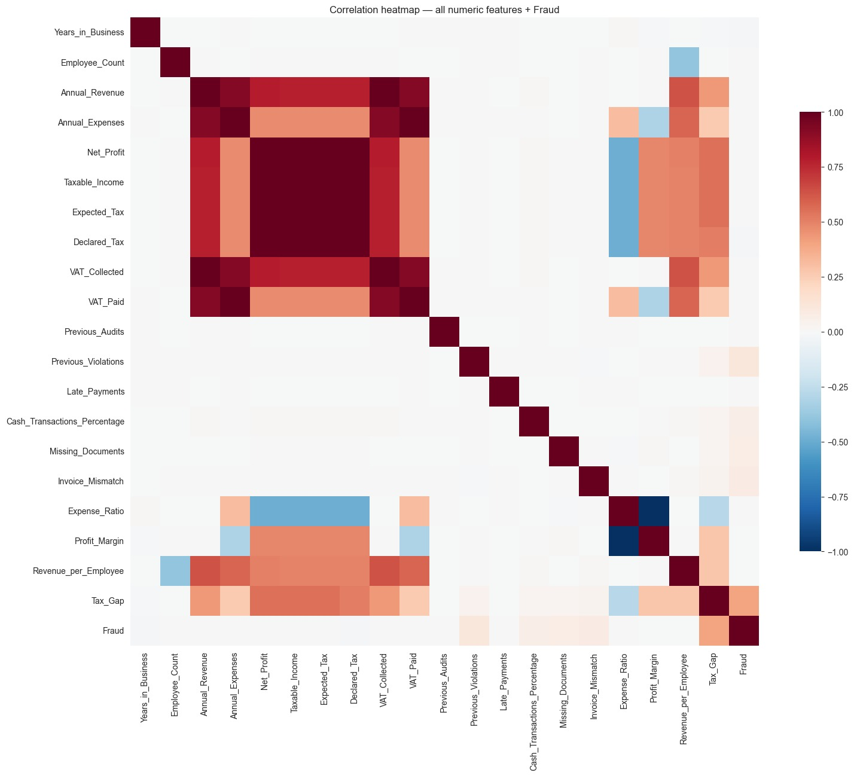
THE FRAUD MODEL
How every feature relates to every other
This full correlation view is what guided feature engineering — which ratios to derive, which raw fields were redundant, and which stood alone.
10

Slide 13
THE FRAUD MODEL
Why recall comes first
Predicted:
Not Fraud
Predicted:
Fraud
Actual:
Not Fraud
True Negative
False Positive
(unnecessary review —
still catchable by a human)
Actual:
Fraud
False Negative
(fraud passes through
undetected)
True Positive
caught
The most serious error is the bottom-left cell — so recall is prioritized over precision.
Reported metrics: ROC-AUC · PR-AUC · Threshold · Precision · Recall
11

Slide 14
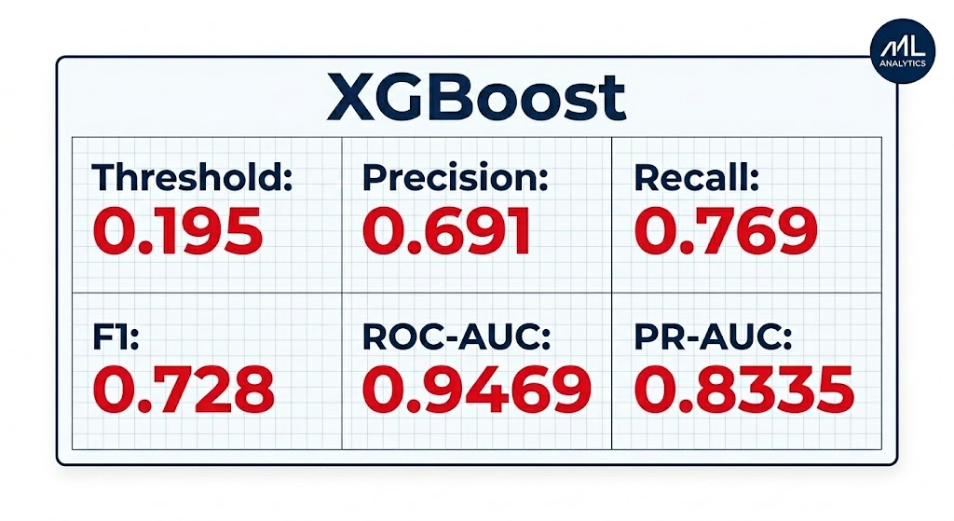
THE FRAUD MODEL
Why recall comes first
11

Slide 15


WHAT CHANGED
From a form to a confirmation
→
→
→
Record pulled
from the database
Pre-filled review
shown to the user
User confirms
or corrects
Model scores it
The system never invents values the user never actually had — it retrieves what's real in their own data and asks for confirmation, not manual entry.
12

Slide 16



DESIGN PRINCIPLE
Where AI ends and code begins
The LLM handles
Code + the database decide
Interpreting a message
Classifying intent
Extracting values
Phrasing an answer
Generating scoped SQL
Summarizing results
User permissions
Missing-value handling
The fraud prediction itself
What data is actually returned
Sara skips a field mid-assessment → the workflow pauses, waits, and resumes exactly where it left off once she fills it in. Nothing restarts.
13

Slide 17

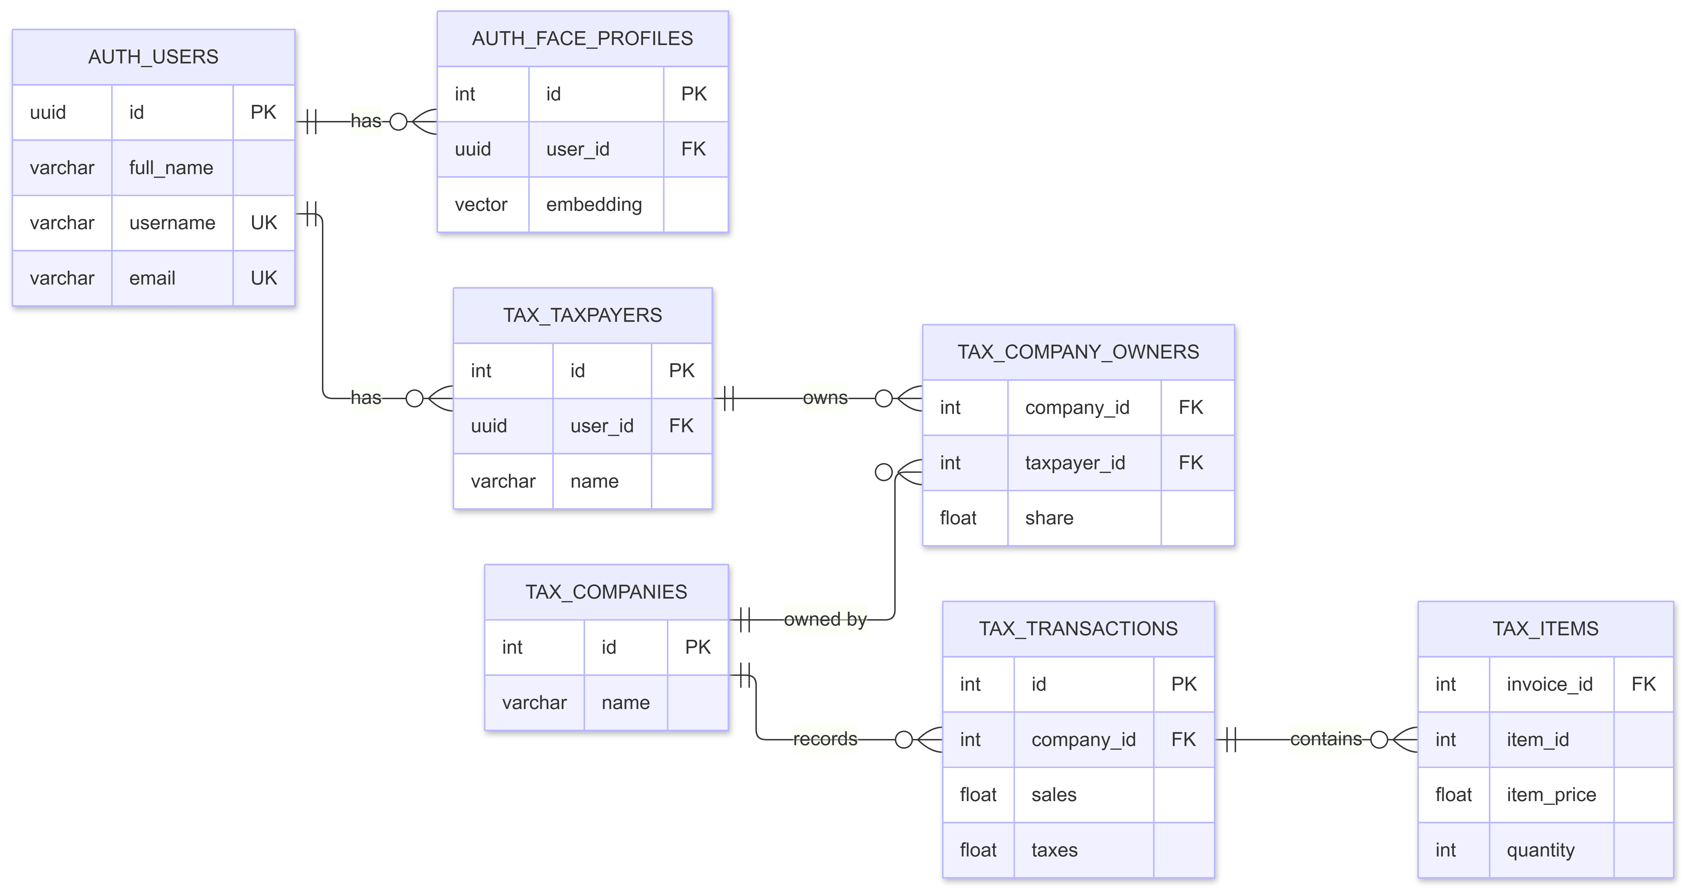
SECURITY
Database Schema
14

Slide 18








Layer Security Model
1. Secure Views
2. Row-Level Security
3. Role Segregation
All queries run against specific views utilizing security_invoker = true. Views strictly filter data based on the dynamic session variable app.current_user_id, guaranteeing contextual isolation.
Forced RLS is active on core tables (company_owners, transactions, items). User IDs are enforced purely by the database session configuration, making it impossible for the LLM to hallucinate or bypass IDs.
The LLM operates exclusively as app_agent. This non-superuser role possesses NOBYPASSRLS and holds tightly scoped SELECT grants, with absolutely zero access to the authentication schema.

Slide 19



Live Demo
Switching to the live application environment...

Slide 20
Thank You
Judgment stays in code and the database. AI handles language — nothing more, nothing less.
The digital taxation hub

