Slide 1
C The Programming Language
Strings
7th dec.

Slide 2
Strings:
Character arrays are many a time called as strings.
A string constant is a one-dimensional array of characters terminated by a null ( ‘\0’ ).
char name[ ] = { 'H', 'A', 'E', 'S', 'L', 'E', 'R', '\0' } ;
Each character in the array occupies one byte of memory and the last character is always ‘\0’.
the elements of the character array are stored in contiguous memory locations.

Slide 3


Slide 4
Shortcut way of initializing string:
char name[ ] = "HAESLER" ;
Note that, in this declaration ‘\0’ is not necessary. C inserts the null character automatically.

Slide 5
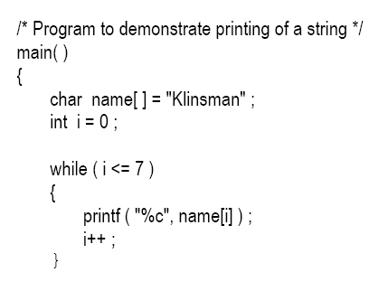

Accessing a String:

Slide 6


Slide 7
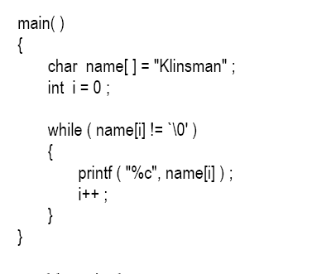
Other way out:

Slide 8
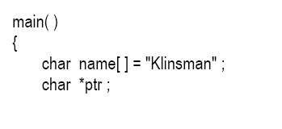
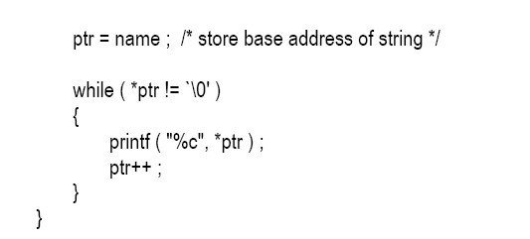
Still another way out:

Slide 9
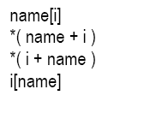

Slide 10
There are so many ways to refer to the elements of a character array, rarely is any one of them used.
This is because printf( ) function has got a sweet and simple way of doing it

Slide 11
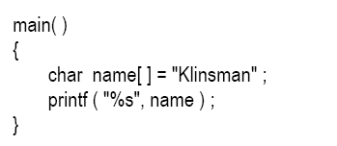
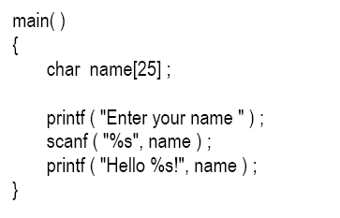
Inputting and Outputting strings:

Slide 12
Cont’d:
While entering the string using scanf( ) we must be cautious about two things:
The length of the string should not exceed the dimension of the character array.
scanf( ) is not capable of receiving multi-word strings.
The way to get around this limitation is by using the function gets( ).

Slide 13
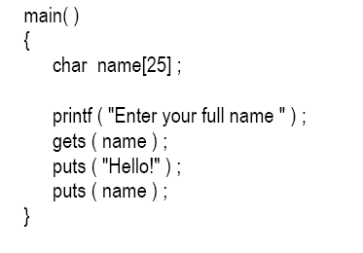

Gets and puts:

Slide 14

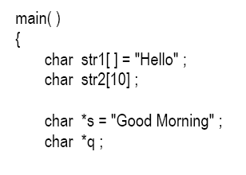
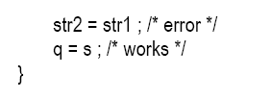
Pointers and Strings

Slide 15
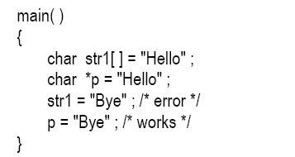

Slide 16
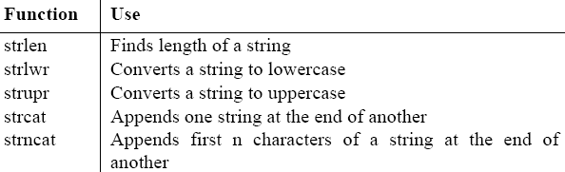
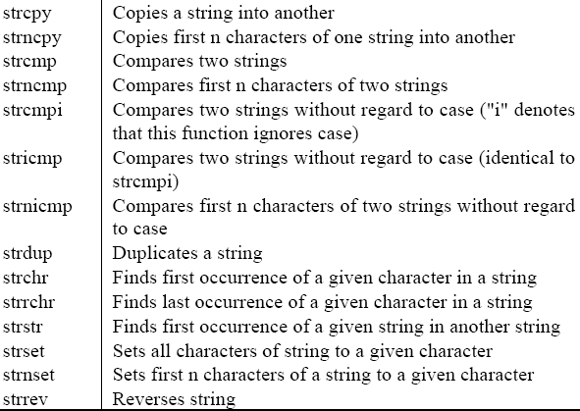
Standard Library Functions:

Slide 17
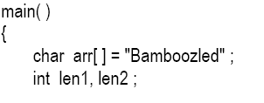
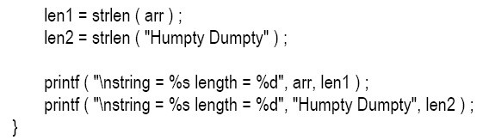
strlen( )
This function counts the number of characters present in a string.

Slide 18
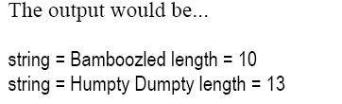

Slide 19
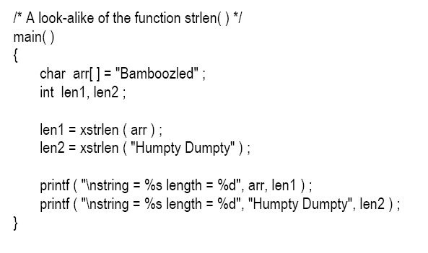
Xstrlen:

Slide 20
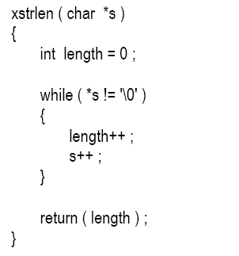
Cont’d:

