Slide 1
C the Programming language
Pointers and Arrays.
30th Nov

Slide 2
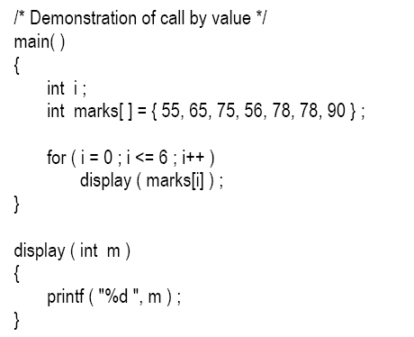
Passing Array Elements to a Function :

Slide 3

OUPUT:

Slide 4
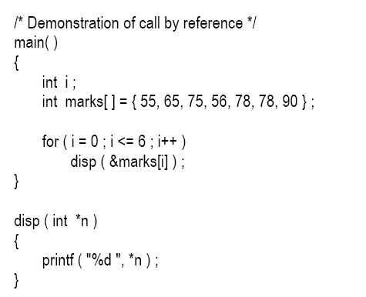
Call by reference:

Slide 5
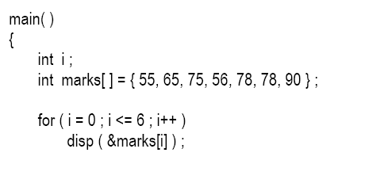
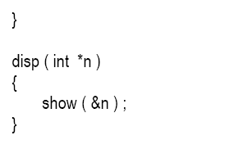
Cont’d:

Slide 6
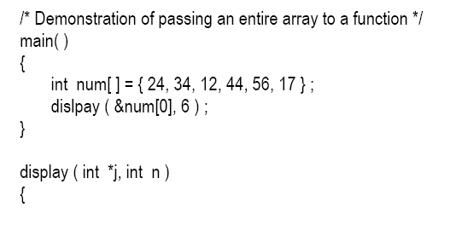
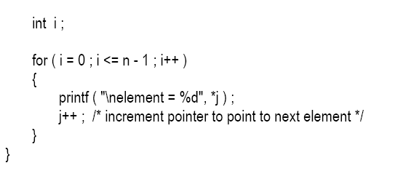
Passing an Entire Array to a Function

Slide 7

Cont’d:
The address of the zeroth element is being passed to the display( ) function.
Just passing the address of the zeroth element of the array to a function is as good as passing the entire array to the function.
Address of the zeroth element (many a times called the base address) can also be passed by just passing the name of the array.

Slide 8


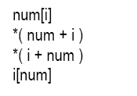
The Real Thing:

Slide 9
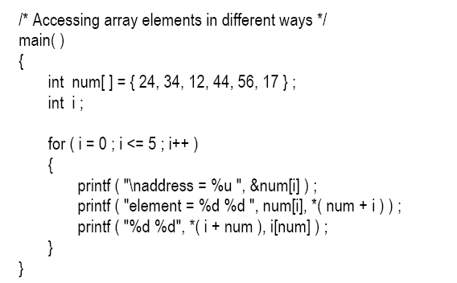
Cont’d:

Slide 10
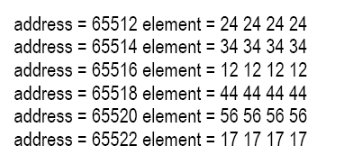
OUTPUT:

Slide 11
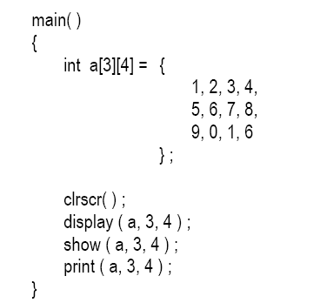
Passing 2-D Array to a Function
There are three ways in which we can pass a 2-D array to a function.

Slide 12
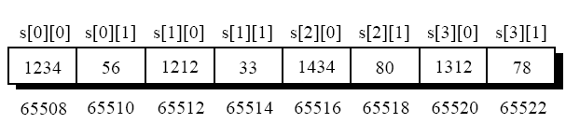
2-Dimensional Array:

Slide 13
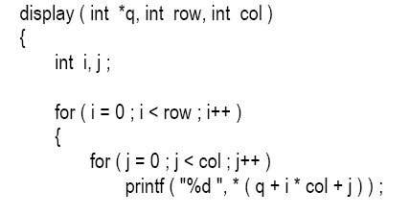
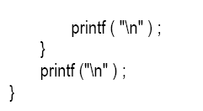

Slide 14
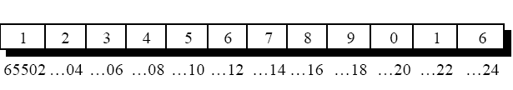

Slide 15
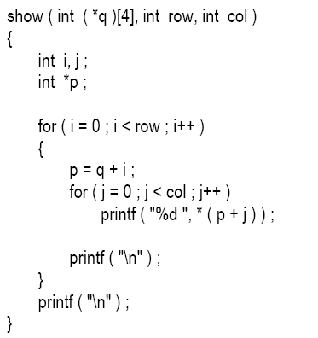

Slide 16
