Slide 1
C the Programming language
Functions and Pointers.
2nd Nov

Slide 2
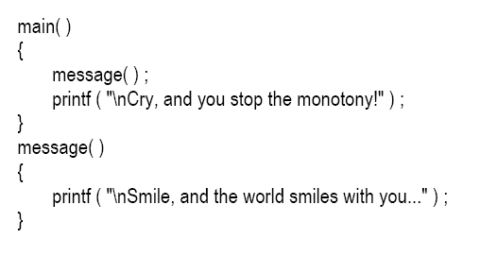
Function:
A function is a self-contained block of statements that perform a coherent task of some kind.

Slide 3
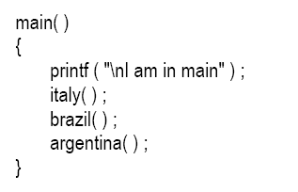
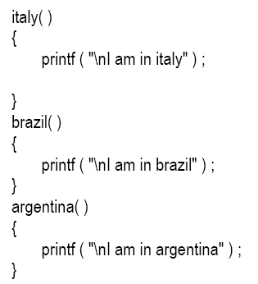
Call to more than one function:

Slide 4
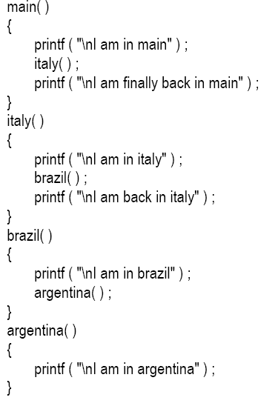

Slide 5
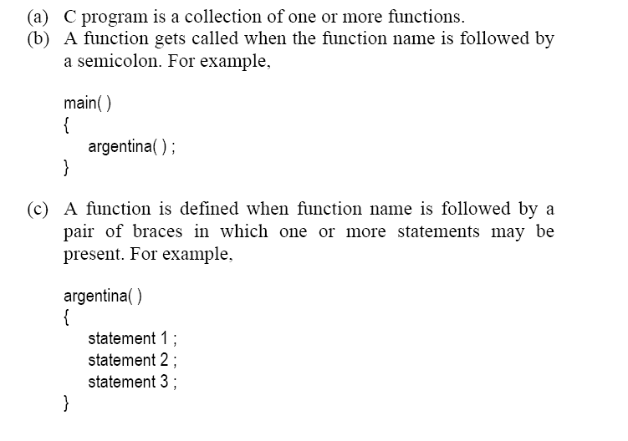

Slide 6
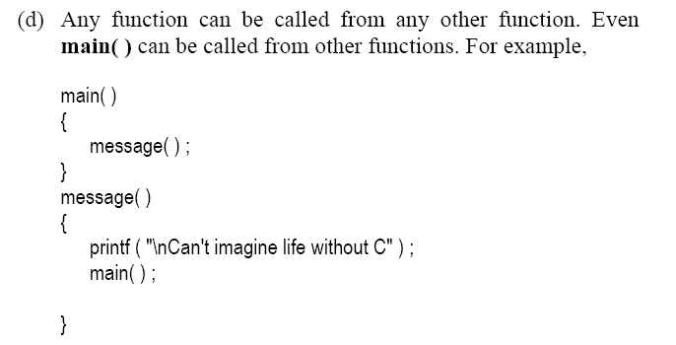

Slide 7
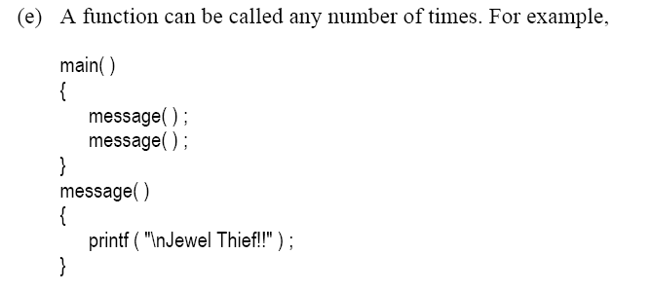

Slide 8
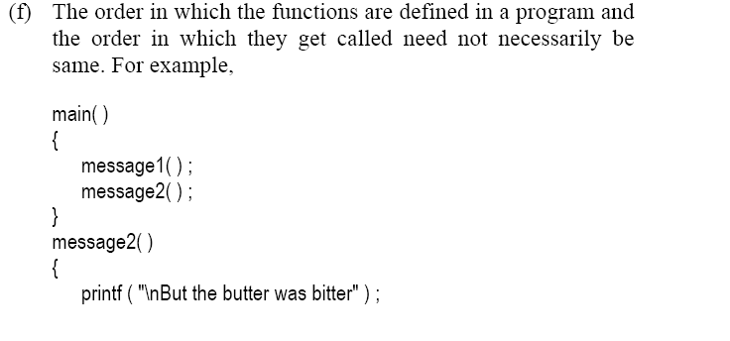
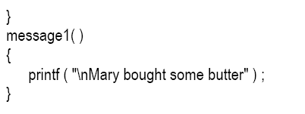

Slide 9
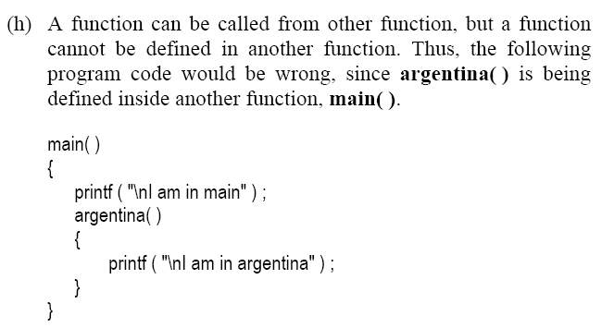

Slide 10
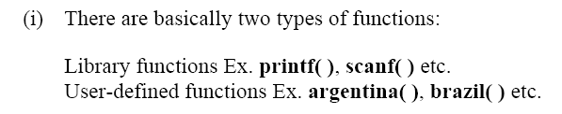

Slide 11
Why Use Function:
Writing functions avoids rewriting the same code over and over.
Using functions it becomes easier to write programs and keep track of what they are doing.

Slide 12
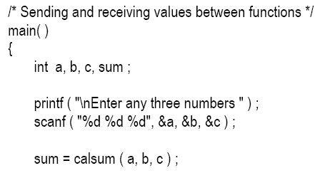
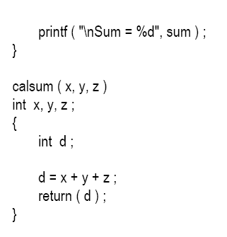
Passing Values between Functions

Slide 13
Return Statement
Return statement is used to return meaningful value to the calling functions.
The return statement serves two purposes:
On executing the return statement it immediately transfers the control back to the calling program.
It returns the value present in the parentheses after return, to the calling program.

Slide 14
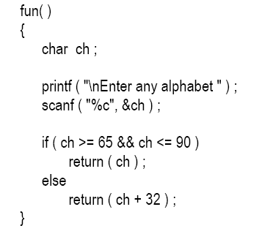
Multiple Return Statements:

Slide 15

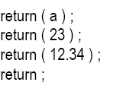

Whenever a meaningful value is returned as in our program it can be equated as:
Valid Return Statements:
Invalid Returns:

Slide 16
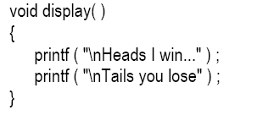
When function do not return any value:
If the value of a formal argument is changed in the called function, the corresponding change does not take place in the calling function.

Slide 17
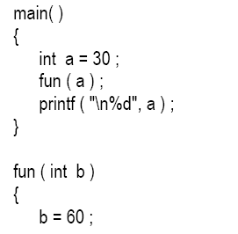


Slide 18
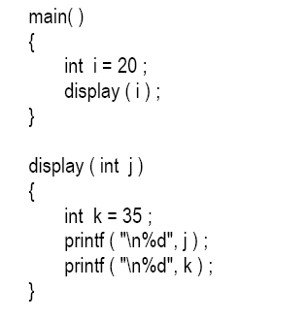
Scope Role of function:

Slide 19
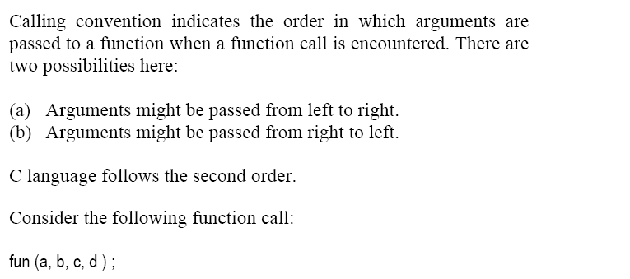

Calling Function:

Slide 20
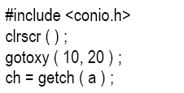
Dicey Issue:

Slide 21
Advanced Features of Functions:
Function Declaration and Prototypes
Calling functions by value or by reference
Recursion

Slide 22
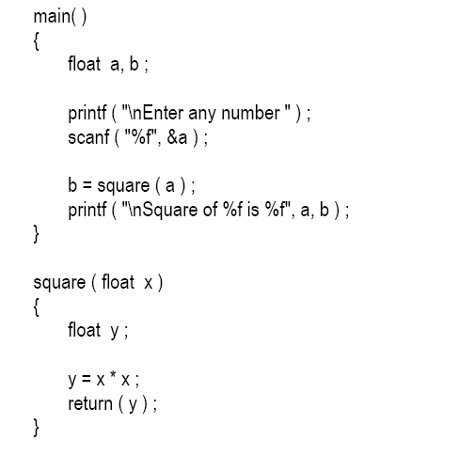
Function Declaration and Prototypes

Slide 23
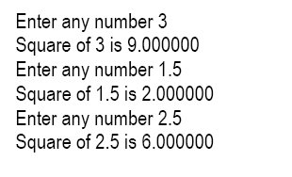
Output:

Slide 24
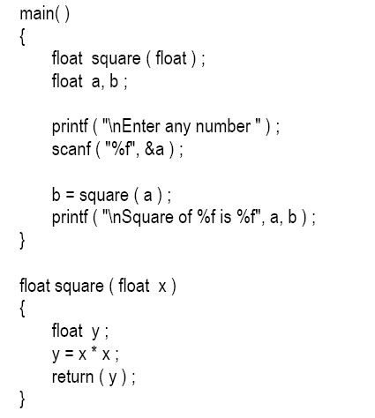

Slide 25
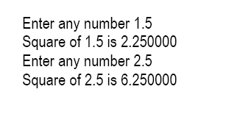
Output:

Slide 26
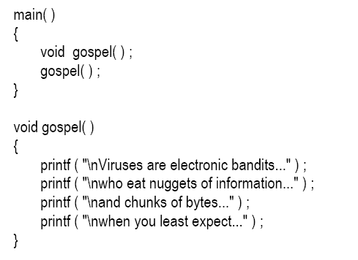
When Function do not returns any value:

Slide 27
Call by Value and Call by Reference
Whenever we call a function and passed something to it we have always passed the ‘values’ of variables to the called function.
‘calls by value’. By this what we mean is, on calling a function we are passing values of variables to it.
sum = calsum ( a, b, c ) ;
f = factr ( a ) ;

Slide 28
Call by Reference:
Variables are stored somewhere in memory.
So instead of passing the value of a variable, can we not pass the location number (also called address) of the variable to a function?
‘call by reference’.

Slide 29
POINTERS : )

Slide 30
Cont’d: Function Calls:
Two types of function calls.
call by value.
call by reference.
Arguments can generally be passed to functions in one of the two ways:
sending the values of the arguments
sending the addresses of the arguments

Slide 31
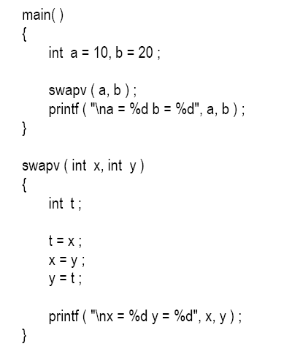
Call by Value:

Slide 32

Output:

Slide 33
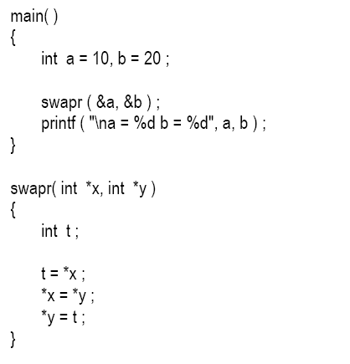
Call by reference:

Slide 34

Output:

Slide 35
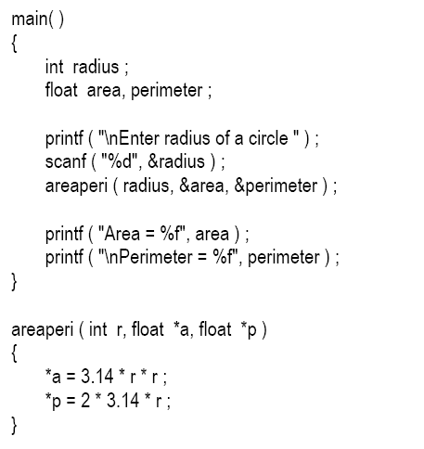
Returning more than One value:

Slide 36
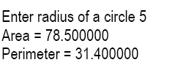
Output

Slide 37
Conclusion:
If we want that the value of an actual argument should not get changed in the function being called, pass the actual argument by value.
If we want that the value of an actual argument should get changed in the function being called, pass the actual argument by reference.
If a function is to be made to return more than one value at a time then return these values indirectly by using a call by reference.

Slide 38
Recursion:
It is possible for the functions to call themselves.
A function is called ‘recursive’ if a statement within the body of a function calls the same function.
‘circular definition’
recursion is thus the process of defining something in terms of itself.

Slide 39
Example:
Factorial Computation:
Non-recursive function for calculating factorial.
Recursive function for calculating factorial.

Slide 40
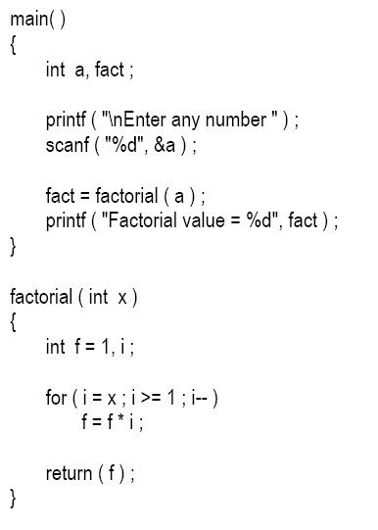
Non-Recursive:

Slide 41
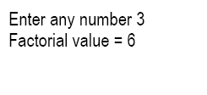
Output:

Slide 42
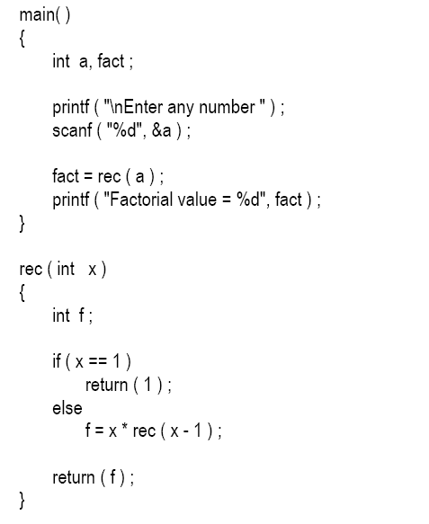
Recursive Version:

Slide 43
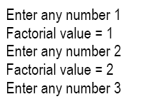

Output:

Slide 44
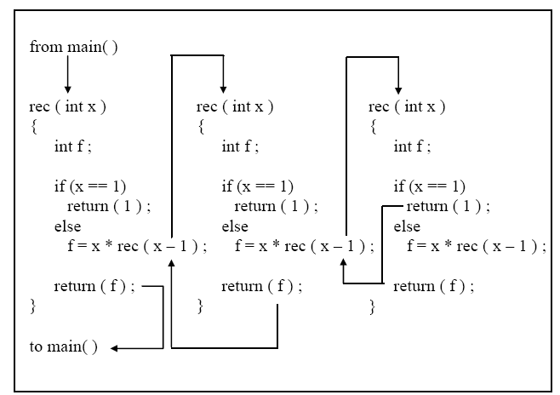

Slide 45
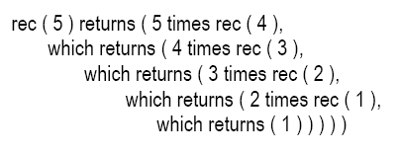
Ladder of Computation:

Slide 46
Recursion and Stack:
There are different ways in which data can be organized.
Variables, Arrays, Linked Lists, binary tree, stacks etc..
The compiler uses one such data structure called stack for implementing normal as well as recursive function calls.
A stack is a Last In First Out (LIFO) data structure.

Slide 47
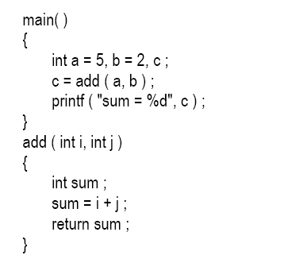
Working of Stack:

Slide 48
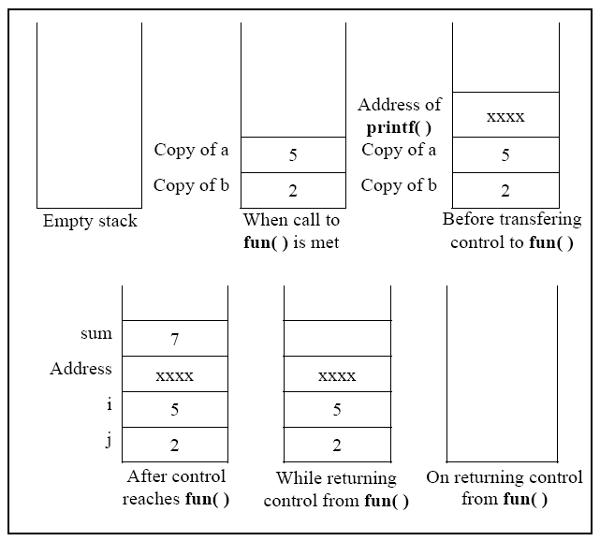

Slide 49
The recursive calls are no different.
Whenever we make a recursive call the parameters and the return address gets pushed on the stack.
The stack gets unwound when the control returns from the called function.

Slide 50
Adding Functions to the Library..
SELF STUDY:

Slide 51
End..

