Slide 1
C the Programming language
Structures.

Slide 2
Structures:
Ordinary variables can hold one piece of information.
Arrays can hold a number of pieces of information of the same data type.
Quite often we deal with entities that are collection of dissimilar data types.
Want to store data about a book.
Want to store its name (a string), its price (a float) and number of pages in it (an int).

Slide 3
Cont’d:
Construct individual arrays, one for storing names, another for storing prices and still another for storing number of pages.
Use a structure variable.

Slide 4
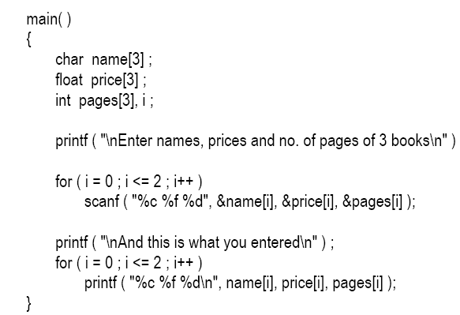
Arrays:

Slide 5
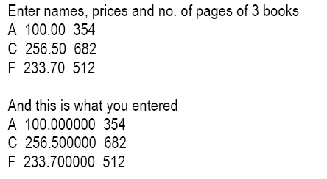
Output:

Slide 6
Structure:
A structure contains a number of data types grouped together. These data types may or may not be of the same type.

Slide 7
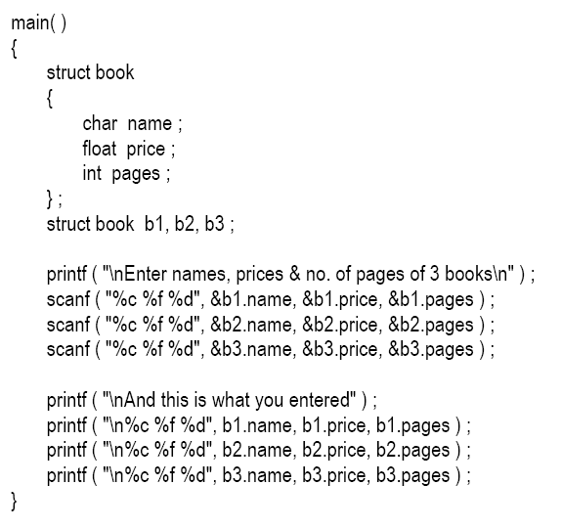

Slide 8
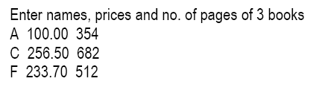
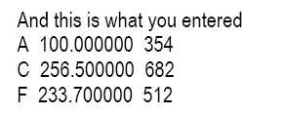

Slide 9
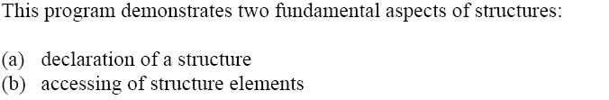
Cont’d:

Slide 10
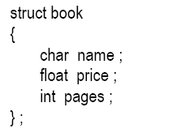
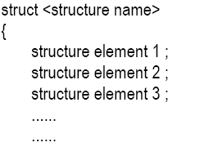

Declaring a Structure:

Slide 11
Cont’d:
Once the new structure data type has been defined one or more variables can be declared to be of that type.
For example the variables b1, b2, b3 can be declared to be of the type struct book:
struct book b1, b2, b3 ;
This statement sets aside space in memory.
Structures bytes are always in adjacent memory locations.

Slide 12
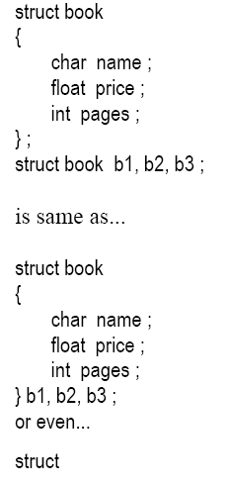
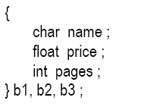

Slide 13
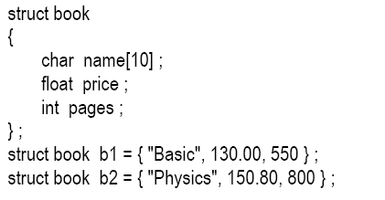
Initialization of structure variables:

Slide 14
Things to remember:
The closing brace in the structure type declaration must be followed by a semicolon.
Structure type declaration does not tell the compiler to reserve any space in memory. All a structure declaration does is, it defines the ‘form’ of the structure.
Usually structure type declaration appears at the top of the source code file, before any variables or functions are defined. In very large programs they are usually put in a separate header file, and the file is included (using the preprocessor directive #include) in whichever program we want to use this structure type.

Slide 15
Accessing Structure Elements:
In arrays we can access individual elements of an array using a subscript.
Structures use a different scheme. They use a dot (.) operator.
b1.pages
b1.price
Note that before the dot there must always be a structure variable and after the dot there must always be a structure element.

Slide 16
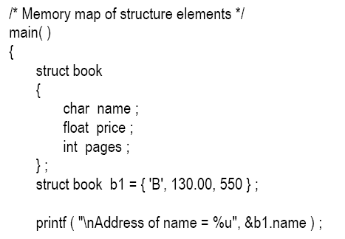

How Structure Elements are Stored :
Whatever be the elements of a structure, they are always stored in contiguous memory locations.

Slide 17
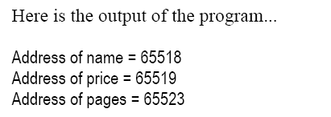
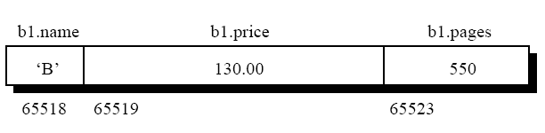
Output:

Slide 18
Array of Structures:
To store data of 100 books we would be required to use 100 different structure variables from b1 to b100,
A better approach would be to use an array of structures.

Slide 19
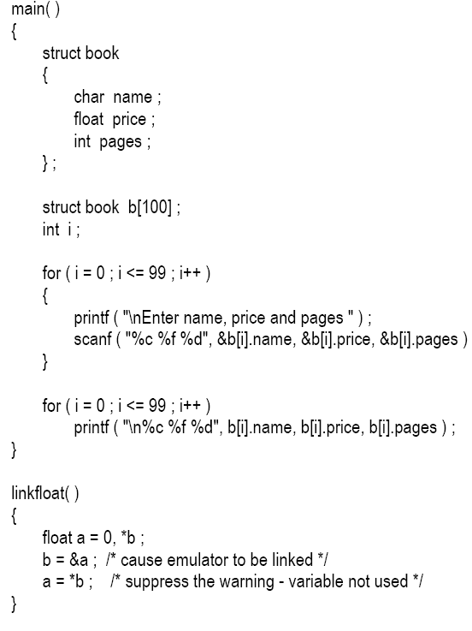

Slide 20
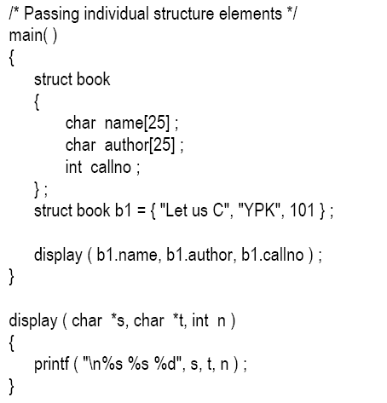
Passing structure to a function:

Slide 21
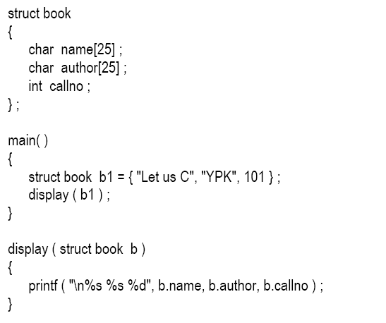

Slide 22
Structure Pointers:
The way we can have a pointer pointing to an int, or a pointer pointing to a char, similarly we can have a pointer pointing to a struct.

Slide 23
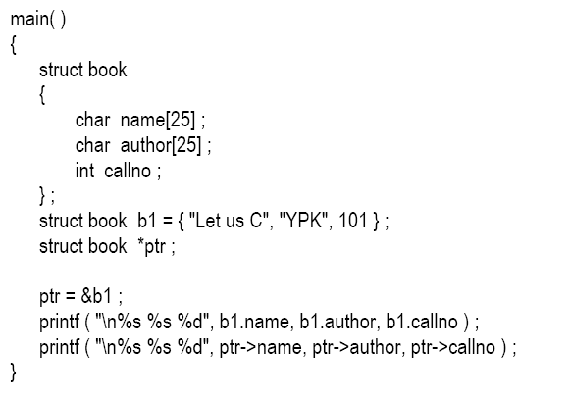

Slide 24
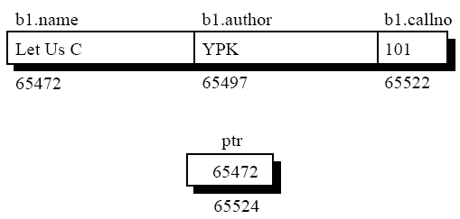

Slide 25
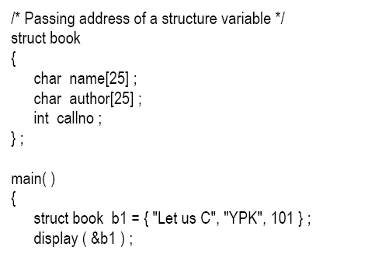
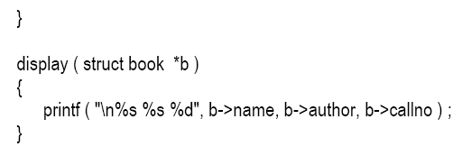

Slide 26
End..

