Slide 1
Introduction to Computers and Programming
Let Us C by Yashavant Kanetkar
Chapter 3
Case Control Structure

Slide 2
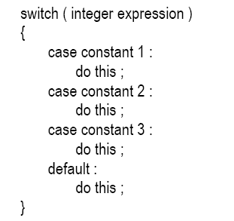
Decisions Using switch
Test variables for multiples values.
The control statement that allows us to make a decision from the number of choices is called a switch, or more correctly a switch-case-default, since these three keywords go together to make up the control statement.

Slide 3
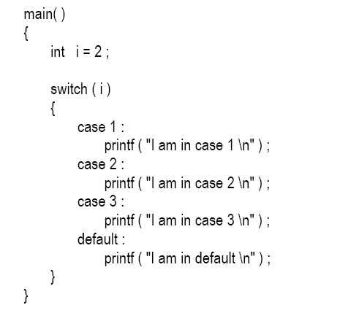
Quick Test:

Slide 4
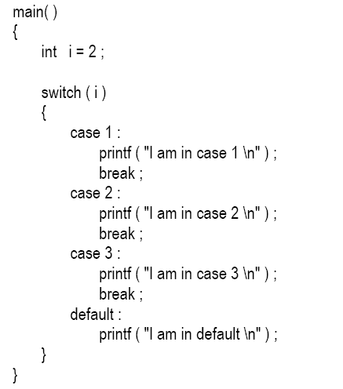
Only Case 2:

Slide 5
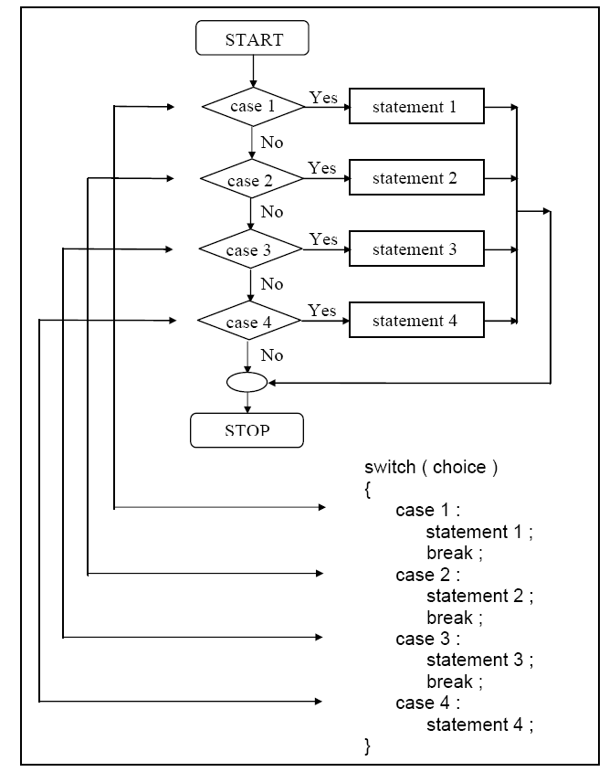

Slide 6
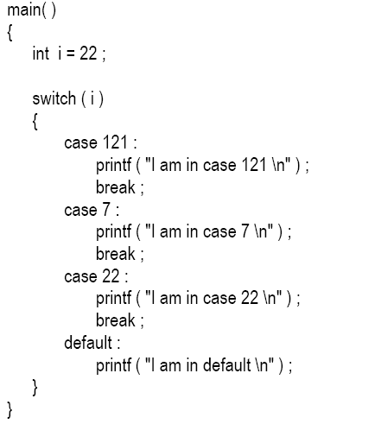
The Tips and Traps
Case constants may have any order.

Slide 7
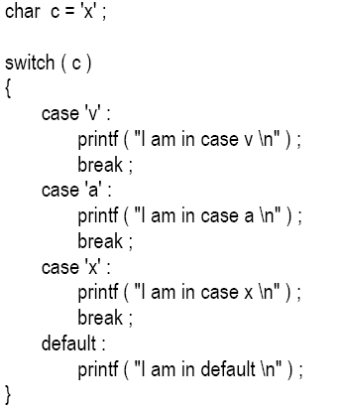
Cont’d:
You are also allowed to use char values in case and switch as shown in the following program:

Slide 8
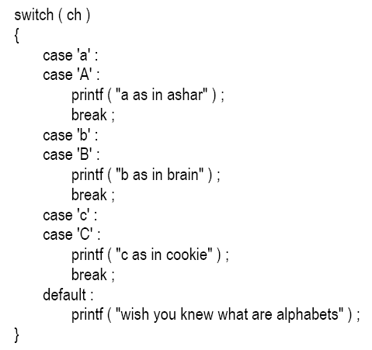
Cont’d:
At times we may want to execute a common set of statements for multiple cases.
char ch ;
printf ( "Enter any of the alphabet a, b, or c " ) ;
scanf ( "%c", &ch ) ;

Slide 9
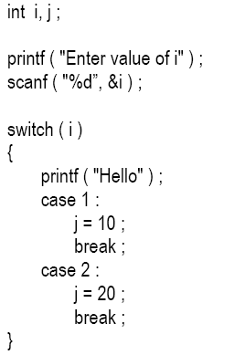
Cont’d:
Even if there are multiple statements to be executed in each case there is no need to enclose them within a pair of braces (unlike if, and else).
Every statement in a switch must belong to some case or the other.

Slide 10
If we have no default case, then the program simply falls through the entire switch and continues with the next instruction (if any,) that follows the closing brace of switch.
Is switch a replacement for if? Yes and no. Yes, because it offers a better way of writing programs as compared to if, and no because in certain situations we are left with no choice but to use if. The disadvantage of switch is that one cannot have a case in a switch which looks like:
case i <= 20 :

Slide 11
Cont’d:
We can check the value of any expression in a switch. Thus the following switch statements are legal.
switch ( i + j * k )
switch ( 23 + 45 % 4 * k )
switch ( a < 4 && b > 7 )
Expressions can also be used in cases provided they are constant expressions.
case 3 + 7 is correct
case a + b is incorrect.

Slide 12
Cont’d:
The break statement when used in a switch takes the control outside the switch. However, use of continue will not take the control to the beginning of switch as one is likely to believe.
In principle, a switch may occur within another, but in practice it is rarely done. Such statements would be called nested switch statements.
The switch statement is very useful while writing menu driven programs.

Slide 13
switch Versus if-else Ladder :
Switch:
No float expressions
No variable expressions
Each case is unique
Faster
2 case switch is slower.

Slide 14
If else:
Float Expressions
Variable expressions
Slow
Condition evaluation is slow
Simple if-else is faster.

Slide 15
The goto Keyword:
Avoid goto keyword!
Using goto results in
Unreadable program
Unreliable program
Hard to debug program.

Slide 16
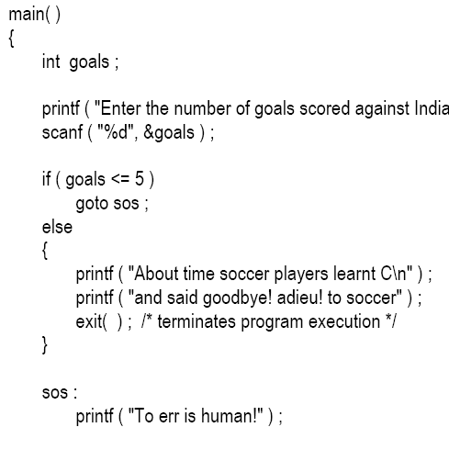
Example goto Statement:
}

Slide 17
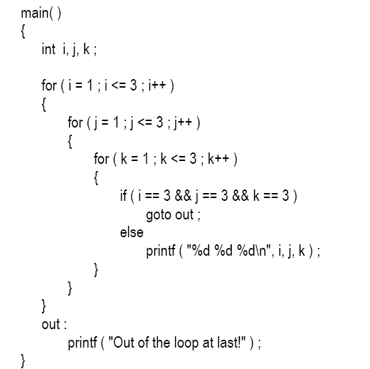
Using goto in Situations:

