Slide 1
Collection - Arraylist
Team 1

Slide 2
Collections in Java
The Collection in Java is a framework that provides an architecture to store and manipulate the group of objects.
Java Collections can achieve all the operations that you perform on a data such as searching, sorting, insertion, manipulation, and deletion.

Slide 3
What is Collection in Java
What is a framework in Java
A Collection represents a single unit of objects.
It provides readymade architecture.
It represents a set of classes and interfaces.

Slide 4
What is an ArrayList?
An ArrayList is a resizable array implementation in Java. It is a dynamic array that can grow or shrink as needed. This makes it a flexible and convenient way to store collections of data.

Slide 5

Key Features of ArrayList
Resizable: ArrayLists can grow or shrink as needed.
Dynamic: ArrayLists are dynamic arrays, which means that they can change size at any time.
Flexible: ArrayLists can store any type of object.
Convenient: ArrayLists are easy to use and have a wide range of methods for working with collections of data.

Slide 6
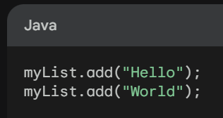
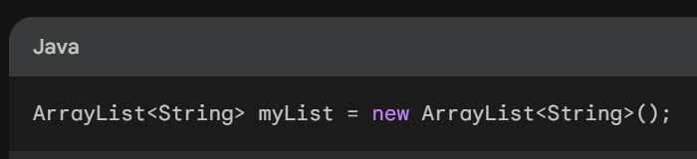
Creating an ArrayList
Adding Elements to an ArrayList

