Slide 1
INTRODUCTION TO MACHINE LEARNING
Week #1
Introduction to AI
Assist. Prof. M. Erdem İSENKUL
Istanbul University-Cerrahpasa, Faculty of Engineering
2024-2025 / Fall
eisenkul@iuc.edu.tr

Slide 2
Course
Lecturer: Assist. Prof. Dr. Muhammed Erdem İSENKUL
Engineering Faculty, Computer Engineering Dept. (Avcilar Campus, B Block)
E-mail: eisenkul@iuc.edu.tr
Course website & lecture notes/codes & announcements: canvas.iuc.edu.tr
Grades & exam results:
aksis.iuc.edu.tr

Slide 3
Course
Grading:
Midterm (%30)
Classic
Homeworks (%20)
Research Papers
Problem Solutions
Basic Coding
Final Project (%50)
Report
Presentation

Slide 4
Course
Resources:
Book-1: S. Russell and P. Norvig, Artificial Intelligence: A Modern Approach, Prentice Hall
Book-2: Z. Demirkol, Herkes için Yapay Zeka, Genç Destek
Open Courses
Youtube
Blogs
etc…

Slide 5
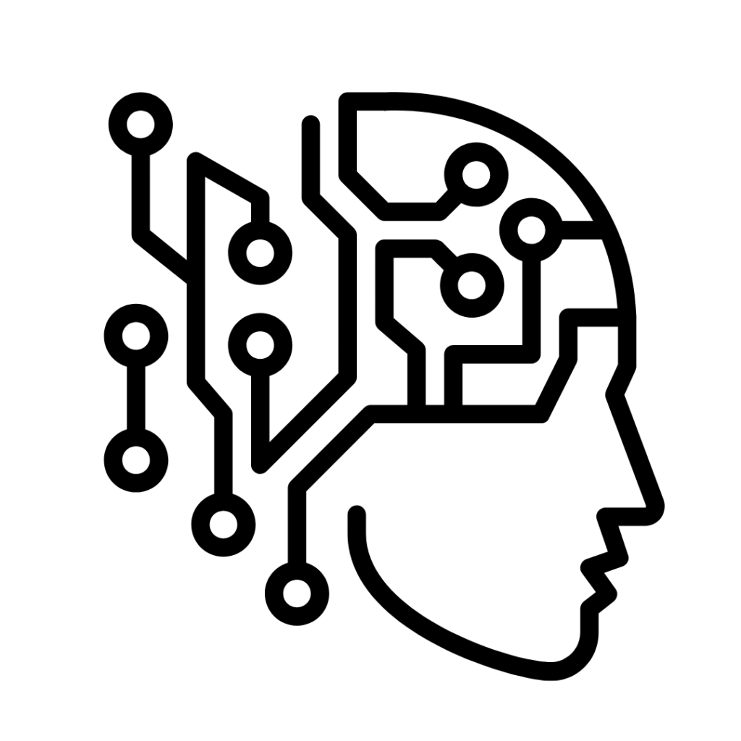
Topics
Basic Concepts of Artificial Intelligence
Data Science
Machine Learning Algorithms
Machine Learning Applications
Artificial Neural Networks
Deep Learning
Computer Vision
Natural Language Processing
Development of Artificial Intelligence Applications

Slide 6
Basic Concepts of Artificial Intelligence
What is Intelligence?
What is Artificial Intelligence?
Sciences behind Artificial Intelligence
The basis of Artificial Intelligence
Smart/Intelligent Behavior’s Tips
Smart Systems
Logical / Humanoid Selections
Thinking Like a Human
Acting Like a Human
Rational Thinking Systems
Rational Acting Systems
Comparison: Human vs AI
History of AI
Examples of AI

Slide 7
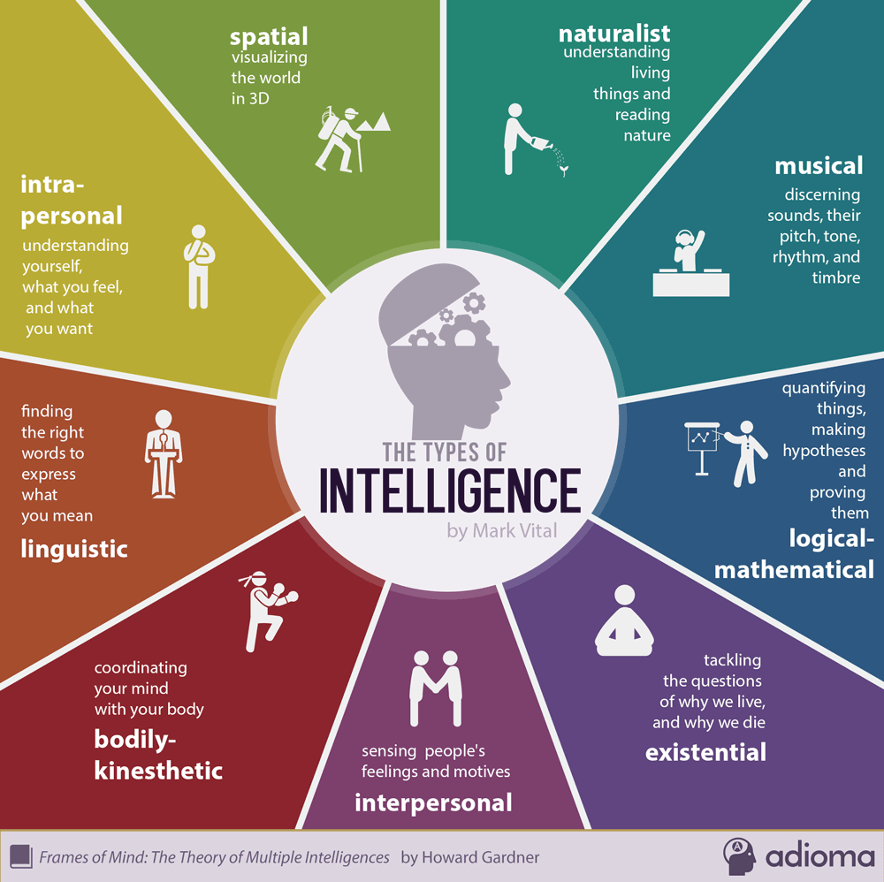
What is Intelligence?
Intelligence is the name given to the mental functions of the brain such as learning, understanding, abstract thinking, reasoning, planning, and problem solving.
With the help of concepts and perceptions
– to be able to comprehend the relationship between abstract or concrete objects,
– abstract thinking,
– reasoning
– be able to use these mental functions coherently for a purpose
Although it consists of a wide variety of concepts, intelligence is mostly evaluated according to the results of the IQtest.
The main target of intelligence researchers is humans, but animals also learn, understand, etc. Work is being done on their abilities.

Slide 8
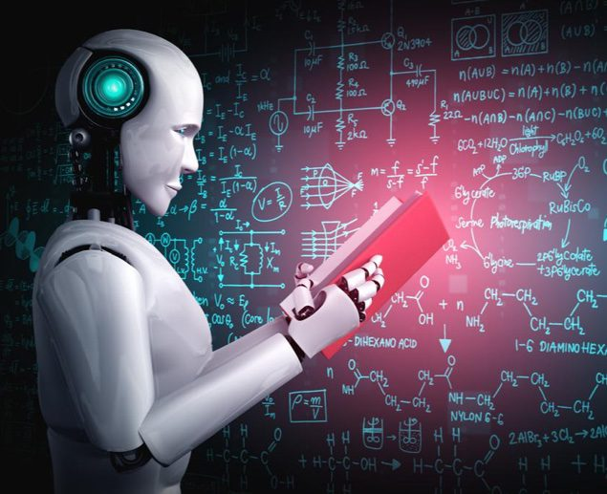
What is Artificial Intelligence?
In order to answer this question, it is necessary to be able to answer the following questions;
Can a machine think?
If it can think, how?
If it can't think, why?
What is smart thinking?
What is acting smart?

Slide 9
What is Artificial Intelligence?
There is no exact definition!
–Sometimes called “Computational Intelligence”
The concept of Artificial Intelligence was introduced at a conference held in Dartmouth-New Hampshire (USA) in 1957.
–At this conference, the problems of simulating human intelligence and thinking computers were discussed.

Slide 10
What is Artificial Intelligence?
'Scientific explanation of the mechanism of thinking and intelligent behavior and the embodiment of this mechanism in machines'
-The American Association for Artificial Intelligence
'Artificial Intelligence is the science of creating a machine that can do things that humans can do using their intelligence'
-Marvin Minsky

Slide 11
What is Artificial Intelligence?
Artificial Intelligence is computer science that deals with the design of intelligent computer systems.
–Intelligent Computer System is one that exhibits qualities comparable to the intelligence of human behavior
For example, understanding language, learning, solving problems and reasoning
Artificial Intelligence applications generally have more contribution from other branches of science and engineering.

Slide 12
Sciences behind Artificial Intelligence
Computer science and engineering (hardware and software)
Mathematics (logic, algorithms, optimization)
Philosophy (rules of reasoning)
Concept science and psychology (modeling of human higher-order thinking processes)
Neuroscience (modeling of low-level human brain activity)
Statistics
Linguistics

Slide 13
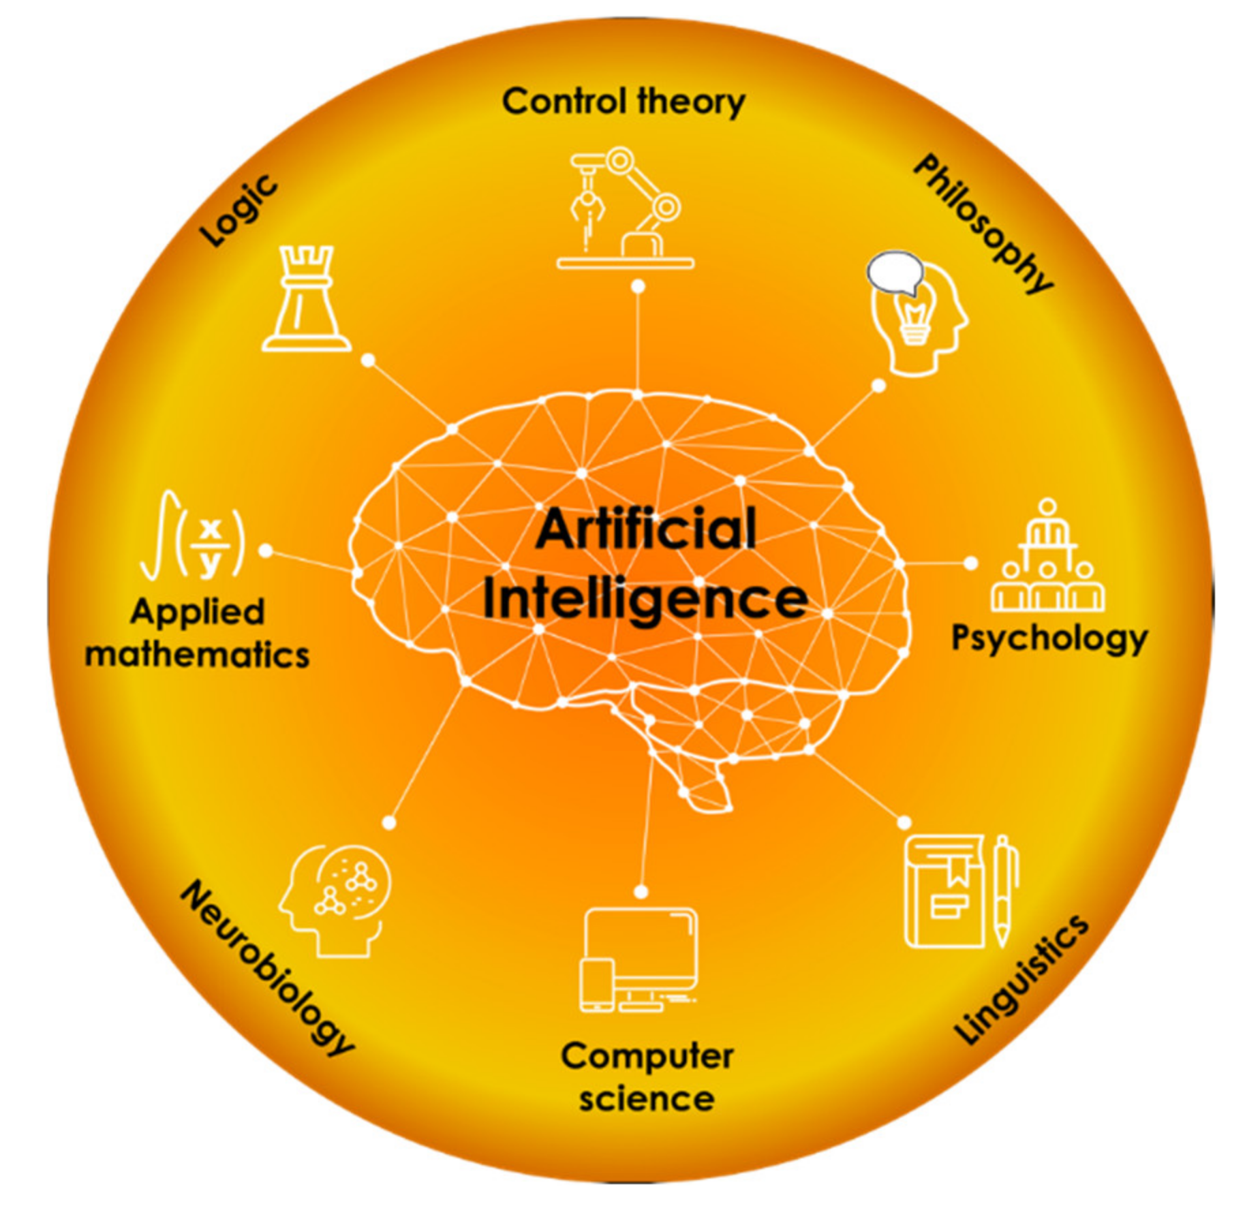
The basis of Artificial Intelligence

Slide 14
Smart/Intelligent Behavior’s Tips
Learning from experience
Successful and quick adaptation to a new situation
Problem solving
Finding and using information
Ability to reason
Ability to take advantage of coincidences
Ability to see the similarities between the different
Ability to see the differences between similar ones
Ability to generate new ideas / concepts
Ability to use very meaningful / contradictory information

Slide 15
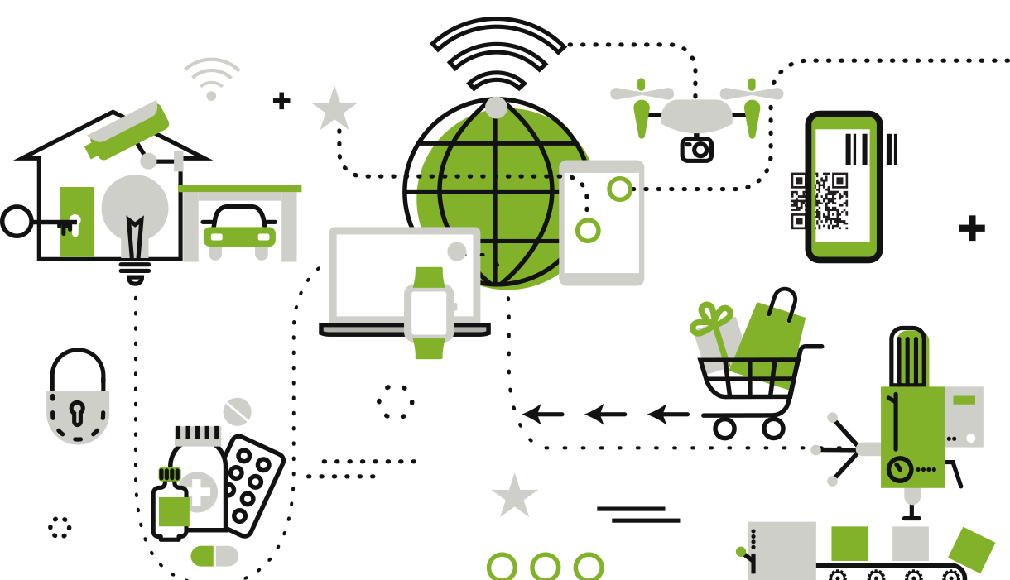
Smart Systems
It can be divided into 4 classes:
-Systems that think like humans
-Systems behaving like humans
-Rational thinking systems
-Systems that act rationally
Rational: As expected, logical

Slide 16
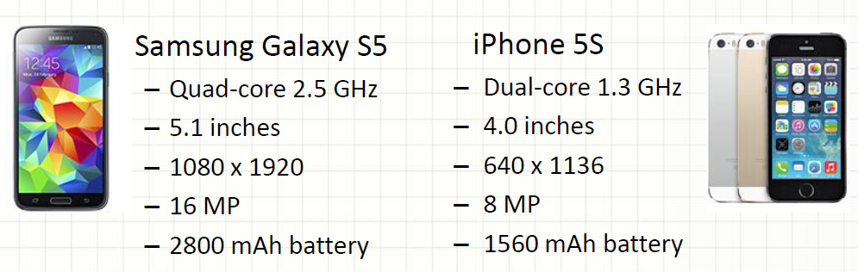
Logical / Humanoid Selections
The logical choice: Samsung Galaxy S5
People's choice: iPhone 5S ->sales more???
We don't always act rationally!!

Slide 17
Smart Systems
Acting wisely: Thinking and acting based on information, facts and evidence
 | Humanoid | Rational
Thinking | Understanding (Perception) Modelling | Demonstrating problems with logical expressions
Acting | Eliza and Turing Tests | Smart Agents
The aim of the artificial intelligence discipline is to make programs and/or machines that think/behave like humans or rationally.

Slide 18
Thinking Like a Human
Developing and researching systems that think like human beings is the field of study of cognitive science.
The aim of these studies is to analyze and understand the thinking processes of human beings and to benefit from computer models for this purpose.

Slide 19
Thinking Like a Human
Cognitive Modeling Approach
Cognitive Science uses experimental techniques in Psychology to produce theories about how the human mind works.
Considering not only input/output and behavior (like ELIZA), reasoning process
The Computational Model should describe how the results are obtained:
-On what basis?
Ways to understand mental processes:
Introspection
Psychological experiments
Linguistics

Slide 20
Acting Like a Human
The biggest goal of artificial intelligence research is to develop systems that behave like humans.
•Turing test aims to develop a human-like model so that the questioner cannot distinguish between human and computer.
– In the Turing test, the computer and human communicate with the interrogator via a terminal.
– If the interrogator cannot determine whether the system it is communicating with is a human or a computer, the computer is deemed to have passed the Turing test.

Slide 21
Turing Test
Alan Turing (1950)
"Can machines think?" and "Can machines act wisely?"
– It doesn't matter how the results are obtained
– It is important that the results are similar to the results obtained by the human

Slide 22
Rational Thinking Systems
Systems that are proven to be accurate and provide the optimal solution
It is based on logic.
The problem to be solved,
– expressed (described) with logical expressions,
– solved using inference rules
3 Important Problems:
Formulation of information
The existence of theoretically unsolvable problems
The insolubility of the theoretically solvable in practice
Artificial intelligence also aims to develop systems that can produce solutions in this way.

Slide 23
Rational Acting Systems
Rational agent approach
Producing appropriate outputs for the given inputs
–these outputs may not always be correct, but the job is done
Use of heuristic methods and rules, simplifications that limit the search for a solution in a large problem space
– Intuitiveness does not guarantee optimal solution; but usually it offers very adequate solution
The aspects that distinguish 'Agent' programs from other programs:
– Autonomous (Autonomous) control
– Environment detection
– Survival over a long period of time
– Adapting to change
The rational agent acts in a way that achieves the best result.

Slide 24
Human vs AI
A simple example of human intelligence:
The operation of one cell of the human eye in 10 ms is equal to the solution of 500 nonlinear differential equations systems with 100 variables.
– It takes a few minutes for the most powerful supercomputers in the world to decode this system.
There are at least 10 million cells in the human eye that communicate with each other.
– Therefore, it may take a supercomputer at least 100 years to do the ordinary job that the eye does every second.

Slide 25
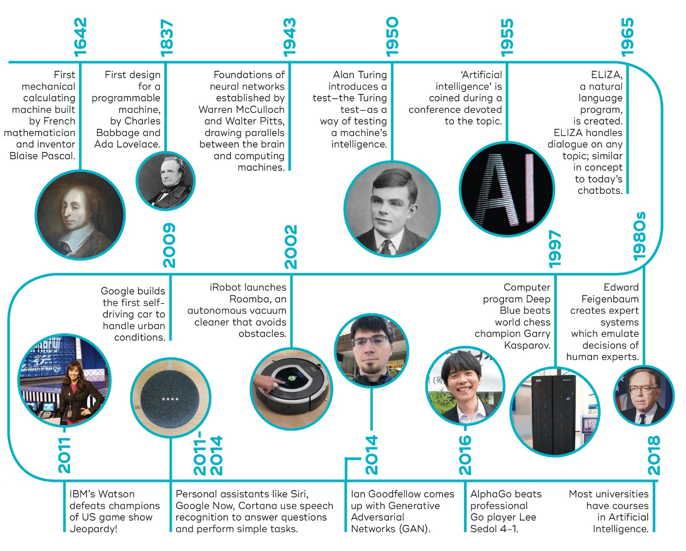
History of AI

Slide 26
Examples of AI
Autonomous Vehicles
Chess Computers
Math and Geometry Theorem Proofs
Scientific Classifications
Advanced Graphical User Interfaces
Face Recognition
Voice Recognition
Web based Applications
Deep Learning Generated Images
Cyber Security
Health Sciences
Etc..

