Slide 1
INTRODUCTION TO MACHINE LEARNING
Week #4
K-Nearest Neighbors (KNN): Classification and Practical Applications
Assist. Prof. M. Erdem İSENKUL
Istanbul University-Cerrahpasa, Faculty of Engineering
2024-2025 / Fall
eisenkul@iuc.edu.tr

Slide 2
Introduction to Classification - Alternative Techniques
Introduction to classification: Predicting the class label of instances based on their features.
Alternative classification techniques like example-based classifiers.
Example-based classifiers rely on storing instances and using them to predict class labels for unseen data.

Slide 3
K-Nearest Neighbors (KNN) Classifier
KNN uses 'k' nearest neighbors to determine the class of a new instance.
Choose 'k' wisely: Small values of 'k' can lead to overfitting, while large values can result in underfitting.
Distance metrics (Euclidean, Manhattan) play a crucial role in determining the nearest neighbors.

Slide 4




Distance Metrics in KNN
Euclidean Distance: Commonly used for numerical data.
Manhattan Distance: Suitable for grid-like data structures.
Minkowski Distance: Generalized distance metric, a parameterized version of both Euclidean and Manhattan.
Feature scaling is crucial to avoid distorted distance calculations.

Slide 5
Choosing the Value of 'k' in KNN
Small 'k': More sensitive to noise and outliers, prone to overfitting.
Large 'k': More generalized, but may include neighbors from other classes, leading to underfitting.
Optimal 'k' is found through cross-validation.
Consider computational costs with larger 'k'.

Slide 6



Feature Scaling in KNN
Feature scaling ensures all attributes contribute equally to distance calculations.
Techniques:
Min-Max Normalization: Scales features to a [0, 1] range.
Z-Score Standardization: Scales data to have a mean of 0 and a standard deviation of 1.
Robust Scaling: Handles outliers by using medians and IQR.

Slide 7
Advantages and Disadvantages of KNN
Advantages:
Simple, intuitive algorithm.
Works well with small and moderate-sized datasets.
Effective for complex decision boundaries.
Disadvantages:
Computationally expensive for large datasets.
Sensitive to noisy and irrelevant features.
Struggles with imbalanced datasets and high-dimensional data (curse of dimensionality).

Slide 8

Optimizing KNN Performance
Dimensionality Reduction: PCA, feature selection to reduce the number of irrelevant features.
Weighted KNN: Weighing closer neighbors more heavily improves accuracy.
Efficient Data Structures: KD-Trees, Ball-Trees to reduce computation time.
Cross-Validation: Tune 'k' and distance metrics through cross-validation.

Slide 9
Practical Implementation of KNN
Use Python libraries like scikit-learn to implement KNN.
Steps:
Preprocess the data (train-test split, scaling).
Train the KNN classifier.
Evaluate the model’s performance using accuracy metrics.
Perform cross-validation to find the best 'k'.

Slide 10
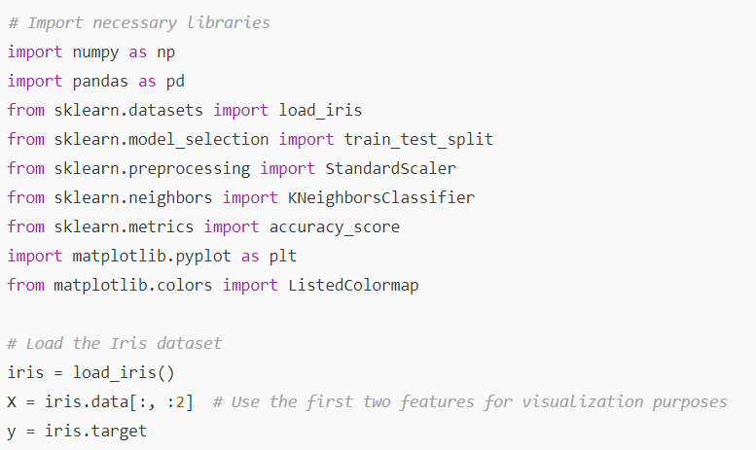
Practical Implementation of KNN
Step 1: Importing Libraries and Dataset

Slide 11
Practical Implementation of KNN
Step 2: Preprocessing the Data
X_train, X_test, y_train, y_test = train_test_split(X, y, test_size=0.2, random_state=42)
scaler = StandardScaler()
X_train = scaler.fit_transform(X_train)
X_test = scaler.transform(X_test)

Slide 12
Practical Implementation of KNN
Step 3: Training the KNN Classifier
knn = KNeighborsClassifier(n_neighbors=5)
knn.fit(X_train, y_train)
y_pred = knn.predict(X_test)

Slide 13

Practical Implementation of KNN
Step 4: Evaluating the Model

Slide 14
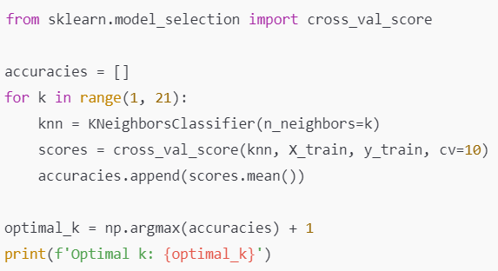
Practical Implementation of KNN
Step 5: Finding the Optimal 'k' Using Cross-Validation

Slide 15
Visualizing KNN Decision Boundaries
Visualizing decision boundaries shows how KNN adapts to local patterns in data.
Small 'k': More flexible, follows training data closely but risks overfitting.
Large 'k': Smooths the decision boundary but may underfit.
Use Matplotlib to create decision boundary visualizations.

Slide 16
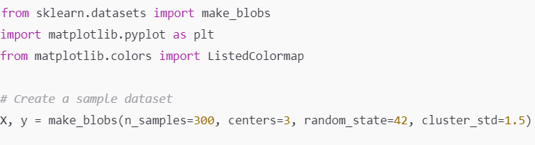
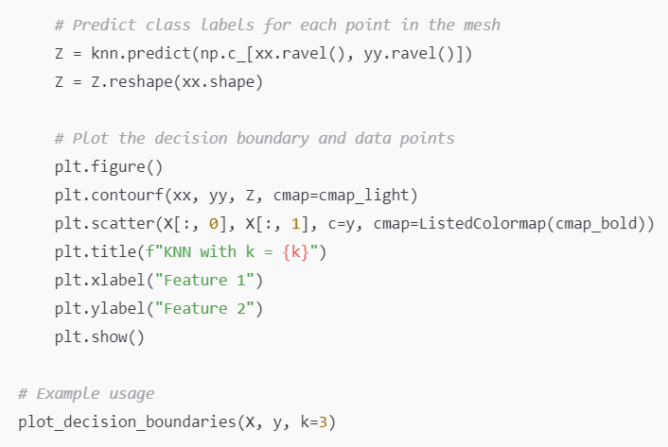
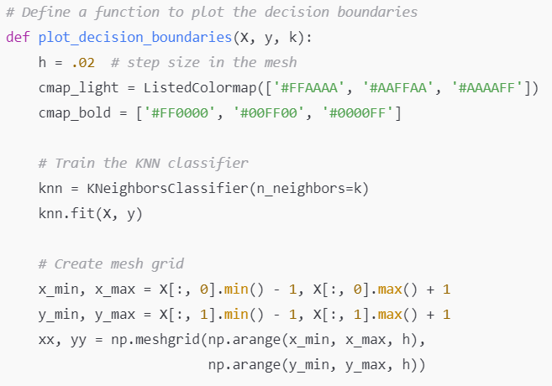
Visualizing KNN Decision Boundaries

Slide 17
Analyzing the Impact of Weighted KNN
Weighted KNN: Assigns higher weight to closer neighbors, improving accuracy in overlapping classes.
Provides smoother decision boundaries and greater precision.
Useful for class imbalance and cases where closer points are more relevant.

Slide 18
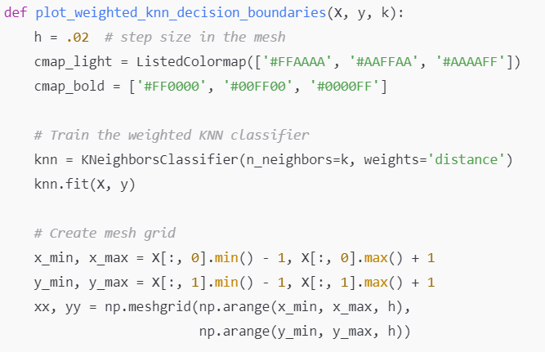
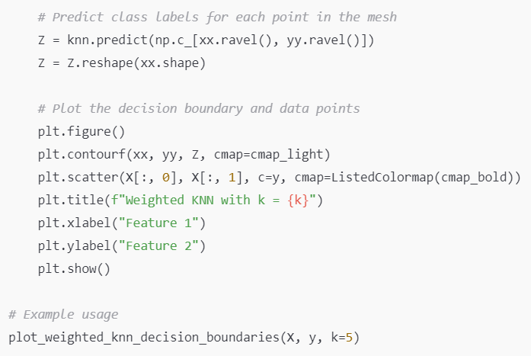
Analyzing the Impact of Weighted KNN

Slide 19
Practical Applications of KNN and Weighted KNN
Image Recognition: Handwritten digit classification (e.g., MNIST dataset).
Recommendation Systems: Suggest items to users based on the behavior of similar users.
Medical Diagnosis: Classify patient symptoms based on historical data.
Anomaly Detection: Detect fraud or cybersecurity threats by identifying unusual patterns.
Customer Segmentation: Segment customers based on purchasing or browsing behavior.

Slide 20
Limitations of KNN and Mitigation Strategies
Computational Complexity: Mitigate with KD-Trees, Ball-Trees, or approximate nearest neighbor algorithms.
Sensitivity to Noise: Feature selection, dimensionality reduction, and outlier detection.
Curse of Dimensionality: Reduce dimensionality through PCA or other techniques.
Class Imbalance: Use weighted KNN or resampling techniques (SMOTE).
Lack of Interpretability in High Dimensions: Use visualization techniques like t-SNE or UMAP to explore the data.

Slide 21
Summary and When to Use KNN
KNN is simple, effective for low-dimensional, small to moderate datasets.
Choose KNN when you need an interpretable model and have no assumptions about the data distribution.
Avoid KNN for high-dimensional or very large datasets without appropriate optimizations.
KNN remains versatile, with applications in image recognition, recommendation systems, and more.

