Slide 1
INTRODUCTION TO MACHINE LEARNING
Week #5
Decision Trees: Classification and Practical Applications
Assist. Prof. M. Erdem İSENKUL
Istanbul University-Cerrahpasa, Faculty of Engineering
2024-2025 / Fall
eisenkul@iuc.edu.tr

Slide 2
Introduction to Classification and Model Evaluation
Classification: Supervised learning method to categorize data into predefined classes.
Model Evaluation: Assessing model performance to ensure accuracy and reliability.
Goals for Today:
Understand classification concepts
Explore classification techniques (e.g., Decision Trees)
Learn evaluation metrics to assess model effectiveness

Slide 3
Definition of Classification
Classification Process: Assigns new records to predefined classes.
Training Set: Data with known class labels used to train the model.
Model Goal: Predict the class for new, unseen records accurately.
Data Split: Training set for learning, test set for validation to prevent overfitting.

Slide 4
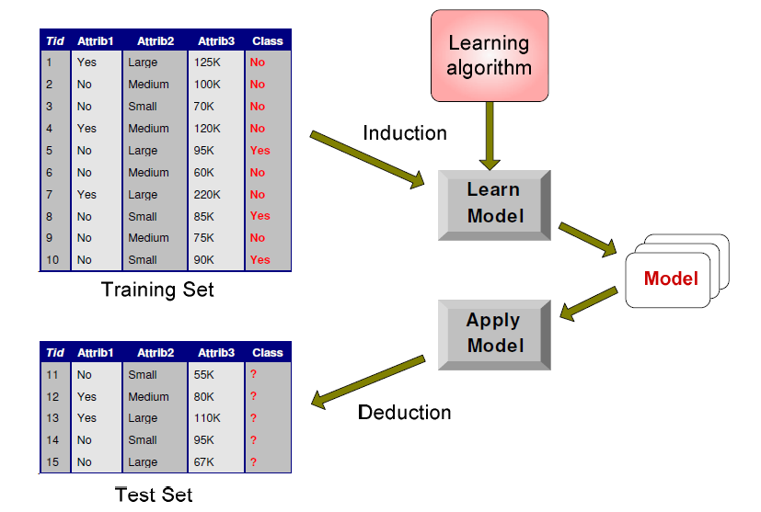
Visualization of the Classification Task
Learning the Model: Train the model using labeled data to identify patterns.
Applying the Model: Use the trained model to classify new instances.
Data Example: Visualizes how attributes are used to classify records.
Purpose: Shows the workflow from input attributes to class prediction.

Slide 5
Examples of Classification
Medical Diagnosis: Predicts conditions (e.g., benign vs. malignant tumors).
Fraud Detection: Classifies transactions as legitimate or fraudulent.
News Categorization: Sorts news into categories like finance, sports, etc.
Protein Structure Prediction: Identifies protein structures (e.g., alpha-helix, beta-sheet).
Key Takeaway: Classification has diverse applications across fields.

Slide 6
Classification Techniques
Decision Trees: Intuitive and interpretable; splits data based on attributes.
Rule-Based Methods: Uses IF-THEN rules for transparent classification.
Memory-Based (k-NN): Classifies based on proximity to known examples.
Artificial Neural Networks (ANNs): Handles complex patterns; resource-intensive.
Naïve Bayes: Probabilistic approach, useful for text classification.
Support Vector Machines (SVM): Effective in high-dimensional spaces with clear class boundaries.
Choosing Technique: Depends on data complexity, interpretability needs, and computational resources.

Slide 7
Example of a Decision Tree
Structure: Tree with nodes representing decisions based on attributes.
Decision Path: Follows branches to reach a final class prediction.
Leaf Nodes: Endpoints of the tree where classification occurs.
Advantages: Easy to interpret, handles categorical and continuous data well.
Example: Classifies tax records based on refund status, marital status, and income.
Key Takeaway: Decision Trees offer a clear, step-by-step classification approach.

Slide 8
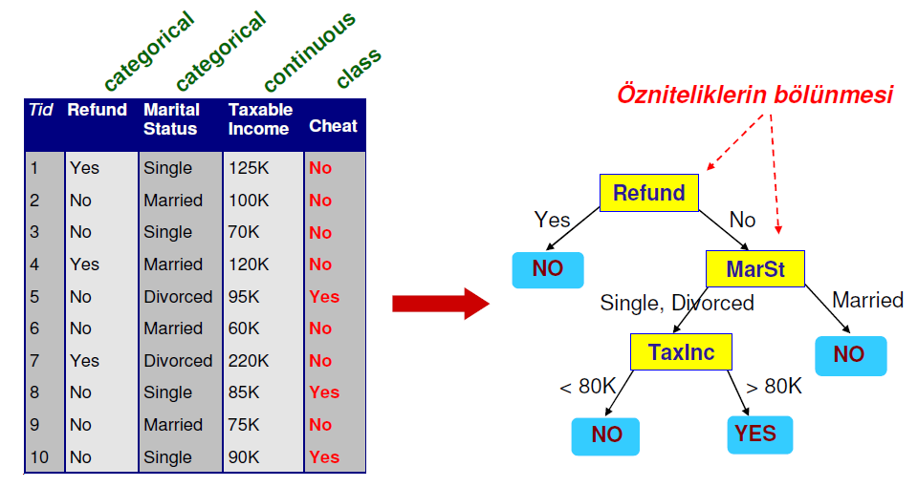
Example of a Decision Tree

Slide 9
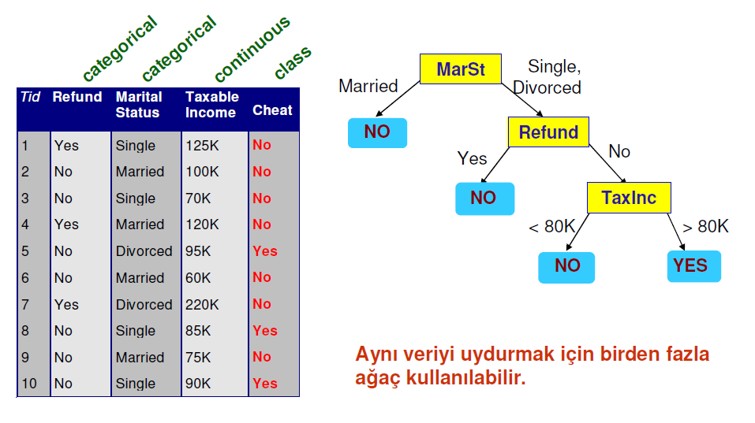
Example of a Decision Tree

Slide 10
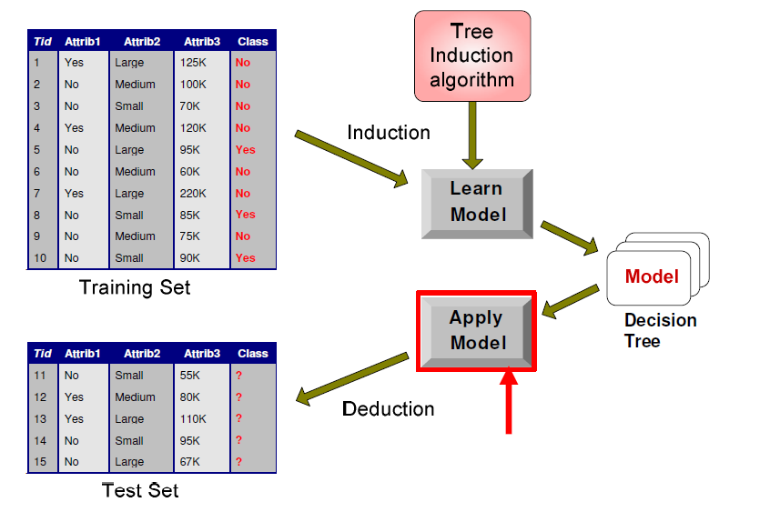
Example of a Decision Tree

Slide 11
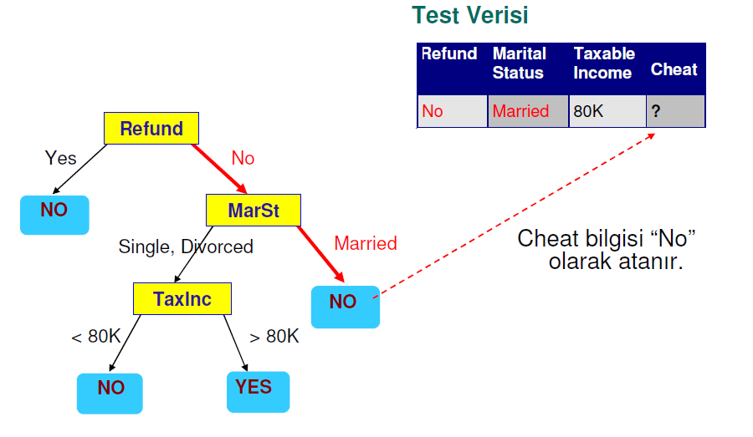
Example of a Decision Tree

Slide 12
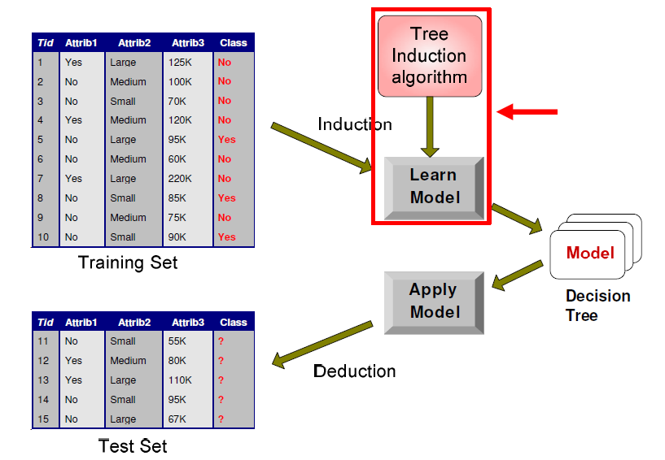
Example of a Decision Tree

Slide 13
General Structure for Hunt’s Algorithm
Hunt’s Algorithm: Early algorithm for constructing decision trees.
Steps:
If all records in a node belong to one class, it becomes a leaf node.
If records are mixed, split the data based on an attribute that best separates the classes.
Recursive Splitting: Continues to split data into smaller subsets until reaching homogeneity.
Application: Forms the basis for modern decision tree methods like CART and ID3.
Summary: Hunt’s Algorithm recursively splits data to create accurate decision trees.

Slide 14
Stopping the Tree Induction
Why Stop Splitting?: Prevents overfitting and keeps the model simple.
Key Stopping Conditions:
All records in a node belong to the same class.
No further meaningful splits can be made.
Other Criteria:
Minimum node size (e.g., no split if fewer than 5 records).
Maximum tree depth to limit complexity.
Benefit: Creates a balanced, generalizable model.
Key Takeaway: Controlled stopping improves model performance and interpretability.

Slide 15
Gini Index in Decision Trees
What is the Gini Index?
Definition: A metric used to measure the impurity or purity of a dataset in classification problems.
Purpose: Helps determine the best feature to split the data in a Decision Tree by quantifying how mixed the classes are within a node.
Range: Values range from 0 to 0.5, where:
0 indicates complete purity (all instances in a node belong to a single class).
0.5 indicates maximum impurity (classes are evenly mixed).

Slide 16

Gini Index in Decision Trees
Formula for Gini Index
​Where:
pip_ipi​ is the probability of a given class within the node.
nnn is the total number of classes.

Slide 17
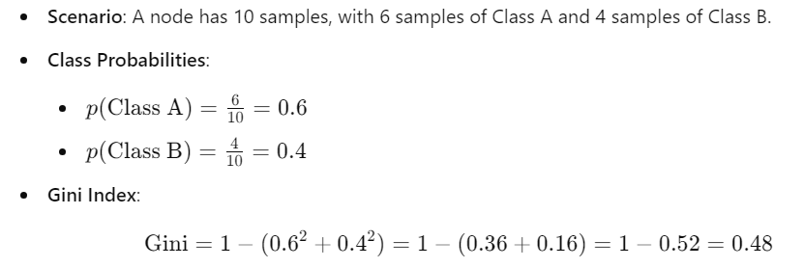
Gini Index in Decision Trees
Example Scenario

Slide 18
Gini Index in Decision Trees
Using Gini Index in Splitting
For each potential split, calculate the Gini index for each child node.
Weighted Gini: Calculate the weighted average Gini index across all child nodes to evaluate the quality of the split.
The split with the lowest Gini index is chosen, as it indicates higher purity and better separation of classes.
Key Takeaway: The Gini Index is a core metric in Decision Trees, guiding splits by quantifying the purity of nodes. Lower Gini values mean better splits and purer nodes, leading to more accurate classifications.

Slide 19




Model Evaluation Metrics
Purpose: Assess model performance to ensure reliability.
Confusion Matrix: Shows counts of:
True Positives (TP) and True Negatives (TN): Correct predictions.
False Positives (FP) and False Negatives (FN): Incorrect predictions.
Key Metrics:
Accuracy: Overall correct predictions.
Precision: Accuracy of positive predictions.
Recall: Ability to capture actual positive cases.
F1 Score: Balance between precision and recall.
Summary: Confusion matrix and derived metrics provide detailed insights into model effectiveness.

Slide 20
Limitations of Accuracy
Issue with Accuracy: Can be misleading, especially for imbalanced datasets.
Imbalanced Data Example:
High accuracy may occur by predicting only the majority class, missing the minority class.
Importance of Other Metrics:
Precision: Important when false positives are costly.
Recall: Crucial when missing positive cases is risky.
F1 Score: Balances precision and recall, useful for imbalanced datasets.
Key Takeaway: Accuracy alone is insufficient; precision, recall, and F1 score offer a clearer performance picture.

Slide 21
Performance Evaluation Methods
Cross-Validation: Divides data into kkk folds; each fold serves as a test set once, averaging results for reliability.
Stratified Cross-Validation: Maintains class distribution across folds, ideal for imbalanced datasets.
Holdout Method: Splits data into training and test sets; simpler but less reliable for small datasets.
Bootstrapping: Resampling with replacement; useful for small datasets by creating multiple samples.
Choosing the Right Method: Depends on dataset size, class distribution, and computational resources.
Summary: Reliable evaluation methods ensure accurate performance estimates and better model generalization.

Slide 22
Performance Evaluation Metrics - Confusion Matrix
Confusion Matrix Structure:
True Positive (TP): Correctly predicted positives.
True Negative (TN): Correctly predicted negatives.
False Positive (FP): Incorrect positive predictions.
False Negative (FN): Missed positive predictions.
Derived Metrics:
Accuracy: Proportion of correct predictions.
Precision: Focuses on the accuracy of positive predictions.
Recall: Measures model’s ability to find all actual positives.
F1 Score: Balances precision and recall, especially valuable for imbalanced data.
Usefulness: Confusion matrix gives a comprehensive view of model performance and types of errors.
Key Takeaway: Confusion matrix and its metrics reveal strengths and weaknesses beyond overall accuracy.

Slide 23
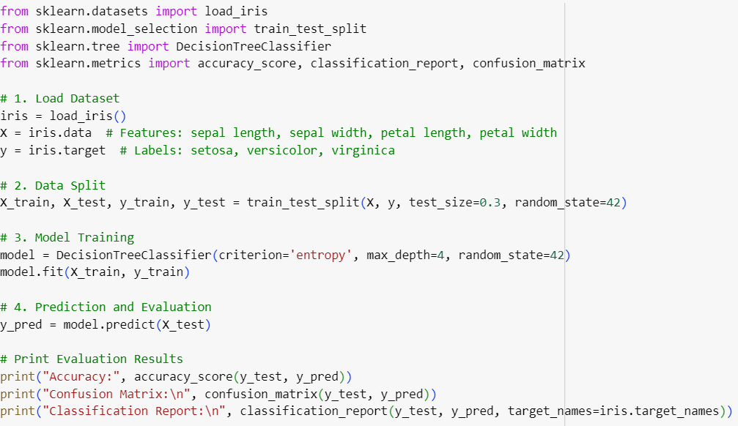
Practical Implementation of Decision Tree (Iris Dataset Example)

Slide 24
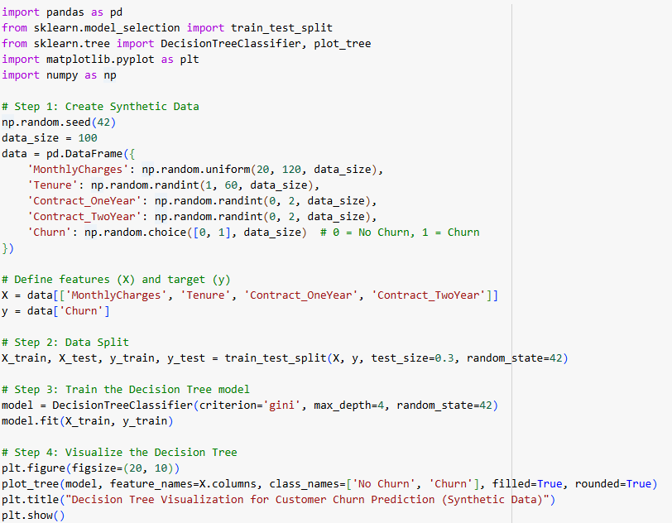
Practical Implementation of Decision Tree (Churn Dataset-Syntetic Example)

Slide 25
Summary
Classification: Categorizes data into predefined classes; widely used in fields like fraud detection and medical diagnosis.
Classification Techniques:
Methods include Decision Trees, k-NN, Neural Networks, Naïve Bayes, and SVM, each suited to different data and requirements.
Decision Trees: Example of Hunt’s Algorithm; intuitive and interpretable classification method.
Model Evaluation Metrics:
Confusion Matrix: Foundation for understanding prediction accuracy and errors.
Key Metrics: Accuracy, Precision, Recall, and F1 Score provide deeper insights.
Limitations of Accuracy: Alternative metrics are essential, especially for imbalanced datasets.
Evaluation Methods: Cross-validation, stratified cross-validation, holdout, and bootstrapping ensure reliable performance estimates.
Takeaway: Effective classification requires careful selection of techniques, metrics, and evaluation methods to ensure accurate, context-sensitive performance.

