Slide 1
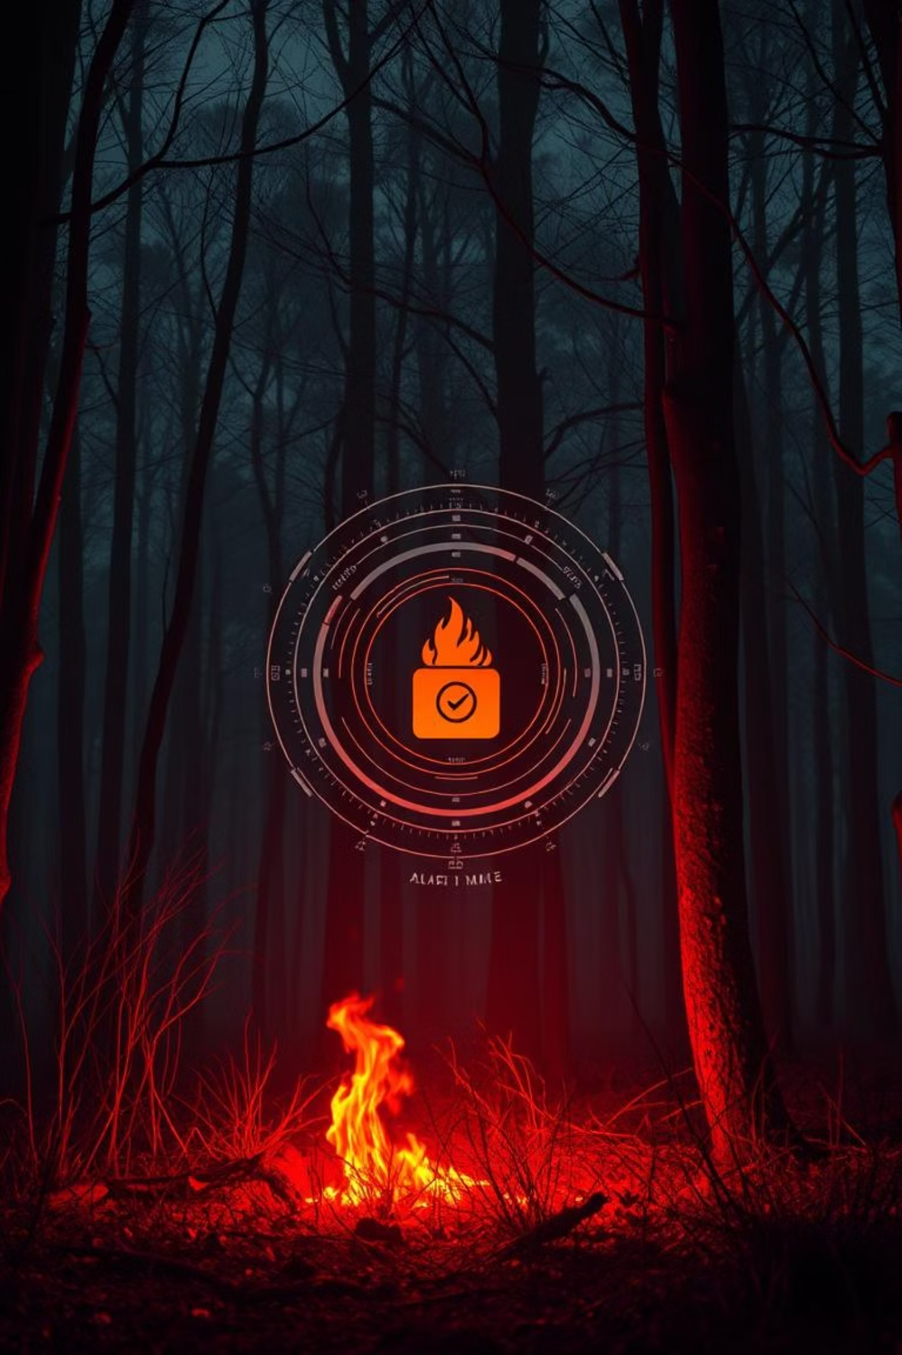
AI Fire Detection
An End-to-End Project: Deep Learning for Image Classification and Web Deployment
Presented by: Ali Ashraf

Slide 2








Presentation Agenda
Introduction: Problem & Solution
Project Objectives
Tools & Technologies
Dataset Overview
Project Workflow
Model Building & Training
Results & Evaluation
Live Application Demo

Slide 3
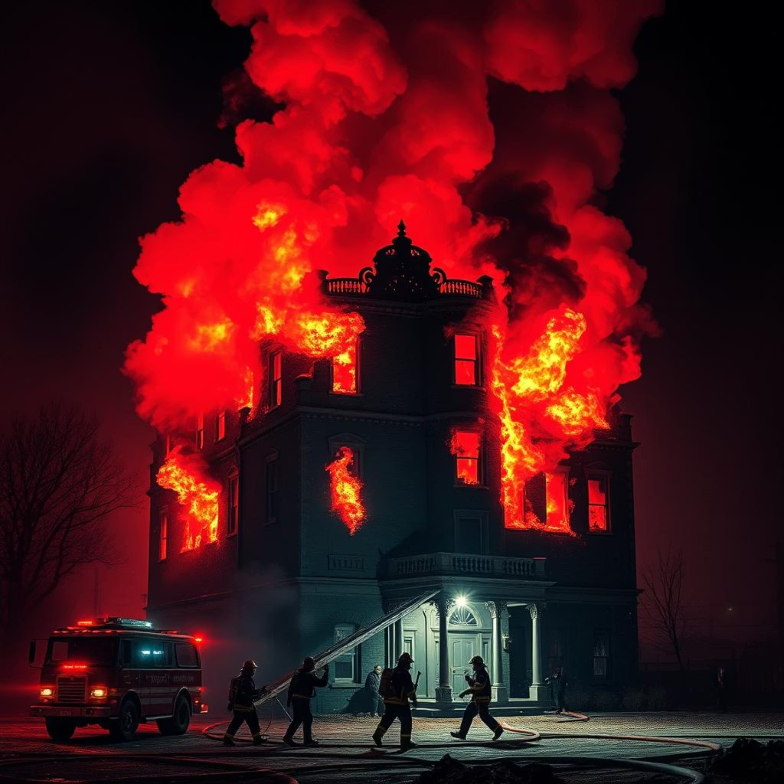
Why Early Fire Detection is Crucial
Detecting fires early is very important to reduce their dangerous effects. Fires can spread quickly and seriously threaten people's safety, causing injuries, deaths, and forcing people to leave their homes.
Environmental Damage: Fires destroy forests and animals, release dangerous smoke, and make climate change worse.
Economic Loss: Every year, fires cause billions in damage to homes and businesses.
Pressure on Services: Firefighters and emergency teams get overwhelmed, which affects other important services.

Slide 4



Our Solution: Computer Vision to the Rescue
Our AI system uses smart cameras and advanced technology to watch areas all the time. It can spot fires quickly and more accurately than old methods. This helps reduce damage and save lives.
Surveillance Images
AI Model
Instant Alert
Real-time image
Analyzes for fire signatures
show if images Contain fires

Slide 5



Project Objectives
Develop an Accurate Model
Build a Practical Web Application
Apply Advanced Concepts
Achieve high precision and recall in classifying fire images using robust deep learning techniques.
Create an intuitive and interactive Flask web interface to showcase the model's capabilities in real-time.
Efficiently utilize Transfer Learning and other state-of-the-art methods for optimized model performance.

Slide 6








Tools & Technologies
Our project leverages a powerful combination of industry-standard tools and frameworks, ensuring robustness, scalability, and ease of deployment.

Slide 7
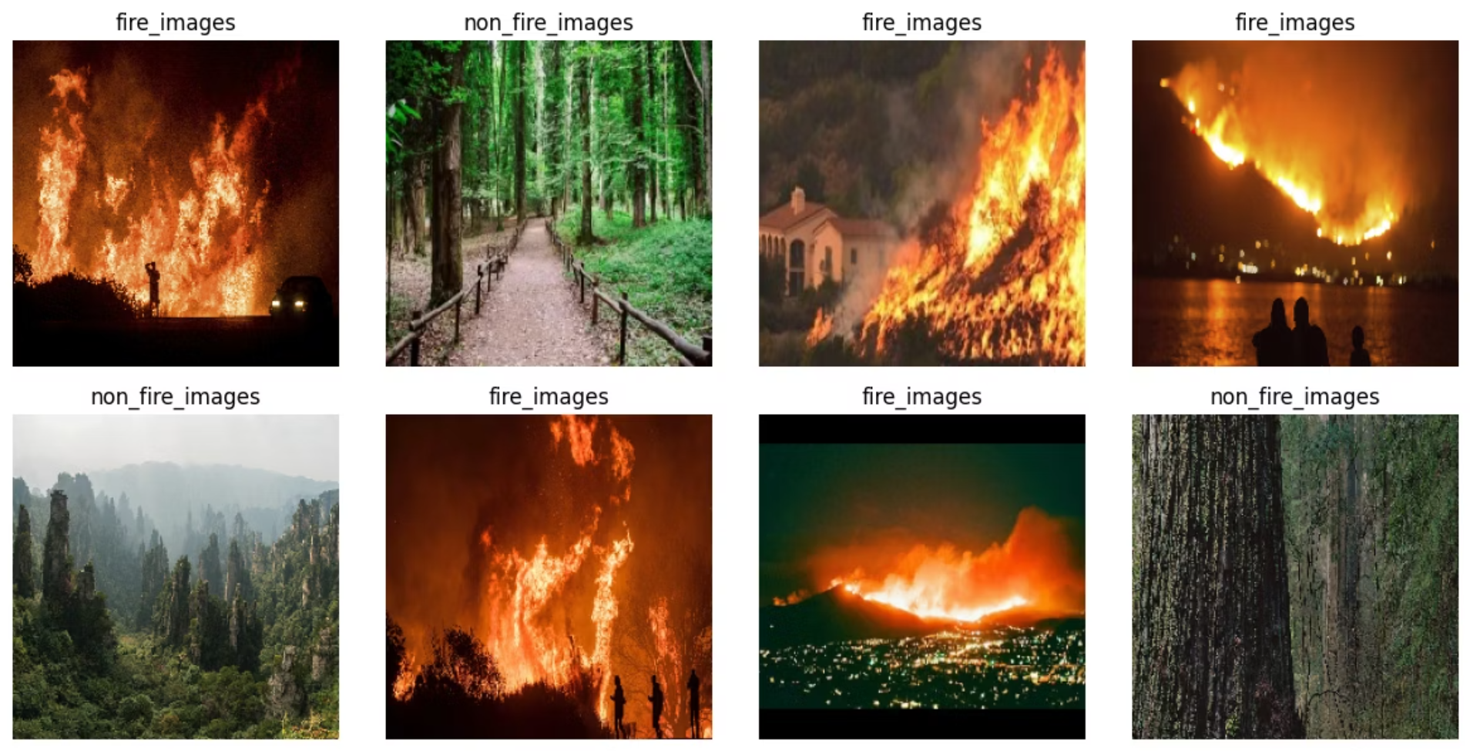
Model Fuel: The Fire Dataset
Our model was trained on a comprehensive dataset to ensure robust fire detection.
Source: Kaggle, a leading platform for data science challenges and datasets.
Size: Approximately 3,000 images, split into training, validation, and test sets.
Classes: Categorized into "Fire" and "No-Fire" to facilitate binary classification.
Diversity: Images captured under various conditions, including different lighting, distances, and fire sizes.

Slide 8






Project Workflow: From Data to Deployment
Data Collection
Gathering diverse fire and non-fire images.
Preprocessing
Cleaning, augmenting, and normalizing the dataset.
Model Building
Designing and configuring the CNN architecture.
Training
Iterative optimization of model parameters.
Evaluation
Assessing performance with metrics and visualizations.
Web App Deployment
Integrating the model into a user-friendly Flask application.

Slide 9
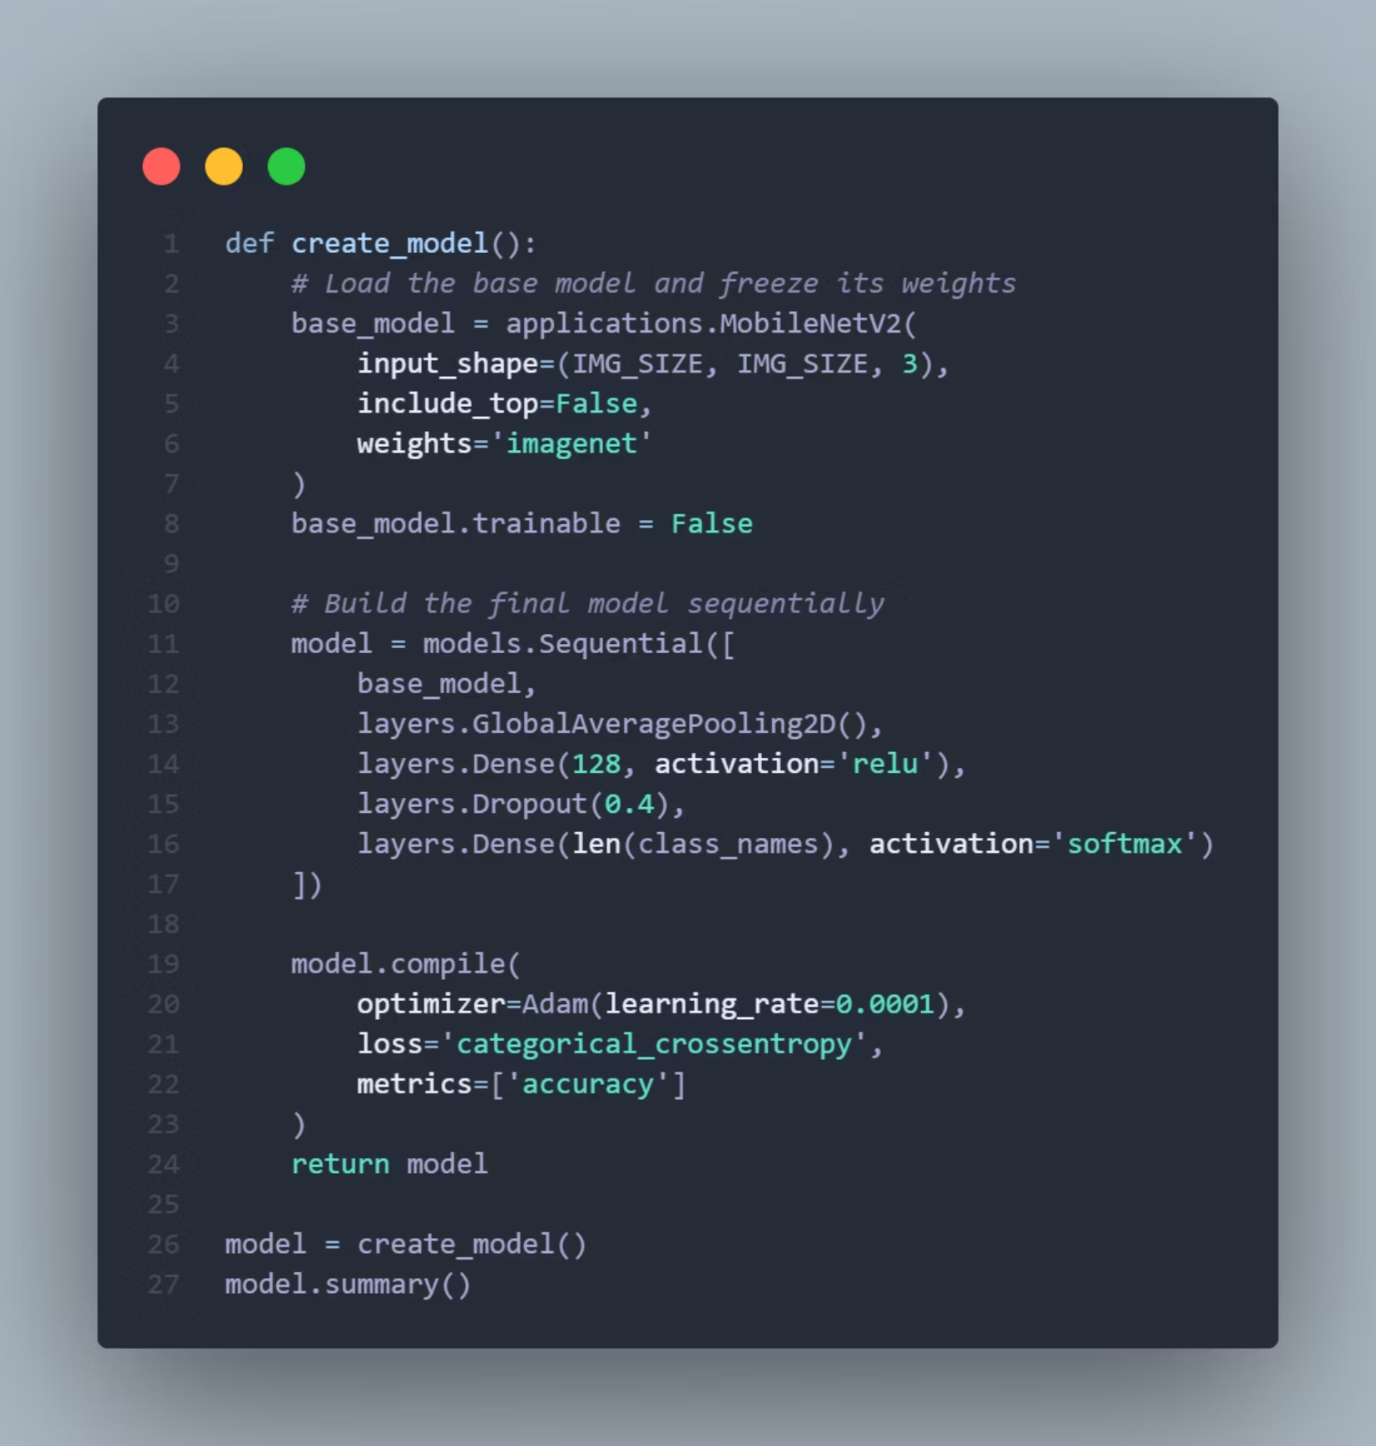
Model Building & Training

Slide 10
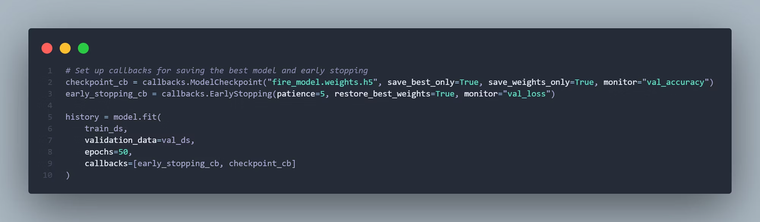
Model Building & Training

Slide 11
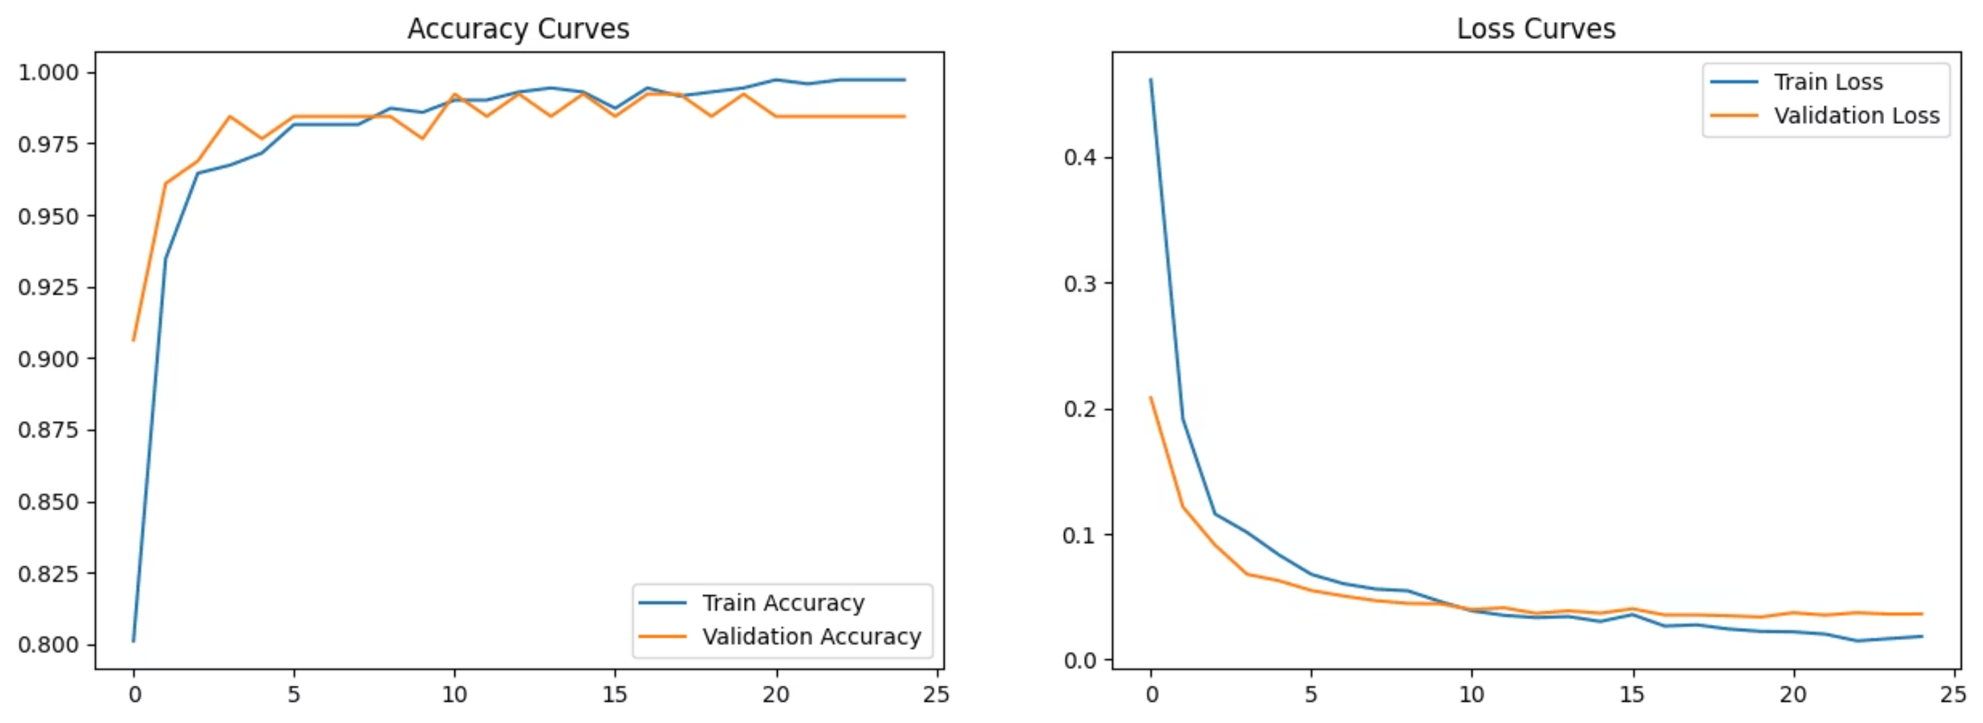
Results & Evaluation
precision recall f1-score support
fire_images 0.99 1.00 1.00 131
non_fire_images 1.00 0.97 0.99 36
accuracy 0.99 167
macro avg 1.00 0.99 0.99 167
weighted avg 0.99 0.99 0.99 167

Slide 12
Thank You

