Slide 1
Forecasting Type II Diabetes Onset in Pima Indians
BANA 7047
Professor Yan Yu
4/3/2018
Vignesh Arasu
Ali Aziz
Amir Babar
Tathagat Kumar

Slide 2
Predicting the Onset of Type II Diabetes
Reliable forecasting can
Enhance preventative health care
Educate individuals who are at risk
Take preventative measures
Improve patient outcomes
Reduce healthcare costs

Slide 3
Data set
Female subject (Pima Indian)
Had to have a nondiabetic GTT, then either:
Diabetes diagnosed within 5 years
No diabetes revealed with GTT 5 or more years later
Cases where diabetes was diagnosed within one year of initial exam were removed
Resulting data set
768 observations
475 positive cases
Source: Kaggle

Slide 4
Predictors Utilized
Previously identified as risk factors
Age
Number of times pregnant
2 hour glucose concentration
2 hour serum insulin
BMI
Triceps skin fold thickness
Diastolic blood pressure
Diabetes pedigree function

Slide 5
Summary statistics of predictors
Variable | Min | Max | Mean | Median | Missing values
Pregnancies | 0 | 15 | 3.86 | 3 | 0
Glucose | 44 | 199 | 122 | 118 | 4
BloodPressure | 24 | 122 | 72 | 72 | 27
SkinThickness | 7 | 99 | 28.8 | 28 | 167
Insulin | 14 | 846 | 159 | 125 | 274
BMI | 18.2 | 59.4 | 32.3 | 32 | 8
DiabetesPedigreeFunction | 0.078 | 2.42 | 0.474 | 0.381 | 0
Age | 21 | 81 | 33.3 | 29 | 0

Slide 6
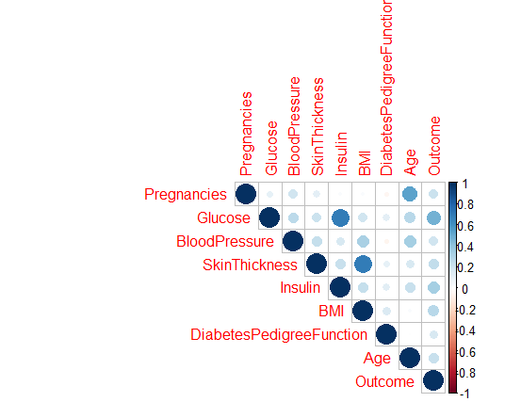
Correlation matrix

Slide 7
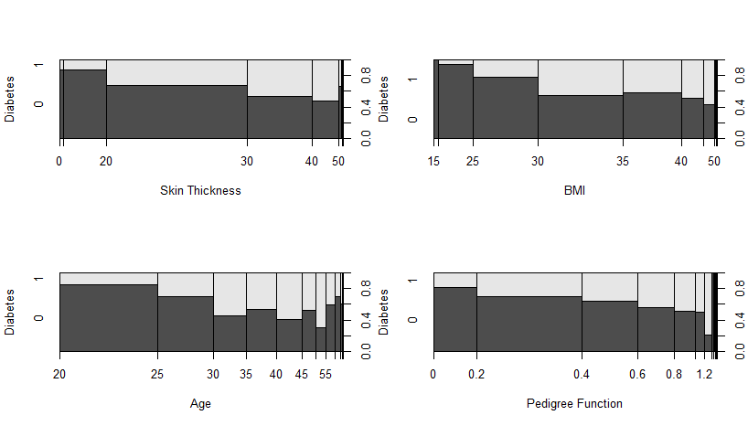
Proportion Variation - 1

Slide 8
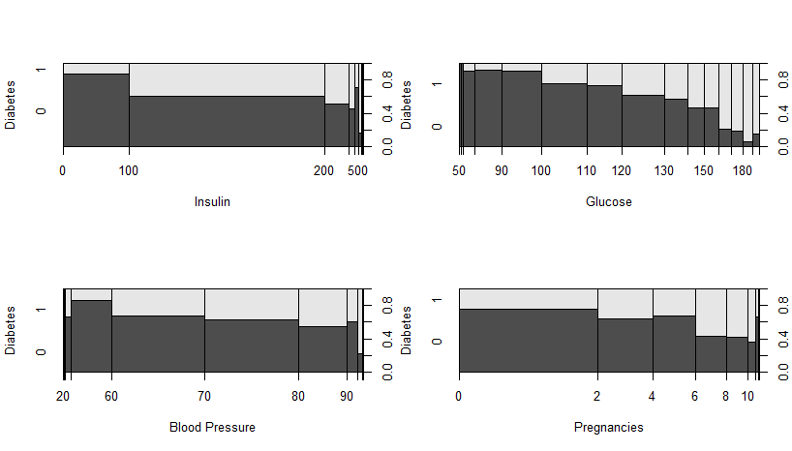
Proportion Variation - 2

Slide 9
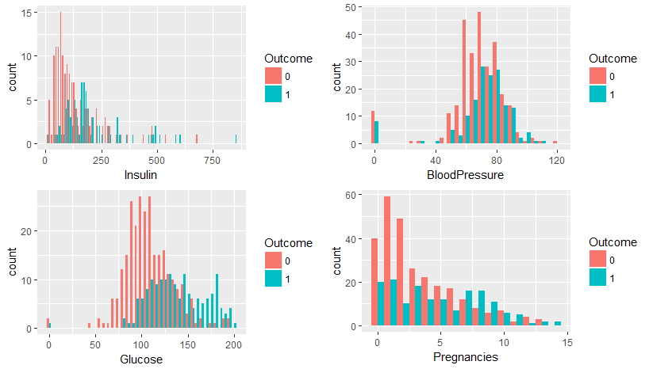
Histograms - 1

Slide 10
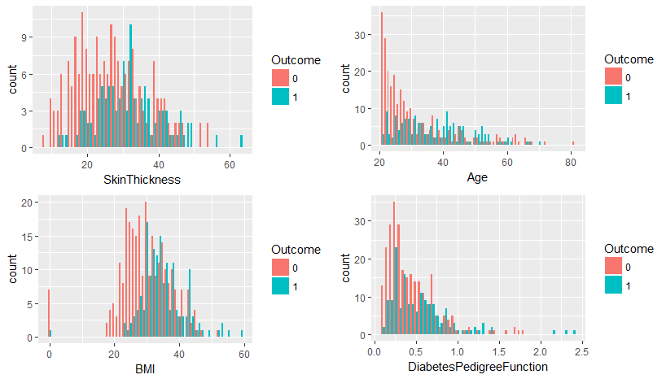
Histograms - 2

Slide 11
Dealing with Missingness

Slide 12
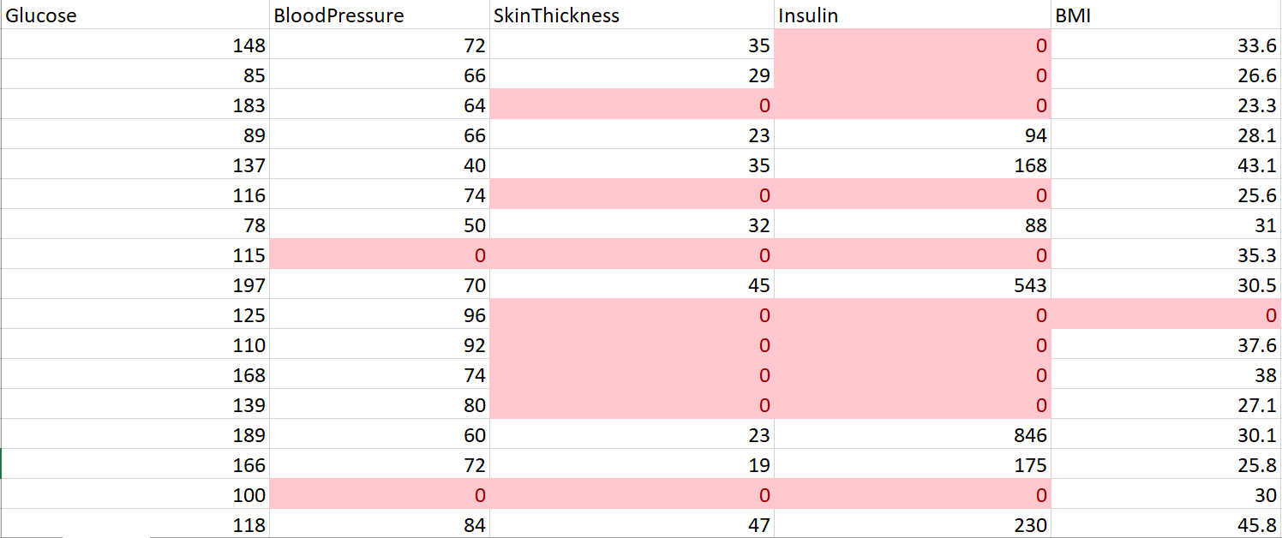
Pima Indian Data set
Complete data set
Closer look…

Slide 13
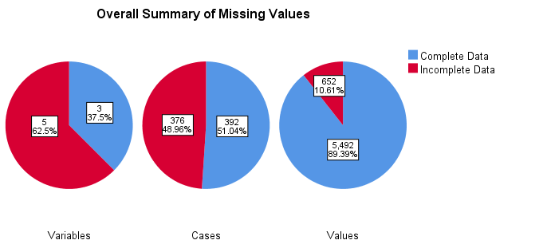
Analysis after recoding to NA
Variable Summary^{a,b}
 | Missing |  | Valid N | Mean | Std. Deviation
 | N | Percent
Insulin | 374 | 48.7% | 394 | 155.55 | 118.776
SkinThickness | 227 | 29.6% | 541 | 29.15 | 10.477

Slide 14
Main Culprits
Variable Summary^{a,b}
 | Missing |  | Valid N | Mean | Std. Deviation
 | N | Percent
Insulin | 374 | 48.7% | 394 | 155.55 | 118.776
SkinThickness | 227 | 29.6% | 541 | 29.15 | 10.477

Slide 15
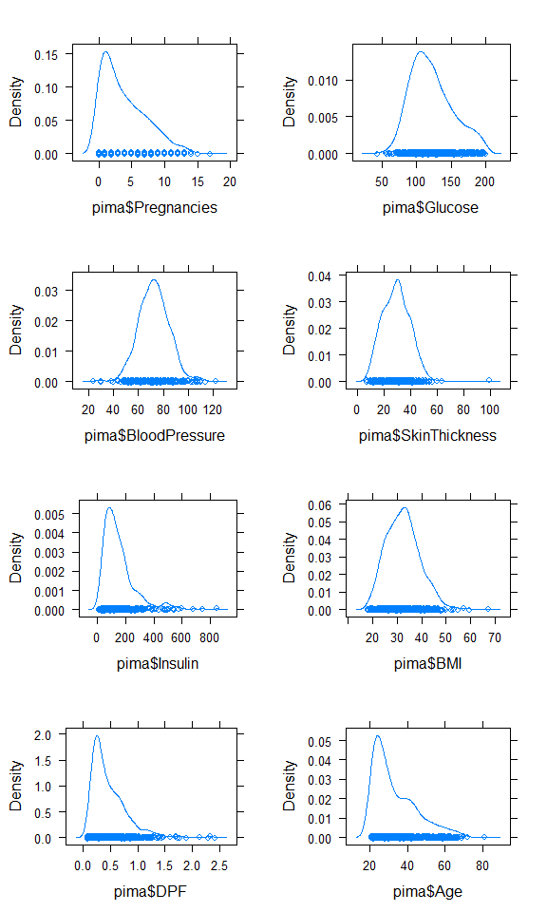
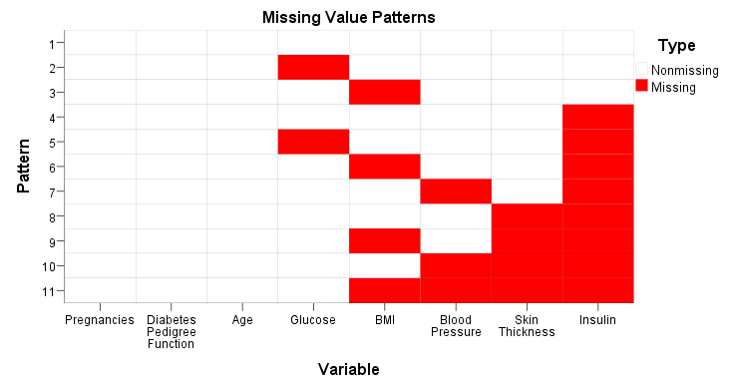
Distribution

Slide 16
Issues
Are we missing valuable data to use for model building?

Slide 17
Imputation
Attempt to fill in missing values
Methods
EM
PMM
FIML

Slide 18
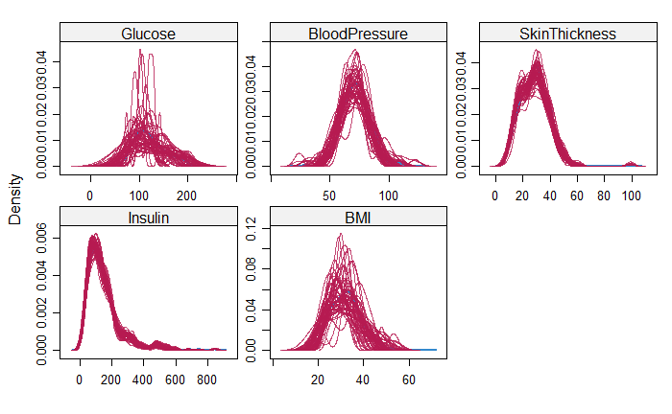
Predictive Mean Matching (PMM)
50 imputations run
GLM run with each imputed dataset, results pooled

Slide 19
Modeling Approach
Data split into 75% training and 25% testing data
Models fitted:
GLM
GAM
CART
NN
AdaBoost
Same seed in order to compare results

Slide 20
GLM
Variable selection using stepwise AIC algorithm
Probability threshold verified using
Variables selected:
Pregnancies
Glucose
BMI
DiabetesPedigreeFunction
Of note: Insulin, skin thickness not identified

Slide 21
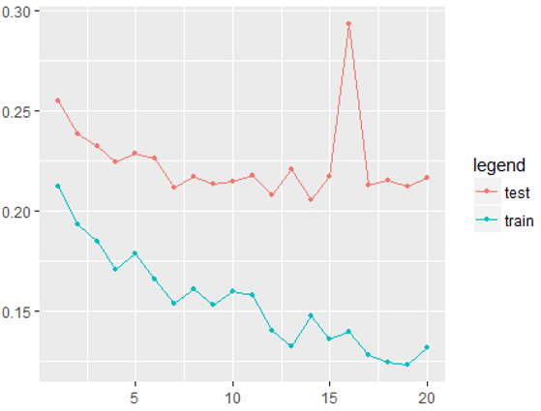
Neural Network
Without variable standardization
Number of hidden nodes chosen using further 90/10 split of training data
Value of 14 chosen
Error rate vs. Number of Hidden nodes

Slide 22
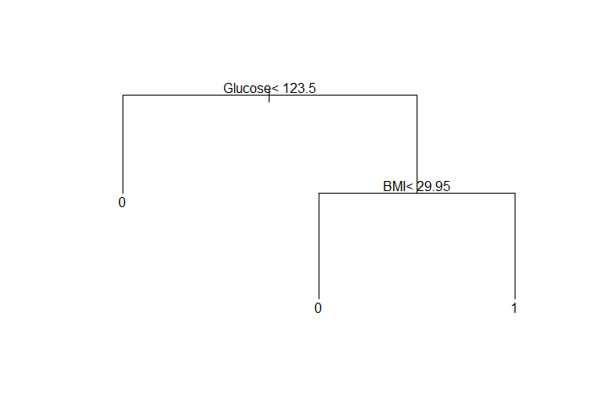
Classification tree
Complexity (cp parameter) based on cross-validation error

Slide 23
Adaptive Boosting (AdaBoost)
First really successful boosting algorithm developed for binary classification
Commonly used with “decision stumps”
Weak models added sequentially
Weighted training data
More weight given to incorrectly predicted instances
Process continues until
Pre-set number of weak learners created
No further improvement
Predictions made by calculating the weighted average of the weak classifiers
More accurate models have more weight
Glucose, Insulin, BMI and Age identified as the most important predictors

Slide 24
Generalized Additive Model Procedure
Smoothing applied to all predictors (all continuous)
Four variables turned out to be significant
Glucose, BMI, DiabetesPedigree Function and Age
All were non-linear
Residual deviance: 0.883
Using effective degrees of freedom

Slide 25
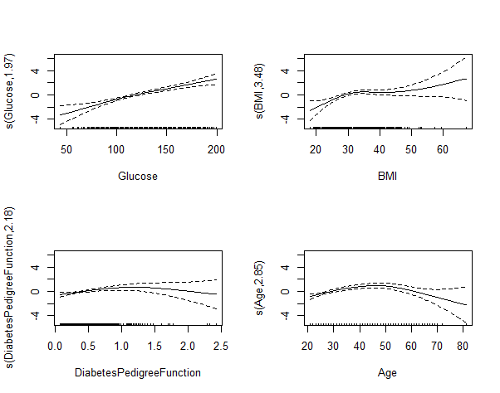
GAM - Significant Variable Plots

Slide 26
Model Comparison - R
Method | In – Sample AUC | Out of Sample AUC | In Sample MR | Out of Sample MR
GLM | 0.84 | 0.87 | 0.22 | 0.23
Classification Tree | 0.88 | 0.84 | 0.23 | 0.24
AdaBoost | 0.85 | 0.87 | 0.22 | 0.23
GAM | 0.86 | 0.88 | 0.21 | 0.19
Neural Network | 0.85 | 0.86 | 0.22 | 0.23

Slide 27
Model Comparison - SPSS
Method | In – Sample AUC | Out of Sample AUC | In Sample MR | Out of Sample MR
GLM | 0.86 | 0.81 | 0.21 | 0.25
Classification Tree | 0.86 | 0.80 | 0.18 | 0.26
Neural Network | 0.87 | 0.82 | 0.22 | 0.27

Slide 28
Some conclusions
Imputation can be challenging
Different models select different variables
GAM performed the best
Cross-validation would give more reliable results/comparisons

Slide 29
References
1. Kahn SE, Cooper ME, Del Prato S. PATHOPHYSIOLOGY AND TREATMENT OF TYPE 2 DIABETES: PERSPECTIVES ON THE PAST, PRESENT AND FUTURE. Lancet. 2014;383(9922):1068-1083. doi:10.1016/S0140-6736(13)62154-6.
2. Afable A, Karingula NS. Evidence based review of type 2 diabetes prevention and management in low and middle income countries. World Journal of Diabetes. 2016;7(10):209-229. doi:10.4239/wjd.v7.i10.209.
3. Olokoba AB, Obateru OA, Olokoba LB. Type 2 Diabetes Mellitus: A Review of Current Trends. Oman Medical Journal. 2012;27(4):269-273. doi:10.5001/omj.2012.68.
Detailed list in report

