Slide 1
Traffic Safety Mobile Application
Name:Ali Osman Mahmoud
ID: 241005798

Slide 2
Core Idea
Digitizes the full lifecycle of a traffic incident
From reporting → police assessment → emergency dispatch → resolution
Replaces slow phone-based reporting with a fast, GPS-based system

Slide 3
Users & Roles: Driver
Reports accidents/hazards with forms and media
One-tap SOS with live GPS location
Live traffic alerts and navigation

Slide 4
Users & Roles: Police Officer
Real-time incident alerts
Review incident details (location, media, type)
Dispatch emergency services or issue e-fines
Send traffic alerts

Slide 5
Users & Roles: Emergency Services
Receive dispatch with GPS location
In-app routing to incident scene
Request road clearance
Status tracking (In Progress → Resolved)

Slide 6
Users & Roles: Administrator
User management
Configure alert rules
Monitor analytics (incidents, response time, fines)
Generate safety reports

Slide 7
Key Features
Real-time incident reporting (GPS + media)
One-tap SOS alerts
Live traffic incident map
Role-based instant notifications
Manual police severity decision
In-app navigation with hazard overlays
Electronic fines system
Incident tracking & Admin analytics

Slide 8
Technical Highlights
Cross-platform (Flutter / React Native)
GPS accuracy up to ~10 meters
Firebase push notifications (<10s delay)
Secure authentication (JWT + bcrypt)
HTTPS encrypted (TLS 1.2+)
Cloud backend (500+ users support)
Arabic + English (Full RTL support)

Slide 9
Importance
Speeds up emergency response
Improves coordination between authorities
Structured, real-time data
Turns smartphones into a safety network

Slide 10
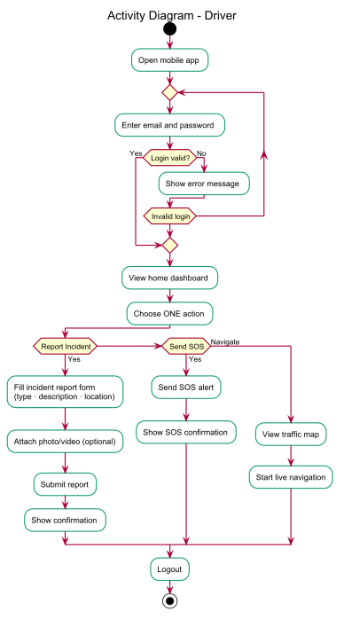
Driver Activity Diagram

Slide 11
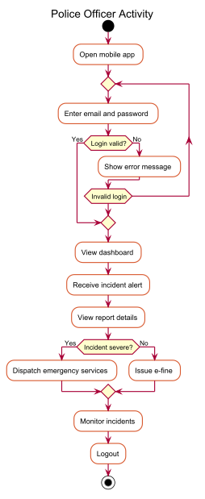
Police Officer Activity Diagram

Slide 12
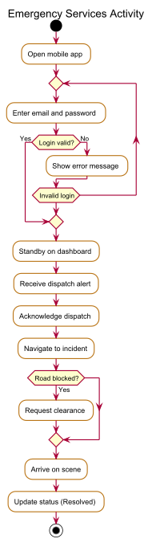
Emergency Services Activity Diagram

Slide 13
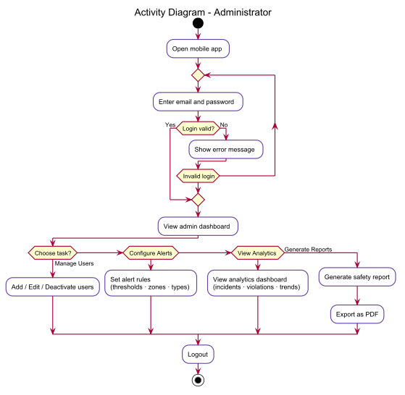
Administrator Activity Diagram

Slide 14
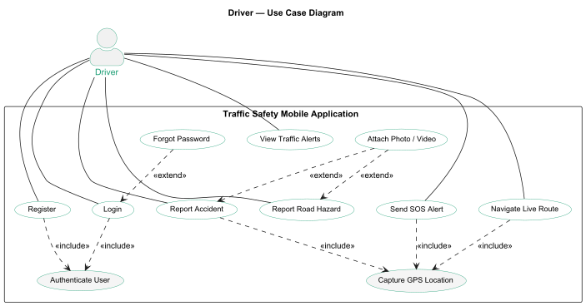
Driver Use Case

Slide 15
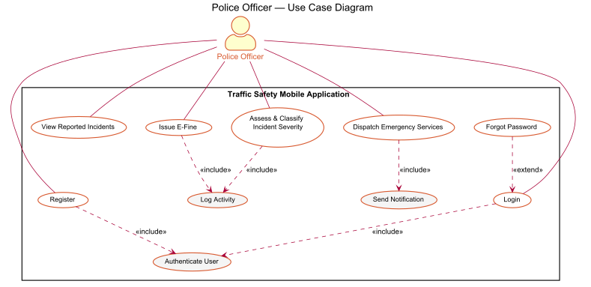
Police Use Case

Slide 16
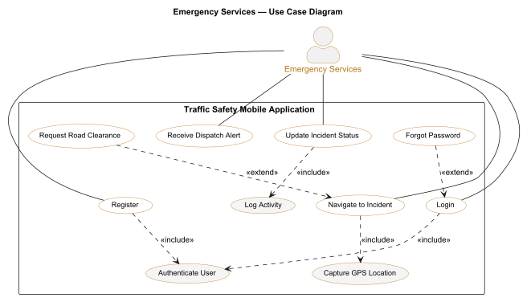
Emergency Service Use Case

Slide 17
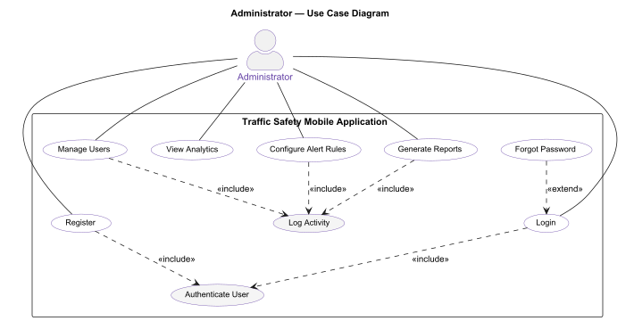
Admin Use Case

Slide 18
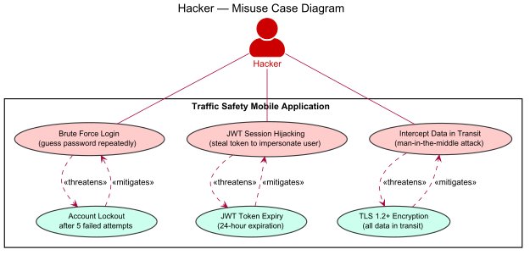
Hacker Misuse Case

Slide 19
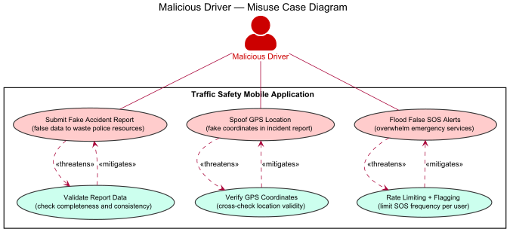
Malicious Driver Misuse Case

Slide 20
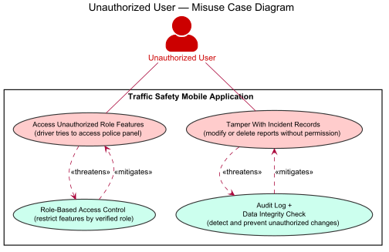
Unauthorized User Misuse Case

Slide 21
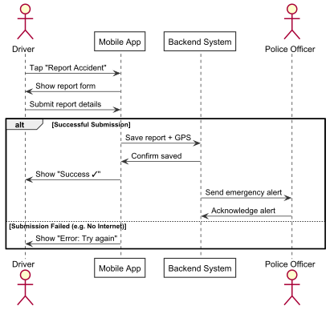
Report Incident Sequence Diagram

Slide 22
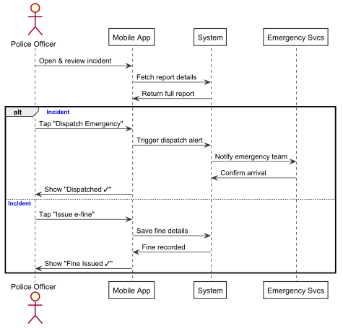
Assess & Dispatch Sequence Diagram

Slide 23
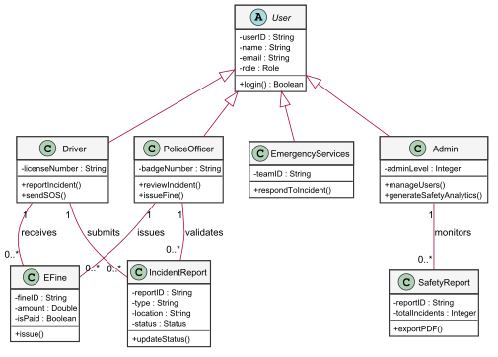
Class Diagram

