Slide 1
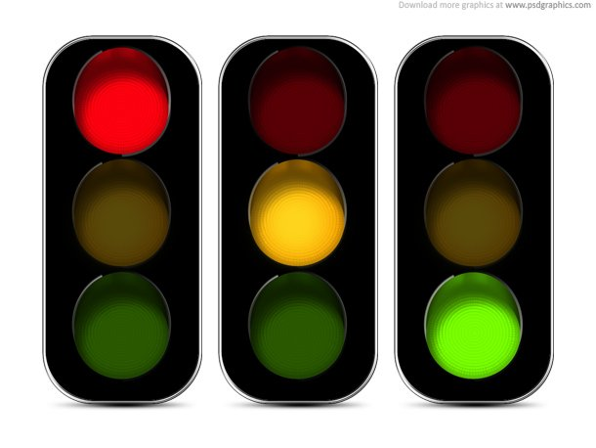
Traffic Signs Classification

Slide 2

Overview:

Slide 3
What is the project idea?
The ability of a neural network to recognize traffic signals by training the network with a large set of images using Convolutional Neural Network (CNN).

Slide 4
Project Structure:
Input folder:
Dataset files
Examples folder:
set of images for testing
GUI folder:
gui.py

Slide 5
Libraries:
numpy
Pandas
Pickle
matplotlib (pyplot)
keras (utils, models, layers)
csv

Slide 6
Training data:
Loads the data, assembles the model, trains, and outputs the sequential model and plot image to disk.

Slide 7
Dataset:
7 GB of image data.
It consists of 9 pickle files divided into two parts:
RGB
Gray-scale

Slide 8
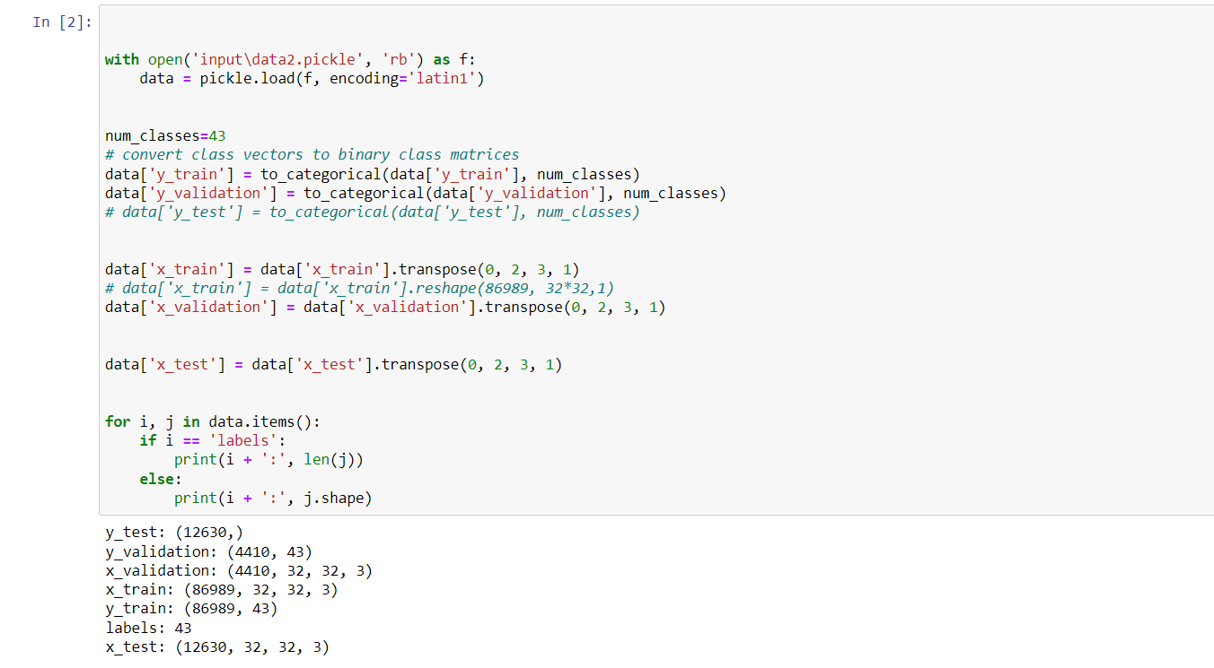
Data split and preprocess

Slide 9
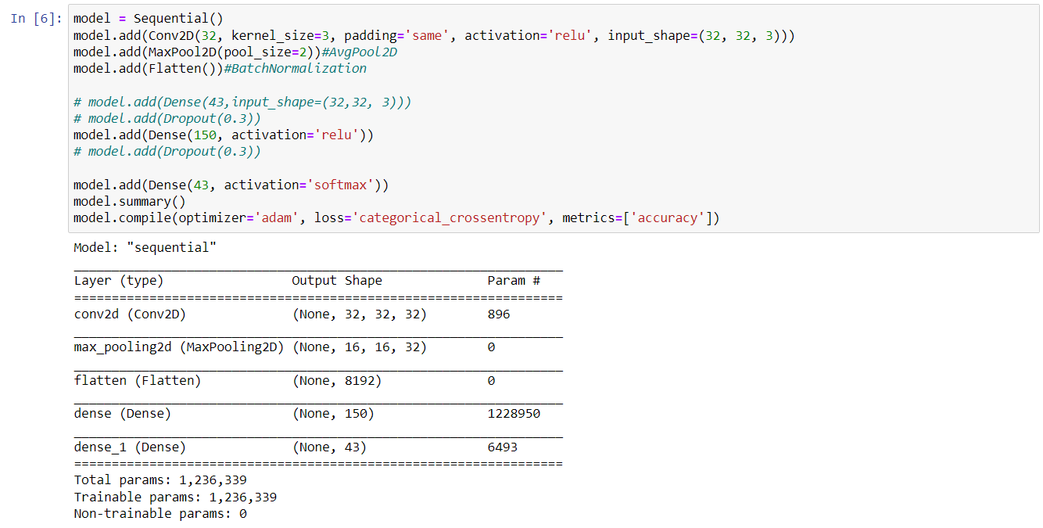
Build Model

Slide 10
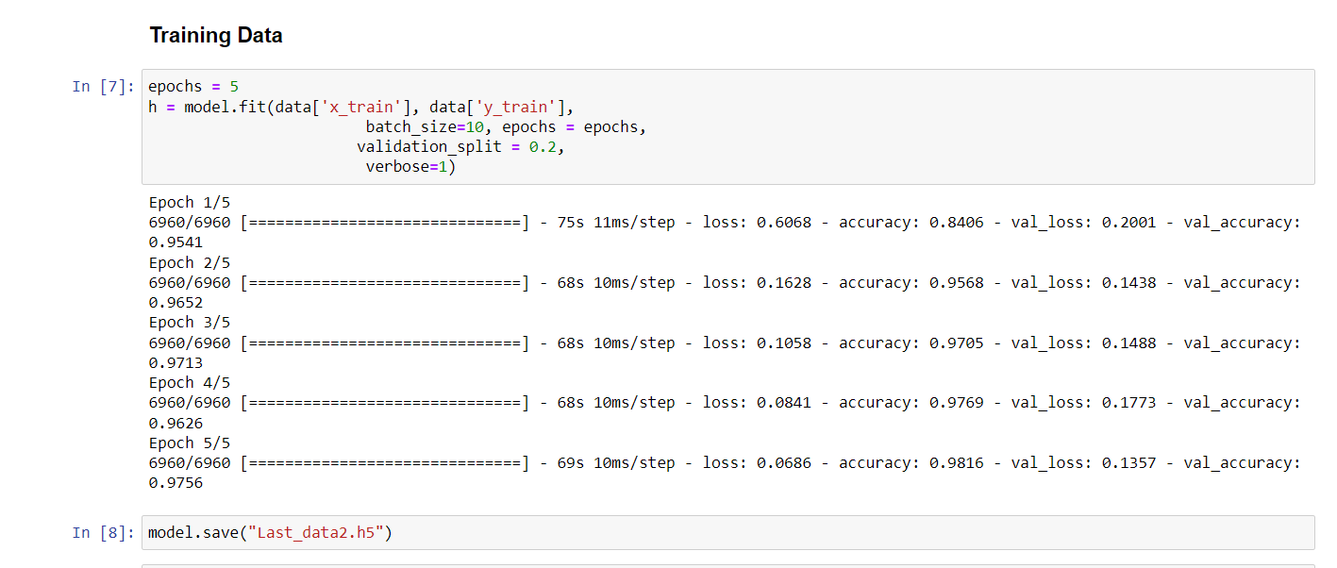
Training Data

Slide 11
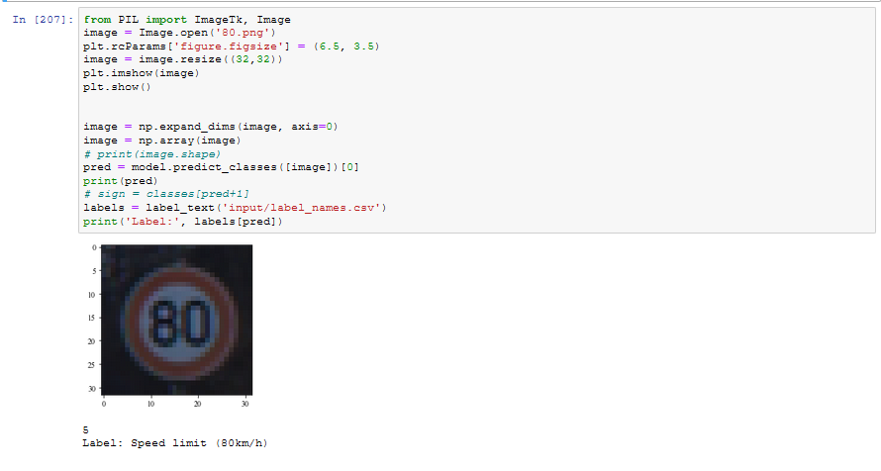
Test

Slide 12
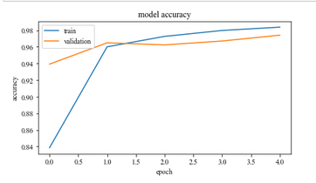
Accuracy per epoch

Slide 13
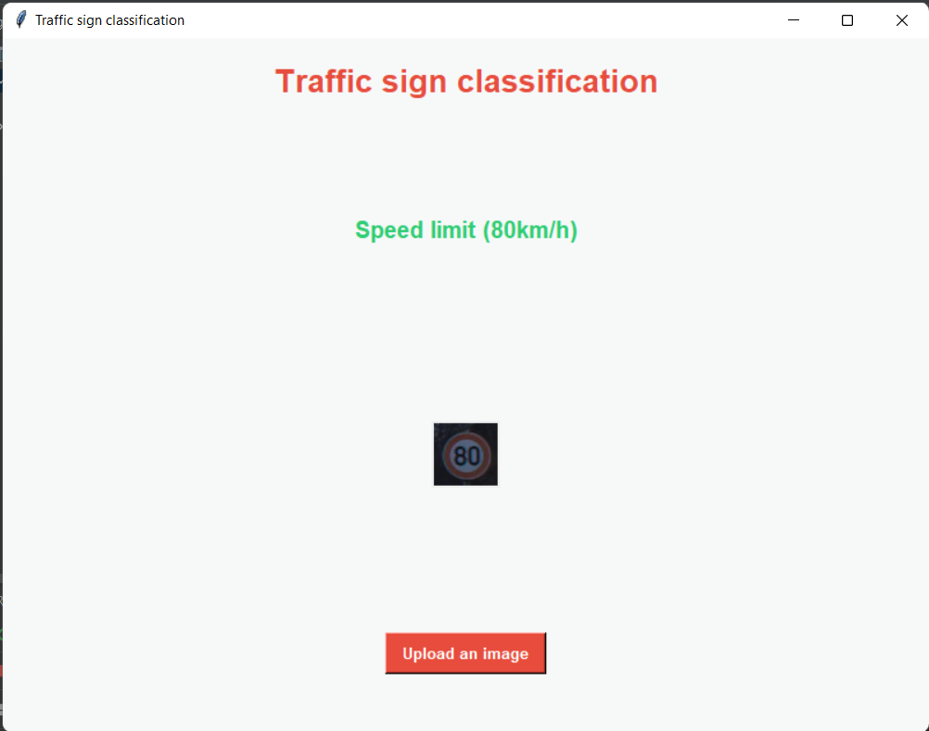
GUI

