Slide 1
HackInsight
From Air Pollution Data to Actionable 24-Hour Forecasts
Team
Laiba Akram · Ali Hasan · Areeba · Bushra Abid
Lahore · 26 sensors
Karachi · 4 sensors
“Knowing today’s air quality is useful. Knowing what tomorrow may look like is actionable.”
Notes:
Hi everyone, we’re Laiba, Ali, Areeba and Bushra, and this is HackInsight. Think about checking an air-quality app in Lahore: it tells you the number right now. But if you’re deciding whether kids play outside tomorrow, that number doesn’t help much. Knowing today’s air quality is useful; knowing what tomorrow may look like is actionable. That gap is what we built HackInsight for. Let’s start with the problem.

Slide 2
Air Quality Isn’t Just a Number
CURRENT
What is happening now?
→
TOMORROW
What happens next?
How certain are we?
→
DECISION
What should I do?
Fresh sensor data isn’t always available. We make data freshness visible instead of hiding it.
Notes:
Current air-quality information tells people what is happening. But a real decision needs three more answers: what happens next, how certain are we, and what should I do? On top of that, fresh sensor readings aren’t always available, so any honest system has to deal with that and not hide it. Our goal was to close this decision gap, so let me show you how.

Slide 3
From Data to Decisions
DATA
→
TRUST
→
PREDICT
→
EXPLAIN
→
ACT
Ground sensors + weather
Validated by an agent
24-hour PM2.5 forecast
Uncertainty + assistant
Mask · exercise · outdoor
REAL PROBLEM → TRUSTWORTHY DATA → PREDICTION → UNCERTAINTY → AI DECISION SUPPORT → ACTION
Notes:
HackInsight is an AI-powered PM2.5 forecasting and decision-support system for Lahore and Karachi. It follows five steps. Data: Pakistani ground-sensor and weather data. Trust: we validate it before using it. Predict: a 24-hour forecast. Explain: with uncertainty and a decision assistant. And Act: clear guidance people can use. Let’s begin with the data.

Slide 4
Built on Real Environmental Data
176K+
30
2
records
sensors
cities
Lahore 26 · Karachi 4 | 16 columns · 0 nulls · 0 duplicate IDs
Weather: temperature · humidity · wind speed & direction · pressure · precipitation · dew point
PAQI + Weather
→
Raw
→
Cleaned
→
Gold
→
Validated
Notes:
We worked with 176,392 rows and 16 columns from 30 sensors: 26 in Lahore and 4 in Karachi. Weather comes alongside: temperature, humidity, wind speed and direction, pressure, precipitation and dew point. Our gold dataset has zero null values and zero duplicate record IDs. It moves through raw, cleaned, then gold, and is validated at each step. Next, the part we’re proudest of: the agent that checks the data.

Slide 5
Before AI Predicts, AI Checks
DATA
→
DATA QUALITY AGENT
→
FIX | FILL | FLAG
→
TRUSTED DATA
Checks: schema · missingness · duplicates · ranges · quality issues
Policy-driven decisions, not raw data fed blindly into a model or LLM.
Notes:
This is a key difference. We don’t send raw data straight into a model or an LLM. A Data Quality Agent checks schema, missing values, duplicates and value ranges, and then makes policy-driven decisions: fix what can be fixed, fill what can safely be filled, and flag what can’t be trusted. Forecasts are only as good as the data under them, and this makes the data trustworthy. Now let’s see the forecast itself.

Slide 6
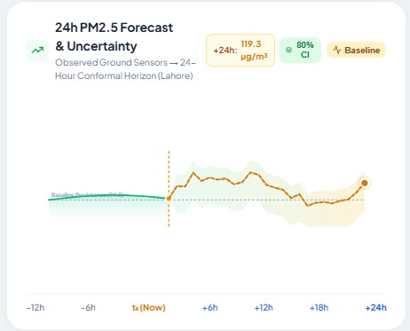
We Don’t Just Measure Pollution. We Forecast It.
HistGradientBoostingRegressor
40 features · 24-hour horizon
log1p target transformation
Uncertainty interval (80%)
Persistence baseline for comparison
Nowcast ≠ model forecast
Notes:
Here’s the 24-hour forecast for Lahore. The solid line is what was observed; the orange line is our prediction for the next 24 hours, with the shaded band showing an 80% uncertainty interval. The model is a HistGradientBoostingRegressor with 40 features, predicting 24 hours ahead on a log1p-transformed target. We always compare it against a persistence baseline, which simply assumes tomorrow looks like now. One note on honesty: the current value is a nowcast or estimate, and the forecast is a model output; we keep them clearly separate. So, does it actually beat the baseline?

Slide 7
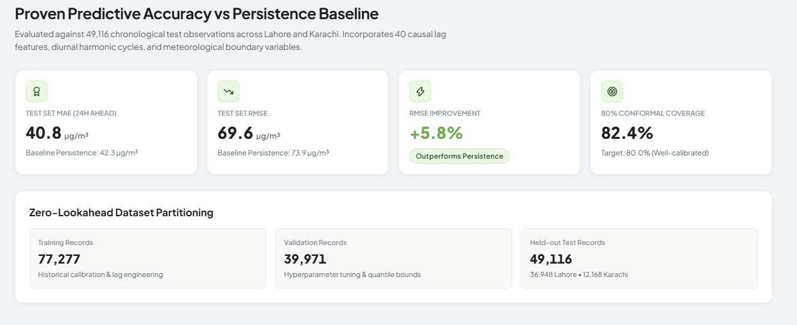
Does the Model Actually Work?
40.8 vs 42.3
−3.63%
−5.79%
82.4%
MAE: model vs persistence (µg/m³)
MAE vs baseline
RMSE vs baseline
coverage (80% target)
49,116
untouched chronological test observations
Beats a simple baseline with calibrated uncertainty.
Notes:
We tested on 49,116 untouched observations, chronologically split so nothing leaks from the future. Model MAE is 40.8 micrograms per cubic metre versus 42.3 for persistence, 3.63% lower. RMSE is 5.79% lower, 69.6 against 73.9. And our 80% uncertainty interval covers 82.4% of real outcomes, so it’s well calibrated. We’re not claiming a perfect model. The honest result is that it beats a simple baseline on an untouched test set and gives calibrated uncertainty. Now, how does that become advice a person can use?

Slide 8
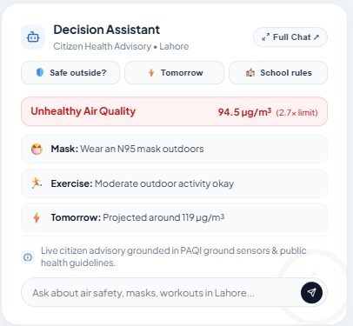
A Forecast Is Only Useful If People Can Act on It
PM2.5
↓
Risk interpretation
↓
Mask · exercise · outdoor guidance
↓
ACTION
Notes:
A PM2.5 number means little to most people. So the assistant turns it into risk and then into guidance. In this Lahore example it flags unhealthy air at 94.5, about 2.7 times the limit, recommends an N95 mask, says moderate outdoor activity is okay, and shows tomorrow’s projection of around 119. That’s the step from prediction to action. And people can ask follow-up questions in a full chat.

Slide 9
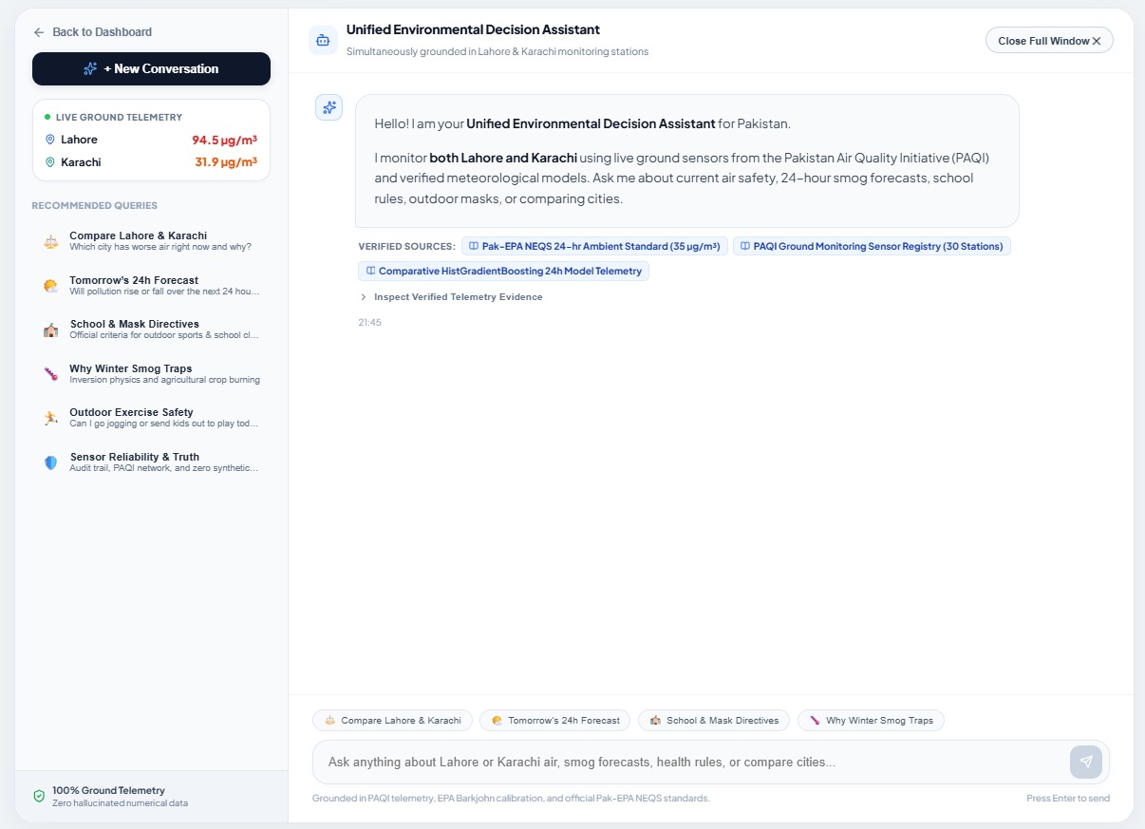
Ask the Air-Quality System Anything
Conversational interaction
Lahore vs Karachi comparison
Tomorrow’s forecast
School & mask guidance
Grounded in trusted sources
No invented numbers
Notes:
The full Decision Assistant is conversational. You can compare Lahore and Karachi, ask about tomorrow’s forecast, or ask about school and mask guidance. Answers are grounded in trusted project information and listed sources, and the assistant isn’t allowed to invent numerical values. That makes it something people can reasonably trust. Now let’s look at how all of this runs automatically.

Slide 10
From One-Time Demo to Automated System
INGEST
→
VALIDATE
→
FORECAST
→
GENERATE INSIGHTS
→
LOG
→
UPDATE
Orchestrated with Prefect
Reproducible · continuously operating · every run logged
Notes:
Behind the dashboard is a Prefect pipeline. It ingests data, validates it, runs the forecast, generates insights, logs everything, and updates the dashboard. Automating this means the system is reproducible and can keep running, not just work once on stage. Okay, time to show you the real product.

Slide 11
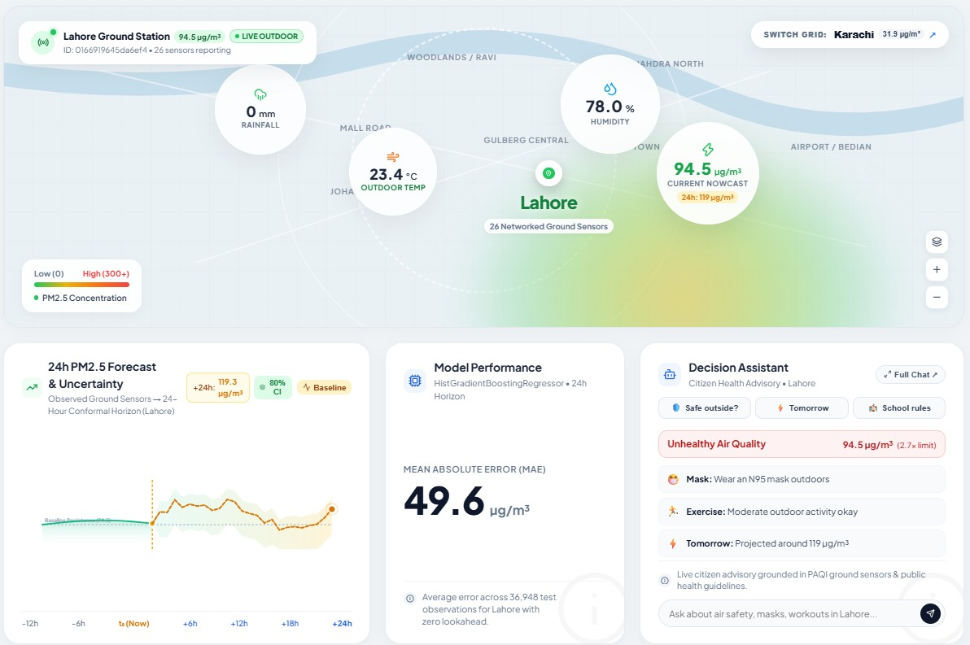
See It in Action
1
Lahore / Karachi switch
2
Current nowcast
3
Weather
4
24-hour forecast
5
Uncertainty
6
Model evidence
7
Decision Assistant
Notes:
Let’s switch to the live dashboard. First, I’ll switch between Lahore and Karachi. Here is the current nowcast and the weather. Here’s the 24-hour forecast with its uncertainty band. This is the model evidence, and finally the Decision Assistant. If sensors haven’t reported recently, the system falls back to historical gold data and labels it that way.

Slide 12
From Data → Prediction → Action
“Don’t just tell people how polluted the air is. Tell them what may happen next — and what they can do about it.”
HackInsight
Laiba Akram · Ali Hasan · Areeba · Bushra Abid
Notes:
To wrap up: real data, validated by an agent, turned into a 24-hour forecast with calibrated uncertainty, and then into advice people can act on. Don’t just tell people how polluted the air is. Tell them what may happen next, and what they can do about it. We’re Laiba, Ali, Areeba and Bushra. Thank you, and we’re happy to take questions.

