Slide 1
Campus Connect Platform
Here is where our presentation begins
Start Now

Slide 2

Background ?
All campus events in our university are currently managed manually.
Event registration, ticketing, attendance, and communication rely on paper-based processes or spreadsheets.
The manual system causes inefficiency, inaccuracy, and less student engagement.
Problems in the Current Manual System
Manual event registration and management.
Errors in storing student information.
Poor communication of event updates.
Offline ticket sales and payments.
Time-consuming manual attendance.

Slide 3

System Discussion?
Event Brite
Features: Event creation, ticket sales, attendee management, push notifications.
Technology:
Languages: Ruby, JavaScript (Node.js), Python
Frameworks: Ruby on Rails for backend, React for frontend
Database: PostgreSQL, Redis (caching), Elasticsearch (search)
Authentication: OAuth 2.0, email/password, social login
Load Balancing: Nginx, AWS Elastic Load Balancer (ELB), CDN for content delivery
Eventbrite (Accessed on: 06-08-2025, 12:01 AM). Available at: www.eventbrite.com

Slide 4

System Discussion?
Ticket Tailor
Features: Ticket sales, discount codes, QR code check-in, simple event pages.
Technology:
Languages: Ruby, JavaScript (Node.js)
Frameworks: Ruby on Rails, StimulusJS for frontend interactivity
Database: PostgreSQL, Redis (for session management/caching)
Authentication: Email/password login, OAuth options
Load Balancing: AWS ELB, Cloudflare CDN
Ticket Tailor (Accessed on: 06-08-2025, 12:56 AM). Available at: https://app.tickettailor.com/

Slide 5

System Discussion?
Google Calendar Event
Features: Event scheduling, reminders, notifications, calendar sharing.
Technology:
Languages: Java, JavaScript, Python
Frameworks: Google Web Toolkit (GWT) for frontend, internal microservices frameworks for backend
Database: Google Spanner (distributed SQL), Bigtable (NoSQL)
Authentication: OAuth 2.0, Google Account authentication
Load Balancing: Google’s global load balancing using edge caching and distributed servers
Goole Calendar (Accessed on: 14-08-2025, 2:00 AM). Available at: https://calendar.google.com/

Slide 6

Common Features (Partially available across the majority of systems)
Event creation & management
Ticketing & payments
User login & attendee management
Event notifications & reminders

Slide 7

What Additional Features Can Be Added
Club management (create clubs, assign president, VP, moderator)
Rule-based personalized suggestions (based on department/interests)
Event certificate generation
Event history
Local payment integration (Bkash, Rocket)
QR code check-in

Slide 8
Gaps
No structured club/community governance → Ownership & role distribution unclear.
Manual/fragmented registration & check-in → Queues, errors, and delays in reporting
Lack of personalized discovery → Irrelevant event suggestions, low attendance.
No verifiable certificate support → Achievements not portfolio-ready
Disconnected event history & records → Attendance, certificates, and participation scattered .
Inefficient payment flow → Friction in local payments, refunds, and cancellations.
Weak support & feedback loop → Slow issue resolution, limited user-driven improvement.

Slide 9

Motives Will Be Covered
Super Admin setup with role-based permissions ensures clear ownership and accountability.
Smart Event Management & QR Check-in for centralized creation, instant attendance, and error-free reporting.
Rule-Based Personalized Discovery using department, interest, past participation, and trends.
Auto-generated, attendance-linked, verifiable certificates that are portfolio-ready.
Unified dashboard for all participation, certificates, and tickets in one place.
Unified Ticketing & Local Payment Integration with smooth checkout (bKash/Rocket), refunds & cancellations supported.
In-app support and feedback system for faster resolution and user-driven growth.

Slide 10

Problem Statements & Technical Challenges
Data Requirements:
Student interests, department, enrolled clubs.
Event participation history & feedback.
Trending/popular events based on total bookings.
Algorithmic Challenges:
Combining rule-based filtering.
Cold start problem for new users with no historical data.
Real-time updates based on continuous user interactions.
Ensuring real-time event recommendation .
Scalability &amp; High Performance
Supporting thousands of concurrent users request on server.

Slide 11
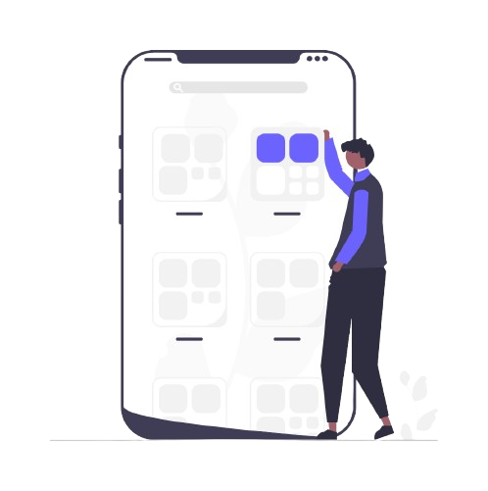
Campus Connect – What we deliver !?
Manual notice boards are replaced with a digital event browsing service, giving users easy event discovery.
Missed schedules are solved through smart notification and reminder services, ensuring users never miss events.
Manual attendance sheets are replaced with a QR code attendance service, providing fast and error-free tracking.

Slide 12

Campus Connect – What we deliver !?
Difficult participation tracking is improved with event history and certificate services, giving users proper records and proof.
Ticket handling problems are addressed with online ticketing and payment services,offering smooth and secure registration.
Delayed updates are solved by real-time notification services, delivering instant updates and synchronization to users.

Slide 13
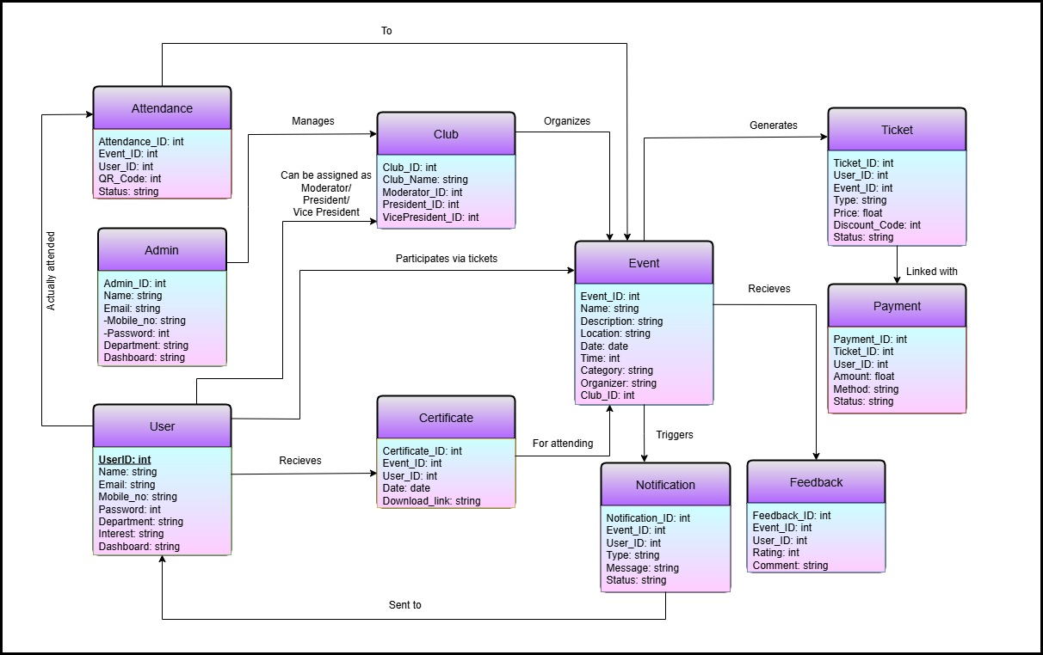
ER Diagram

Slide 14
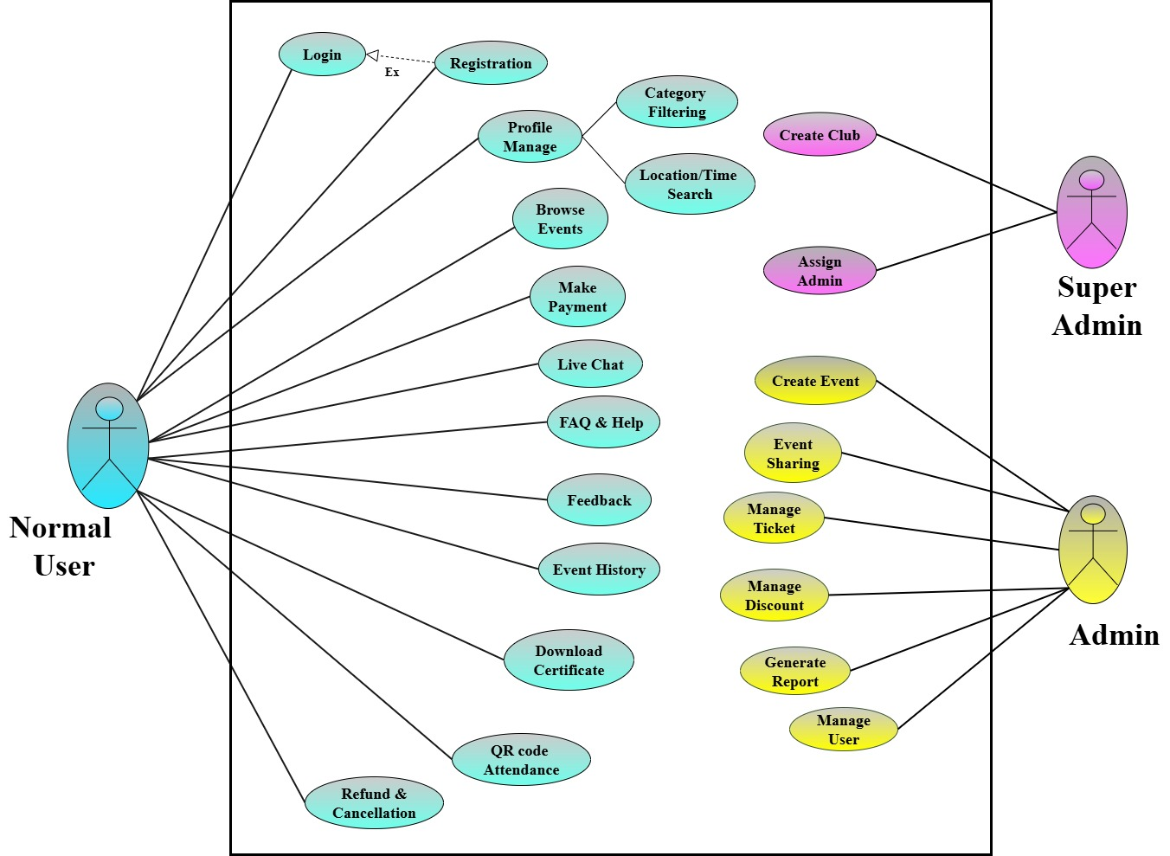
Use Case Diagram

Slide 15
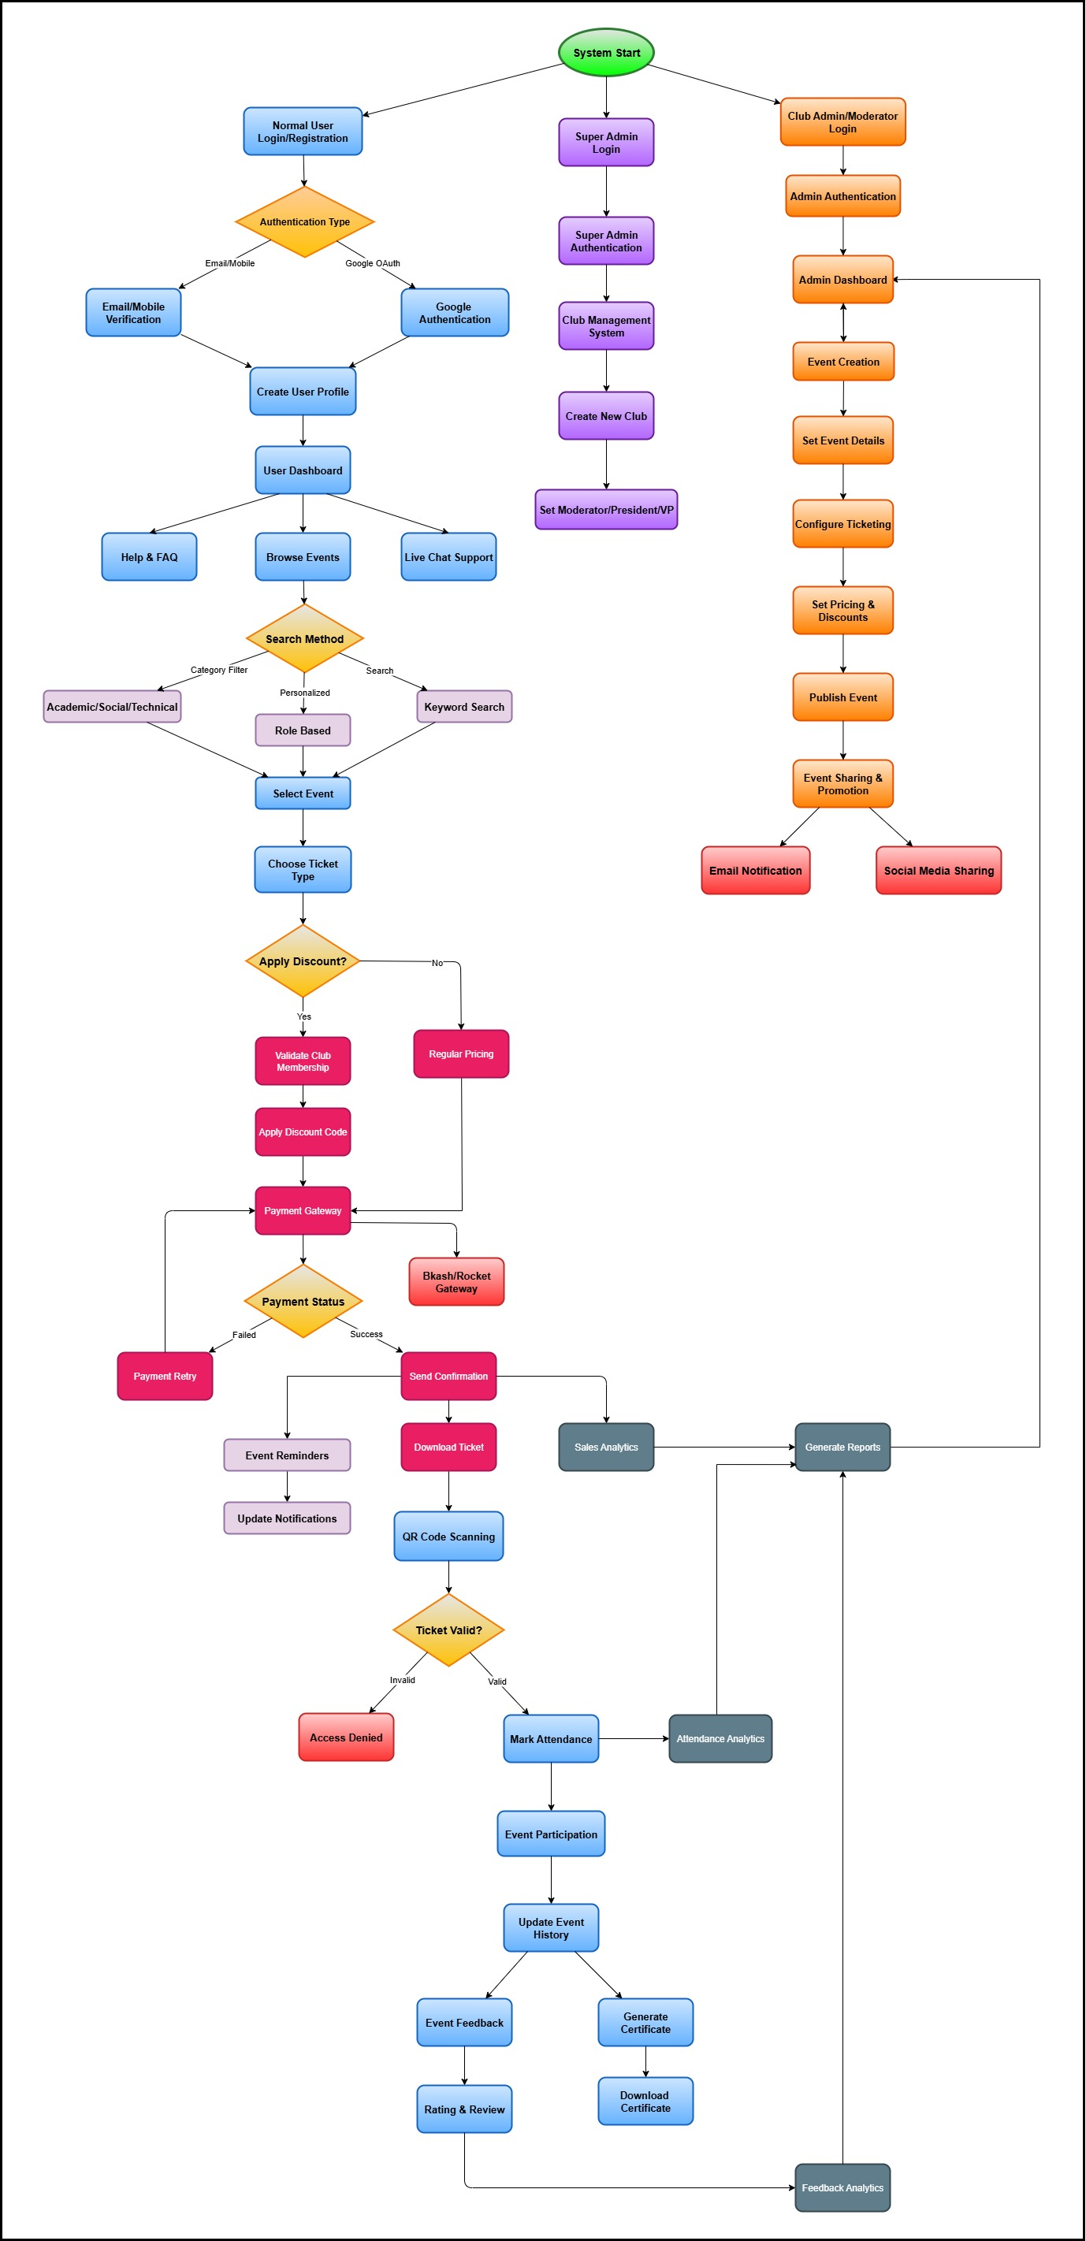
Data Flow Diagram

Slide 16
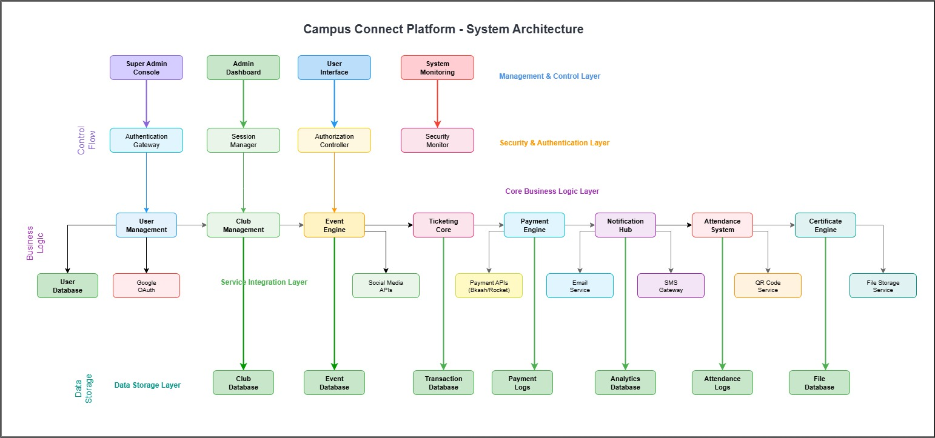
Block Diagram

Slide 17

Technology
Frontend :
React.JS , Material UI , Bootstrap , Type Script
Backend :
Node.JS , Nest.JS , Type Script
Authentication
Passport JWT , Google Authentication
Scalability Performance
NGINX
Database
PostgreSQL (Using Prisma ORM)
Testing
Selenium

Slide 18
Future Goal
In Capstone B :
Implement the whole system .
In Capstone C :
Check the effectiveness .

Slide 19
Thank You

