Slide 1

INTELLIGENT SYSTEMS PROJECT P7
Handwritten Sudoku Reader and Solver
Calibrated Neural Perception, State-Space Search, and Arc-Consistent CSP Verification
10-Minute Presentation & 5-Minute Live Demo | Seed=42

Slide 2
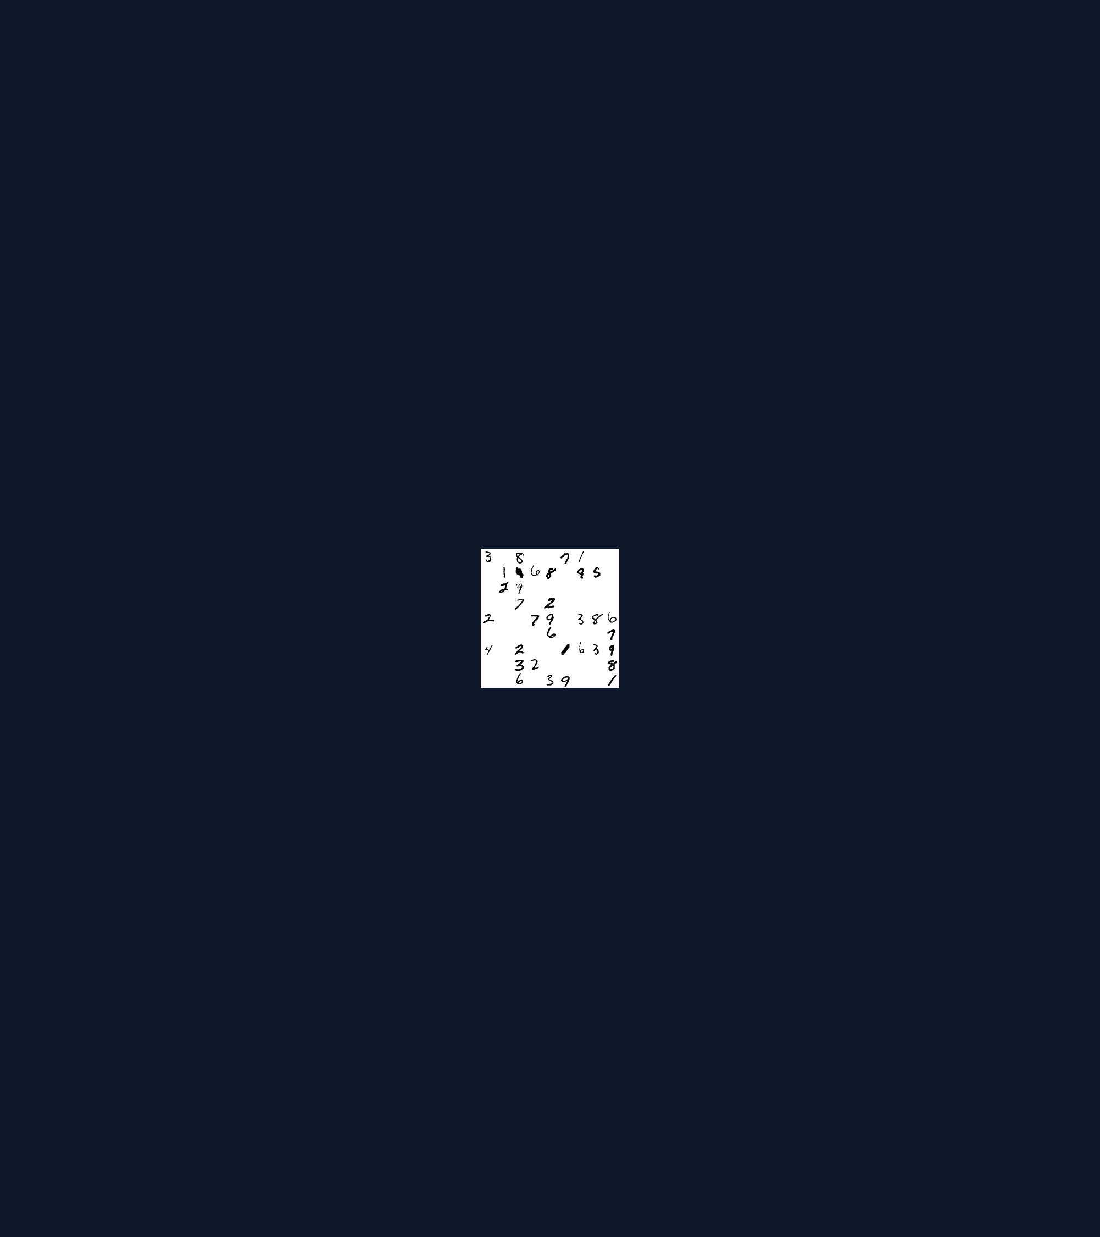
1. PROBLEM & MOTIVATION
Single OCR Errors Break CSP Solvers
Compound Error Across 35 Givens
Grid-Level Failure: At 98.63% digit accuracy, 38.3% of 35-clue grids have >=1 error.
Rigid CSP Wipeout: One duplicate clue (7 read as 1) triggers domain wipeout.
Neuro-Symbolic Fix: Calibrated probabilities guide A* search to fix faulty clues.
Right: 252x252 MNIST Sudoku mosaic (seed=101, 35 givens)

Slide 3
2. SYSTEM ARCHITECTURE
Three Intelligent Modules Cooperate in 12 Stages
Neural OCR
MNIST 1-9 Split: 45,073 train, 9,004 val, 9,020 test digits.
Temp Scaling: Val T=1.1406 cuts test ECE to 0.0024.
Search Repair
Log-Ratio Cost: Penalty ln P(top1) - ln P(alt) >= 0.
Admissible h(n): Disjoint conflict packing lower-bounds cost.
CSP Solver
Three Modes: Switchable BT, BT+FC, and BT+FC+AC3.
AC-3 Conflict: Detects duplicate givens in zero steps.
Grounded in Searching Lecture/Lab, CSP Lecture/Lab, and Neural Networks Lecture

Slide 4
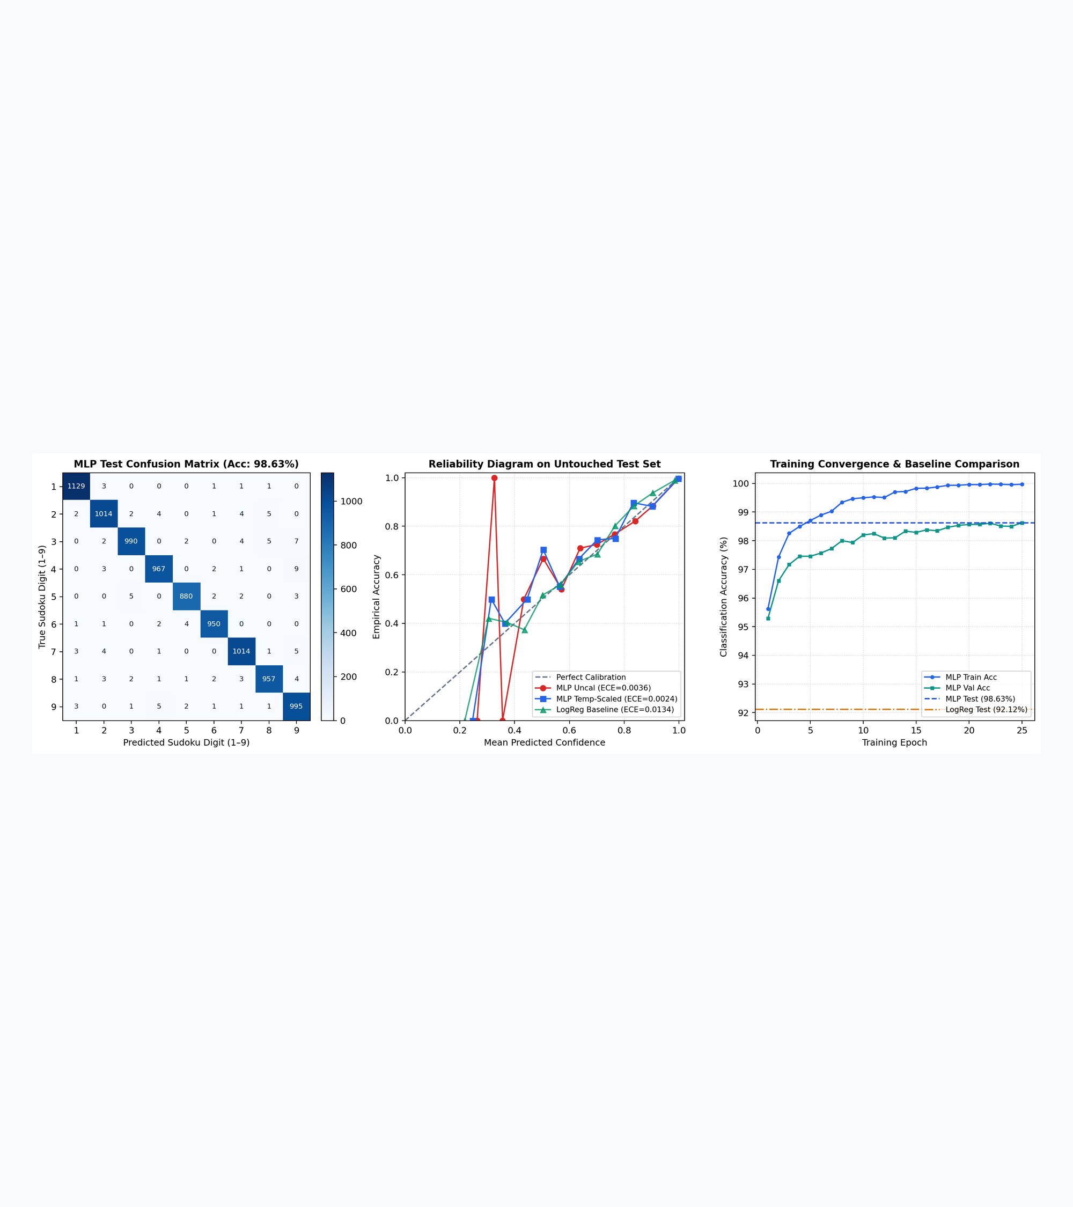
3. HANDWRITTEN DIGIT RECOGNITION
MLP Reaches 98.63% Accuracy & 0.0024 ECE
DigitMLP vs. Logistic Baseline
MLP Architecture: 784->128->64->9 ReLU model beats 92.12% linear baseline.
Post-Hoc Calibration: Validation T=1.1406 cuts test ECE by 33% to 0.0024.
Top-4 Coverage: True digit ranks inside top-4 on 99.9% of test images.
Evaluated on untouched MNIST 1-9 official test set (N = 9,020)

Slide 5
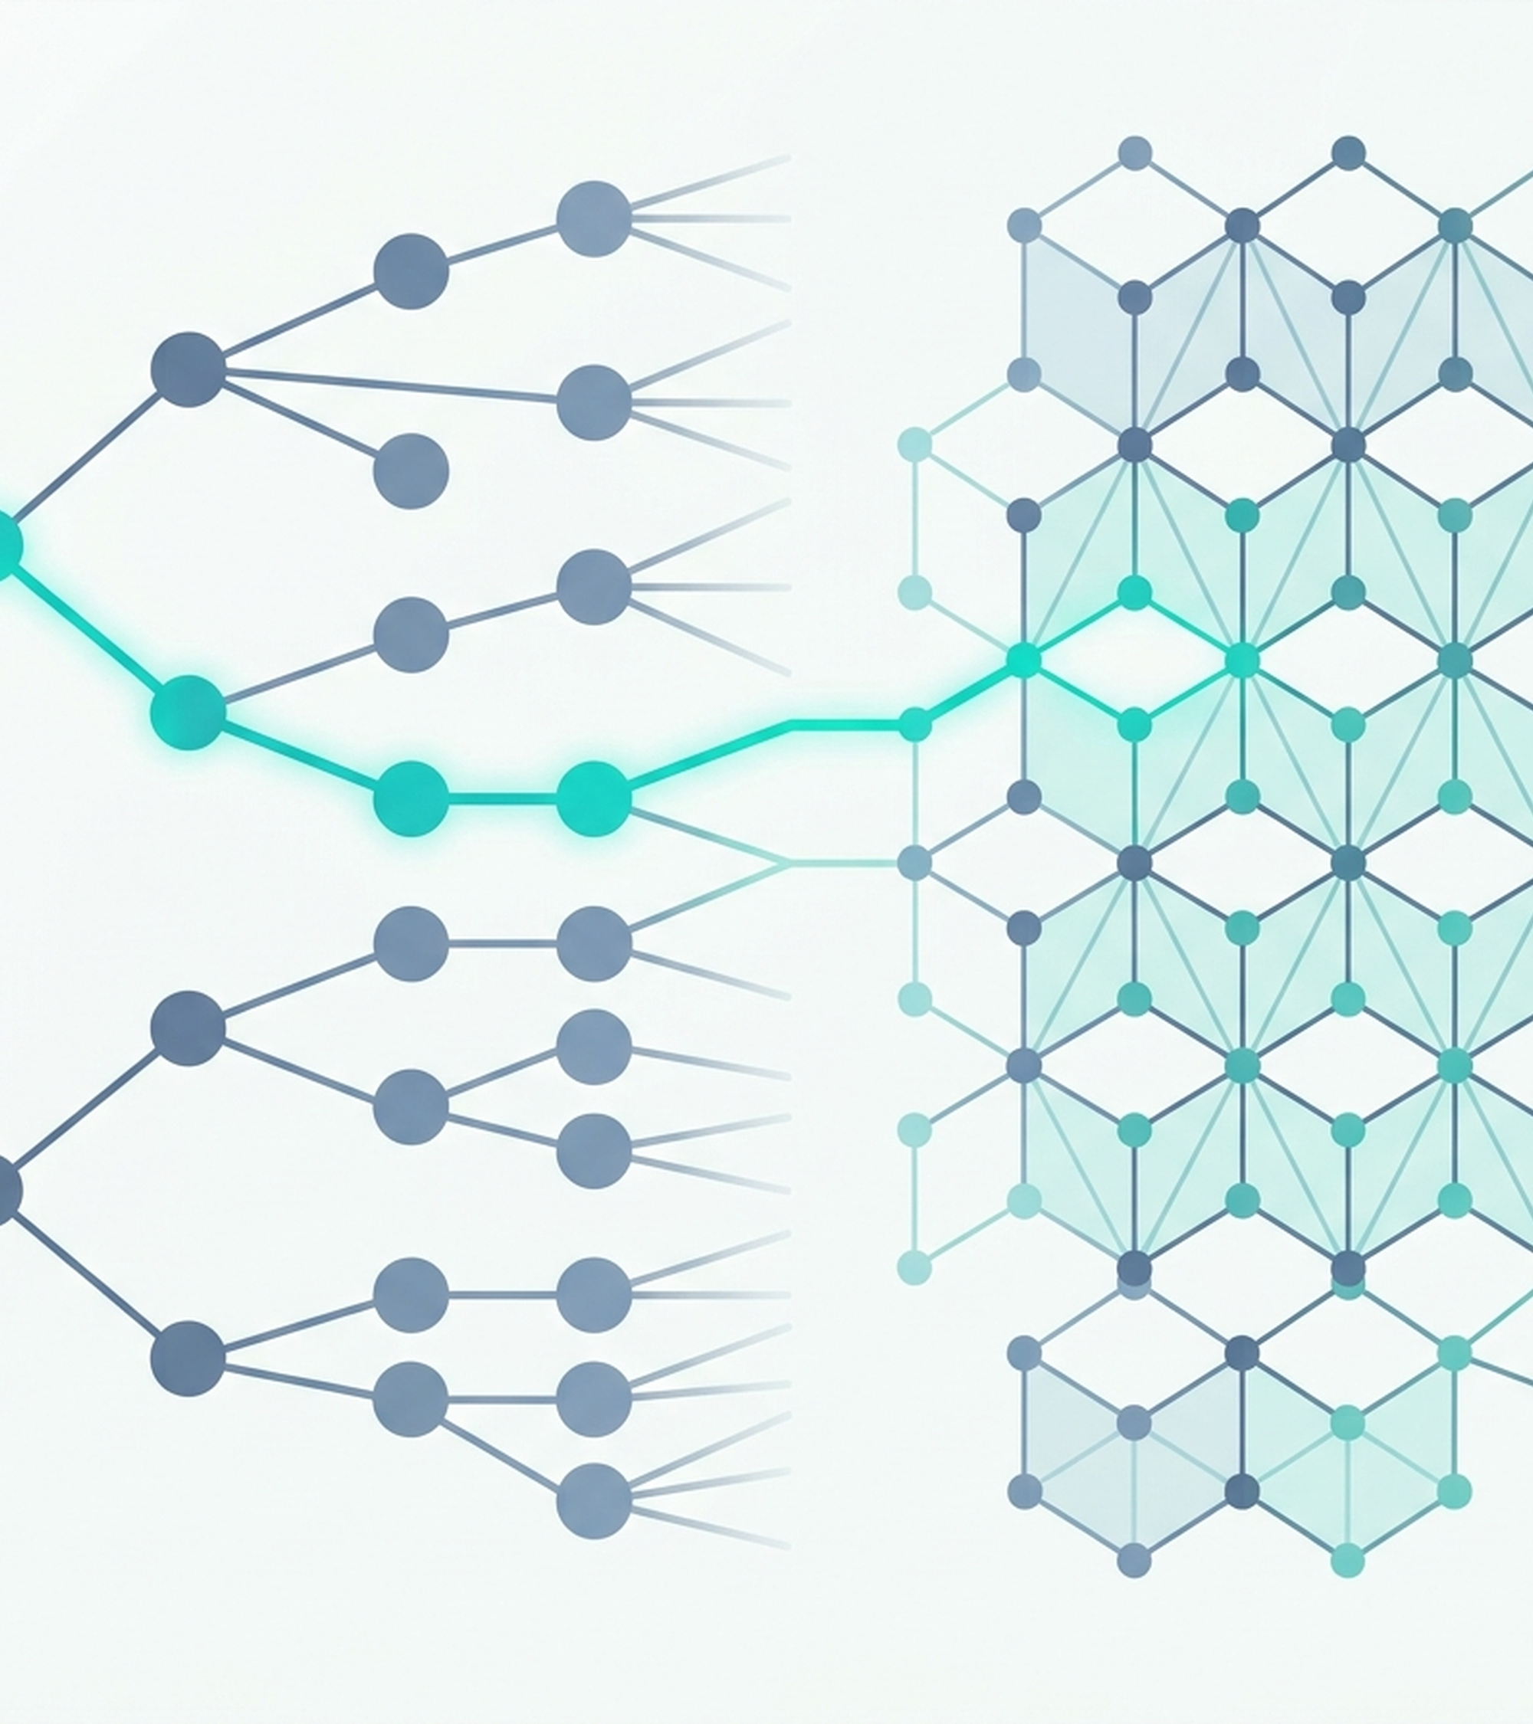
4. STATE-SPACE SEARCH FORMULATION
Disjoint Conflict Packing Is Admissible
Optimal Probability-Guided Repair
Canonical States: Sorted cell-override tuples prevent duplicate graph states.
Log-Likelihood Cost: Step cost ln P(d1) - ln P(d) >= 0 penalizes unlikely edits.
Admissible h(n): Disjoint conflict packing guarantees 0 <= h(n) <= h*(n).
Supports configurable correction budget B (default B=3, up to B=4)

Slide 6
5. CONSTRAINT SATISFACTION SOLVER
AC-3 Prunes 97.7% of Backtracks on 25-Clue Grids
Backtracking
MRV + LCV Order: Picks smallest domain and LCV digit.
High Backtracks: 3,815.9 assigns and 3,759.9 backtracks.
Forward Check
Peer Pruning: Prunes assigned value from 20 peers.
Fastest Runtime: Solves 25-clue grids in 7.97 ms.
Arc Consistent
Global REVISE: Cascades arc reductions across grid.
Minimal Tree: 140.7 assigns (25 clues); 0.3 backtracks.
All three solver modes are independently switchable and fully instrumented

Slide 7
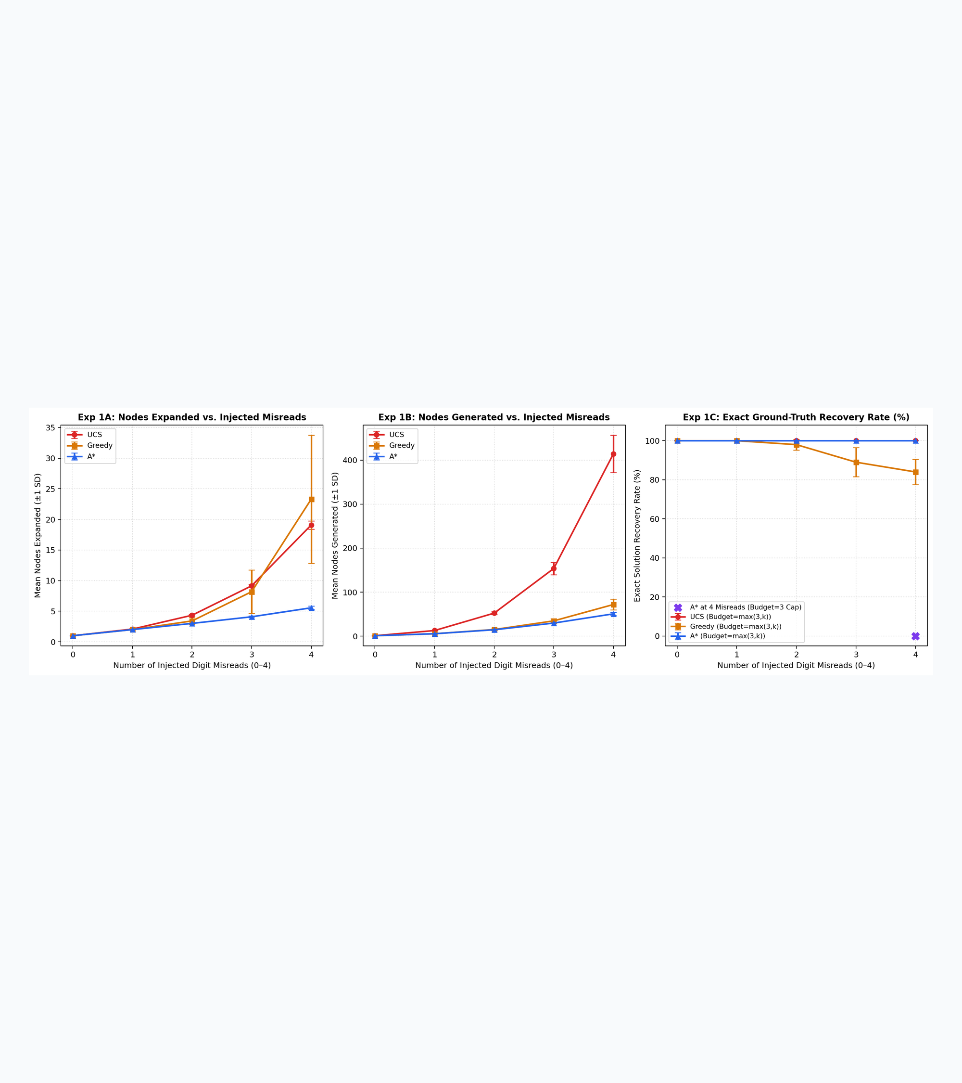
6. EXPERIMENT 1: SEARCH COMPARISON
A* Cuts Node Expansions by 70.9%
5 Seeds x 20 Grids (100/Level)
100% Exact Recovery: A* and UCS recover 100% of grids across 1 to 4 misreads.
A* Pruning Gain: At 4 misreads, A* expands 5.56 nodes vs 19.09 for UCS.
Greedy Suboptimality: Greedy drops to 84% recovery at 4 misreads (cost 2.54).
Source: results/tables/experiment1_search_summary.csv

Slide 8
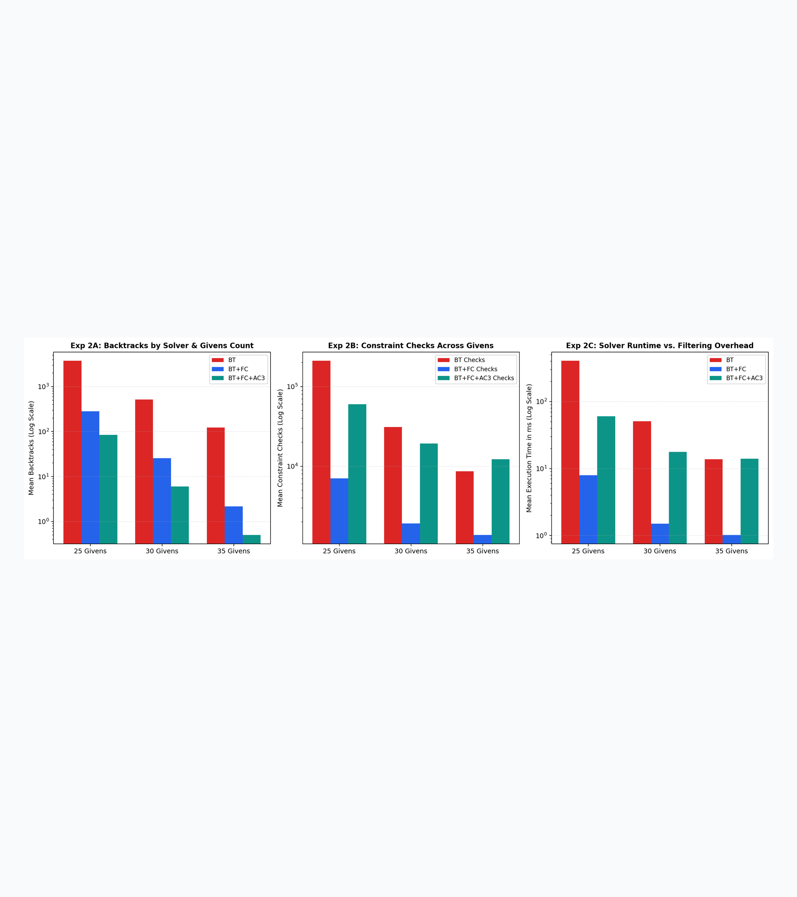
7. EXPERIMENT 2: CSP SOLVER SCALING
FC and AC-3 Crush Exponential Growth
5 Seeds x 10 Grids (25, 30, 35 Clues)
27x Fewer Nodes: At 25 clues, BT+FC+AC3 needs 140.7 steps vs 3,815.9 for BT.
Near-Zero Backtracks: At 35 clues, BT+FC+AC3 averages just 0.3 backtracks/grid.
Propagation Trade-Off: BT+FC is fastest on valid grids; AC-3 rejects bad grids fast.
Source: results/tables/experiment2_csp_summary.csv

Slide 9
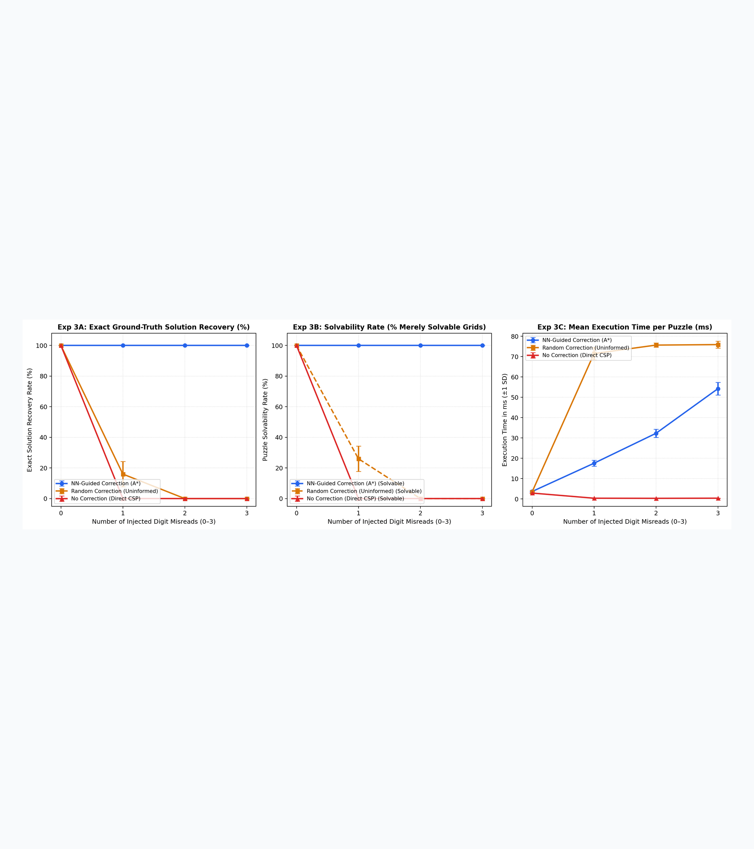
8. EXPERIMENT 3: CORRECTION STRATEGIES
Random Repair Yields 10% False Grids
Why NN Probabilities Matter
No Correction Fails: Even 1 misread drops uncorrected solvability from 100% to 0%.
Spurious Repair Trap: At 1 misread, Random solves 26% but recovers truth on 16%.
NN-Guided Precision: Calibrated A* achieves 100% exact recovery across 0-3 errors.
Source: results/tables/experiment3_correction_summary.csv

Slide 10
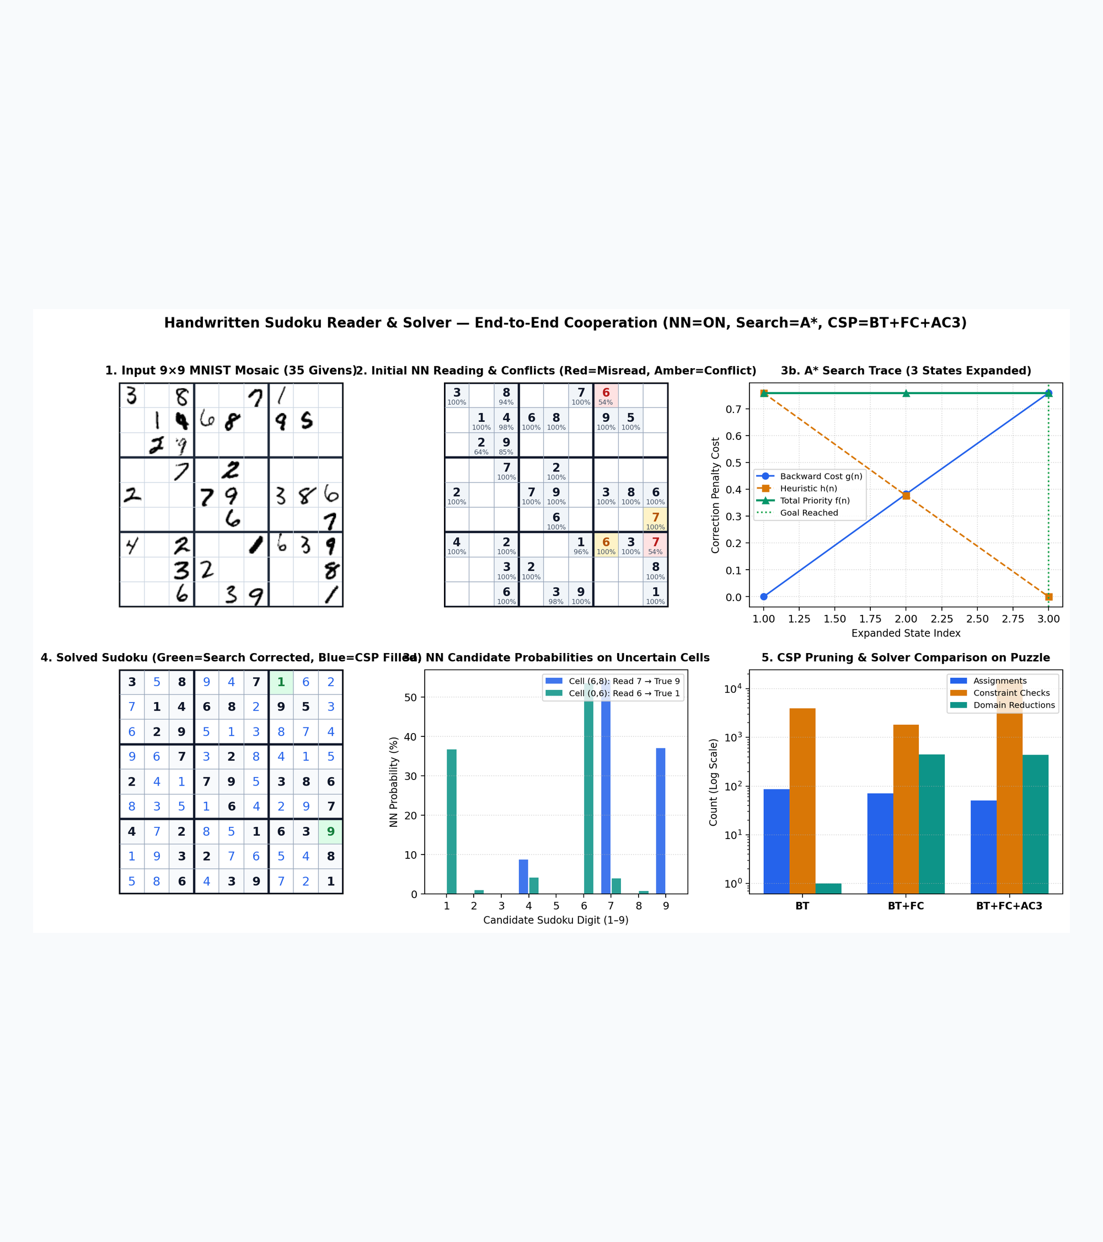
9. FIVE-MINUTE LIVE DEMO WALKTHROUGH
Live Demo: 2 Errors Fixed in 3 Steps
Command: python run_demo.py
Injected Conflicts: Cell (0,0) 7->1 (p=0.52) and Cell (4,4) 5->6 (p=0.50).
A* Search Trace: AC-3 flags conflicts; A* restores both at cost g=0.2725.
Mode & Failure Tests: Compares BT/FC/AC3, NN-off baseline, and 4-error Unreadable.
Right: 4-panel figure generated by python run_demo.py

Slide 11
10. LIMITATIONS & FUTURE WORK
Boundary Conditions, Auditability, and Extensions
Failure Modes
Budget Cap: Errors > budget return Unreadable status.
Top-K Cutoff: Distortions outside top-4 block repair.
Ethical Design
Audit Logging: Logs every altered cell, confidence, cost.
Writer Fairness: Regional strokes need diverse training data.
Future Work
Camera Warp: Homography unwarping for mobile photos.
Dynamic AC-3: Reuse AC-3 domains across search states.
24/24 unit and integration tests passing in 3.62s (pytest)

Slide 12
HANDWRITTEN SUDOKU READER AND SOLVER
Calibrated Perception and Symbolic Search Solve Imperfect Inputs.
Thank You | Questions & Live Demonstration

