Slide 1
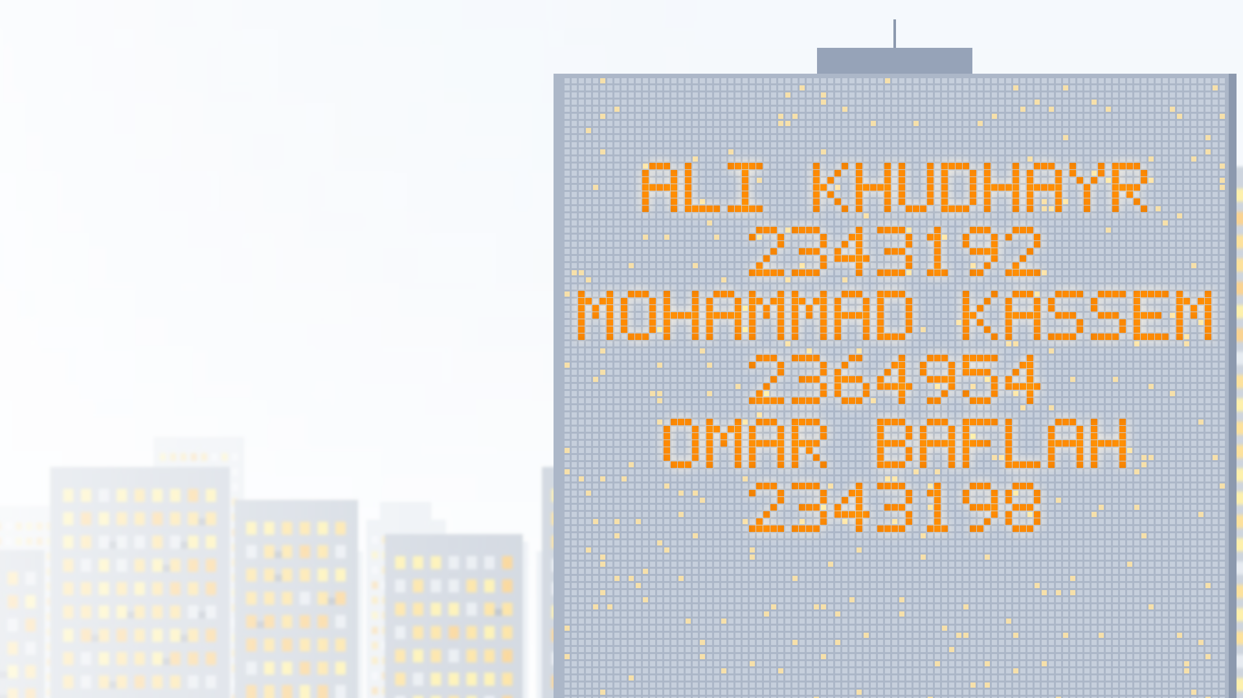

EE499 SENIOR DESIGN PROJECT
Report 1 — Problem & Design Requirements
Smart Home
Energy Management
with Priority-Based Load Control
TEAM 16 · PME
ADVISOR & CUSTOMER
Dr. Fahd Hariri
Electrical and Computer Engineering
King Abdulaziz University · Fall 2026
Notes:
⏱ 0:30
Opening slide: the tower spells our names and university IDs while we introduce the project — Smart Home Energy Management with Priority-Based Load Control, Report 1, advisor Dr. Fahd Hariri.

Slide 2




AGENDA
What we will cover
01
02
03
04
Introduction
Problem Statement
Objectives
Design Requirements
EE499 · Team 16 · Smart Home Energy Management
2
Notes:
⏱ 0:10
Four parts: introduction, problem statement, objectives, design requirements.

Slide 3

01
Introduction
Why household energy needs managing
01
02
03
04
Notes:
⏱ 0:05
Why household energy needs managing.

Slide 4



01 · INTRODUCTION
Where household electricity goes
47 %
≈ 70 %
+67 %
of Saudi electricity → homes
of home electricity → air-conditioning
per extra kWh above 6,000 kWh / month
Residential share of national consumption
Highest share worldwide
18 → 30 halalas / kWh
EE499 · Team 16 · Smart Home Energy Management
4
Notes:
⏱ 0:35
Homes take 47 % of Saudi electricity; about 70 % of home electricity goes to air-conditioning; above 6,000 kWh/month every extra kWh costs 67 % more (18 → 30 halalas).

Slide 5



01 · INTRODUCTION
What the single total hides
14 %
5–15 %
≈ 53
median electricity saved
extra AC energy from a dirty filter
house fires / day in KSA
with real-time, per-appliance feedback
Hidden in the total — visible per appliance
#1 cause: electrical incidents
14 %: ACEEE meta-review, 57 studies (2010) — an indication, not a promise. · 5–15 %: U.S. DOE, Energy Saver, “Maintaining your air conditioner”.
53 / day: 193,437 house fires in 10 years (Civil Defense via Arab News, 2015) ÷ 3,650 days.
EE499 · Team 16 · Smart Home Energy Management
5
Notes:
⏱ 0:35
Per-appliance feedback saved a median 14 % (ACEEE, 57 studies). A dirty AC filter wastes 5–15 % and stays hidden in the total. About 53 house fires a day in KSA, mostly electrical.

Slide 6






01 · INTRODUCTION
One meter. One number.
Not a luxury. A need.
?
?
TOTAL
Cost
kWh
Which appliance? → see the bill, stay in budget
Air conditioner
Water heater
Continuity
?
?
Which can wait? → essentials stay ON
Safety
Refrigerator
Washing machine
Which misbehaves? → warn early, fail safe
EE499 · Team 16 · Smart Home Energy Management
6
Notes:
⏱ 0:30
A conventional meter gives one number. Three questions it cannot answer — which appliance, which can wait, which misbehaves — map to cost, continuity and safety. Not a luxury: a need.

Slide 7





01 · INTRODUCTION
From one total to per-appliance visibility
Conventional meter
Per-appliance monitoring
Air conditioner
Refrigerator
Water heater
Washing machine
MEASURED FOR EACH APPLIANCE
Whole-house total only
– Voltage (V) and current (I)
– Power (P) and energy (kWh)
– ON / OFF status
EE499 · Team 16 · Smart Home Energy Management
7
Notes:
⏱ 0:25
Our system measures each appliance separately: voltage, current, power, energy and ON/OFF status.

Slide 8

01 · INTRODUCTION
Priority-based load management
1
User sets priorities
2
Demand > limit → shed lowest
3
Essentials stay ON
Demand-side management concept. Reproduced from [4].
EE499 · Team 16 · Smart Home Energy Management
8
Notes:
⏱ 0:30
User sets priorities; when demand exceeds the limit the lowest-priority load is shed; essentials stay on.

Slide 9




01 · INTRODUCTION
Abnormal operation — a supporting function
EVIDENCE
Deviation from baseline
Whole-house estimate
User warning
less reliable
Supports — not replaces — control
Direct sub-metering
more reliable
Anomaly detection on appliance data — Rashid et al., Applied Energy, 2019.
EE499 · Team 16 · Smart Home Energy Management
9
Notes:
⏱ 0:25
Abnormal operation is a supporting function: deviation from the appliance’s own baseline triggers a warning. Direct sub-metering is more reliable than whole-house estimates.

Slide 10

02
Problem Statement
The engineering need
01
02
03
04
Notes:
⏱ 0:05
Problem statement.

Slide 11




02 · PROBLEM STATEMENT
What households face today
No per-appliance visibility
Heavy loads overlap
Costs rise unnoticed
Essentials not prioritised
Abnormal behaviour hidden
EE499 · Team 16 · Smart Home Energy Management
11
Notes:
⏱ 0:25
Five problems households face today.

Slide 12




02 · PROBLEM STATEMENT — RESIDENTIAL ENERGY MANAGEMENT WITH
The need
Appliance-level monitoring
Priority-based load control
Consumption & cost management
Essential loads kept supplied
EE499 · Team 16 · Smart Home Energy Management
12
Notes:
⏱ 0:20
The need: residential energy management with monitoring, priority control, cost management and supplied essentials.

Slide 13
Notes:
⏱ 0:25
Two core problems: limited visibility of energy and cost, and no priority-based load control.

Slide 14

03
Objectives
Higher-level goals · lower-level behaviours
01
02
03
04
Notes:
⏱ 0:05
Objectives.

Slide 15
03 · OBJECTIVES
Higher-level objectives
HLO-1
HLO-2
HLO-3
Economic
Reliability
Safety & efficiency
Lower consumption
Lower cost
Essentials stay
supplied
Safer operation
Efficient use
EE499 · Team 16 · Smart Home Energy Management
15
Notes:
⏱ 0:25
Three higher-level objectives: economic, reliability, safety and efficiency.

Slide 16






03 · OBJECTIVES
Lower-level objectives
LLO-1
LLO-2
LLO-3
Monitor
Detect
Prioritise
Each load + total
Abnormal → warn
Shed lowest above limit
LLO-4
LLO-5
LLO-6
Budget
Inform
Stay safe
Energy & cost vs. budget
Status · cost · warnings
Fail-safe · override
EE499 · Team 16 · Smart Home Energy Management
16
Notes:
⏱ 0:30
Six lower-level objectives: monitor, detect, prioritise, budget, inform, stay safe.

Slide 17

04
Design Requirements
Specs · constraints · standards · assumptions · deliverables
01
02
03
04
Notes:
⏱ 0:05
Design requirements.

Slide 18
04 · DESIGN REQUIREMENTS
Design specifications (1/2)
DS-01
Accuracy
DS-02
Update rate
±5 %
V · I · P · energy
≤ 3 s
Readings + status
→ LLO-1
→ LLO-1 · 5
DS-03
Abnormal detection
DS-04
Load control
≥ 90 %
120 / 80 % · 5 s
≤ 1 s
≥ 4 channels · ≥ 3 levels
→ LLO-2
→ LLO-3
EE499 · Team 16 · Smart Home Energy Management
18
Notes:
⏱ 0:30
DS-01 to DS-04: ±5 % accuracy, ≤ 3 s updates, ≥ 90 % abnormal detection, ≤ 1 s load control.

Slide 19
04 · DESIGN REQUIREMENTS
Design specifications (2/2)
DS-05
Reconnection
DS-06
Cost & budget
5 s
Stable margin · highest first
±5 %
Alerts 50 · 80 · 100 %
→ LLO-3 · 6
→ LLO-4
DS-07
User warnings
DS-08
Fail-safe
≤ 5 s
7-day log · 1 h
≤ 2 s
De-energize · override
→ LLO-2 · 5
→ LLO-6
EE499 · Team 16 · Smart Home Energy Management
19
Notes:
⏱ 0:30
DS-05 to DS-08: reconnection, cost and budget alerts, user warnings, ≤ 2 s fail-safe.

Slide 20

REQUIRED BEHAVIOUR · DS-03 / DS-07
Abnormal-operation warning
120 / 80 %
of baseline
≥ 5 s
persistence
≥ 90 %
detection rate
≤ 5 s
to warn
Notes:
⏱ 0:25
The warning behaviour: outside 120 / 80 % of baseline for ≥ 5 s → warn within 5 s.

Slide 21
04 · DESIGN REQUIREMENTS
Realistic constraints
C-01 · BUDGET
C-02 · SCOPE
C-03 · LAB POWER
≤ 1,000 SAR
Single-phase
≤ 2 kW
C-04 · SCHEDULE
C-05 · APPLIANCES
C-06 · SAFETY
Before the deadline
No modification
Supervised lab
EE499 · Team 16 · Smart Home Energy Management
21
Notes:
⏱ 0:20
Constraints C-01 to C-06: budget, single-phase scope, lab power, schedule, no appliance modification, supervised lab.

Slide 22




04 · DESIGN REQUIREMENTS
Engineering standards
IEC 60730-1:2022
IEC 62053-21:2020
Automatic controls
Energy-metering accuracy
IEC
IEC
SBC 401 (2024)
Gulf Technical Regulation
Wiring & protection
Low-voltage equipment
SBC
GSO
Engineering and safety guidance — certification out of scope.
EE499 · Team 16 · Smart Home Energy Management
22
Notes:
⏱ 0:20
Standards we follow for guidance: IEC 60730-1, IEC 62053-21, SBC 401, GSO low-voltage regulation.

Slide 23




04 · DESIGN REQUIREMENTS
Realistic assumptions
Normal operation at baseline
Test loads available
Lab + calibrated instruments
Protected, grounded supply
Up-to-date tariff
Correct user inputs
EE499 · Team 16 · Smart Home Energy Management
23
Notes:
⏱ 0:20
Assumptions behind the design.

Slide 24

04 · DESIGN REQUIREMENTS
Project deliverables
D-1
D-2
D-3
D-4
D-5
Prototype
Test bench
Firmware & UI
Validation results
Documentation
EE499 · Team 16 · Smart Home Energy Management
24
Notes:
⏱ 0:20
Five deliverables: prototype, test bench, firmware and UI, validation results, documentation.

Slide 25


EE499 · TEAM 16
Thank you — questions?
Visibility. Priority. Safety. A need — not a luxury.
PRIORITY CONTROL IN ACTION · DS-04 / DS-05
Team 16 · Ali Khudhayr · Mohammad Kassem · Omar Baflah
Notes:
⏱ 0:15
Close. The summary and the priority-control demo loop on their own during questions.

Slide 26
SOURCES
References
[1] M. Aldubyan, “Future of residential electricity demand in Saudi Arabia and the role of energy efficiency in 2060’s net zero pledge,” Development and Sustainability in Economics and Finance, vol. 8, p. 100086, Dec. 2025.
[2] N. Howarth et al., “Staying cool in a warming climate: Temperature, electricity and air conditioning in Saudi Arabia,” Climate, vol. 8, no. 1, p. 4, Jan. 2020.
[3] Saudi Electricity Regulatory Authority (SERA), “Consumption tariff.” [Online]. Available: sera.gov.sa. Accessed 29 Sep. 2026.
[4] S. Panda et al., “Priority-based scheduling in residential energy management systems integrated with renewable sources using adaptive Salp swarm algorithm,” Results in Engineering, vol. 23, p. 102643, Sep. 2024.
[5] H. Rashid, P. Singh, V. Stankovic and L. Stankovic, “Can non-intrusive load monitoring be used for identifying an appliance’s anomalous behaviour?,” Applied Energy, vol. 238, pp. 796–805, Mar. 2019.

