Slide 1


EE499 SENIOR DESIGN PROJECT
Report 1 — Problem & Design Requirements
Smart Home Energy Management
with Priority-Based Load Control
ADVISOR & CUSTOMER
TEAM 16
Ali Khudhayr 2343192 · PME
Mohammad Kassem 2364954 · PME
Omar Baflah 2343198 · PME
Dr. Fahd Hariri
Electrical and Computer Engineering
King Abdulaziz University · Fall 2026

Slide 2




AGENDA
What we will cover
01
02
03
04
Introduction
Problem Statement
Objectives
Design Requirements
EE499 · Team 16 · Smart Home Energy Management
1

Slide 3

01
Introduction
Why household energy needs managing
01
02
03
04

Slide 4

EE499 · TEAM 16
of Saudi electricity → homes
Residential share of national consumption

Slide 5


INSIDE THE HOME
HOUSEHOLD ELECTRICITY
من سلايد 4 الى 9 ادمج في سلايدين
about
≈30 %
other uses
≈70 %
air-conditioning
of home electricity
→ air-conditioning
Highest share worldwide

Slide 6

THE TARIFF
30
Above 6,000 kWh / month
18
per extra kWh
18 → 30 halalas / kWh
≤ 6,000 kWh
> 6,000 kWh

Slide 7




THE COST OF NOT SEEING
median
WHAT WORKED
Real-time
Per appliance
electricity saved
Energy + cost
with real-time, per-appliance feedback
ACEEE meta-review, 57 studies (2010) · many small and short — an indication, not a promise.

Slide 8



شوف حريري
هل نقدر نحط معلومة جديدة ما استخدمنا رفرنسها
HIDDEN WASTE
a dirty AC filter costs
WHERE IT SHOWS
5–15 %
Total: hidden
Per appliance: visible
extra AC energy
vs. its own baseline
Neglect → energy use steadily rises
U.S. Department of Energy, Energy Saver: “Maintaining your air conditioner”.

Slide 9




SAFETY AT HOME
about
2018 · HOUSE FIRES
90 deaths
1,364 injuries
house fires / day in KSA
Fire detection: out of scope (C-03)
#1 cause: electrical incidents
193,437 house fires in 10 years (Civil Defense via Arab News, 2015) ÷ 3,650 days ≈ 53 per day.

Slide 10






One meter. One number.
?
?
TOTAL
kWh
Air conditioner
Water heater
?
?
ادمج 10و 11
واختصر
Refrigerator
Washing machine
Which appliance?
Which can wait?
Which misbehaves?

Slide 11


Not a luxury. A need.
Cost
Continuity
Safety
See the bill
Stay in budget
Essentials stay ON
when demand is limited
Warn early
Fail safe

Slide 12





01 · INTRODUCTION
From one total to per-appliance visibility
Conventional meter
Per-appliance monitoring
وضح واعد الصياغة
حط شرطات
اختصر
لا تكرر ال v I p kwh on off
Air conditioner
V · I · P · kWh · ON/OFF
Refrigerator
V · I · P · kWh · ON/OFF
Total only
Water heater
V · I · P · kWh · ON/OFF
Washing machine
V · I · P · kWh · ON/OFF
EE499 · Team 16 · Smart Home Energy Management
12

Slide 13

01 · INTRODUCTION
Priority-based load management
1
User sets priorities
2
Demand > limit → shed lowest
3
Essentials stay ON
Demand-side management concept. Reproduced from [4].
EE499 · Team 16 · Smart Home Energy Management
13

Slide 14




01 · INTRODUCTION
Abnormal operation — a supporting function
EVIDENCE
Deviation from baseline
Whole-house estimate
User warning
less reliable
Supports — not replaces — control
Direct sub-metering
more reliable
Anomaly detection on appliance data — Rashid et al., Applied Energy, 2019.
EE499 · Team 16 · Smart Home Energy Management
14

Slide 15

02
Problem Statement
The engineering need
01
02
03
04

Slide 16





02 · PROBLEM STATEMENT
What households face today
No per-appliance visibility
Heavy loads overlap
Costs rise unnoticed
Essentials not prioritised
Abnormal behaviour hidden
EE499 · Team 16 · Smart Home Energy Management
16

Slide 17



02 · PROBLEM STATEMENT — RESIDENTIAL ENERGY MANAGEMENT WITH
The need
Appliance-level monitoring
Priority-based load control
Consumption & cost management
Essential loads kept supplied
EE499 · Team 16 · Smart Home Energy Management
17

Slide 18

03
Objectives
Higher-level goals · lower-level behaviours
01
02
03
04

Slide 19
03 · OBJECTIVES
Higher-level objectives
HLO-1
HLO-2
HLO-3
Economic
Reliability
Safety & efficiency
Lower consumption
Lower cost
Essentials stay
supplied
Safer operation
Efficient use
EE499 · Team 16 · Smart Home Energy Management
19

Slide 20






03 · OBJECTIVES
Lower-level objectives
LLO-1
LLO-2
LLO-3
Monitor
Detect
Prioritise
Each load + total
Abnormal → warn
Shed lowest above limit
LLO-4
LLO-5
LLO-6
Budget
Inform
Stay safe
Energy & cost vs. budget
Status · cost · warnings
Fail-safe · override
EE499 · Team 16 · Smart Home Energy Management
20

Slide 21

04
Design Requirements
Specs · constraints · standards · assumptions · deliverables
01
02
03
04

Slide 22
04 · DESIGN REQUIREMENTS
Design specifications (1/2)
DS-01
Accuracy
DS-02
Update rate
±5 %
V · I · P · energy
≤ 3 s
Readings + status
→ LLO-1
→ LLO-1 · 5
DS-03
Abnormal detection
DS-04
Load control
≥ 90 %
120 / 80 % · 5 s
≤ 1 s
≥ 4 channels · ≥ 3 levels
→ LLO-2
→ LLO-3
EE499 · Team 16 · Smart Home Energy Management
25

Slide 23
04 · DESIGN REQUIREMENTS
Design specifications (2/2)
DS-05
Reconnection
DS-06
Cost & budget
5 s
Stable margin · highest first
±5 %
Alerts 50 · 80 · 100 %
→ LLO-3 · 6
→ LLO-4
DS-07
User warnings
DS-08
Fail-safe
≤ 5 s
7-day log · 1 h
≤ 2 s
De-energize · override
→ LLO-2 · 5
→ LLO-6
EE499 · Team 16 · Smart Home Energy Management
26

Slide 24
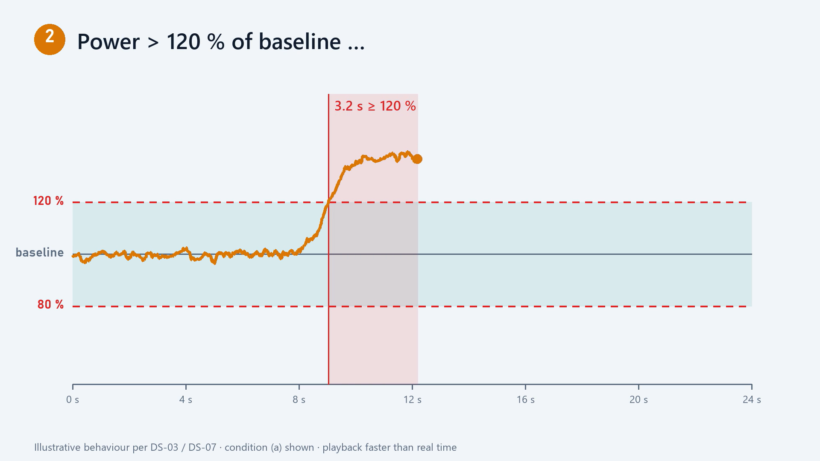
REQUIRED BEHAVIOUR · DS-03 / DS-07
Abnormal-operation warning
120 / 80 %
of baseline
≥ 5 s
persistence
≥ 90 %
detection rate
≤ 5 s
to warn

Slide 25
04 · DESIGN REQUIREMENTS
C2 to c4, c3 to c2
Realistic constraints
C-01 · BUDGET
C-02 · SCHEDULE
C-03 · SCOPE
≤ 1,000 SAR
Before the deadline
Single-phase
C-04 · LAB POWER
C-05 · APPLIANCES
C-06 · SAFETY
≤ 2 kW
No modification
Supervised lab
EE499 · Team 16 · Smart Home Energy Management
27

Slide 26
04 · DESIGN REQUIREMENTS
Engineering standards
Add icons for every standard
IEC 60730-1:2022
IEC 62053-21:2020
IEC
IEC
Automatic controls
Energy-metering accuracy
SBC 401 (2024)
Gulf Technical Regulation
SBC
GSO
Wiring & protection
Low-voltage equipment
Engineering and safety guidance — certification out of scope.
EE499 · Team 16 · Smart Home Energy Management
28

Slide 27




04 · DESIGN REQUIREMENTS
Realistic assumptions
Normal operation at baseline
Test loads available
Lab + calibrated instruments
Protected, grounded supply
Up-to-date tariff
Correct user inputs
EE499 · Team 16 · Smart Home Energy Management
29

Slide 28

04 · DESIGN REQUIREMENTS
Project deliverables
D-1
D-2
D-3
D-4
D-5
Prototype
Test bench
Firmware & UI
Validation results
Documentation
EE499 · Team 16 · Smart Home Energy Management
30

Slide 29

Visibility. Priority. Safety.
A need — not a luxury.
Thank you — questions?
Team 16 · Ali Khudhayr · Mohammad Kassem · Omar Baflah

Slide 30

REQUIRED BEHAVIOUR · DS-04 / DS-05
Priority control in action
≤ 1 s
Thank you — questions?
shedding starts
≥ 4 · ≥ 3
channels · priorities
5 s
stable margin
3 s
motor restarts

