Slide 1
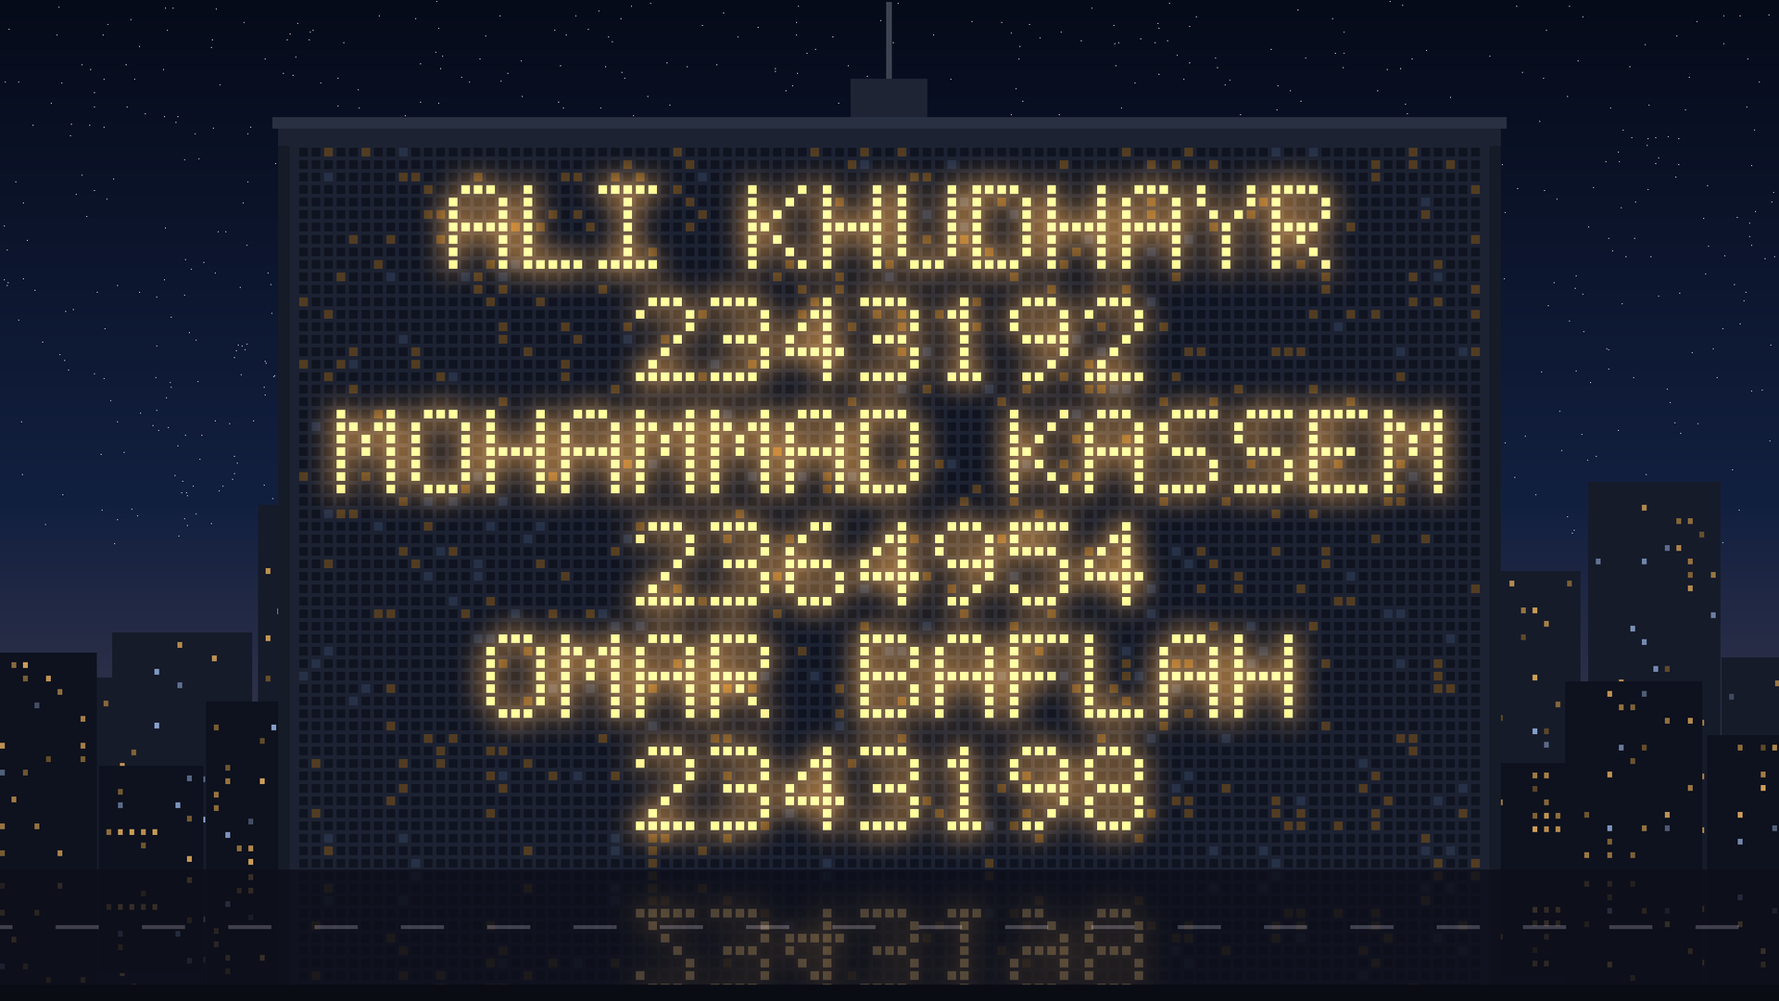
Notes:
⏱ 0:15
Let the opening video play — the tower spells our names and IDs. Advance once it stops.

Slide 2


EE499 SENIOR DESIGN PROJECT
Report 1 — Problem & Design Requirements
Smart Home Energy Management
with Priority-Based Load Control
ADVISOR & CUSTOMER
TEAM 16
Ali Khudhayr 2343192 · PME
Mohammad Kassem 2364954 · PME
Omar Baflah 2343198 · PME
Dr. Fahd Hariri
Electrical and Computer Engineering
King Abdulaziz University · Fall 2026
Notes:
⏱ 0:20
Project title, team, advisor. Report 1 covers the problem and the design requirements.

Slide 3




AGENDA
What we will cover
01
02
03
04
Introduction
Problem Statement
Objectives
Design Requirements
EE499 · Team 16 · Smart Home Energy Management
3
Notes:
⏱ 0:10
Four parts: introduction, problem statement, objectives, design requirements.

Slide 4

01
Introduction
Why household energy needs managing
01
02
03
04
Notes:
⏱ 0:05
Why household energy needs managing.

Slide 5



01 · INTRODUCTION
Where household electricity goes
47 %
≈ 70 %
+67 %
of Saudi electricity → homes
of home electricity → air-conditioning
per extra kWh above 6,000 kWh / month
Residential share of national consumption
Highest share worldwide
18 → 30 halalas / kWh
EE499 · Team 16 · Smart Home Energy Management
5
Notes:
⏱ 0:35
Homes take 47 % of Saudi electricity; about 70 % of home electricity goes to air-conditioning; above 6,000 kWh/month every extra kWh costs 67 % more (18 → 30 halalas).

Slide 6



01 · INTRODUCTION
What the single total hides
14 %
5–15 %
≈ 53
median electricity saved
extra AC energy from a dirty filter
house fires / day in KSA
with real-time, per-appliance feedback
Hidden in the total — visible per appliance
#1 cause: electrical incidents
14 %: ACEEE meta-review, 57 studies (2010) — an indication, not a promise. · 5–15 %: U.S. DOE, Energy Saver, “Maintaining your air conditioner”.
53 / day: 193,437 house fires in 10 years (Civil Defense via Arab News, 2015) ÷ 3,650 days.
EE499 · Team 16 · Smart Home Energy Management
6
Notes:
⏱ 0:35
Per-appliance feedback saved a median 14 % (ACEEE, 57 studies). A dirty AC filter wastes 5–15 % and stays hidden in the total. About 53 house fires a day in KSA, mostly electrical.

Slide 7








01 · INTRODUCTION
One meter. One number.
Not a luxury. A need.
?
?
TOTAL
Cost
kWh
Which appliance? → see the bill, stay in budget
Air conditioner
Water heater
Continuity
?
?
Which can wait? → essentials stay ON
Safety
Refrigerator
Washing machine
Which misbehaves? → warn early, fail safe
EE499 · Team 16 · Smart Home Energy Management
7
Notes:
⏱ 0:30
A conventional meter gives one number. Three questions it cannot answer — which appliance, which can wait, which misbehaves — map to cost, continuity and safety. Not a luxury: a need.

Slide 8





01 · INTRODUCTION
From one total to per-appliance visibility
Conventional meter
Per-appliance monitoring
Air conditioner
Refrigerator
Water heater
Washing machine
MEASURED FOR EACH APPLIANCE
Whole-house total only
– Voltage (V) and current (I)
– Power (P) and energy (kWh)
– ON / OFF status
EE499 · Team 16 · Smart Home Energy Management
8
Notes:
⏱ 0:25
Our system measures each appliance separately: voltage, current, power, energy and ON/OFF status.

Slide 9

01 · INTRODUCTION
Priority-based load management
1
User sets priorities
2
Demand > limit → shed lowest
3
Essentials stay ON
Demand-side management concept. Reproduced from [4].
EE499 · Team 16 · Smart Home Energy Management
9
Notes:
⏱ 0:30
User sets priorities; when demand exceeds the limit the lowest-priority load is shed; essentials stay on.

Slide 10




01 · INTRODUCTION
Abnormal operation — a supporting function
EVIDENCE
Deviation from baseline
Whole-house estimate
User warning
less reliable
Supports — not replaces — control
Direct sub-metering
more reliable
Anomaly detection on appliance data — Rashid et al., Applied Energy, 2019.
EE499 · Team 16 · Smart Home Energy Management
10
Notes:
⏱ 0:25
Abnormal operation is a supporting function: deviation from the appliance’s own baseline triggers a warning. Direct sub-metering is more reliable than whole-house estimates.

Slide 11

02
Problem Statement
The engineering need
01
02
03
04
Notes:
⏱ 0:05
Problem statement.

Slide 12




02 · PROBLEM STATEMENT
What households face today
No per-appliance visibility
Heavy loads overlap
Costs rise unnoticed
Essentials not prioritised
Abnormal behaviour hidden
EE499 · Team 16 · Smart Home Energy Management
12
Notes:
⏱ 0:25
Five problems households face today.

Slide 13



02 · PROBLEM STATEMENT — RESIDENTIAL ENERGY MANAGEMENT WITH
The need
Appliance-level monitoring
Priority-based load control
Consumption & cost management
Essential loads kept supplied
EE499 · Team 16 · Smart Home Energy Management
13
Notes:
⏱ 0:20
The need: residential energy management with monitoring, priority control, cost management and supplied essentials.

Slide 14

03
Objectives
Higher-level goals · lower-level behaviours
01
02
03
04
Notes:
⏱ 0:05
Objectives.

Slide 15
03 · OBJECTIVES
Higher-level objectives
HLO-1
HLO-2
HLO-3
Economic
Reliability
Safety & efficiency
Lower consumption
Lower cost
Essentials stay
supplied
Safer operation
Efficient use
EE499 · Team 16 · Smart Home Energy Management
15
Notes:
⏱ 0:25
Three higher-level objectives: economic, reliability, safety and efficiency.

Slide 16






03 · OBJECTIVES
Lower-level objectives
LLO-1
LLO-2
LLO-3
Monitor
Detect
Prioritise
Each load + total
Abnormal → warn
Shed lowest above limit
LLO-4
LLO-5
LLO-6
Budget
Inform
Stay safe
Energy & cost vs. budget
Status · cost · warnings
Fail-safe · override
EE499 · Team 16 · Smart Home Energy Management
16
Notes:
⏱ 0:30
Six lower-level objectives: monitor, detect, prioritise, budget, inform, stay safe.

Slide 17

04
Design Requirements
Specs · constraints · standards · assumptions · deliverables
01
02
03
04
Notes:
⏱ 0:05
Design requirements.

Slide 18
04 · DESIGN REQUIREMENTS
Design specifications (1/2)
DS-01
Accuracy
DS-02
Update rate
±5 %
V · I · P · energy
≤ 3 s
Readings + status
→ LLO-1
→ LLO-1 · 5
DS-03
Abnormal detection
DS-04
Load control
≥ 90 %
120 / 80 % · 5 s
≤ 1 s
≥ 4 channels · ≥ 3 levels
→ LLO-2
→ LLO-3
EE499 · Team 16 · Smart Home Energy Management
18
Notes:
⏱ 0:30
DS-01 to DS-04: ±5 % accuracy, ≤ 3 s updates, ≥ 90 % abnormal detection, ≤ 1 s load control.

Slide 19
04 · DESIGN REQUIREMENTS
Design specifications (2/2)
DS-05
Reconnection
DS-06
Cost & budget
5 s
Stable margin · highest first
±5 %
Alerts 50 · 80 · 100 %
→ LLO-3 · 6
→ LLO-4
DS-07
User warnings
DS-08
Fail-safe
≤ 5 s
7-day log · 1 h
≤ 2 s
De-energize · override
→ LLO-2 · 5
→ LLO-6
EE499 · Team 16 · Smart Home Energy Management
19
Notes:
⏱ 0:30
DS-05 to DS-08: reconnection, cost and budget alerts, user warnings, ≤ 2 s fail-safe.

Slide 20
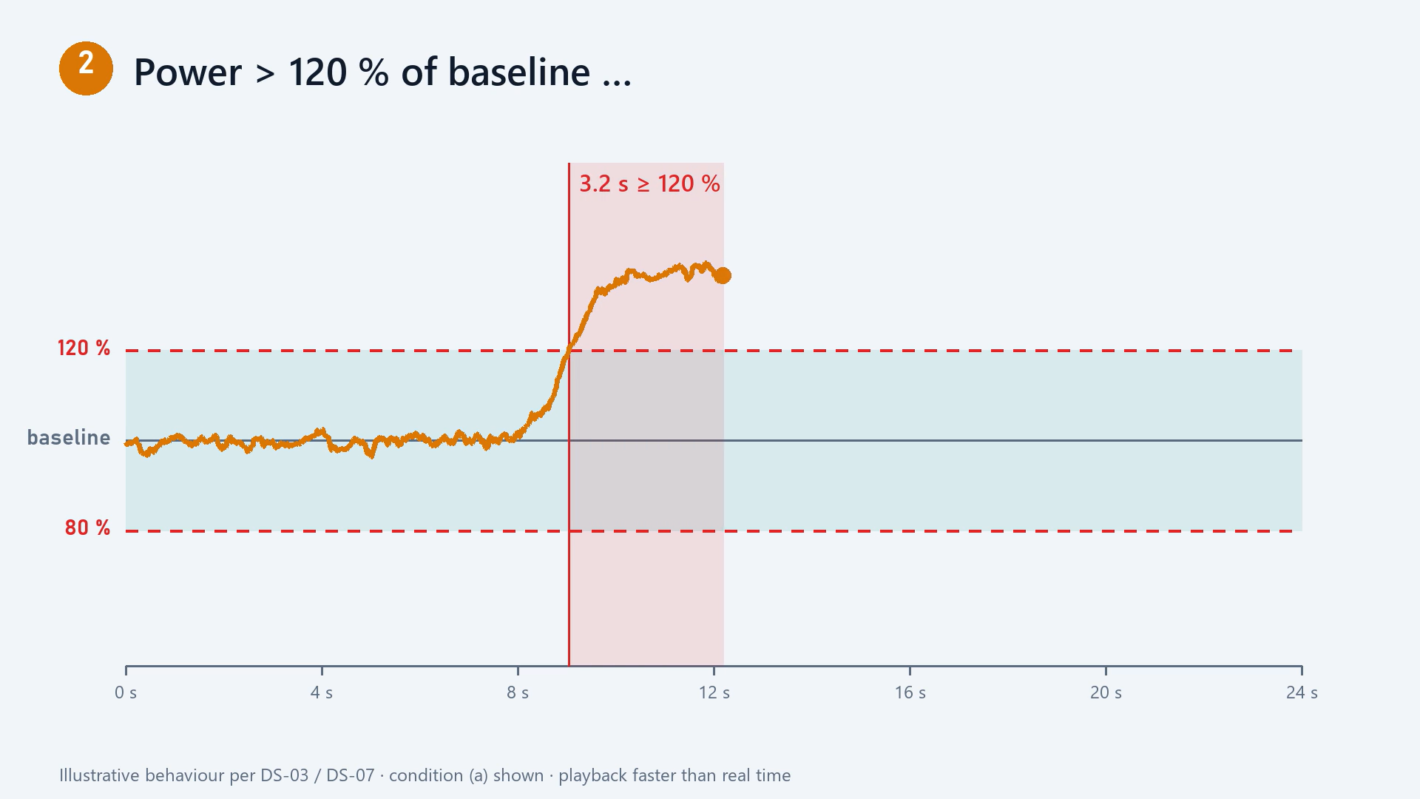
REQUIRED BEHAVIOUR · DS-03 / DS-07
Abnormal-operation warning
120 / 80 %
of baseline
≥ 5 s
persistence
≥ 90 %
detection rate
≤ 5 s
to warn
Notes:
⏱ 0:25
The warning behaviour: outside 120 / 80 % of baseline for ≥ 5 s → warn within 5 s.

Slide 21
04 · DESIGN REQUIREMENTS
Realistic constraints
C-01 · BUDGET
C-02 · SCOPE
C-03 · LAB POWER
≤ 1,000 SAR
Single-phase
≤ 2 kW
C-04 · SCHEDULE
C-05 · APPLIANCES
C-06 · SAFETY
Before the deadline
No modification
Supervised lab
EE499 · Team 16 · Smart Home Energy Management
21
Notes:
⏱ 0:20
Constraints C-01 to C-06: budget, single-phase scope, lab power, schedule, no appliance modification, supervised lab.

Slide 22




04 · DESIGN REQUIREMENTS
Engineering standards
IEC 60730-1:2022
IEC 62053-21:2020
Automatic controls
Energy-metering accuracy
IEC
IEC
SBC 401 (2024)
Gulf Technical Regulation
Wiring & protection
Low-voltage equipment
SBC
GSO
Engineering and safety guidance — certification out of scope.
EE499 · Team 16 · Smart Home Energy Management
22
Notes:
⏱ 0:20
Standards we follow for guidance: IEC 60730-1, IEC 62053-21, SBC 401, GSO low-voltage regulation.

Slide 23




04 · DESIGN REQUIREMENTS
Realistic assumptions
Normal operation at baseline
Test loads available
Lab + calibrated instruments
Protected, grounded supply
Up-to-date tariff
Correct user inputs
EE499 · Team 16 · Smart Home Energy Management
23
Notes:
⏱ 0:20
Assumptions behind the design.

Slide 24

04 · DESIGN REQUIREMENTS
Project deliverables
D-1
D-2
D-3
D-4
D-5
Prototype
Test bench
Firmware & UI
Validation results
Documentation
EE499 · Team 16 · Smart Home Energy Management
24
Notes:
⏱ 0:20
Five deliverables: prototype, test bench, firmware and UI, validation results, documentation.

Slide 25

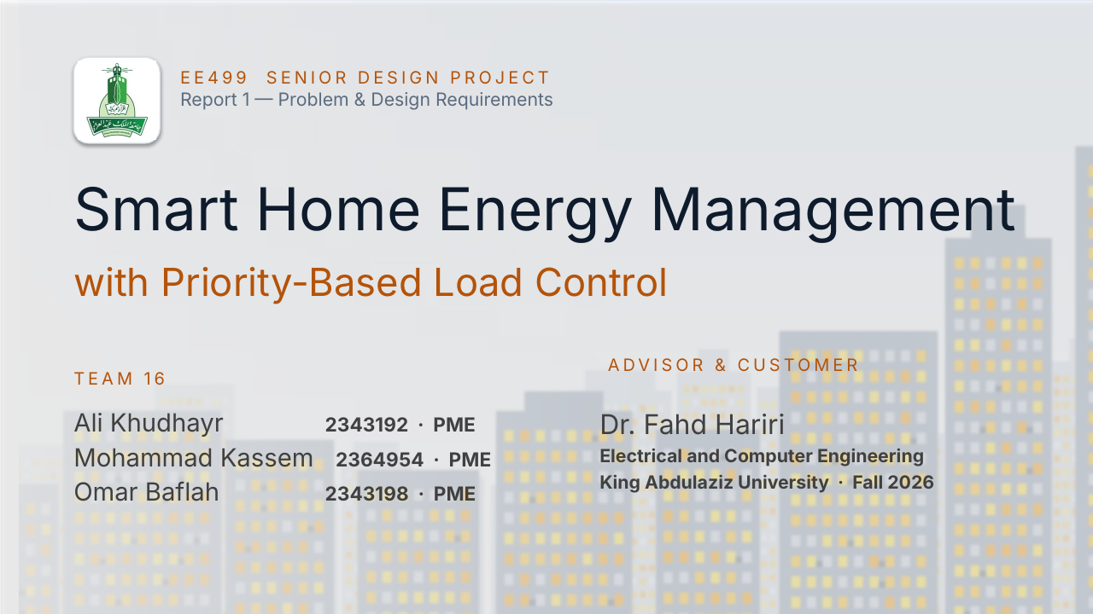

EE499 · TEAM 16
Thank you — questions?
Visibility. Priority. Safety. A need — not a luxury.
Team 16 · Ali Khudhayr · Mohammad Kassem · Omar Baflah
IN SUMMARY
PRIORITY CONTROL IN ACTION · DS-04 / DS-05
Notes:
⏱ 0:15
Close. The summary and the priority-control demo loop on their own during questions.

