Slide 1
AYA
Recover software.
Improve the agents that build it.
Crusoe · Hermes · OpenShell · REA · MASS
Notes:
AYA has two peer workflows: reverse engineering and agent improvement. The measured example ports Fireworks SQL tool behavior to Crusoe, then runs Sakana MASS RHI and a separate verified-answer SFT integration test. Sources: https://github.com/Ali-Maq/aya and https://github.com/Ali-Maq/mass/pull/1

Slide 2
A feature request becomes a reviewable change
YOUR REPOSITORY + A REFERENCE
Recover the behavior
Investigate what it does, including edge cases.
Define what must work in your product.
Inspect → build → test → review
Hermes + REA · OpenShell execution · Crusoe models · GitHub delivery
Notes:
Product workflow. A user supplies a target repository, reference software and a precise behavior contract. Hermes investigates the reference with REA, implements the bounded component inside OpenShell and returns an accepted GitHub change. The working example ports selected Fireworks SQL-tool behavior to Crusoe; this is source/runtime analysis, not binary decompilation. Measured results and limitations are preserved in the evidence appendix.

Slide 3
Target outcome: useful software with evidence
01
A feature that passes independent tests
02
The least expensive workflow that meets the bar
03
The full cost of each experiment is visible
04
A limited rollout checks whether people want it
TARGET · These are product goals, not claimed measured results.
Notes:
These are target outcomes, not measured economic or recursive-improvement results. Independent acceptance tests define useful behavior. A cost-aware selection policy should select the least expensive passing workflow using provider prices when available, while reporting total experiment cost. The current prototype records calls, tokens and latency rather than complete dollar cost. Controlled rollout, adoption and willingness-to-pay measurement are future extensions. Actual experiment results are in the appendix.

Slide 4
Improve the process, then test the next version
Search a workflow → measure quality + effort
Keep verified examples → train a student
Evaluate the next version → repeat
Keep the simpler approach when extra agent work does not help.
CURRENT GATE · The trained checkpoint needs serving and evaluation.
Notes:
MASS alternates workflow search with training, then repeats with updated weights. AYA ran one actual upstream RHI proposal-and-comparison round, selected verified final answers and completed a Crusoe supervised training job. This is final-answer distillation, not the paper's full trajectory-training recipe. The new checkpoint still requires deployment and independent evaluation; no recursive tuned-model gain was demonstrated. Exact outcomes are in the evidence appendix.

Slide 5
Spend less to learn what customers value
FEATURE LOOP
Recover a feature → test its behavior → ship
LEARNING LOOP
Learn a workflow → measure effort + quality → reuse
Keep specs, tests, traces and decisions when models change.
FUTURE · Roll out gradually → learn what people use and pay for → choose the next feature
Target, not a measured economic result. Token activity is not customer value.
Notes:
Target architecture and future economics, not measured revenue or willingness-to-pay results. Two connected loops recover useful software and improve the process used to build it. Specs, tests, traces, decisions and outcomes are durable organization knowledge, portable across models. A future controlled rollout measures adoption and willingness to pay and feeds the next feature objective. Current evaluation did not establish accuracy improvement; serving and evaluating the trained checkpoint remain required. Actual numbers are preserved in the appendix.

Slide 6
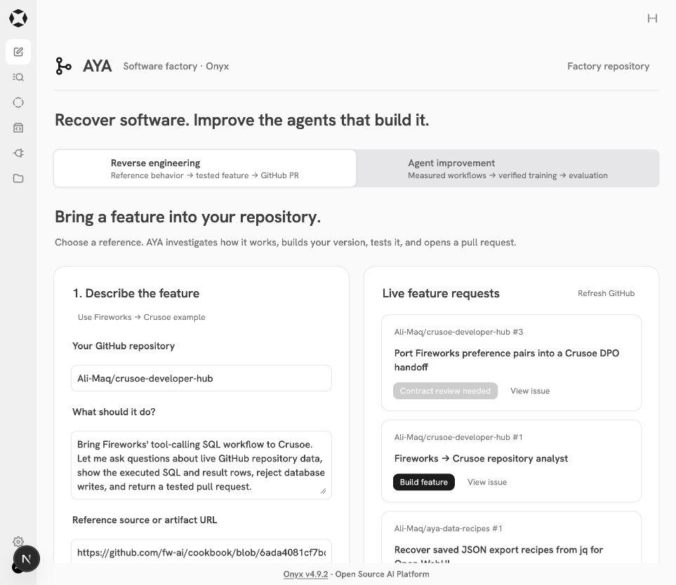
Two workflows, one evidence trail
github.com/Ali-Maq/aya
Notes:
Open the actual app at http://localhost:3021/app/factory. Reverse engineering is the default tab; Agent improvement is http://localhost:3021/app/factory?tab=improve. This screenshot records a real run and is not a new execution. Inspect the exact GitHub PR, native tool activity, Langfuse trace, retained workflow and provider training receipt. Sources: https://github.com/Ali-Maq/aya/pull/1; https://github.com/Ali-Maq/crusoe-developer-hub/pull/2; https://github.com/Ali-Maq/mass/pull/1.

Slide 7
Evidence · Recovered SQL behavior
117 / 118
118 / 118
First submitted component
Accepted + fresh-seed checks
An empty SQL operation failed the contract.
The gate required a repair before GitHub delivery.
54 target tests passed · GitHub PR and CI · 4 real Crusoe questions
Notes:
A target GitHub repository, reviewed behavior contract, and pinned reference define the job. Native Hermes investigates selected unchanged upstream SQL functions through REA process capture, implements the bounded component, and repairs failed independent checks inside OpenShell. This source/runtime example is not binary decompilation and does not reproduce Fireworks RL training. First candidate 117/118; accepted and fresh-seed 118/118. Target tests 54; real Crusoe questions 4/4. Source: https://github.com/Ali-Maq/crusoe-developer-hub/pull/2 and aya/demo/evidence/492e2ca7851347f5.

Slide 8
Evidence · MASS did not beat the bare model
Public SQL workflow | Development | Calls | Tokens | Seconds
One-shot baseline | 12 / 12 | 1 | 4,544 | 13.92
Initial Hermes v0 | 11 / 12 | 8 | 48,451 | 182.71
MASS candidate v1 | 11 / 12 | 22 | 68,667 | 315.38
Retained v0: 3 / 6 held-out questions passed
Baseline held-out performance was not evaluated. No accuracy gain is established.
Notes:
Actual public Spider development results and measured whole-episode usage. {
"status": "awaiting_deployment",
"title": "Spider · 18 questions across 9 databases",
"source": "https://huggingface.co/datasets/xlangai/spider/resolve/6232cc3fad6d54c62b3ba23a364083a98ff36a17/data/spider.zip",
"source_revision": "6232cc3fad6d54c62b3ba23a364083a98ff36a17",
"source_sha256": "5ddff97bb1d421282c593e8d30ce0ce107270f4dd4a21d60eba4bf287d5956b1",
"license": "CC-BY-SA-4.0",
"development_questions": 12,
"heldout_questions": 6,
"development_databases": 6,
"heldout_databases": 3,
"results": [
{
"name": "One-shot baseline",
"development": "12 / 12",
"heldout": "Not evaluated",
"calls": 1,
"tokens": 4544,
"elapsed_seconds": 13.92
},
{
"name": "Initial Hermes v0",
"development": "11 / 12",
"heldout": "3 / 6",
"calls": 8,
"tokens": 48451,
"elapsed_seconds": 182.71,
"children": 1
},
{
"name": "MASS candidate v1",
"development": "11 / 12",
"heldout": "Not selected",
"calls": 22,
"tokens": 68667,
"elapsed_seconds": 315.38,
"children": 1
}
],
"status_note": "Evaluation complete; public SQL SFT succeeded. Dedicated serving and tuned-model evaluation are required.",
"limitation": "Single-database execution agreement on a fixed 18-question subset; not the official Spider test-suite metric or a leaderboard result. Public questions may occur in model training. Native trace comments claimed familiarity with Spider answers; possible memorization must be considered.",
"run_id": "db5f5b51190a4b97",
"result_note": "Baseline 12/12; both native workflows 11/12. The v0/v1 tie retains v0. No MASS accuracy gain is established.",
"mass_revision": "2818e476eafd415d573c27d94b3335391a194605",
"contract": "../specs/mass-public-sql.json",
"selection_manifest": "../specs/spider-benchmark.json",
"executor": "public_db_executor.py",
"checks_per_question": 1,
"runtime_observation": "The v0 native trace accessed an unrelated prior repository-fixture file from a sibling workspace. No current Spider reference SQL was observed.",
"baseline_response_id": "2cf646cdf216408884acba66a90684b6",
"selected": "v0",
"heldout": {
"passed": 3,
"total": 6
},
"heldout_usage": {
"calls": 9,
"tokens": 35003,
"elapsed_seconds": 101.34,
"children": 0
},
"heldout_note": "Retained v0: 3 / 6 held out. Baseline held-out performance was not evaluated.",
"training": {
"id": "ftjob-3f54c5ea7cee4dbcb1819004d2c1d7a9",
"status": "succeeded",
"model": "Qwen/Qwen3.5-9B",
"fine_tuned_model": "ftmodel-2ac55e69-6a3c-4b2d-a3d1-0fd93bf5455a",
"trained_tokens": 26624,
"error": null,
"updated_at": "2026-10-17T23:27:50.118500+00:00",
"url": "https://console.crusoecloud.com/foundry/fine-tuning/jobs/ftjob-3f54c5ea7cee4dbcb1819004d2c1d7a9/overview",
"deployment_status": "required",
"promotion": "blocked until tuned inference passes independent evaluation"
},
"training_manifest": {
"format": "assistant-only supervised chat",
"teacher": "deepseek-ai/DeepSeek-V4-Pro",
"student": "Qwen/Qwen3.5-9B",
"kind": "distilled final SQL outputs from ranked verified trajectories",
"mode": "supervised integration smoke test",
"selection_sha256": "82525dd318fdf8b56b526c4cc5381871164b1e71dfbb368b6619d362df8e7470",
"selection_rule": "Independent question pass rate, then measured episode API calls, tokens, latency, stable run ID",
"source_runs": [
"db5f5b51190a4b97-baseline"
],
"source_readback": [
{
"run_id": "db5f5b51190a4b97-baseline",
"trace_id": "2b4a2864da8a7660c35556732f6245b0",
"trajectory_revision": "a8b32f778a735507c0edd283c69863268a038bd9ac2aab773653aaa9f719a559"
}
],
"verified_at": "2026-10-17T23:25:45.908183+00:00",
"training_rows": 10,
"validation_rows": 2,
"question_ids": {
"training": [
"spider-dev-0176",
"spider-dev-0177",
"spider-dev-0278",
"spider-dev-0293",
"spider-dev-0426",
"spider-dev-0427",
"spider-dev-0843",
"spider-dev-0856",
"spider-dev-0896",
"spider-dev-0900"
],
"validation": [
"spider-dev-0667",
"spider-dev-0684"
]
},
"heldout_rows": 0,
"submission_eligible": true,
"submission_gate": "At least ten passing training tasks and two preassigned passing validation tasks",
"mass_winning_teacher_sources": [],
"mass_eligibility": "Includes non-winning sources; final-answer distillation, not a MASS winning-teacher round",
"workflow_sha256": "cff98d9905afef42cb94a65581d11a5bef2236c510ec0aacfbe463e779ed0f8d",
"files": {
"training": "2846135616058556c030e632d1757a883bf09576f4ab1a8efa2b6c45804e00bc",
"validation": "099468bdfe2719841785d71aeee64162bfc1f4d83d8c5ffdd592900b54ca4a14"
},
"limitations": "Small final-answer corpus; no full tool-trajectory training or model-improvement claim"
},
"selection_note": "All 12 selected answers came from the independently verified bare baseline.\n10 training rows · 2 fixed validation rows · 0 held-out rows.",
"training_note": "Crusoe SFT succeeded: 26,624 trained tokens.\nFinal-answer distillation; serving and tuned-quality evaluation remain required.",
"rhi": {
"calls": 3,
"tokens": 40840,
"beats_reference": false
}
}. The baseline uses one Crusoe completion. Native v0 and v1 each use one child. The actual upstream MASS RHI proposes and compares workflows; v0/v1 tie so the controller retains v0. The bare reference performed better. This is not a claim of improved model accuracy. Keep this public 12/6 experiment separate from the historical fixture experiment with 36 checks per split. Source: https://github.com/Ali-Maq/mass/pull/1 and the run's sanitized receipts.

Slide 9
Evidence · Verified answers trained a 9B student
Training succeeded
Qwen3.5-9B
26,624
10 training examples
2 validation examples · 1 epoch
trained tokens
SFT integration test. No winning MASS teacher or tuned-quality gain.
Deployment and independent tuned-model evaluation are still required.
Notes:
The public Spider development selection chose12 verified direct-baseline answers:10training,2fixedvalidation,0heldout. Actual Crusoe job ftjob-3f54c5ea7cee4dbcb1819004d2c1d7a9 succeeded. Student Qwen/Qwen3.5-9B; checkpoint ftmodel-2ac55e69-6a3c-4b2d-a3d1-0fd93bf5455a; trained tokens 26624. 10 training + 2 validation examples, 1 epoch, no heldout training rows. This is assistant-only supervised distillation of verified final SQL outputs, not a MASS winning-teacher training round because no workflow beat the bare reference. Dedicated serving and tuned inference evaluation remain separate gates. Source: https://console.crusoecloud.com/foundry/fine-tuning/jobs/ftjob-3f54c5ea7cee4dbcb1819004d2c1d7a9/overview and aya/.state/mass/db5f5b51190a4b97/training/receipt.json.

Slide 10
Appendix · One SQL component comparison
SQL component | Contract-only one shot | AYA accepted
Independent checks | 107 / 118 | 118 / 118
Fresh-seed checks | 107 / 118 | 118 / 118
Model calls | 1 | 98
Cumulative tokens | 2,268 | 191,554
Unequal budgets. This does not isolate REA's effect or establish superiority.
Notes:
Same model, reviewed contract, evaluator and seeds. Unequal budget and tool access. One task and one baseline sample. No Claude Code or Codex baseline ran. This measures the component contract, not the NL 36-check benchmark. {
"experiment": "sql-contract-only-one-shot",
"model": "deepseek-ai/DeepSeek-V4-Pro",
"contract_sha256": "7c56492fc8333c3a770e2b692ee8df12652266bd6bb768dec1cde2486b2a5ee6",
"evaluator": "aya-sql-v1",
"evaluator_source_sha256": "5655684c8fbdd5a0ef9cf862978d865ad83aac70d6fd00096cac19c42ebd5c80",
"one_shot": {
"source_sha256": "ed18579afc33c87b26ef0d5d61305ffb2ed7840ff8d674a2cae8bc18eb556ce9",
"response_id": "b192491f60204bc6a85d69190e49abb9",
"development": {
"passed": 107,
"total": 118,
"seed": "15388528694062393949"
},
"fresh_seed": {
"passed": 107,
"total": 118,
"seed": "9633811139305601742"
},
"model_calls": 1,
"usage": {
"prompt_tokens": 659,
"total_tokens": 2268,
"completion_tokens": 1609,
"prompt_tokens_details": null,
"reasoning_tokens": 0
},
"inference_seconds": 9.301,
"evaluation_seconds": 0.589,
"reference_source": false,
"tool_use": false,
"repair_feedback": false,
"source_modified": false
},
"aya_completed_run": {
"run_id": "492e2ca7851347f5",
"source_sha256": "c79ae1a51002b2132b511e4fad4be785dd5e60fb54088a9ba90e771b92a897ff",
"first_candidate": {
"passed": 117,
"total": 118
},
"accepted_development": {
"passed": 118,
"total": 118,
"seed": "15388528694062393949"
},
"fresh_seed": {
"passed": 118,
"total": 118,
"seed": "9633811139305601742"
},
"planning_and_native_model_calls": 98,
"planning_and_native_usage": {
"input_tokens": 138162,
"output_tokens": 53392,
"total_tokens": 191554
},
"usage_exclusions": [
"Four live verification questions",
"Later browser and CLI product calls"
],
"reference_source": true,
"tool_use": true,
"repair_feedback": true,
"pull_request": "https://github.com/Ali-Maq/crusoe-developer-hub/pull/2"
},
"limits": [
"One task and one baseline sample, not a benchmark or statistical significance claim.",
"Same model, reviewed contract, evaluator and evaluation seeds; unequal inference budget and tool access.",
"Does not isolate the effect of REA, reference access, native tools, delegation or repairs separately.",
"No Claude Code or Codex baseline ran. Do not attribute this result to those products.",
"Fresh-seed evaluation changes generated data; it reuses the contract's error checks.",
"Baseline source was never repaired or activated in a product."
]
}

Slide 11
Appendix · Boundaries and review links
Current Spider reference SQL stays controller-side.
SQL runs in a separate restricted executor.
Native workspaces share one worker filesystem.
Factory
https://github.com/Ali-Maq/aya/pull/1
Recovered SQL component
https://github.com/Ali-Maq/crusoe-developer-hub/pull/2
MASS integration
https://github.com/Ali-Maq/mass/pull/1
No cross-run filesystem isolation. Native Landlock is unavailable on this host.
Notes:
The controller retains credentials and current Spider reference SQL. The public benchmark uses public_db_executor.py; the earlier fixture uses the digest-bound accepted repository component. Both execute generated SQL in restricted containers. Native Hermes uses fresh workspaces in one shared OpenShell worker, with no per-job filesystem isolation. The public v0 trace read an unrelated earlier fixture file from a sibling workspace; no current Spider reference SQL was observed. Landlock is unavailable on Docker Desktop. These are execution controls, not a formal security proof. Relevant sources: aya/DEMO.md, aya/aya_factory/sql_eval.py, aya/aya_factory/sql_benchmark.py.

