Slide 1
Introduction to Python (version 2)

Slide 2
Introduction and Overview
Chapter 0

Slide 3
What Should You Expect to Achieve?
Reading/writing familiarity with Python
Understanding of the basic data types and operations
Appreciation of object-oriented programming
Insight into various standard library modules
The ability to keep code appropriately simple
Some understanding of how the interpreter works
“Underneath the hood”

Slide 4
Your Instructor: Steve Holden
President of Holden Web LLC
Systems design and implementation
Training and consulting
Long-term interest in object-oriented systems
Since 1973 (SmallTalk)
Python user since 1998
Author of Python Web Programming
Chairman, Python Software Foundation
Over forty years programming experience
Over twenty years as a teacher
I used to have more hair …

Slide 5
Other Python Information (1)
The material is for programmers
If you are new to programming, also look at http://en.wikibooks.org/wiki/Non-Programmer%27s_Tutorial_for_Python
An “immersion” approach
Designed to help you understand how Python works
Don’t just sit there and soak it up!
Try things in the interactive interpreter!
Python users are friendly: ask them for help
Mailing lists, newsgroups, conferences etc.

Slide 6
Make the Most of the Class
Ask questions!
People are reticent to confess “ignorance”
But if you aren’t ignorant, why are you in the class?
Try things in Python’s interactive interpreter
This helps you test the limits of your understanding
Talk to each other
You are stuck in this room together for three days anyway …

Slide 7
Other Python Information (1)
www.python.org has an extensive reading list
docs.python.org documents the current release
Dive Into Python – “immersive” text, also in print
http://www.diveintopython.org/
comp.lang.python newsgroup
Also available as a mailing list python-list
Subscribe at http://mail.python.org/mailman/listinfo

Slide 8
Other Python Information (2)
Python in a Nutshell – Alex Martelli (O’Reilly)
ActiveState’s Python Cookbook: http://aspn.activestate.com/ASPN/Python/Cookbook/
Many other useful texts
Depending on personal taste
Google is your friend
There is a huge amount of information about Python on the web
Google are also a major Python user, by the way
They employ Python’s inventor, Guido van Rossum

Slide 9
Above All …
Don’t leave the class thinking “I wish I’d asked Steve that”!
Don’t think it’s over!
You can always email info@holdenweb.com
Quick answers are just value added to the class
And we do consult
We want you to recommend this class enthusiastically
Or tell us accurately why you can’t
So, on with the show!

Slide 10
The Python Language
Chapter 1

Slide 11
Python Characteristics (1)
Simple
Interpreted
Interactive
Can test ideas immediately
Use it to verify learning points in class!
Dynamically typed
Variables (names) don't have types, values do
Object-Oriented
Multi-Platform
Supported on all major operating systems
There’s even still a DOS version
Though it’s no longer officially supported

Slide 12
Python Characteristics (2)
Clean syntax with indented block structure
C and C++ programmers tend to prefer braces
Though they indent their code just the same!
Wide range of built-in functions and methods
“Batteries included”
Extensive standard libraries for many applications
Good, extensible set of data types
Integer, float, complex, string, list, tuple, dict, set, ...

Slide 13
Interactive Characteristics
Normally start the interpreter with the command python filename.py
Files need not be called xxx.py
Though it’s usual as a convenience
Python runs interactively when no filename given
Expression values are printed out
Statements are executed
Reads one line at a time, prompting the user
>>> : interpreter expects an expression or statement
... : expression or statement needs more input
Very useful for trying things out
We recommend you always have an interactive window available

Slide 14
An Interactive Python Session
$ python
Python 2.5.1 (r251:54863, May 18 2007, 16:56:43)
[GCC 3.4.4 (cygming special, gdc 0.12, using dmd 0.125)] on cygwin
Type "help", "copyright", "credits" or "license" for more information.
>>> import os
>>> len(os.listdir('.'))
504
>>> 53+121.2
174.19999999999999
>>> d ={1: "one", 2: "two"}
>>> d[2]
'two'
>>> d["large"] = 10000000.0
>>> len(d
... )
3
>>>

Slide 15
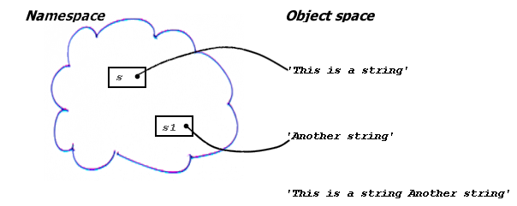
Python’s Spaces (1)
Objects are allocated from a heap (“object space”)
Namespaces hold names, which refer to objects
>>> s = “This is a string” # Pound sign introduces comment
>>> s1 = ‘Another string’ # ‘’ and “” are really '' and ""
>>> s + “ “ + s1
This is a string Another string
Garbage (space can be collected for re-use)

Slide 16
Python’s Spaces (2)
Each function call has a local namespace
Access to local namespace is fast
Interpreter knows which names are local
Each module has a global namespace
There is a built-in namespace
Contains built-in functions
Classes and instances each have a namespace
All instances have access to the namespace of their class
Memory allocation and deallocation is automatic
Saves a huge amount of “bookkeeping” required in (e.g.) C or C++
Array bounds are always checked

Slide 17
Basic Syntax
Each line is a single statement
Except when it’s continued
A line is continued if
It ends with a backslash
Any brace, bracket or parenthesis is unmatched at the end of the line
Multiple statements on a single line can be separated by semicolons
This is not good style, so we don’t recommend it
Leading spaces are significant!
Statements at the same indentation level form a block
Often also referred to as a suite

Slide 18
Datatypes, Values and Literals
Chapter 2

Slide 19
Names and Assignment
s = “This is a string”
As in most programming languages the equals sign indicates an assignment
Many languages speak about “assigning to variables”
In those languages a variable is a fixed-size slot
Used to store a value of a specific type
Python programmers tend to talk about “binding names”
Names are references to values
Any name can refer to any value
Names do not need to be declared
They are created by assignment
Names consist of letters, digits and underscores
First character may not be a digit

Slide 20

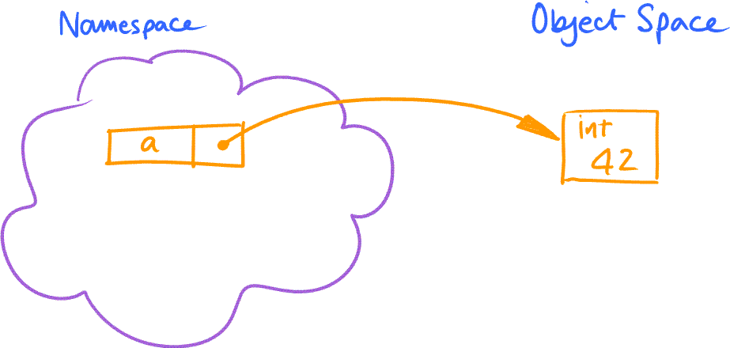
Understand Python’s Assignment Semantics
Python variables are COMPLETELY different from C++ variables
They are bound inside some namespace (which one?)
The names are references to values
The value determines the type, not the name
Values of any type can be bound to any name
Names are created if necessary, then bound or re-bound to new value
Object of type <type ‘int’>

Slide 21
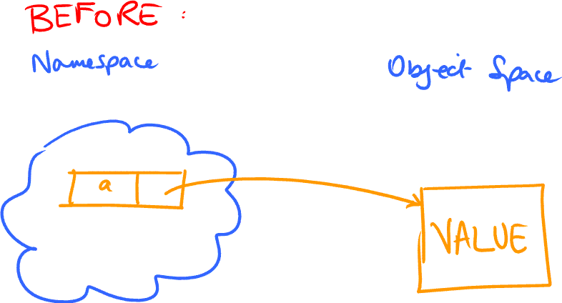
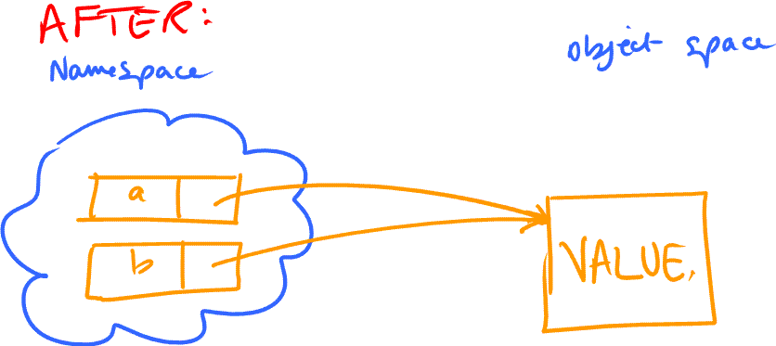
Assignment Copies References, Not values
No data movement is ever involved in assignment
Consider b = a
Note that b may or may not exist before this binding If it does, any existing binding is overwritten If it doesn’t, it is created

Slide 22
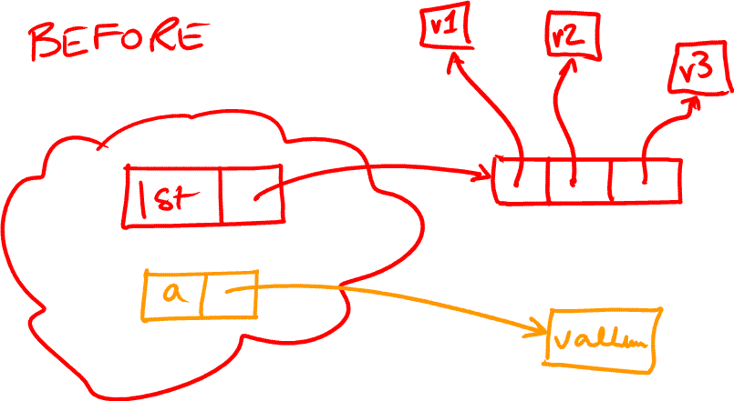
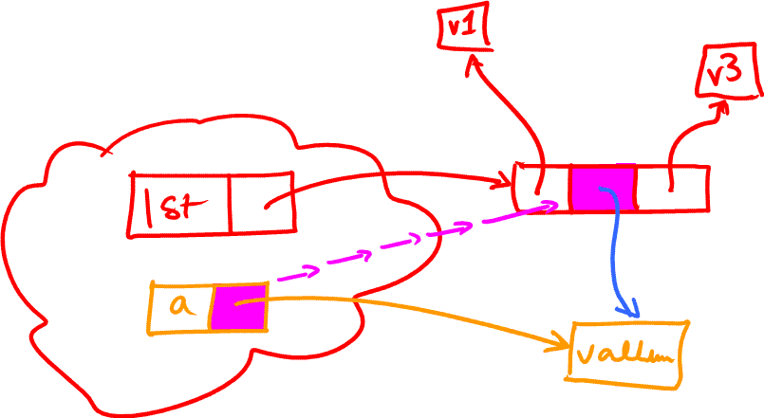

The Same is True of Assignment to Containers
The reference is copied into the container element rather than a namespace
We’ll be discussing containers later
Otherwise exactly the same principles apply
lst[1] = a

Slide 23
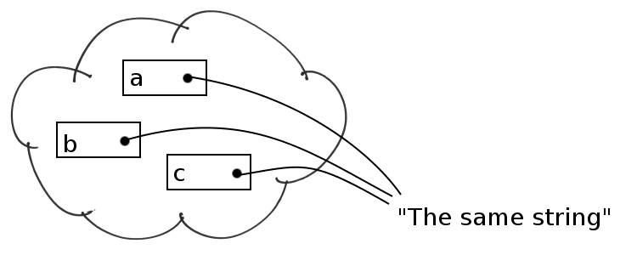
Multiple Assignment
Multiple names can be bound to the same value a = b = c = “The same string”
Namespace
Object space

Slide 24
Numeric Data Types
Integer: 10 or 1000000000000000000000000000001
In Python 2.5 and up the integers are unbounded
Float: 23.456 or 3.14159E19
Complex: 3+4j
Contains a real part and an imaginary part
When combined in arithmetic operations the interpreter “widens” to make types compatible
Integers can be converted to float or complex
Floats can be converted to complex
>>> 1 + 2.3 + (5 + 6j)
(8.3000000000000007+6j)

Slide 25
Arithmetic Operations
All the usual suspects are present: + - * / etc.
Exponentiation is **
Can also do bitwise not, and, or, xor (~, &, |, ^) on integer values, and shift them (<<, >>)
% returns remainder after division
always returns a value with same sign as divisor:
>>> -7 % 3
2
// is an explicit integer division operator
Should be used for integer division
Traditional division is morphing
Eventually 3/4 will be 0.75
Currently it’s 0

Slide 26
Comparisons
Numeric values of all types can be mixed
Widening is used before comparison
Again all the standard operators are available
>, >=, ==, <=, < and <> or !=
<> will disappear in Python version 3.0
The is operator checks for object identity
A is B is true only when A and B are references to the same object
Comparisons return either True or False
Can also be chained:
>>> 7 > 5 > 12 False >>> 7 > 5 > 3 True >>>

Slide 27
“Truthiness” In Python
Python has a flexible idea of truth and falsity*
not, and, or
and and or are “short-circuiting”
They don’t evaluate unnecessary operands
and returns its left-hand operand if that evaluates to false
otherwise its right-hand operand
or returns its left-hand operand if that evaluates to true
otherwise its right-hand operand
The right-hand operand may therefore not be evaluated
Depending on the operation and the value of the left-hand operand
* As described later
* Unusually, in Python any value can be considered true or false in a Boolean context

Slide 28
Sequence Types
Sequences allow individual elements to be individually addressed by index value
The most natural types to iterate over
The simplest Python sequence is the string
Single characters are just strings of length 1
Lists are changeable sequences
Elements are usually of the same type
Though this is not a requirement
Tuples are immutable sequences
Elements are frequently of different types
Though again this is not a requirement

Slide 29

Sequence Handling
These rules apply to all sequence types
Indexing is indicated by square brackets
Can access individual elements – s[i]
The first element in a sequence s is s[0]
Negative indexes start from the right
Can extract a subsequence using slicing: s[m:n]
Think of indexes as numbering the gaps:
The indexed element is to the right of the specified position

Slide 30
Python String Literals
Python has a rich set of string literal representations
The simple ones suffice for most cases
Simple literals can use single- or double-quotes as the opening and closing quotes
These simple literals cannot span line boundaries
More complex values can use three quotes as delimiter
Again, single or double quotes can be used
These literals can span line boundaries
The newlines are just additional characters in the string
A backslash at the end of the line is an instruction to ignore the newline

Slide 31
String Literal Escapes*
Certain characters need special representations:
\”
Double-quote
\’
Single-quote (apostrophe)
\\
Backslash
\r
Carriage return
\n
Line feed
\{newline}
Ignored – allows continuation of triple-quoted strings
\0nn
Octal character value
\xnn
Hexadecimal character value
* Only the most frequently-used escape sequences are shown in this table

Slide 32
String Handling Examples
>>> s4 = "Nineteen characters" >>> s4[-1] 's' >>> s4[-19] 'N' >>> s4[0:19] # a nineteen-character slice 'Nineteen characters' >>> s4[:] # omitted index means start or end 'Nineteen characters' >>> s4[:-1] # includes all but last item 'Nineteen character' >>> s4[1:] # includes all but first item 'ineteen characters'
A slice s[m:n] will (normally) be of length n-m
Indexing past the end of a string raises an exception
Slices, however, can reference non-existent positions

Slide 33
Unicode Strings
The computer world has finally realised that not everyone can use ASCII
Unicode is a standard for representing text in pretty much any character set
Unicode literals are introduced by “U” or “u”
u”This is Unicode”
When Unicode and regular strings are mixed the result is Unicode: >>> "a"+u"b" u'ab'
Unicode escape sequences can also be used in literals: U"\u20ac" # Euro symbol represents the Unicode string containing a single character whose ordinal value is hex 20ac

Slide 34
Raw String Literals
Useful when strings contain backslashes
Introduced by “R” or “r”
r”This contains \r as two characters”
Need to use care when reading interpreter output!
When printing the value of an expression the interpreter uses repr()
A function that attempts to show something close to the original Python source literal (when it can)
The print statement uses str()
A function that returns a printable representation
>>> "\r" # Single-character string
'\r'
>>> r"\r“ # Two-character string
'\\r'
>>> print r"\r“ # Two-character string
\r
>>>

Slide 35
Functions and Methods
Python objects have methods, which you can call like functions
Available methods depend on the type of object
How do you call an object’s methods?
follow a reference to the object with a dot and the method name
>>> s = “This is a string” >>> s.upper()
‘THIS IS A STRING’
>>> s.capitalize() ‘This Is A String’ >>> s.replace("s", "*")
'Thi* i* a *tring'
>>>

Slide 36
String Functions and Methods (1)
Python includes functions that operate on strings and characters:
chr(n): the character whose code value is n
ord(c): the code value of character c
len(s): the number of characters in string s
Strings also have methods you can use to operate on them
Since strings are immutable* the methods return new strings
* Immutable: cannot be modified

Slide 37
Common String Methods
s.lower() | Returns a copy of s with all letters in lower case
s.upper() | Returns a copy of s with all letters in upper case
s.strip() | Returns a copy of s with both leading and trailing whitespace characters removed
s.startswith(x) s.endswith(x) | Returns true if string s begins (or ends) with the string x
s.replace( old, new [, max]) | Returns a copy of s with the first max occurrences of old replaced by new
s.split() | Returns a list of substrings of s (various argument combinations are possible)

Slide 38
Lists and Tuples
Handled similarly to strings
Same indexing rules, including slicing
Tuples are indicated by comma separation
Parentheses are often optional but usually present
Once created a tuple cannot be changed: it’s immutable
Lists are introduced by brackets: [ … ]
Elements of a list may be changed
Elements can be added and removed
Elements of either structure can be of any type
Including other lists and tuples
Allows for arbitrarily nested structures in source code

Slide 39
Some Lists and Tuples
>>> l1 = [1, 4, 'nine', 'sixteen', 25] >>> l1[0] 1 >>> l1[-1] 25 >>> t1 = 'one', 'four', 'nine', 16, 'twenty-five' >>> t1[0] 'one' >>> t1[4] 'twenty-five' >>> t1[2][2] 'n‘ >>> l2 = ['*', ['/', 32, 4], ['+', 3, 10]] >>> l2[1] ['/', 32, 4] >>> l2[1][0] '/'

Slide 40
Why Lists and Tuples?
Tuples are immutable (like strings)
Were originally intended for structures where position meant something
The boundary has blurred a little since those days
Dictionary keys (see later) must be immutable
So it’s necessary to use tuples rather than lists
Note that a list and a tuple can never be equal
Even when they have exactly the same elements
Interpreter does not “widen” as it does for numbers
It’s the way things are! Don’t get hung up on it
Can easily convert between these two types
Use the tuple() and list() functions
>>> tuple([1, 2, 3])
(1, 2, 3)
>>> list((3, 2, 1))
[3, 2, 1]
>>>

Slide 41
List Methods
L.count(x) | Returns the number of occurrences of x in L
L.index(x) | Returns index of the first occurrence of x
L.append(x) | Appends the item x to the end of L
L.extend(l) | Appends all items of list l to the end of L
L.insert(i, x) | Inserts item x at index i in L
L.remove(x) | Removes the first occurrence of x from L
L.pop([i]) | Returns the value of L[i] and removes it from L
L.reverse() | Reverses the order of the items in L in place
L.sort([f]) | Sorts the items of L in place

Slide 42
Mapping Types: the Dict
The dict (dictionary) is Python’s only built-in mapping type
Can indexed by arbitrary* keys
Dict literals are a comma-separated list of key:value pairs surrounded by braces: {”one”: 1, ”two”: 2}
Both keys and values can be arbitrarily complex
Numeric keys of different types will compare equal if their values are equal
* There are some limitations: technically indexes must be hashable, which excludes lists

Slide 43
Simple Dict Operations
>>> d1 = {'one': 1, 'two': 2, 'three': 3} >>> d1["one"] # Retrieve element 1 >>> d1["Nosuch"] # Must exist KeyError: non-existent >>> d1[(1, 2, 3)] = "tuple"
>>> d1[1] = "integer"
>>> d1[1, 2, 3]
'tuple'
>>> d1[1.0+0.0j] # Numeric key
'integer'
>>> "one" in d1 # Test for key existence
True
>>>

Slide 44
Python Sets and Frozensets
A set is neither a sequence nor a mapping
Simply an unordered collection
So sets cannot be subscripted or sliced (which required ordering)
Sets have a length (number of objects)
An object occurs in a set exactly one or zero times
You’re either in the set or you’re not
Created using set() and frozenset() functions >>> S = set("This is a string") >>> S set(['a', ' ', 'g', 'i', 'h', 'n', 's', 'r', 'T', 't'])
You can convert them to a list or a tuple
But you can iterate over the elements without doing so
Can test for membership x in S, x not in S
Frozen sets are immutable, sets aren’t

Slide 45
Files in Python
Files are just sequences of bytes
Unicode decoding must be specified if required
Three files are available by default in the sys module
sys.stdin: standard input
sys.stdout: standard output
sys.stderr: standard error
These are inherited from the parent process
In an interactive session they will be the terminal by default
But you can alter them with command-line shell syntax when you run Python programs
Important to distinguish between text and binary modes
On some platforms the two are equivalent
On Windows they are definitely not

Slide 46
The None Type
This type has only one value!
Always referred to as None
Often used as a sentinel or null indicator
The only value not printed as an expression value by the interactive interpreter:
>>> None
>>>

Slide 47
Binding vs. Assignment
Python is unlike many other languages
Other languages require declaration of the type associated with a name (the name of a variable)
The variable is a fixed portion of memory, sized to hold a value of the declared type
Python does not associate specific areas of memory to the values for particular names
So we talk about binding values to names rather than assigning values to variables
Any value may be bound to any name
If a name has not been previously bound in a namespace
Assigning in that namespace creates the name automatically
Implication: Python does not need declarations!

Slide 48
Unpacking Assignments
The elements of a sequence can be bound to individual variables in a single statement
Use a comma-separated list of names on the left hand side: a, b, c = (1, 2, 3)
This even extends to nested structures: a, (b, c) = (1, (2, 3))

Slide 49
Assignment to Container Elements
Left-hand side of an assignment can nominate an element of a list or dict
This causes update in-place
>>> l2 ['*', ['/', 32, 4], ['+', 3, 10]] >>> l2[1] = 8 # Bind list element to value >>> l2 ['*', 8, ['+', 3, 10]] >>> d1 {'one': 1, 'three': 3, 'two': 2} >>> d1["one"] = "Have a banana“ # Bind new dictionary key to value >>> d1 {'one': 'Have a banana', 'two': 2, 'three': 3}

Slide 50
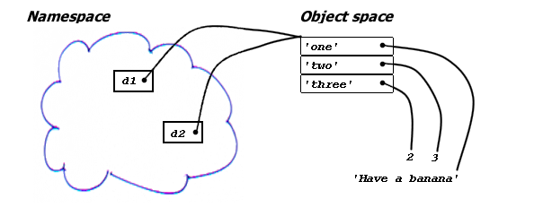
What “Assignment” To A Container Element Really Does
>>> d2 = d1 >>> d2 {'one': 'Have a banana', 'two': 2, 'three': 3}
>>> d2["one"] = "Zipfile" >>> d1 {'one': 'Zipfile', 'two': 2, 'three': 3}

Slide 51

Elements are Also References
d1 and d2 are references to the same object
If that object is mutable and gets changed …
… both references “see” the change
Container elements are also references to values
Not always obvious
Dereferencing is automatic, as we usually want values
Remember: the value provides the type

Slide 52
Assignment to Slices (1)
Can assign to slices of a list
Elements of the slice are replaced
>>> l = [0, 1, 2, 3, 4, 5, 6, 7, 8, 9] >>> l[2:4] [2, 3] >>> l[2:4] = ["two", "three"] >>> l [0, 1, 'two', 'three', 4, 5, 6, 7, 8, 9] >>> l[2:3] = [7, 7, 7, 7, 7] >>> l [0, 1, 7, 7, 7, 7, 7, 'three', 4, 5, 6, 7, 8, 9] >>> l[14:14] [] >>> l[14:14] = ["extra", "elements"] >>> l [0, 1, 7, 7, 7, 7, 7, 'three', 4, 5, 6, 7, 8, 9, 'extra', 'elements'] >>>

Slide 53
Assignment to Slices (2)
Assigned value must also be iterable …
Assigning an empty list deletes elements *
>>> l[5:16] = "Wrong" >>> l[6:100] = ["Right"] >>> l [0, 1, 7, 7, 7, 'W', 'Right']
>>> l[2:4] = [] >>> l [0, 1, 7, 'W', 'Right']
* But the del statement offers a better way

Slide 54
Augmented Assignments(1)
Most operators have an “augmented” form
Specifies “perform operation then assign”
Care is needed until you know what you are doing
Sometimes these operations update in place
So other references to same object also see value change
Sometimes they create a new value
In which case the target is re-bound

Slide 55
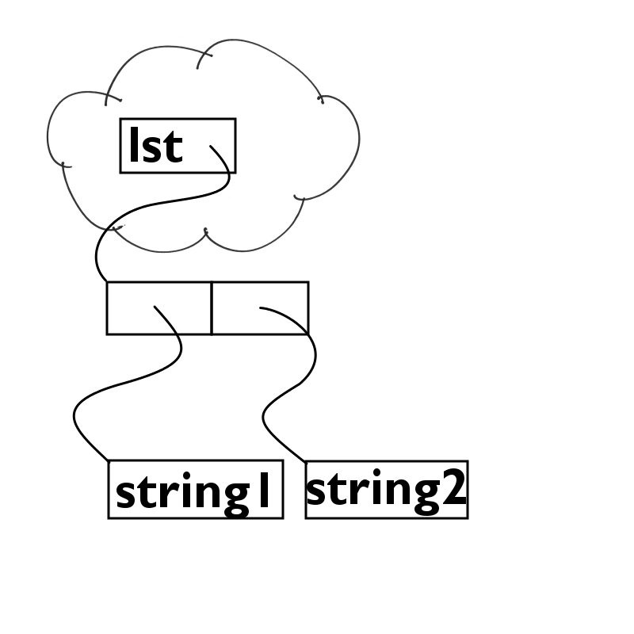
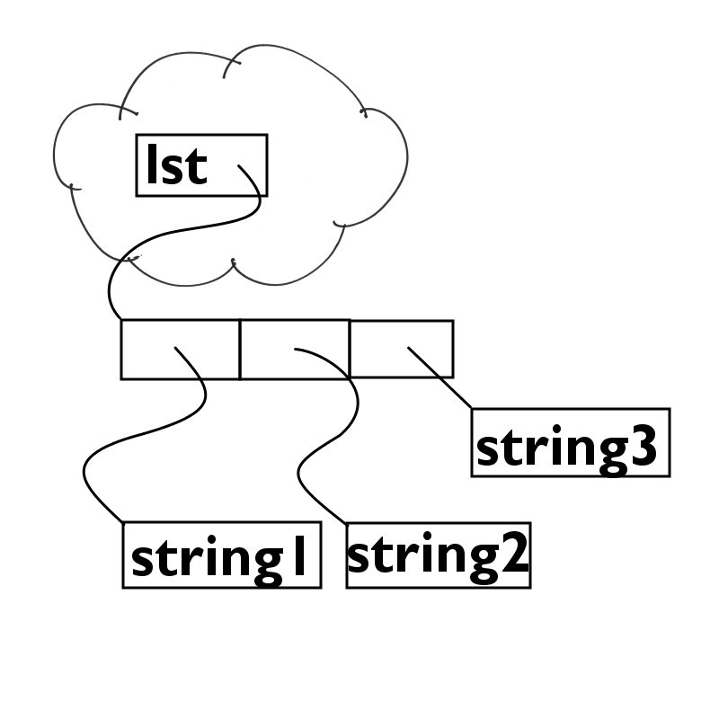
Augmented Assignments(2)
In-place modification: lst = [‘string1’, ‘string2’] lst += [‘string3’]
The list is extended by the addition of an element, but it is the same list
After first statement
After second statement

Slide 56
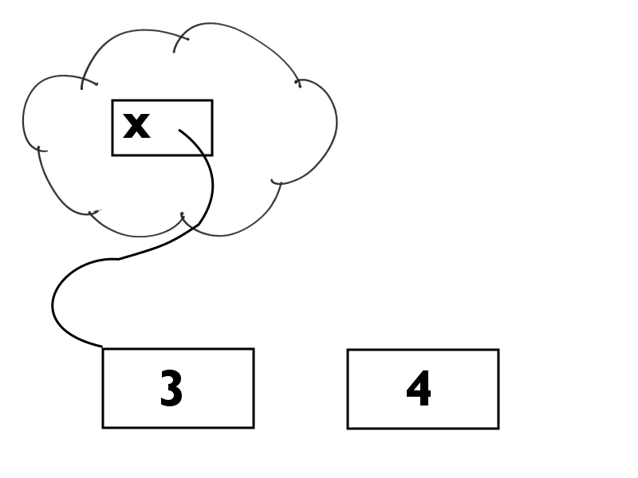
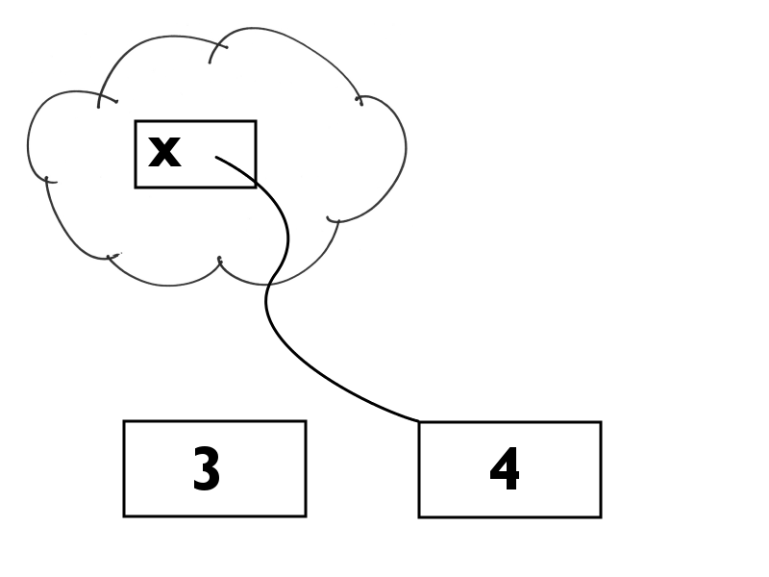
Augmented Assignments(3)
Rebinding: x = 1 x += 3 Integers are immutable, so the name must be rebound to the new value
After first statement
After second statement

Slide 57
Common List and Tuple Operations
Can add two lists/tuples together: >>> [1, 2, 3] + [4, 5, 6] [1, 2, 3, 4, 5, 6]
Can multiply them by an integer: >>> ("a", "b") * 3 ('a', 'b', 'a', 'b', 'a', 'b')
Can test for membership: >>> "dick" in ("tom", "dick", "harry") True

Slide 58
Python Statements
Chapter 3

Slide 59
Simple Python Statements (1)
Assignment (already covered)
pass simply does nothing
del removes a reference from a namespace or container object
break and continue are used in looping
return returns a value from a function
global identifies a name as global to the module
exec executes a Python string
As though it appeared as part of your program
Usually, when you think you need this, there’s a better way
Use only as a last resort

Slide 60
Simple Python Statements (2)
print sends (string representations of) a comma-separated list of values to the output stream
Inserts a space between each value
Puts a newline at the end
Unless the statement has a trailing comma
raise raises an exception
Can be used on its own to re-raise an existing exception
import makes external code available
Discussed in detail in Chapter 5
Python comes with an extensive library

Slide 61
Compound Statements
Python’s block structuring is different from most languages
Indentation is the block structure
This is a contentious feature for some
Newcomers from C and C++ often dislike it
Don’t criticize until you get used to it!
No more “braces and indentation don’t match” issues!

Slide 62
Conditional Execution (1)
if statement allows code guarded by conditions
If one statement is guarded, it can go on the same line
Unless it too is a complex statement
>>> if not mylst: ... print "List is empty" ... List is empty
>>> if not mylst: print "List is empty" ... List is empty
* This is considered poor style in finished code

Slide 63
Conditional Execution (2)
Can specify a second alternative with else
One-line forms are considered bad style
Reduces readability for little advantage
We usually try to avoid them
Though it can help to get code into a single slide ☺
>>> mylst = [1, 2, 3, "bananas"] >>> if not mylst: print "List is empty" ... else: print "List contents:", mylst ... List contents: [1, 2, 3, 'bananas']

Slide 64
Conditional Execution (3)
Python has no case or switch statement
It has been seriously discussed, and rejected for good reasons
else if can be elided into elif
Reduces nesting levels
This is just as efficient as most case implementations
if this: …
else if that: … else if the other:
…
else if whatever:
…
and so on
if this: …
elif that: … elif the other:
…
elif whatever:
…
and so on

Slide 65
What’s “True” in Python?
The result of comparisons is True or False
Any object can be used as a truth value
Most values will be treated as true in decisions
The following specific values are treated as false
Any numeric zero – 0, 0.0, 0+0j
Any empty container – [], (), {}
The empty string – “”
None
False
Others a little too complex to discuss here

Slide 66
for Loops
Used to iterate over sequences
Binds successive elements to the control variable(s)
Note that there is no special naming scope here
>>> for w in ["this", "is", "a", ... "python", "program"]: ... print w ... this is a python program >>>

Slide 67
So We Don’t Index the Elements?
Most often you just don’t need the index
The for iteration give you the elements directly!
The enumerate function provides (index, value) pairs as tuples
for loops allow unpacking, so each element gets its own index
>>> for i, w in enumerate( ... ["this", "is", "a", "python", "program"]): ... print i, w ... 0 this 1 is 2 a 3 python 4 program >>>

Slide 68
while Loops
Used to iterate until some condition becomes false
>>> lst = ["this", "is", "a", ... "python", "program"] >>> while lst: # false for empty list ... print lst ... del lst[0] ... ['this', 'is', 'a', 'python', 'program'] ['is', 'a', 'python', 'program'] ['a', 'python', 'program'] ['python', 'program'] ['program']

Slide 69
Early Loop Termination
break terminates any loop immediately
while True: s = raw_input('Enter something : ') if s == 'quit': break print 'length of the string is', len(s) print 'Done‘
Enter something : hello
Length of the string is 5
Enter something : quit
Done

Slide 70
Early Termination of an Iteration
continue immediately starts the next iteration
for i in range(4):
if i % 2 == 0:
continue
print i, “is odd”
1 is odd
3 is odd

Slide 71
Detecting Normal Loop Termination
An else clause after any loop is executed only if the loop terminates normally
If a break statement is executed, the else clause is skipped
for name in sequence: loop-suite else: termination-suite
while condition: loop-suite else: termination-suite

Slide 72
Exceptions
Python is an exception-based language
This goes well with its general philosophy
Simplifies mainstream logic
We simply assume success
So our logic shows what we expect will normally happen
Exceptional conditions alter the normal flow of control
try: suite except exceptions[, value]: handler 1 suite except exceptions[, value]: handler 2 suite else: no-exception suite
finally: termination suite # always runs

Slide 73
Handling Exceptions (1)
The try suite executes normally unless an exception is raised. Then
The interpreter matches the exception against the except clauses
else clause only executes if no exception
finally always executes
Allows clear-up, but may require some care
Need to ensure names were actually bound, etc.
Unrecognized exceptions are passed to an “outer handler”, if one exists
Uncaught exceptions in a function call interrupt the function call
If no handler is available at any level the interpreter terminates with a traceback print
Except in interactive mode, when it continues after printing the traceback

Slide 74
Handling Exceptions (2)
exceptions in except clause may be
A single exception
A tuple of exceptions
Allows different exceptions to share the same logic
Must put parentheses around tuple form
Avoids misinterpretations: comma might indicate value
Several different except clauses can catch separate (sets of) exceptions if required

Slide 75
Running Programs
Edit a “script file” named something.py
Under Windows or Unix: python something.py
Alternatively, under Unix only, with #! line: chmod +x something.py something.py

Slide 76
The __name__ Variable
The interpreter binds a module’s name to the __name__ variable in the importing module’s namespace
This is normally the name of the .py file
When the module is run as a program the interpreter binds a special value to __name__
“__main__”
Test for this value to see if your module has been run as a program
>>> import mymodule
>>> mymodule.__name__
‘mymodule’

Slide 77
Programs are Modules
A soundly-written module should run tests when it is run as a program
Test for the special name “__main__”:
if __name__ == “__main__”: run_test_code()
run_test_code() is called only when the module is executed as a program
Never when another program imports it
Very useful for executing a quick “self-test”
This feature is used by many standard library modules
You should incorporate it in your own modules

Slide 78
Defining and Using Functions
Chapter 4

Slide 79
The Purpose of Functions
A function allows the same piece of code to be used at different places in a program
with variations if necessary
Here’s a simple example
def celsius_to_fahrenheit(c_temp): return 9.0 / 5.0 * c_temp + 32
To convert a Celsius temperature c to Farenheit you would write something like f = celsius_to_farenheit(c)
The argument c is passed into the function body
Where it can be referenced as the parameter c_temp

Slide 80
Defining Functions
Functions are defined by the def statement
def function-name(parameters): function-body # indented suite
def is an executable statement
Like most Python statements
The interpreter reads and compiles the indented body
The resulting function object is bound to the function name in current namespace
Functions can be bound to other names, passed as arguments, etc. like any other Python objects
The body is only executed when the function is called

Slide 81
Parameter Specifications
A function definition lists the parameters (if any)
The user calling the function provides arguments
The arguments give values to the parameters
The argument values are bound to the parameter names
in the call’s local namespace
A parameter may be positional: a simple identifier
Values must be provided for every call
It may also be a keyword parameter: name=default
The default is only applied when no corresponding argument is found
Otherwise the parameter’s value is the argument
Positional parameters must precede keywords
Failure to observe this rule gives a syntax error

Slide 82
Variable Parameter Lists
Some functions can take an indefinite number of positional and keyword arguments
These are caught with a special parameter syntax
*args becomes a tuple of “extra” positional arguments to a call
The tuple is available as args in the function body
**kwargs becomes a dict of “extra” keyword arguments to a call
n=v becomes {‘n’: v}
The dict is available as kwargs in the function body
If both are present, * must precede **
You will often see *args and **kwargs used in existing code
This is a purely stylistic choice
You can use any names you like
But consistency is helpful for readability

Slide 83
Calling a Function (1)
Arguments to the call associate values with the function’s parameters (for this call only)
Arguments can be supplied in two ways
Positional: expression
position in argument list determines corresponding parameter receiving expression as value
Keyword: name=expression
name of argument determined corresponding parameter receiving expression as value
Positional arguments must precede keywords

Slide 84
Calling a Function (2)
The positional arguments are bound first
One at a time to successive parameters
Then keyword arguments are bound
To parameters with matching names
Unmatched keyword parameters take their defaults
As specified in the function definition

Slide 85
Arguments to Function Calls(1)
Simple expressions are positional arguments
Those of the form identifier=expression are named arguments
The identifier must be the name of a formal parameter*
The expression values are assigned to the parameters in the function call’s local namespace
* Unless the function has a **kw parameter

Slide 86
Arguments to Function Calls (2)
Can supply a tuple of additional positional arguments as *sequence
Can supply a dict of additional named arguments as **dict
>>> def testf(a, b, c, d):
... print "A:", a, "B:", b
... print "C:", c, "D:", d
...
>>> t = ("one", "two")
>>> d = {'c': "three", 'd': "four"}
>>> testf(*t, **d)
# equivalent to testf(“one”, “two”, c=“three”, d=“four”)
A: one B: two
C: three D: four
>>>

Slide 87
The return Statement
Outside a function this is illegal
return is optionally followed by an expression
This is the value to be returned from the call
Function body terminates when return executed
Function returns None if no return is present
Or when no expression follows return
Do not put return None at the end of a function
Confusing and unnecessary

Slide 88
Which Parameter Gets Which Argument?
The interpreter makes a list of positional arguments to the call
Including those provided by *args, if any
It assigns them one by one to the formal parameters
In the order they appear in the definition
Including named parameters if all positionals filled
The remainder are assigned to the *args parameter, if any
If there are unassigned arguments but no *args, an exception is raised
Keyword arguments are then assigned to their respective named parameters
The remainder assigned to the **kwargs parameter, if any
If there are unmatched keyword arguments but no **kwargs, an exception is raised
Any unmatched positional arguments will cause an exception to be raised
Any unmatched keyword parameters will take their default values

Slide 89
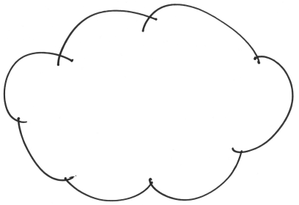
Passing Values to Function Calls
Caller’s namespace
Object space
x
x value
[]
y
y value
Definition: def f(a, b, c=[])
Called function namespace
Called function namespace
a
Call: f(x, y)
b
c

Slide 90
Arguments and Parameters
Arguments are references to objects
Names are direct references
Expressions become references to the expression value
The corresponding parameter is a copy of that reference
Not a copy of the value
Rebinding a parameter cannot rebind the argument
The rebinding takes place in the function call’s local namespace
A change to a mutable parameter passed as an argument also appears as a change to the argument
In this case the argument and the parameter are simply two references to the same (mutable) value

Slide 91
Mutable Default Values (1)
The same object is bound to a keyword parameter each time no corresponding argument is supplied
This can be tricky if the object is changed!
def f(x, y=[]): y.append(x) return y print f(23) # prints: [23] print f(42) # prints: [23, 42]
How do we bind y to a new empty list each call?

Slide 92
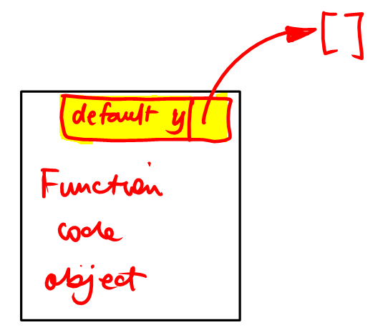
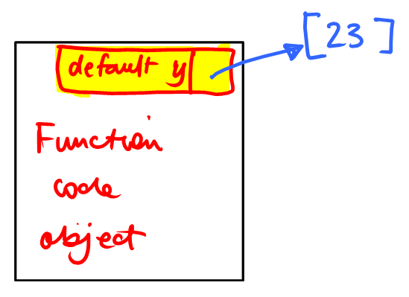
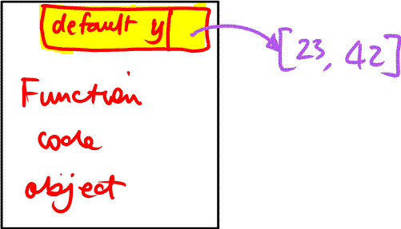
Mutable Default Values (2)
When function is declared
Code object is created
Contains reference to the default value
This value is used whenever no argument is given
Default pointer always references same object
First call f (23) # mutates default object
Reference is now to a list with an element
Second call f (42) # mutates default object again!

Slide 93
Mutable Default Values (3)
Standard solution is to use None as a sentinel
Its presence indicates that the caller did not provide an argument
def f(x, y=None): if y is None: y = [] y.append(x) return y print f(23) # prints: [23] print f(42) # prints: [42]
The is comparison tests for identity
Only sensible comparison for None
Also, be careful not to be sloppy in your testing
In the function above it might be tempting to write if not y: y = []
But what if the caller has passed an empty list?

Slide 94
Function Execution
The call to a function creates a new namespace
Initially populated only by the argument values
Assignments inside the body bind to names in the call’s namespace
Unless the bound name is defined as global in the function body
Then the name is bound in the module global namespace
These names are known as “local” variables
You can access a dict of them using the locals() function
Names are resolved in a specific namespace order:
Local
Module (global)
Built-in
Access to locals is more efficient than access to globals
The interpreter works out which names are local
Anything assigned to inside the function
Unless declared as global …
Therefore there’s no need to search for local names

Slide 95
Functions Are Just Values
Functions can be bound (assigned) and passed as arguments just like other values
Remember: the def statement binds the newly-created function to its name
>>> def celsius_to_fahrenheit(c_temp):
... return 9.0 / 5.0 * c_temp + 32
...
>>> f = celsius_to_fahrenheit
>>> print f(100)
212.0
>>>

Slide 96
Don’t Forget Function Call Parentheses
Python is neither Perl nor Ruby
Functions and methods are first-class objects
They can be bound to variables
They can be passed as function arguments
Etc. – use them just like any other values
So, you must put parentheses after the function name to specify a call
Even (especially) when no arguments are being passed
f.close() closes a file
f.close doesn’t – it’s just a reference to the file’s close() method
I once spent two hours wondering why transactions weren’t being commited to a database
I could see the commit call in the code
Only, as you will have guessed, it turned out not to be a call … dbconn.commit # aaaarrrrgggghhhh!!!!

Slide 97
Nested Functions and Closures
It is possible to define one function inside another
The inner function then has access to the namespace of the outer function
This allows you to build closures: parameterized functions created on demand
Before Python 2.2 you could achieve similar effects using defaulted named arguments
def adderOld(n): def add(m, N=n): return m+N return add
def adderNew(n): def add(m): return m+n return add

Slide 98
Built-In Functions and Methods
We haven’t yet looked at object orientation
That is where methods will be formally defined
For now, regard a method as a function with an implicit argument
E.g. the lst.append() call we used earlier operates on the list whose name is qualified by the method name
There are quite a few functions built in to the language
Built-in types have lots of pre-defined methods

Slide 99
Further Functions and Methods
It would be somewhat tedious to detail
All the built-in functions
All the methods of all the built-in types
So use the documentation
And talk to people – you will usually get help
“How can I …” questions will get quick answers on comp.lang.python if there’s a built-in to do the work
And if there isn’t you will almost always get helpful replies anyway
People don’t generally mind answering these questions over and over
Though it helps to make it obvious you’ve done some research

Slide 100
Some Useful Built-In Functions
Python has many built-in functions
Some obscure but occasionally useful
Others more generally useful
There is a still more functionality in the stdlib
Difficult to cover all that in a short course
Be prepared to read the documentation
We cover the easier/more useful built-ins here
Learning the language is easy
Learning the library takes a long time
Many fine examples of standard library use are available in Doug Hellman’s Python Module of the Week series
http://www.doughellmann.com/PyMOTW/

Slide 101
Conversion Functions
oct(x) | Returns x converted to an octal string
hex(x) | Returns x converted to a hexadecimal string
str(x) | Returns x converted to a string
repr(x) | Returns a “complete” string representation of x
chr(x) unichr(x) | Returns the (Unicode) character whose ordinal value is x
ord(c) | Returns the ordinal value of the ASCII (or Unicode) character c

Slide 102
Introspection Functions
dir([obj]) | Returns the sorted list of all variables bound in the object’s namespace (defaults to current scope)
getattr(obj, name[, dflt]) | Returns the value of the named attribute of the given object
setattr(obj, name, value) | Sets the named attribute of the given object to the given value
delattr(obj, name) | Deletes the named attribute of the given object
isinstance( obj, cls) | Returns True if obj is an instance of the given class (or of one of a tuple of classes)
issubclass( cls1, cls2) | Returns True if cls1 is a direct or indirect subclass of cls2

Slide 103
Mathematical Functions
abs(x) | Returns the absolute value of number x
divmod(x, y) | Returns (x//y, x%y) – the quotient and remainder of dividing x by y
pow(x, y[, z]) | Returns x**y%z – if z omitted, returns x**y
round(x, n) | Returns x rounded to n decimal places

Slide 104
Know Which Methods Don’t Return Values
A fruitful source of bugs is expecting values that don’t get returned
mylist = mylist.append(x)
Sets mylist to None
D = {...} for k in D.keys().sort(): print D[k]
Tries to iterate over None
Raising TypeError: iteration over non-sequence
Can make the same mistake with .reverse()
The sorted() and reversed() functions were introduced in 2.4
These can be used to alleviate some of these problems

Slide 105
Modules and Packages
Chapter 5

Slide 106
Programming Mechanics
Modularity is an established organizing principle
Splitting code makes it more manageable
People more readily understand smaller units
Also encourages code re-use
You can package useful functions inside modules
The standard library comprises packages and modules
A module is just a piece of Python code in a file
You access modules with the import statement

Slide 107
Importing a Module
The first execution of the statement import mod1 causes the interpreter to look for a module or package named mod1
we’ll see how shortly
If the module or package cannot be identified an ImportError exception is raised
Otherwise the code of mod1 is executed
Any name bindings occur in mod1’s global (module) namespace
The module namespace is then bound to the name mod1 in the current namespace
It will also be bound to sys.modules[“mod1”]
Note: the module’s namespace is bound to its name!

Slide 108
A Simple Module Example
# app1.py print "First import" import mod1 print "Second import" import mod1 print mod1.x
# mod1.py print "Mod1 executing" x = 100
$ python app1.py First import Mod1 executing Second import 100

Slide 109
How Modules Are Found
The sys module contains information about your system
sys.path is a list of directories
The interpreter searches each one in turn
For a .py (Python source) file
And/or a .pyc (Python compiled) file
You can set the PYTHONPATH environment variable to a list of directories to be added to sys.path on interpreter start-up
You can also manipulate sys.path in your code if you wish

Slide 110
Import Semantics (1)
sys.modules is a dict of imported modules
The interpreter checks it when each import is requested
If a module is found is sys.modules, that is immediately used
The module code is only executed the first time the module is imported
Avoids unnecessary duplication of initialization code
The module’s namespace is accessible to the importing module or program
Qualify the module’s name with the required name: module.variable
This makes modules very useful for defining functions
And other re-usable code objects like classes

Slide 111
Import Semantics (2)
For a module not present in sys.modules
The interpreter locates the module’s source code (.py) file
It also looks for a compiled (.pyc) file
If .pyc is found, it compares dates
If the source is newer it is recompiled
A new .pyc file is created (if possible)
This minimizes the amount of compilation needed

Slide 112
import … as …
Sometimes you would like to import a module under a different name
To avoid a clash with a name already in use
To allow different modules to be used in the same role depending on conditions
import module as myname is (almost) equivalent to import module myname = module del module

Slide 113
from … import …
Sometimes you only want a few names
And you don’t want to use qualified names
In that case you can use this form: from module import name1, name2
The module is imported (if necessary)
Then the requested names are copied into the current namespace
If the imported module later rebinds a name this is invisible to the importer
The importer’s name still references the original object

Slide 114
Python Packages [Advanced Topic]
Sometimes a coordinated set of modules is required
A package is a directory containing (at a minimum) an __init__.py file
When the package is imported __init__.py is run
The package namespace receives any bindings
Other modules can be imported from the package tree
A package can also contain modules and sub-packages
You import module M from package P as P.M
You can also use from P import M

Slide 115
Object-Oriented Programming
Chapter 6

Slide 116
Types and Instances
We have seen a number of Python’s built-in data types
Each different type has methods that perform certain operations on it
list.sort(), dict.keys() etc.
We don’t have to redefine the methods for each new list or dict
The methods are defined by the types
Each instance of the type uses the same method definitions
Python’s designers could have defined functions instead
But it would have then been easier to pass (an instance of) the wrong type
A method call makes it very obvious which object is being operated on
Python allows you to define your own types
With methods, just like the built-in types

Slide 117
Representing Data Structures (1)
Suppose we want to write an accounting program
Each account needs a name, an opening date, a balance and a history
Could represent this as a list: Amex = ["American Express", "2000-11-18", 0.0, []]
Can get name as Amex[0], balance as Amex[2], and so on
This is not the easiest way to program
Difficult to read
Therefore difficult to maintain
Therefore expensive

Slide 118
Representing Data Structures (2)
It would help (some) to use symbolic constants as field indexes: AcName = 0 OpenDate = 1 Balance = 2 History = 3
Can now refer to balance as Amex[Balance]
But if code is imported (say, from module accts) …
We would then have to use Amex[accts.Balance]
Not that much easier
So lists probably aren’t much good as general data structures

Slide 119
Representing Data Structures (3)
So, how about a dict? Amex = {'AcName': 'American Express', 'OpenDate': '2000-11-08', 'Balance': 0.0, 'History': []}
Now we use strings as indexes: Amex["AcName"] Amex["History"].append(('2000-11-20', 'Laptop Computer', 3896.99))
Somewhat easier to read
But all that typing: [“…”]
And all those strings
Again we could use symbolic constants for the strings
But the brackets would still remain

Slide 120
What Would We Really Like?
Simpler, more usable, more readable mechanism
A true namespace, similar to a module
So we can write acbal = Amex.balance
We need to define the class of all accounts
Then make each account an instance of that class
In Python we can do this with a class statement
Very similar to def – it’s also executable
Interpreter compiles the indented suite
Binds it to the class name in the current namespace

Slide 121
The Simplest Possible Class Definition
class Account: pass
We can use this class definition in the following way:
Amex = Account() # call creates an instance
This is OK, but there are no attributes. Let’s set some!
Great!
This actually looks quite usable
>>> Amex = Account() >>> Amex.AcName = "American Express" >>> Amex.OpenDate = '2000-11-18' >>> Amex.Balance = 0.0 >>> Amex.History = [] >>> dir(Amex) ['AcName', 'Balance', 'History', 'OpenDate', '__doc__', '__module__'] >>>

Slide 122
An “Account Factory Function”
If we put all these bits together we could define a function to create accounts
Gives us an easy way to build account instances
Makes sure nothing is forgotten
Provides sensible defaults
def newAccount(AcName, OpenDate, Balance=0.0): a = Account() a.OpenDate = OpenDate a.AcName = AcName a.Balance = Balance a.History = [] return a # return the newly-created instance Amex = newAccount("American Express", "2000-11-18")

Slide 123
Separating Creation and Initialization
Another way to organize the code:
Create an instance, then initialize it
In this case, initAccount takes an Account instance argument and modifies it
We can think of it as an operation on an account
def initAccount(ac, AcName, OpenDate, Balance=0.0): ac.OpenDate = OpenDate ac.AcName = AcName ac.Balance = Balance ac.History = [] Amex = Account() initAccount(Amex, "American Express", "2000-11-18")

Slide 124
Another Account Operation
Suppose we want to standardize transaction processing:
We could implement all this in a module, say accts
and use that!
What does class do for us that this doesn’t?
def processTransaction(ac, date, amount, reason): ac.Balance += amount ac.History.append((date, amount, reason))
import accts Amex = accts.Account() accts.initAccount(Amex, “American Express”, “2000-11-18”) accts.ProcessTransaction(Amex, “2000-11-30”, 3499.99, “Personal Computer)

Slide 125
Instances are Namespaces
We can pass an instance as an argument
Then access and/or change the argument’s attributes inside the function
Does the interpreter know in advance what attributes an instance has?
No! It looks them up when access is attempted!
This “late binding” behavior seems strange to programmers used to C or C++
And it does incur a run-time cost
However it also gives us considerable power
So Python programmers regard it as an acceptable trade-off

Slide 126
Classes Are Namespaces Too
We have seen that a function call creates a namespace
Defining a class also creates a namespace
Bindings inside the class body are made in the class namespace, giving rise to class attributes
Defining a function inside the class body binds the function name to the function code object in the class namespace
This is how we create methods!

Slide 127
Namespace Hierarchy
The interpreter will look in the class for an attribute it cannot find in an instance
As you see, an instance attribute will override a class attribute with the same name
>>> class AttTest: ... attval = "DEFAULT“ ... >>> i1 = AttTest() >>> i2 = AttTest() >>> i2.attval = "instance“ >>> i1.attval 'DEFAULT‘ >>> i2.attval 'instance‘ >>>

Slide 128
Classes Can Specify Behavior
We can define functions to operate on instances of a specific class
How do we make the functions a part of the class?
That looks like it might work … let’s try it (note: the method code is exactly that of the functions we were just looking at)
class Account: def initAccount(ac, AcName, OpenDate, Balance=0.0): ac.OpenDate = OpenDate ac.AcName = AcName ac.Balance = Balance ac.History = [] def processTransaction(ac, date, amount, reason): ac.Balance = acct.Balance + amount ac.History.append((date, amount, reason))

Slide 129
Using the Methods
Current = Account() Account.initAccount(Current, "Checking Account", "2000-11-26", 1234.56) Account.processTransaction(Current, "2000-11-26", -1000.00, "Cash Withdrawal") print "%8.2f" % (Current.Balance, ) 234.56
Creates an instance by calling the class
Then operates on the instance by calling the methods from the class
This means that we are referencing both the class and the instance
Could we access the methods from the instance instead?

Slide 130
Methods as Instance Attributes
Current = Account() Current.initAccount(Current, "Checking Account", "2000-11-26", 1234.56) Current.processTransaction(Current, "2000-11-26", -1000.00, "Cash Withdrawal") print "%8.2f" % Current.Balance Traceback (most recent call last): File "exectest.py", line xx, in ? Current.initAccount(Current, "Checking Account", "2000-11-26", 1234.56) TypeError: initAccount() takes at most 4 arguments (5 given)
Five arguments?
Where does the extra one come from?
The interpreter special-cases instance method calls!

Slide 131
Instance Method Calls
When you call a method’s instance …
You almost invariably need a reference to the instance
So the interpreter provides it as the first argument
This is automatic
So there’s a simple fix to our code
Remove the instance arguments!
Let the interpreter provide them, now we know it does …
Yay! ☺
Current = Account() Current.initAccount("Checking Account", "2000-11-26", 1234.56) Current.processTransaction("2000-11-26", -1000.00, "Cash Withdrawal") print "%8.2f" % Current.Balance 234.56

Slide 132
The self Convention
When we qualify a class with a method name
The interpreter returns a regular reference to the method
If called, the argument list is exactly as passed
When we qualify an instance with a method name
The interpreter creates what is called a bound method
Implicitly knows which method it “belongs to”
When called, the instance is put as the first argument
Usually we call this implicit argument self
Though as we have just seen, it works whatever the name
But any other name makes your code harder to read
So we suggest you stick to self

Slide 133
The __init__() Special Method
When a class is called, Python creates an instance
If the class has an __init__() method it is called
Arguments to the call are passed to __init__()
Preceded by the newly-created instance, as self
__init__() must never return a value
Instance is created before __init__() is called
So, what would our class look like if we use all this new stuff?

Slide 134
The Final Account Class
class Account: def __init__(self, AcName, OpenDate, Balance=0.0): self.OpenDate = OpenDate self.AcName = AcName self.Balance = Balance self.History = [] def processTransaction(self, date, amount, reason): self.Balance += amount self.History.append((date, amount, reason))
We create a new account as follows:
Amex = Account("American Express", "2000-11-18")

Slide 135
Polymorphism
Polymorphism means that different types of object can respond to the same operations
They have the same methods, and the methods take the same arguments
Suppose classes A and B both have a doit() method …
You can write this.doit() in your code
It doesn’t matter whether this is an A or a B
The interpreter will find the method
Because names are resolved at run-time

Slide 136
Encapsulation
Encapsulation means you don’t need to know the implementation details of an object
You just need to know its API
Python users aren’t rigorous about encapsulation
It’s OK to access attributes directly
This would be a no-no in Java, for example
This makes it easier to reorganize your code
Users need not know what’s behind the API
As long as the API remains the same nobody’s code will break
The important part is the interface
Which you publish to your class’s users
API: Application programmer interface – the methods, and their required arguments

Slide 137
Inheritance
Inheritance allows you to form new classes from those you have already defined
You create subclasses of existing classes
“A checking account is like an account but …”
You can
Add new methods
Replace existing methods
Create methods that extend the superclass’s methods
By calling the superclass method as a part of the subclass method

Slide 138
A Simple Inheritance Example (1)
We have already defined an Account class
Four attributes and two methods
Suppose we want a class that does everything our Account class does …
But with an additional method to print the history
Could write an enhanced class that is a subclass of Account
With a printHistory() method specific to the subclass
Our subclass will automatically inherit the Account methods

Slide 139
A Simple Inheritance Example (2)
import accts class QuickAccount(accts.Account): def printHistory(self): for h in self.History: print "%12s %10.2f" % (h[0], h[1])
Does everything the same way except printing the history
Because it inherits all methods and attributes from the parent accts.Account class

Slide 140
How Inheritance Works
When an instance attribute (including a method) is accessed, the interpreter looks …
In the instance’s namespace
Then in the instance’s class’s namespace
Then in the class’s parent class’s namespace
… and so on until there is nowhere left to look
Failure raises an AttributeError exception
This “method resolution order” allows a subclass to override its parent’s methods (and other attributes)

Slide 141
The Object Hierarchy
In modern Python (since 2.2) everything ultimately inherits from the object class
Prior to 2.2 you could not subclass the built-in types
The issubclass(c, classinfo) built-in returns True if the first argument is a direct or indirect subclass of the second
classinfo may be either a class or a tuple of classes
In the latter case result is True if c is a subclass of any class in the classinfo tuple

Slide 142
Formatting and I/O
Chapter 7

Slide 143
Opening a File
Use the open(path[, mode[, bufsiz]]) built-in to open a file
Read, write or append indicated by mode ‘r’, ‘w’, or ‘a’
Read mode expects the file to exist and raises an exception if it doesn’t
Write mode truncates any existing file to zero length, creating it if needed
Append mode will create if necessary
Otherwise appends to existing file’s contents
bufsize values are usually omitted
0: unbuffered
1: line buffered
+ve: use (roughly) that much space
-ve: use system default
Returns a file object, whose methods are used to access the file

Slide 144
Additional Modes and Some Other Considerations
The second argument can specify additional modes
‘+’ : file can be updated (modifying existing content)
‘b’ : file is opened in binary mode
In binary mode the file is read/written byte for byte
Otherwise the program sees “\n” line endings
No matter what line endings the OS uses on media
Translation is automatic as data is read/written
When you read lines from a file they always include the line ending
End of file is indicated by a completely empty line
Blank lines are read in as “\n”

Slide 145
The File API (Abbreviated)
The open() function returns a file with “the usual methods”
There are others too, see the documentation
Files can also be used directly in for loops
for line in open(“myfile.txt”): do_something_with(line)
f.read() | All data from file
f.readlines() | A list of the lines in a file
f.xreadlines() | A generator of the lines in a file
f.readline() | The next line in the file
f.write(s) | Writes s into the file
f.seek(p) | Moves current position
f.tell() | Reports current position

Slide 146
“File-Like Objects”
Many contexts accept a “file-like object”
If the necessary methods are supported, file handling works just fine
This raises a frequent approach in Python
Two objects with the same methods are effectively interchangeable
Sometimes called “duck typing” (if it quacks like a duck …)
This is an effective use of polymorphism
The standard library provides StringIO and cStringIO libraries
These allow the creation of file-like objects
Provide most of the standard file interface
Data are stored in memory
Give exceptionally high speed with a higher memory cost
Very useful for small-ish temporary files and so on

Slide 147
File Handling Example (1)
# Write a file out_ file = open("test.txt", "w") out_file.write("This Text is going out\nLook at the file!") out_file.close() # Read the same file back in in_file = open("test.txt", "r") text = in_file.read() in_file.close() print text
This test is going out Look at the file!
This straightforward example shows how to deal with whole text files
This approach is less realistic with large files
In such cases we frequently need to iterate over small chunks

Slide 148
Formatting Operations
With a string as the left-hand operand % is a formatting operator
The left-hand operand contains format specifiers
Introduced by percent signs
Codes parallel C’s printf formatting codes
But if you don’t know C they aren’t hard to learn
The right-hand operand can be
A single value (if LHS has only one format code) >>> "It's a %s today" % dow "It's a Sunday today"
A tuple: format specifiers take successive tuple elements >>> "%s owes me %.2f" % ("Dougie", 123.45) 'Dougie owes me 123.45'
A dict or other mapping: format specifiers include a parenthesized mapping key >>> "My %(relation)s is aged %(age)d" % { "relation": "brother", "age": 60} 'My brother is aged 60'

Slide 149
Most Common Format Codes
s | String – uses value’s str() method
d | Decimal (integer)
F, f | Floating-point decimal: value will be rounded to an appropriate number of places
G, g | General: fixed or floating, depending on data value
c | Single character
X, x | Unsigned hexadecimal
% | Inserts a literal percent sign

Slide 150
Simple Formatting Examples
Format specifiers can include a length and a number of places
Negative lengths imply left-justification
If length begins with “0” zero-filling will be used
>>> "%12s %5d" % ("Welcome", 23)
' Welcome 23'
>>> "%-12s %5d" % ("Welcome", 23)
'Welcome 23'
>>> "%(lang)s: %(ct)d" % {"lang": "Python", "ct": 23}
'Python: 23'
>>> "%8.2f" % 314.159
' 314.16'
>>> "image%03d.png" % 2
'image002.png'

Slide 151
File Handling Example (2)
import sys
if len(sys.argv) < 2: # Check command-line argument given
sys.exit("No filename")
f = open(sys.argv[1], 'r')
n = 0
for line in f: # Iterate over lines in file
n += 1
print "%4d %s" % (n, line[:-1]) # Trims newline
f.close()
1 import sys
2 if len(sys.argv) < 2:
3 sys.exit("No filename")
4 f = open(sys.argv[1], 'r')
5 n = 0
6 for line in f:
7 n += 1
8 print "%4d %s" % (n, line[:-1])
9 f.close()

Slide 152
More Advanced Topics
Chapter 8

Slide 153
Regular Expressions: The re Module
Some people, when confronted with a problem, think "I know, I'll use regular expressions." Now they have two problems.
Jamie Zawinski
Why do regular expressions cause so much trouble?
They are “parsers in a box”
Grammar set is somewhat limited
They are very useful when used properly
But they should not be the first tool out of the box

Slide 154
When Regular Expressions Aren’t Required (1)
A typical (small) horror story: identify lines beginning with “Python” m = re.match(s, “^Python”) if m: # s begins with “Python”
re.match (and its corresponding method) is anchored
So there’s really no need for the pattern to start with “^”
But anyway, there’s a string method for this! if s.startswith(“Python”): # s begins with “Python”
Please also avoid this one: m = re.match(s, “.*Something”) # all problems are nails
You were actually looking for m = re.search(s, “Something”)
But what you really wanted was m = “Something” in s

Slide 155
When Regular Expressions Aren’t Required (2)
Some character class tests are available as string methods
re.match(s, “[0-9]*$”) … … s.isdigit() re.match(s, “[a-zA-Z]*$”) … … s.isalpha()
Similarly, please use isalnum, islower, isupper, isspace, istitle
I particularly like s.istitle()
Though I have never found a use for it
Perhaps it helps in testing s.title()?
I have even seen this in student code: re.match(s, “^$”)
This is a very long-winded test for not len(s)
So, just because regular expressions are a great idea, don’t get carried away!

Slide 156
When Regular Expressions Are Useful
Ideally you need to match a pattern, not just a literal value
A string having given characteristics
A bracketed set of characters matches any one of the characters:
A dash between two characters indicates a range
\d is special – matches any digit m = re.match(“[A-Z]\d”, s) # A8, Q1, Z9 etc.
Can use + for “one or more”, * for “zero or more”, ? for “zero or one”
They apply to the pattern element they follow
Any string of letters followed by a string of digits: m = re.match(“[a-zA-Z]+\d+”, s)
A dot matches any character
Except newline, and the re.DOTALL flag will make it match that too
^ matches the beginning of the string, $ the end
Can also set re.MULTILINE flag
Then they match just after or before newline too

Slide 157
Further Specifications
Can provide alternates separated by pipe bars
re.match(“this|that|the other”, s)
Matches any of the three phrases
\s matches any whitespace character
\S matches any non-whitespace character
\w matches any alphanumeric or an underscore
\W matches anything but an alphanumeric or underscore
[^… ] matches any character not in the set following ^
( … ) specifies a grouping (see Match Objects)
(?P<name> … ) also specifies a grouping, and gives it a name (see Match Objects)
Can match meta-characters like “(” and “)” with a backslash escape

Slide 158
Matching and Searching
re.match requires the match to start at the beginning of the subject string
re.search allows the match to occur anywhere within the subject string
Note that these functions, are also available as methods of patterns
A pattern is just a regular expression string that’s been compiled
Which you can do with re.compile()
Same is true of other matching functions available in the re module
So m = re.match(pat, s[, flags]) is equivalent to p = re.compile(pat) m = p.match(s[, flags])
Optional flags (or’ed together with |) control matching functionality
re.MULTILINE Matches can span line boundaries
re.IGNORECASE Makes alpha matching case-insensitive
re.DOTALL Allows the dot to match newlines too
re.VERBOSE Allows patterns to be more readable
Plus others …

Slide 159
Verbose Regular Expressions are More Readable
When the re.VERBOSE flag is set
Whitespace characters are ignored unless backslash-escaped
Comments (like Python comments) are ignored
pattern = '^M?M?M?M?(CM|CD|D?C?C?C?)(XC|XL|L?X?X?X?)$'
pattern = ""“ ^ # beginning of string M{0,4} # thousands - 0 to 4 M's (CM|CD|D?C{0,3}) # hundreds - 900 (CM), 400 (CD), 0-300 (0 to 3 C's), # or 500-800 (D, followed by 0 to 3 C's) (XC|XL|L?X{0,3}) # tens - 90 (XC), 40 (XL), 0-30 (0 to 3 X's), # or 50-80 (L, followed by 0 to 3 X's) (IX|IV|V?I{0,3}) # ones - 9 (IX), 4 (IV), 0-3 (0 to 3 I's), # or 5-8 (V, followed by 0 to 3 I's) $ # end of string ""“

Slide 160
Match Objects
When a match succeeds it returns a match object
Match failure returns None
The match object API is intended to make analysis easier
m.group(…) returns items matched by pattern groups
No arguments, returns whole matched string
Single argument, returns string matched as that group
Multiple arguments, returns a tuple of strings matched by given groups
Arguments can be numbers or strings (which select named groups)
>>> m = re.match(r"(?P<first>\w+) (?P<last>\w+)", “Steve Holden") >>> m.group('first') ‘Steve' >>> m.group(2) ‘Holden'
When repeated groups match multiple times you only get the last one

Slide 161
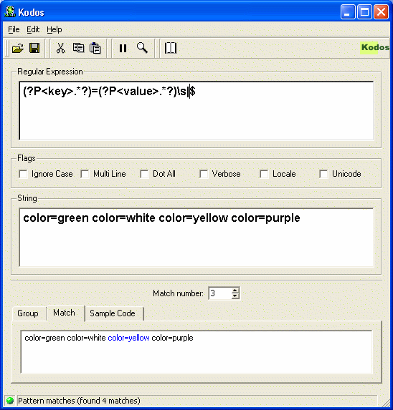
For More Regular Expression Practice
The open source Kodos tool really helps with Python regular expressions
Written in Python, so you know it’s giving you correct results
It lets you enter re’s and target strings
Highlights syntax errors in re’s
Shows matches, including named groups
Shows all matches in the subject string

Slide 162
Other Useful re features
pat.split(s[, maxsplit=n]) Split string s by occurrences of pat >>> re.compile('\W+‘).split('Words, words, words.') ['Words', 'words', 'words', '']
pat.findall(s[, pos[, endpos]]) Returns a list of all non-overlapping matches of pat in s
pat.sub(repl, s[, count=0]) Returns the string obtained by replacing the leftmost count (0 meaning all) occurrences of pat with repl

Slide 163
List Comprehensions
A concise way to create lists
Avoids use of repeated append() calls
Evaluates an expression repeatedly
Under the control of a for iteration
With the chance to “veto” values with if
You give an expression
This produces a value for each element of an iterator
The resulting list is those values included by any “if” clauses
>>> vec = [1, 2, 3, 4, 5] >>> [3*x for x in vec] [3, 6, 9, 12, 15] >>> [3*x for x in vec if x != 2] [12, 18] >>> [3*x for x in vec if not (x % 5)] [15] >>> vec2 = [4, 3, -9] >>> [x*y for x in vec for y in vec2] [4, 3, -9, 8, 6, -18, 12, 9, -27]

Slide 164
Another List Comprehension
>>> words = 'The quick brown fox jumps over the lazy dog‘\ .split() >>> print words ['The', 'quick', 'brown', 'fox', 'jumps', 'over', 'the', 'lazy', 'dog'] >>> stuff = [[w.upper(), w.lower(), len(w)] for w in words] >>> for i in stuff: ... print i ... ['THE', 'the', 3] ['QUICK', 'quick', 5] ['BROWN', 'brown', 5] ['FOX', 'fox', 3] ['JUMPS', 'jumps', 5] ['OVER', 'over', 4] ['THE', 'the', 3] ['LAZY', 'lazy', 4] ['DOG', 'dog', 3]

Slide 165
Containers Can Be Expensive
Generating a large list or tuple just to iterate over it is inefficient
All items have to be created (occupying memory)
The container itself occupies memory
Also takes time to allocate memory and garbage collect it
The container has a reference to each item
No memory can be reclaimed until the container is no longer referenced
What if sequences could be generated on demand?
Each element taking up space only as long as referenced!

Slide 166
Replacing Containers
It’s easy to iterate over a list or a tuple
Because the values can be accessed by indexing
Could we write a “function” that returned the values one at a time, on demand, to a loop?
This would let us deal with infinite sequences
We have no way to create an infinite list or tuple!
But functions are “one-shot”
A single call returns a result
We want a function that can return repeatedly
Until the values run out

Slide 167
Introduction to Generators
Generators are exactly what we have been looking for
A generator can be used in place of a sequence
Inside a looping context
for loop, list comprehension, etc.
It creates values, one by one, on demand
How do you use these generators?
The usual way is just to iterate over them generator = generatorFunction() for x in generator: process(x)

Slide 168
Generator Functions
A class of objects called generators are also iterable
Generators let you perform computation to create each element of a sequence
You can define your own generator functions
Definition is like normal function
But it contains one or more yield expressions
Calling the function returns a generator-iterator
Usually just called a “generator”
You iterate over the generator-iterator
Each yield produces the next value for the iteration
Function execution is suspended after each yield
Until next value is required
All local variables are retained until the function terminates

Slide 169
Generators: Beyond the Container
yield can only be used inside a function body
Easily policed with static checks
But does the generator function return anything?
No!
Function return indicates that iteration must stop
return statements cannot return a value
return x will cause a syntax error if seen in a generator function
Functions containing a yield expression do not “run” when called
Instead the call returns a generator
When used in a loop the generator yields successive values
No need for a sequence to hold the values!

Slide 170
Generator Function Example
Suppose we needed [1, 1, 2, 2, …, N, N]
For some value of N to be decided by the user
Duplication is easy
Just use two successive yields of each value!
>>> def pairsto(N):
... for i in range(N): # 0, 1, …, N-1
... yield i+1
... yield i+1
...
>>> [j for j in pairsto(3)]
[1, 1, 2, 2, 3, 3]
>>>

Slide 171
Iterating Over a Generator (1)
When the function is called, it returns a generator-iterator object
Without the function body running at all
The function namespace is created, including the arguments
The namespace continues to exist until
Function body returns (raising StopIteration)
Or the generator is no longer referenced

Slide 172
Iterating Over a Generator (2)
Iterating over the generator repeatedly calls its next() method
Each time next() is called the function body resumes
A yield expression generates a result for next()
Expression value passes into iteration
Namespace is retained by generator for re-activation
When the function returns (terminates) this causes next() to raise a StopIteration exception
This terminates the loop

Slide 173
Advantages of Generators
You can express producer-consumer algorithms more naturally
Generation of values is cleanly separated from their processing
Each generator has its own namespace
Just like each function call
So you can create multiple independent generators from any generator function
Complex logic can be layered inside the generator API
Which just yields each time a new value becomes available
Avoids messy solutions like callback arguments
Provides a simplified interface between producer and consumer
The consumer just iterates over the generator function result

Slide 174
Containers, Generators and Iterators
Sometimes you need to have all elements present together
In which case lists and tuples are fine
When it isn’t necessary we can use generators
Saves memory overhead
Is often quicker too
Sometimes it’s nice to have other ways to interact with Python’s iteration features
For this we can roll our own iterators

Slide 175
Avoiding Containers and Generators
As we have seen, sometimes it is better to do without containers
Avoids using space to store all elements
Sometimes we need a solution that is more complex than a generator function
Typically implementing our solution as a class
But how?
Need to interact with the interpreter’s iteration protocol
Which we therefore have to understand

Slide 176
Iteration in Python
Python has several iteration contexts
Basically, anywhere the keyword for is used
So far we have shown you iteration over containers
for item in list:
for item in tuple:
for (key, value) in dict.items():
How does the interpreter interact with these objects to iterate over them?

Slide 177
Iteration Support in Python 2.1 and Before
Lists and tuples have a __getitem__(self, i) method
for loops would call it repeatedly with successively higher values of i
Failure of __getitem__() (indicated by an IndexError exception) occurred on exhaustion of the list/tuple

Slide 178
Legacy Iteration Support
>>> class Thing:
... def __init__(self, what):
... self.what = what
... def __getitem__(self, i):
... print "Accessing item", i
... if i > self.what:
... raise IndexError
... return i * i
...
>>> thing = Thing(2)
>>> for i in thing:
... print i
...
Accessing item 0
0
Accessing item 1
1
Accessing item 2
4
Accessing item 3
>>>

Slide 179
Python 2.2 Iteration Changes (1)
Python 2.2 instead used iterators
The interpreter constructs an iterator as required
The older mechanism remains as a fallback
__getitem__() is now mostly used for random access
The new iteration protocol lets classes specify iteration behavior
__iter__() method of an object returns an iterator
In simplest cases, __iter__() just returns self
Implies the object is directly iterable
Returned iterator object should have a next() method
Either returns next value in the iteration
Or raises StopIteration to indicate no more values
More sophisticated implementations use __iter__() to create a new iterator for each call
In all cases the object returned by __iter__() has a next() method that produces the values on successive calls

Slide 180
Observing Iterables
An iterable is something you can iterate over
Lists, tuples, sets, etc.
It must implement an __iter__() method
This method must return an iterator
Lists and tuples are iterables
>>> l = [1,2,3]
>>> l.__getitem__(2)
3
>>> ll = l.__iter__()
>>> ll
<listiterator object at 0x7ff2c38c>
>>> dir(ll)
['__class__', …, '__iter__', … , 'next']
>>>

Slide 181
Implementing Iterators (1)
Python defines an “iterator protocol” that iterator objects must implement:
obj.__iter__() Must return an iterator object that can iterate over all (remaining) objects
Most iterators just return self
obj.next() Must return the next object in the iterator or, if the iterator is exhausted, raise a StopIteration exception

Slide 182
Implementing Iterators (2)
class EveryOther:
def __init__(self, seq):
self.seq = seq self.idx = 0
def next(self):
self.idx += 1
if self.idx >= len(self.seq):
raise StopIteration
value = self.seq[self.idx]
self.idx += 1
return value
def __iter__(self):
return self
print [x for x in EveryOther(range(10))
[1, 3, 5, 7, 9]
Why not print EveryOther([ … ])?

Slide 183
“Iterability” Is a Fundamental Property
We don’t always want to create the sequences
The itertools standard library module contains many very helpful functions
Though we don’t have time to cover it here
The functions it defines work with iterators as well as sequence objects
Use the documentation …
One small example might give you the flavor
>>> amounts = [120.15, 764.05, 823.14]
>>> for checknum, amount in itertools.izip( itertools.count(1200), amounts):
... print 'Check %d is for $%.2f' % (checknum, amount)
...
Check 1200 is for $120.15
Check 1201 is for $764.05
Check 1202 is for $823.14

Slide 184
Generator Expressions (1)
Sequence arguments to functions are often list comprehensions
e.g. sum([i**2 for i in somelist])
Same disadvantages as unnecessary lists
List comprehension does actually create the list
Developers wanted to retain similar syntax but use generators
Simple answer: omit the brackets
Interpreter produces a generator expression

Slide 185
Generator Expressions (2)
A generator expression is a normal expression followed by a for clause
Optionally followed by one or more for or if clauses
Very similar syntax to list comprehensions, but returns a generator
It yields the value of the expression each time round the for
Unless an if expression excludes that value
In most uses, the generator expression will be surrounded by parentheses
Example: links = (link for link in get_all_links() if not link.followed) for link in links: …
This is equivalent to links = [link for link in get_all_links() if not link.followed] for link in links: …
But it doesn’t materialize the list of links

Slide 186
Built-In Generators (1)
Files are now generators
Here’s a generator function to omit comment lines:
def nocomments(fn): for line in open(fn): if line.startswith("#"): continue yield line

Slide 187
Built-In Generators (2)
Iterating over a dictionary without building a list of the keys:
>>> d = {1: "one", 2: "two"} >>> for k in d.iterkeys() : ... print k, ":", d[k] ... 1 : one 2 : two >>>
This can save large amounts of memory with a huge dict

Slide 188
Unit Testing Framework
Unit tests are intended to be “go/no-go” tests
They are not integration or system tests
They test the components for correct operation
They should ideally be short
Testing is important for a number of reasons
The tests are, in test-driven development, the specifications
Written before the code, which is then written to pass them
They validate refactorings and bug fixes
So can catch bad fix injections before they take root
They allow other people to make changes to the code
They improve code quality
It’s easy to start, and you’ll never regret it
People talk about becoming “dot addicted”

Slide 189
unittest Library Module (“PyUnit”)
Modeled after the Java “Junit” testing framework
The building block is the test case
Single scenario that must be set up and checked for correctness
Built by subclassing unittest.TestCase
Simplest way is to override the runTest() method
Can use TestCase methods to assert required conditions
Test succeeds if all assertions succeed
Simple example from Python docs (test1.py):
import unittest
from widget import Widget
class DefaultWidgetSizeTestCase(unittest.TestCase):
def runTest(self):
widget = Widget('The widget')
self.assertEqual(widget.size(), (50, 50), 'incorrect default size')

Slide 190
Initial Widget Implementation
Just enough to see the test running
Makes imports succeed – nothing else
#
# widget1.py: the simplest thing that can possibly error
#
class Widget:
pass
$ python test1.py
E
======================================================================
ERROR: runTest (__main__.DefaultWidgetSizeTestCase)
----------------------------------------------------------------------
Traceback (most recent call last):
File "test1.py", line 6, in runTest
widget = Widget('The widget')
TypeError: this constructor takes no arguments
----------------------------------------------------------------------
Ran 1 test in 0.001s
FAILED (errors=1)

Slide 191
Test Results
Tests can have three outcomes
Succeed – clearly this is the one we want to see
Fail – “Oh bugger, back to the drawing board”
Error – The test didn’t conclude naturally for some reason
In this case we got an error
Our object’s __init__() method signature didn’t match the call
We may have to re-write our tests to overcome errors
Not necessary in this case as it’s a clear problem with the Widget
So let’s add a compatible method to the widget
If at first you don’t succeed …

Slide 192
First Widget Revision
Purpose of this revision was simply to lose the error
Not necessarily expecting success
$ cat widget2.py
#
# widget2.py: the next simplest thing that can possibly error
#
class Widget:
def __init__(self, title):
self.title = title
$ python test1.py
E
======================================================================
ERROR: runTest (__main__.DefaultWidgetSizeTestCase)
----------------------------------------------------------------------
Traceback (most recent call last):
File "test1.py", line 7, in runTest
self.assertEqual(widget.size(), (50, 50), 'incorrect default size')
AttributeError: Widget instance has no attribute 'size'
----------------------------------------------------------------------
Ran 1 test in 0.001s
FAILED (errors=1)

Slide 193
Rats, We Got Errors Again
But this is progress!
Now we know something else to change
There’s a size() method being called, dagnabbit
For now we’ll just provide a stub
We’ll also have to default the size
May as well change __init__()
#
# widget3.py: the simplest thing that can possibly fail
#
class Widget:
def __init__(self, title, size=(50, 50)):
self.title = title
self._size = size
def size(self):
pass

Slide 194
Our First Real Failure!
python test1.py
F
======================================================================
FAIL: runTest (__main__.DefaultWidgetSizeTestCase)
----------------------------------------------------------------------
Traceback (most recent call last):
File "test1.py", line 7, in runTest
self.assertEqual(widget.size(), (50, 50), 'incorrect default size')
AssertionError: incorrect default size
----------------------------------------------------------------------
Ran 1 test in 0.001s
FAILED (failures=1)
YAAAAAYYYY!!!!
Our test ran to completion for the first time
Who’d have thought a failure could be so exciting?

Slide 195
And Finally …
So now we know the test fails
The size() method isn’t returning the size …
Which we might have anticipated
But didn’t need to, because our test pretty much told us what to do
One (final?) revision and we see our test finally succeeding!
$ cat widget.py
#
# widget4.py: the simplest thing that can possibly work
#
class Widget:
def __init__(self, title, size=(50, 50)):
self.title = title
self._size = size
def size(self):
return self._size
$ python test1.py
.
----------------------------------------------------------------------
Ran 1 test in 0.000s
OK

Slide 196
Isn’t This a Lot of Work for One Test?
Not really – and think of the advantages
We have a known-working primitive Widget on which to build
Or would you rather crank our something that doesn’t work?
That would have been much quicker
In the beginning, at least
We are starting to understand the significance of unit testing
Doesn’t this create an awful lot of files?
It would if we had to build all our tests this way
But fortunately, the unittest framework allows you to bundle them
Rather than overriding RunTest(), define multiple testXXX() methods
The standard runTest() will run each one
Printing consolidated results
It’s all rather friendly, really …

Slide 197
What If a Test Needs Fixtures Set Up?
The TestCase class will run a method before the test
It will also run a method afterwards
Whether the test succeeds or not
If many tests have common setUp and tearDown requirements?
Define a TestCase subclass with those methods installed
Then let your real tests subclass from that
Note that setUp and tearDown are run before and after each individual test

Slide 198
A (Slightly) More Comprehensive Set of Tests
Note that we write these tests before we make any changes to widget.py
Because they are going to tell us what changes we need to make!
$ cat test2.py
import unittest
from widget import Widget
class WidgetTestCase(unittest.TestCase):
def setUp(self):
self.widget = Widget('The widget')
def tearDown(self):
self.widget.dispose()
self.widget = None
def testDefaultSize(self):
self.failUnless(self.widget.size() == (50,50),
'incorrect default size')
def testResize(self):
self.widget.resize(100,150)
self.failUnless(self.widget.size() == (100,150),
'wrong size after resize')
if __name__ == "__main__":
unittest.main()

Slide 199
To the Tests, To the Tests!
$ python test2.py
EEE
======================================================================
ERROR: testDefaultSize (__main__.WidgetTestCase)
----------------------------------------------------------------------
Traceback (most recent call last):
File "test2.py", line 9, in tearDown
self.widget.dispose()
AttributeError: Widget instance has no attribute 'dispose'
======================================================================
ERROR: testResize (__main__.WidgetTestCase)
----------------------------------------------------------------------
Traceback (most recent call last):
File "test2.py", line 17, in testResize
self.widget.resize(100,150)
AttributeError: Widget instance has no attribute 'resize'
======================================================================
ERROR: testResize (__main__.WidgetTestCase)
----------------------------------------------------------------------
Traceback (most recent call last):
File "test2.py", line 9, in tearDown
self.widget.dispose()
AttributeError: Widget instance has no attribute 'dispose'
----------------------------------------------------------------------
Ran 2 tests in 0.002s
FAILED (errors=3)
Are we downhearted?
No – the changes are screaming out at us!

Slide 200
Let’s Add the dispose() and resize() methods
To start with, these can be quite simple
That’s called British understatement ☺
$ cat widget5.py
#
# widget5.py: A more complex but still working widget (we hope)
#
class Widget:
def __init__(self, title, size=(50, 50)):
self.title = title
self._size = size
def size(self):
return self._size
def resize(self, height, width):
self._size = (height, width)
def dispose(self):
pass
$ python test2.py
..
----------------------------------------------------------------------
Ran 2 tests in 0.000s
OK

Slide 201
Higher-Level Test Groupings
A unittest.TestCase can house a number of individual tests
With common setUp and tearDown requirements
You can create an instance to run just one of the tests
Simply give the test methd name as a creator argument
E.g. resizeTestCase = WidgetTestCase('testResize')
TestCase instances can be grouped together in a unittest.TestSuite
Often in functions for testing convenience
In fact, you can also add a TestSuite to a TestSuite
There’s more
But I hope by now you will be encouraged to read the documentation

Slide 202
Course Summary
Chapter 9

Slide 203
OK, Let’s See How You Did
On the following two slides are two versions of the same program
It analyzes text, counting the number of occurrences of each word
Once the text is analyzed it prints out the words in alphabetical order with the occurrence count for each
This should make some sort of sense

Slide 204
Some Real (Old) Python Code
1 counter = {} # create empty dictionary 2 file = open("walrus.txt") # open file for input 3 while 1: # forever ... 4 line = file.readline() # read the next line 5 if line == "": # end of file? 6 break # yes: terminate loop 7 for w in line.split(): # for each word in line 8 if counter.has_key(w): # seen this word before? 9 counter[w] += 1 # yes: add one to count 10 else: 11 counter[w] = 1 # no: set count of one 12 file.close() # tidy up 13 14 words = counter.keys() # extract list of words 15 words.sort() # sort the list 16 for w in words: # for each word in list 17 print w, counter[w] # print word and count
Note the rather contorted file access logic
This is a pre-Python 2.2 program

Slide 205
Same Algorithm Updated
1 counter = {} # create empty dictionary 2 file = open("walrus.txt") # open file for input 3 for line in file: # iterate over lines 4 for w in line.split(): # for each word in line 5 if w in counter: # seen this word before? 6 counter[w] += 1 # yes: add one to its count 7 else: 8 counter[w] = 1 # no: establish count of one 9 file.close() # tidy up 10 11 for w in sorted(counter.keys()):# for each word in the list 12 print w, counter[w] # print word and its count
Logic is now rather clearer
Code is also smaller
Less to go wrong
Easier to maintain
Further compressions would be possible
The “Python way” values clarity over compactness

Slide 206
Input and Output of the Program
If the file walrus.txt contains the following text
the time has come the walrus said to speak of many things of sailing ships and sealing wax of cabbages and kings
The output of the program will be
and 2 cabbages 1 come 1 has 1 kings 1 many 1 of 3 said 1 sailing 1 sealing 1 ships 1 speak 1 the 2 things 1 time 1 to 1 walrus 1 wax 1

Slide 207
Not Really the End: Actually Only the Beginning
This course is designed to provide
Reading/writing familiarity with Python
Understanding of the basic data types and operations
Appreciation of object-oriented programming
Insight into various standard library modules
The ability to keep code appropriately simple
Some understanding of how the interpreter works
“Underneath the hood”
There’s a huge amount to learn about the standard library
And learning it will save you lots of time
If you need more, feel free to ask
Email info@holdenweb.com
We are always happy to hear from students
And can save you time as you climb the learning curve

Slide 208
Help Is Available
comp.lang.python is friendly and helpful
Attend the annual PyCon for tutorials and talks
Next run March 2009, in Chicago
Local conferences are becoming more popular
Consider starting a local user group
You might be surprised at the response
A “quick reference sheet” is available: http://www.limsi.fr/Individu/pointal/python/pqrc/
Though at 15 pages it’s larger than you’d expect

Slide 209
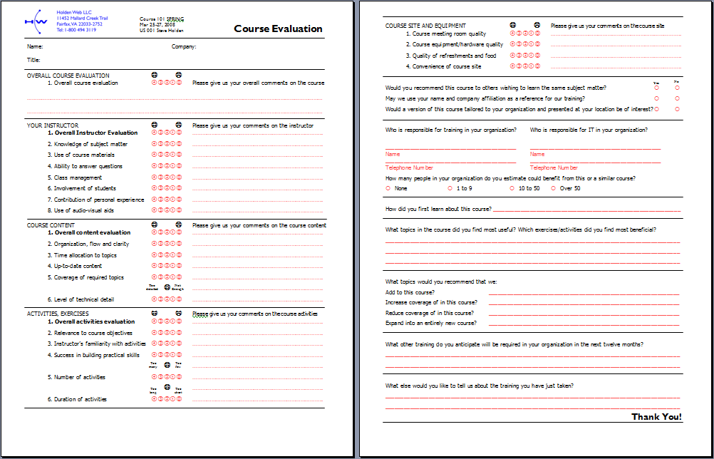
Your Evaluation is Important
Please fill out both sides of the form
Your comments will help us improve
Which we are always keen to do!

Slide 210
Finally …
We are grateful for your attendance!
What other training would help you?
We are expanding our training services
Coming soon: Advanced Python Introduction to Django 1.0
We give on-site classes
We consult
Need help with a project? Just ask!

Slide 211
And, Last of All But Definitely Not Least
See you next time!

