Slide 1
Statistical Modelling with Python
Lighthouse Labs Project

Slide 2
Project Goals
Accessing data using APIs
Cleaning and transforming data using Python
Loading data into a database using Python
Performing EDA, including using both statistics and visualizations
Identifying trends and patterns in data using statistical models
Interpreting the results of the statistical models

Slide 3
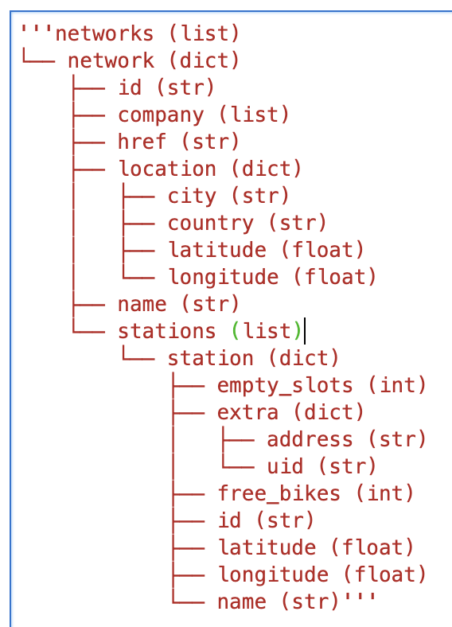
Step 1: Connecting to City Bikes API
For this step I had to explore the structure of the API, and make API request:
I chose my own city of Vancouver, and retrieved the list of bike stations, free bikes, longitude and latitude.
  My results were 241 bike stations

Slide 4
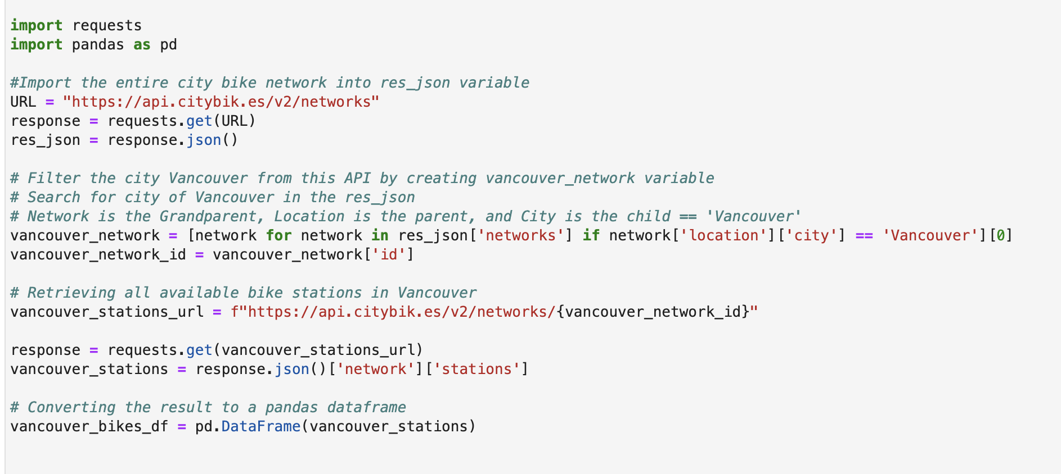
Code for part 1:

Slide 5
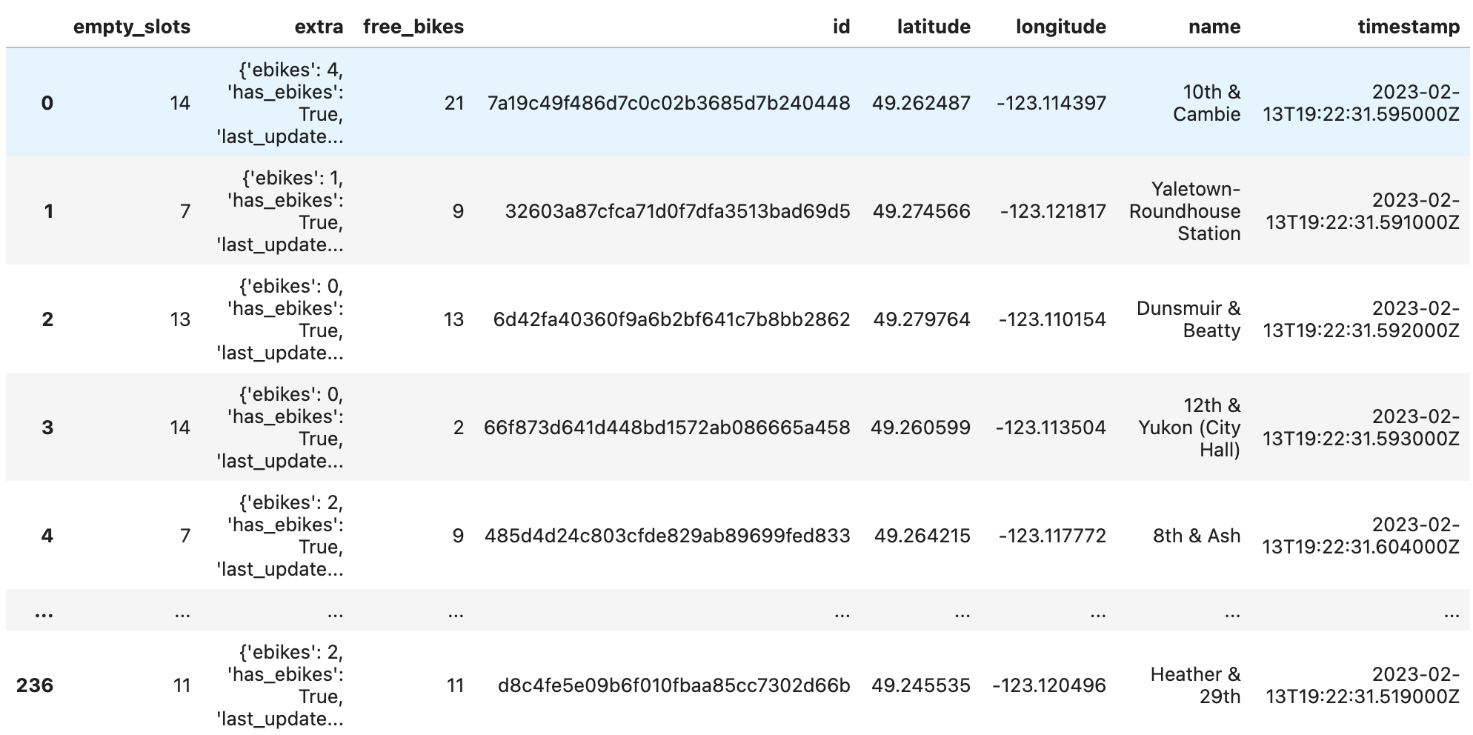
Output:

Slide 6
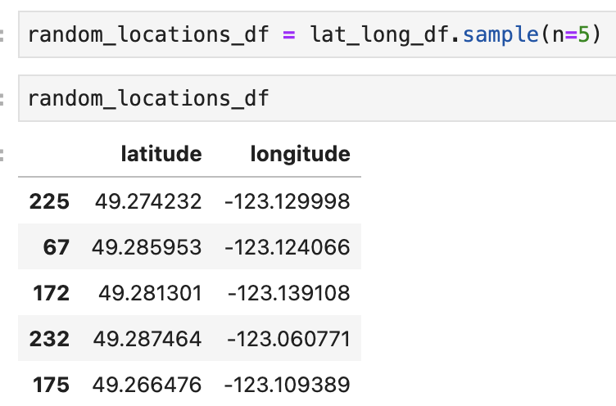
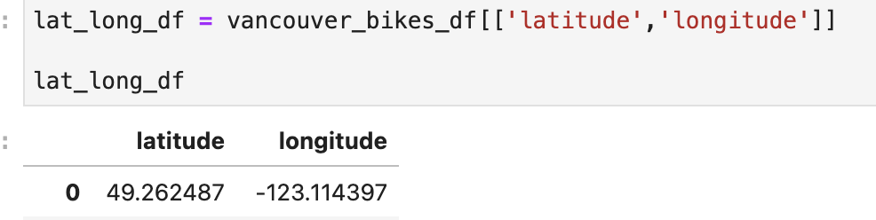
Step 2: Connecting to FOURSQUARE/YELP API
Connecting to the API based on each bike_station in part 1 and query the API to retrieve information on restaurants in that area.
First I imported the dataframe from part 1 by converting it into a CSV and loading it into the next notebook.
Challenge: I had difficulty creating a loop through API search, eventually leading to me. Choosing 5 random bike stations.

Slide 7
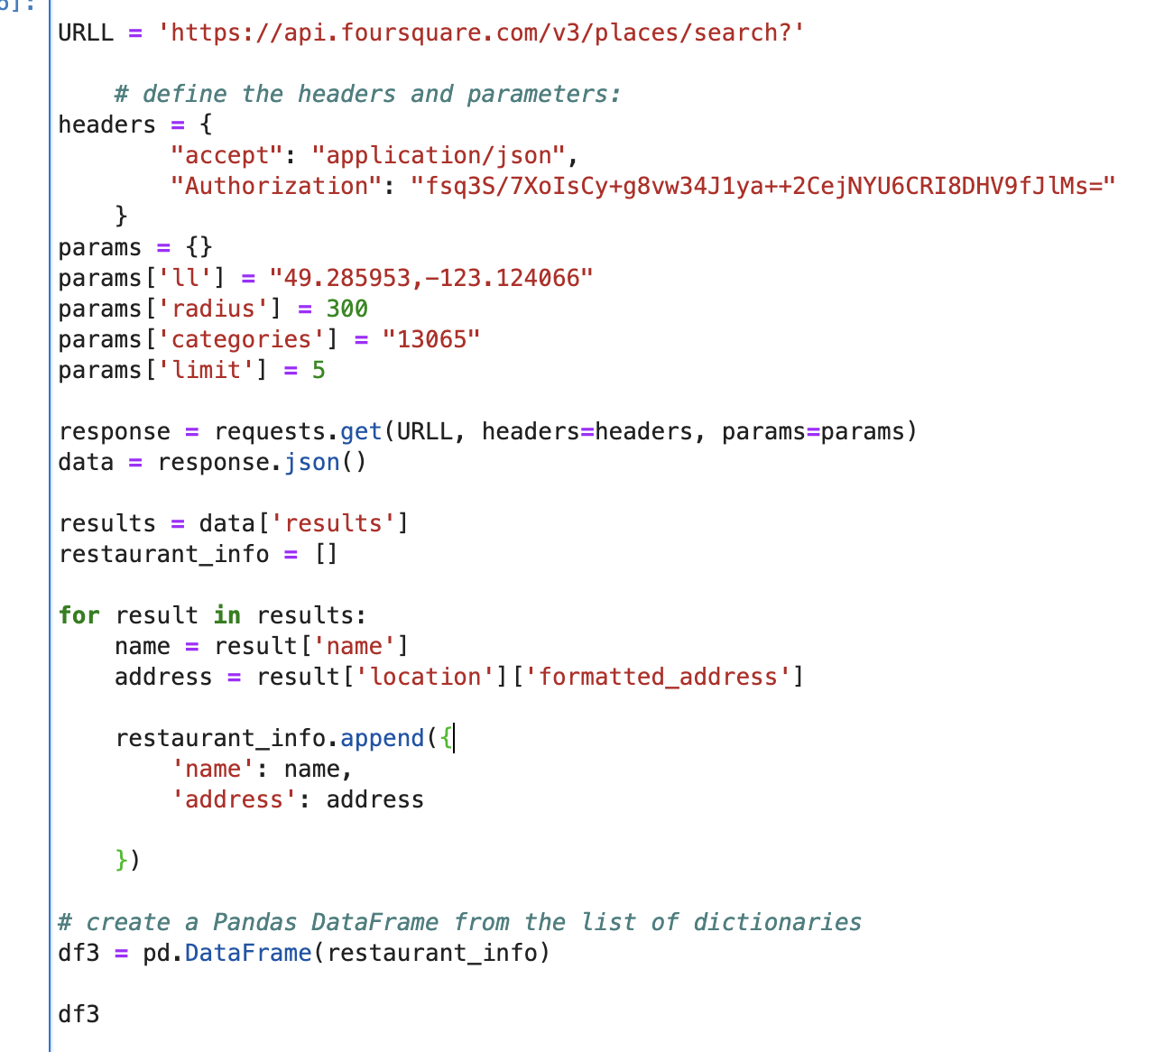
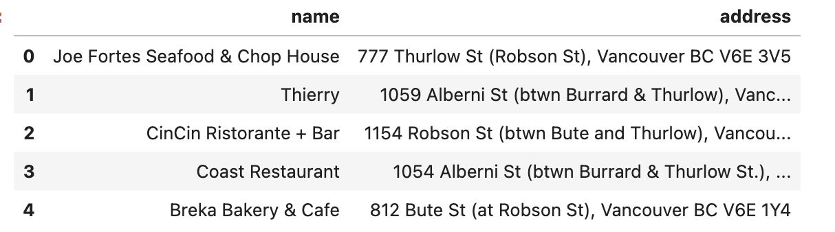
API request code:
My solution was to run this request code 5 times. Based on the sample of the 5 random bike stations coordinates.

Slide 8
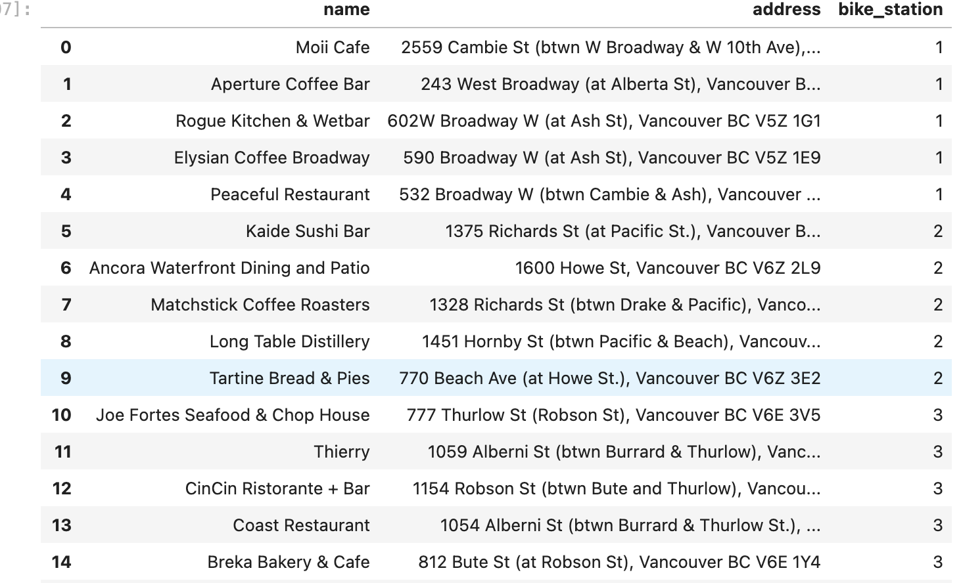
Combined results
Then I assigned each bike station coordinates a number and combined all 5 queries

Slide 9
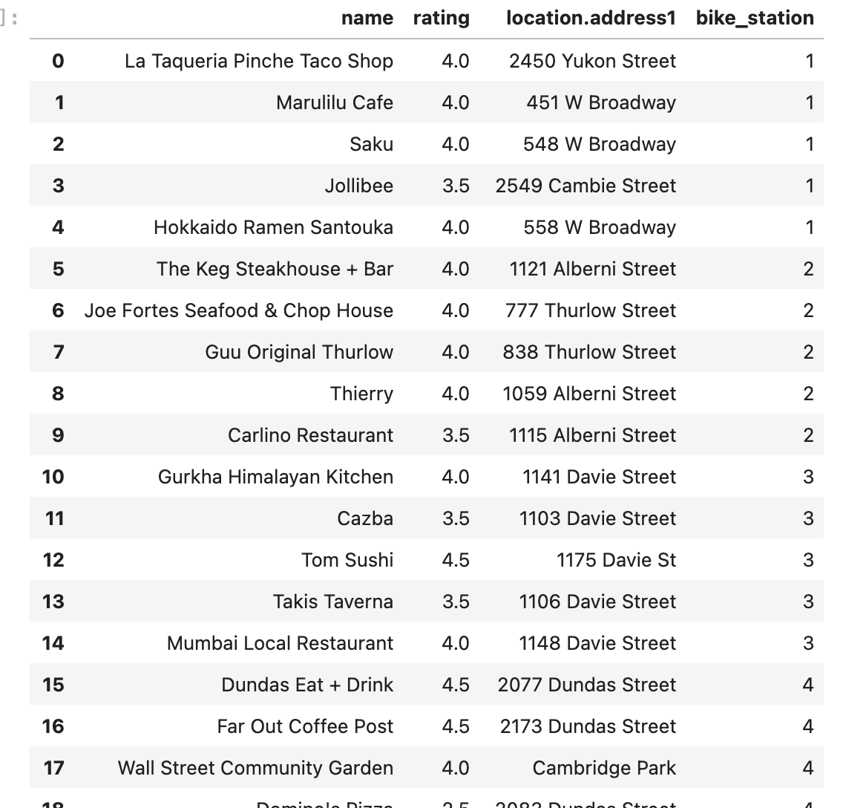
Yelp API
I followed the same process for the Yelp API using the same 5 bike stations.
I included rating in the search for the yelp API query.

Slide 10
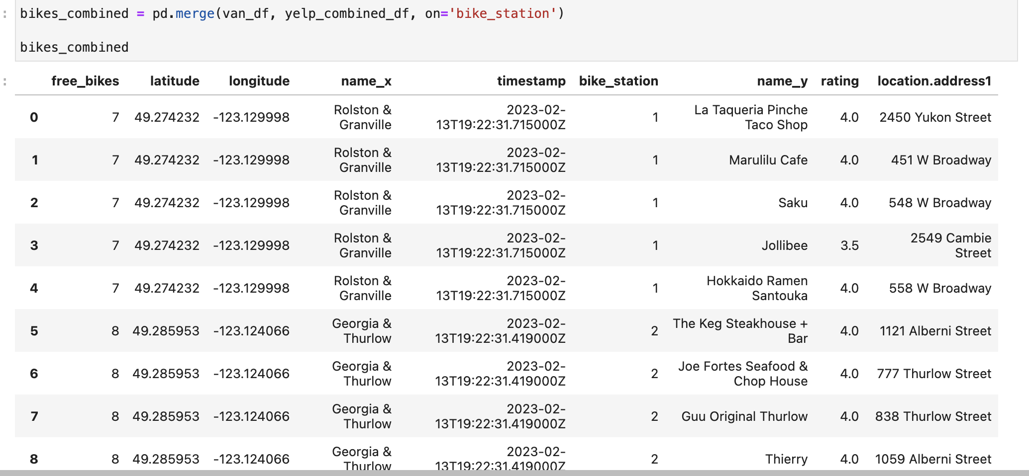
Part 3: Joining data
During this step I combined the Yelp data and the coordinates data
I now had a table that had the bike station with the coordinates, restaurants nearby with the rating of it, and their addresses.

Slide 11

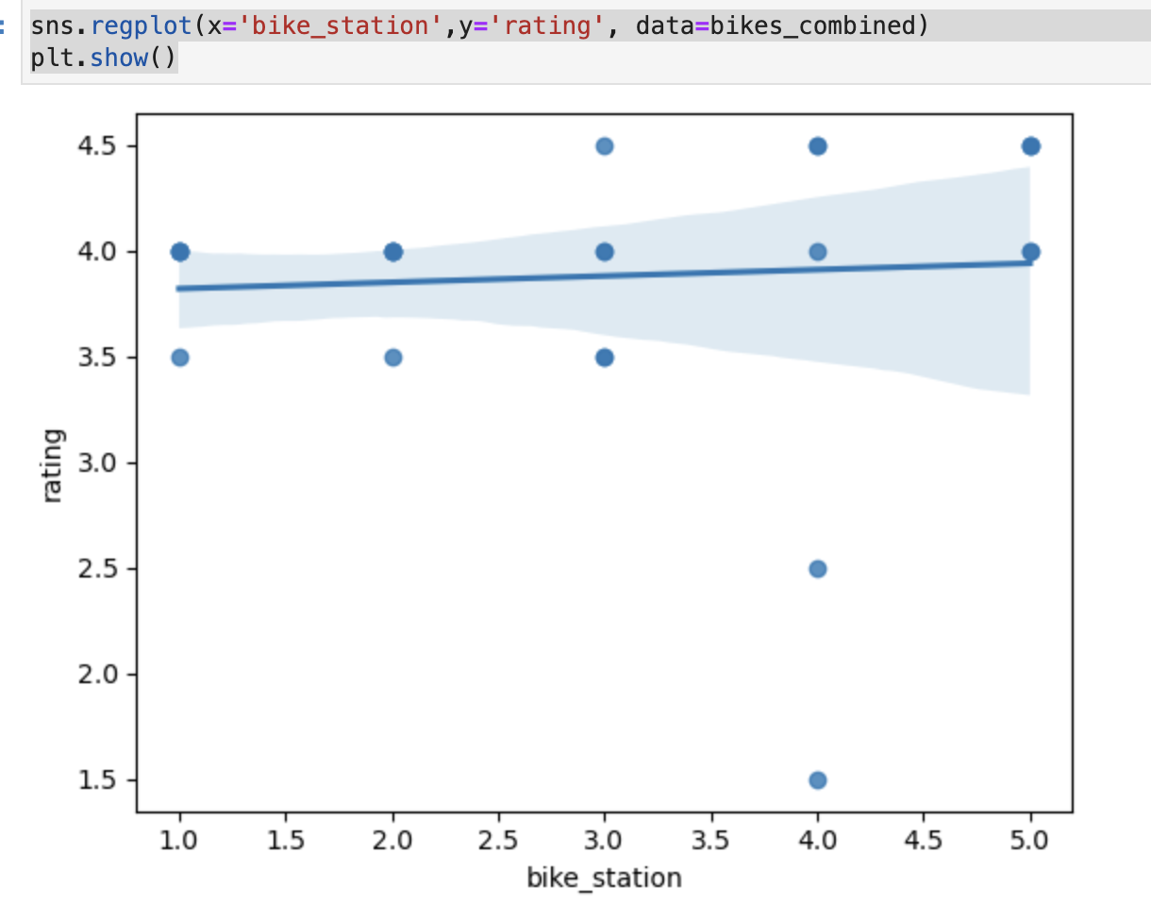
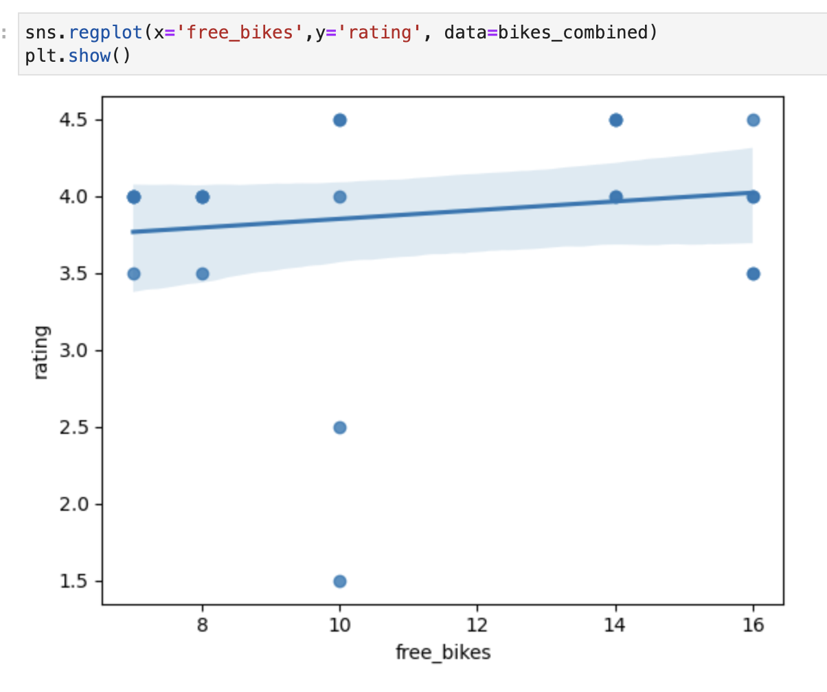
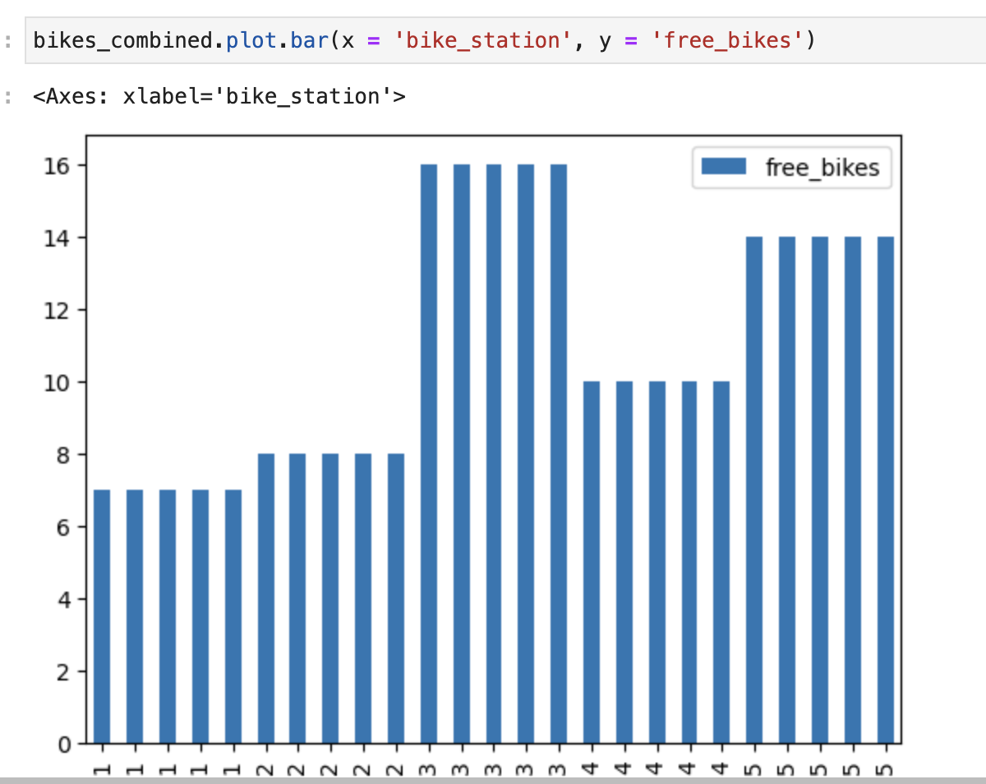
Visualizations for EDA process.
There was only 5 API queries with ratings, restaurants that were searched for so my results were limited.

Slide 12
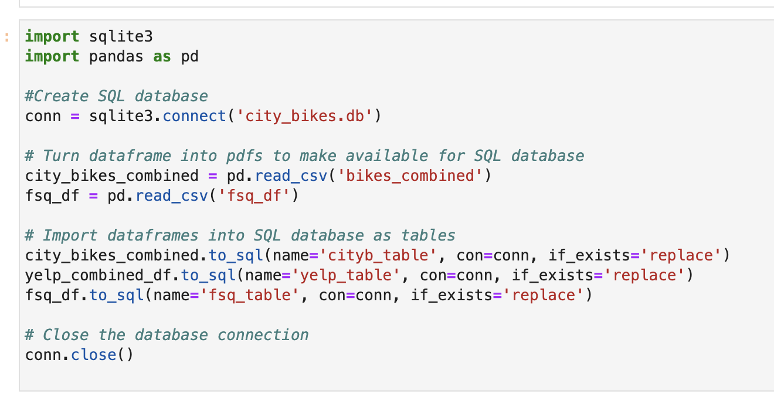
Import results into SQLite database
I created the SQL database in my notebook.
Imported each of the dataframes as a table within the database

Slide 13
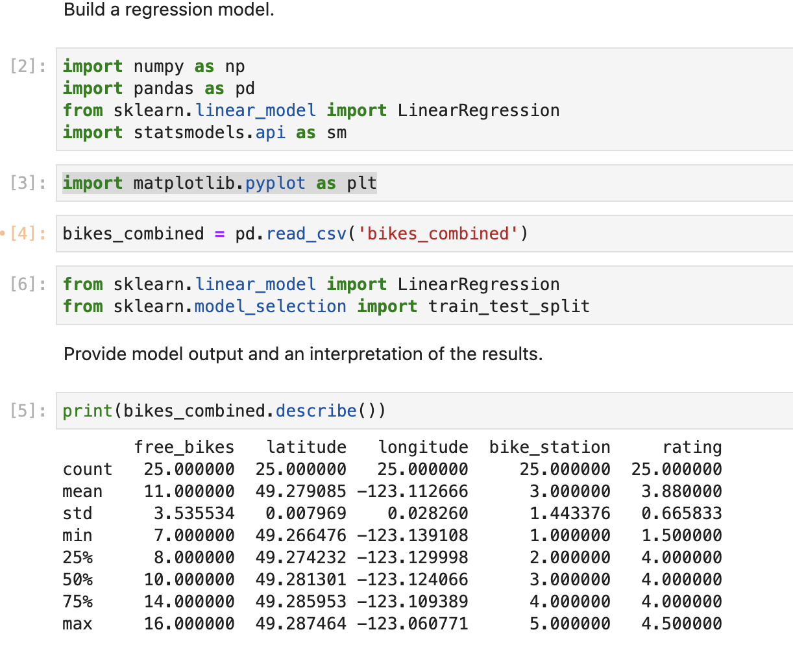
Part 4: Regression Model building

Slide 14
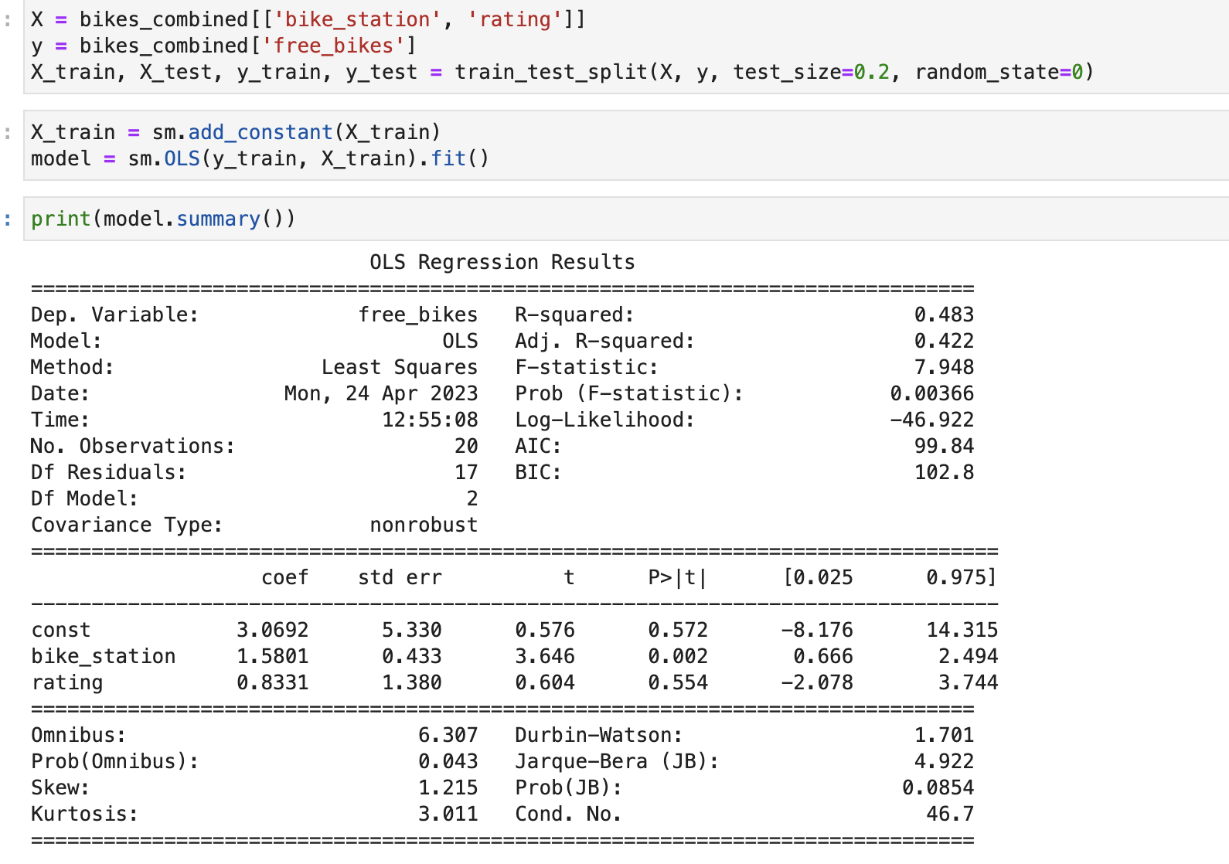
Regression results:
I used free bikes as the dependent variable
I used bike station and restaurant rating as the independent variables.
Sample size is very small
Does not answer whether the variance of free_ bikes depends on ratings of nearby restaurants or location of bike_station

