Slide 1


Slide 2

Online Grocery Shop Android App

Slide 3
Group Members Introduction
Group ID: F2202F1A76
BC190400069 - Ali Raza
BC190409290 - Savera Zafar

Slide 4

INTRODUCTION OF PROJECT
Online shopping is a way to sell food and other household items using an Android application. This project is an attempt to offer the benefits of online shopping to stationary customers. Helps you shop anywhere online via Android app. By using this app, the customer gets online sales without any physical intervention .

Slide 5
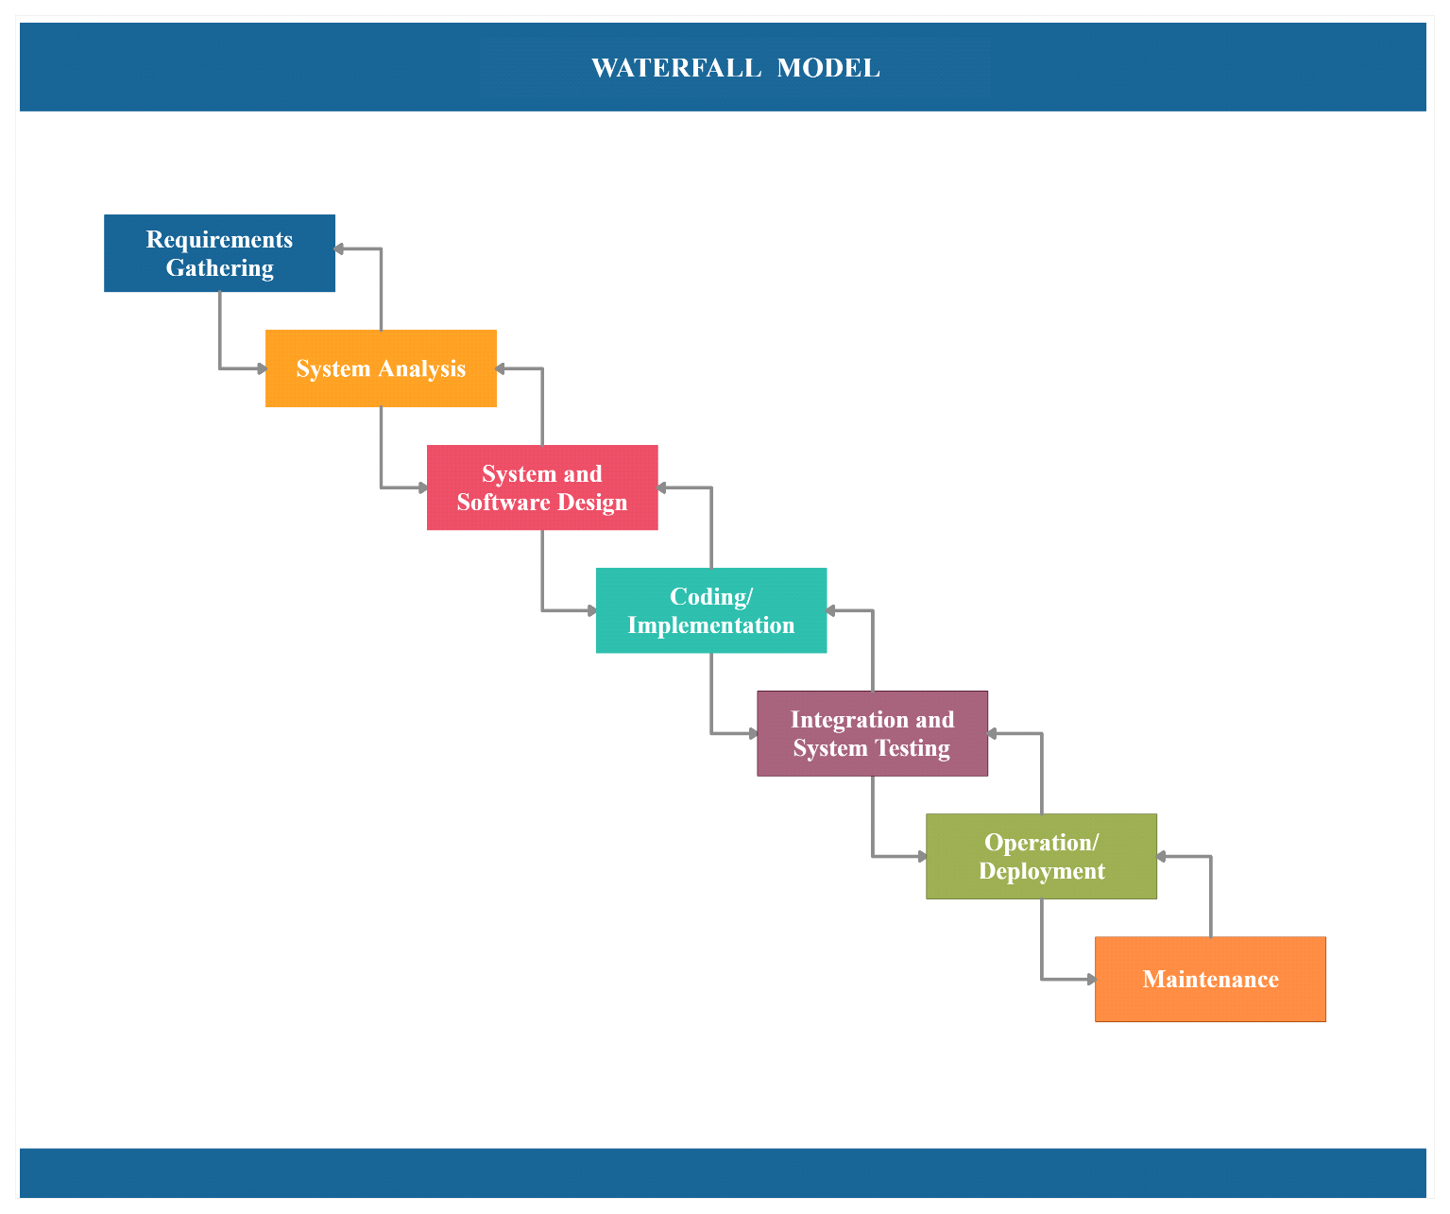
Vu Process Model

Slide 6
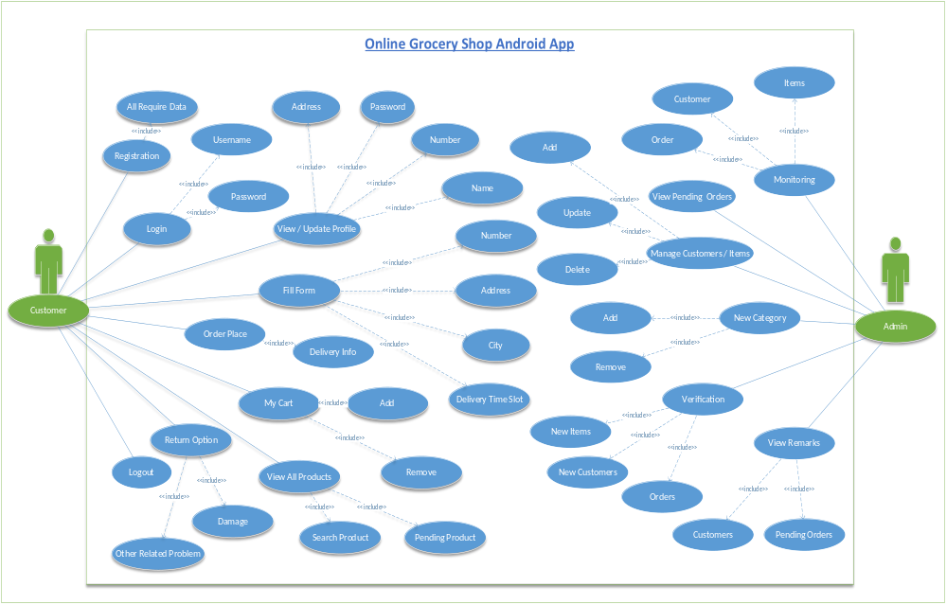
Use Case Diagram

Slide 7
Business Rules Catalog
Customer Module:
User registration and login functionality
Ability for customers to view different types of products
Ability for customers to add items to their cart and place an order
Ability for customers to view and edit their profiles
Ability for customers to view their order history
Ability for customer to schedule incoming deliveries

Slide 8
Ability to return items if customers are damaged or unsatisfied
Ability for customers to pay cash on delivery
Ability for users to fill a form providing their name, number, address, CNIC city, delivery time slot and payment method
Ability for customers to search for a specific product in the list by name
Ability for users to view and edit their profiles
Ability for customers to view all pending orders

Slide 9
Business Rules Catalog
Administrator Module:
Administrator ability to monitor online grocery shop
Administrator ability to add, update and delete categories and items
Administrator’s ability to verify orders and new customers
An Admin can add now new category of items or remove an existing category
Admin ability to manage orders, update status, pickup, generate reports and more
Admin ability to view all pending orders and customer’s remarks

Slide 10
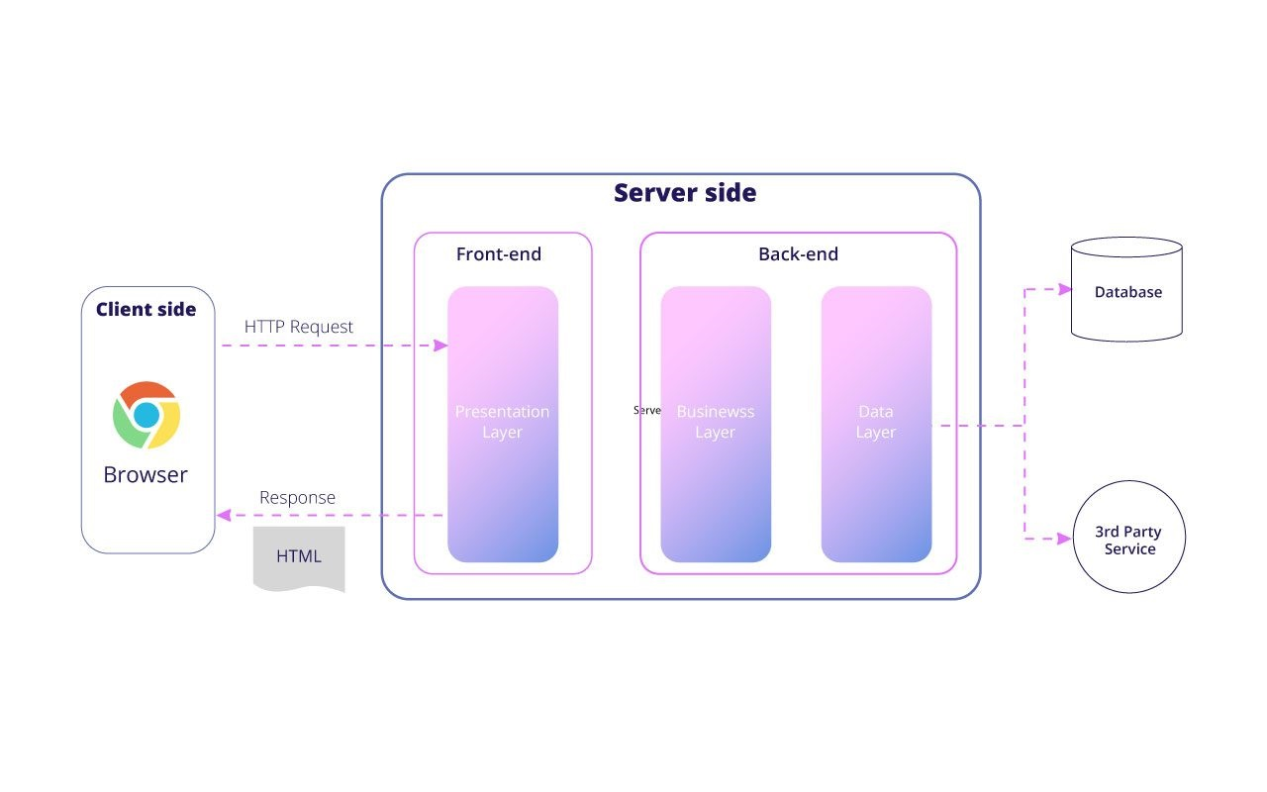
Architectural Design

Slide 11
Team Structure
Savera Zafar (BC190409290)
Ali Raza (BC190400069)

Slide 12
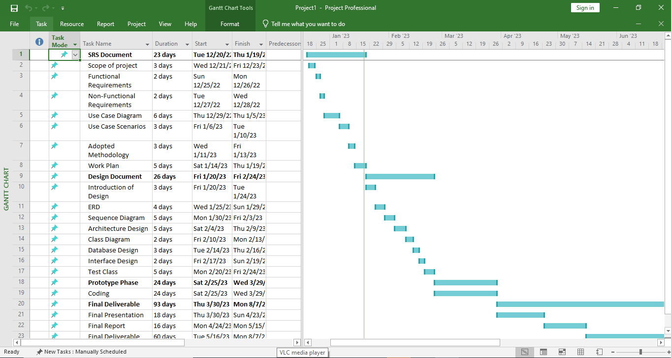
Project Schedule

Slide 13
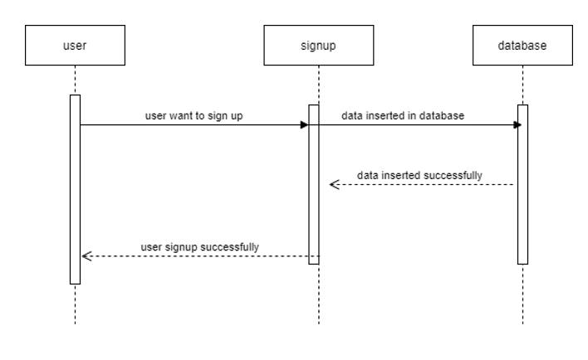
Sequence Diagrams

Slide 14
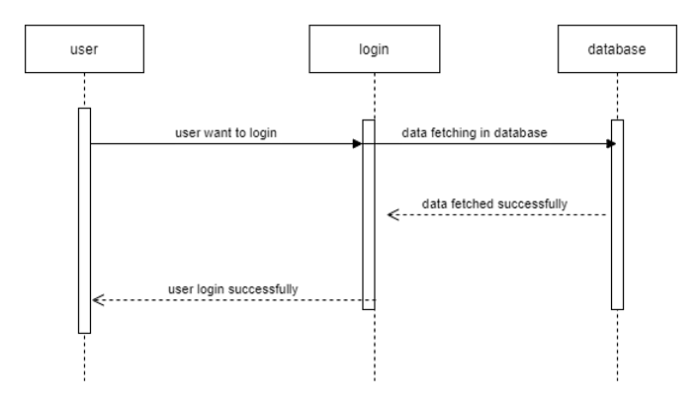

Slide 15
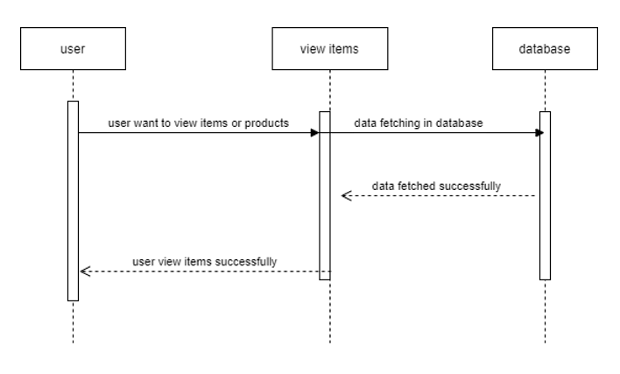

Slide 16
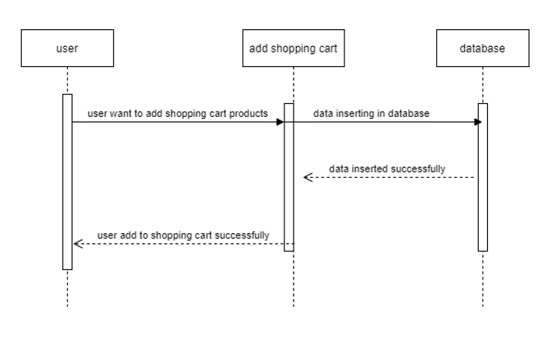

Slide 17
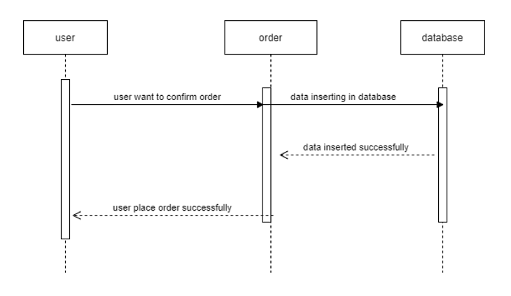

Slide 18
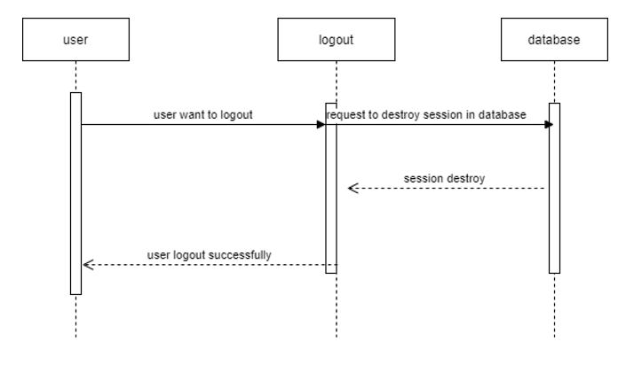

Slide 19
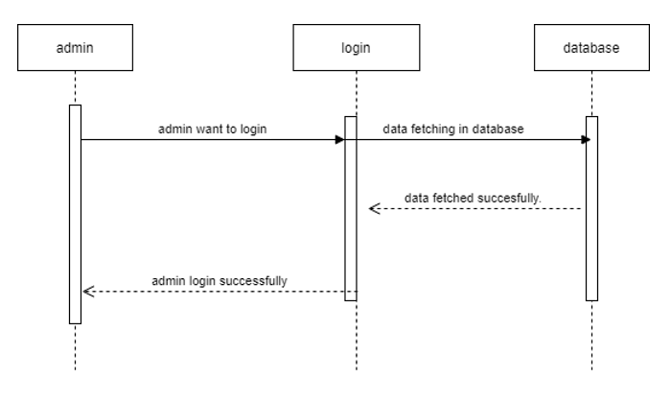

Slide 20
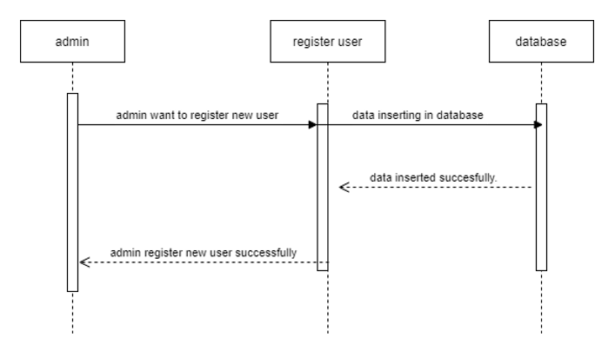

Slide 21
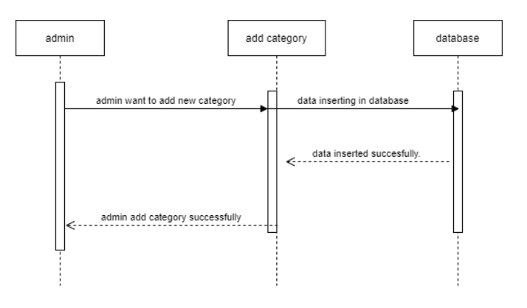

Slide 22
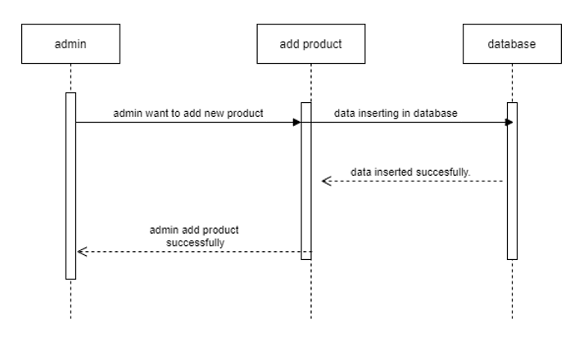

Slide 23


Slide 24
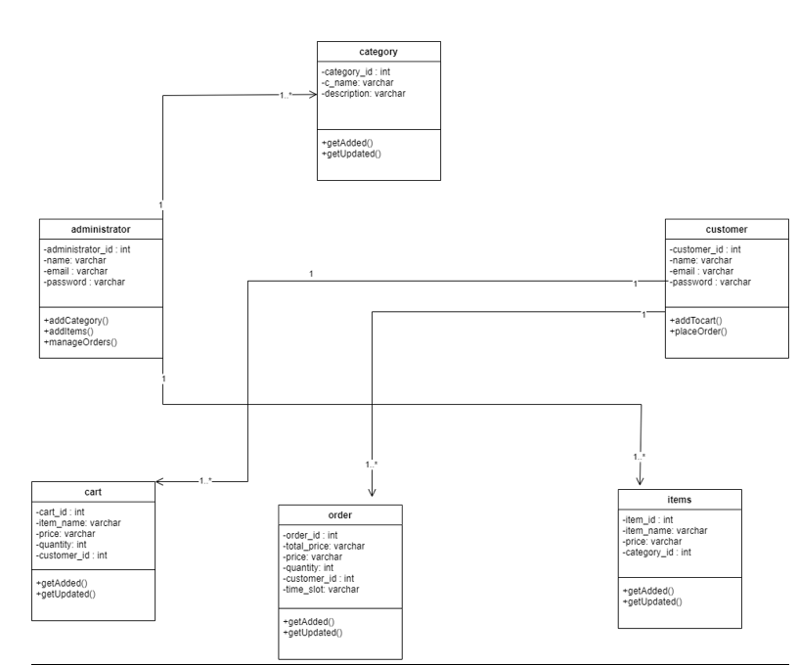
Logical Model/Class Diagram

Slide 25
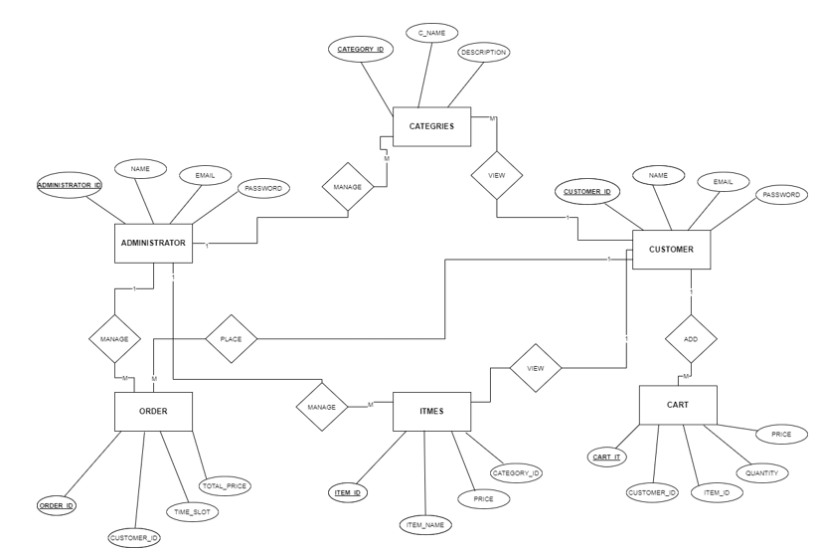
Entity-Relationship Diagram

Slide 26
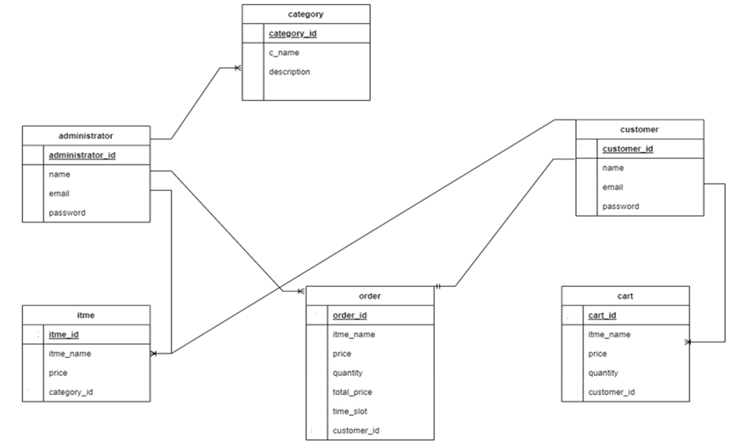
Database Diagram

Slide 27
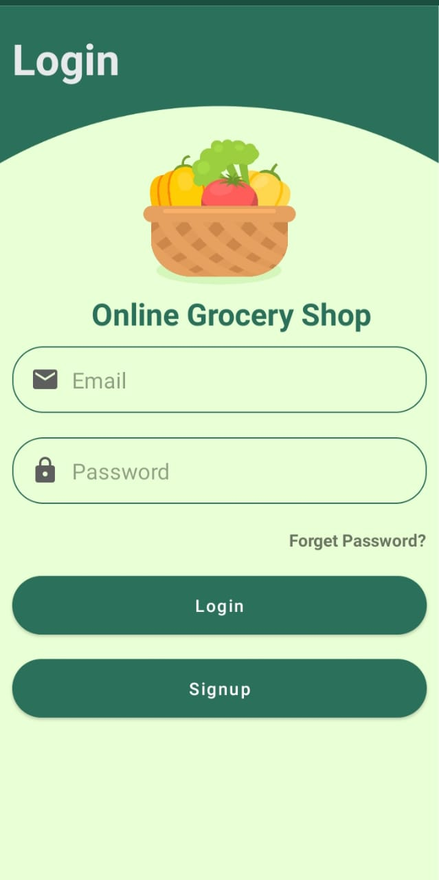
User Interfaces

Slide 28
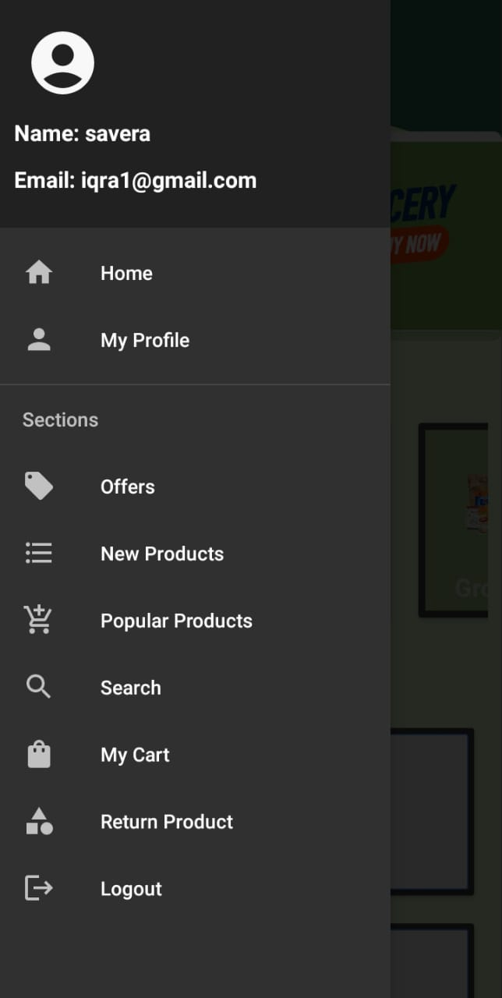

Slide 29
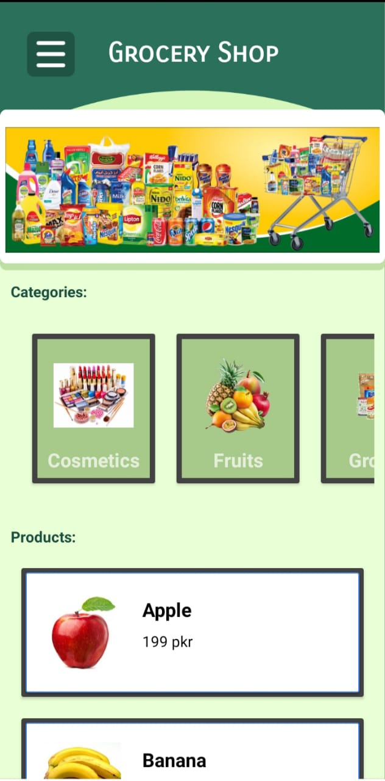

Slide 30
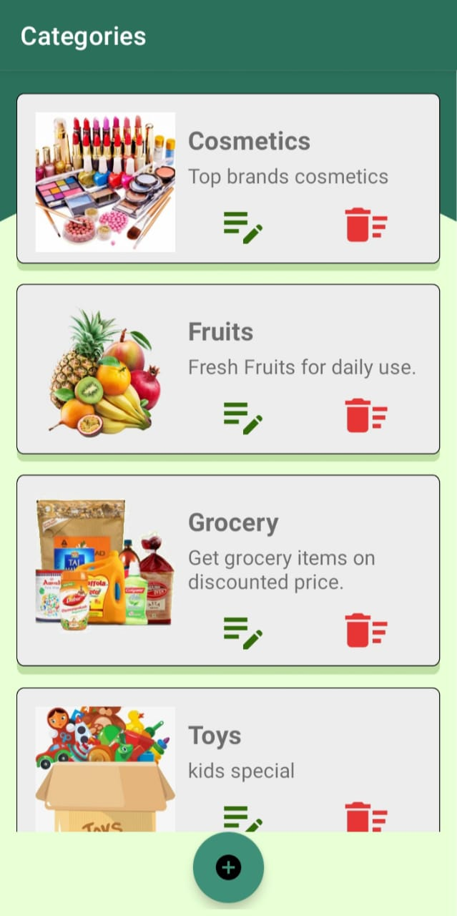

Slide 31
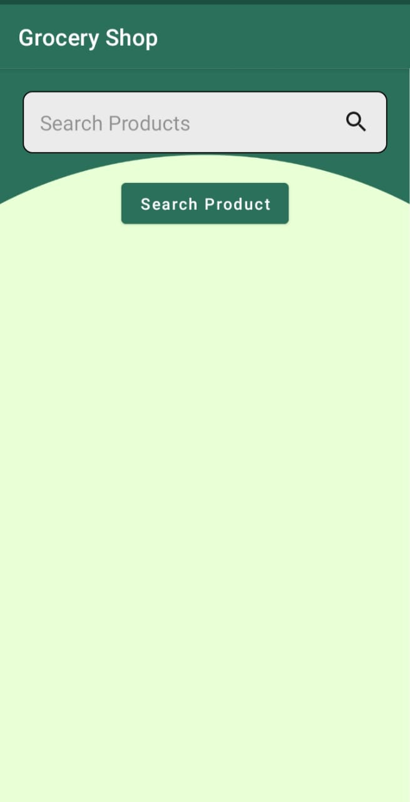

Slide 32
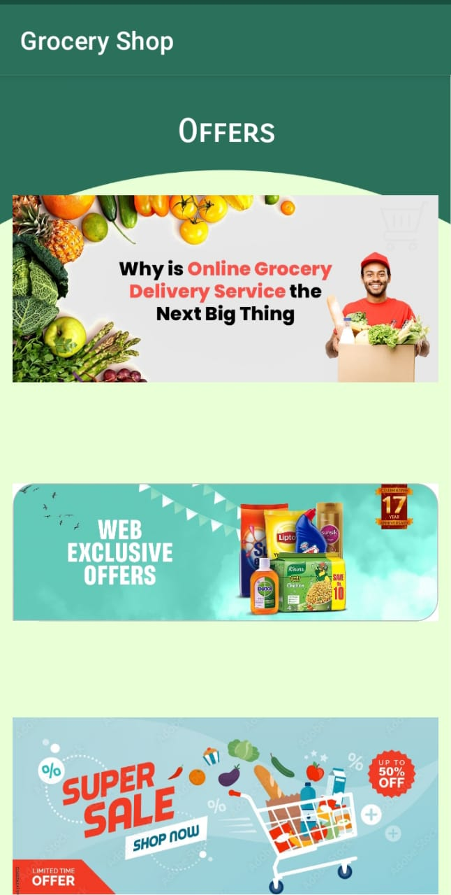

Slide 33
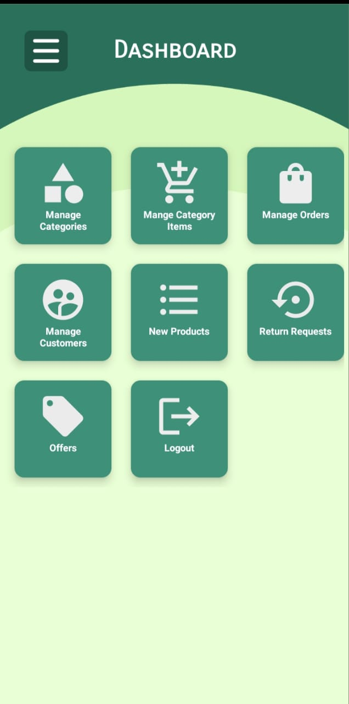

Slide 34
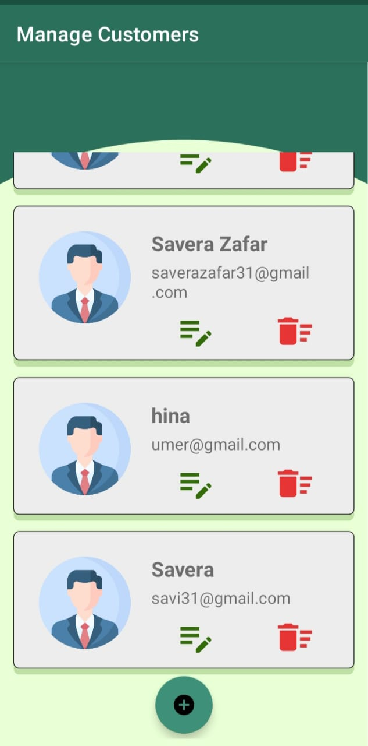

Slide 35
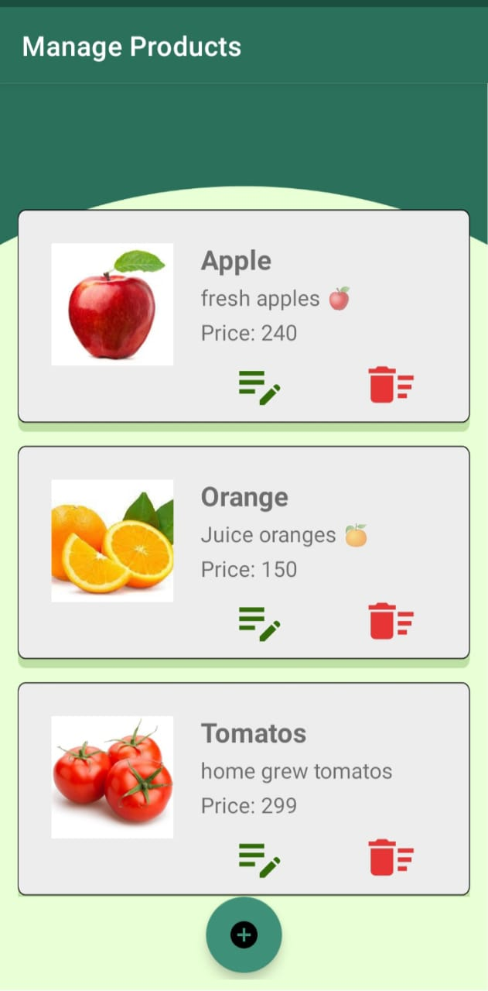

Slide 36
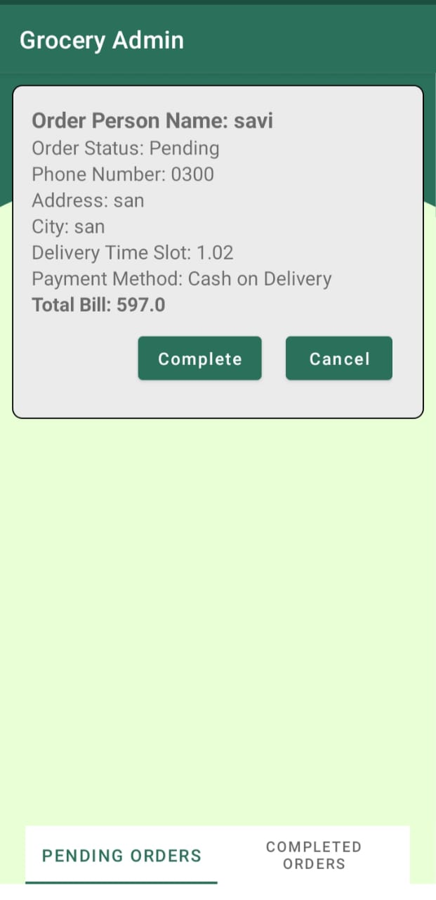

Slide 37
Tools
IDE: Android Studio
DBMS: Firebase
Programming Language: Java/Kotlin
UML: MS Visio, Office

