Slide 1

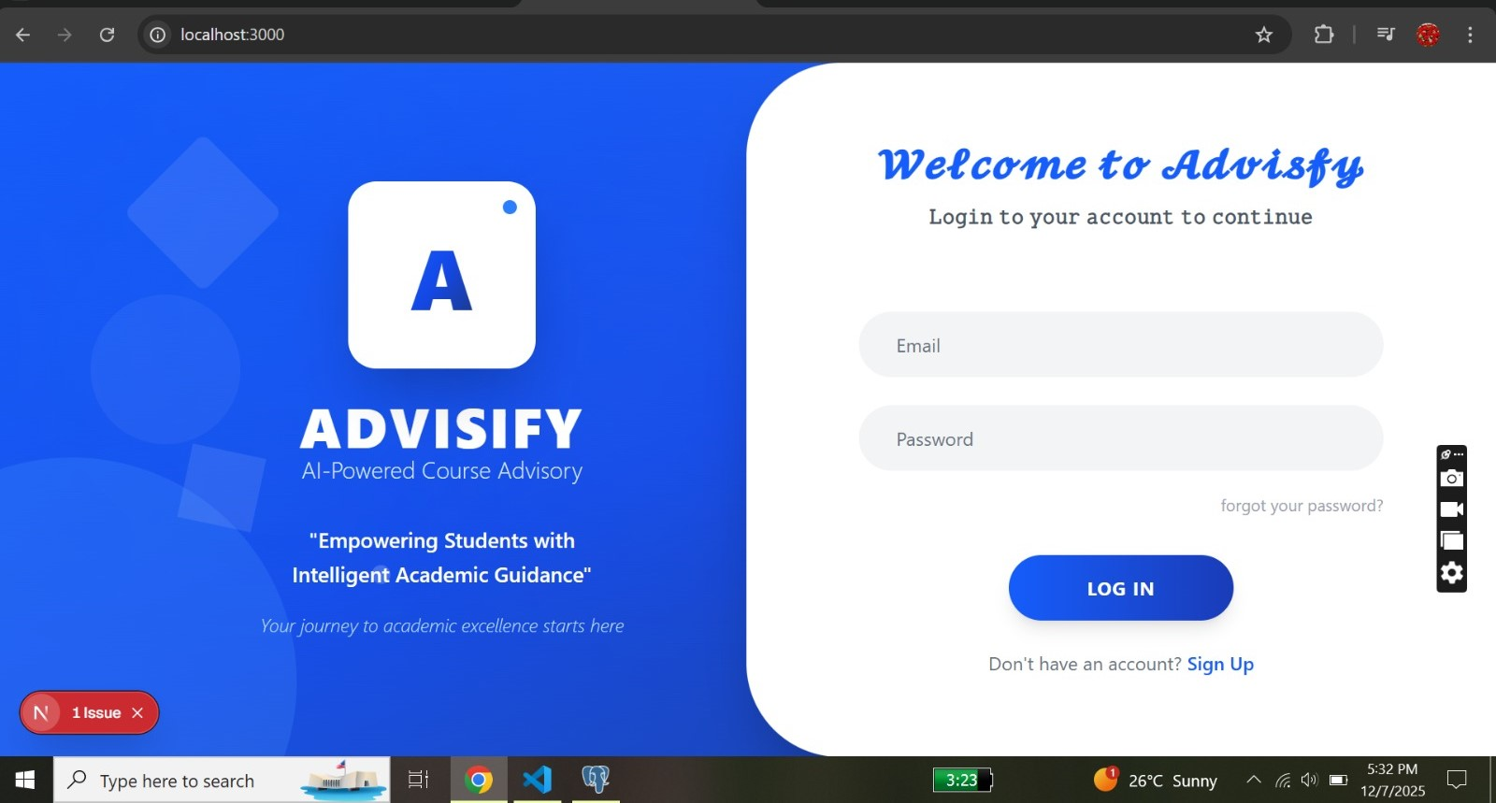
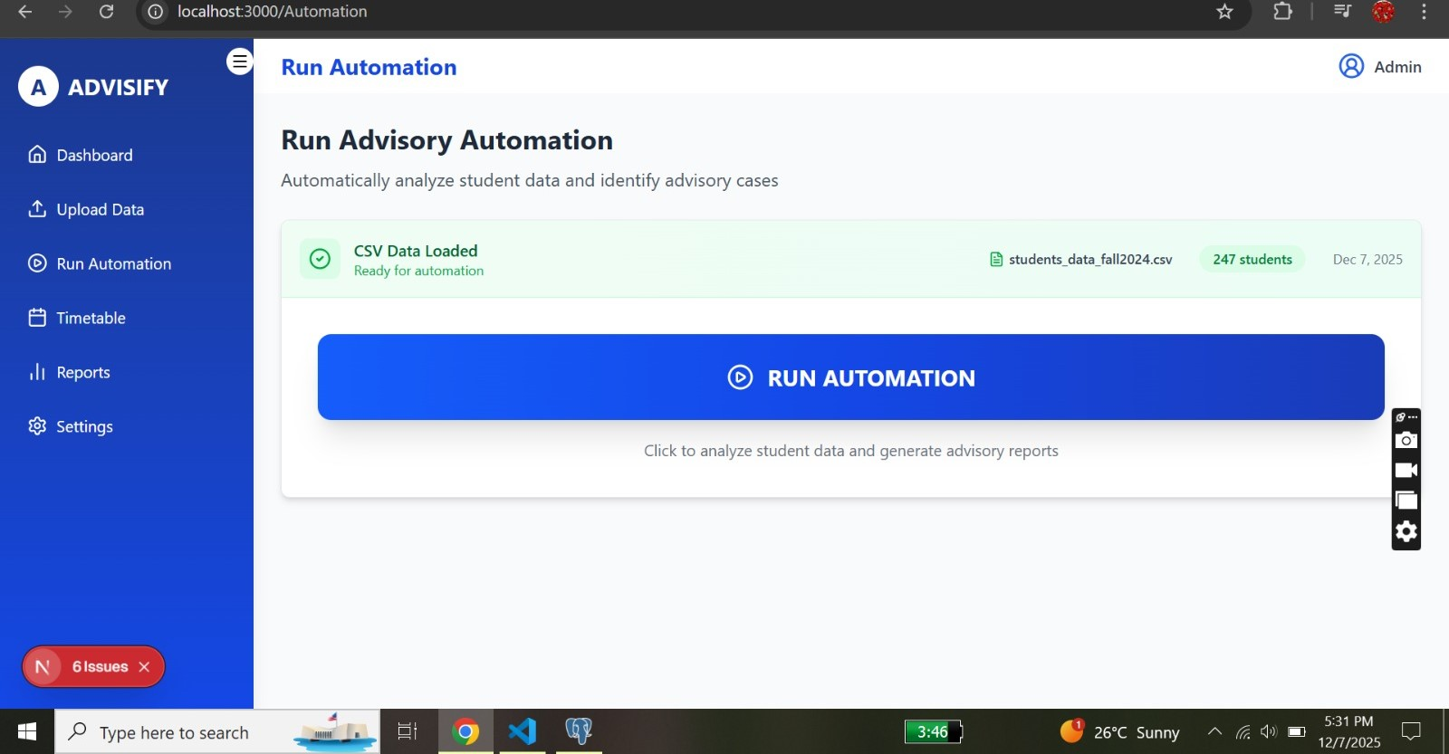
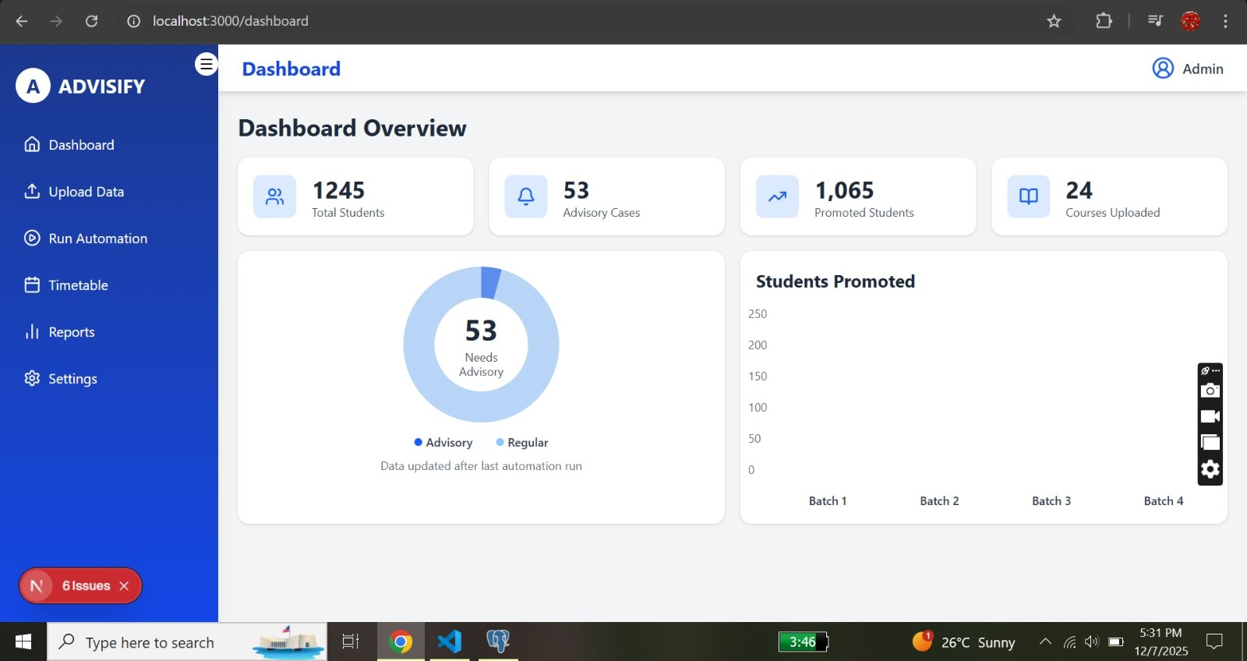
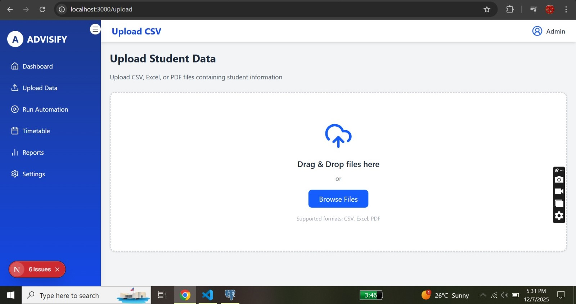
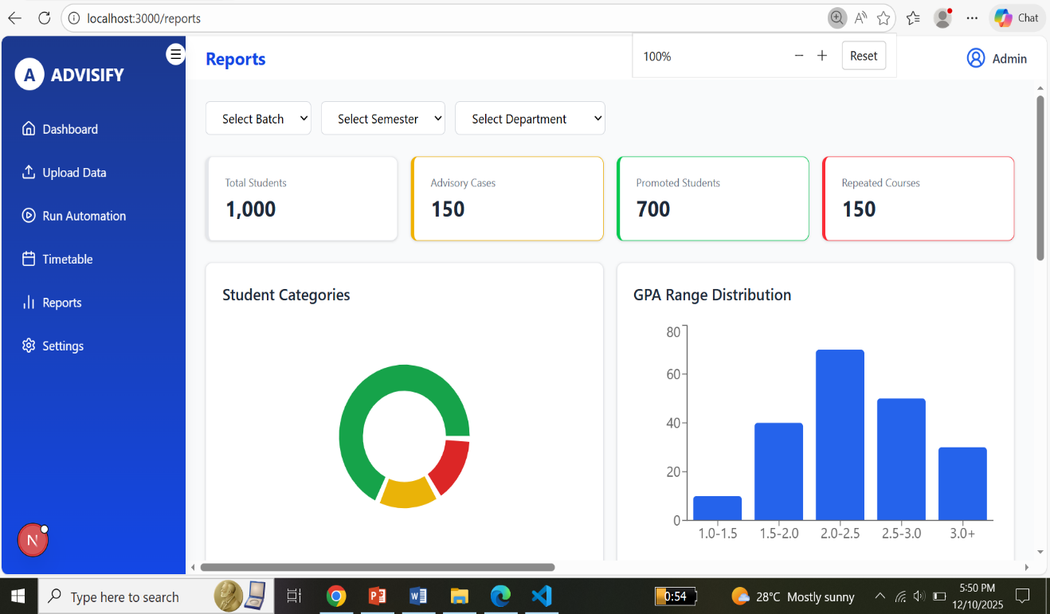
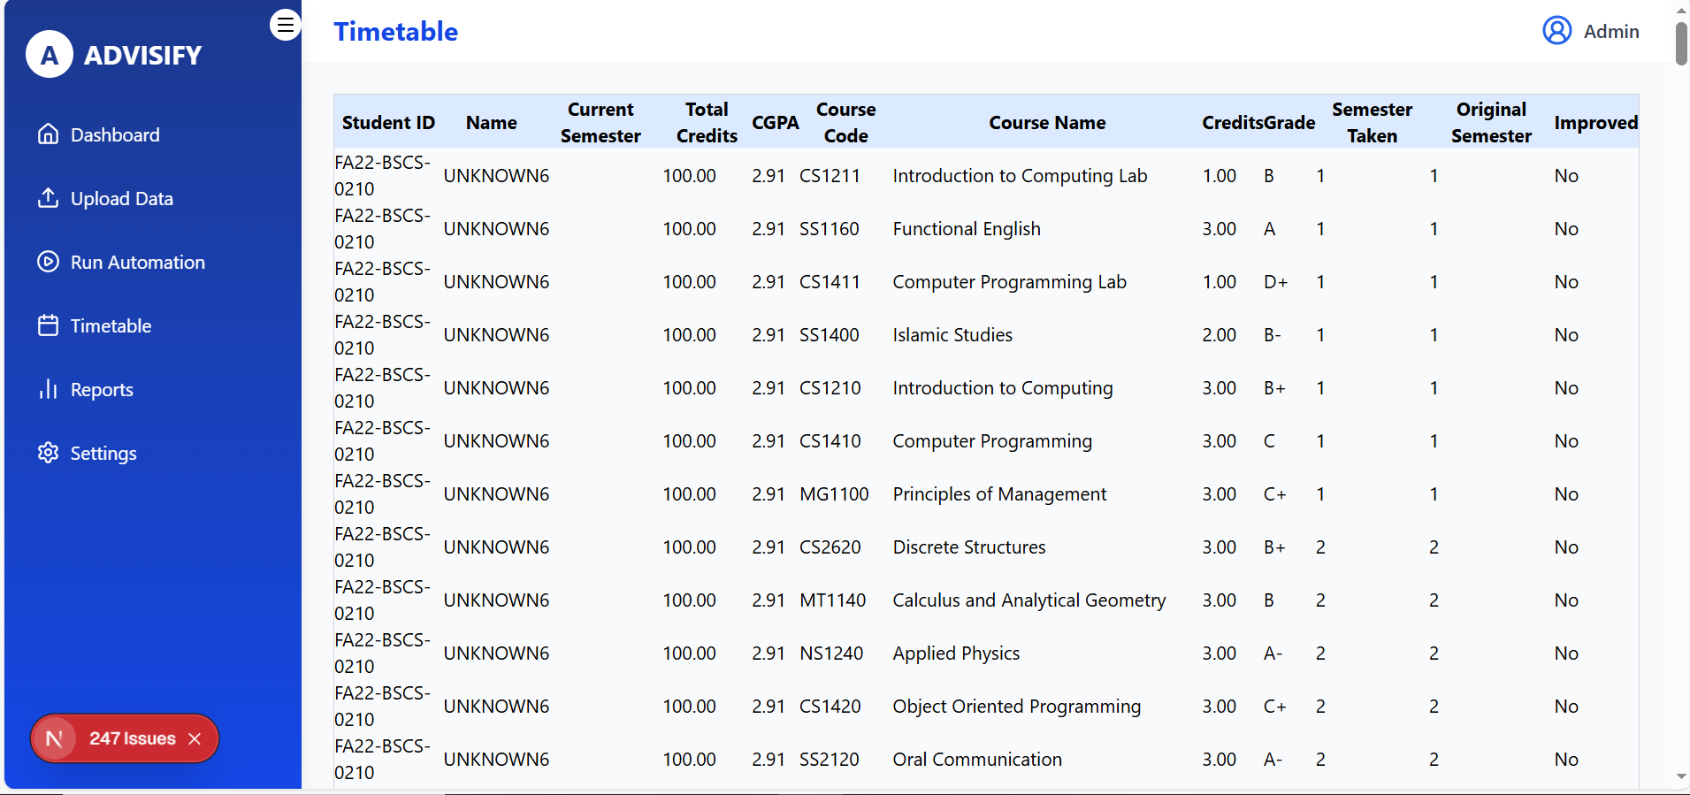








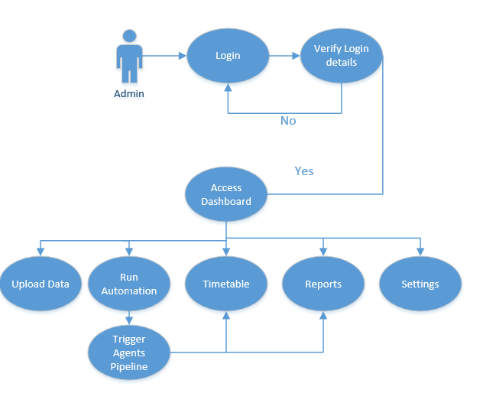
Advisify
Ali Raza Bugti (FA22-BSCS-0136),
Muhammad Ahmed (FA22-BSCS-0210),
Arfat Ayub (FA22-BSCS-0138)
Project ID – CS/FYP/FA25/31
Supervisor
Syed Haider Imam jaffery
BS (Computer Science)
Faculty of Computing, Mohammad Ali Jinnah University
Problem Statement
Result
BSCS course registration process is manual, complex, and inefficient, especially for advisory students. Advisors must check each student’s transcript, track failed courses, prerequisites, and semester requirements, leading to long queues, delays, and administrative overhead. Existing systems lack AI-driven automation to prioritize failed courses, ensure prerequisite compliance, and generate optimized semester-wise course allocations, making the registration process time-consuming and error-prone.
Login Interface
Run Automation
Dashboard
Upload Data - CSV
Reports
Timetable
Develop an AI-assisted multi-agent system (Advisify) to automate BSCS course registration.
The system will:
Take students’ transcript CSVs as input.
Detect advisory cases by analyzing failed courses and missing prerequisites.
Prioritize failed and core courses, while respecting credit limits.
Automatically assign semester-wise courses and generate clash-free timetables.
Store results in a PostgreSQL database and provide an admin frontend for uploads and reports.
Solution
Tool & Technologies
Methodology
The anticipated results demonstrate that Advisify successfully automates the course registration process, reducing manual workload for administrators while ensuring accuracy and compliance with academic rules. The system identifies advisory students, prioritizes failed courses, enforces prerequisites, and generates optimized, clash-free timetables. With a centralized database, administrators can efficiently manage student registrations, view detailed course assignments, and produce actionable reports.
Conclusion

