Slide 1
MIDTERM PROJECT
Sabith Ali

Slide 2
INTRODUCTION
In our analysis of the sales data for coffee, espresso, tea, and herbal tea products across various states in the US, we aimed to identify areas for improvement, particularly focusing on why coffee and espresso products did not meet profit targets. We used several charts to visualize and understand the underlying trends and factors affecting sales and profits.

Slide 3
OVERVIEW
A geographical profit analysis by state.
A comparative profit variance by product type.
An investigation of sales variance for coffee and espresso products.
A detailed expense vs. profit analysis for coffee products.
A breakdown of marketing expenditures by region.

Slide 4
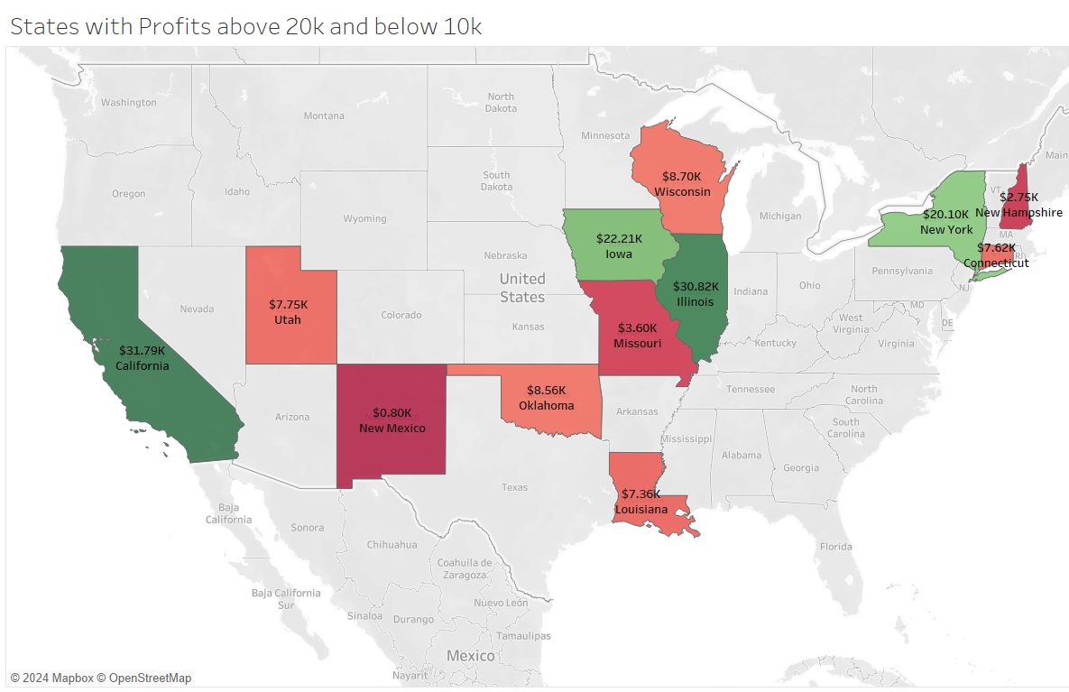
Map of States with Profits Above $20K and Below $10K
This map highlights the states with the highest and lowest profits. California and Illinois emerged as the top performers, with profits exceeding $30K, while New Mexico, New Hampshire, and Missouri recorded profits below $5K. This geographic analysis helps us identify key regions where our products perform well and areas needing improvement.

Slide 5
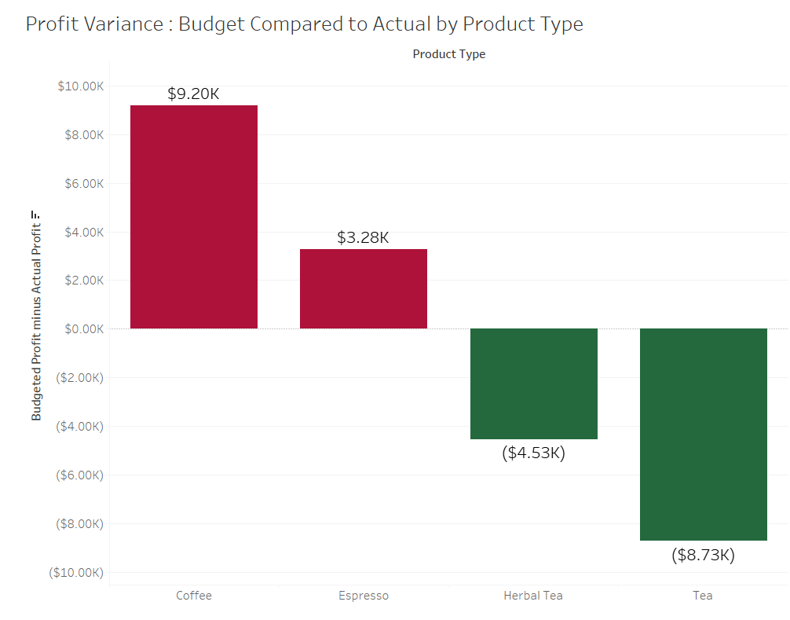
Bar Chart of Profit Variance by Product Type
This chart compares the budgeted profits to actual profits across different product types. Coffee and espresso products underperformed, with profits falling short by $9.2K and $3.28K, respectively. On the other hand, herbal tea and tea products exceeded their profit targets by $4.53K and $8.73K. This variance analysis indicates a need to reassess our strategies for coffee and espresso products.

Slide 6
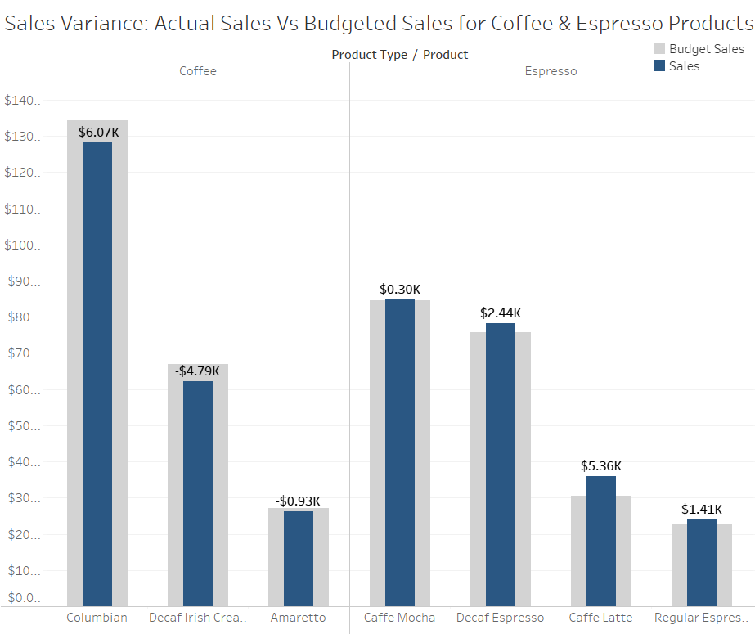
Bar Chart of Actual Sales vs. Budgeted Sales for Coffee and Espresso Products
We further analyzed the sales variance for coffee and espresso products. Coffee products like Columbian, Decaf Irish Cream, and Amaretto fell short of their sales targets by $6.07K, $4.79K, and $0.93K, respectively. Although espresso products met their sales targets, the increases were minimal (ranging from $0.30K to $5.36K), which explains their inability to meet profit targets, especially compared to the robust performance of tea and herbal tea products.

Slide 7
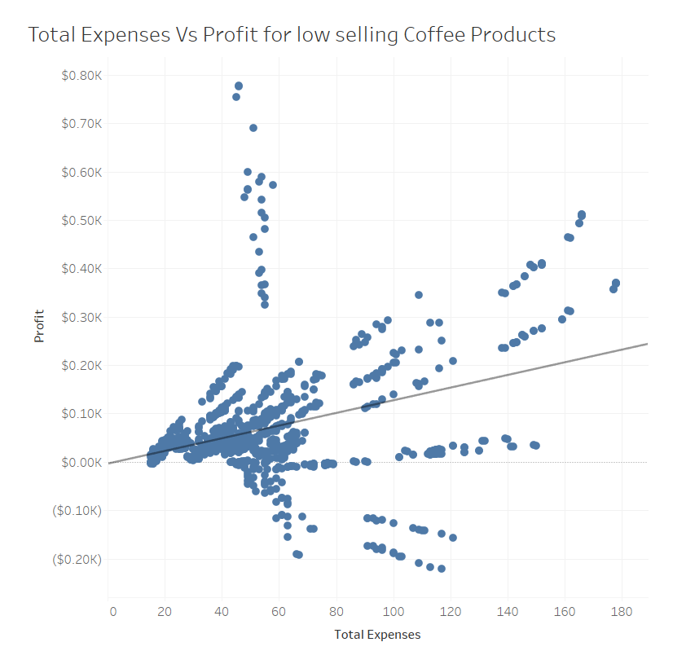
Scatter Plot of Total Expenses vs. Profit for Coffee Products
To understand the low profitability of coffee products, we plotted total expenses against profits. The trend line equation, profit = 1.31 * total expenses - 3.73, indicates a significant number of data points in the loss-making zone, with expenses between $50 and $120. Most data points clustered within a profit range of $0 to $0.20K and total expenses of $20 to $80, underscoring the inefficiency in expense management for these products.

Slide 8
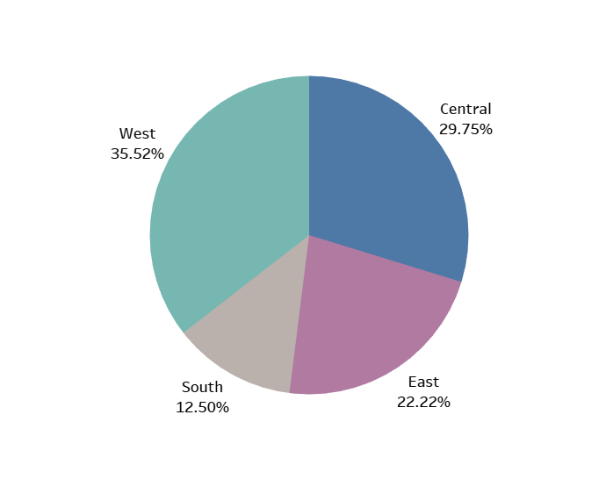
Pie Chart of Marketing Spend by Region
Our marketing spend is distributed, with the West region receiving the highest share at 35.52%, followed by Central at 29.75%, East at 22.22%, and South at 12.5%. This allocation strategy reflects our focus areas but also raises questions about the correlation between marketing spend and sales performance in different regions.

Slide 9
SUMMARY
Our detailed analysis reveals that while tea and herbal tea products are performing well, coffee and espresso products are underachieving in terms of profits. The primary reasons include lower-than-expected sales and inefficiencies in managing total expenses. The geographic and regional analysis further provides insights into where our strategies are working and where adjustments are needed.

Slide 10
ACTIONABLE INSIGHTS
Reevaluate Marketing Strategies: Improve marketing effectiveness for coffee and espresso products, particularly in underperforming states.
Optimize Expense Management: Implement better cost-control measures to reduce losses for coffee products.
Sales Strategy Adjustment: Explore new sales strategies or product improvements for coffee varieties that are underperforming.
By addressing these key areas, we can work towards improving the profitability of our coffee and espresso products, aligning with the strong performance of our tea and herbal tea lines.

Slide 11
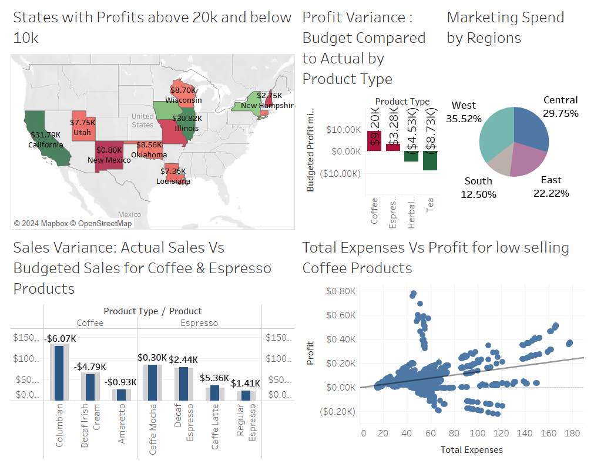
DASHBOARD

Slide 12
THANK YOU
Sabith Ali
A00295187
ANA1006 Dashboards And Data Modelling
Cambrian College

