Slide 1
Modeling Infectious Diseases Chapter 2: Introduction to Simple Epidemic Models Part 3
Ali Setareh Kokab
Feb 2021

Slide 2
Table of contents
SEIR model
Infections with a Carrier State
Discrete-Time Models
Parameterization

Slide 3
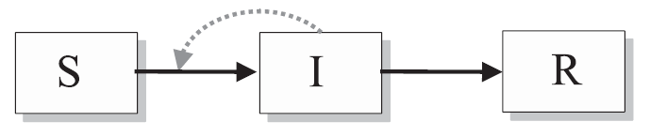
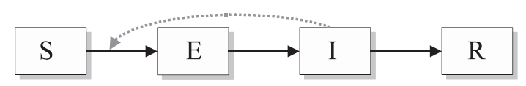
SEIR Model
infected but not yet infectious
(Exposed)

Slide 4
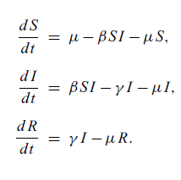
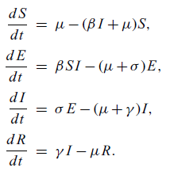



$$σ$$
$$σ$$
the average duration of the latent period is given by 1/$σ$

Slide 5
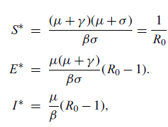

Fixed points:
$$S^{∗}=1$$
$$E^{∗}=0$$
$$I^{∗}=0$$
$$R^{∗}=0$$
Disease Free
Endemic

Slide 6
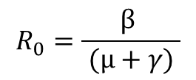


$$R_{0}=\frac{β σ}{ (μ+γ)(μ+σ)}$$
σ/(μ+σ) ∼ 1
$$R_{0}=\frac{β }{ (μ+γ) }$$
the latent is far smaller that the expected lifespan
death of some individuals in the exposed class who do not contribute to the chain of transmission
σ →∞
endemic equilibrium to be feasible and stable
$R_{0}$ > 1

Slide 7

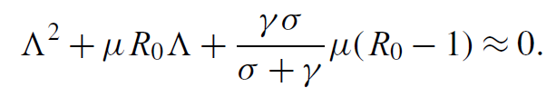


$$\det{J−ΛI=0}$$
in many cases σ and γ will be much larger than $μ$ and $μR_{0}$.
$$Λ∼−(σ +γ )$$
SIR

Slide 8



($βSIR/γSIR = βSEIR/γSEIR$) , ($1/γSIR = 1/γSEIR +1/σSEIR$)
SIR $∼$ SEIR

Slide 9
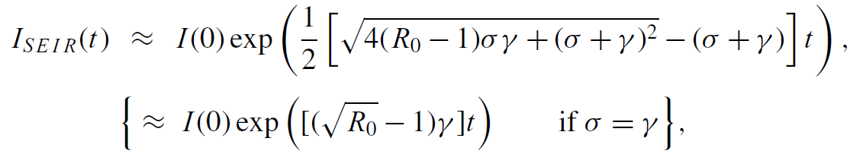
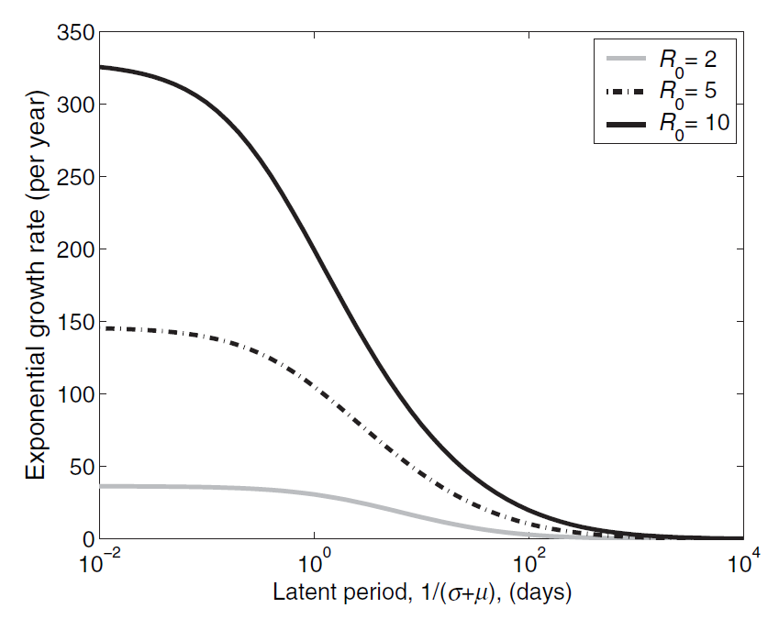

However, the two models behave very differently at invasion:

Slide 10
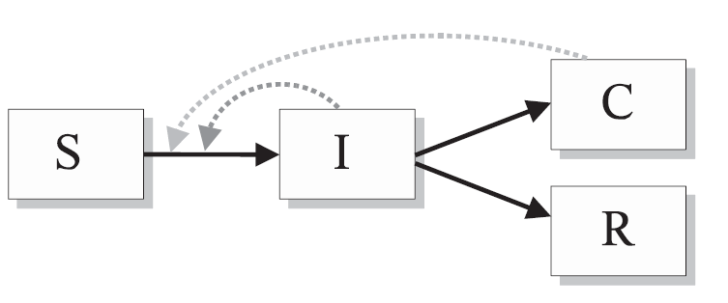
Infections with a carrier state
Hepatitis B
Chronic carriers, transmitting infection at a low rate for many years
susceptible individuals can be infected by either carriers or acutely infectious individuals
It is generally assumed that the progress of infection within an individual is independent of their source of infection

Slide 11
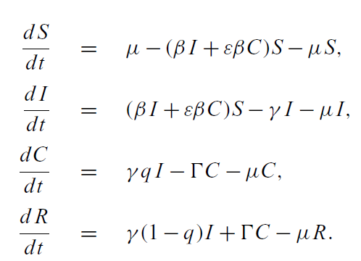
ε is the reduced transmission
rate from chronic carriers compared to acute infectious individuals
Γ is the
rate at which individuals leave the carrier class
q is the proportion of
acute infections that become carriers while a fraction (1−q) simply recover

Slide 12

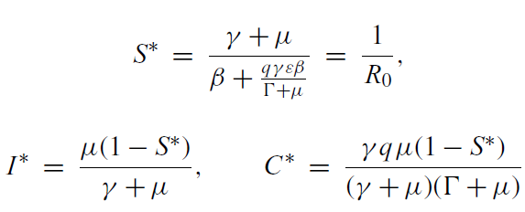
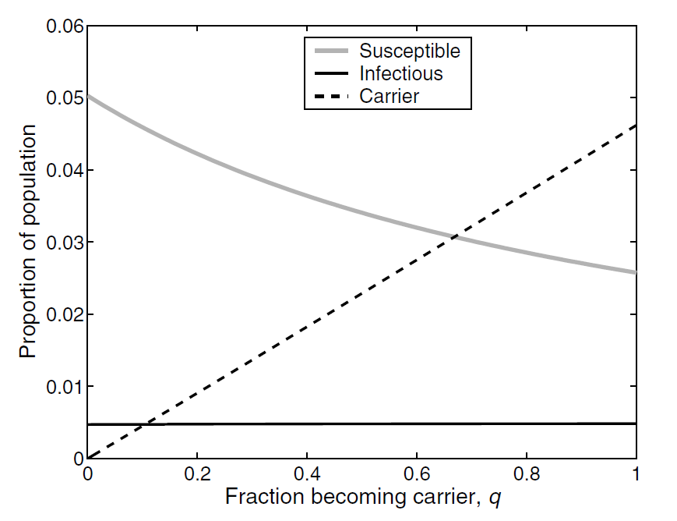

Slide 13
Discrete-time models
The inherent assumption has been that the processes of disease transmission occur in real time and that variability in factors such as the infectious period may be dynamically important.
~ constant factors
Discrete-time
what a time increment represents?

Slide 14
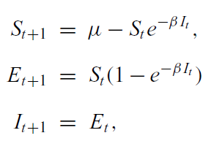
Ideally, units of time should represent the “generation” length of the infection through a host, though in some cases this can lead to some difficulty especially if latent and infectious periods differ markedly.
per capita probability of not contracting the infection given It infectives with transmission β
Latent period= 1 week
β, very much analogous to R0 in the continuous-time models. Thus,
as before, for the infection to invade, we require β >1.

Slide 15

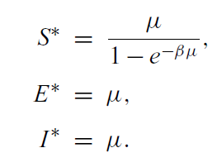

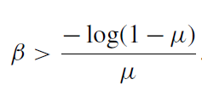

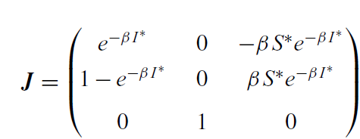
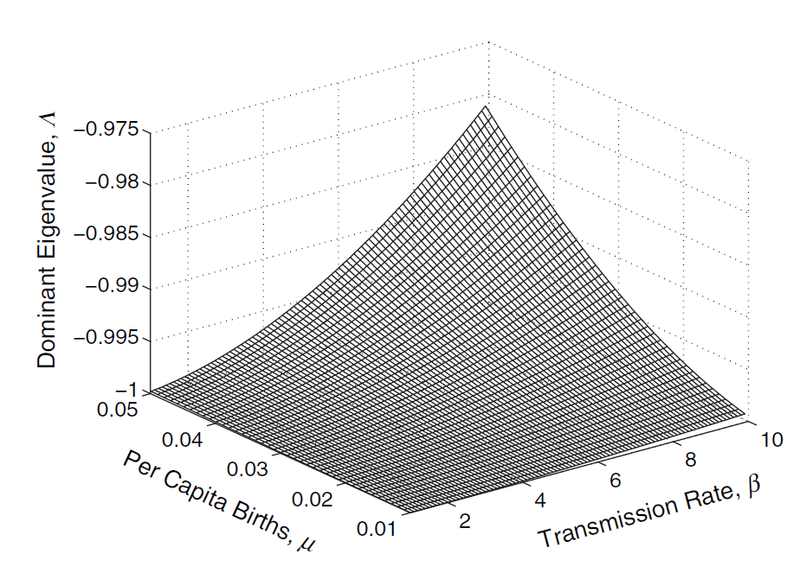
Stability of the equilibrium solution requires the dominant eigenvalue to have magnitude less than one

Slide 16


Parameterization
A good understanding of the host’s biology, for example, will provide accurate estimates of the birth and death rates
The infectious period can usually be estimated independently via clinical monitoring of infecteds, either by observation of transmission events or by more detailed techniques measuring the amount of pathogen excreted.
β?
Estimating $R_{0}$ from Reported Cases
$$R_{0}$$
Estimating R0 from Seroprevelance Data

Slide 17


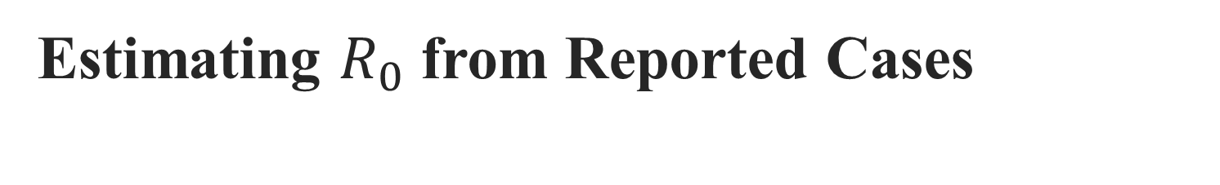
Estimating $R_{0}$ from Reported Cases
we are unlikely to record every case within a population as many infections will go unreported.
(1) this method can work only if there is an epidemic to be
observed, and cannot provide information on endemic diseases;
(2) in the early stages of an epidemic, due to the low number of cases, the dynamics may be highly stochastic.
(3) The final difficulty with this approach is that unless the pathogen is novel to the
population, some individuals are likely to be immune

Slide 18


Y(t) in models vs epidemiological data typically available
In general, it is reasonable to assume that case reports take place once an individual leaves the infectious class
the number of new cases reported at time point T
Age of infection is given by A ≈ 1/[μ($R_{0}$ −1)]
The average age of infection is generally estimated by simply
finding the average age of all reported cases.

Slide 19


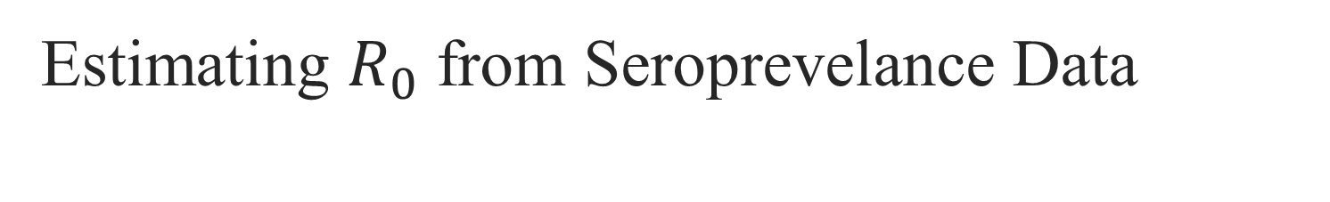
Estimating $R_{0}$ from Seroprevelance Data
Estimating R0 from case report data is problematic in humans because reporting is often patchy and biased because not all infected individuals seek medical advice.
serological information
The complication with this approach is that we need to make sure that our
sample represents of the entire population
age-dependent nature of the likelihood of
being susceptible

