Slide 1
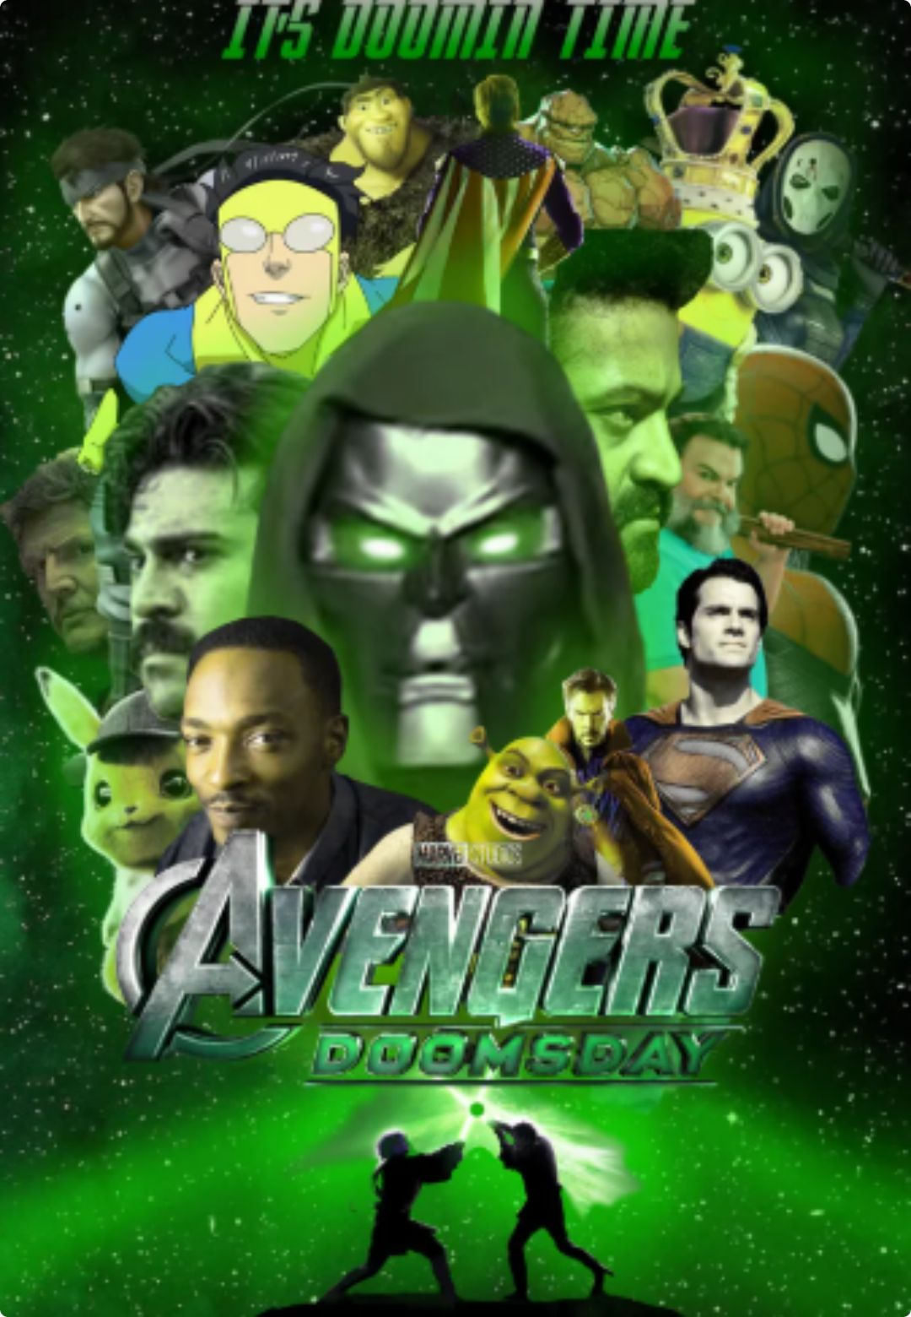
DOCTOR DOOM’S
GRAMMAR DOOMSDAY 💥
MCU: Multiverse of Common Mistakes 🦸‍♂️
Subject–Verb Agreement: Indefinite Pronouns
Doctor Doom is trying to destroy the universe using ONE major weapon: bad English grammar. Today, we defeat him.
[Muhammad Ahsan Tanveer] | [01-134262-051]
[BSCS-1C]
Notes:
Welcome, class. Today we enter the Marvel Cinematic Universe to face Doctor Doom's deadliest threat: bad subject-verb agreement. Pay attention to how indefinite pronouns behave so we can defend the multiverse.

Slide 2
THE GRAMMAR RULE
SUBJECT + VERB MUST MATCH ⚡
The subject tells us who or what. The verb must match it: singular with singular, plural with plural.
Some words sound like groups, but grammar treats them as one.
EXAMPLE
EVERYONE IS READY.
“Everyone” may mean many people, but it takes the singular verb is.
Also singular: somebody, nobody, everything, each, neither.
Notes:
Set up the central rule before the examples: the subject and verb must agree. Point out that indefinite pronouns can refer to groups or sound plural, but they take singular verbs.

Slide 3
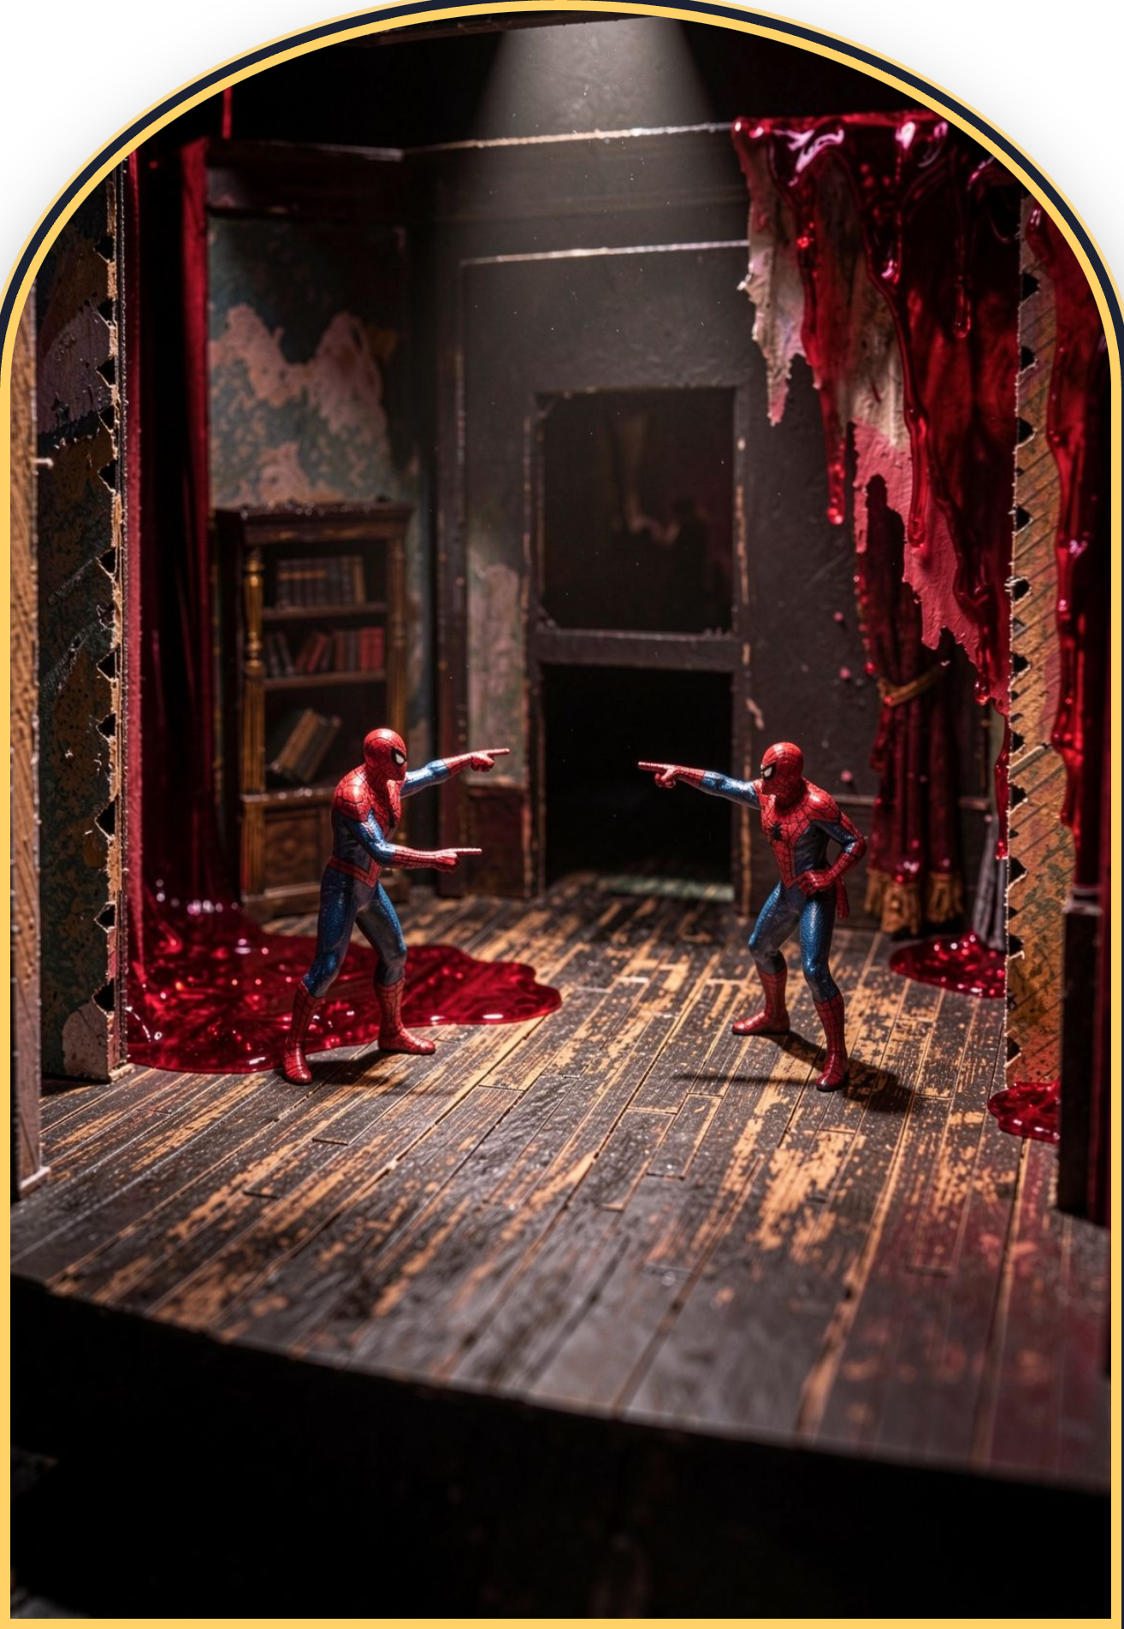
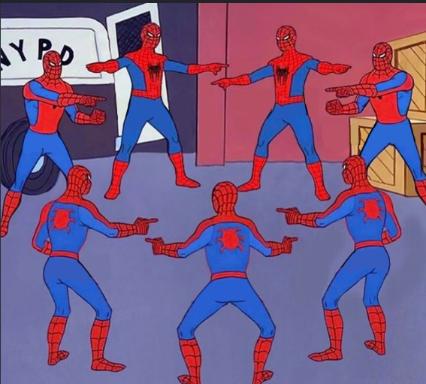
THE SPIDER-MAN MULTIVERSE PARADOX 🕷️
1
The Problem: Why our brain gets tricked into thinking general words are plural.
Everyone
Nobody
2
The Analogy: In 'Spider-Man: Into the Spider-Verse', there are 100 Spider-People pointing at each other. They feel like a massive crowd, but each individual Spider-Man is still ONE person.
Somebody
Neither
Everything
Each
EveryBody
3
The Confusion: Words like 'Everyone' or 'Everybody' sound like a whole multiverse, but in grammar rules, they count as just ONE singular hero.
Notes:
Notice the paradox: a hundred Spideys in a room feels like a crowd, but each one is an individual. That is exactly how words like 'Everyone' trick your brain.

Slide 4
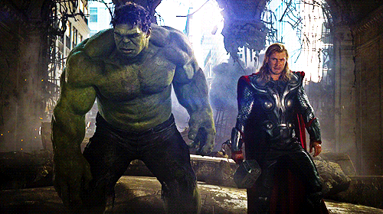
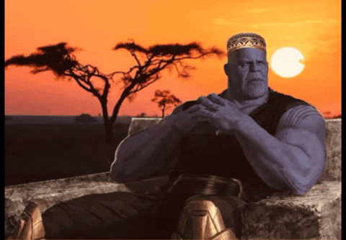
PHASE II · TITANIC LAW
THE HULK & THANOS SECRET: MASSIVE SIZE, SINGULAR SUBJECT 🟢
1
The Rule: Indefinite pronouns ending in -ONE, -BODY, or -THING are ALWAYS grammatically SINGULAR.
2
The Analogy: Think of a classroom full of many Hulks and Thanoses. There may be many of them, but when we talk about the class as one group, it is ONE subject: The class is ready.
3
Memory Cue: A crowded classroom still has ONE subject.
REMEMBER: MANY IN THE ROOM = ONE SUBJECT = SINGULAR VERB
Notes:
Thanos can summon an entire legion, but syntactically he is just one entity. When pronouns end in -one, -body, or -thing, treat them as a single commander.

Slide 5
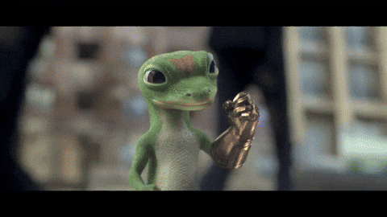




THE INFINITY STONES OF VERBS (MATCHING THE RULES) 💎
Core Formula: Singular Subject = Singular Verb!
IS
WAS
HAS
-S VERBS
Use "IS" (Not "Are")
Use "WAS" (Not "Were")
Use "HAS" (Not "Have")
Use verbs ending in -S (knows, wants, smashes, saves)
IF THE VERB ENDS IN 'S', IT SNAPS BAD GRAMMAR OUT OF EXISTENCE!
Notes:
Here is your cheat code: singular verbs carry the letter 'S'. Is, was, has, smashes, saves. Lock this in memory.

Slide 6
COMBAT PROOF · REALITY CHECK
BATTLE EXAMPLES (SOUNDS WRONG, BUT 100% RIGHT) 🎯
BATTLE 01 · THE SNAP
BATTLE 03 · STARK ARMORY
BATTLE 02 · DOOM'S PLOT
EXAMPLE 1
EXAMPLE 3
EXAMPLE 2
"Everyone HAS survived the Snap."
"Each of the Iron Man suits IS fully loaded."
"Nobody KNOWS Doctor Doom's master plan."
(Not 'have' — the entire surviving group acts as 1 unit!).
(Don't let 'suits' trick you — 'Each' is the real subject!).
(Singular -S verb).
Notes:
Read Example 3 carefully: your ear wants to hear 'suits are', but 'Each' is the grammatical subject. Guard against that illusion.

Slide 7
TACTICAL WARNING · DEFENSE PROTOCOL
THE "PREPOSITIONAL PHRASE" TRAP 🪤 (DOCTOR DOOM'S TRAP)
The Trap: Prepositional phrases stuffed between the subject and verb to confuse your brain.
DOCTOR DOOM'S ILLUSION
AVENGERS CORRECT SHIELD
INCORRECT:
CORRECT:
"Everyone in the Avengers ARE fighting..." ❌
"Everyone (in the Avengers) IS fighting..." ✔
Doom wants you to match with 'Avengers'!
The true subject 'Everyone' requires 'IS'.
Pro Tip: Block out the middle team name with Captain America's shield and look only at the main subject!
Notes:
Prepositional phrases like 'in the Avengers' or 'of the suits' act as smoke grenades. Shield them out and look straight at the pronoun.

Slide 8
LIVE ENGAGEMENT · ARENA COMBAT
MULTIVERSE POP QUIZ (BATTLE MODE ⚔️)
Q1 | "Neither of the multiverses (is / are) safe from Doom."
Q2 | "Everybody in Wakanda (fight / fights) till the end."
Q3 | "Something (seem / seems) broken in the timeline."
3/3 HITS TO REPEL DOOM'S ASSAULT
Answers: 1. IS 2. FIGHTS 3. SEEMS
Notes:
Work through these three questions with the class. Have them call out the subject first, shield the middle phrase, and confirm the singular verb.

Slide 9
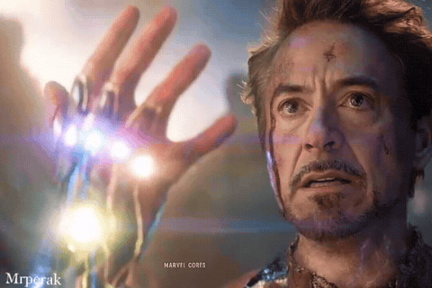
INTERACTIVE CLASS TEST (GAMING / MCU EDITION 🎮)
Question 1: "Everyone on the Discord server (is / are) waiting for the new Marvel movie."
Question 2: "Each of the Infinity Stones (has / have) a unique power."
Question 3: "Nobody in the lobby (know / knows) how to beat the final boss."
Answer reveal badge with celebratory victory graphics!
Notes:
Run this interactive test with the students. Let them vote in real time before triggering the answer reveal console.

Slide 10
SUMMARY & VICTORY CHEAT SHEET 📌
1
2
3
ADMIT
RULE 01
RULE 02
RULE 03
ONE
Rule 1: -one, -body, -thing = SINGULAR SUBJECT.
Rule 2: Pair with IS, WAS, HAS, or verbs ending in -S.
Rule 3: Shield yourself from middle descriptive phrases!
RULES
CLOSING: "THANK YOU! ANY QUESTIONS BEFORE DOCTOR DOOM INVADES OUR NEXT LECTURE?"
Notes:
Review the three core rules on the cheat sheet and open the floor to questions from the class.

Slide 11
