Slide 1
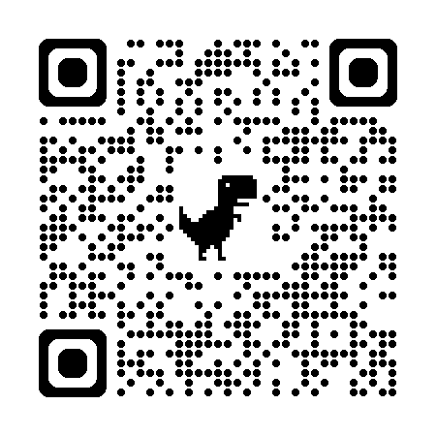

Introduction to Scientific Computing
ENGR1050 – Lecture 6
Fall 2025
Nat Trask
Guest Lecture by Ben Shaffer
University of Pennsylvania

Slide 2

Introduction to Microcontrollers
Hello world on the
Raspberry Pi Pico
Real Python Programs
Installing Thonny
In-class exercise
Submit a picture showing you installed Thonny and can run a python script outside colab
Note
Depending on your background, it may range from trivial to painful to install Thonny. Today is a nice slow day to get Thonny set up on everyone’s computer.

Slide 3
Introduction to Microcontrollers
To drive a circuit, we can’t use Colab – it lives in the cloud and can’t touch a circuit in real life!
Today we will install Thonny, which is a tool to run Python on your laptop that we can use to drive circuits and make robots
Today you only have one job: get Thonny installed and working on your computer

Slide 4
Real Python Programs
First we will see a demo running a python program using Thonny
Then we’ll see a demo of how easy it is to use python to drive a microcontroller
(don’t worry – you won’t need to do this yourself for another week or two)
Finally, we will install Thonny on all of your computers. For directions go to the course github and check the notes for todays lecture

Slide 5
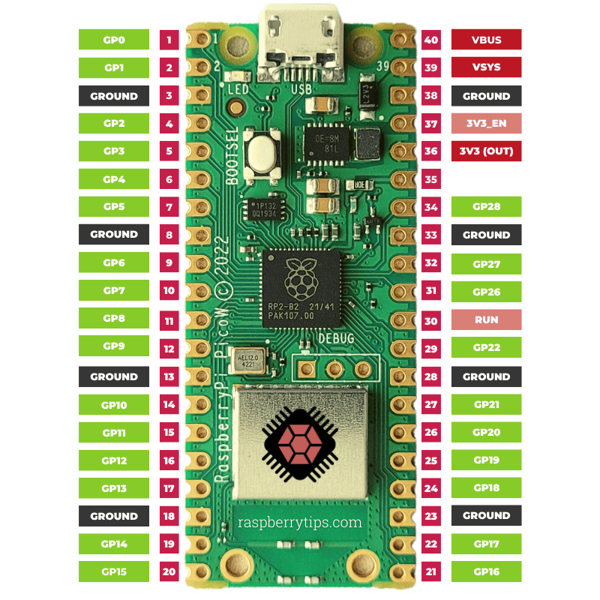
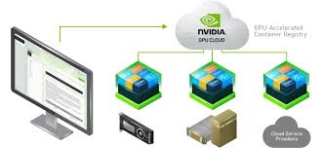

Three places so far for you to run code – understand what they mean
Runs in the cloud
You connect through the internet to see program output, but its running on some GPU in Google’s basement
Run on a microcontroller
We’ll show how to run a program on this little black chip This is good for steering robots, drones, and other little mechatronic systems
Run on your laptop
Today we’ll use Thonny to run directly on your laptop

Slide 6
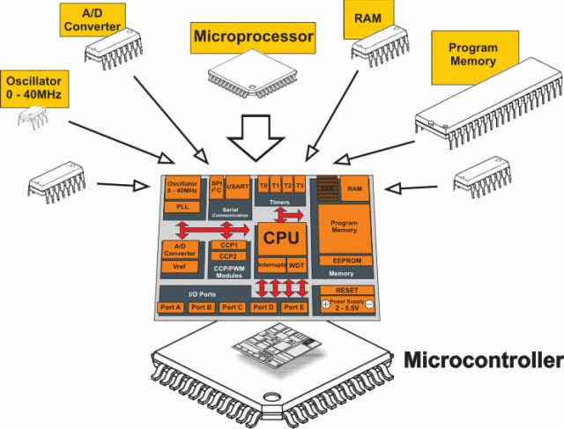
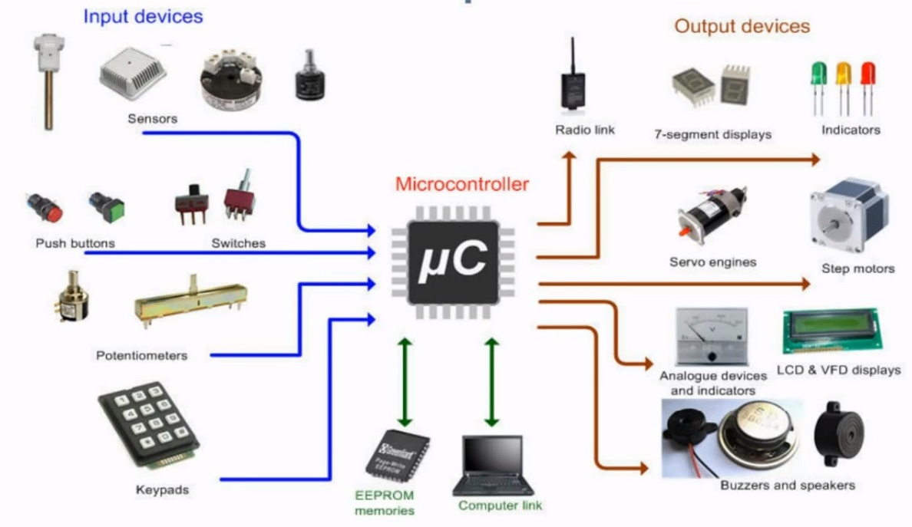
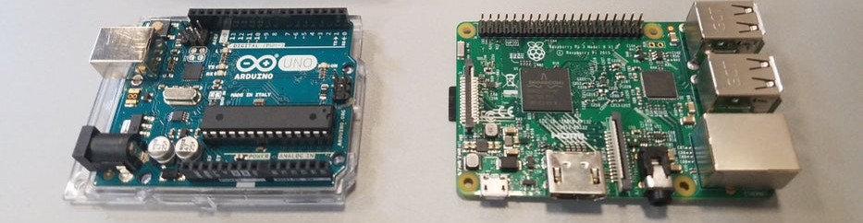
What is a microcontroller?

Slide 7
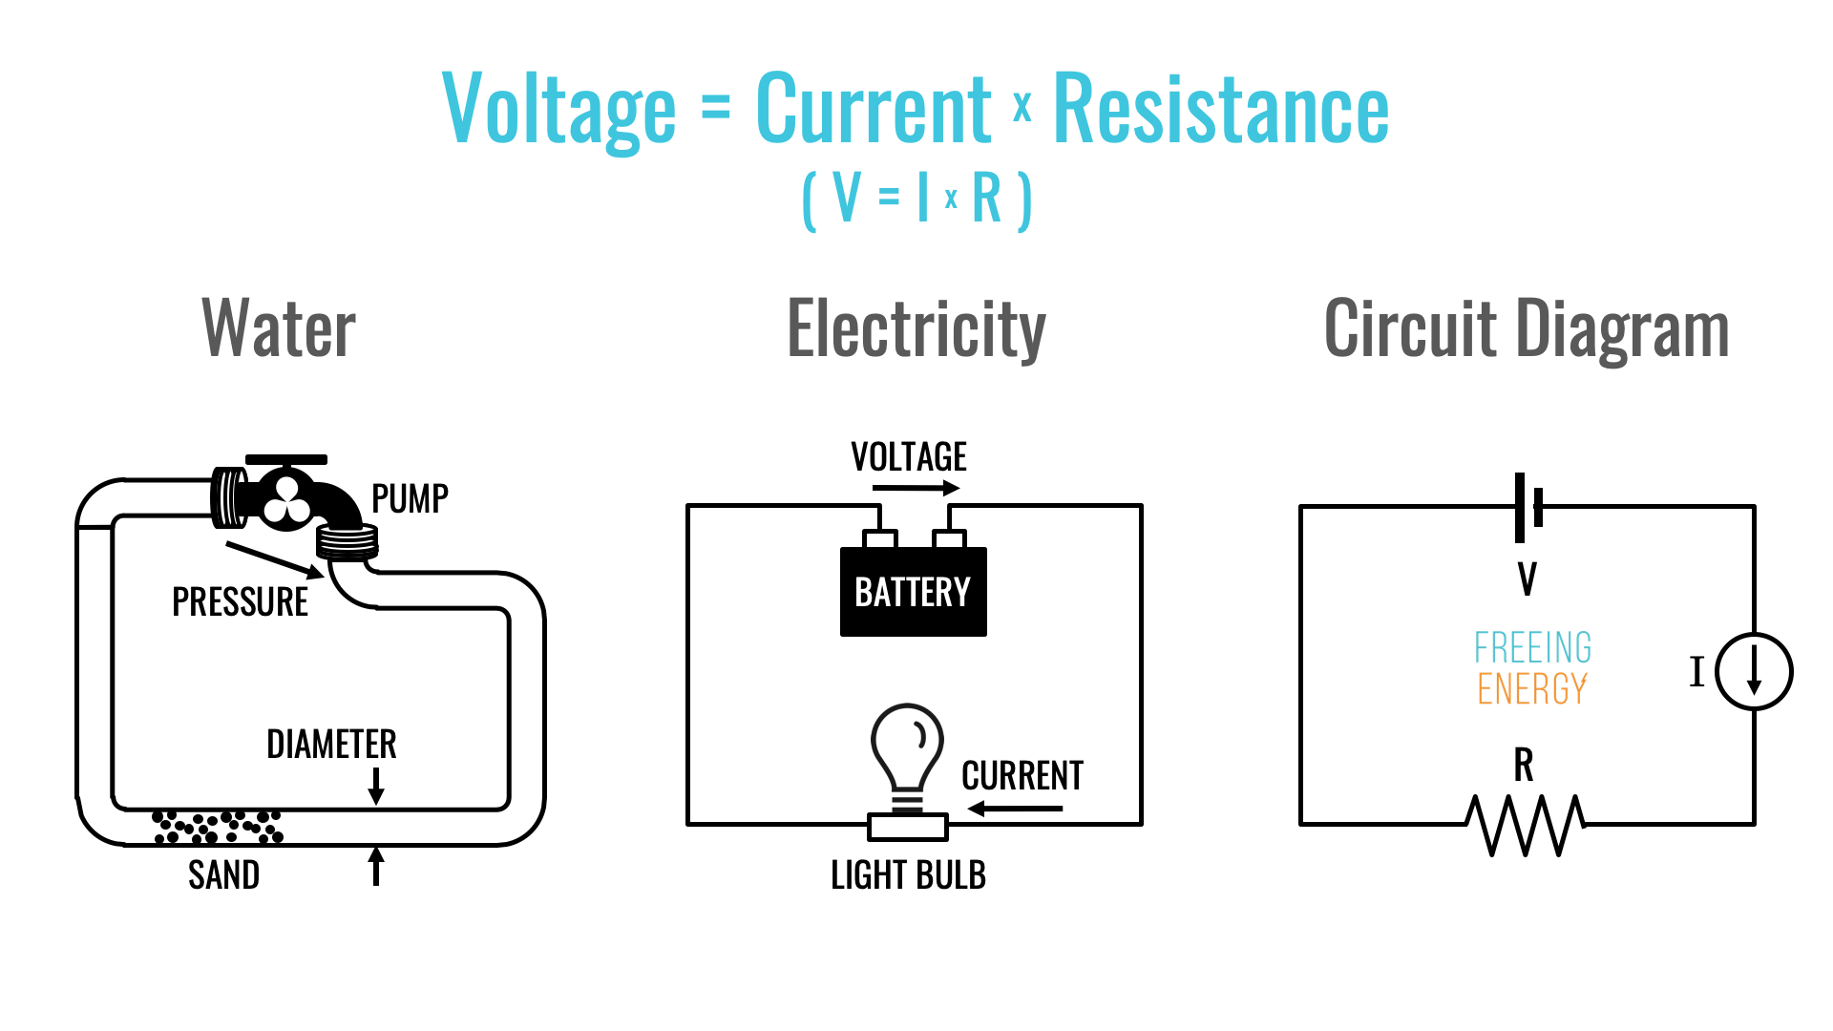
What is a circuit?

Slide 8
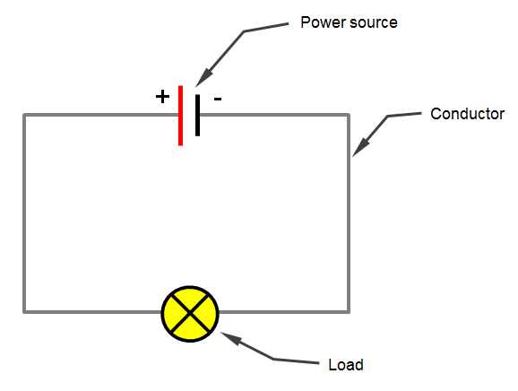
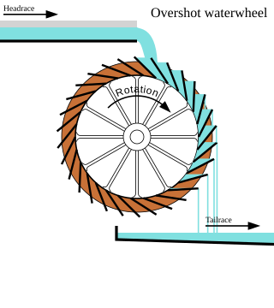
How does electricity drive a circuit element? A hydraulic analogy
Change in potential energy
Change in potential energy drives a current
Potential energy: Voltage difference between two points on circuit
Current: flow of electrons through wire
Potential energy: Difference in elevation storing gravitational energy
Current: flow of water through pipe

Slide 9
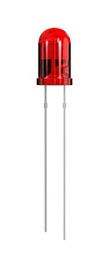
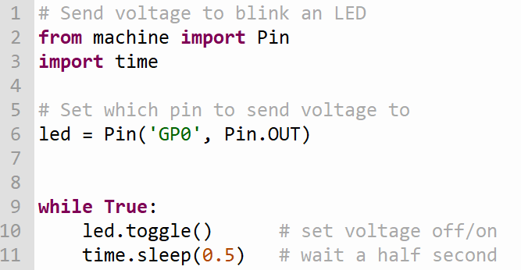
We will write a program that sets a voltage at one “pin” to switch lights off/on

Slide 10
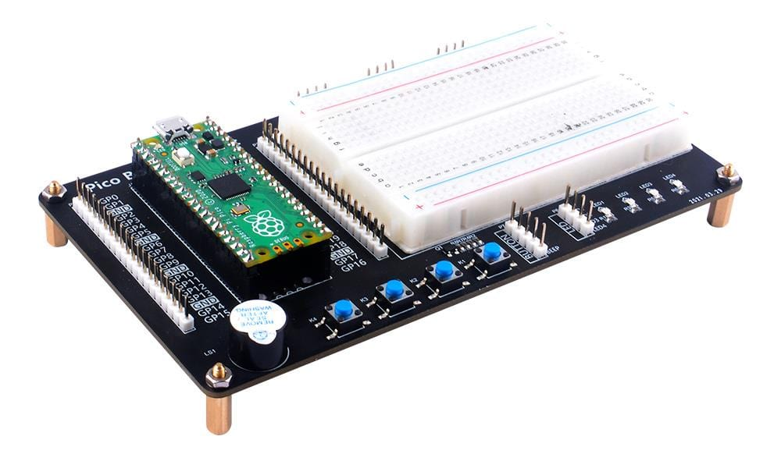
This is your Raspberry Pi Pico – a microcontroller with some basic functionality
A nice setup that minimizes wire management, with built in:
Power/ground lines
Buttons
LEDs
Speakers
Compact breadboard

Slide 11
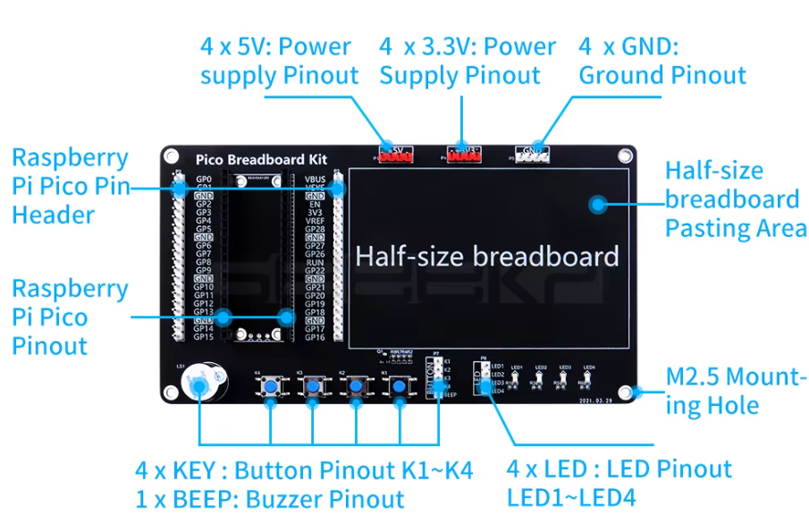
This is a mounting board that your Pico is attached to, with lights and convenient pins for connecting wires

Slide 12
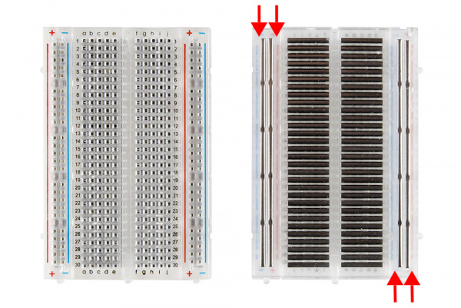
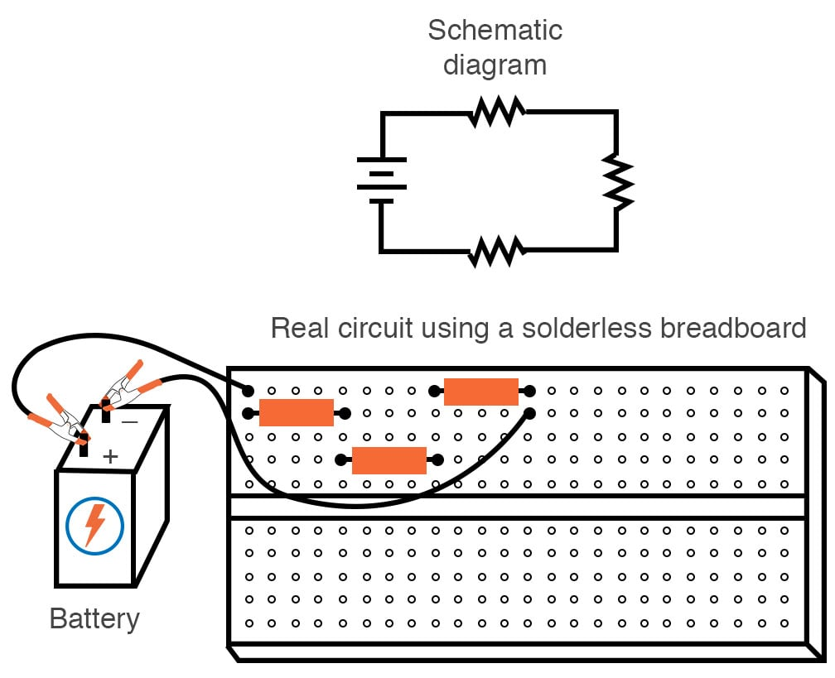
This is a breadboard – it lets you build circuits without needing to solder wires

Slide 13
This is the actual Pico – we can use python to feed juice to pins
LED – built in LED on the pico can be lit without wiring for diagnostics
GPX – general purpose input output (GPIO), which the microcontroller can set to high or low voltage in output mode. Rated for 3.3V and 20mA.
3V3 – A power source pin, which always outputs 3.3V and can draw up to 1A.
Ground – Where to close the circuit
ADC pins – Only some pins can convert analog to digital. Raspberry Pi Pico (RP2040):
ADC0: GPIO26
ADC1: GPIO27
ADC2: GPIO28

Slide 14
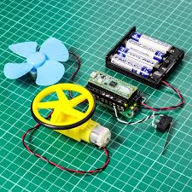
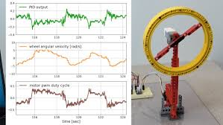
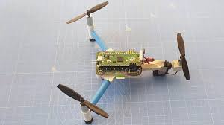
Ready for labs
We now know enough python to write programs to drive loads and build some basic robots. Every couple weeks we’ll break to play with robots in the GM lab.

Slide 15
Ready for labs
We now know enough python to write programs to drive loads and build some basic robots. Every couple weeks we’ll break to play with robots in the GM lab.

