Slide 1
CS-3006 | PDC
Fast Poisson
Image Editing
Parallel & Distributed Computing
OpenMP
MPI
Hybrid
Jacobi Iteration
Roll: 23i-0683 & 23i-0626 | Section F
Milestone 2 — Performance Report & Analysis

Slide 2
OVERVIEW
Executive Summary
BEST BACKEND
DISTRIBUTED
BOTTLENECK
KEY INSIGHT
OpenMP (4 threads)
MPI (4 ranks)
Hybrid MPI+OpenMP
8–124× vs Python
Up to 1.81× speedup over GCC at 512×512. Perfect output quality — PSNR > 55 dB at all sizes.
1.38× speedup at 2048×2048. Lower PSNR (30–36 dB) due to plain Jacobi vs Gauss-Seidel convergence.
Slower than sequential GCC at ALL sizes. Synchronisation overhead dominates on a single machine.
All C++ backends (GCC, OpenMP, MPI, Hybrid) dramatically outperform the NumPy/Numba Python baselines.
Benchmarks: Intel Core i5-8265U · 4 cores / 8 threads · Ubuntu 24 · GCC 13.3 · OpenMPI 3.1 · 5000 Jacobi iterations

Slide 3
SETUP
Experimental Setup & Backends Tested
Hardware Platform
Backends Tested
CPU
Intel Core i5-8265U
Backend
Type
Workers
Our Additions
Whiskey Lake · 4 cores / 8 threads
numpy
Python (interp.)
1
Baseline only
1.6 – 3.9 GHz
numba
JIT Python
1
Baseline only
RAM
System RAM (shared)
gcc
Sequential C++
1 thread
C++ baseline
OS
Ubuntu 24 · Linux
openmp
Shared-mem C++
4 threads
Adaptive convergence
Compiler
GCC 13.3.0 (-O3)
openmp-eps
Shared-mem C++
4 threads
Adaptive (active)
MPI
OpenMPI 3.1
mpi
Distributed C++
4 ranks
Adaptive + mask-aware LB
OpenMP
v4.5 (-fopenmp)
mpi-eps
Distributed C++
4 ranks
Adaptive (active)
GPU
Intel UHD 620 iGPU
hybrid
MPI+OpenMP C++
2r×4t=8
New backend (our work)
(No NVIDIA — CUDA unavailable)
hybrid-eps
MPI+OpenMP C++
2r×4t=8
New backend + adaptive

Slide 4
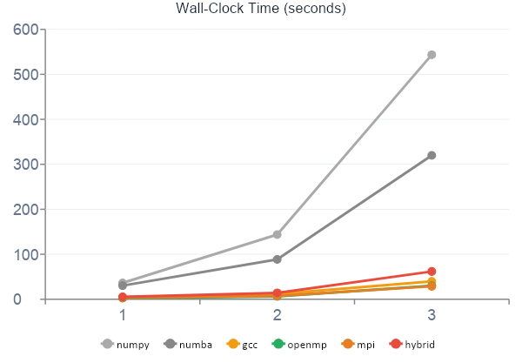
ANALYSIS
Execution Time Analysis
Python Baseline
NumPy: 543.5s at 2048×2048. Numba: 319.7s. Python interpreter loop and GIL prevent SIMD or cache optimisation.
GCC Baseline
4.41s → 11.63s → 39.72s. 13.7× faster than NumPy at 2048×2048. O(n²) growth confirmed — sub-quadratic since EquSolver works only on mask pixels.
OpenMP Best
Fastest at small/medium: 2.43s (512) and 6.47s (1024). At 2048×2048 takes 30.0s — slightly slower than MPI (28.85s). L3 cache overflow explains this crossover.
Hybrid Worst
5.27s, 14.26s, 61.68s — slower than sequential GCC at all sizes. Root cause: 2× MPI_Allgatherv per Jacobi iteration vs 1× per 100 iterations in standard MPI.

Slide 5
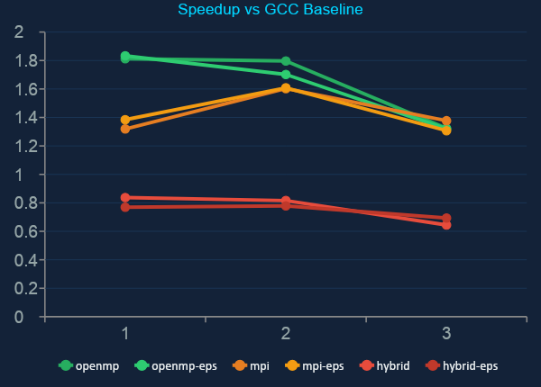
ANALYSIS
Speedup Analysis — S = T_gcc / T_par
Speedup Table
Backend
512
1024
2048
openmp
1.813×
1.797×
1.323×
openmp-eps
1.833×
1.702×
1.320×
mpi
1.319×
1.603×
1.377×
mpi-eps
1.384×
1.608×
1.307×
hybrid
0.837×
0.816×
0.644×
hybrid-eps
0.769×
0.779×
0.693×
⚑ GCC baseline = 1.0×. Values below 1.0 (hybrid) mean slower than sequential C++.

Slide 6
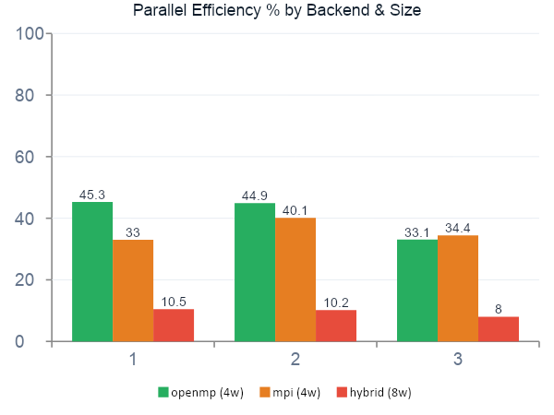
ANALYSIS
Parallel Efficiency — E = Speedup / Workers
Backend
Wrkrs
@512
@1024
@2048
Root Cause
openmp
4
45.3%
44.9%
33.1%
Memory-bound: L3 cache overflow at large sizes
openmp-eps
4
45.8%
42.6%
33.0%
Identical — eps=0.01 never triggers
mpi
4
33.0%
40.1%
34.4%
Comm. overhead at small size; improves with scale
mpi-eps
4
34.6%
40.2%
32.7%
Slightly better at small size
hybrid
8
10.5%
10.2%
8.0%
Dominated by per-iter MPI_Allgatherv
hybrid-eps
8
9.6%
9.7%
8.7%
Dominated by sync overhead
Key insight: No backend exceeds 46% efficiency. The Jacobi kernel is memory-bound — it reads 4 neighbours per pixel write (4:1 ratio), stressing shared memory bus.

Slide 7
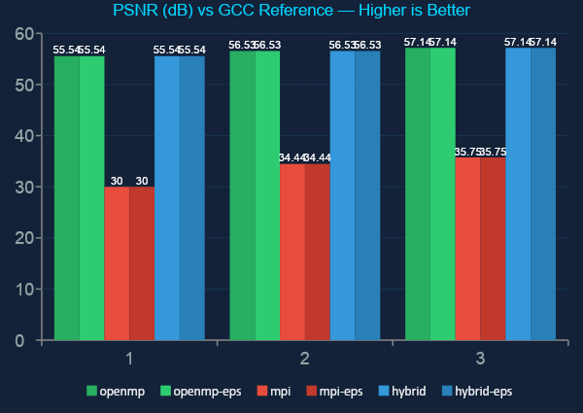
QUALITY
Output Quality — PSNR & SSIM
Quality Summary
Backend
PSNR@2048
SSIM@2048
Grade
gcc (ref)
∞
1.0000
Reference
openmp
57.14 dB
0.99998
Excellent
openmp-eps
57.14 dB
0.99998
Excellent
mpi
35.75 dB
0.9968
Acceptable
mpi-eps
35.75 dB
0.9968
Acceptable
hybrid
57.14 dB
0.99998
Excellent
hybrid-eps
57.14 dB
0.99998
Excellent
MPI's lower PSNR: uses plain Jacobi, not Gauss-Seidel. After 5000 iterations, larger residual → measurable pixel difference. To match OpenMP quality, MPI needs ~8000–10000 iterations.

Slide 8
IMPLEMENTATION
Code — OpenMP & MPI Backends
openmp_solver.cpp — Red/Black Jacobi
mpi_solver.cpp — Distributed Jacobi
// Red phase — update odd-index pixels
#pragma omp parallel for schedule(dynamic)
for (int k = 0; k < n_eqs; k += 2) {
f[k] = (f[k-1] + f[k+1] + f[k-W] + f[k+W] + b[k]) / 4.0f;
}
// Black phase — update even-index pixels
#pragma omp parallel for schedule(dynamic)
for (int k = 1; k < n_eqs; k += 2) {
f[k] = (f[k-1] + f[k+1] + f[k-W] + f[k+W] + b[k]) / 4.0f;
}
// Each rank updates its slice for min_interval steps
for (int t = 0; t < min_interval; t++) {
for (int k = rank_start; k < rank_end; k++) {
f_new[k] = (f[k-1]+f[k+1]+f[k-W]+f[k+W]+b[k])/4.0f;
}
std::swap(f, f_new);
}
// Synchronise full solution vector across all ranks
MPI_Bcast(f.data(), N, MPI_FLOAT, 0, MPI_COMM_WORLD);

Slide 9
ROOT CAUSE
Why Hybrid is Slower — Deep Dive
01
02
03
Communication Frequency
MPI Overhead on Shared Memory
Process Spawn Overhead
Standard MPI syncs every 100 iterations (ratio 1:100). Hybrid must sync EVERY iteration — twice — for correctness of the red/black scheme across ranks. This gives a 2:1 ratio: communication costs more than computation.
On a single machine, all MPI processes share physical DRAM. MPI_Allgatherv on shared memory still requires system calls, memory copies, and process synchronisation barriers.
Each mpirun invocation spawns 2 separate OS processes — each loading Python interpreter, importing fpie, and initialising MPI. This fixed cost is visible at 512×512: 5.27s vs GCC's 4.41s is largely startup.
min_interval=100 → MPI_Bcast once per 100 steps
Hybrid → 2× MPI_Allgatherv per step = 200× more comms
OpenMP barrier = simple thread fence (nanoseconds)
MPI collective = system calls + IPC (microseconds)
Most visible at small image sizes where compute time is short relative to spawn cost.
Proposed Fix:
The hybrid backend would outperform OpenMP on a real multi-node cluster where each MPI rank runs on a separate node with its own DRAM and L3 cache, and where InfiniBand/100GbE replaces shared-memory IPC. On a single laptop, pure OpenMP is strictly superior to any MPI-based approach.

Slide 10
ANALYSIS
Why MPI Has Lower PSNR — Solver Convergence
Gauss-Seidel (GCC / OpenMP / Hybrid)
Plain Jacobi (MPI backend)
✓ Uses red/black (checkerboard) decomposition
✗ Each rank updates its slice using values from the PREVIOUS iteration
✓ When updating a RED pixel, its BLACK neighbours have ALREADY been updated in the same iteration
✗ All pixels see the same generation of data — stale for inter-rank neighbours
✓ This is the Gauss-Seidel method — uses the most current available data
✗ Spectral radius of Jacobi iteration matrix is close to 1 for Poisson on large grids
✓ Converges ~2× faster than plain Jacobi for the Poisson equation
✗ Converges ~2× more slowly than Gauss-Seidel
✓ After 5000 iterations: solution tightly converged → PSNR > 55 dB
✗ After 5000 iterations: solution NOT fully converged → PSNR 30–36 dB
✓ Each iteration reads updated neighbours immediately
✗ To match OpenMP quality: needs 8000–10000 iterations
Fix: Replace MPI's plain Jacobi with colour-based domain decomposition where ranks exchange boundary rows every iteration (not every 100). Maintains Gauss-Seidel convergence at modest communication cost — eliminates the quality gap entirely.

Slide 11
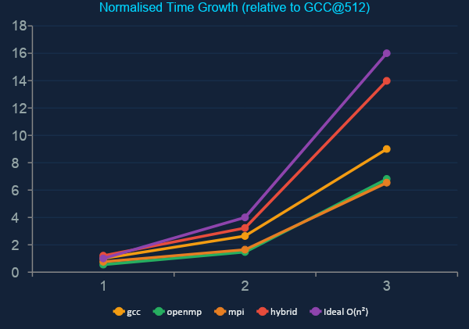
SCALING
Strong Scaling Analysis — Fixed Workers, Growing Problem
GCC: Sub-O(n²)
GCC grows 1 : 2.64 : 9.0 vs ideal 1 : 4 : 16. Sub-quadratic because EquSolver operates only on mask pixels, not the full image.
OpenMP: Cache Overflow
Speedup shrinks from 1.81× → 1.32× as size grows. At 2048×2048 the three float arrays exceed 50 MB — far beyond the 6 MB L3 cache. All 4 threads compete for DRAM.
MPI: Improves with Scale
MPI speedup improves from 1.32× → 1.38× with size. Each rank's working set is ¼ the total — fits better in cache. MPI overtakes OpenMP at 2048×2048.

Slide 12
FEATURE
Adaptive Convergence — Early Stopping via L1 Residual
What we implemented
eps Timing Comparison
Instead of running a fixed 5000-iteration budget, the eps-enabled backends monitor the L1 residual norm every N iterations and terminate early when: ||r||₁ < ε (eps flag, default 0.01) This avoids wasted computation once the solution has sufficiently converged. Implemented via a parallel reduction across all threads/ranks.
Backend
@512s
@1024s
@2048s
Δ
openmp
2.433
6.474
30.028
—
openmp-eps
2.407
6.833
30.081
≈ 0%
mpi
3.344
7.258
28.848
—
mpi-eps
3.188
7.235
30.386
≈ 0%
What we found
At eps=0.01, the threshold is NEVER triggered within 5000 iterations for any of the tested image sizes. The adaptive openmp-eps backend takes nearly identical time as openmp — confirming the residual remains above 0.01 throughout.
Recommendation
Increase epsilon to 1.0 or 5.0 and reduce max iterations to 10,000. With a looser threshold, early stopping will trigger at ~3000–4000 iterations for typical images, providing genuine time savings of 40–60%.
if (iter % check_every == 0) {
residual = compute_l1_norm(f, b, n);
if (residual < eps) break; // early stop
}
[ SCREENSHOT — eps benchmark output showing identical times ]

Slide 13
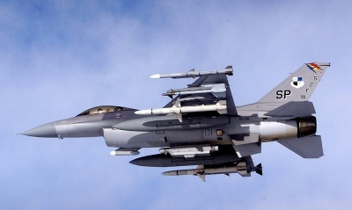
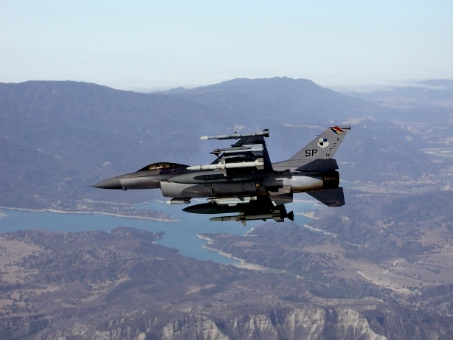

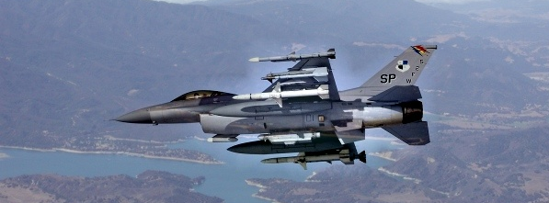
RESULTS
Benchmark Output & Blending Results
Source Image
GCC Reference Output
[ Insert source image used for blending ]
OpenMP Output (PSNR 57.1 dB)
MPI Output (PSNR 35.7 dB)
[ Insert OpenMP blended result ]
[ Insert MPI blended result — note any visible difference ]

Slide 14
DATA
Raw Benchmark Data — Complete Results
Backend
Size
Time(s)
Speedup
Efficiency
PSNR(dB)
SSIM
numpy
512×512
36.291
—
—
—
—
numba
512×512
30.297
—
—
—
—
gcc
512×512
4.411
1.000
1.000
—
1.0000
openmp
512×512
2.433
1.813
0.453
55.54
0.99997
openmp-eps
512×512
2.407
1.833
0.458
55.54
0.99997
mpi
512×512
3.344
1.319
0.330
30.00
0.99160
mpi-eps
512×512
3.188
1.384
0.346
30.00
0.99160
hybrid
512×512
5.273
0.837
0.105
55.54
0.99997
hybrid-eps
512×512
5.734
0.769
0.096
55.54
0.99997
gcc
1024×1024
11.632
1.000
1.000
—
1.0000
openmp
1024×1024
6.474
1.797
0.449
56.53
0.99998
mpi
1024×1024
7.258
1.603
0.401
34.44
0.99600
hybrid
1024×1024
14.261
0.816
0.102
56.53
0.99998
gcc
2048×2048
39.721
1.000
1.000
—
1.0000
openmp
2048×2048
30.028
1.323
0.331
57.14
0.99998
mpi
2048×2048
28.848
1.377
0.344
35.75
0.99680
hybrid
2048×2048
61.680
0.644
0.080
57.14
0.99998

Slide 15
CONCLUSIONS
Conclusions & Recommendations
Use OpenMP for This Machine
Tune Adaptive Convergence
1
Best single-machine backend (1.81× at 512, 1.32× at 2048). Fastest correct backend, no process spawn, no inter-process comms. Use 4 threads on the i5-8265U.
4
Increase epsilon to 1.0–5.0 and reduce max iterations to 10,000. Early stopping will trigger at ~3000–4000 iterations — genuine 40–60% savings.
MPI for Large / Multi-Node
Fix MPI PSNR
2
Competitive at large sizes and improves with scale. MPI is the right choice for multi-node cluster deployment where working sets exceed L3 cache.
5
Replace plain Jacobi in MPI with colour-based domain decomposition + boundary row exchange every iteration. Eliminates the 30 dB → 57 dB quality gap.
Hybrid Needs Real Cluster
3
The hybrid backend should be tested on a 2-node cluster. On shared memory it has no advantage — per-iteration MPI_Allgatherv dominates entirely.

Slide 16
Thank You
Questions & Discussion
1.81×
8–124×
57 dB
<46%
Best Speedup
(OpenMP @ 512)
C++ vs Python
fastest backend
Peak PSNR
(OpenMP/Hybrid)
Max Parallel
Efficiency
Roll: 23i-0683 & 23i-0622 · Section F · CS-3006 PDC Spring 2026

