Slide 1
Parallel and Distributed Computing Overview
(CS 3006)
Muhammad Aadil Ur Rehman
Department of Computer Science,
National University of Computer & Emerging Sciences, Islamabad Campus
Credits: Dr. Muhammad Aleem

Slide 2
Flynn’s Taxonomy
Specific classification of parallel architecture
By Michael Flynn (from Stanford, in 1966)
  Made a classification of computer systems known as Flynn’s Taxonomy
Computer
  Instructions
  Data

Slide 3
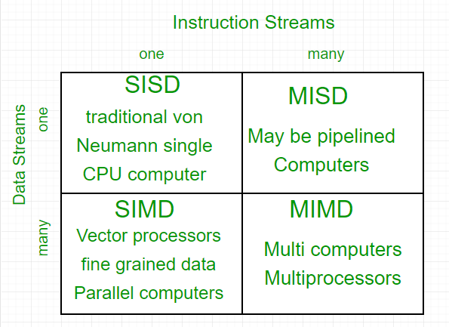
Flynn’s Taxonomy
AVX2

Slide 4
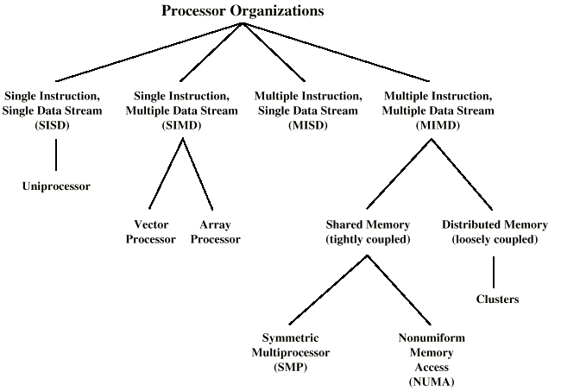
Taxonomy of Processor Architectures
Notes:
Array processors widely known as Vector processor corresponds to CPU Design in which CPU is implemented with instructions to work upon a one-dimensional arrays of data called as vectors.
Vector processor corresponds to CPU Design in which CPU is implemented with instructions to work upon a one-dimensional arrays of data called as vectors.

Slide 5
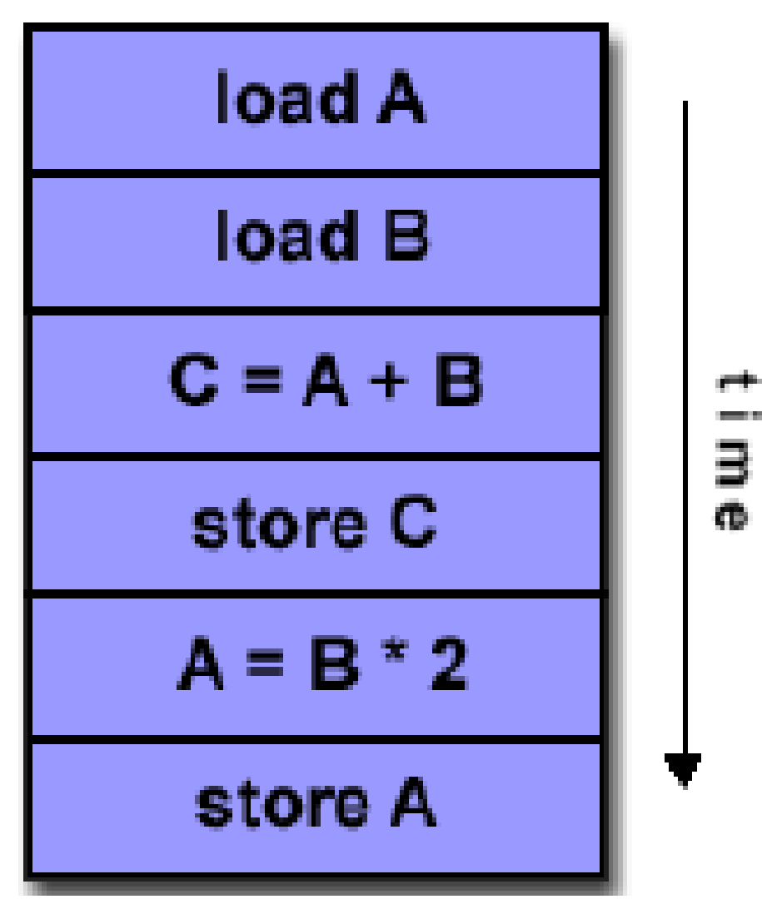
1. Single Instruction, Single Data Stream – SISD
Single processor
Single instruction stream
Data stored in single memory
Deterministic execution
SI
SISD
SD

Slide 6
2. Single Instruction, Multiple Data Stream - SIMD
A parallel processor
Single instruction: all processing units execute same instruction at any given clock cycle
Multiple data: Each processing unit can operate on a different data element
Large number of processing elements (with local memory)
Examples: GPUs, etc.
SISD
SD
SI
SISD
SD
SISD
SD

Slide 7
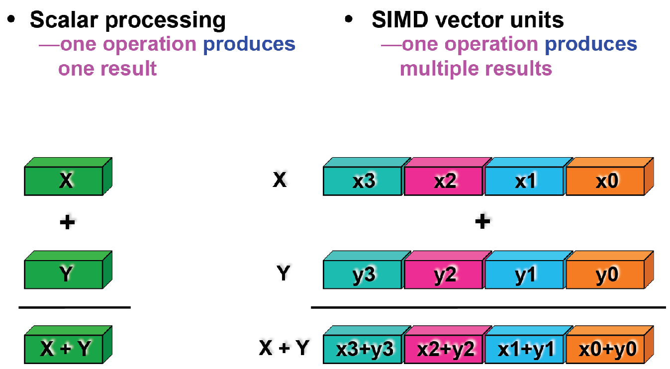
2. Single Instruction, Multiple Data Stream - SIMD
Slide Credit: Alex Klimovitski & Dean Macri, Intel Corporation

Slide 8
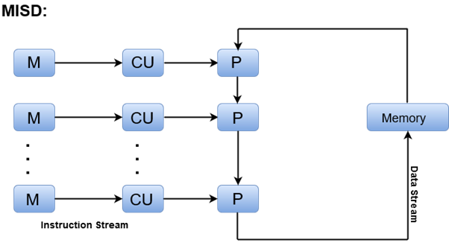
3. Multiple Instruction, Single Data Stream - MISD
Sequence of data
Transmitted to set of processors
Each processor executes different instruction sequence, using same Data
Examples: Pipelined Vector Processors, etc.
Notes:
In parallel computer architectures, a systolic array is a homogeneous network of tightly coupled data processing units (DPUs) called cells or nodes. Each node or DPU independently computes a partial result as a function of the data received from its upstream neighbors, stores the result within itself and passes it downstream. Systolic arrays were invented by Richard P. Brent and H. T. Kung, who developed them to compute greatest common divisors of integers and polynomials.

Slide 9
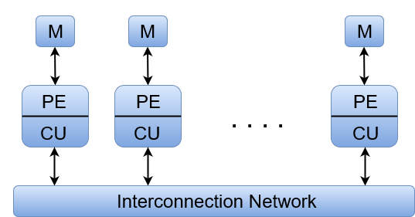
4. Multiple Instruction, Multiple Data Stream- MIMD
Most common parallel processor architecture
Simultaneously execute different instructions
Using different sets of data
Examples: Multi-cores, SMPs, Clusters, Grid, Cloud

Slide 10
MIMD - Overview
General purpose processors
Each can process all instructions necessary
Further classified by method of processor communication:
  Shared Memory
  Distributed Memory (Will be discussed later)

Slide 11
Taxonomy of Processor Architectures

Slide 12
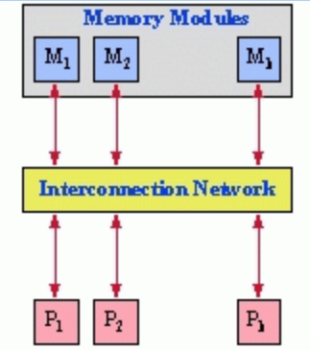
Symmetric Multiprocessor (SMP)
Processors share memory (tightly coupled)
Communicate via shared memory (single bus)
Same memory access time (any memory region, from any processor)
  Uniform Memory Access (UMA)
Processors share I/O address space too

Slide 13
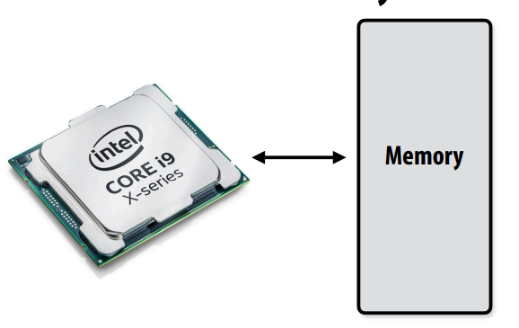
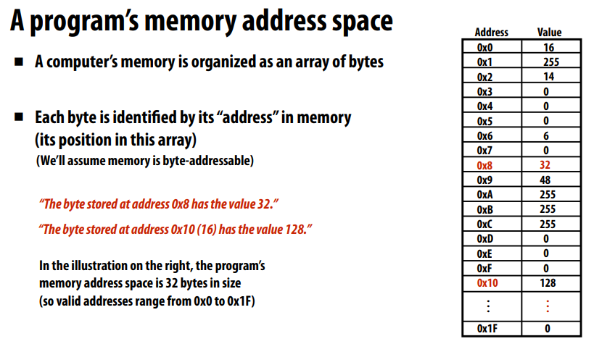
Accessing Memory
Stanford CS149, Fall 2025

Slide 14
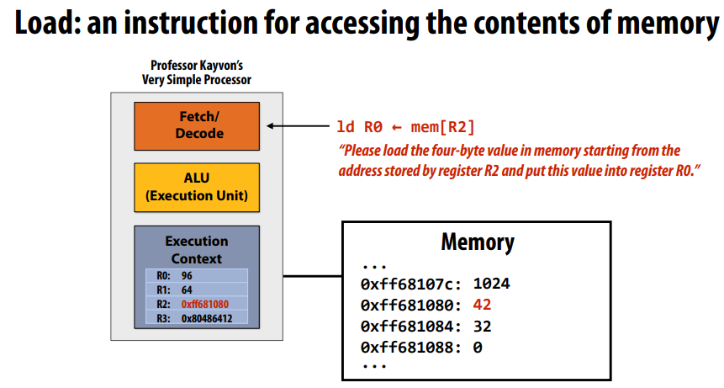
Accessing Memory
Stanford CS149, Fall 2025
Stanford CS149, Fall 2025
Stanford CS149, Fall 2025

Slide 15
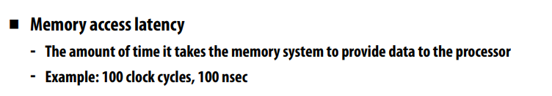
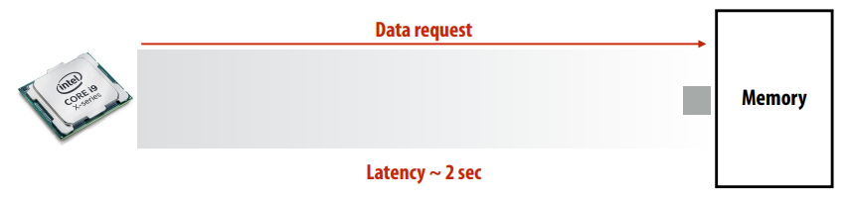
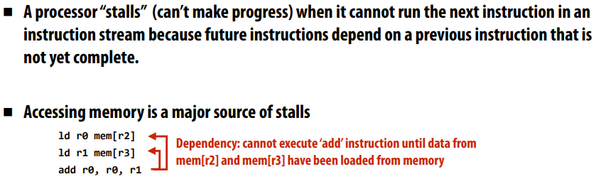
Review from Lecture 1
Stanford CS149, Fall 2025

Slide 16
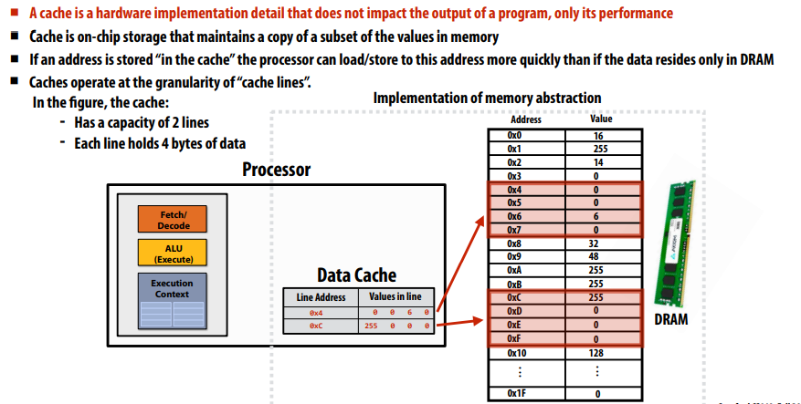
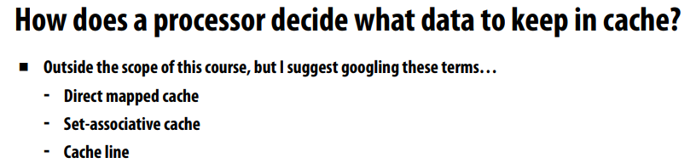
What Are Caches?
Stanford CS149, Fall 2025

Slide 17
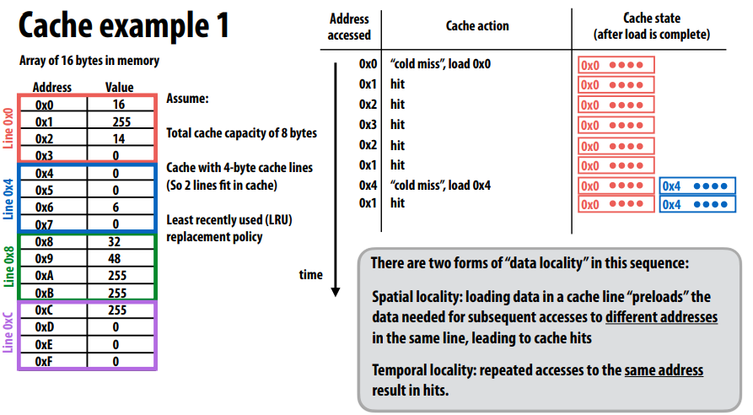
Stanford CS149, Fall 2025

Slide 18
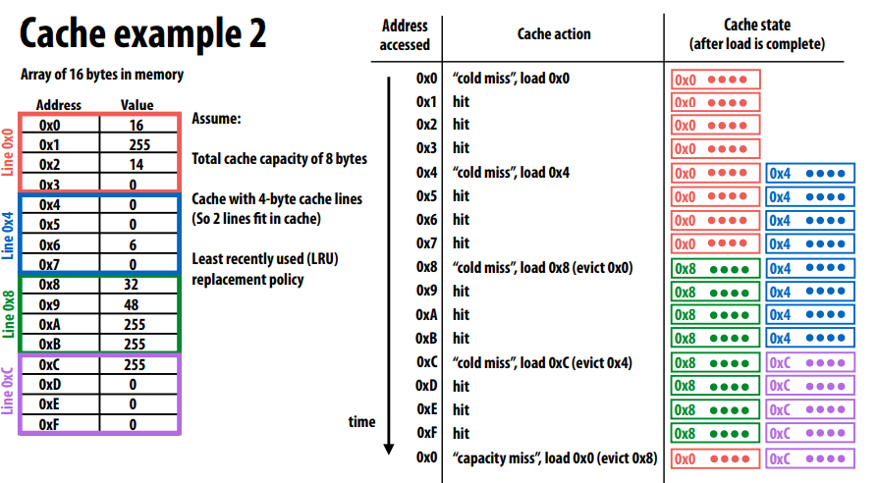
Processors run efficiently when they access data that is resident in caches
Caches reduce memory access latency when processors accesses data that they have recently accessed! *
Stanford CS149, Fall 2025

Slide 19
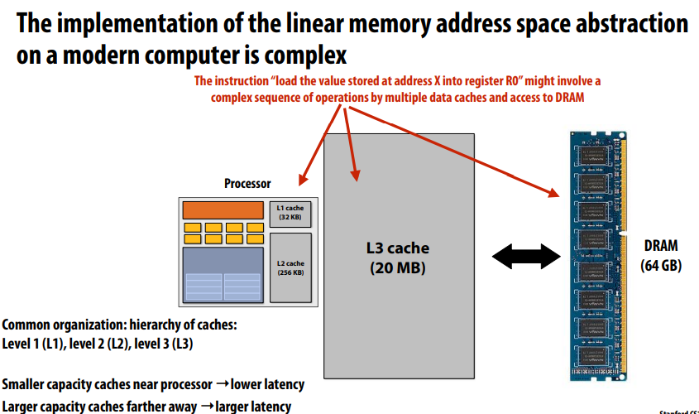
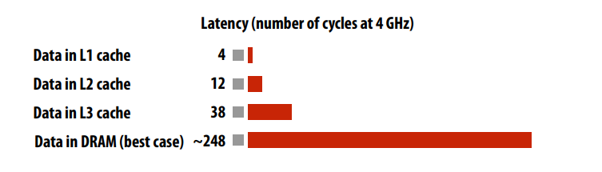
Stanford CS149, Fall 2025

Slide 20
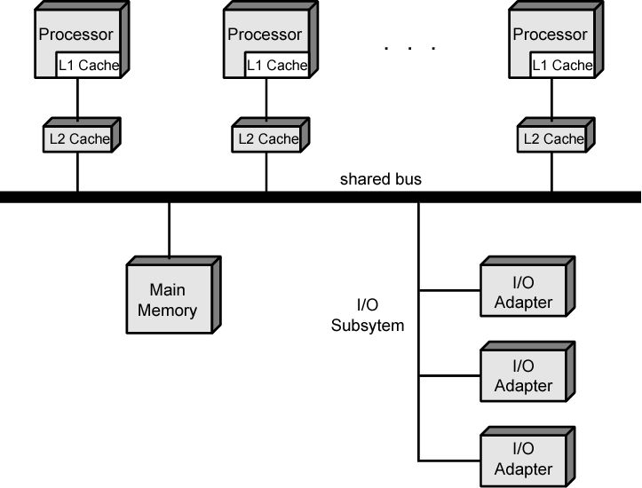
Symmetric Multiprocessor Organization

Slide 21
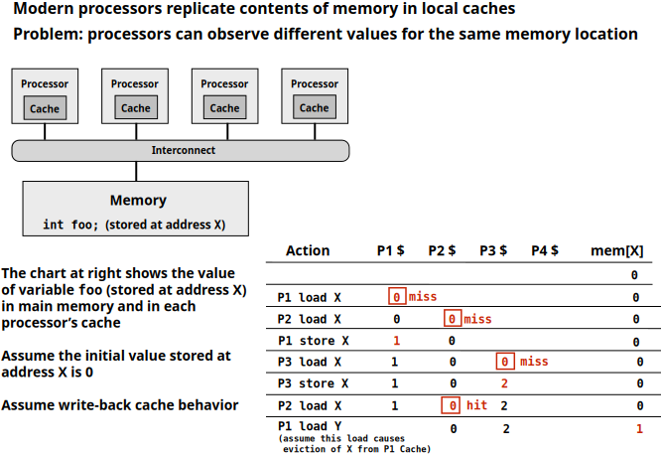
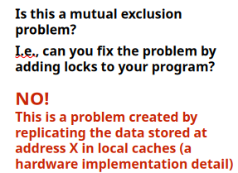

Cache Coherence Problem

Slide 22
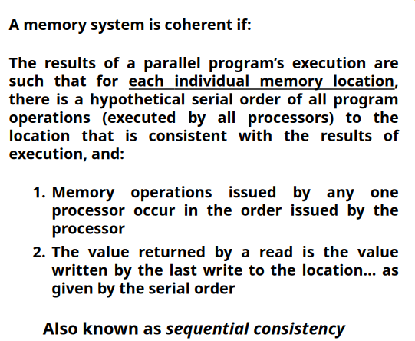
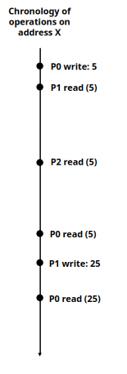
Cache Coherence Problem
Cache Coherence in SMPs is maintained by Hardware, so they are also known as CC-UMA

Slide 23
SMP Advantages
Performance
  work can be done in parallel
Availability
  Failure of a single processor does not halt system
Incremental growth
  Adding additional processors enhances performance
Scaling
  Range of products based on number of processors

Slide 24
Multithreading and Chip Multiprocessors
Instruction stream divided into smaller streams called “threads”
Executed in parallel

Slide 25
Taxonomy of Processor Architectures

Slide 26
Tightly Coupled - NUMA
Non-Uniform Memory Access (NUMA)
  Access times to different regions of memory differs

Slide 27
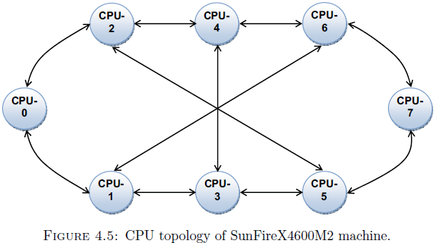
SunFire X4600M2 NUMA machine

Slide 28
Non-uniform Memory Access (NUMA)
Non-uniform memory access
  All processors have access to all parts of memory
  Access time of processor differs depending on memory region
  Different processors access different regions of memory at different speeds
Cache-coherent NUMA (cc-NUMA)
  Cache coherence is maintained among the caches of the various processors

Slide 29
Motivation (Why NUMA)
SMP has practical limit to number of processors
  Bus traffic limits to between 16 and 64 processors
In clusters each node has own memory:
  Apps do not see large global memory
  Coherence maintained by software not hardware
NUMA retains SMP flavour while giving large scale multiprocessing

Slide 30
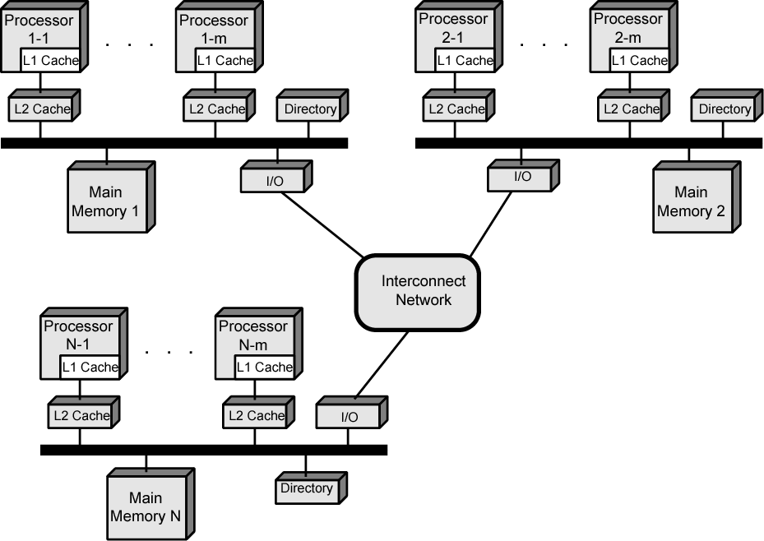
CC-NUMA Organization

Slide 31
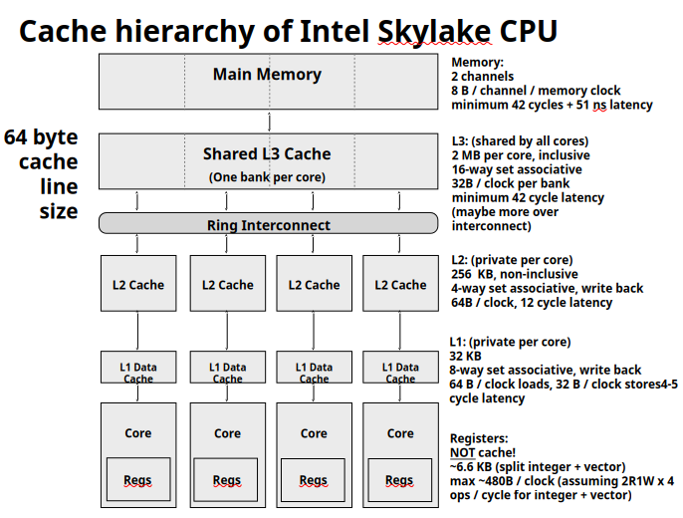

Slide 32
CC-NUMA Operation
Each processor has own L1 and L2 cache
Each node has own main memory
Nodes connected by some networking facility
Each processor sees single addressable memory
Hardware support for read/write to non-local memories, cache coherency
Memory request order:
  L1 cache 🡪 L2 cache (local to processor)
  Main memory (local to node)
  Remote memory

Slide 33
NUMA Pros & Cons
Effective performance at higher levels of parallelism than SMP
No major software changes
Performance can breakdown if too much access to remote memory

Slide 34
Taxonomy of Processor Architectures

Slide 35
Distributed Memory / Message Passing
Each processor has access to its own memory only
Data transfer between processors is explicit (via message passing functions): E.g., MPI library
User has complete control/responsibility for data placement and management
Interconnection Network
CPU
Memory
CPU
Memory
CPU
Memory

Slide 36
Hybrid Systems
Distributed memory system with multiprocessor shared memory nodes
Most common parallel architecture
Interconnection Network
Network Interface
Network Interface
Network Interface
CPU
CPU
CPU
CPU
Memory
CPU
CPU
Memory
Memory
CPU
CPU
CPU

Slide 37
Distributed Computing
We will discuss it at a later stage.
Using distributed systems to solve large problems
Paradigms:
  Cluster computing
  Grid computing
  Cloud computing

Slide 38
Any Questions?

