Slide 1
RESEARCH PROJECT
Predicting Hotel Booking Cancellations Using Machine Learning
Across Multiple Datasets
Team 32 · Ali Hassan Sulaiman · Mohamed Waleed Galal · Omar Hassan Mostafa · Zyad Tarek Mohamed
Faculty of Computer Science · Misr International University, Cairo, Egypt

Slide 2
WHAT WE WILL COVER
Agenda
01
02
03
04
Problem & Motivation
Related Work
Datasets
Preprocessing
Why cancellations hurt hotels
What other papers have done
Three hotel datasets we used
How we cleaned the data
05
06
07
Algorithms
Results
Conclusion
The five models we tested
Per dataset and overall
Takeaways and future work
Hotel Booking Cancellation Prediction | Team 32
2 / 19

Slide 3
01 · THE PROBLEM
Why Cancellations Matter
40%+
The Pain
Cancellation rate seen in some hotels
When guests cancel late, hotels rarely find a replacement booking in time, especially during off peak seasons. Rooms sit empty and the loss hits revenue directly.
Cancellations also throw off staffing, food orders and cleaning schedules. A small change in the cancellation rate can move the entire operations plan.
Most hotels still rely on historical averages or gut feeling. These approaches are not accurate enough when booking data has dozens of variables interacting with each other.
$$$
Lost revenue from empty rooms
?
Hard to predict with simple rules
Hotel Booking Cancellation Prediction | Team 32
3 / 19

Slide 4
02 · RELATED WORK
What Other Papers Have Done
We reviewed twelve recent papers on hotel booking cancellation prediction to see what worked, what did not, and where there is still room to improve. The four cards below are the ones we found most relevant to our setup.
[2]
2025
[7]
2025
[10]
2025
[11]
2025
87.6%
0.93
~90%
93.5%
XGBoost accuracy
RF F1 on resort
XGBoost accuracy
Gradient Boosting
Six ML models on Kaggle hotel data
City vs resort hotels with TabNet
DT, RF, XGBoost on Portuguese data
Feature interaction with 8 models
XGBoost dominates the literature. Random Forest and gradient boosting are close behind. Most studies use a single dataset and few include deep learning baselines.
Hotel Booking Cancellation Prediction | Team 32
4 / 19

Slide 5
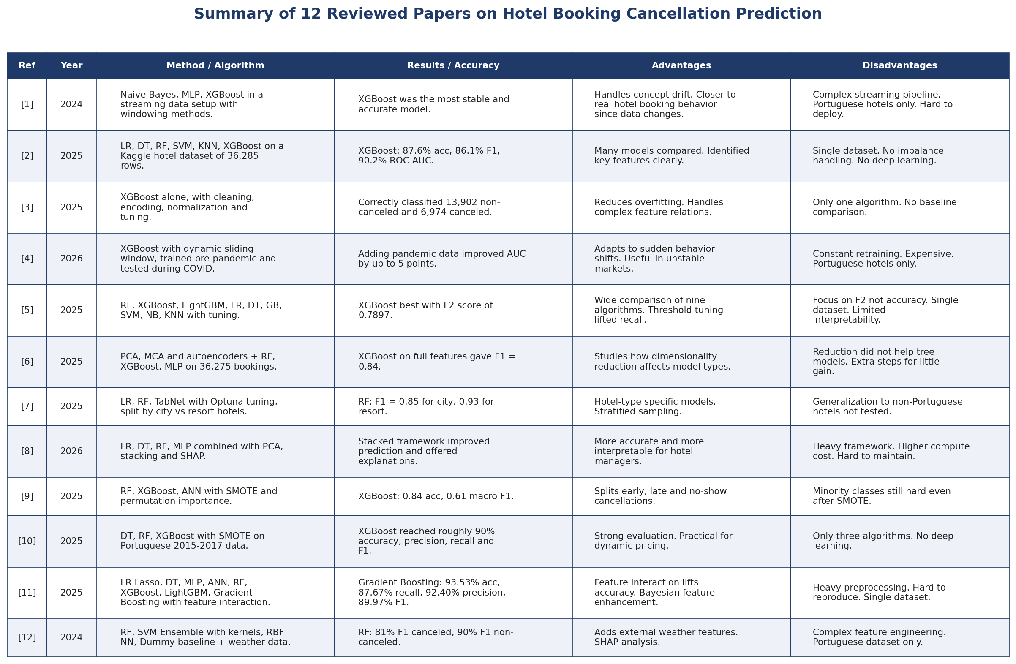
02 · RELATED WORK
Summary of 12 Reviewed Papers
Hotel Booking Cancellation Prediction | Team 32
5 / 19

Slide 6
02 · RELATED WORK
Patterns We Noticed in the Literature
9
8
Used Portuguese hotel data
Picked XGBoost as the winner
Most studies pull from the same two public datasets collected from Portuguese hotels. Geographic generalization is rarely tested.
Gradient boosting is the most consistent winner in this domain. Random Forest comes second on several benchmarks.
of 12 papers
of 12 papers
3
1
Tested a deep learning model
Compared across multiple datasets
Most papers stay with classical ML. The few that test ANN, MLP or TabNet usually find they tie or lose to gradient boosting on tabular data.
Only one paper [7] tested on more than one dataset, and even that was a split of the same Portuguese source by hotel type.
of 12 papers
of 12 papers
Hotel Booking Cancellation Prediction | Team 32
6 / 19

Slide 7
02 · RELATED WORK
The Gap and What We Add
THE GAP
OUR APPROACH
What current research is missing
How this paper fills the gap
Almost every paper uses the same Portuguese dataset, so geographic generalization is untested.
Studies report a single best model on a single dataset, which makes it hard to know if the ranking would hold elsewhere.
Deep learning is rarely included as a baseline, so we do not really know if neural networks lose on tabular booking data.
Even after using SMOTE, the minority class (canceled) recall stays low in most experiments.
Three independent datasets including Indian resort hotels, not just Portuguese ones.
Same preprocessing pipeline across all three sources, which makes the cross dataset comparison fair.
Five algorithms tested in one run, covering linear, distance, tree, ensemble and deep learning families.
Random Forest is identified as the consistent winner with rankings that hold on every dataset.
Hotel Booking Cancellation Prediction | Team 32
7 / 19

Slide 8
02 · DATA
Three Hotel Datasets
Dataset 1
Dataset 2
Dataset 3
Indian Resort Hotels
Inn Hotel (international)
Inn Hotel (variant)
119,390
33
36,275
19
36,285
17
records
features
records
features
records
features
Target: canceled
Target: booking_status
Target: booking status
Hotels in Mumbai, Delhi, Bangalore and Chennai. Rich feature set with deposit type, market segment and customer history.
Cleaner schema, fewer columns. Meal plan, room type and market segment are the main categorical features.
Same Inn source with renamed columns. Used as a generalization test for our preprocessing pipeline.
Hotel Booking Cancellation Prediction | Team 32
8 / 19

Slide 9
03 · PIPELINE
Preprocessing in Six Steps
1
2
3
4
5
6
Data Loading
Column Removal
Missing Values
Encoding
Feature Scaling
Target Encoding
Read all 3 CSV files with pandas
Drop IDs, leakage and low-value columns
Fill with 0, mean or mode based on type
One-hot encoding for categorical features
StandardScaler: zero mean, unit variance
Canceled = 1, Not_Canceled = 0
The same pipeline runs on all three datasets which is what makes the model comparison fair.
Hotel Booking Cancellation Prediction | Team 32
9 / 19

Slide 10
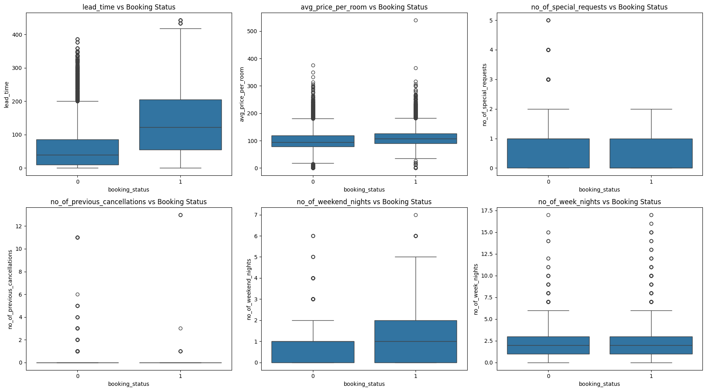
03 · EDA
Lead Time is the Strongest Signal
Key Observations
Lead time gap
Canceled bookings sit around 120 days median vs 40 days for non-canceled.
Special requests
Guests who add requests are more committed and rarely cancel.
Price per room
Slightly higher for canceled bookings. Pricier rooms get second-guessed.
Length of stay
Weak predictor. Distributions overlap heavily between the two classes.
Hotel Booking Cancellation Prediction | Team 32
10 / 19

Slide 11
04 · MODELS
Five Algorithms, One Fair Pipeline
LR
KNN
DT
RF
CNN
Logistic Regression
K-Nearest Neighbors
Decision Tree
Random Forest
1D CNN
Linear baseline. Fast, interpretable, simple decision boundary.
Lazy learner. Predicts by looking at the k closest neighbors (k = 5).
Splits data with yes/no questions. Handles non-linear patterns.
Ensemble of 100 trees. Robust to overfitting and high dimensions.
Conv1D + dense layers. Tests deep learning on tabular data.
WINNER
Hotel Booking Cancellation Prediction | Team 32
11 / 19

Slide 12
05 · EVALUATION
How We Measure Success
Accuracy
(TP + TN) / total
Precision
TP / (TP + FP)
Overall fraction of correct predictions. Easy to read but can lie when classes are imbalanced.
Out of bookings flagged as canceled, how many actually were. Low precision means too many false alarms.
Recall
TP / (TP + FN)
F1 Score
2·P·R / (P + R)
Out of real cancellations, how many were caught. This is the metric hotels care about most.
Harmonic mean of precision and recall. Useful single number when balance matters.
Hotel Booking Cancellation Prediction | Team 32
12 / 19

Slide 13
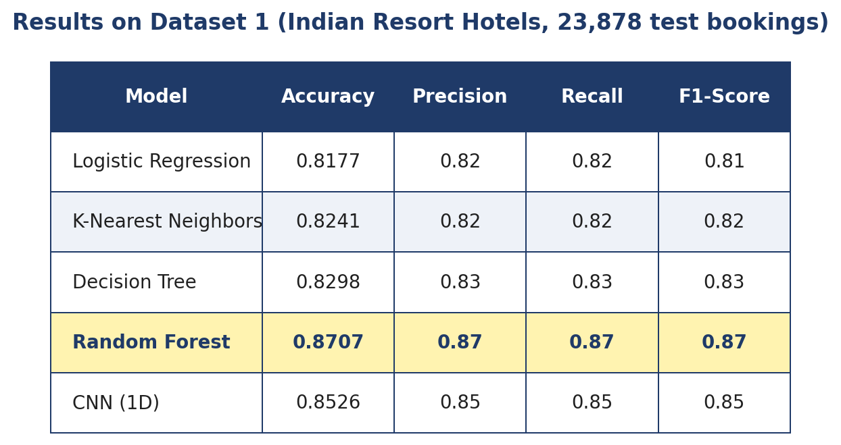
06 · RESULTS
Dataset 1 — Indian Resort Hotels
Highlights
Random Forest
87.07 %
Worst model
Logistic Regression
81.77 %
Test set
23,878 bookings
Hotel Booking Cancellation Prediction | Team 32
13 / 19

Slide 14
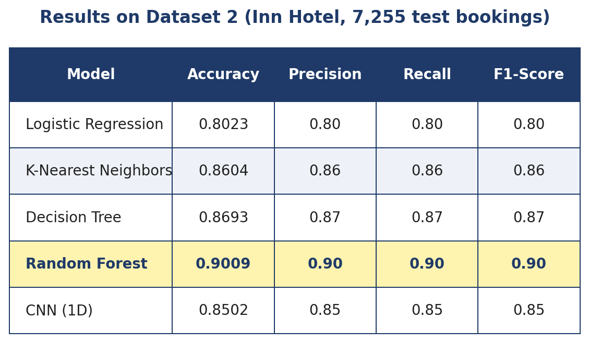
06 · RESULTS
Dataset 2 — Inn Hotel
Highlights
Random Forest
90.09 %
Best dataset overall
Worst model
Logistic Regression 80.23 %
Test set
7,255 bookings
Hotel Booking Cancellation Prediction | Team 32
14 / 19

Slide 15
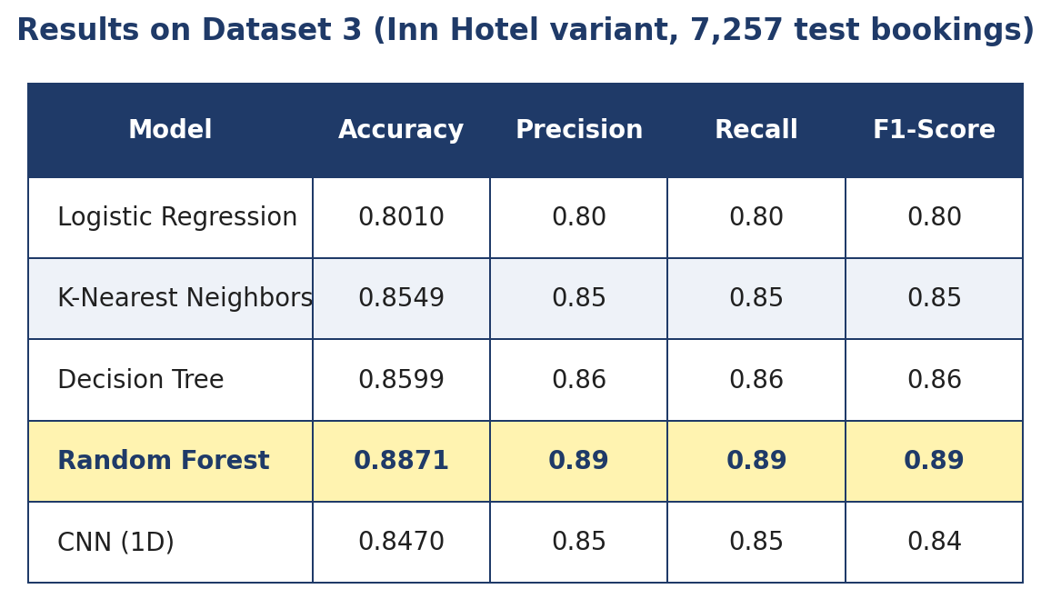
06 · RESULTS
Dataset 3 — Inn Hotel (variant)
Highlights
Random Forest
88.71 %
Same Inn source as
Dataset 2, different column names
Worst model
Logistic Regression 80.10 %
Test set
7,257 bookings
Hotel Booking Cancellation Prediction | Team 32
15 / 19

Slide 16
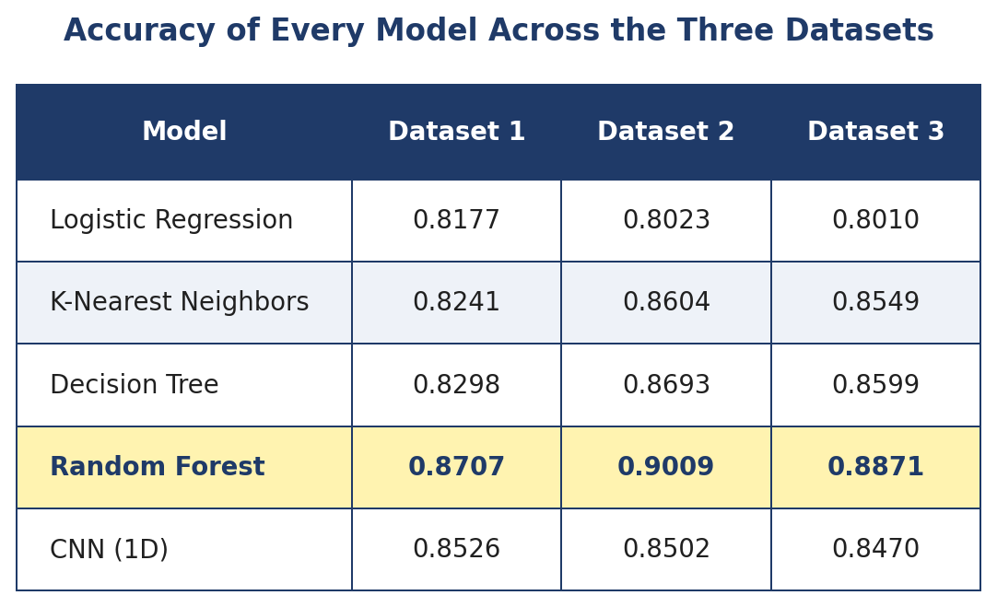
06 · RESULTS
All Datasets, Side by Side
Random Forest wins on all three datasets. The ranking is identical every time, which makes the result much more trustworthy.
Hotel Booking Cancellation Prediction | Team 32
16 / 19

Slide 17
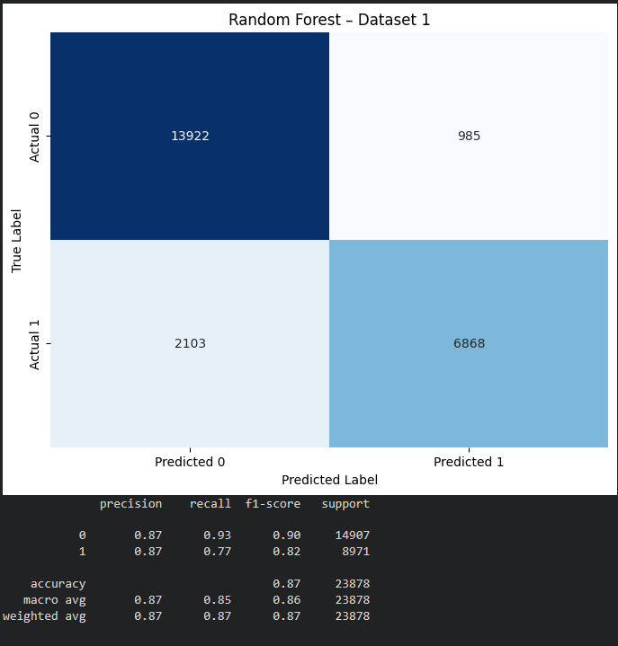
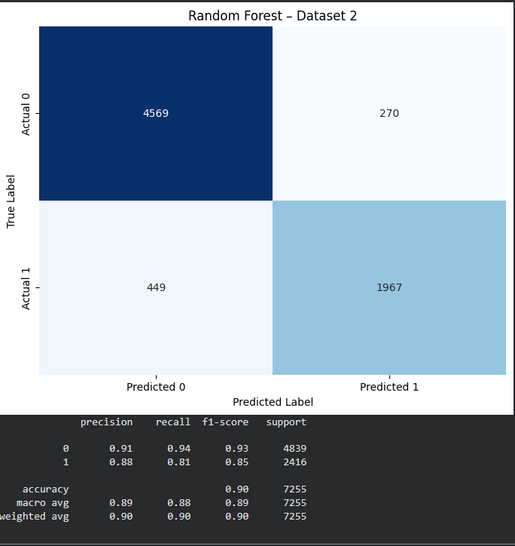
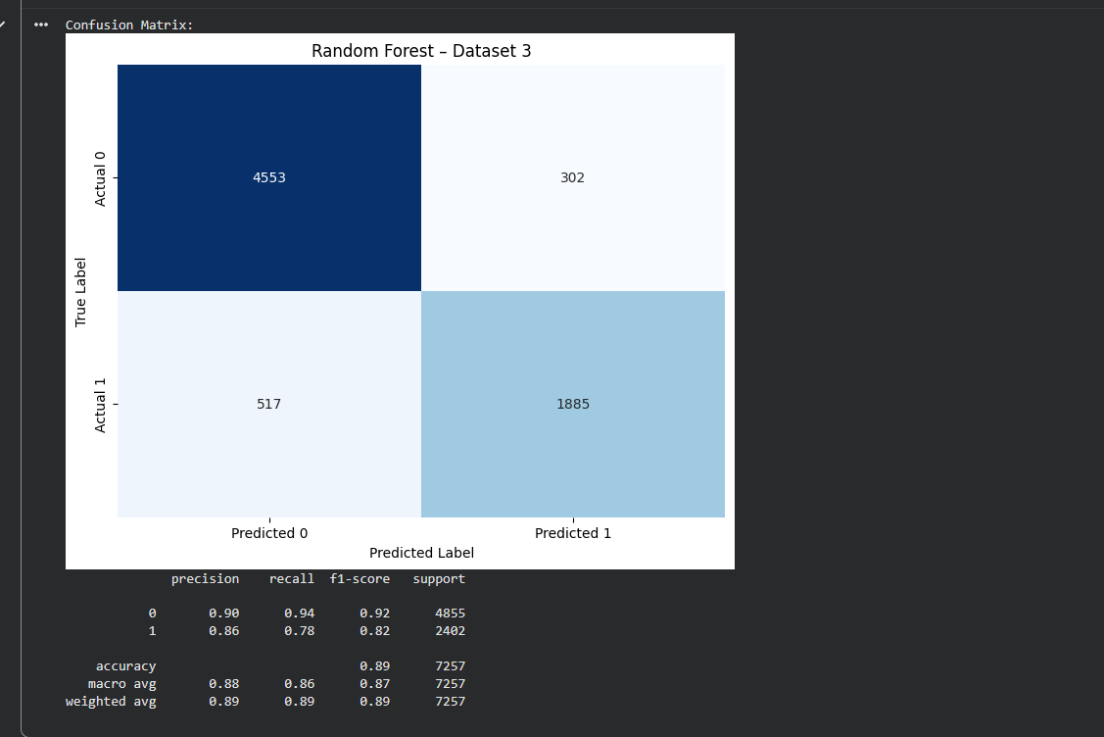
06 · ANALYSIS
Why Random Forest Won
Dataset 1
Dataset 2
Dataset 3
Why it works: Random Forest combines 100 trees, each trained on a random sample of rows and features. It handles mixed numeric and categorical features without preprocessing tricks, captures non-linear interactions between lead time and deposit type, and resists overfitting through bagging. CNN underperformed because Conv1D assumes spatial structure in features, which tabular data does not have.
Hotel Booking Cancellation Prediction | Team 32
17 / 19

Slide 18
07 · CONCLUSION
What We Learned
1
Random Forest is the right tool
2
Tabular data does not need deep learning
Highest accuracy on every dataset (87 to 90 percent). The ranking did not flip once across three independent sources, which makes this a reliable result.
Conv1D-based CNN lost to tree-based models. Column order is arbitrary in tabular data so the convolutional bias does not help.
3
Lead time and deposit type carry the most signal
4
Class imbalance hurts recall
Visualization confirmed it before the models did. These two features alone separate the classes very well.
Even our best model missed roughly 20 percent of real cancellations. The minority class is harder than the headline accuracy suggests.
Hotel Booking Cancellation Prediction | Team 32
18 / 19

Slide 19
WHAT COMES NEXT
Future Work
Fix class imbalance with SMOTE or class weights to lift recall on cancellations
Run grid search or randomized search on RF, KNN and Decision Tree hyperparameters
Move from a single split to 5 or 10 fold cross validation
Compare against XGBoost, LightGBM and TabNet to test gradient boosting and tabular DL
Engineer seasonal features, holiday flags and day of week from dropped date columns
Wrap the final model in an API for real time risk scoring on incoming bookings
Thank You
Questions?
Team 32
Ali Hassan Sulaiman
Mohamed Waleed Galal
Omar Hassan Mostafa
Zyad Tarek Mohamed
Misr International University · Faculty of Computer Science

