Slide 2
1

Slide 3
2

Slide 4
3

Slide 5
4

Slide 6
5

Slide 7
6

Slide 8
7

Slide 9
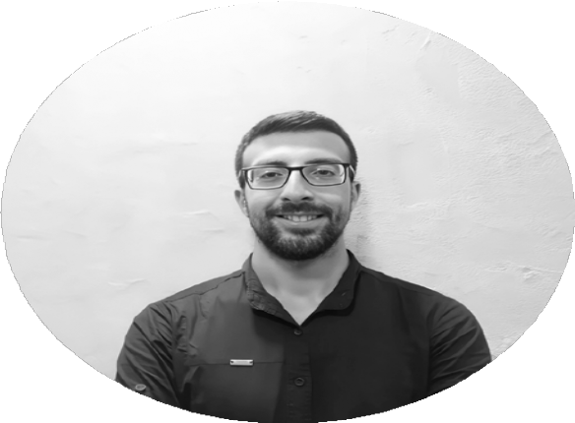
ALI TRABOULSI
Follow mg For morg InvgsĒigaĒions in Ēhg world of AI

