Slide 1






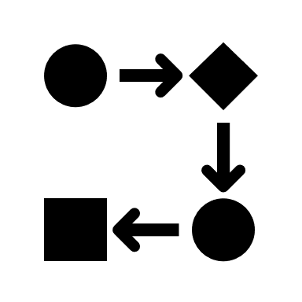
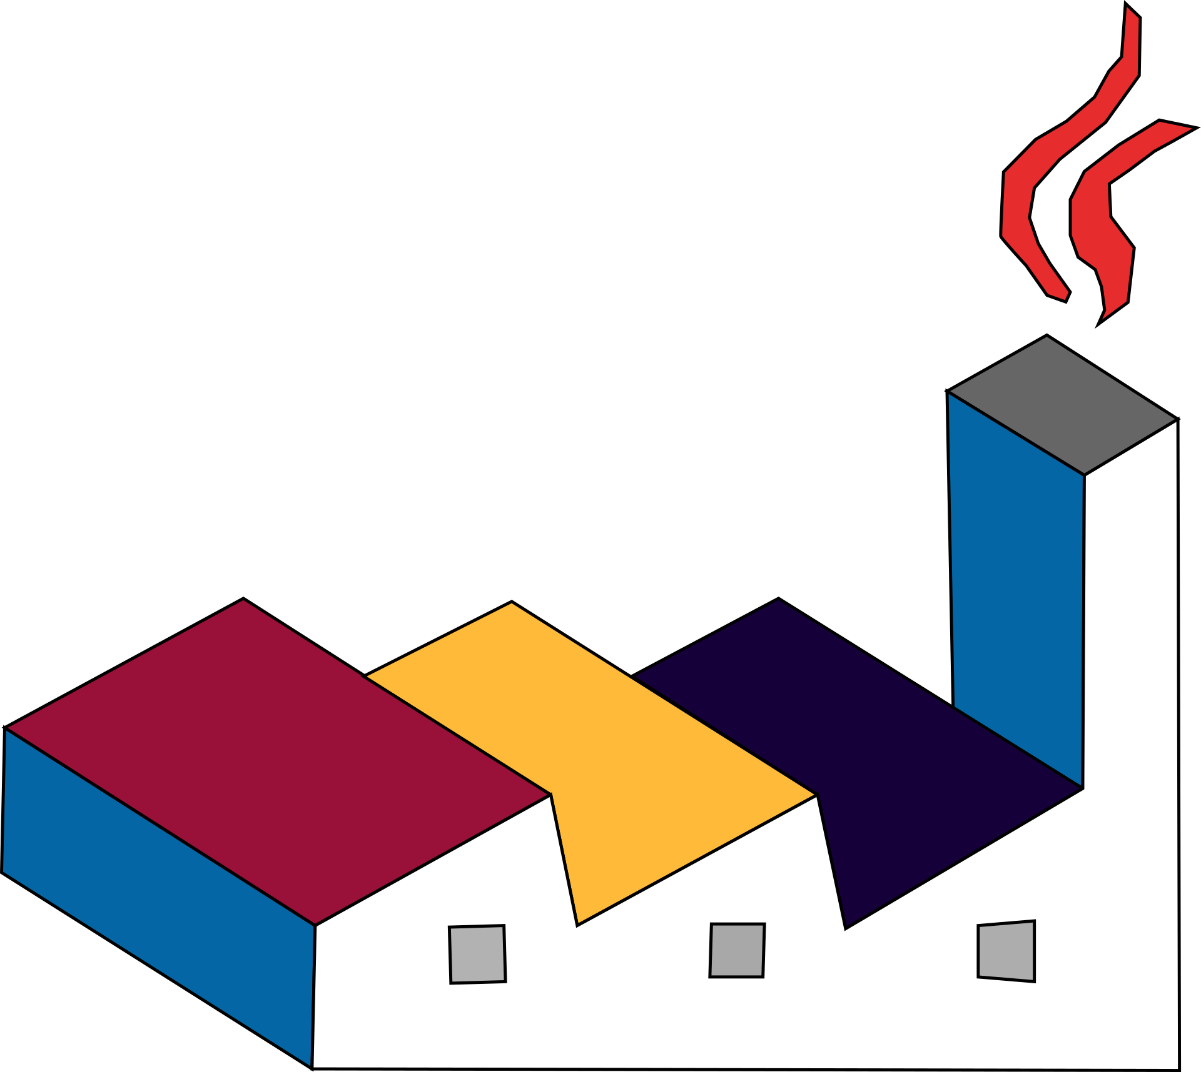


Analyzer
Render Application
Aggregate Renderer
Event Flow Renderer
AsciiDoc
Solution
JSON File
dotnet tool
… Renderer
PlantUML
Project Specific Tool
Markdown

