Slide 1
Styling Your Text
Styling your text

Slide 2
Options
Many options for styling your text:
font (family, style, variant, size)
color and background
alignment
line-height

Slide 3
font-family
Font families are styles of text
Examples:
Helvetica, Courier, “Courier New”, “Comic Sans MS”, cursive, Verdana

Slide 4
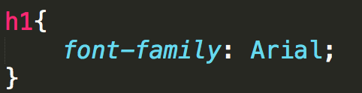

font-family

Slide 5
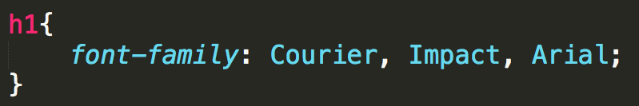
font-family
Not all font-families supported by all of the operating systems, so you can provide alternatives.

Slide 6
font-family Considerations
Some fonts are not as user-friendly, use sans-serif when possible.
Test
Test

Slide 7
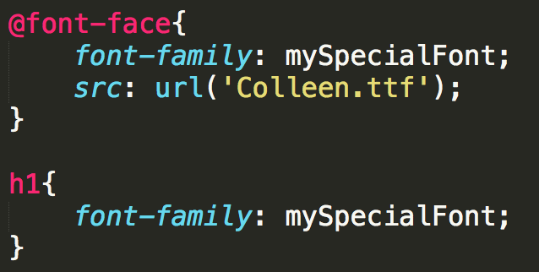
Custom fonts
To expand beyond "web-safe" fonts use @font-face

Slide 8
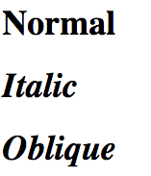
font-style
font-style:
normal
italic
oblique

Slide 9
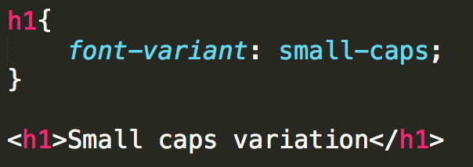

font-variant
font-variant:
normal
small-caps

Slide 10
font-size
This is only the beginning of our discussion on sizes…
Options
xx-small, x-small, small, smaller
medium
larger, x-large, xx-large, larger
Use pixel
Use %

Slide 11
color and background-color
The color attribute is the color of the foreground.
The background-color is the color of the background

Slide 12
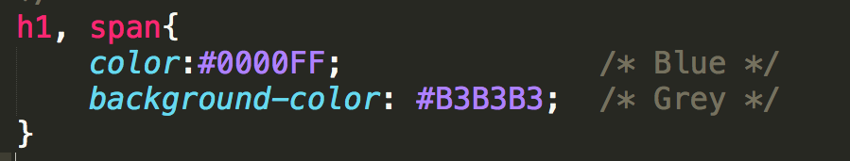
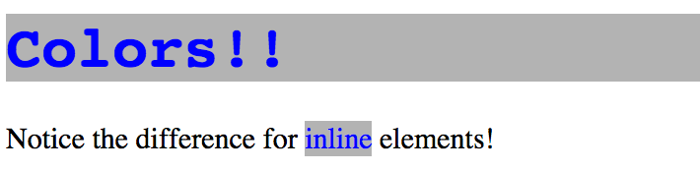
colors

Slide 13
text-align
Aligning text is simple!
text-align
left
right
center
justify

Slide 14
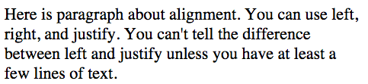
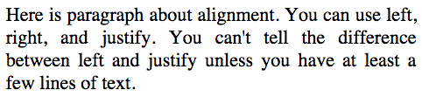
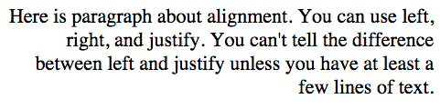
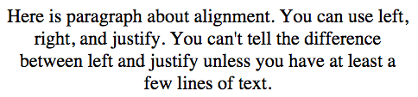

Slide 15
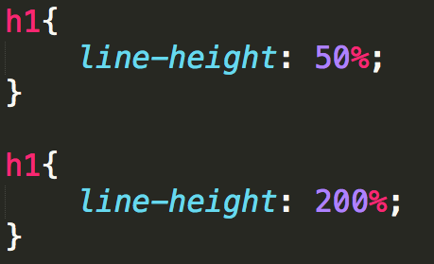
line-height
As you can guess, doesn’t affect font
Adjusts the space between the lines of text

Slide 16
Review
The number of options for styling text can seem overwhelming.
Practice on toy problems!
Design larger projects on paper first!!!

Slide 17

Acknowledgements/Contributions
These slides are Copyright 2015- Colleen van Lent as part of http://www.intro-webdesign.com/ and made available under a Creative Commons Attribution Non-Commercial 4.0 License. Please maintain this last slide in all copies of the document to comply with the attribution requirements of the license. If you make a change, feel free to add your name and organization to the list of contributors on this page as you republish the materials.
Initial Development: Colleen van Lent , University of Michigan School of Information

