Slide 1
Homework One
Adding style with an external Style Sheet

Slide 2
Objective
Create your own unique style sheet that will be used by three different html files.

Slide 3
Before
http://www.intro-webdesign.com/CSS/assignment-1/index.html
http://www.intro-webdesign.com/CSS/assignment-1/teams.html
http://www.intro-webdesign.com/CSS/assignment-1/history.html

Slide 4
After
http://www.intro-webdesign.com/CSS/assignment-1/index.jpg
http://www.intro-webdesign.com/CSS/assignment-1/teams.jpg
http://www.intro-webdesign.com/CSS/assignment-1/history.jpg

Slide 5
You must leave the HTML alone
Create style sheet that updates:
header, headings, section, links and images

Slide 6
header
Change background color

Slide 7
h1 and h2
Change the font color
Make sure the heading is displayed in all capital letters
For just h1:
Center the text

Slide 8
section
Change the background color

Slide 9
Links
Change the background color and font color
Center the text (subtle change)

Slide 10
Images
Since we haven’t talked yet about the best way to get those images where we want them, just use CSS3 to remove them from the page.

Slide 11
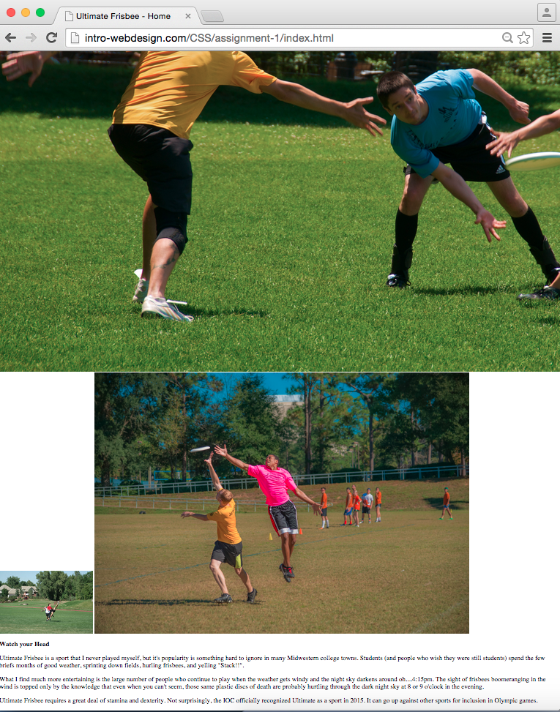
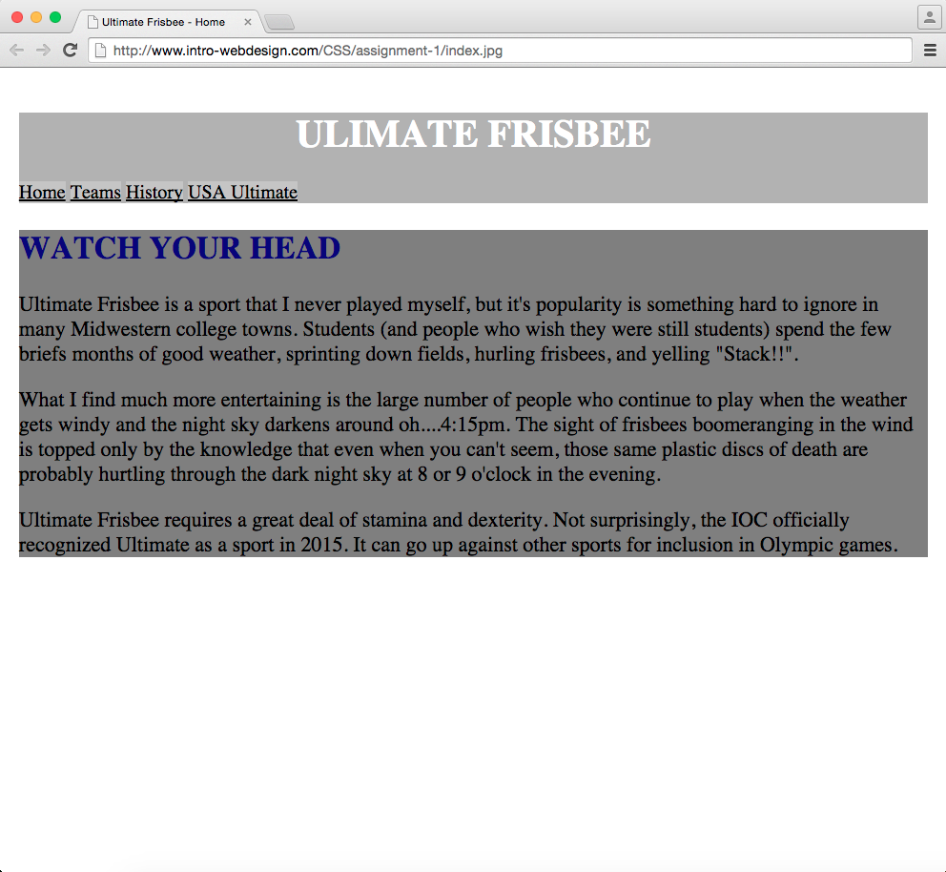
BEFORE
AFTER

Slide 12
Peer grading
Grades will be based on level of completion, not aesthetics
Proper standards do apply
Only style the listed elements, otherwise it makes it harder to grade

Slide 13

Acknowledgements/Contributions
These slides are Copyright 2015- Colleen van Lent as part of http://www.intro-webdesign.com/ and made available under a Creative Commons Attribution Non-Commercial 4.0 License. Please maintain this last slide in all copies of the document to comply with the attribution requirements of the license. If you make a change, feel free to add your name and organization to the list of contributors on this page as you republish the materials.
Initial Development: Colleen van Lent , University of Michigan School of Information

