Slide 1
Designing for Accessibility
POUR

Slide 2
Overview
The content of your page should be in the HTML.
It is tempting to add content via colors, images, etc.
Follow the POUR guidelines
Perceivable, Operable, Understandable, Robust

Slide 3
Perceivable
Provide text alternatives for images
Provide captions and transcripts for video and audio
Use correct semantic markup so content can be presented in different ways
Make it easier for users to see content by using good color contrast

Slide 4
Operable
All functionality available from the keyboard!
Users have control over timing and limits
Do not cause seizures (don’t flash content)
Provide ways to help users navigate, find content, and determine where they are

Slide 5
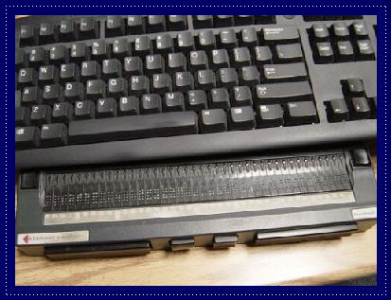
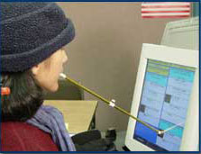
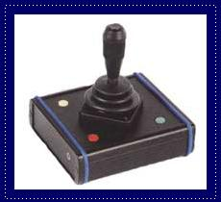
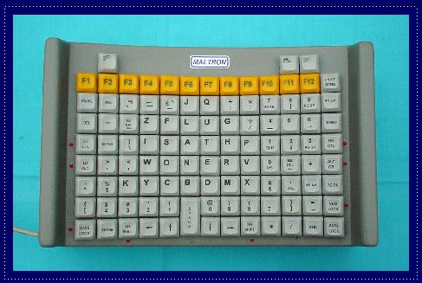
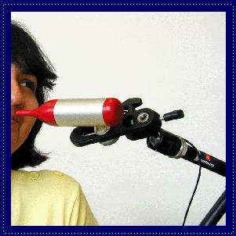

Slide 6
Understandable
Economical and plain use of language
Text supplemented with illustrations, videos, and other formats where appropriate (i.e., use good Universal Design)
Navigation, information structure are discernable and consistent
Make pages operate in predictable ways
Help users avoid and correct mistakes
Notes:
Chunking appropriately, avoiding jargon or institutional language, avoid URL descriptors
Different learning modalities, visual versus verbal
Don’t change nav and layout structure
Careful with AJAX-y elements, pop-ups
Considerate form validation and error correction

Slide 7
Robust
Is your site functional across various technologies (smart phone, screen reader, laptop, pensticks, etc..)?
Syntax errors that don’t affect visual presentation may hamper assistive technology and accessibility tools
Adhering to W3C standards ensures future compatibility
Validate your code at validator.w3c.org and wave.webaim.org

Slide 8
Review
Accessibility starts with proper HTML tags
Styling can actually make it HARDER for some people to access the information
Get into the early habit of utilizing accessibility tools
“Cool” new style should not be at the cost of accessibility

Slide 9

Acknowledgements/Contributions
These slides are Copyright 2015- Colleen van Lent as part of http://www.intro-webdesign.com/ and made available under a Creative Commons Attribution 4.0 License. Please maintain this last slide in all copies of the document to comply with the attribution requirements of the license. If you make a change, feel free to add your name and organization to the list of contributors on this page as you republish the materials.
Initial Development: Colleen van Lent , University of Michigan School of Information

