Slide 1

6
10
Core ERP modules
Report sections covered
ERP FINAL PROJECT
ERP Solution Design
& Business Analytics
4
1
Implementation phases
Single source of truth
Nishat Textiles
Submitted by
Ali Irtza
Integrated Odoo ERP proposal for manufacturing, retail, supply chain and analytics.
Submitted to: Ma’am Madiha Kanwal
Notes:
Introduce the project and clarify that it is an ERP solution design and analytics proposal for Nishat Textiles.

Slide 2
Project Direction
Moving from fragmented legacy operations to controlled ERP integration
Current state
ERP redesign
Business outcome
Oracle 10g + separate storefront
Odoo modules + API connector
Cleaner stock visibility
Manual reconciliation
Shared master data
Faster management decisions
Delayed reporting
Workflow-based fulfilment
Lower rework and refund risk
Core idea: the ERP is not only software replacement — it is end-to-end process control.
Nishat Textiles ERP Final Project
02
Notes:
Explain that the project direction is from fragmented legacy workflows to a unified Odoo ERP operating model.

Slide 3
Current System Problems
The existing weakness is fragmentation across systems, data and decisions
Lack of integration
Inventory mismatch
Duplicate entry
Sales, stock and finance remain separated
Online availability does not reflect warehouse reality
Orders require manual transfer and rework
Delayed reports
Poor communication
Excel consolidation slows decision-making
Teams rely on handoffs and exception lists
Main risk
Different departments act on different versions of the same transaction.
Why it matters
Stockouts become customer-facing failures
Reports become retrospective instead of operational
Manual work hides the real process cost
Nishat Textiles ERP Final Project
03
Notes:
Highlight that these are business process problems, not only IT problems.

Slide 4
ERP Solution Design: Odoo
Selected for modular ERP coverage, manufacturing fit and integration flexibility
Shopify
Storefront
API / Connector
Validation Layer
Odoo ERP
Shared Workflow
ERP Modules
+ BI Dashboard
Integration is treated as a managed connector project
Critical design principle
Modules can be deployed in controlled phases
Do not recreate old manual workflows inside new software.
ERP creates one operational data foundation
Nishat Textiles ERP Final Project
04
Notes:
Explain why Odoo is selected and why Shopify integration must be treated as a managed connector project.

Slide 5
ERP Modules: Integrated Operating Model
Six required modules work as one connected enterprise system
CRM
SCM / MRP
HRM
Customers • leads • demand
BoM • work centres • production
Finance
Attendance • payroll • labour
Invoices • costing • reports
Shared ERP
Data Core
Inventory
Procurement
Stock moves • routes • barcode
POs • suppliers • replenishment
Value comes from module linkage, not from isolated automation.
Nishat Textiles ERP Final Project
05
Notes:
Describe how the six modules work together as one ERP system.

Slide 6
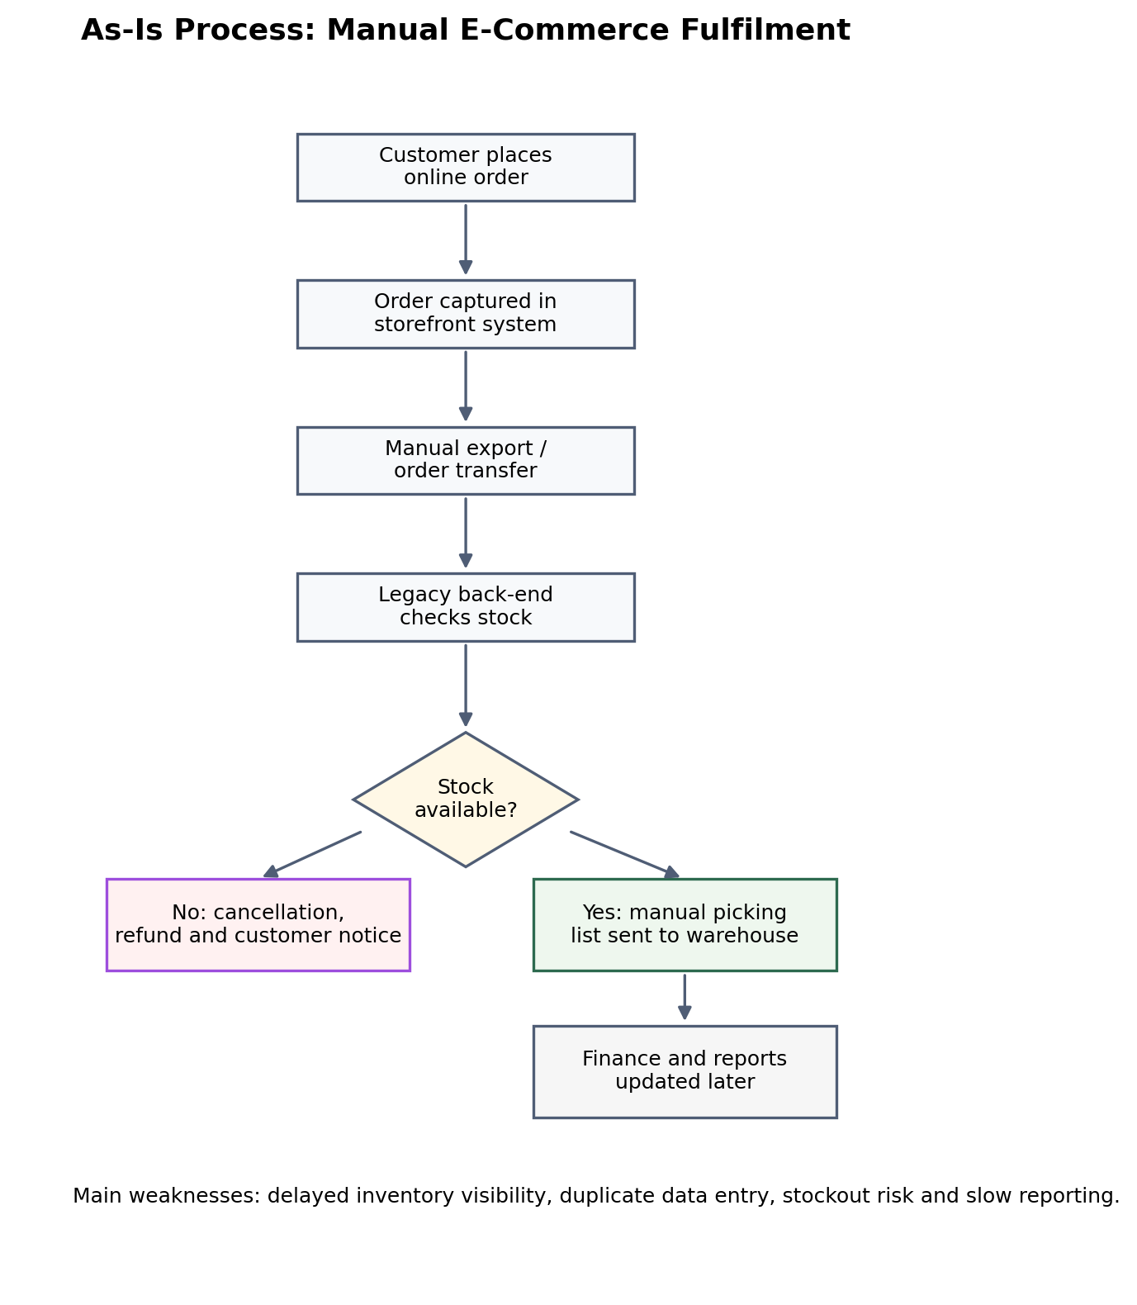
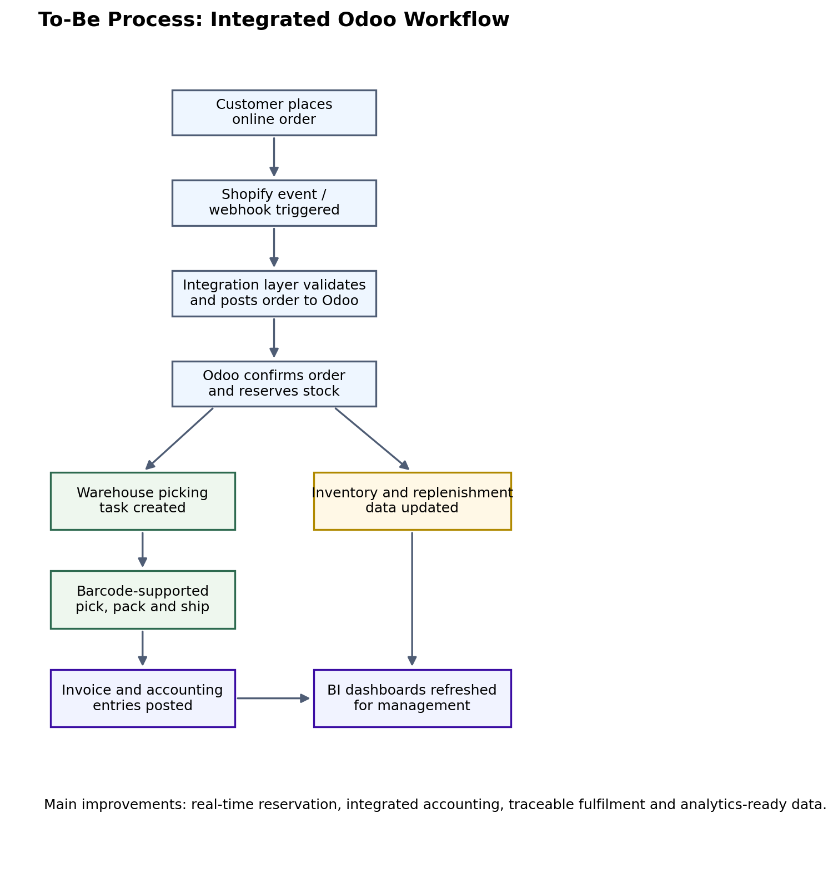
Business Process Mapping
Order fulfilment redesigned from manual reconciliation to real-time control
AS-IS: MANUAL
TO-BE: INTEGRATED
Delayed stock check • duplicate entry • refund risk
Reservation • picking task • accounting update • BI refresh
Nishat Textiles ERP Final Project
06
Notes:
Compare the manual As-Is process with the integrated To-Be process.

Slide 7
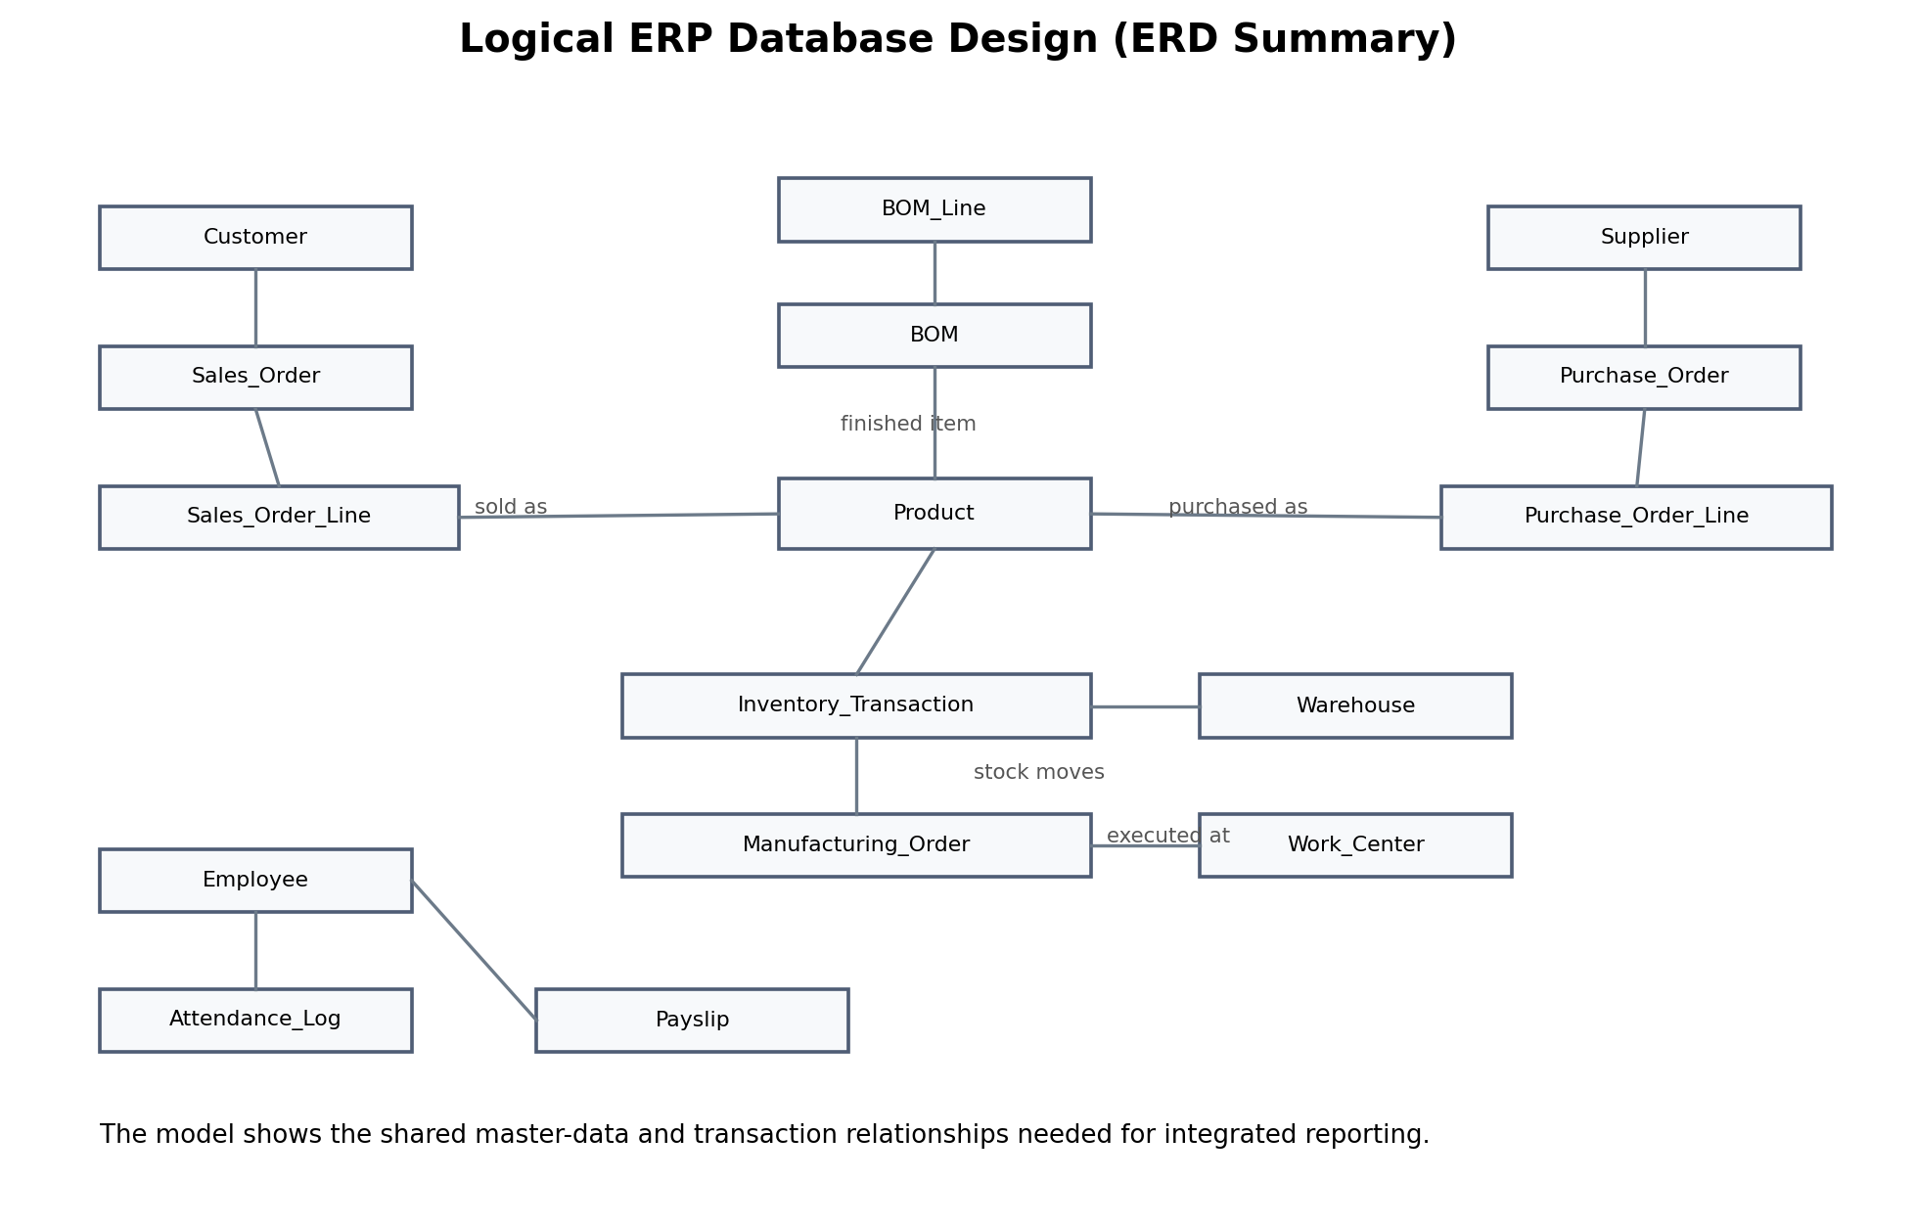
Database Design: Logical ERD
Shared master data enables reliable operations and analytics
Key relationships
Customer → Sales Order → Order Line
Supplier → Purchase Order → PO Line
Product → Inventory Transaction → Warehouse
BOM → Manufacturing Order → Work Center
Employee → Attendance → Payslip
Why this matters
Product master links sales, purchasing, inventory and production.
Dashboards are only trustworthy when master data is clean.
Nishat Textiles ERP Final Project
07
Notes:
Explain that the ERD is a logical model for shared master data and analytics readiness.

Slide 8
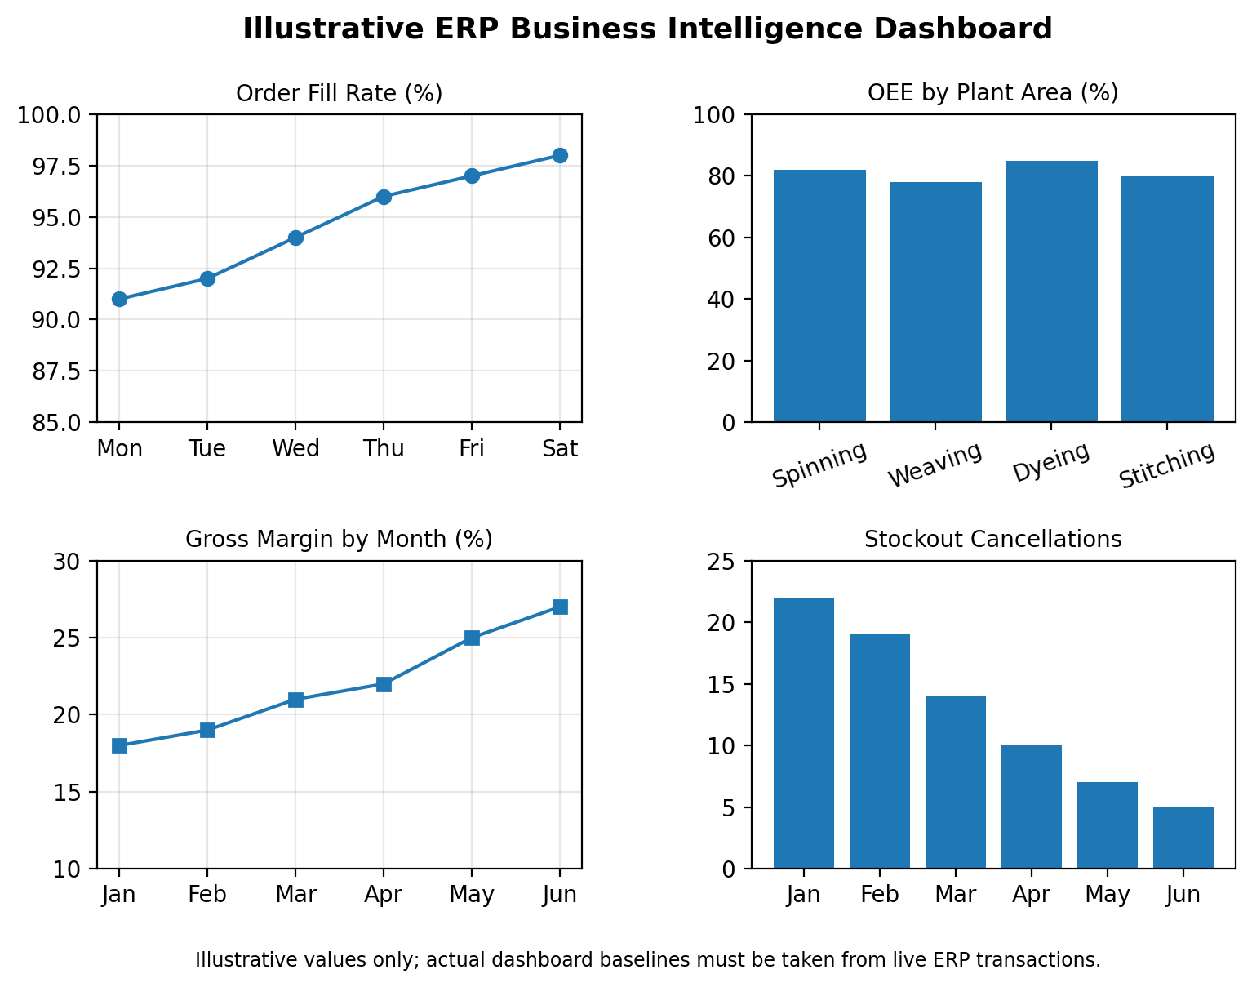
Analytics & BI Dashboard
KPIs are designed around management decisions, not chart volume
Order fill rate
Stockout cancellations
Service reliability
Revenue leakage
OEE
Gross margin
Plant efficiency
Product profitability
Dashboard rule
Every KPI must answer a decision question.
Nishat Textiles ERP Final Project
08
Notes:
Explain the KPI dashboard as management decision support, not decoration.

Slide 9
ERP Implementation Lifecycle
A phased rollout protects live operations during migration
1
2
3
4
5
6
Planning
Requirements
Configuration
Testing
Training
Deployment
Recommended rollout sequence
1) Sales + Inventory + Procurement → 2) Manufacturing + SCM → 3) Finance + HRM → 4) Advanced BI
Nishat Textiles ERP Final Project
09
Notes:
Walk through the lifecycle and justify phased rollout over big bang migration.

Slide 10
Challenges & Risk Controls
Main project risks must be managed before and after go-live
Risk
Control
Resistance to change
→
Super users + role-based training
Dirty master data
→
Cleansing + reconciliation checks
Integration failure
→
API monitoring + retry logic
Scope creep
→
Strict change control
Security exposure
→
Role access + audit logs
Biggest threat: a technically live ERP that users still bypass with spreadsheets.
Nishat Textiles ERP Final Project
10
Notes:
Emphasize data quality, user adoption and integration governance as the main risk areas.

Slide 11
Final Recommendations
Priority actions for a successful ERP transformation
Govern master data
Integrate core flow first
1
2
Clean product, supplier, customer and warehouse records before migration.
Prioritize sales, inventory and procurement for early operational impact.
Monitor Shopify connector
Train by role
3
4
Use validation, retries and exception ownership for API reliability.
Build change champions across warehouse, finance, HR and management.
Measure success through process outcomes — not software installation.
Nishat Textiles ERP Final Project
11
Notes:
Present the practical recommendations in priority order.

Slide 12
Conclusion
A successful ERP turns fragmented operations into one controlled transaction flow.
Stock accuracy
Faster reporting
Cleaner inventory truth
Less manual consolidation
Better fulfilment
Decision support
Lower cancellation risk
Operational KPIs in one view
Thank you
Questions?
Notes:
Close with the main message: ERP success is measured by improved process outcomes.

