Slide 1
Computer Systems
Exercise 8

Slide 2
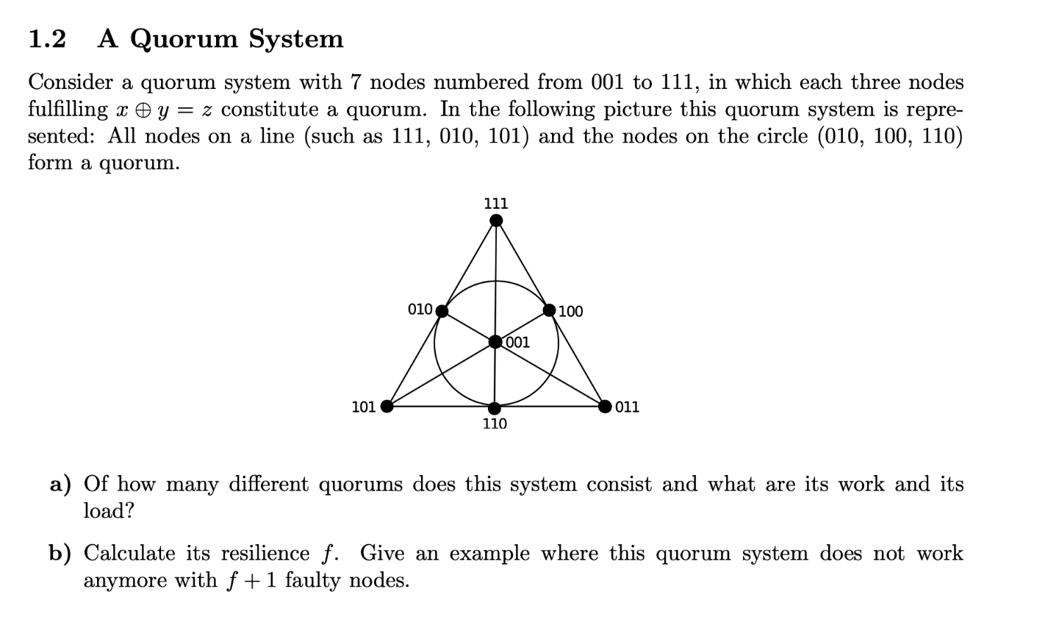
Last exercise
Quorums: 7 Work: 3 Load: 3/7

Slide 3
Last exercise
Quorums: 7 Work: 3 Load: 3/7
Resilience: 2, because every
node is in 3 quorums, so two
nodes can be contained in at most 2*3 quorums

Slide 4
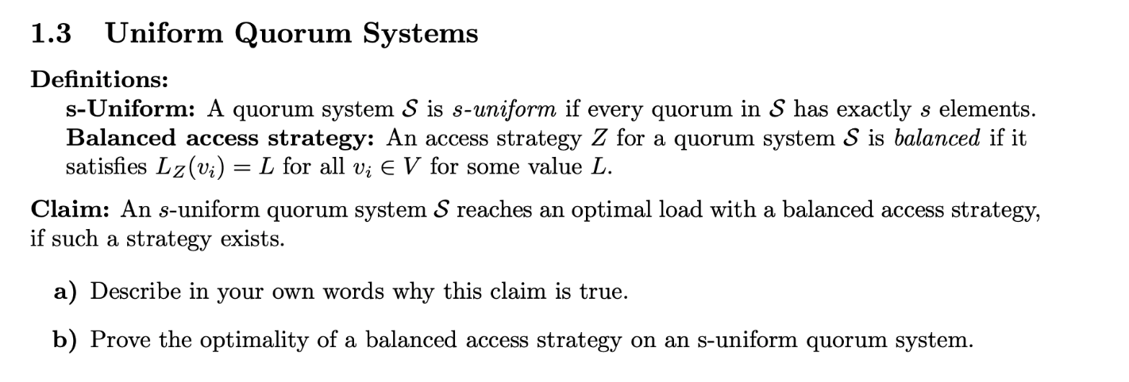
Last exercise
Idea: No matter which quorum gets accessed, exactly s nodes have to work. Therefore the sum of all loads should sum up to s (sum of access probabilities must sum to s if always s get accessed). To minimize the maximum element of a sum, set all elements to the average (balanced access strategy).

Slide 5
Last exercise

Slide 6
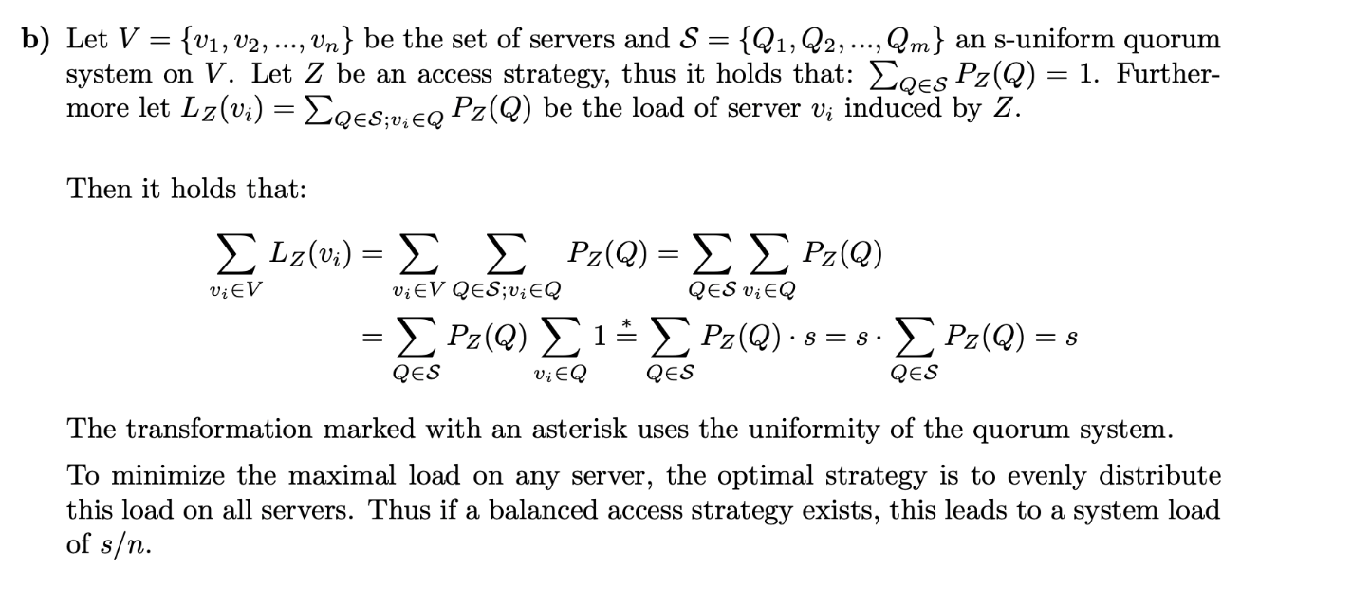
Last exercise

Slide 7
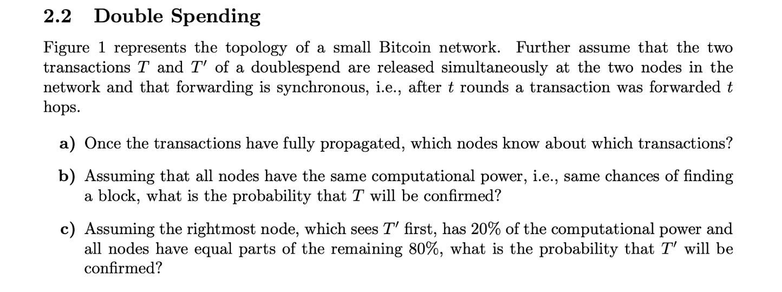
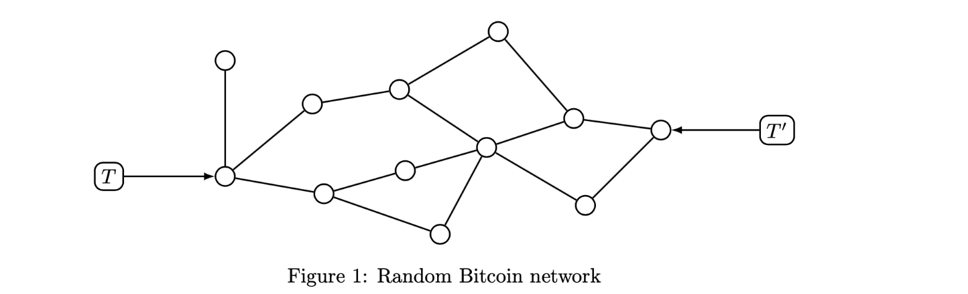


Last exercise
$$\frac{7}{12}$$
20+4* $\frac{80}{11}=49\%$

Slide 8
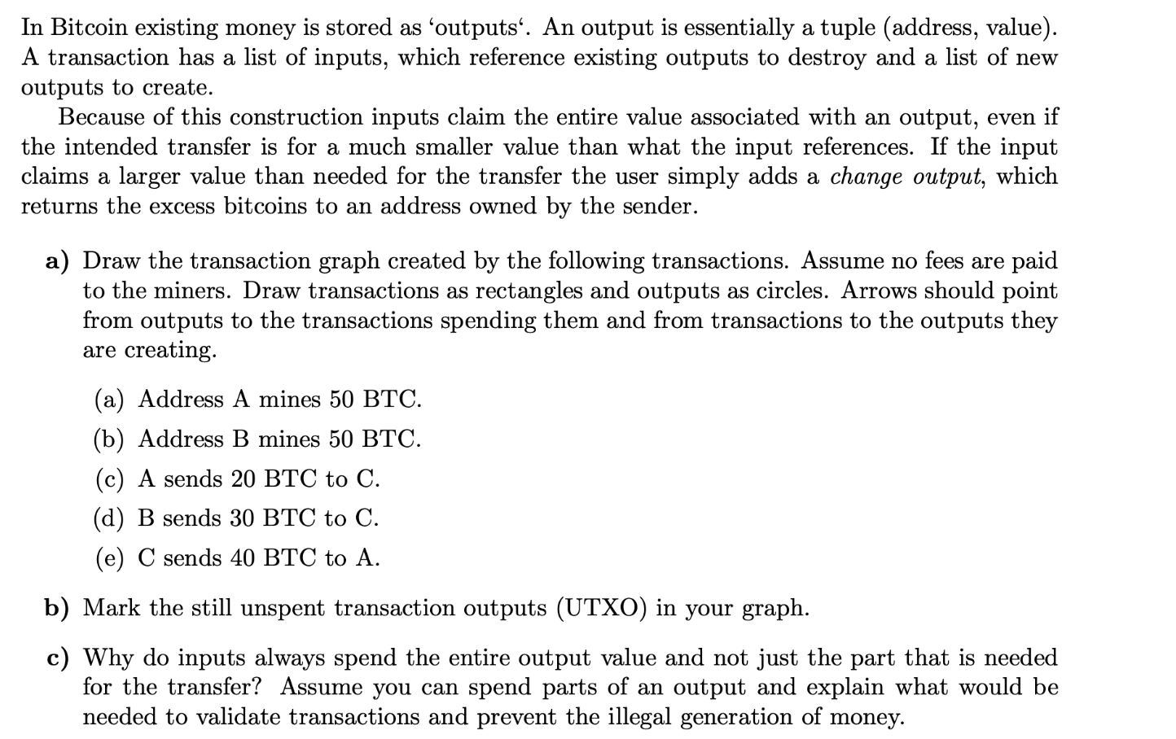
Last exercise

Slide 9
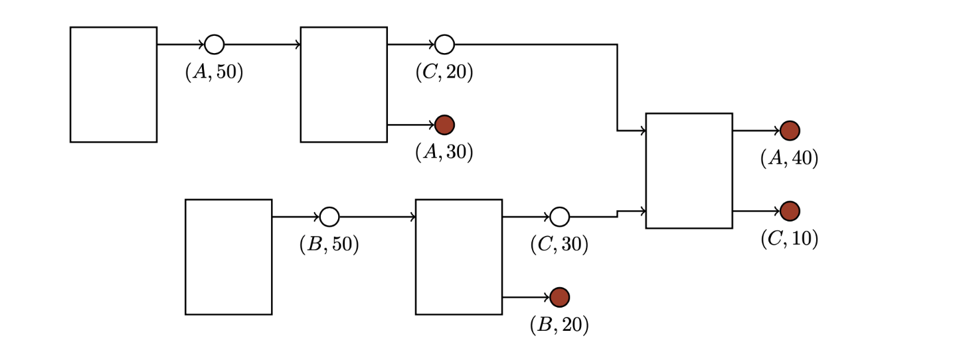
Last exercise

Slide 10
Last exercise

Slide 11

Last exercise

Slide 12
Last exercise

Slide 13
Last exercise

Slide 14
Last exercise

Slide 15
Last exercise

Slide 16
Last exercise

Slide 17
Last exercise

Slide 18
Last exercise

Slide 19
Last exercise
For simplicity reasons, would need to handle a partially spent output.
For more details, refer to the master solution (interesting note on becoming rich)

Slide 20
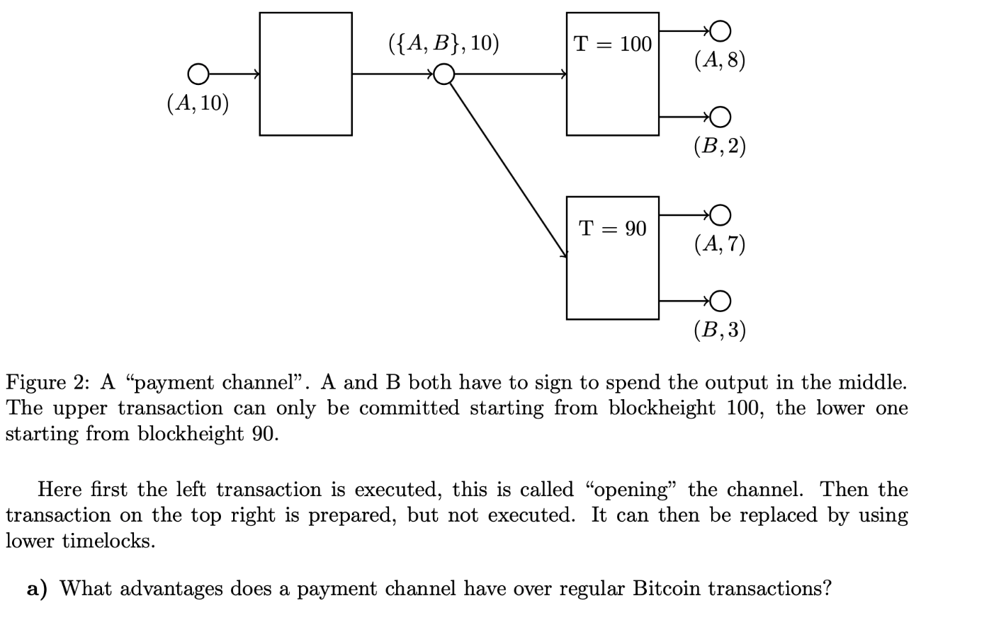
Last exercise
Transactions are instantly finalized, so large
confirmation delay of blockchain is irrelevant.
Parties do not have to pay transaction fee for
every transaction.

Slide 21
Last exercise
Without needing B’s signature, A could just
transfer the whole shared output to itself before the timelock expires

Slide 22
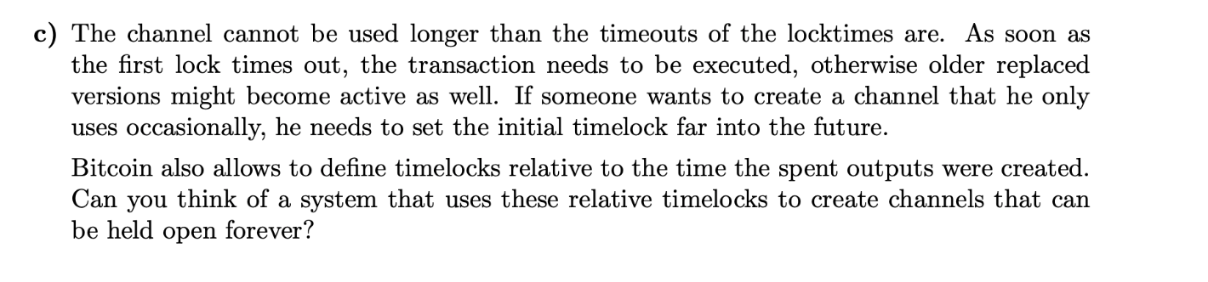
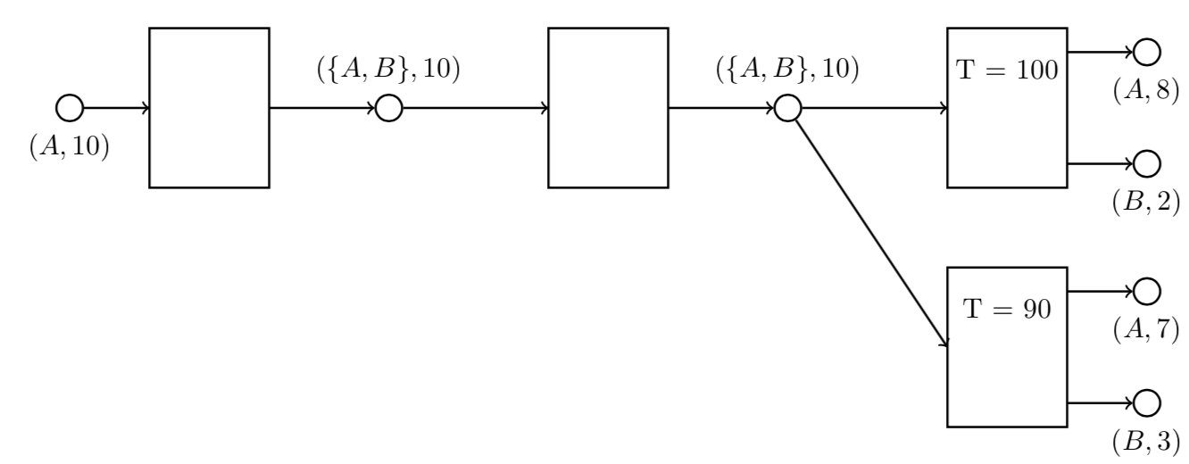
Last exercise

Slide 23
Memory management and virtual memory
Goal: Allocate memory for every process. Memory allocation should be efficient and memory should be fast to access.

Slide 24
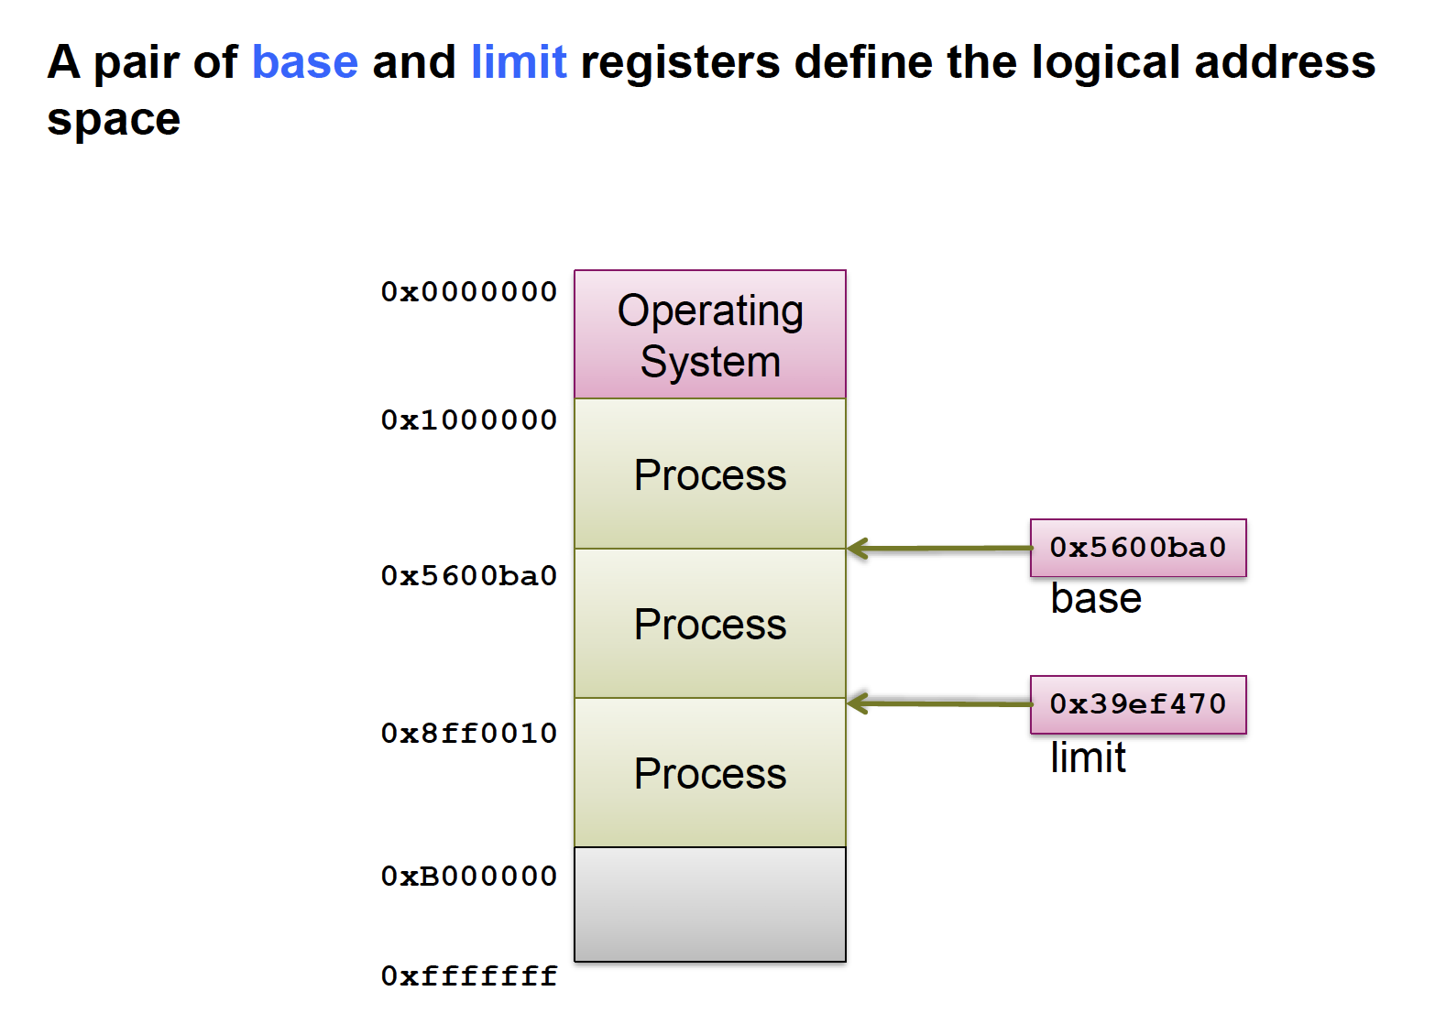
Partitioned Memory
Issue:
Addresses are not known
until load time.
Solution:
Code is completely position-independent
Relocation register maps compiled addresses to physical addresses
Issue:
Only continuous memory regions per process
external fragmentation
no memory sharing between processes

Slide 25
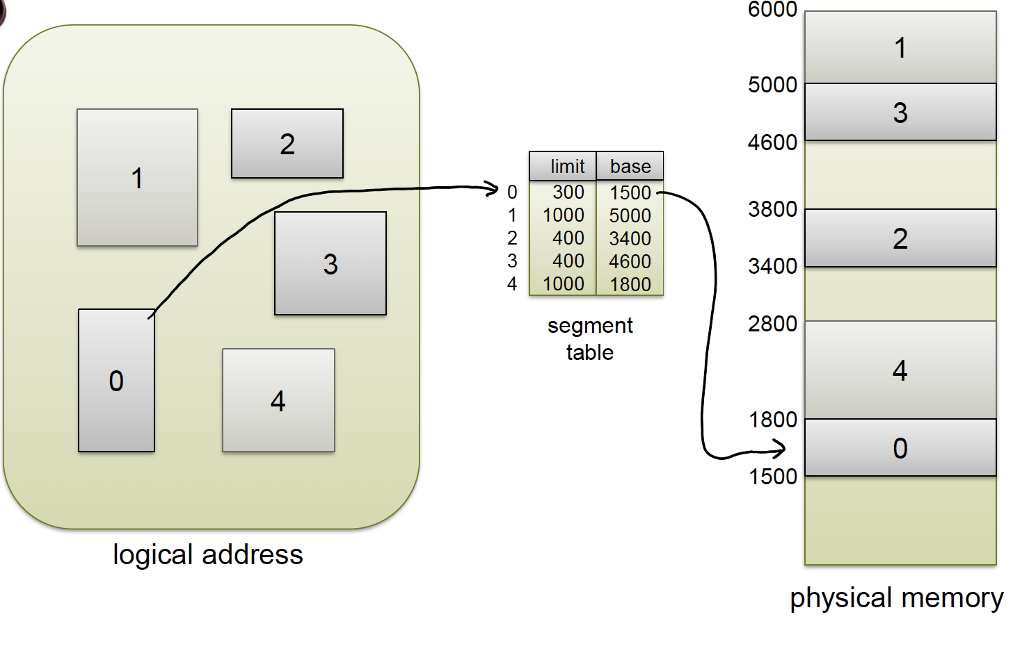
Segmentation
Idea: not only one address range per process, but multiple segments.

Slide 26
Segmentation Architecture
Segment table – each entry has:
base
limit
Segment-table base register
current segment table location in memory
Segment-table length register
current size of segment table
Summary:
Segments can be shared
Fast context switches (only reload segment table registers)
external fragmentation still a problem

Slide 27
Paging
Divides physical memory into fixed size frames
Divides virtual memory into pages of same size
uses page table to do mapping from virtual to physical memory
Solves external fragmentation problem – process can always fit if there is available free memory
Notes:
Shouldn’t it be flipped?
Can always fit?

Slide 28
Different Page Tables
Linear page table
array of physical page numbers indexed by virtual pages numbers
grows in size with memory
Hierarchical page table
organized in multiple layers, each translating different part of virtual address

Slide 29
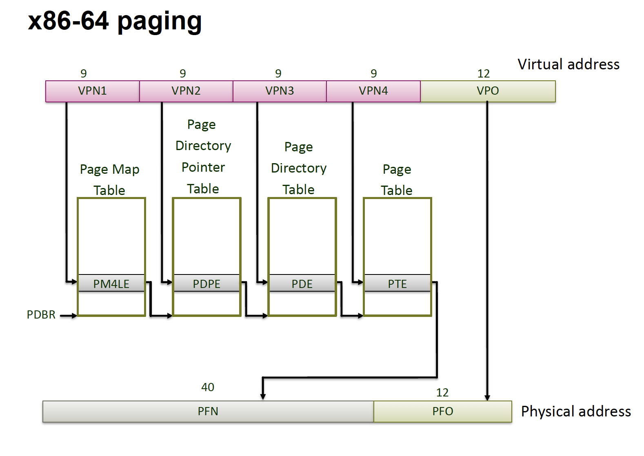
Example: x86

Slide 30
Copy on write (COW)
Have shared memory until one process writes to memory, then copy it
How:
forking process, change rights of both processes to READONLY
if one process tries write to memory, copy page and add it to childs page table as WRITEABLE
mark page in parent’s page table as WRITEABLE
makes fork much faster, since you don’t need to copy whole address space

Slide 31
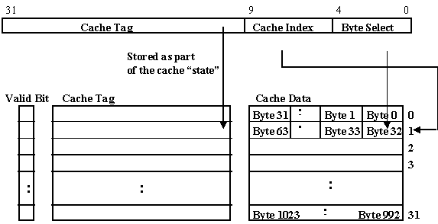
Cache types
virtually indexed, virtually tagged
suffers from homonyms, because same virtual
address can mean different physical address in
different processes
address-space tags can prevent that by adding to a cache line which address space it belongs to
fast
physically indexed, physically tagged
good for context switches
slow, since address needs to be translated before lookup
virtually indexed, physically tagged
good if it works
complicated
physically indexed, virtually tagged
not really useful

Slide 32
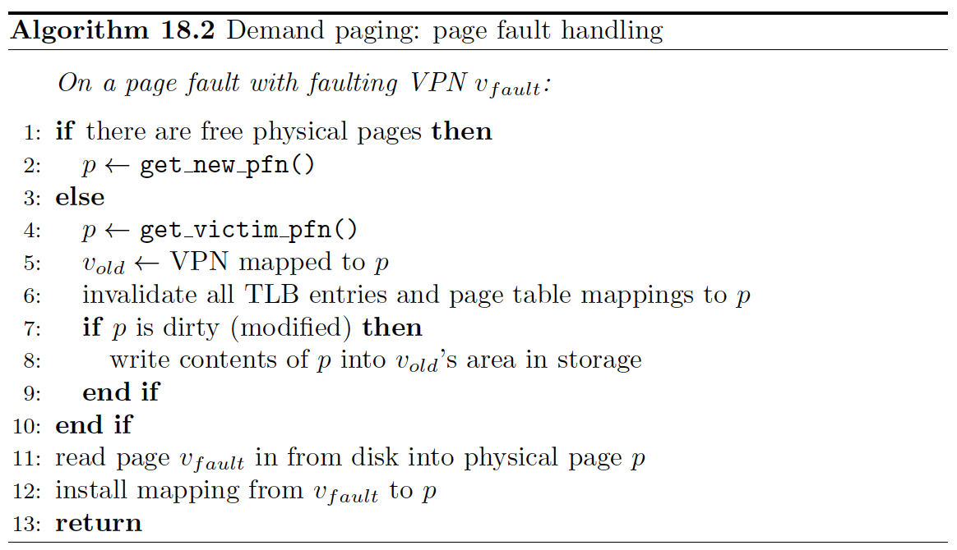
Demand paging
Idea: only page in page into main memory when needed.

Slide 33
Page replacement strategies
How does actually work?
optimal page replacement: take page that won’t be used for the longest
gives optimal performance
not feasible in practice, since we do not know page accesses in advance
FIFO page replacement
easy to implement
does not give good performance
Beladys anomaly

Slide 34
Page replacement strategies
Least recently used
good performance
hard to implement, OS usually gets informed about page faults, but not every memory access
2nd chance replacement – approximation to least recently used
Idea: every time a page gets referenced, a “referenced” bit gets set to true (does not tell when exactly it got referenced, just that it got referenced recently). When looking for a victim page, iterate through all pages and set all true referenced bits to false. Take the first one that has “referenced = false”
approximation to LRU
hardware sometimes provides referenced bit
we can have better approximation

Slide 35
Allocating Pages between processes
Global page allocation: OS selects page replacement from set of all pages
each process needs minimum number of pages
Local page allocation: OS selects page replacement from current faulting process
works
Question here: how many pages get allocated per process?

Slide 36
Working set
Working set: set of pages accessed by a process during a fixed time window
Working set size: size of working set ☺
Thrashing: Working set size a lot bigger than size of physical memory
Notes:
Thrashing, bigger than size of pages allocated to the process

Slide 37

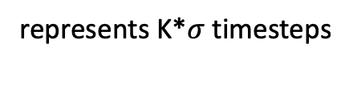
Working set estimation
$$K−1$$
1
0
1
0
0
1
represents K*$σ$timesteps
$$σ$$

Slide 38
Working set estimation
$$K−1$$
1
0
1
0
0
1
represents K*$σ$timesteps
$$σ$$

Slide 39
Working set estimation
$$K−1$$
1
0
1
0
0
1
0
or over all those bits, if at least one is 1, then add to working set

Slide 40
Working set estimation
page 0
0
0
0
0
0
0
not in set
page 1
0
1
0
0
1
0
in set
Working set = {page 1, page2}
page 2
0
1
0
0
1
0
in set
page 3
1
0
0
0
0
0
not in set

Slide 41
Quiz
Why doesn’t Beladys anomaly happen with stack-based replacement strategies?
Because with stack-based implementations, a set size of k is always a subset of a set size of k+n. So a page fault in k+n always happens in k too.
What is a criteria for a good page replacement strategy?
The number of page faults should be as small as possible
Is there a scenario when COW is slower then just copying the whole process?
Yes, if a large amount of pages gets written to. COW has a certain overhead to just copying everything, because of marking everything as readable/writable and the page faults it causes.

Slide 42
Next exercise

