Slide 1
Computer Systems Exercise 9
© Systems Group | Department of Computer Science | ETH Zürich

Slide 2

Feedback
https://bit.ly/2Fuon6W (Claudio)
https://bit.ly/2Qb4JBb (Amray)

Slide 3
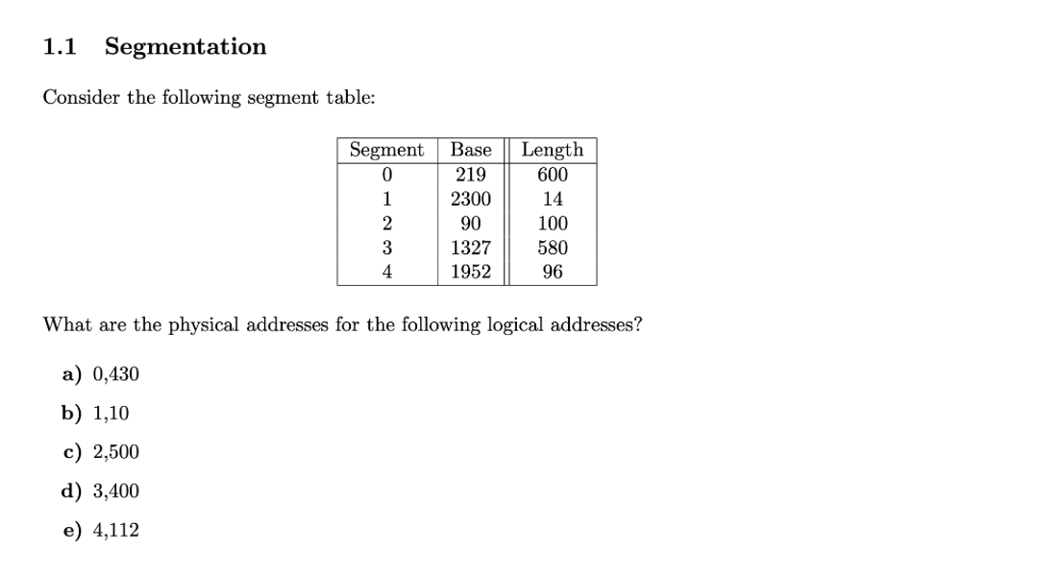

Last Exercsie
1.) 430 < 600?
2.) 219 + 430 = 649

Slide 4

Last Exercsie
1.) 500 < 100?

Slide 5
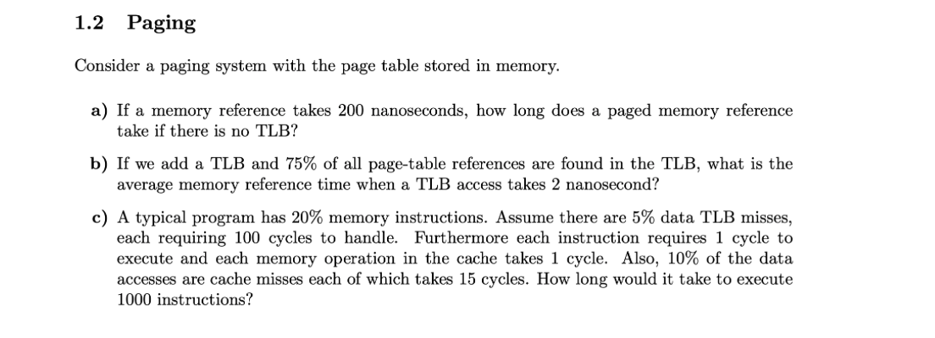
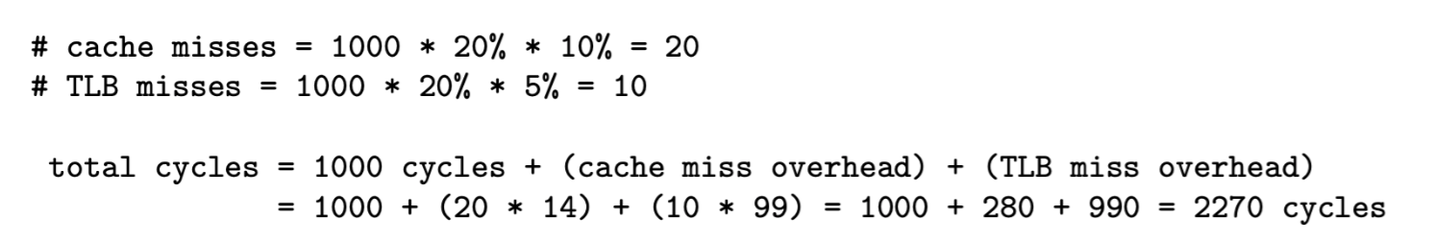
Last Exercise
No TLB: one access for page, one access for page table: 200 + 200 = 400
(2+200)*0.75 + (2+200+200)*0.25 = 252ns
Idea: calculate the overhead

Slide 6
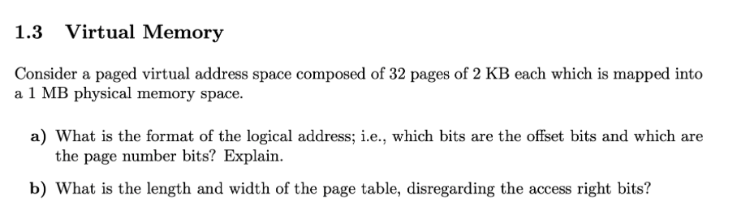

Last exercise
offset: each byte needs to get accessed
2KB = $2^{11}$ bytes -> 11 offset bits
page number: each page needs to get accessed
32 pages = $2^{5}$ pages -> 5 page number bits
b) length of page table: for each page one entry
32 entries
width of page table: each entry contains one physical address
size of physical address: 1MB = $2^{20}$ bytes. So 20 bits to represent address
Length = 32, width = 20

Slide 7
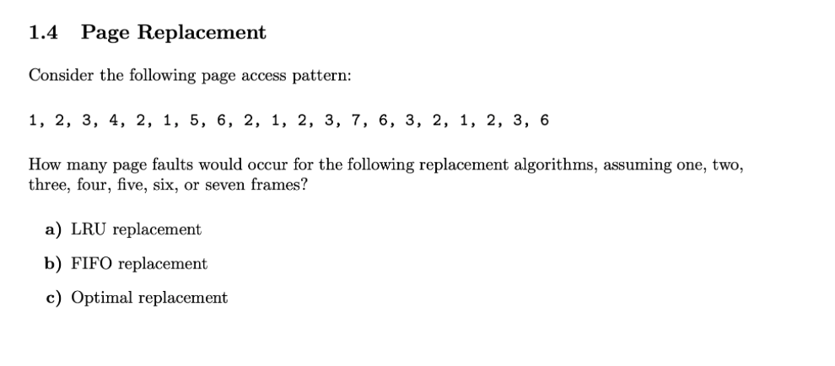
Last exercise
1

Slide 8
Last exercise
1
2
1

Slide 9
Last exercise
1
2
3
1
2
1

Slide 10
Last exercise
1
2
3
4
1
2
3
1
2
1

Slide 11
Last exercise
1
2
3
4
2
1
2
3
4
1
2
3
1
1

Slide 12
Last exercise
1
2
3
4
2
1
1
2
3
4
2
1
2
3
4
1
1
3

Slide 13
Last exercise
1
2
3
4
2
1
5
1
2
3
4
2
1
1
2
3
4
2
1
1
3
4
3

Slide 14
Last exercise
1

Slide 15
Last exercise
1
2
1

Slide 16
Last exercise
1
2
3
1
2
1

Slide 17
Last exercise
1
2
3
4
1
2
3
1
2
1

Slide 18
Last exercise
1
2
3
4
1
2
3
1
2
1

Slide 19
Last exercise
1
2
3
4
1
2
3
1
2
1

Slide 20
Last exercise
1
2
3
4
5
1
2
3
4
1
2
3
1
2
1

Slide 21
Last exercise
1
2
3
4
5
1
2
3
4
1
2
3
1
2

Slide 22
File system in context
Application
Library
File system
File system API and implementation
Block cache
Block device interface
Device driver
I/O system
I/O, DMA, Interrupts
Physical device

Slide 23
File systems operations
Files
Read
Write
Execute
Directory
Link
Unlink
Rename
List

Slide 24
File metadata
Metadata: important concept!
Data about an object, not the object itself
File metadata examples:
Name
Location on disk
Times of creation, last change, last access
Ownership, access control rights File type, file structure
Arbitrary descriptive data (used for searching)

Slide 25
Protection
File owner/creator should be able to control:
what can be done
by whom
Types of access
Read
Write
Execute
Append
Delete
List (“read” for directory)

Slide 26
Access control matrix
For a single file or directory:
Objects
 | File1 | File2 | File3 | File4 | File5 | File6 | File7 | …
A | rwx | r | x |  |  | rw | x
B | r | rwx |  | x |  |  | x
C | rw |  |  |  | rwx
D | rw | rw | x | x
E | r
F | r |  |  |  | rw
…
Principals
Problem: how to scalably represent this matrix?

Slide 27
ACLs
Access Control Lists
For each file, list the principals and their rights on the object
Store with the file
Good:
Easy to change rights quickly
Scales to large numbers of files
Bad:
Doesn’t scale to large numbers of principals

Slide 28
File System Implementation

Slide 29
Implementation aspects
Directories and indexes
Where on the disk is the data for each file?
Index granularity
What is the unit of allocation for files?
Free space maps
How to allocate more sectors on the disk?
Locality optimizations
How to make it go fast in the common case

Slide 30
FAT

Slide 31
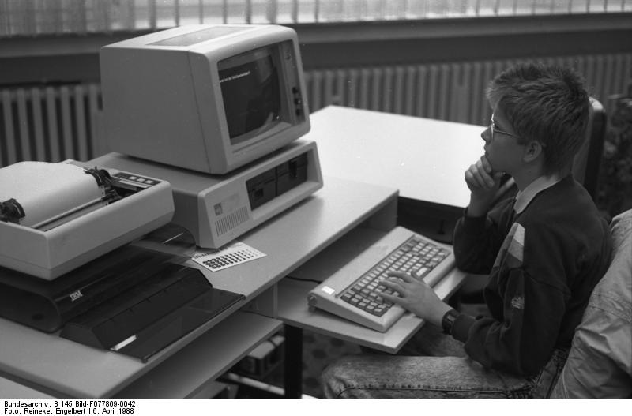
FAT background
No access control
Very little metadata
Limited volume size
BUT still extensively used ☹
Flash devices, cameras, phones

Slide 32
FAT file system
FAT
Data blocks
0
1
2
Directory
3
file 9 block 3
Foo
.exe
9
4
5
Bar
.doc
12
6
7
8
9
file 9 block 0
10
file 9 block 1
11
file 9 block 2
12
file 12 block 0
13
14
15
16
file 12 block 1
17
18
file 9 block 4
19

Slide 33
FAT file system
FAT
Data blocks
Free space:
Linear search through FAT
0
Slow random access: need to traverse linked list for file block
1
2
3
file 9 block 3
4
Very little support for reliability: lose the FAT and it’s game over
5
6
7
8
9
Poor locality: files can end up fragmented on disk
file 9 block 0
10
file 9 block 1
11
file 9 block 2
12
file 12 block 0
13
14
15
16
file 12 block 1
17
18
file 9 block 4
19

Slide 34
FFS

Slide 35
FFS uses indexed allocation
Inode array
Inode
Metadata
Data block
Data block
Data block
Block pointers
Data block
File inode number from directory entry
File is represented by an index block or inode
File metadata
List of blocks for each part of file
Directory contains pointers to inodes

Slide 36
Inode and file size in FFS
Example:
Inode is 1 block = 4096 bytes
Inode metadata = 512 bytes
Block addresses = 8 bytes
Hence:
(4096-512) / 8 = 448 block pointers
448 * 4096 = 1792kB max. file size

Slide 37
Unix file system inode format (simplified)
Inode:
(all blocks 4kB)
File mode
Data block
Owner/group
Data block
Timestamps
Data block
Size
…
<other metadata>
Data block
12 direct block pointers
Question:
How to extend file size if there are no more block pointers in the Inode?
…

Slide 38
Unix file system inode format (simplified)
Inode:
File mode
(all blocks 4kB)
Data block
Owner/group
Data block
Timestamps
Data block
Size
…
Data block
<other metadata>
Data block
…
12 direct block pointers
Data block
indirect block
…
Data block
…
indirect block
Data block
Single indirect
Double indirect
…
indirect block
Data block
indirect block
…
Triple indirect
Data block
4k / 8 = 512 block pointers

Slide 39
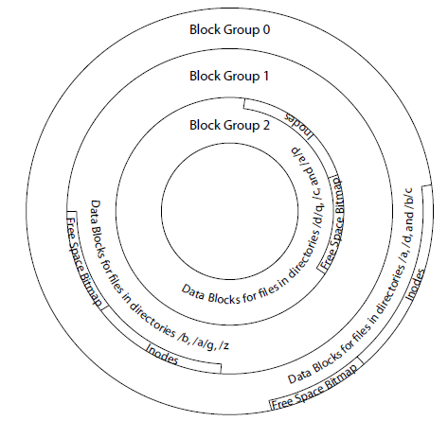
Block groups
1. Optimize disk performance by keeping together related:
Files
Metadata (inodes)
Free space map
Directories
2. Use first-fit allocation within a block group to improve disk locality
3. Layout and block groups defined in the superblock (not shown);
Replicated several times.

Slide 40
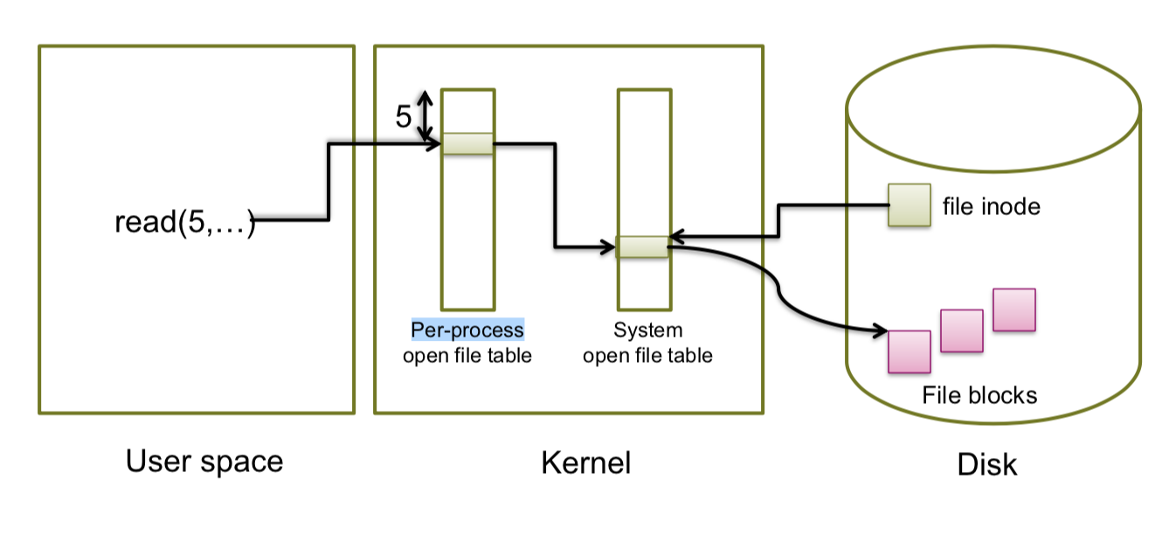
Open Files
inodes of open files cached
open(“myfile”);
returns for example 5
file handle used to identify open file

Slide 41
NTFS

Slide 42
NFTS Master file table
MFT
Lots of options for what goes in here
MFT record:
Std. info
Attributes, data, metadata
free
1 kB fixed size

Slide 43
NTFS small files
Small file fits into MFT record:
Hard links (multiple names) stored in MFT:
Std. info
Filename
File data
free
“resident” data
Std. info
Filename1
Filename2
File data
free

Slide 44
NTFS normal files
MFT holds list of extents:
Std. info
Filename
Start, length
Start, length
Start, length
free
Data (extent 0)
Data (extent 1)
Data (extent 2)

Slide 45
Too many attributes?
Attribute list holds list of attribute locations
MFT entry
Std. info
Attr. list
Filename 1
Filename 2
name
name
data
2nd MFT entry
Std. info
Start, length
Start, length
Start, length
free
In addition, attributes can also be stored in extents ⇒ very large scaling

Slide 46
Metadata files
File system metadata in NTFS is held in files!
File num. | Name | Description
0 | $MFT | Master file table
1 | $MFTirr | Copy of first 4 MFT entries
2 | $Logfile | Transaction log of FS changes
3 | $Volume | Volume information & metadata
4 | $AttrDef | Table mapping numeric IDs to attributes
5 | . | Root directory
6 | $Bitmap | Free space bitmap
7 | $Boot | Volume boot record
8 | $BadClus | Bad cluster map
9 | $Secure | Access control list database
10 | $UpCase | Filename mappings to DOS
11 | $Extend | Extra file system attributes (e.g. quota)
Question:
Huh?
Where is it then?
Answer:
First sector of volume points to first block of MFT

Slide 47
File system implementations
 | FAT | FFS | NTFS
Index structure | Linked list | Fixed, assymetric tree | Dynamic tree
Index granularity: | Block | Block | Extent
Free space management | FAT Array | Fixed bitmap | Bitmap in file
Locality heuristics | Defragmentation | Block groups, Reserve space | Best fit, Defragmentation

