Slide 1
Computer Systems
Exercise 7

Slide 2
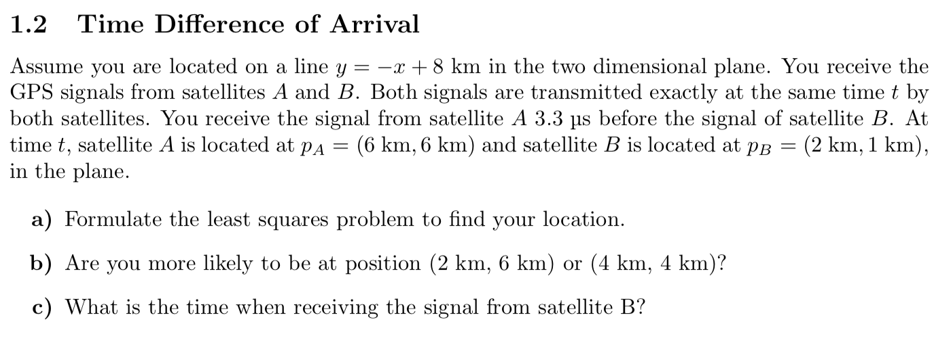
Last Exercise

Slide 3
Last Exercise 1.2
||pA – p||
pA
p
||pB – p||
pB

Slide 4
Last Exercise 1.2
||pB-p||-||pA-p|| = 1km
so we want to minimize:
abs(||pB-p||-||pA-p|| - 1)
pA
p
pB

Slide 5
Last Exercise
Residual at (2,6): abs(||(2,1)-(2,6)||-||(6,6)-(2,6)||-1) = 5 – 4 – 1 = 0
Residual at (4,4): abs(||(2,1)-(4,4)||-||(6,6)-(4,4)||-1) = 3.6 – 2.8 – 1 = -0.2

Slide 6
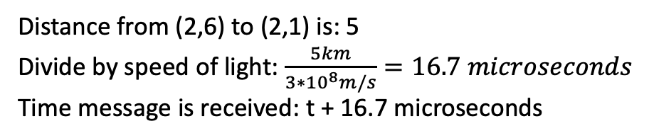
Last Exercise
Distance from (2,6) to (2,1) is: 5
Divide by speed of light: $\frac{5km}{3∗{10}^{8}m/s}=16.7 microseconds$
Time message is received: t + 16.7 microseconds

Slide 7
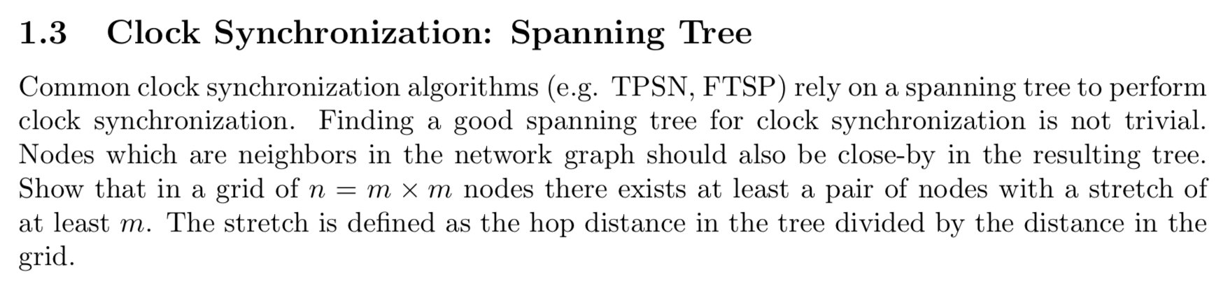
Last Exercise

Slide 8
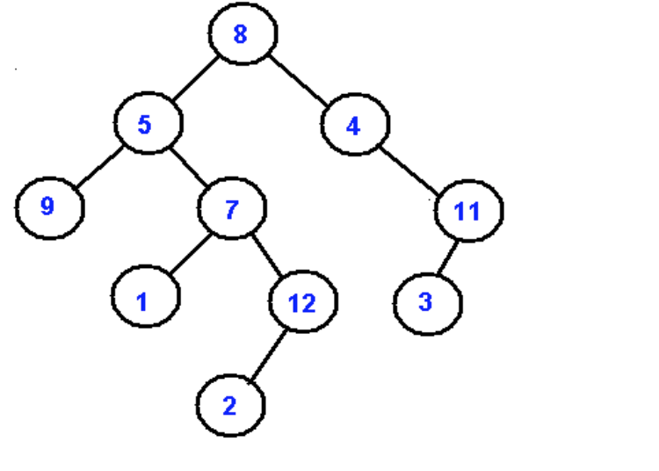
Last exercise 1.3
General layout of spanning tree:

Slide 9
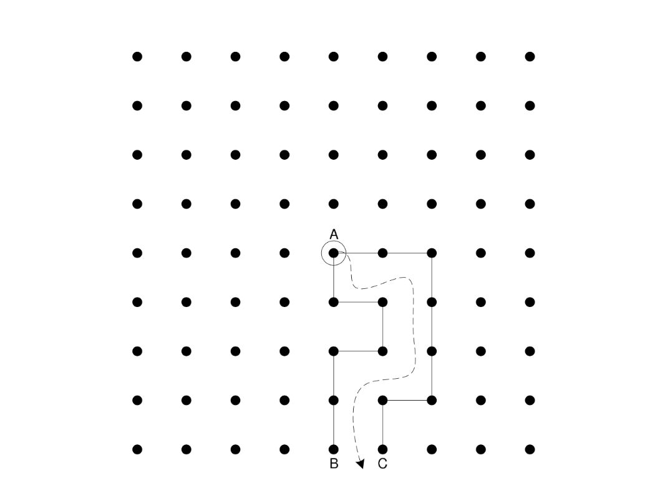
Last Exercise 1.3

Slide 10
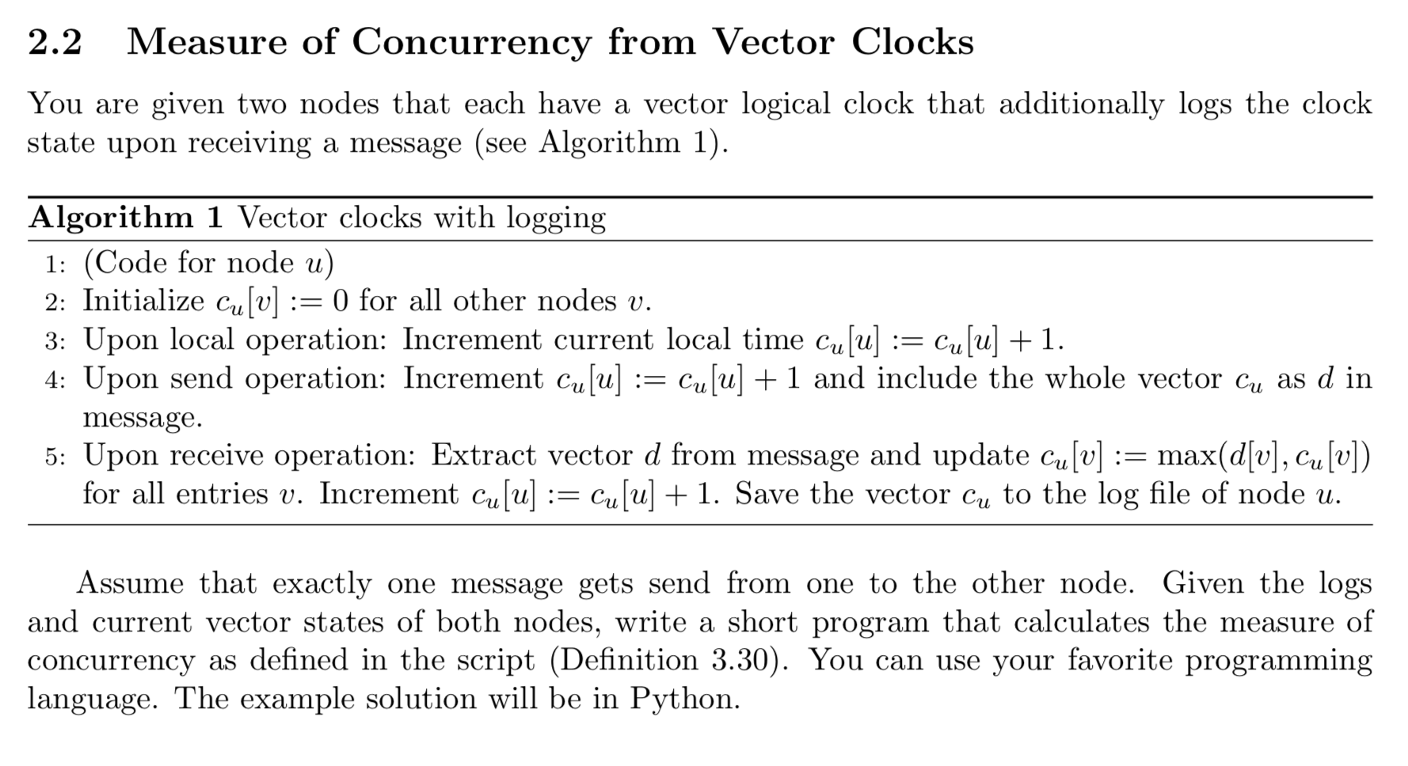
Last Exercise

Slide 11

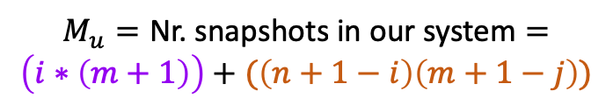

Last Exercise 2.2
i
n
j
m
$$M_{s}=\text{Nr}\text{. }\text{sequential} \text{snapshots}\text{ =} n+m+1$$
Measure of concurrency: $\frac{M_{u}−M_{s}}{M_{c}−M_{s}}$
$$M_{c}=\text{Nr}\text{. }\text{concurrent} \text{snapshots} = (m+1)(n+1)$$
$$M_{u}=\text{Nr}\text{. }\text{snapshots} \text{in} \text{our} \text{system}=$$
$$\left(i∗\left(m+1\right)\right)+(\left(n+1−i\right)\left(m+1−j\right))$$

Slide 12

Last Exercise 2.2
i
n
j
m
$$M_{s}=\text{Nr}\text{. }\text{sequential} \text{snapshots}\text{ =} n+m+1$$
Measure of concurrency: $\frac{M_{u}−M_{s}}{M_{c}−M_{s}}$
$$M_{c}=\text{Nr}\text{. }\text{concurrent} \text{snapshots}\text{ =}(n+1)(m+1)$$
$$M_{u}=\text{Nr}\text{. }\text{snapshots} \text{in} \text{our} \text{system}=$$
$$\left(i∗\left(m+1\right)\right)+(\left(n+1−i\right)\left(m+1−j\right))$$

Slide 13
Quorum Systems
Load ~ probability
Load of access strategy on node: Probability it gets accessed
Load on quorum system induced by access strategy: load of node with maximal load
Load of quorum system: load induced by access strategy with best access strategy
Work ~ count
Work of quorum: number of nodes
Work induced by access strategy: expected number of nodes accessed
Work of quorum system: work induced by access strategy with best access strategy

Slide 14
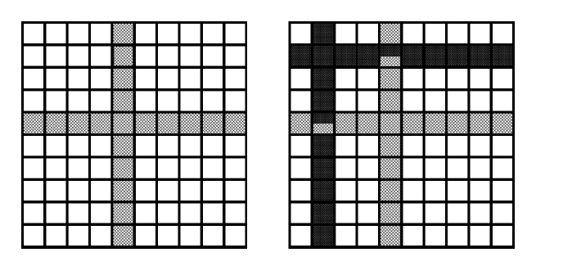
Grid quorum system – Basic Grid
Problem:
2 quorums intersect
in two nodes -> deadlock

Slide 15
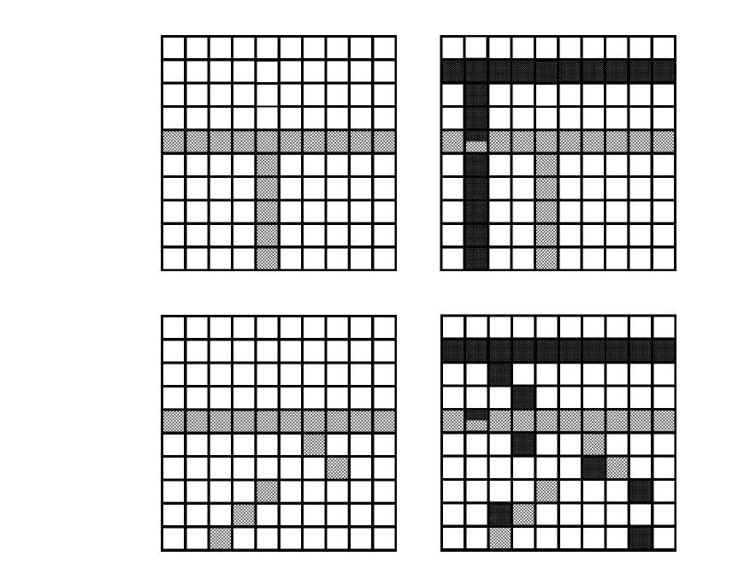
Grid quorum system – Another Grid
Better:
Two quorums won’t run into a
deadlock anymore
Problem:
It can still happen with three
or more threads

Slide 16
Grid quorum system – Another Grid
Solution:
Try to get all locks in order (by id), if
one is locked release all and start
over.
-> at least one quorum will always
make progress (the one with highest
identifier locked currently)

Slide 17
Fault tolerance
f-resilient
any f nodes can fail and at least one quorum still exists
resilience: largest such f

Slide 18
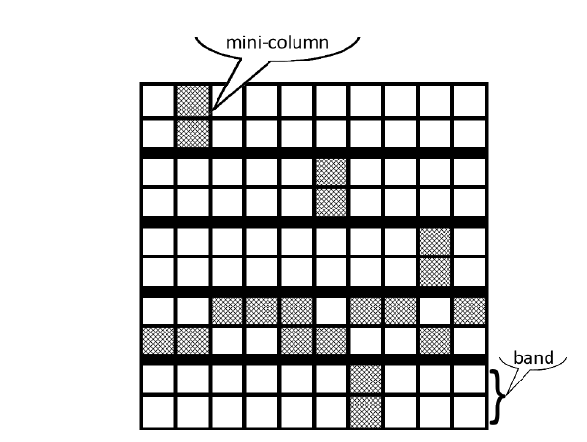
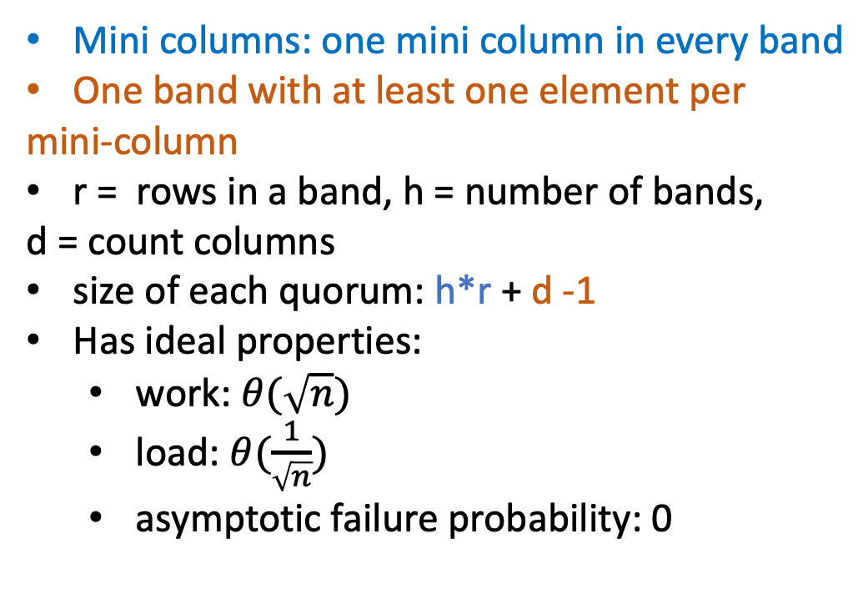
B-grid quorum system
Mini columns: one mini column in every band
One band with at least one element per
mini-column
r = rows in a band, h = number of bands,
d = count columns
size of each quorum: h*r + d -1
Has ideal properties:
work: $θ(\sqrt{n})$
load: $θ(\frac{1}{\sqrt{n}})$
asymptotic failure probability: 0

Slide 19
Byzantine quorum systems
f-disseminating
if the intersection of two quorums always contains f+1 nodes
for any set of f byzantine nodes, there always is a quorum without byzantine nodes
good model if data is self-authenticating, if not we need a stronger one
f-masking
if the intersection of two quorums always contains 2f+1 nodes
for any set of f byzantine nodes, there always is a quorum without byzantine nodes
correct nodes will always be in majority

Slide 20
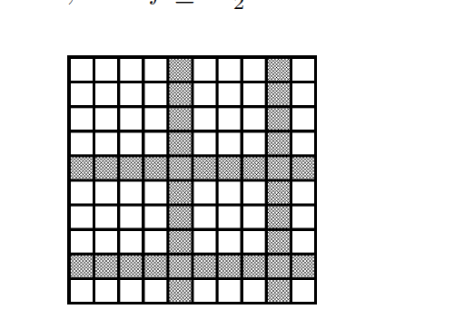

Byzantine quorum systems – M grid
$\sqrt{f+1}$ rows and $\sqrt{f+1}$ columns
$\sqrt{f+1}$* $\sqrt{f+1}=f+1$intersections
-> f disseminating

Slide 21
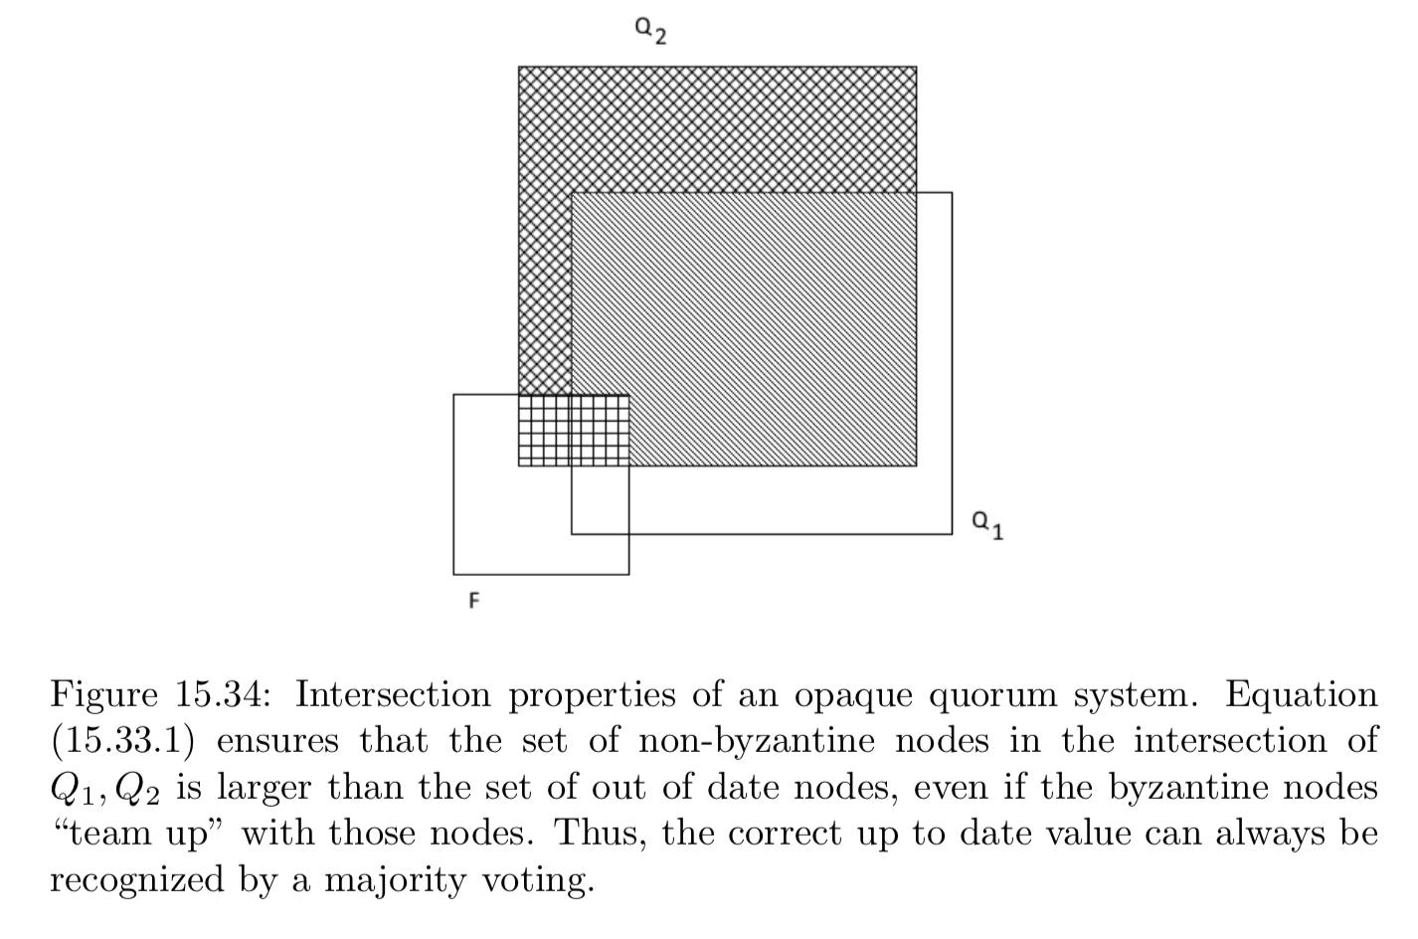
Opaque quorum systems
Also we want at least one Quorum that contains no byzantine nodes

Slide 22


Consistency, Availability and Partition tolerance
Consistency:
All nodes agree on the current state of the system
Availability:
The system is operational and instantly processing incoming requests
Partition tolerance:
Still works correctly if a network partition happens
Good news:
achieving any two is very easy
Bad news:
achieving three is impossible (CAP theorem)

Slide 23
Bitcoin
decentralized network consisting of nodes
users generate private/public key pair
address is generated from public key
it is difficult to get users “real” identity from public key
6
signature a
5
signature a
Inputs
Outputs
4
signature b
3
signature b
1signature a
Transaction

Slide 24
Bitcoin transactions
Conditions:
Sum of inputs must always be at least the sum of outputs
unused part is used as transaction fee, gets paid to miner of block
An input must always be some whole output, no splitting allowed!
Money that a user “has” is defined as sum of unspent outputs

Slide 25


Blockchain
1. issue transaction
3. send transaction to other nodes in network
2. add transaction to local history
4. check whether transaction is valid
input of transaction must be in local UTXO
must have valid signature
sum of inputs >= sum of outputs
5. remove any input of transaction from local UTXO
6. add transaction to local history
7. propagate transaction further

Slide 26
Blockchain
Right now we have infinitely growing memory pool and we can’t be sure that other nodes have the same pool
Solution: Propagate memory pool through network and make sure everybody else will have same state
Problem: How to avoid that everybody wants to propagate it’s own memory pool?
Solution: Proof-of-Work
proof that you put a certain amount of work into propagating your memory pool

Slide 27
In Bitcoin
A node is allowed to propagate block as soon as it has calculated a hash with some special property
no better method than iterating through different input values until the right hash appears
Problem: What happens if two nodes calculate a correct hash at the same time? Some nodes will accept one block then, the other ones another block
Solution: Nodes will always accept the block with the longest chain, so in order to keep up the split, the nodes would have to always calculate two hashes at the same time -> probability goes to 0

Slide 28
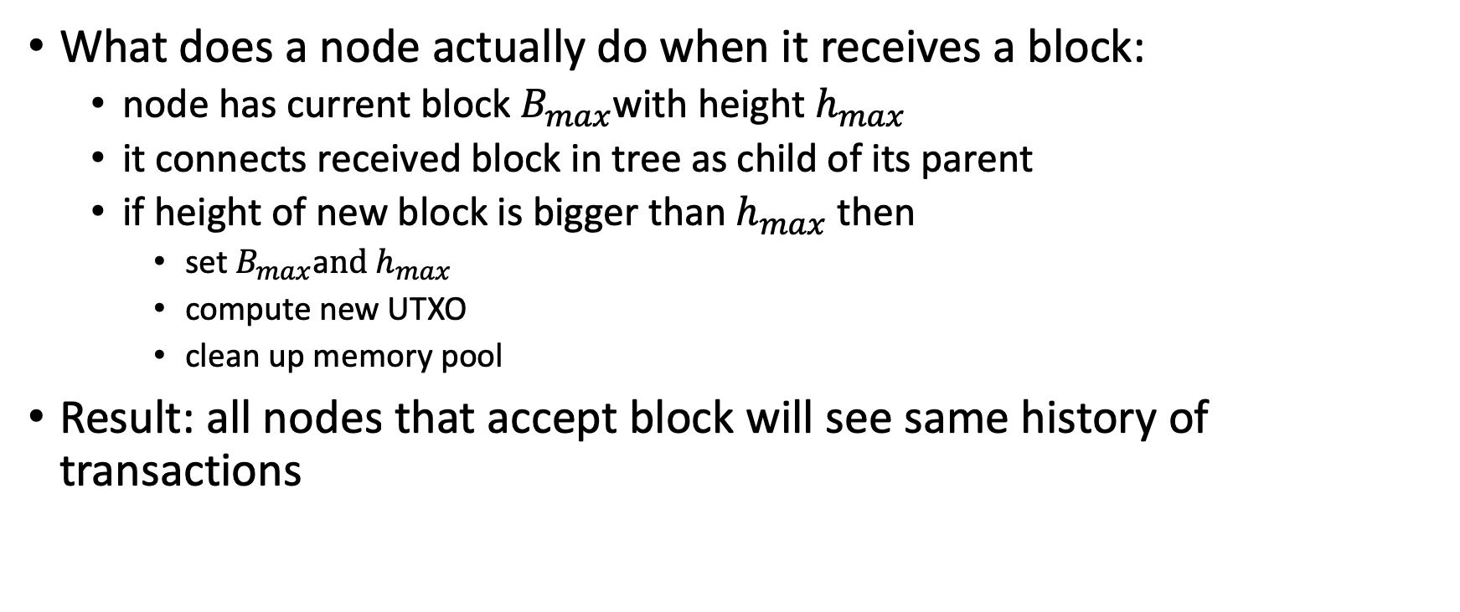
Bitcoin
What does a node actually do when it receives a block:
node has current block $B_{max}$with height $h_{max}$
it connects received block in tree as child of its parent
if height of new block is bigger than $h_{max}$ then
set $B_{max}$a$nd h_{max}$
compute new UTXO
clean up memory pool
Result: all nodes that accept block will see same history of transactions

Slide 29
Smart Contracts
Contract between two or more parties, encoded in such a way that correct execution is guaranteed by blockchain
Timelock: transaction will only get added to memory pool after some time has expired
Micropayment channel:
Idea: Two parties want to do multiple small transactions, but want to avoid fees. So they only submit first and last transaction to blockchain and privately do everything inbetween

Slide 30
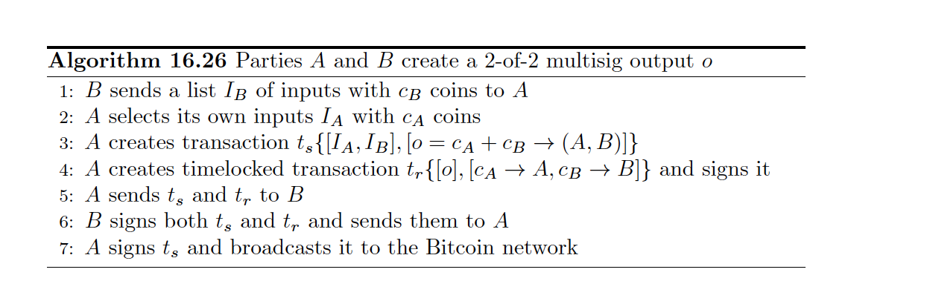
Micropayment channel – setup transaction
A
B
cannot do anything with this,
since no transaction has
all required signatures
1) creates shared “account”, does not sign it
2) creates timelocked transaction that unrolls
shared account, signs it
3) sends them to B
can’t do anything with this, since unroll
transaction is not valid without create
transaction
4) signs both transactions
5) signs create transaction
6) broadcasts them to network

Slide 31
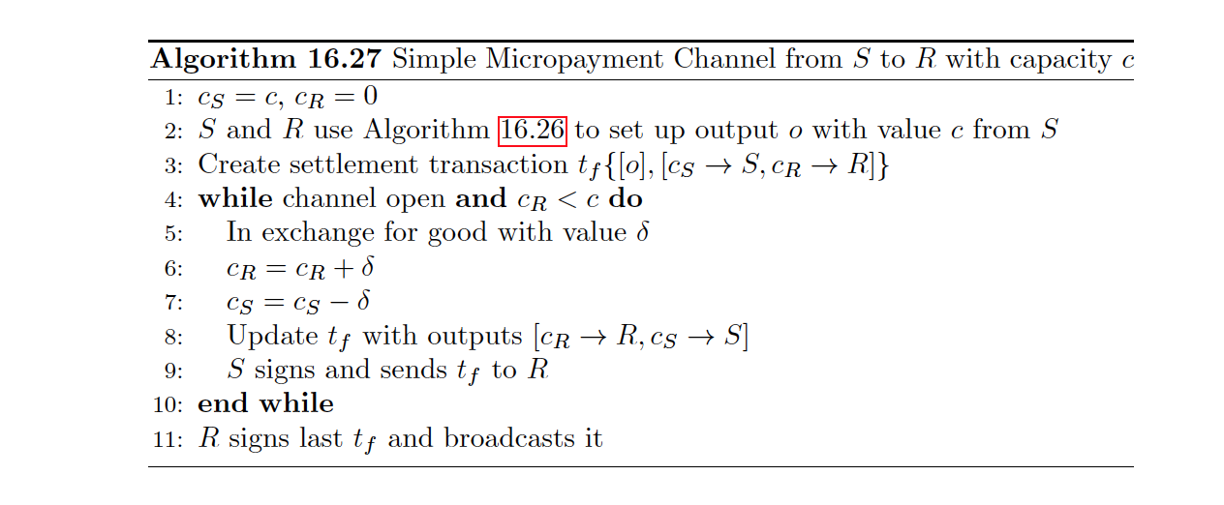
Micropayment channel
set up shared account and unrolling
create settlement transaction
while buyer still has money and timelock not expired
exchange goods and adapt money
update settlement transactions with new values
S signs transaction and sends it to R
R signs last transaction and broadcasts it
before timelock expires
Why does s sign it?
like this, R always holds all fully signed transactions and can choose the last one (where he gets the most money)
S cannot submit any transaction, so S cannot get the goods and later submit a transaction where S did not pay
the money for it

Slide 32
Quiz
What is the biggest number of nodes that can fail so that the majority quorum system still works?
n/2-1
Are effects of blockchain transactions on a node deterministic?
yes
Can a micropayment channel be used bidirectionally?
No, because then both parties would hold fully signed transactions and then submit the ones that are best for them

Slide 33
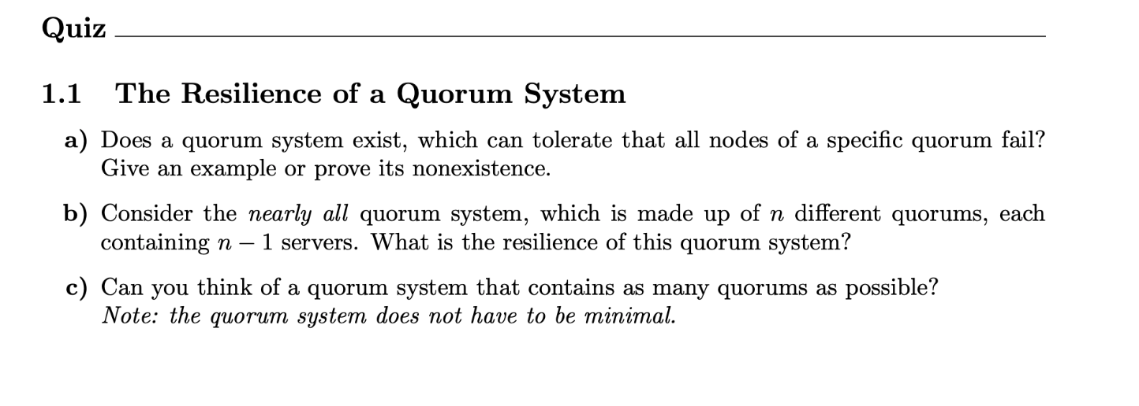

Slide 34
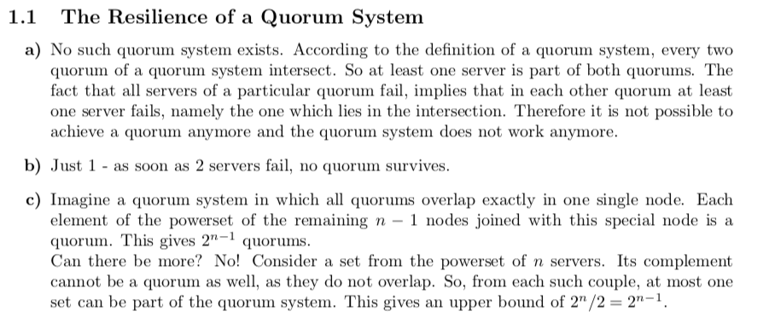

Slide 35
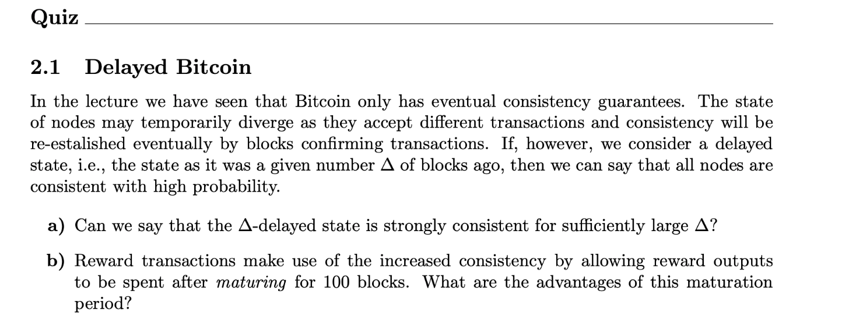

Slide 36
