Slide 1
Computer Systems
Exercise Session 1

Slide 2
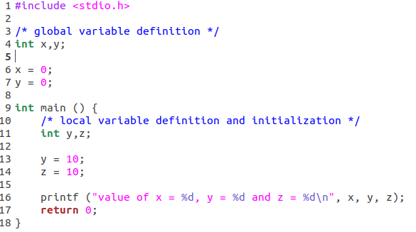
Naming Basics
Name
Object
Object my_object = new Object();
Binding

Slide 3


Naming Networks
etc/
Desktop/
/
home/
compSys/
Documents/
usr/
Downloads/
link
Context matters:
cd Desktop
cd home
cd /home/compSys/Downloads
cd /link/Downloads
cd Desktop/../Downloads
Create SymLink: ln –s /home/compSys /link

Slide 4
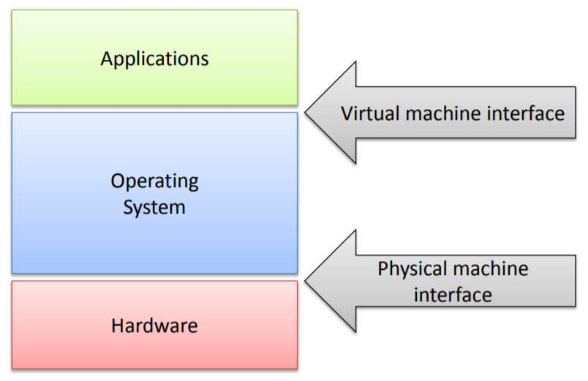
The Role of the OS
Referee:
Ensure resource sharing
Ensure protection (mem protection, process isolation)
Illusionist:
provide virtual resources to user-space processes
Virtual Memory (full address space)
Shared network interface
Glue:
Provide high-level abstraction to user-space applications

Slide 5
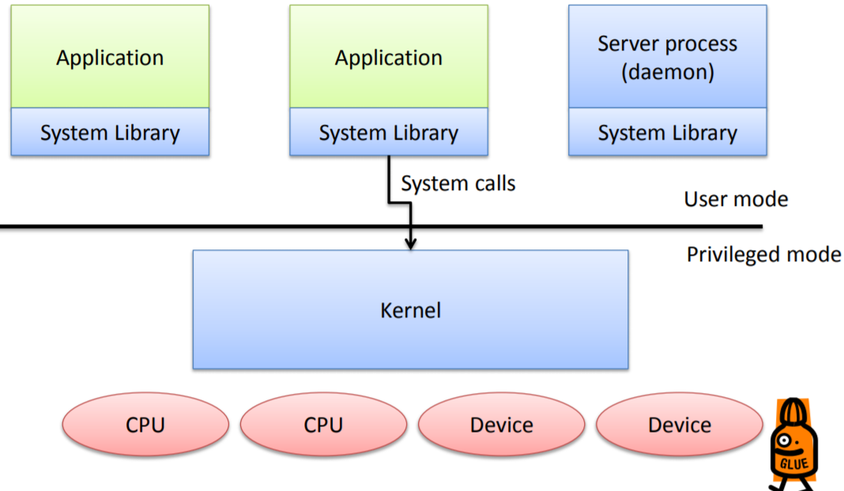
General OS Structure
Kernel:
Special process that runs in privileged mode
Typically event driven server
SysLib:
Provide convenience functions and sysCall wrappers
Deamon:
Processes which are part of the kernel but live in user-space
Provides modularity, fault-tolerance

Slide 6
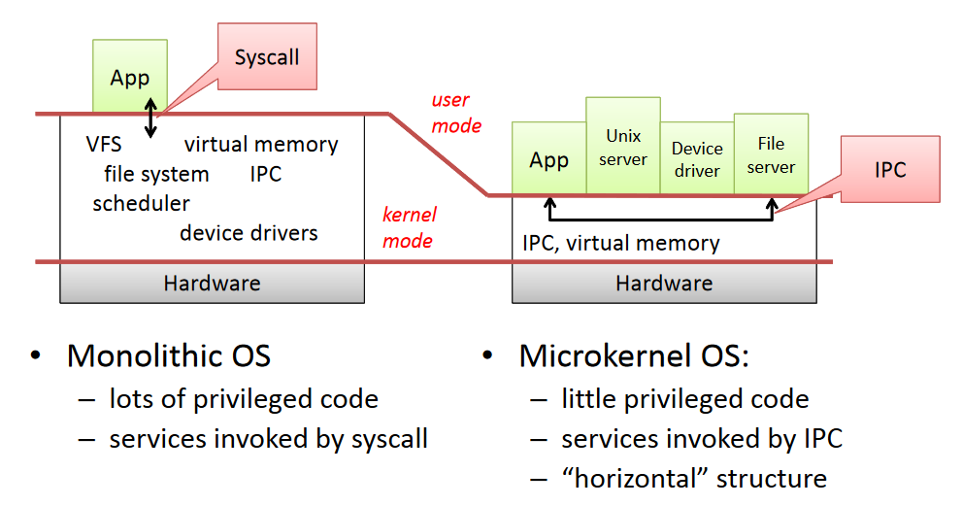
Monolithic vs. Microkernel
Exokernel: move functionality into system libraries instead of user-space

Slide 7
Bootstrapping
Power on
Load BIOS from ROM to memory
BIOS loads boot loader into memory
boot loader loads OS (kernel)from disk
Transfer control to OS
ROM
BIOS
Disk
2.
memory
boot loader
3.
OS
4.
Illustration adapted from Maegan Pitman

Slide 8
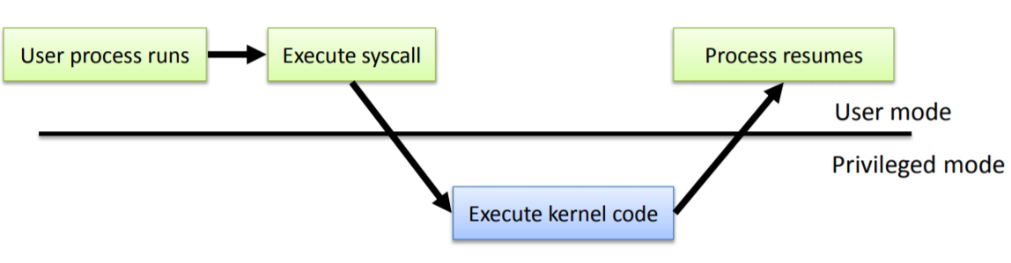
Entering and Leaving the Kernel
on Start-Up
Exception occurs(caused by program )
Interrupt occurs (caused by “something else)
upon a System Call

Slide 9
Quiz
What is the difference between synonym and homonym?
synonym different name for one object
homonym same name for different objects
Is an IP address a pure name?
no, because it contains routing information
To what does a symbolic link point?
a name/another link
What is the difference between monolithic kernel and microkernel?
monolithic: everything in kernel
micro: as little as possible in kernel (move functionalities to user space process)

Slide 10
What are the pros and cons of microkernel and monolithic kernel?
microkernel: more entering/exiting kernel, potentially faster to do that since kernel is way smaller
monolithic: less entering/exiting kernel
What is the advantage of running a process in userspace?
failing process easier to handle in user space easier to handle than in kernel
Look at algorithm 3.15, write down in what order the individual steps will happen
1,2,3,6-14,4,5

