Slide 1
Computer Systems
Exercise 7

Slide 2
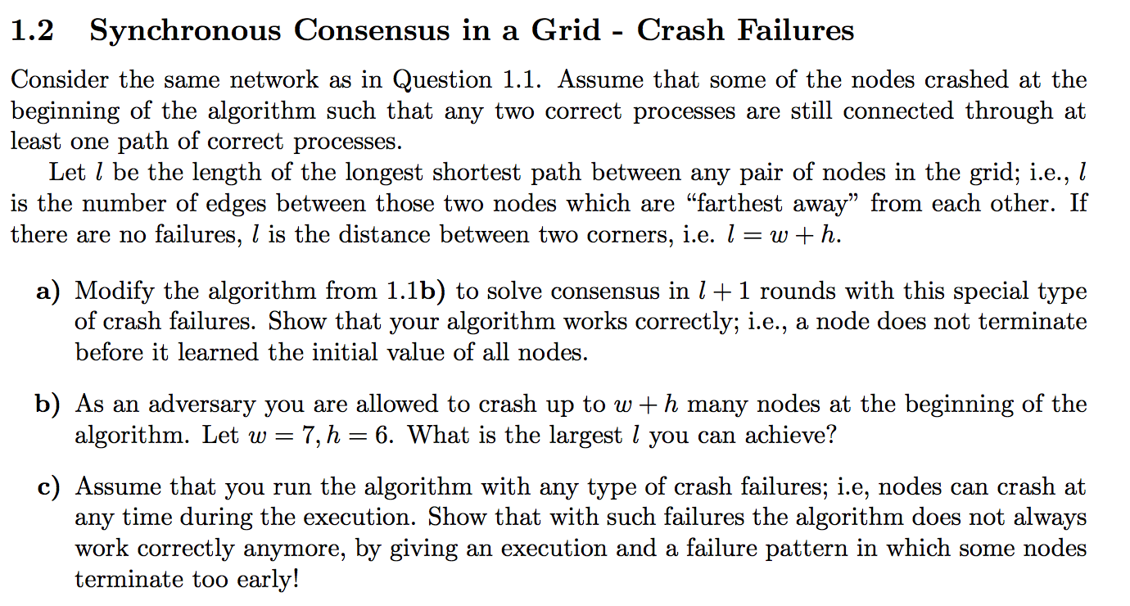
Last Exercise
(2 dimensional grid)
Answer: keep the exact same algorithm as we discussed last time (forward everything, decide when you don‘t learn anything new in one round, because it means you learned everything).
Correctness: In round i a node receives all values from neighbors of distance i, it will keep receiving new values every round until it has all
Termination: After at most l+1 rounds all information will have propagated through the grid

Slide 3
Last Exercise

Slide 4
Optimal if w ≈ h, gives longest distance of about 3(w+h)
27 in this case

Slide 5
Possible also in a general case, gives longest distance of about 2(w+h)

Slide 6
Last Exercise

Slide 7
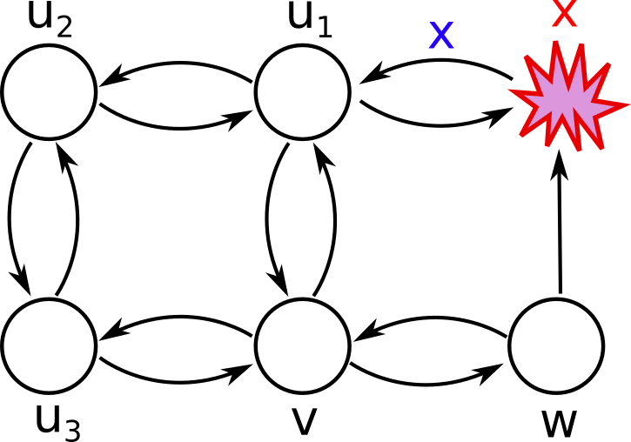
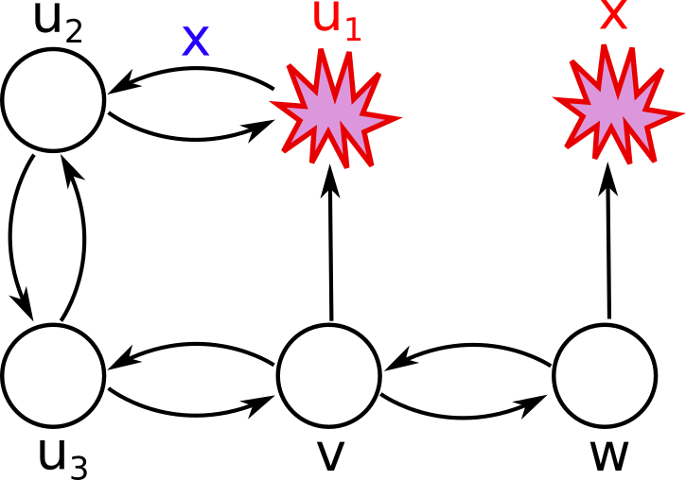
1. Node x crashes, u1 learns value, w does not
u3, w, u1
2. Node u1 crashes, u2 learns value, v does not
u3, w, u1, u2
3. After 2 rounds, v will have learned the values of all nodes except x. In round 3 the value of x is at node u3, therefore v does not learn anything new and will terminate prematurely
u3, w, u1, u2

Slide 8
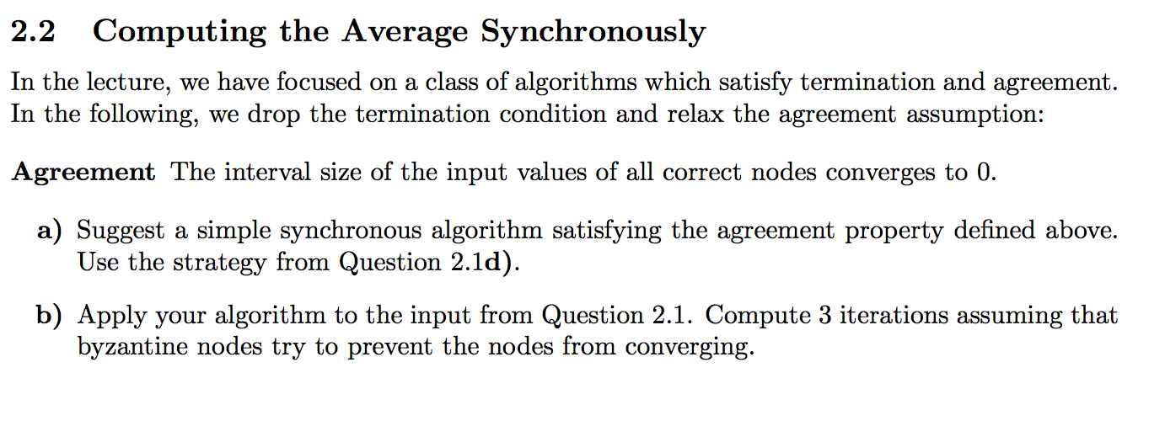
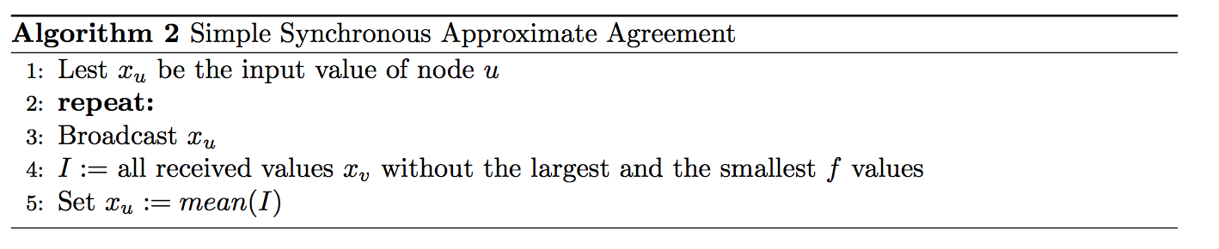
Last Exercise

Slide 9
Last Exercise
{-3,-2,-1,0,1,2,3}

Slide 10
[-4, -4, -3, -2, -1, 0, 1, 2, 3]
[ -4, -3, -2, -1, 0, 1, 2, 3, -4]
[ -3, -2, -1, 0, 1, 2, 3, 4, 4]
{-1,-1,-1,0,1,1,1}
[-4, -4, -1, -1, -1, 0, 1, 1, 1]
[ -4, -1, -1, -1, 0, 1, 1, 1, -4]
[ -1, -1, -1, 0, 1, 1, 1, 4, 4]
{-2/5, -2/5, -2/5, 0, 2/5, 2/5, 2/5}
[-4, -4, -2/5, -2/5, -2/5, 0, 2/5, 2/5, 2/5]
[ -4, -2/5, -2/5, -2/5, 0, 2/5, 2/5, 2/5, -4]
[ -2/5, -2/5, -2/5, 0, 2/5, 2/5, 2/5, 4, 4]
{-4/25, -4/25, -4/25, 0, 4/25, 4/25, 4/25}

Slide 11
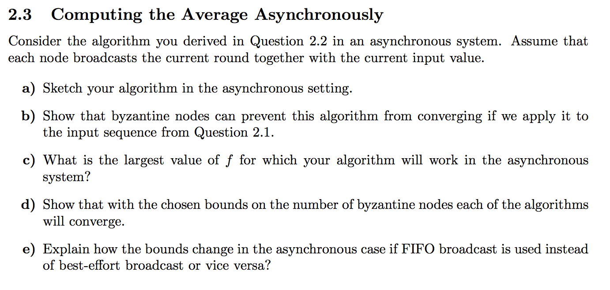
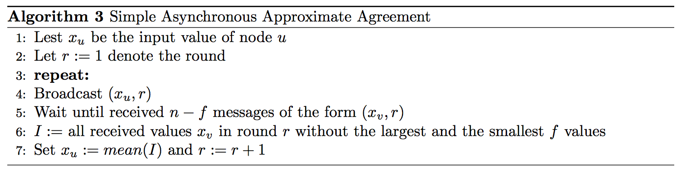
Last Exercise

Slide 12
Last Exercise
[-4, -4, -3, -2, -1, 0, 1]
[ -3, -2, -1, 0, 1, 2, 3]
[-1, 0, 1, 2, 3, 4, 4]
{-2,-2,-2,0,2,2,2}
[-4, -4, -2, -2, -2, 0, 2]
[ -3, -2, -2, 0, 2, 2, 2]
[-2, 0, 2, 2, 2, 4, 4]
{-2,-2,-2,0,2,2,2}

Slide 13
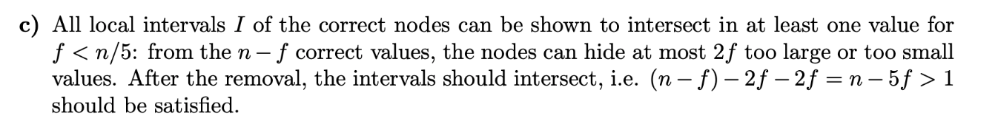
Last Exercise

Slide 14
Last Exercise
In every round, all nodes will have a least one common value inside the intervals. Therefore, the nodes will converge.

Slide 15
Last Exercise
Now the byzantine nodes can only use scheduling to hide values. So now the byzantine nodes can only make the
nodes see 2f different values from each side, so f < n/4

Slide 16
Consistency Models
Linearizability (implies both others)
Sequential Consistency
Quiescent Consistency
If you are confused or need an overview:
http://coldattic.info/post/88/

Slide 17
Linearizability
“one global order”
Linearizability -> put points on a “line”
Strongest assumption, implies other two
write x = 1
write x = 3
read x = 2
read x = 1
write y = 1
write x = 2
read y = 1
write x = 1 < read x = 1 < write x= 3 < write y = 1 < write x = 2 < read x = 2 < read = 1

Slide 18
Sequential Consistency
similar as linearizability, but can ”shift” and “squeeze” threads compared to each other
sequential consistency -> build “sequences”
write x = 1
read x = 2
read y = 2
write x = 2
write y = 1
write y = 2
read y = 2

Slide 19
Sequential Consistency
similar as linearizability, but can ”shift” and “squeeze” threads compared to each other
sequential consistency -> build “sequences”
write x = 1
read x = 2
read y = 2
write x = 2
write y = 1
write y = 2
read y = 2
write x = 1 < write x = 2 < write y = 3 < read x = 2 < read y = 2 < read y = 2 < write y = 1

Slide 20
Quiescent Consistency
synchronizes all threads whenever there is a time when there is no possible execution
quiescent -> “Quietschente”
read x = 1
read y = 1
write x = 1
write y = 1
write x = 2
read y = 1
write x = 2 < write x = 1 < write y = 1 < ready y = 1 < read x = 1 < read y = 1

Slide 21
Composable (applies to consistency models)
Definition: If you only look at all operations concerning any object and the execution is consistent, then also the whole execution is consistent
sequential consistency is not composable
linearizability is composable
quiescent consistency is composable
write x = 1
write x = 3
read x = 2
read x = 1
write y = 1
write x = 2
read y = 1

Slide 22
Logical Clocks
happened before relation „->“ holds:
If f < g on the same node
Send happens before receive
If f -> g and g -> h then f -> h (Transitivity)
c(a) means timestamp of event a
logical clock: if a -> b, then c(a) < c(b)
strong logical clock: if c(a) < c(b), then a -> b (in addition)

Slide 23
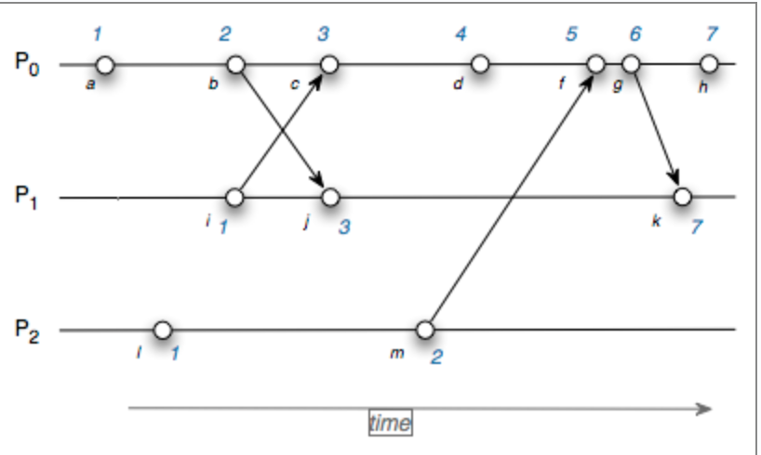
Lamport Clock
+1
max(1,2) + 1
send current timestamp
store own clock
https://www.cs.rutgers.edu/~pxk/rutgers/notes/clocks/index.html

Slide 24
Lamport Clock
Is a logical clock (so if a -> b then c(a) < c(b))
but the reverse does not hold, so not a strong logical clock

Slide 25
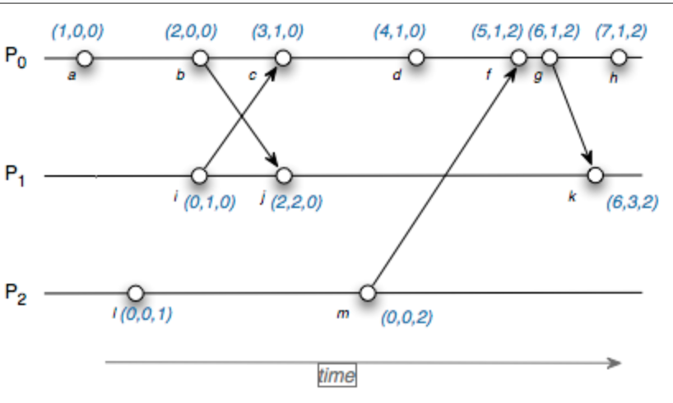
Vector Clock
now vector of clocks
increase own clock for event
send current timestamp
increase own by one and
take max of received and own
for every other one

Slide 26
Vector Clock
what does c(a) < c(b) mean now?
if all the entries are in a <= b and at least one entry where a < b
is a logical clock (so if a -> b then c(a) < c(b))
is also a strong logical clock (if c(a) < c(b) -> a -> b)
intuition: because in order to achieve c(a) < c(b), all entries have to be at least as big, so a message from a must have reached b (not necessarily directly) so that b has the right a value

Slide 27
Consistent Snapshot
Cut
prefix of a distributed execution
Consistent Snapshot
a cut for which holds that for every operation g in that cut, if f->g, then also f is there
-> if all “connected” preceding operations are included
with number of consistent snapshots, one can make conclusions about degrees of concurrency in system

Slide 28






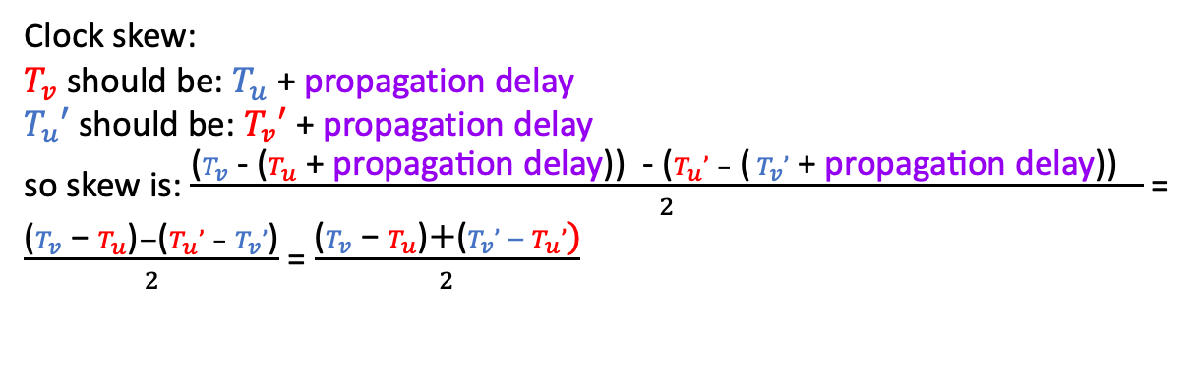
NTP
u
v
(+5)
request
0
$$T_{u}$$
first propagation delay
$$T_{v}$$
15
propagation delay = 10
processing time at node v
processing time = 5
$$T_{v}′$$
20
response
propagation delay = 10
second propagation delay
25
$T_{u}$’
Clock skew:
$T_{v}$ should be: $T_{u}$ + propagation delay
$T_{u}′$ should be:${ T}_{v}′$ + propagation delay
so skew is: $\frac{\text{(}T_{v}\text{ − (}T_{u} \text{+ }\text{propagation} \text{delay}\text{)}\text{)} \text{−} \text{(}T_{u}’ – \text{(}{ T}_{v}’ \text{+ }\text{propagation} \text{delay}\text{)}\text{)} }{2}$ =
$\frac{{\text{(}T}_{v}\text{ − }T_{u}\text{)}−\text{(}T_{u}’ – T_{v}’\text{)}}{2}$ = $\frac{{\text{(}T}_{v}\text{ − }T_{u}\text{)}\text{+}\text{(}{T_{v}’ − T}_{u}’\text{)}}{2}$
skew = (15-0) +(20-25)/2 = 5

Slide 29
GPS – General idea
one of them close to earth distance, one far away
Satellite 1
Satellite 2
we are here
compare satellite timestamp
to local timestamp and calculate distance
Transmits location of satellite
and timestamp when sent
Satellite 3

Slide 30
GPS - Problem
Problem: we do not have the same time as the satellite, so calculating the distance might not be accurate
Solution: take measurement from forth satellite!

Slide 31
GPS - Refined
Satellite 1
Satellite 2
Satellite 4
Satellite 3

Slide 32
Quiz
Sequential Consistency implies Quiescent consistency
wrong. E.g. x = 1. 5 is a valid outcome for sequential consistency, but not quiescent
Are there guarantees a lamport clock can achieve and a vector clock cannot?
No, because the concept of a lamport clock is included in the vector clock concept
A high number of consistent snapshot implies a high level of concurrency
true
x = 2 * x
x = x + 1

Slide 33


Quiz
What is the difference between jitter and drift?
Drift: JJitter:

Slide 34
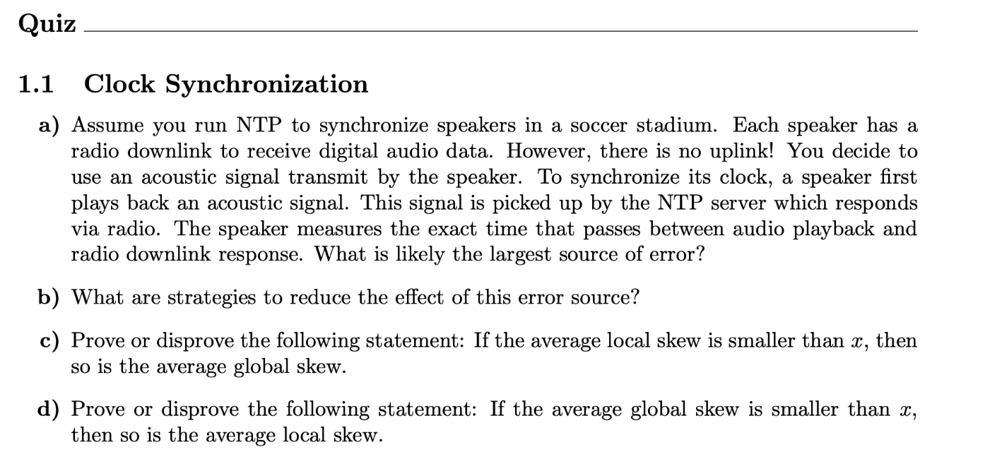

Slide 35
